Slide 1

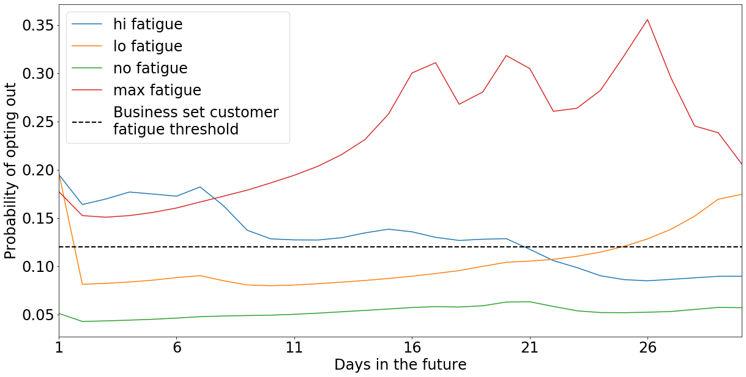
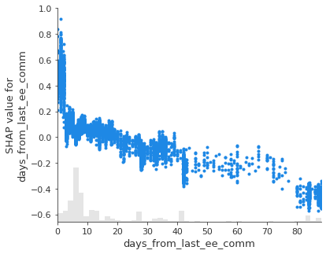
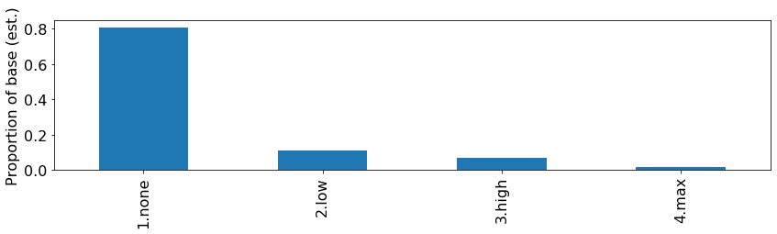
ATC: Marketing Fatigue Model insight teaser Please note that this model is under development and insights may be subject to change
Business problem: Business insights into opt outs from EE SMS and MMS campaigns indicate that the exposure to a high density of marketing messages is a key driver of opt outs.
Solution: By analysing the customers comm history over the previous 60 days, we can predict their tolerance to comms 30 days into the future and calculate a ‘fatigue window’ after which a customer becomes ‘eligible’ to contact and therefore should be more engaged.
Impact: Early estimates that fatigued customers are over three times more likely to opt out than eligible customer, and that Air Traffic Control is required to manage this at risk group.
2) A customer’s probability of opting out is observed to ‘decay’ at different rates as they shift from ‘fatigued’ to ‘eligible’ states, as defined by a business-set threshold. Eligible customers are available to receive comms but fatigued customers should be rested.
FATIGUED
ELIGIBLE
1) Customer’s with shorter breaks between comms are more likely to opt out
None – customers who are not an opt out risk and are available to be contacted at any time
Low – customers whose fatigue decays to nominal levels within 2 days
High – customers whose fatigue decays to nominal levels between 2 and 29 days
Max – customers whose fatigue remains high for greater that 30 days
Shap value
(indicating likelihood of opting opt)
Fatigue
segment
Days since last comm

