Slide 1

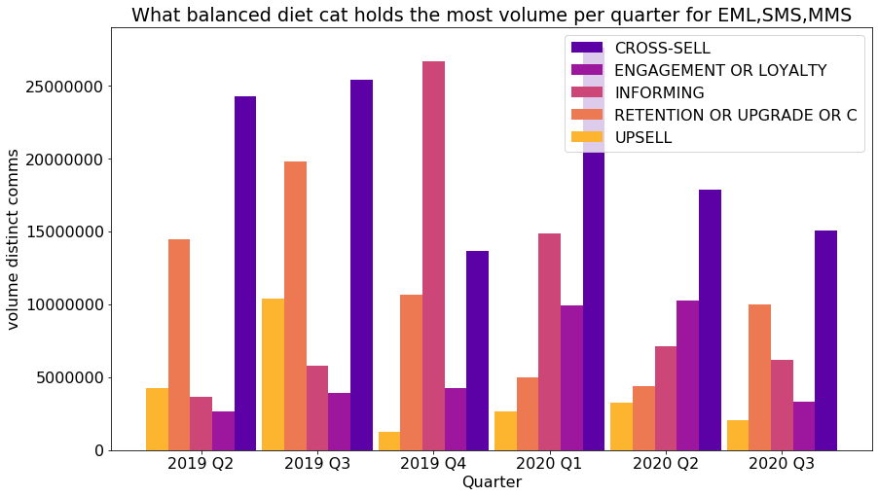
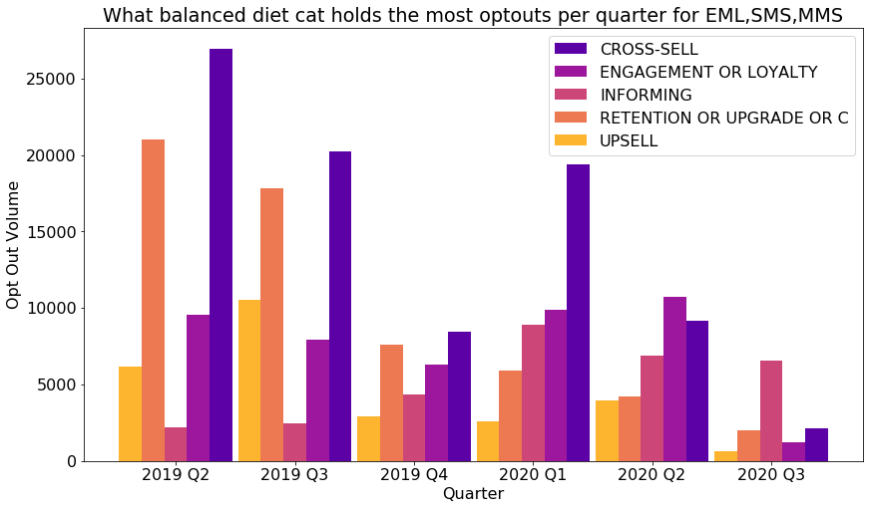
ATC: Drivers of Optouts for X-sell Email and MMS campaigns Please note that this model is under development and insights may be subject to change
Objective: The Cross-sell balanced diet category consistently holds the highest volumes of sends and opt outs across the calendar year. There is a business need to understand what elements of these campaign are driving customer optouts to help info individual campaign design and the wider contact strategy of the business.
Solution: Using the XGBoost Machine learning algorithm it is possible to model customer propensity to optout and analyse which customer attributes and business behaviours drive customers to unsubscribe. Some of the most important feature profiles are displayed in the following pages.
Impact: The following top features and their impact were identified:
Customer Tenure
Active Handset MRC
Total X-sell comms in the last month
Total Apple comms in the last month
Total MMS comms in the last month
Days since last EE comm
Data Allowance
Average Weekly Voice use
ANPU

Slide 2
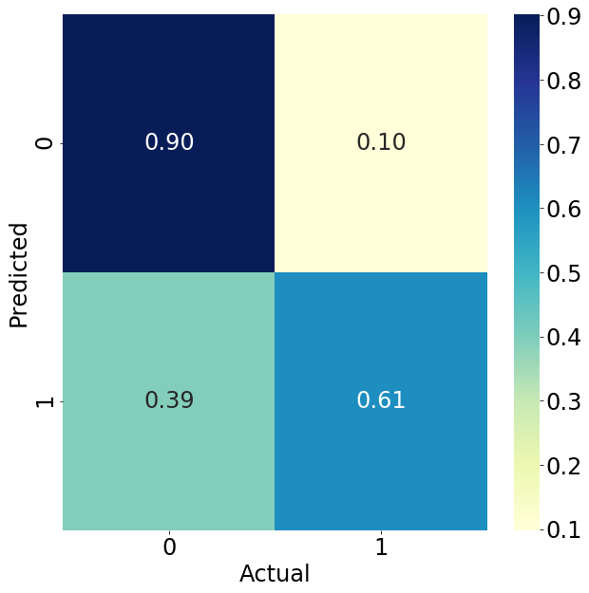
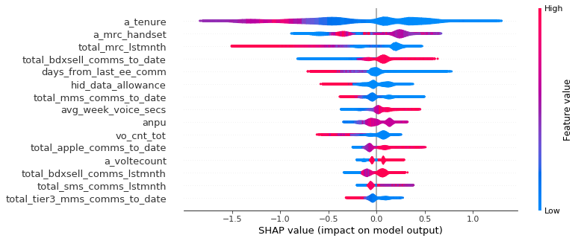
Model base and performance
The model was trained on the following base:
Balanced diet category = CROSS-SELL
Email and MMS channels
EE brand
Timescales – Calendar year 2020
Medium sized campaigns (between 75K and 2,000k customers)
Excluding exceptionally low optout campaigns (less than 0.01%)
Target variable = optout_flg with a training imbalance of 0.35%
Performance:
Almost 800 customer attributes and business behaviours
Optimised on Recall
Recall in first decile = 61%

Slide 3




How to use the AMI opt out model…
AMI
Opt out
model
Campaign managers want to understand the performance of campaign segment
Run the segment through the AMI opt out model
Report on the key model insights

Slide 4
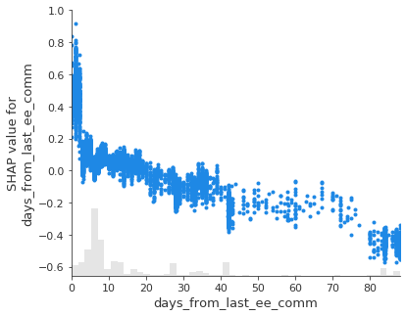
Partial Dependency Insights – how to read this plot
Shap value is metric for measure an attribute impact on a customer outcome (in this case propensity to optout)
Strongly positive values indicate high likelihood of opting out (and vice versa)
Each dot represents an individual customer
The red line indicates the overall trend
Bars indicate the population density of that attribute or behaviour
The value of specific customer attribute or business behaviour

Slide 5
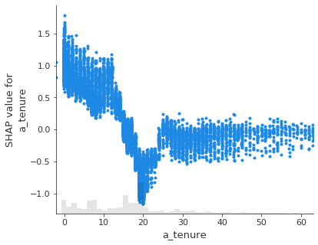
Customer Tenure (months)
Generally speaking, the more loyal a customer, the less likely they are to opt out.
New customers are highly likely to drop off, but this sharply falls away after 12 months, only to increase somewhat between 18 and 24 months as customer reach the end of their contracts.

Slide 6
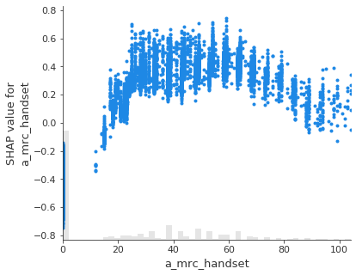
Active Handset Monthly Rolling Contract (£)
Customers who are not currently paying for a handset have a low likelihood of opting out.
Likelihood increases with MRC before topping out between £30 and £60 before marginally falling at the highest MRC values.

Slide 7
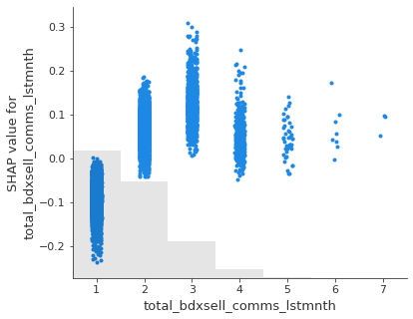
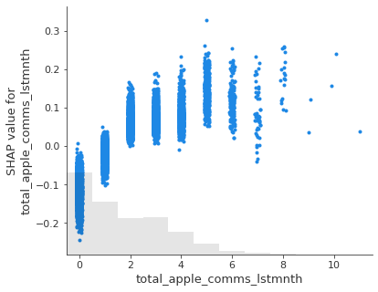
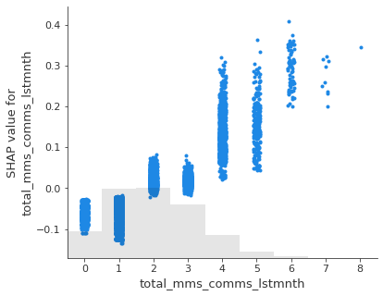
Total X-sell/Apple/mms comms in the last month
The density of X-sell/Apple/MMS comms are show similar trends in driving opt outs.
Between zero and one message per month does not have a detrimental impact of opt outs.
However, at higher densities, the customer is increasingly likely to optout.
This effect somewhat plateaus after three comms per month for X-sell or Apple comms, but continues to increase for general MMS comms.

Slide 8
Days since last EE comms
Contact a customer within 2 to 3 days of their last comm is strongly correlated with opt outs.
The impact on opt out then steadily falls off to the extent that after 4 weeks the frequency of contact is not having a detrimental impact.

Slide 9
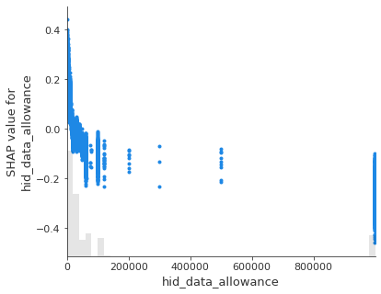
Data allowance (Mbytes)
Customer’s with the lowest MB allowances are the most likely to opt out.
This trend quickly drops off toward the highest data allowances.
Likely this trend is connected to MRC, and the general affluence of the customer (less affluent = most sensitive to x-sell comms).

Slide 10
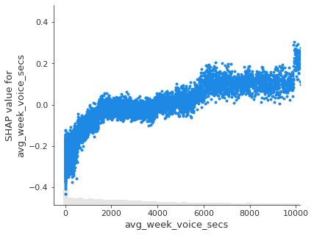
Average weekly voice use (sec)
Customer’s who use voice the least are also the least sensitive likely to opt out.
This rises quickly up to about 30min, and then more slowly after that.

Slide 11
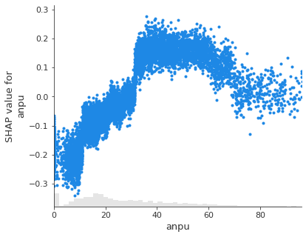
Average Net-profit per user (ANPU - £)
The least profitable customer’s are less likely to opt out.
This likelihood increases and peaks between £30 and £60, before experience a marginal drop off for the most profitable customers.

