Slide 1

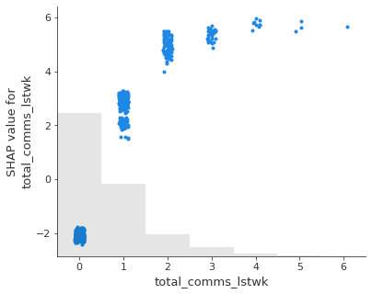
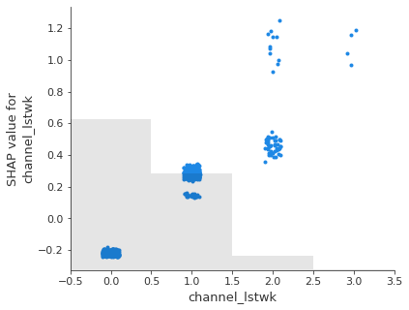
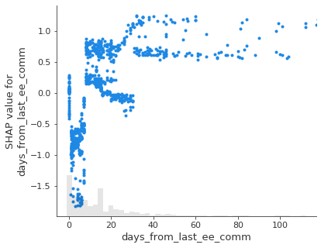
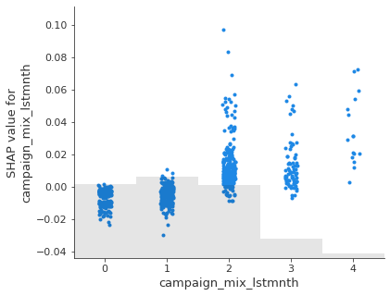
ATC: Opt-out model teaser insights Please note that this model is under development and insights may be subject to change
Opt-outs are rare!
OOR=0.19%
Can we predict the 8,399 EE SMS or MMS Opt-outs in September 2020?
Top left: Customers receiving more comms per week are more likely to Opt-out
Top right: Customers receiving multiple channels per week are more likely to Opt-out
Bottom left: Customers contacted immediately and those left uncontacted for more than two weeks are more likely to Opt-out
Bottom right: Customers receiving multiple campaign categories per month are more likely to Opt-out

