Slide 1
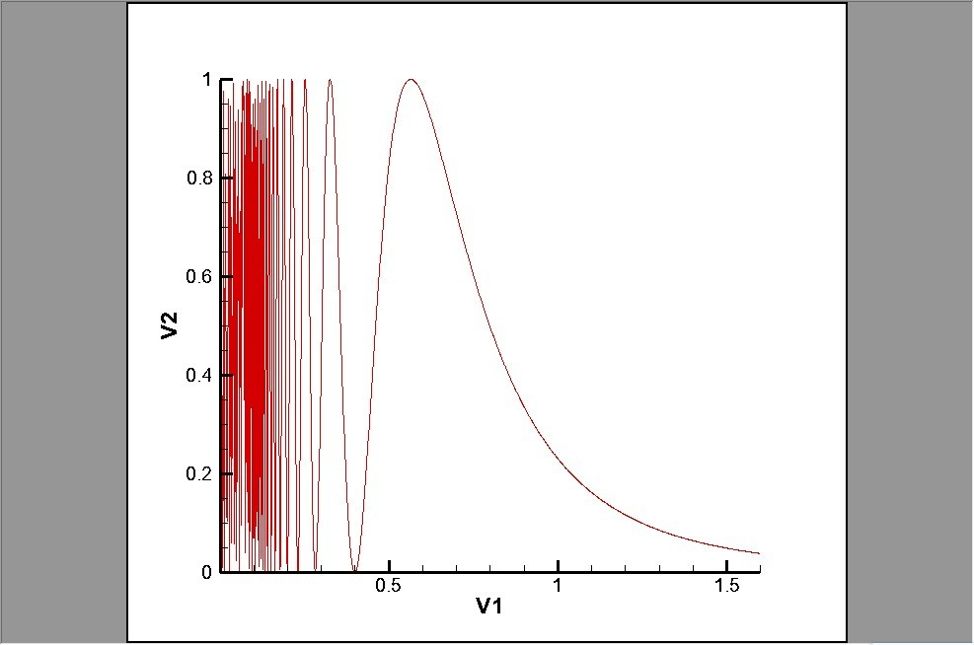

Slide 2
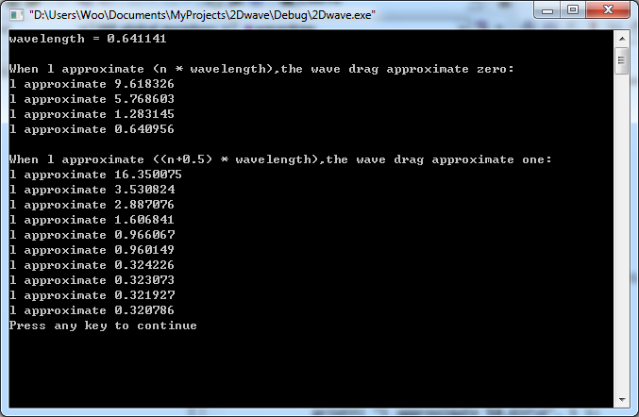

Slide 3
F D l
F D l
0.397000 0.000949 0.647430
0.398000 0.000222 0.644181
0.399000 0.000001 0.640956 <-
0.400000 0.000275 0.637755
0.401000 0.001034 0.634578
0.197000 0.097309 2.629308
0.198000 0.034721 2.602816
0.199000 0.003545 2.576723 <-
0.200000 0.004399 2.551020
0.201000 0.035831 2.525700
0.280000 0.008878 1.301541
0.281000 0.002404 1.292294
0.282000 0.000018 1.283145 <-
0.283000 0.001610 1.274093
0.284000 0.007043 1.265136
0.175000 0.336248 3.331945
0.176000 0.176492 3.294190
0.177000 0.062022 3.257072
0.178000 0.005301 3.220579 <-
0.179000 0.010563 3.184695
0.180000 0.074190 3.149408
0.228000 0.037002 1.962927
0.229000 0.011996 1.945821
0.230000 0.000730 1.928938 <-
0.231000 0.002982 1.912273
0.232000 0.018179 1.895824
0.233000 0.045438 1.879585
l = n * wavelength
wavelength = 0.641141

Slide 4
F D l
F D l
0.562000 0.999850 0.323073
0.563000 0.999956 0.321927
0.564000 0.999999 0.320786 <-
0.565000 0.999980 0.319652
0.566000 0.999899 0.318523
0.211000 0.945747 2.291970
0.212000 0.983354 2.270399
0.213000 0.999367 2.249131 <-
0.214000 0.993992 2.228160
0.215000 0.968329 2.207481
0.324000 0.997441 0.972039
0.325000 0.999545 0.966067
0.326000 0.999941 0.960149 <-
0.327000 0.998676 0.954286
0.328000 0.995799 0.948476
0.186000 0.903795 2.949498
0.187000 0.974235 2.918036
0.188000 0.999910 2.887076 <-
0.189000 0.980583 2.856606
0.190000 0.920003 2.826615
0.250000 0.978830 1.632653
0.251000 0.993226 1.619670
0.252000 0.999618 1.606841 <-
0.253000 0.998188 1.594164
0.254000 0.989230 1.581636
l = (n+0.5) * wavelength
wavelength = 0.641141

