Slide 1
Project Présentation
Matteo Mesa Gonzalez
Ludovic Pujol
Mike Timmerman
Dimitri Jacquemont
December 2022

Slide 2
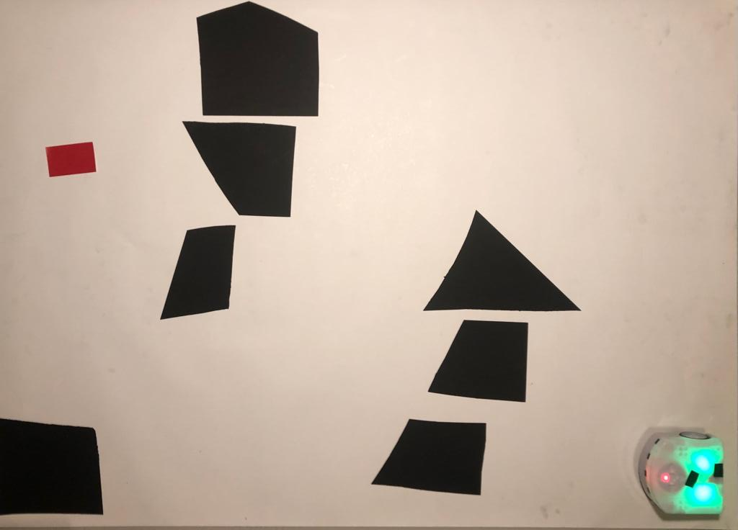
Global navigation
Choice for the environment
Feature |  | Solution
Robot | Position | Green LEDs’ center
 | Orientation | Red LED & robot position
Obstacles |  | Black geometrical shapes
Goal position |  | Red rectangle
Implemented mechanisms for recognition
Pixel thresholding
Blob analysis
Blob count threshold
Blob area threshold

Slide 3
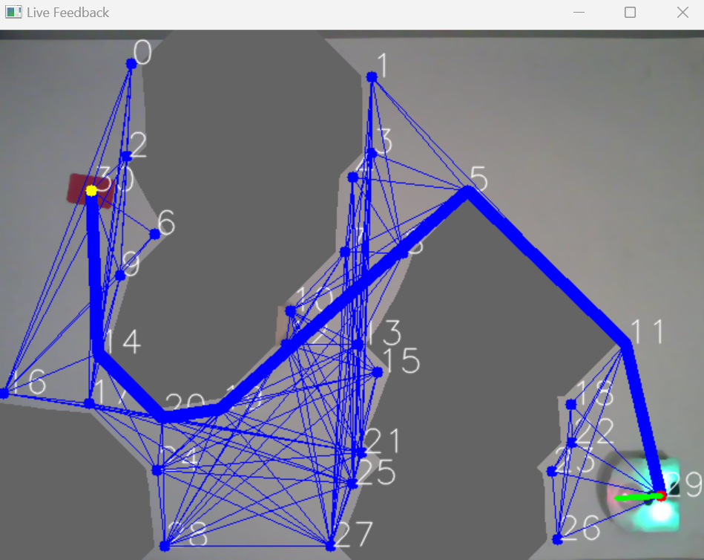
Global navigation
Visibility graph computation
Algorithm
Pixel thresholding
Blob analysis to threshold by area
Blob dilatation using a SE
Corner search using cv2.cornerharris()
Goal position & robot pose fetching
Iteration of each node over all nodes to check for direct connection
Returns an array of connections & nodes

Slide 4
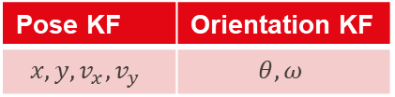
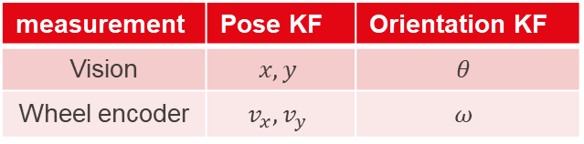
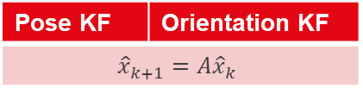
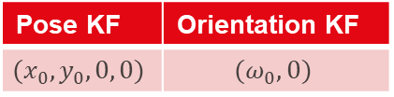
State estimation
Pose KF | Orientation KF
$$x, y, v_{x}, v_{y}$$ | $$θ, ω$$
Initialization
Pose KF | Orientation KF
$$(x_{0}, y_{0}, 0, 0)$$ | $$(ω_{0},0)$$
From vision
measurement
Next estimate
- Prediction step
Pose KF | Orientation KF
$${\hat{x}}_{k+1}=A{\hat{x}}_{k}$$
- Update step
measurement | Pose KF | Orientation KF
Vision | $$x,y$$ | $$θ$$
Wheel encoder | $$v_{x}, v_{y}$$ | $$ω$$

Slide 5
Global navigation
Initial situation
Nodes
[x₁,y₁]
[x₂,y₂]
[x₃,y₃]
[x₄,y₄]
[x₅,y₅]
Edges
[x₁,y₁], [x₂,y₂]
[x₁,y₁], [x₃,y₃]
[x₁,y₁], [x₄,y₄]
[x₁,y₁], [x₅,y₅]
[x₂,y₂], [x₃,y₃]
[x₂,y₂], [x₄,y₄]
[x₃,y₃], [x₅,y₅]
[x₂,y₂], [x₁,y₁]
[x₃,y₃], [x₁,y₁]
[x₄,y₄], [x₁,y₁]
[x₅,y₅],[x₁,y₁]
[x₃,y₃], [x₂,y₂]
[x₄,y₄], [x₂,y₂]
[x₅,y₅], [x₃,y₃]
TabLenPath
Inf
Inf
Inf
Inf
Inf
Starting node
Goal node
TabPath
[ ]
[ ]
[ ]
[ ]
[ ]
act_node = starting point
Map
act_path = [act_node]
3
act_dist = 0
2
4
5
Iteration = 0
1

Slide 6
Global navigation
After 1st iteration
Nodes
[x₁,y₁]
[x₂,y₂]
[x₃,y₃]
[x₄,y₄]
[x₅,y₅]
Edges
[x₁,y₁], [x₂,y₂]
[x₁,y₁], [x₃,y₃]
[x₁,y₁], [x₅,y₅]
[x₂,y₂], [x₃,y₃]
[x₃,y₃], [x₅,y₅]
[x₂,y₂], [x₁,y₁]
[x₃,y₃], [x₁,y₁]
[x₅,y₅],[x₁,y₁]
[x₃,y₃], [x₂,y₂]
[x₅,y₅], [x₃,y₃]
TabLenPath
…
…
Inf
Inf
Inf
Starting node
Goal node
TabPath
[ [x₄,y₄], [x₁,y₁] ]
[ [x₄,y₄], [x₂,y₂] ]
[ ]
[ ]
[ ]
act_node = [x₂,y₂]
act_path = [ [x₄,y₄], [x₂,y₂] ]
3
act_dist = TabLenPath[2]
2
4
5
Iteration = 1
1

Slide 7
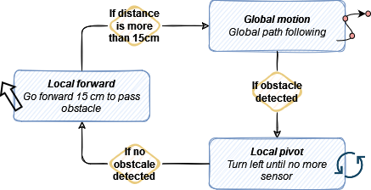
Motion control
FSM: global to local

Slide 8





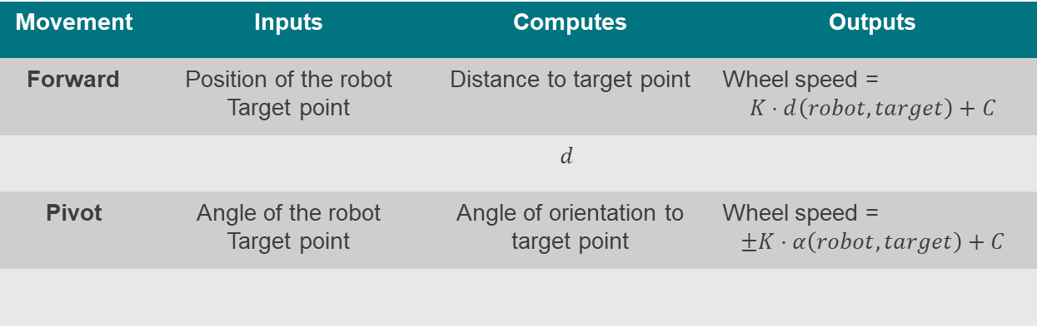
Motion control
Global navigation
Movement | Inputs | Computes | Outputs
Forward | Position of the robot Target point | Distance to target point | Wheel speed = $$K⋅d\left(robot,target\right)+C$$
 |  | $$d$$
Pivot | Angle of the robot Target point | Angle of orientation to target point | Wheel speed = $$±K⋅α\left(robot,target\right)+C$$
$$α$$

