Slide 1
Financial Statements for 2022
FINAC-43
20 May 2023
EC-77/Doc 5 and EC-77/INF 5(1)

Slide 2
Agenda
Highlights of 2022
Details of 2022 elements
Draft Resolutions

Slide 3
Highlights of 2022 ”A Return to the New Normal”

Slide 4

Highlights of 2022 – Comparing 2022 to 2021
Item | 2022 | 2021
Impact COVID-19 pandemic | Global restrictions on travel and face-to-face meetings significantly reduced. Allowed for significant increase in travel expenditures beginning in Q3 2022 and increased meeting and project related expenditure Face-to-face meetings, particularly constituent body meetings funded by the Regular Budget, began to be held again. Virtual possibilities continued. | Continued low level of travel, meetings and fellowships Implementation modalities shifted for improved delivery Reduction in new extrabudgetary contributions – significant no-cost extensions

Slide 5
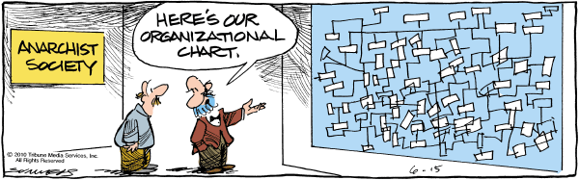
Highlights of 2022 – Comparing 2022 to 2021
Item | 2022 | 2021
Secretariat Reorganization | Most technical position hiring finalized at the end of 2021, with some final elements in 2022. Full financial impact of technical hiring seen in 2022 resulting in overall salary and benefit increase of around CHF 5.5 million as compared to 2021. | Significant hiring activities of newly approved Technical positions in 2021; however, much of the hiring occurred in the second half of 2021 Structures stabilized and functioning well Limited impact on employee benefit liabilities

Slide 6

Highlights of 2022 – Comparing 2022 to 2021
Item | 2022 | 2021
Employee Benefit Liabilities | Change in methodology for estimating medical claims cost from premium basis to actual claims study. Resulted in: An approximately 50% increase in the recorded value of the liabilities A reduction in the active staff medical insurance expense of CHF 1.9 million, recognizing these costs as expenses associated with ASHI | No changes in methodology or bases for assumption Employee benefit liabilities decreased by CHF 11.4 million overall, primarily related to the increase in the reference discount rate during 2021

Slide 7

Highlights of 2022 – Comparing 2022 to 2021
Item | 2022 | 2021
Assessed Contributions | Payment levels were generally consistent with 2021, with slight deterioration due to consistent non-payers Payments in 2023 related to 2022 and prior assessments has been strong 2022 end of year cash position remained strong for Regular Budget | Consistent and strong level of assessed contributions in 2021. Payment levels generally consistent with pre-2020 More regular payment levels continued during 2021 Additional allowance for bad debts required due to ongoing payment delays for those without voting rights 2021 end of year cash position was strong for Regular Budget

Slide 8
Highlights of 2022 – Comparing 2022 to 2021
Item | 2022 | 2021
Voluntary Contributions | Overall increase in all elements of voluntary contributions: Revenue increased by 21% to CHF 23 million Receivables related to voluntary contributions increased by 27% to CHF 27 million related to multi-year contribution agreements Deferred revenue increased by 28% to CHF 71 million following increased overall contributions – expected to be implemented in the next few years | Voluntary contribution elements were generally consistent with 2022, with slight reductions resulting of the COVID-19 pandemic impact on implementation.

Slide 9
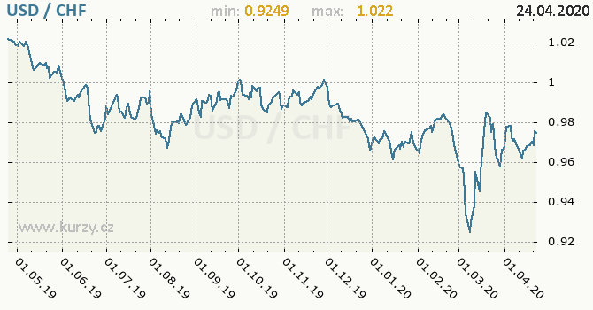
Highlights of 2022 – Comparing 2022 to 2021
Item | 2022 | 2021
Interest rates / negative interest | Global central banks increased interest rates during 2022 in order to address inflationary pressures CHF interest rates became neutral in the middle of 2022 and then positive at the end of 2022. USD interest rates increased throughout 2022. Resulted in positive interest of CHF 26,000 and experiencing significantly higher returns in 2023. | CHF interest rates continued negative and further declined to -0.75% USD interest rates were lower during 2021 Resulted in net negative interest of CHF 129,000

Slide 10
Overall Analysis of 2022
Statement of Financial Performance

Slide 11
Revenues
(in 000’s of CHF)
Revenue Category | 2022 | 2021 | Difference | Change (%)
Assessed Contributions | 67,886 | 67,886 | 0 | 0%
Voluntary Contributions | 22,879 | 18,879 | 4,000 | 21%
Revenue from Services | 1,161 | 1,885 | (724) | (38%)
Other Revenue | 1,183 | 2,861 | (1,678) | (59%)
In-Kind Contributions | 1,870 | 1,870 | 0 | 0%
Total Revenue | 94,979 | 93,381 | 1,598 | 2%

Slide 12
Revenues
Consistent level of Assessed Contributions revenue due to annual split of biennial budget
Voluntary contribution revenue increased as a result of reduced COVID-19 pandemic restrictions on implementation and increased overall level of contributions for climate adaptation and mitigation.
Revenue from services decreased as the main agreement for providing services completed in 2021.
Primary change in other revenue was driven by foreign exchange losses experienced in 2022 due to strengthening of CHF as compared to USD. Other elements remained consistent (e.g. rental of office facilities)

Slide 13
Expenses
(in 000’s of CHF)
Expense Category | 2022 | 2021 | Difference | Change (%)
Salaries and employee benefits | 62,640 | 54,833 | 7,807 | 14%
Meeting and projects | 11,161 | 7,454 | 3,707 | 50%
Travel | 5,430 | 308 | 5,122 | 1663%
Supplies, consumable and other running costs | 6,207 | 6,140 | 67 | 1%
Depreciation and amortization | 4,215 | 4,306 | (91) | (2%)
In-kind expenses | 1,870 | 1,870 | 0 | 0%
Finance costs | 1,934 | 2,806 | (872) | (31%)
Fellowships and training | 990 | 829 | 161 | 19%
Other expenses | 2,154 | 1,522 | 632 | 42%
Impact of joint ventures | 126 | (567) | 693 | 122%
Total Expense | 96,727 | 79,501 | 17,226 | 22%

Slide 14
Expenses
Salaries and employee benefits increased primarily due to:
Increase in professional staff costs totalling approximately CHF 5.5 million resulting from most of the completion of the hiring of technical staff following the Secretariat reorganization that was begun in 2020.
Overall additional expense of CHF 1.4 million for the hiring of short-term staff to cover illnesses and to fill, in the short-term, staff positions during the recruitment of fixed term staff.
Meetings and Projects expenditure and Travel expenditure increased due to overall implementation increases resulting from the reduction of COVID-19 pandemic related restrictions. Under the General Fund, constituent body and related meetings began again from mid-2022 with more face-to-face sessions.

Slide 15
Overall Analysis of 2022
Statement of Financial Position

Slide 16
Assets
(in 000’s of CHF)
Item | 31 Dec 2022 | 31 Dec 2021 | Change
Cash and cash equivalents | 127,999 | 123,132 | 4,867
Assessed contributions receivable | 22,993 | 20,270 | 2,723
Voluntary contributions receivable | 27,041 | 19,014 | 8,027
Advances for projects and meetings | 8,156 | 9,261 | (1,105)
Property, plant and equipment | 57,470 | 60,987 | (3,517)
All other assets | 4,336 | 4,409 | (73)
Total Assets | 247,995 | 237,073 | 10,922

Slide 17
Assets
Cash and Investments increased due to increased in voluntary contribution activity, primarily related to deferred revenue on cash received
Assessed contributions increased primarily due to the continued non-payment of some Members. Seeing good payment activity in the first half of 2023 leading up to Congress and related elections
Voluntary contributions receivable increased due to overall higher levels of contributions to WMO supporting Early Warnings and other areas such as capacity development and climate adaptation and mitigation

Slide 18
Liabilities
(in 000’s of CHF)
Item | 31 Dec 2022 | 31 Dec 2021 | Change
Payables and accruals | 4,685 | 4,066 | 619
Employee benefits | 127,215 | 84,676 | 42,539
Contributions received in advance | 6,975 | 10,192 | (3,217)
Unearned revenue from exchange transactions | 20 | 651 | (631)
Deferred Revenue | 71,301 | 55,737 | 15,564
Borrowings | 28,229 | 29,002 | (773)
Funds held in trust | 30,373 | 29,014 | 1,359
Provisions | 1,706 | 1,910 | (204)
Total Liabilities | 270,504 | 215,248 | 55,256

Slide 19
Liabilities
Employee Benefit Liabilities increased as a result of
Change in medical cost estimation assumption from premium based to claim based
Change in certain financial assumptions, primarily higher discount rate due to global interest rate increases
Contributions received in advance (assessed contributions) decreased significantly in 2022; however, those traditional advance payments were received in Q1 2023, so no real financial impact
Deferred revenue increased significantly due to increased level of new contributions, many of which are multi-year in nature

Slide 20
Overall Net Assets By Fund
(in 000’s of CHF)
 | Assets | Liabilities | 2022 Net Assets | 2021 Net Assets
General Fund Group | 156,558 | 196,837 | (40,279) | 3,064
Regular Budget Support Funds | 16,964 | 6,223 | 10,741 | 11,192
Development and Technical Assistance Funds | 74,335 | 67,359 | 6,976 | 7,517
Others | 138 | 54 | 53 | 52
Total | 237,073 | 215,248 | (22,509) | 21,825
Overall WMO and General Fund Group went into a net negative asset position in 2022 resulting from the increase in the net actuarial loss on employee benefit liabilities.
Voluntary contribution fund groups’ net asset positions remained generally consistent with a small decrease resulting from the net deficit experienced during 2022.

Slide 21
Draft Executive Council Resolution
Noting the unqualified audit opinion of the External Auditor on the Financial Statements,
Noting also that the Secretary-General has taken action to implement the external auditor recommendations that were open during 2022 and that additional external audit recommendations were identified during 2022,
Approves the audited financial statements for the World Meteorological Organization for the year 2022 (see document EC-77/INF. 5(1));
Requests the Secretary-General to:
Transmit the financial statements together with his report and the report of the External Auditor thereon to all Members of the World Meteorological Organization;
Continue to report progress on the implementation of the management action plan related to External Auditor recommendations to the Audit and Oversight Committee and the Executive Council; and

Slide 22
FINAC Recommendation
Recommendation 8:
“That the Executive Council adopts draft Resolution 5/1 (EC-77) – Financial Statements of the World Meteorological Organization for the year 2022”

