Slide 1


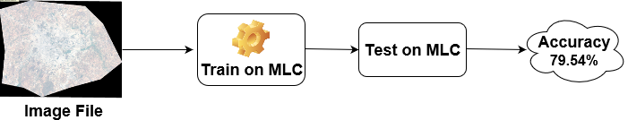
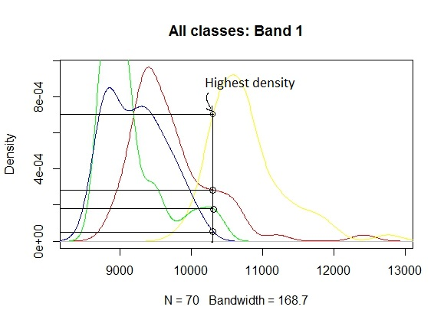
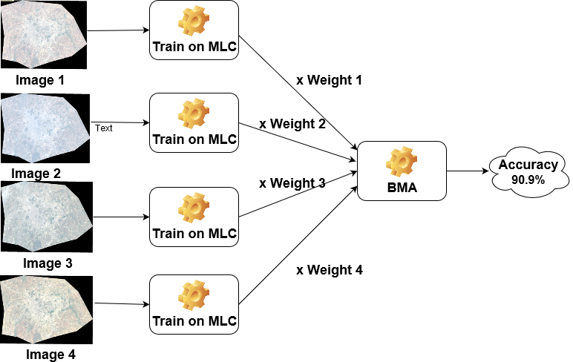
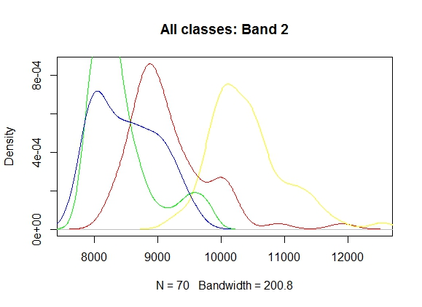
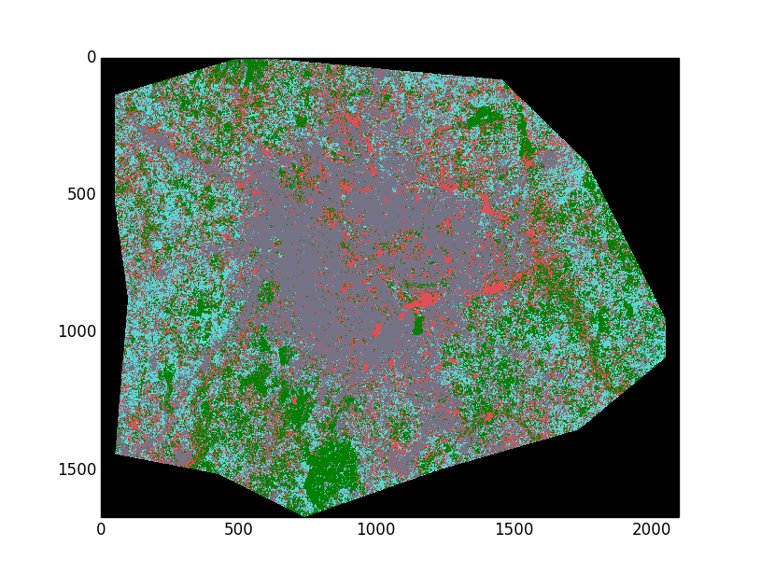
Multi Temporal Classification Of Satellite Images
Ankur Garg, Dhananjay Sathe, Kushal Nawalakha, Pranav Nawathe, Sanket Shahane
Department of Computer Science
Introduction
Classification Methodology MLC and BMA
Challenges & Solutions
Studying spatial changes using multi temporal remotely sensed images has varied uses from monitoring the agricultural land use, natural resource management such as water resource monitoring to study the changes in metropolitan areas in temporal sense.
In this study, our focus is on analysing Land Use and Land Cover (LULC) changes in urban settings, particularly in Bangalore city, India.
Maximum likelihood classification (MLC) works well if the data in the image is spectrally well separable. But, most of the times, due to changes in reflectance of earth’s surface during various seasons and other factors like moisture content, terrain, the data becomes not well separable and has many classification errors.
Hence, it becomes necessary to study and analyse data from various seasons to improve the classification results. Using multitemporal data, this error can be reduced as it enables us to consider changing spectral signatures of same class over different images.
What is MLC? MLC is the base classification algorithm. MLC uses class prior which is multiplied to the likelihood of the data to get the posterior probability. Finally, Maximum posterior probability is assigned.
MLC will classify the given image and for multiple images, it will have models corresponding to each image.
Since, a single decision for each test point is required, so Bayesian Model Averaging (BMA) is used to combine all the decisions from the models.
What is BMA? Every classifier is assigned a weight based on its performance on the validation data, then input is given to all classifiers and probability output is multiplied by respective weights,. This output of all the classifiers is averaged and maximum posterior probability is assigned as class label.
4 images with 300,000 points each have to be classified for BMA. Time required is approx. 30 mins per image. Our MLC and BMA implementation is vectorized and multithreaded for parallel processing.
Weight calculation of classifiers involves raw probability multiplications leading to precision error. We used logarithm to convert multiplication to addition. And to avoid log(0) we rescaled probs to [1,2]
Due to Monsoon open land changes to green land causing change in class labels. Manually removed conflicting points.
Cross marginal and testing errors had marginal difference 9%. Regenerated training and testing data.
Conclusions
BMA can be a useful technique where individual classifiers do not perform very well. In our case we observed improvement in accuracy of some classes. But overall accuracy was quite similar to individual classifier accuracies. Dimensionality reduction and feature subset selection helped in significantly improving the accuracy.
Figure 1 : MLC
Figure 2: BMA
Data description
Results
Data Images - 4 Landsat 30m X 30m resolution images of Bangalore city, India.
We identified 4 major classes in these images, open land, buildings, vegetation and water bodies.
177 points are randomly selected as training data and remaining as accuracy testing data.
We analysed the density plot and found the data follows Gaussian distribution and hence MLC was a natural choice of classifier.
 | MLC | PCA | Feature subset
Model 1 | 88.63% | 88.63% | 93.18%
Model 2 | 79.54% | 81.82% | 88.64%
Model 3 | 86.36% | 90.91% | 93.18%
Model 4 | 95.45% | 90.91% | 97.72%
BMA | 90.90% | 90.90% | 93.18%
References
GitHub link https://github.ncsu.edu/ppnawath/Multi-temporal-Classification-of-satellite-images
Bruzzone, L., and D. F. Prieto. “Unsupervised Retraining of a Maximum Likelihood Classifier for the Analysis of Multitemporal Remote Sensing Images.” IEEE Transactions on Geoscience and Remote Sensing 39, no. 2 (February 2001): 456–60. doi:10.1109/36.905255.
Center for History and New Media. “Zotero Quick Start Guide,” n.d. http://zotero.org/support/quick_start_guide.
Eason, G., B. Noble, and I. N. Sneddon. “On Certain Integrals of Lipschitz-Hankel Type Involving Products of Bessel Functions.” Philosophical Transactions of the Royal Society of London A: Mathematical, Physical and Engineering Sciences 247, no. 935 (April 19, 1955): 529–51. doi:10.1098/rsta.1955.0005.
Gorunescu, Florin. “Introduction to Data Mining.” In Data Mining, by Florin Gorunescu, 1–43. Berlin, Heidelberg: Springer Berlin Heidelberg, 2011. doi:10.1007/978-3-642-19721-5_1.
“Introduction to Data Mining - Springer.” Accessed April 21, 2017. https://link.springer.com/chapter/10.1007%2F978-3-642-19721-5_1.
“Remote Sensing Digital Image Analysis - Springer.” Accessed April 21, 2017. https://link.springer.com/book/10.1007/978-3-642-30062-2.
Strahler, Alan H. “The Use of Prior Probabilities in Maximum Likelihood Classification of Remotely Sensed Data.” Remote Sensing of Environment 10, no. 2 (September 1, 1980): 135–63. doi:10.1016/0034-4257(80)90011-5.

