Slide 1


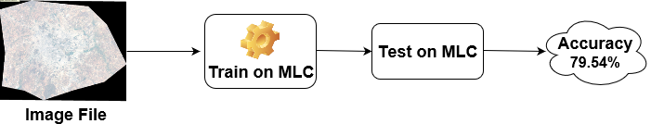
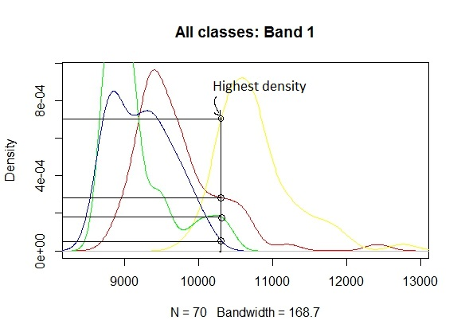
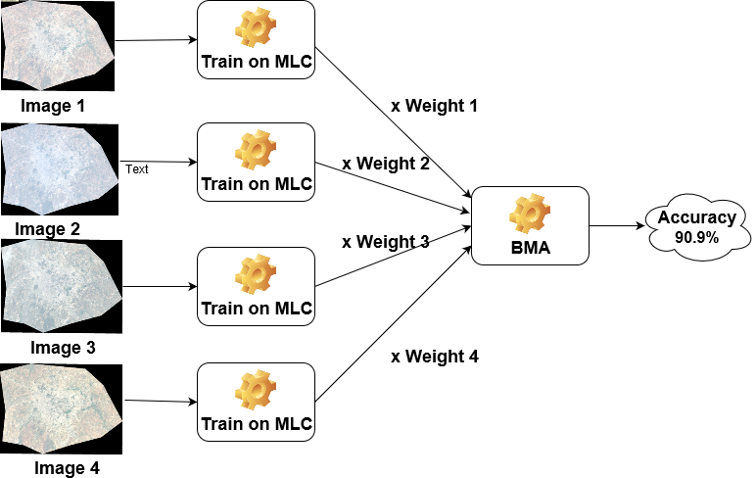
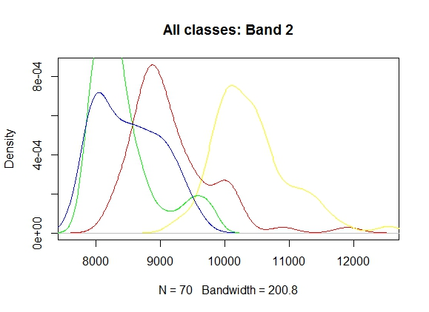
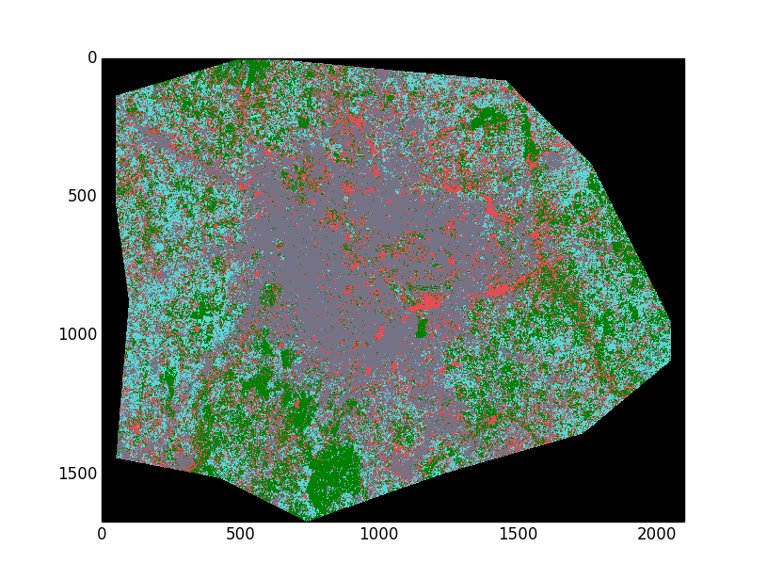
Multi Temporal Classification Of Satellite Images
Ankur Garg, Dhananjay Sathe, Kushal Nawalakha, Pranav Nawathe, Sanket Shahane
Department of Computer Science
Introduction
Classification Methodology MLC and BMA
Challenges & Outcomes
Studying spatial changes using multi temporal remotely sensed images has varied uses from monitoring the agricultural land use, natural resource management such as water resource monitoring to study the changes in metropolitan areas in temporal sense.
In this study, our focus is on analysing Land Use and Land Cover (LULC) changes in urban settings, particularly in Bangalore city, India.
Maximum likelihood classification (MLC) works well if the data in the image is spectrally well separable. But, most of the times, due to changes in reflectance of earth’s surface during various seasons and other factors like moisture content, terrain, the data becomes not well separable and has many classification errors.
Hence, it becomes necessary to study and analyse data from various seasons to improve the classification results. Using multitemporal data, this error can be reduced as it enables us to consider changing spectral signatures of same class over different images.
What is MLC? MLC is the base classification algorithm. MLC uses class prior which is multiplied to the likelihood of the data to get the posterior probability. Finally, Maximum posterior probability is assigned.
MLC will classify the given image and for multiple images, it will have models corresponding to each image.
Since, a single decision for each test point is required, so Bayesian Model Averaging (BMA) is used to combine all the decisions from the models.
What is BMA? Every classifier is assigned a weight based on its performance on the validation data, then input is given to all classifiers and probability output is multiplied by respective weights,. This output of all the classifiers is averaged and maximum posterior probability is assigned as class label.
Number of components in Gaussian Mixture Models = ...
Patch size = ….
Initial centers for the GMM were chosen as the centers from agglomerative hierarchical clustering because….
Components in pairs of GMMs were matched using …
OR
Batch size, learning rate, learning rate decay, momentum, network architecture, activation function. Reasons for all choices.
(Note: Use bullet points, no paragraphs)
Conclusions
<what conclusions did you draw from your semester long work>
CNNs perform the best on this task because….
Random forests beat all other methods by a huge margin because….
Figure 1 : MLC
Figure 2: BMA
Data description
Results
Data Images - 4 Landsat 30m X 30m resolution images of Bangalore city, India.
We identified 4 major classes in these images, open land, buildings, vegetation and water bodies.
177 points are randomly selected as training data and remaining as accuracy testing data.
We analysed the density plot and found the data follows Gaussian distribution and hence MLC was a natural choice of classifier.
 | MLC | PCA | Feature subset
Model 1 | 88.63% | 88.63% | 93.18%
Model 2 | 79.54% | 81.82% | 88.64%
Model 3 | 86.36% | 90.91% | 93.18%
Model 4 | 95.45% | 90.91% | 97.72%
BMA | 90.90% | 90.90% | 93.18%
References
GitHub link https://github.ncsu.edu/ppnawath/Multi-temporal-Classification-of-satellite-images
Raju’s paper
http://www.isprs.org/proceedings/XXXV/congress/comm4/papers/480.pdf
http://www.sciencedirect.com.prox.lib.ncsu.edu/science/article/pii/0034425780900115
http://www.qgis.org/en/site/
http://www.sciencedirect.com.prox.lib.ncsu.edu/science/article/pii/S0034425705002646
https://link.springer.com/book/10.1007/978-3-642-30062-2
http://ieeexplore.ieee.org.prox.lib.ncsu.edu/document/905255/
https://link.springer.com/chapter/10.1007%2F978-3-642-19721-5_1

