Slide 1


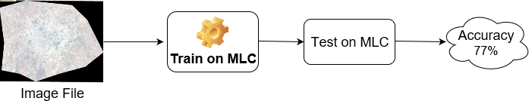
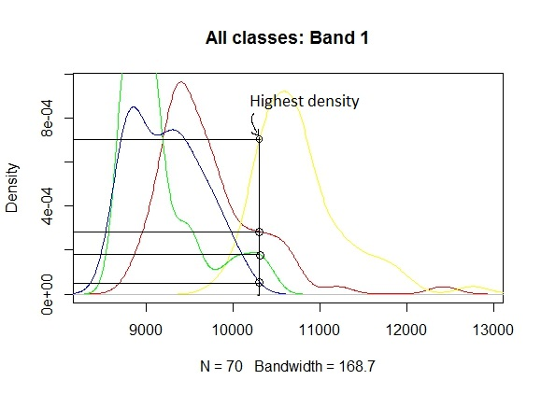
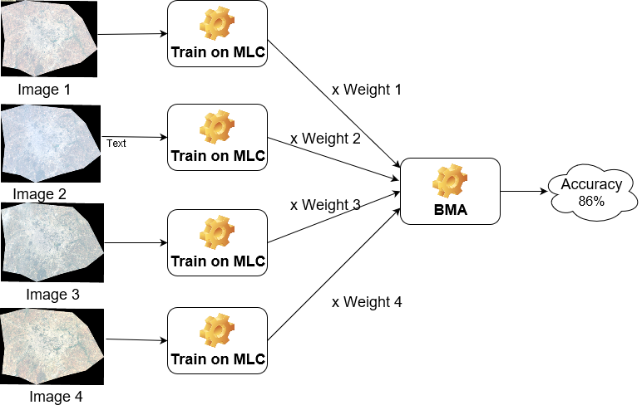
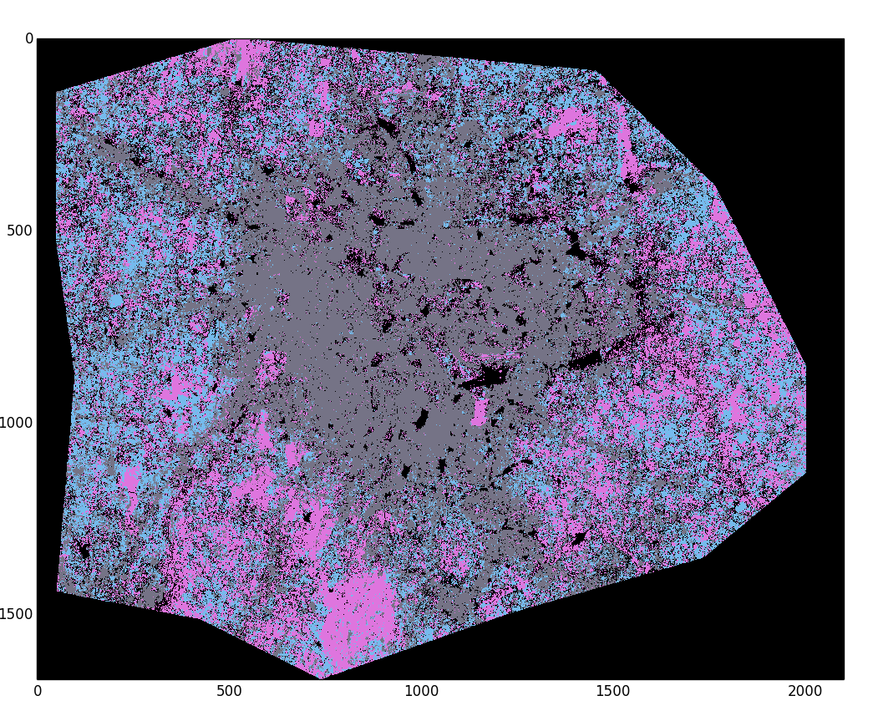
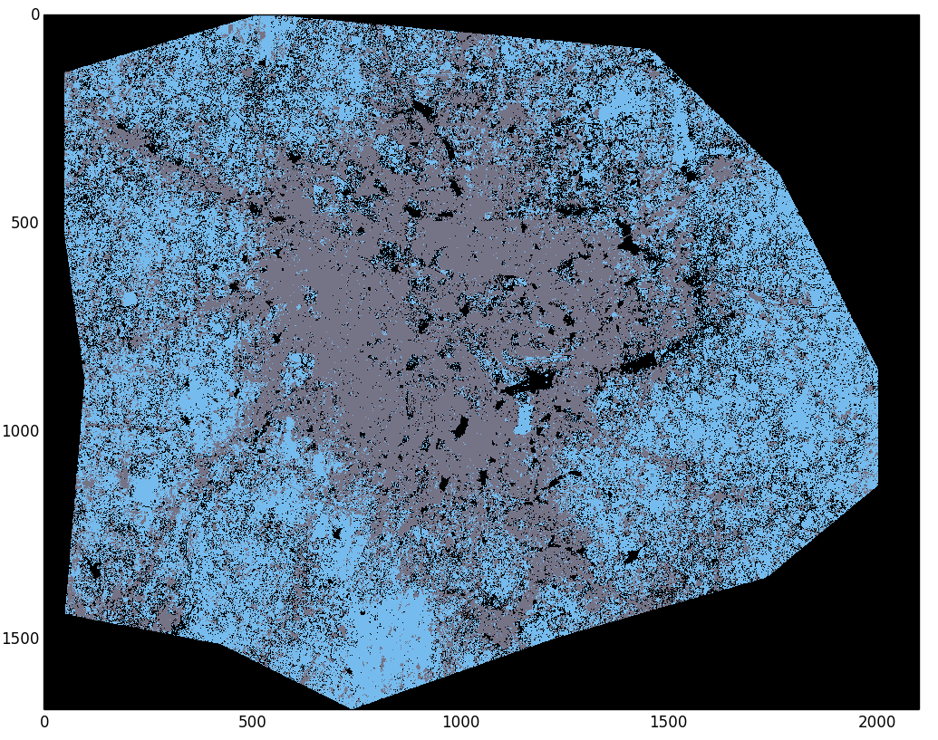
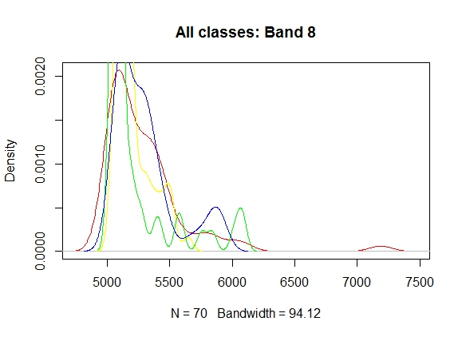
Multi Temporal Classification Of Satellite Images
Ankur Garg, Dhananjay Sathe, Kushal Nawalakha, Pranav Nawathe, Sanket Shahane
Department of Computer Science
Introduction
MLC and BMA
Parameter choices
Studying spatial changes using multi temporal remotely sensed images has varied uses from monitoring the agricultural land use, natural resource management such as water resource monitoring to study the changes in metropolitan areas in temporal sense.
In this study, our focus is on analysing Land Use and Land Cover (LULC) changes in urban settings, particularly in Bangalore city, India.
Maximum likelihood classification (MLC) works well if the data in the image is spectrally well separable. But, most of the times, due to changes in reflectance of earth’s surface during various seasons and other factors like moisture content, terrain, the data becomes not well separable and has many classification errors.
Hence, it becomes necessary to studyanalyse data from various seasons to improve the classification results. Using multitemporal data, this error can be reduced as it enables us to consider changing spectral signatures of same class over different images.
MLC is the initial classification algorithm. MLC uses prior information about the expected distribution of classes in final classification stage. This prior information is used for weighing the classes as per their expected distribution in output dataset.
MLC will classify the given image and for multiple images, it will have models corresponding to each image.
Since, a single decision for each test point is required, so Bayesian Model Averaging (BMA) is used to combine all the decisions from the models.
In BMA, parameter uncertainty is modelled through the prior distribution, uncertainty obtaining posterior parameter and model posteriors using Bayes’ theorem which allows to do direct model selection, combined estimation and prediction.
Number of components in Gaussian Mixture Models = ...
Patch size = ….
Initial centers for the GMM were chosen as the centers from agglomerative hierarchical clustering because….
Components in pairs of GMMs were matched using …
OR
Batch size, learning rate, learning rate decay, momentum, network architecture, activation function. Reasons for all choices.
(Note: Use bullet points, no paragraphs)
Conclusions
<what conclusions did you draw from your semester long work>
CNNs perform the best on this task because….
Random forests beat all other methods by a huge margin because….
Figure 1 : MLC
Figure 2: BMA
Data description
Results
Data Images used for the project , 4 Landsat 8 ETM 30m X 30m images of Bangalore city, India.
We identified 4 classes in these images, open land, buildings, vegetation and water bodies
178 points are randomly selected as training data and kept remaining as accuracy testing data.
We observed a fact that band 8 has very less classification capability.
To confirm this fact, we calculated correlation between every pair of the bands.
<diagrams showing the results of your method>
(For example,
For CNNs for classification, true positive, one false positive, one false negative. Learning curves for loss vs. number of iterations, training and testing accuracies vs. number of iterations.
For GMMs, a portion of the image (original and classified) that the method found hard to discriminate.
Table with performance of different methods under some accuracy measure.
Performance (qualitative or quantitative) of your methods under different parameter settings.)
References
Bands | Correlation
Ultra-Blue and Blue | 0.99
Green and Blue | 0.80
Red and Green | 0.90
Red and SWN1R1 | 0.76
Green and SWN1R2 | 0.65
Red and SWN1R2 | 0.79
SWN1R1 and SWN1R2 | 0.96
GitHub link https://github.ncsu.edu/svshahan/Multi-Temporal-Classification
Raju’s paper
http://www.isprs.org/proceedings/XXXV/congress/comm4/papers/480.pdf
http://www.sciencedirect.com.prox.lib.ncsu.edu/science/article/pii/0034425780900115
http://www.qgis.org/en/site/
http://www.sciencedirect.com.prox.lib.ncsu.edu/science/article/pii/S0034425705002646
https://link.springer.com/book/10.1007/978-3-642-30062-2
http://ieeexplore.ieee.org.prox.lib.ncsu.edu/document/905255/
https://link.springer.com/chapter/10.1007%2F978-3-642-19721-5_1

