Slide 1

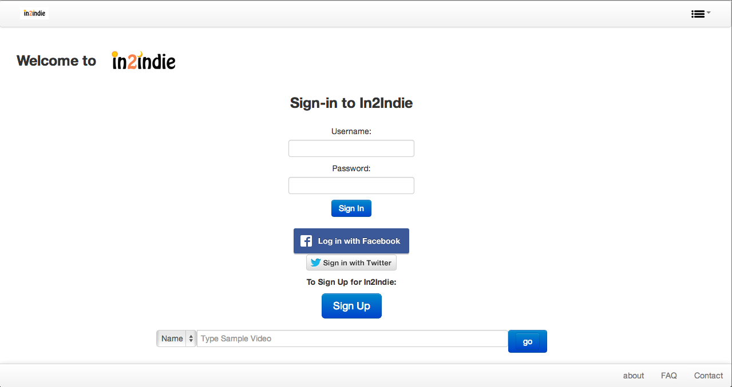
What is In2Indie?
In2Indie is a web- application that hosts Indie- genre products that include (but are not limited to) video games, music, and movies.
Why In2Indie?
HELP INDEPENDENT PRODUCERS/ DEVELOPERS, OF COURSE!!!
They are people that want others to appreciate hard their work! They also should be given money for their work!
Jonathan Piatos
CMSI402: Senior Project Laboratory
Spring 2014
The Design:
Implementation
JavaScript and Jade/Stylus for HTML/CSS generated stubs – All through Node.js!
SQL (through Node.js, of course) into a PostgreSQL Database

