Slide 1
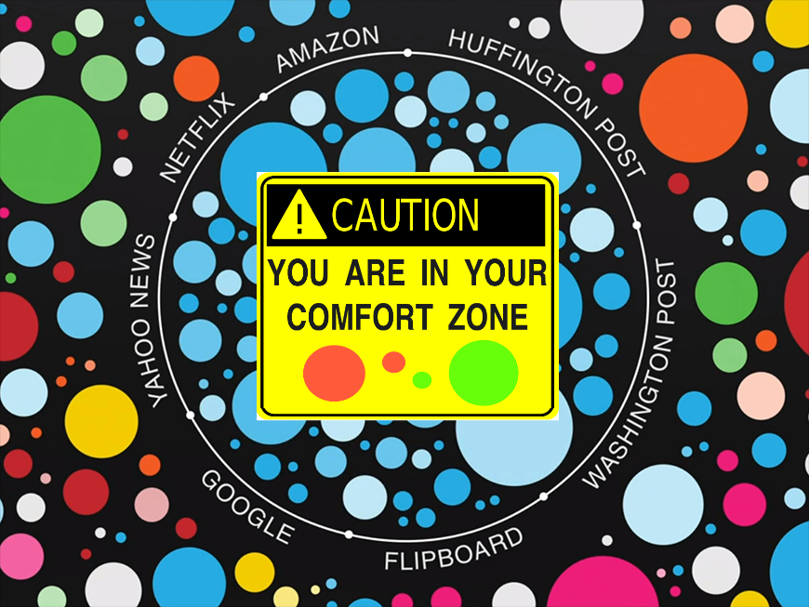

Deconstructing the Filter Bubble
User Decision-Making and Recommender Systems
Paul van Laer & Daniëlle Jongstra
Why?
Feared Recommender System side effects
Filter bubble: a user gets isolated from a
diversity of viewpoints or content
Homogenization: the behavior in a group of
users becomes more similar
Model (components)
Items are consumed sequentially. Large set to choose from, but only a small fraction can be consumed
Uncertainty about how well an item is liked before consumption
User beliefs change after an item is consumed
Recommendation provides information
consumption

