Slide 1
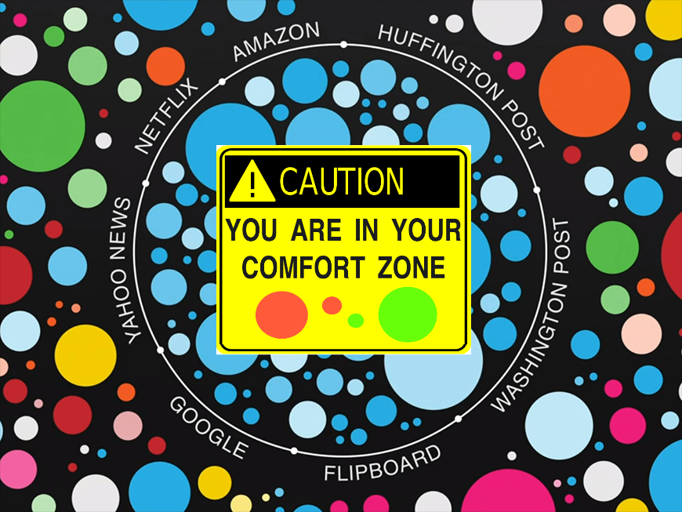


Deconstructing the Filter Bubble
User Decision-Making and Recommender Systems
Paul van Laer & Daniëlle Jongstra
Why?
Model
Feared Recommender System side effects
Filter bubble: a user gets
isolated from a diversity of
viewpoints or content
Homogenization: the behavior in a group of users becomes more similar
Key insight: user beliefs drive consumption choices
Describing different graphs?
☺
☺
consumption
☺
☹
Components
Recommendation provides information
Items are consumed sequentially. Large set to choose from, but only a small fraction can be consumed
Uncertainty about how well an item is liked before consumption
Experience goods: true value only discovered after consumption
User beliefs change after an item is consumed
Reveals information about similar items
Either graphs here, or covering the entire length?
consumption

