Slide 1
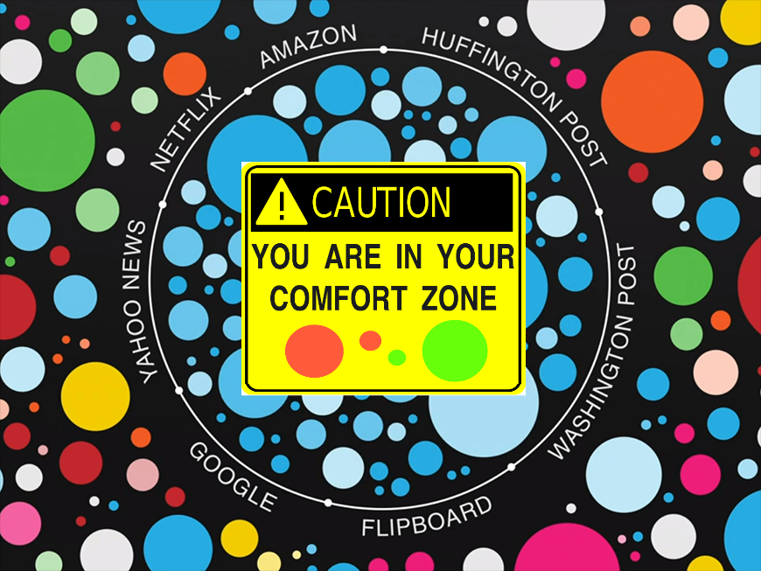
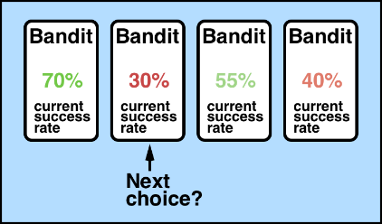
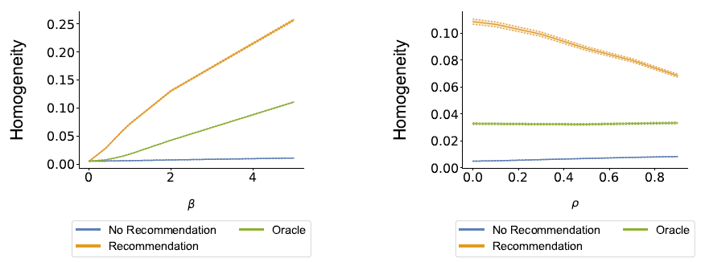
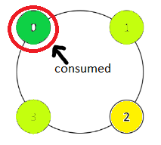
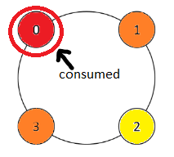




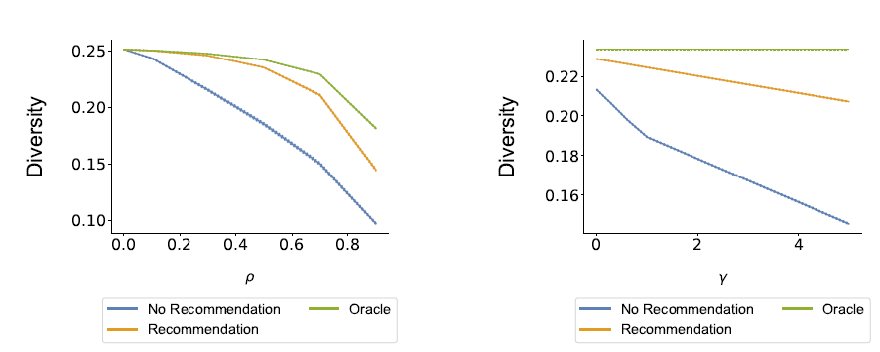
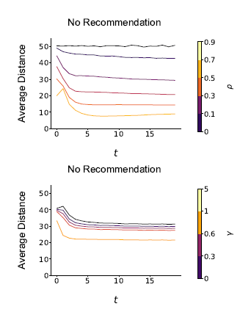
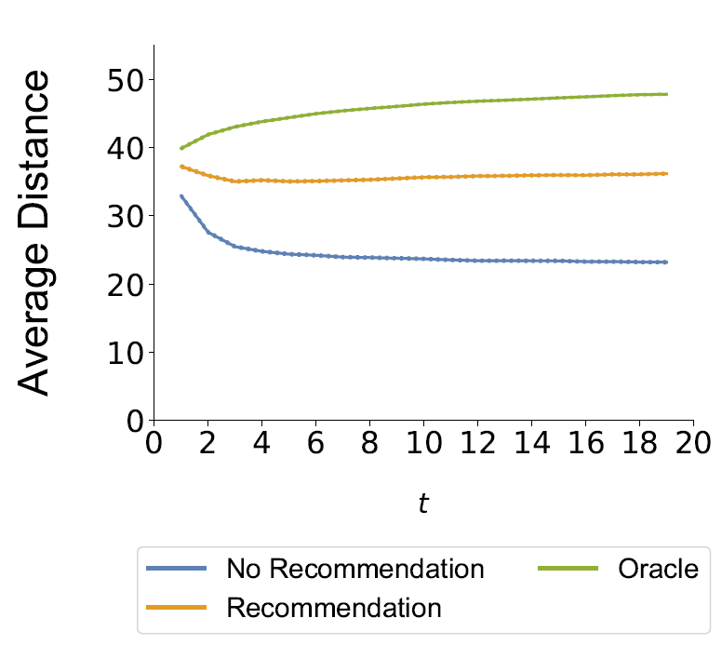
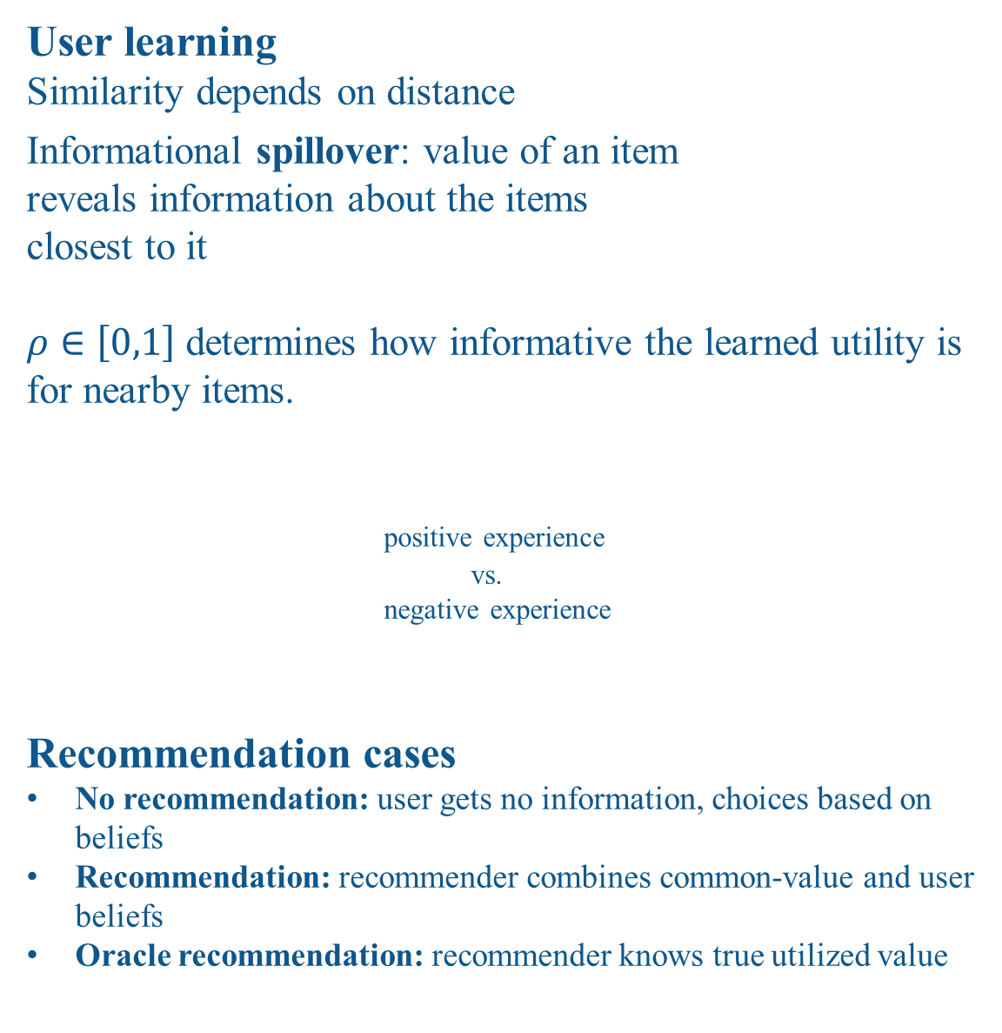
Deconstructing the Filter Bubble
User Decision-Making and Recommender Systems
Paul van Laer & Daniëlle Jongstra
Why?
Model
User homogenization
Feared Recommender System side effects
Filter bubble: a user gets
isolated from a diversity of
viewpoints or content
Homogenization: the behavior
in a group of users becomes
more similar
Key insight: user beliefs drive consumption choices
Study how recommender systems influence user behavior for:
Consequences
Design
User Decisions
Each user assigns a monetary value to the experience of consuming an item.
Consumption of an item = gamble.
User evaluates an item by its expected utility
A user is risk-averse if he prefers the sure thing to a gamble
The certainty equivalent is how much extra money the gamble should give for the user to be indifferent between the sure thing and the gamble
User i’s realized value when consuming item n
Idiosyncratic component + weighted common-value
Users have beliefs over the valuation of an item
Assumption: users maximize the expected utility
Cert. eq.
Expected value for item n – weighted variance for item
User learning
Similarity depends on distance
Informational spillover: value of an item
reveals information about the items
closest to it
$ρ∈\left[0,1\right]$determines how informative the learned utility is for nearby items.
positive experience
vs.
negative experience
Recommendation cases
No recommendation: user gets no information, choices based on beliefs
Recommendation: recommender combines common-value and user beliefs
Oracle recommendation: recommender knows true utilized value
Measured via jaccard index between the consumption sets of users
Homogenization effect strongest when:
Recommendation case
The common-value weight increases
Spillover decreases
☺
☺
Diversity
consumption
Defined as average pairwise distance between the items in a consumption set
Decreases when spillover increases, heightened effect by risk-aversity
☺
☹
Components
Recommendation provides information
Items are consumed sequentially. Large set to choose from, but only a small fraction can be consumed
Uncertainty about how well an item is liked before consumption
Experience goods: true value only discovered after consumption
User beliefs change after an item is consumed
Reveals information about similar items
Filter bubble effect
Characterized as the amount of local consumption the users engage in
Local consumption = average consumption distance between items consumed at time
t-1 and t
Filter bubble effect when:
Average consumption distance decreases over time
Levels are lower for given recommendation case than for another case
Recommender system Design
consumption
No recommendation: users over-exploit spillovers
Recommendation decreases degree of local consumption, but not as much as oracle case
Informational spillovers + risk-aversion can lead users into filter bubble
Good recommendations are not always useful
Not useful if user would make interference themselves
e.g. Frozen ☺ => Frozen 2 ☺
Instead predict what the most useful information is, leading the user to change the item they will eventually consume
Above: influence of spillover parameter
Below: influence of risk-aversion parameter

