Slide 1


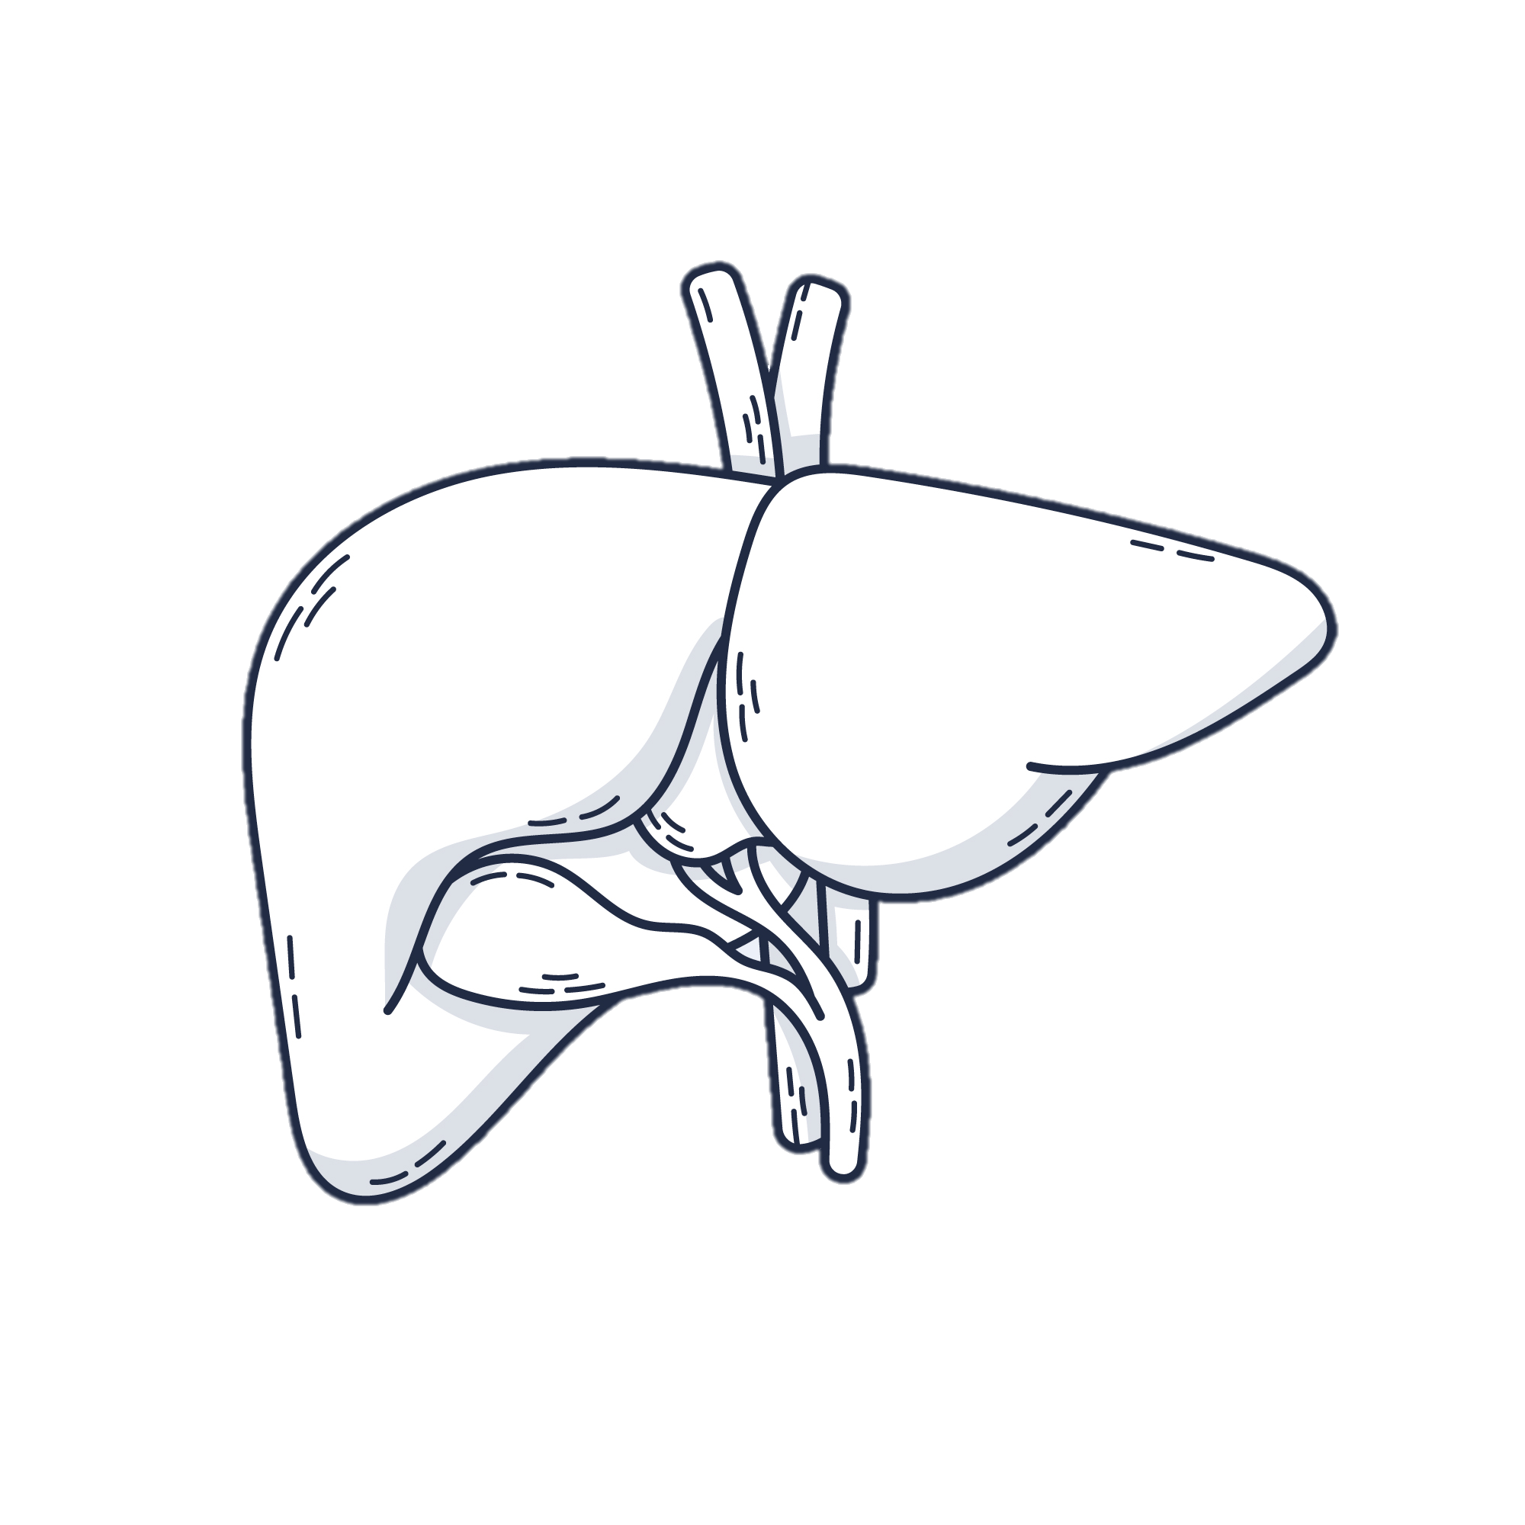
- Biochemical
- Mid-infrared spectroscopy
- Metallomic
multimodal data obtained from serum
Mixed Integration
Late Integration
Early Integration
New - Sequential Integration
Strategies of data integration
Simplest representations of each dataset are pooled
Predictive performance of liver Steatosis
<
=
<
+
+

