Slide 1





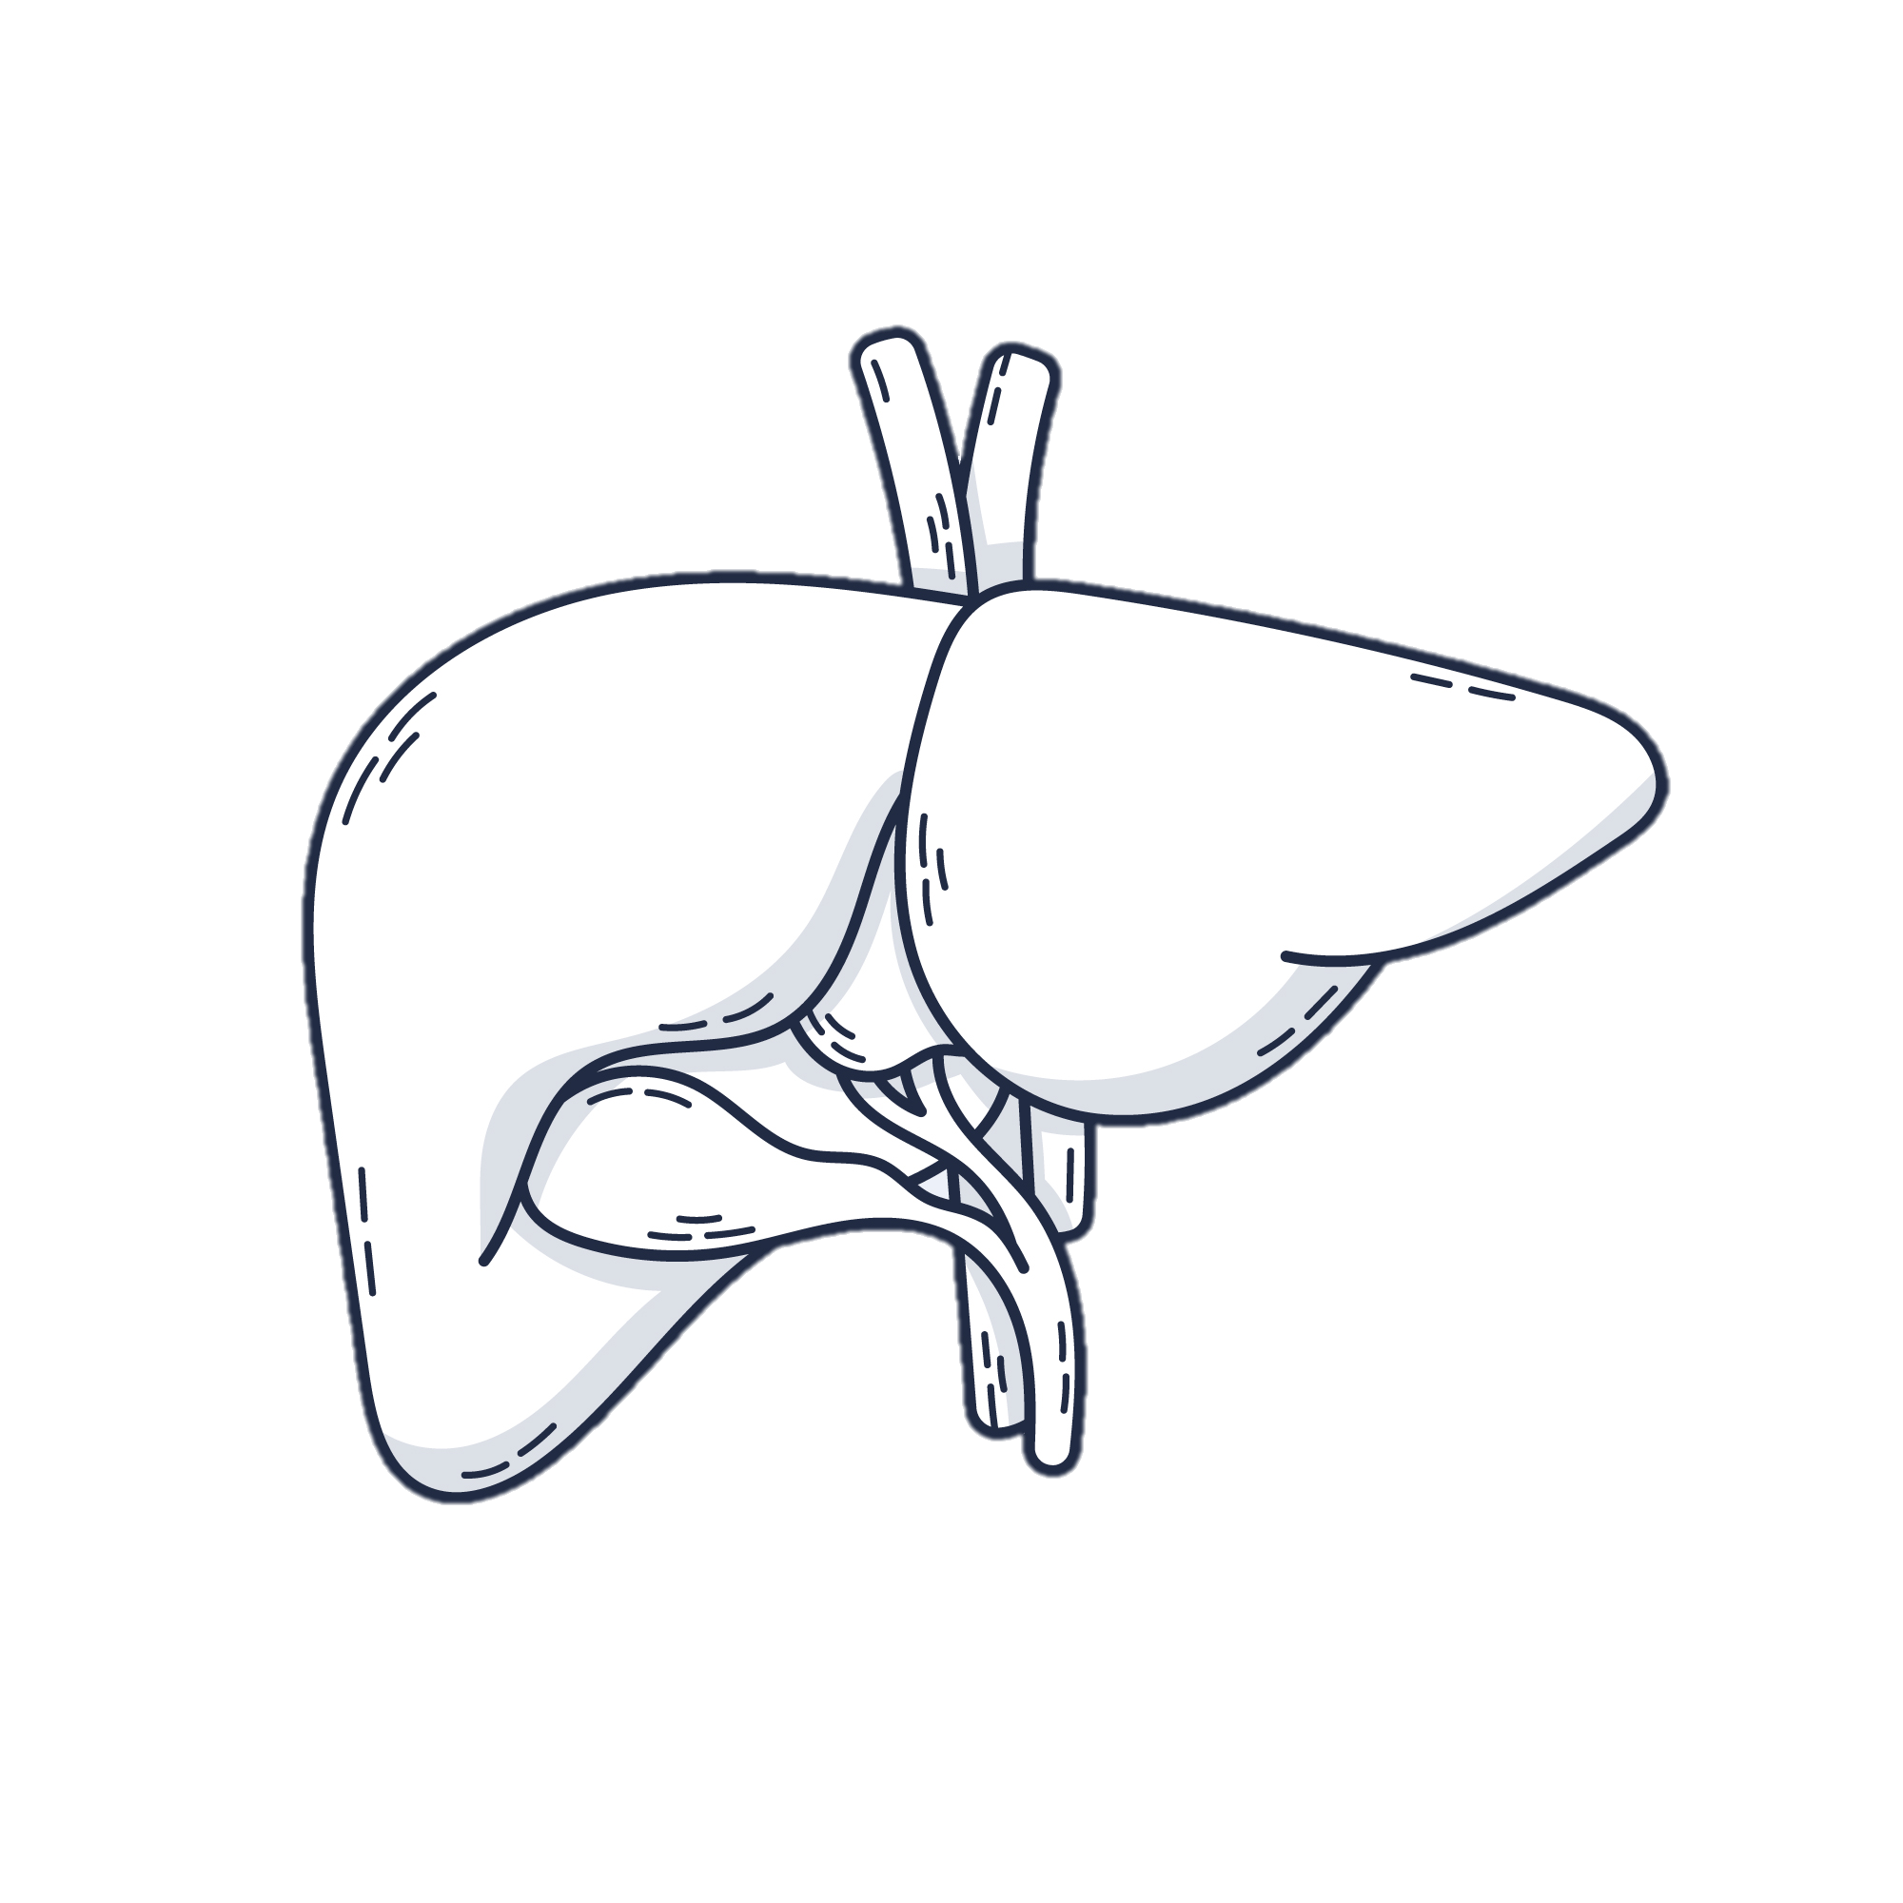
Experimental design
Multi-omics data
IRON
(n=25)
IRON + HFHC
(n=23)
- Biochemical
- Mid-infrared spectroscopy
- Metallomic
Iron content
CTL
(n=24)
HFHC
(n=23)
Steatosis evaluation
- Histological score
- Triglyceride content
- mRNA level of Fsp27
Steatosis

