Slide 1

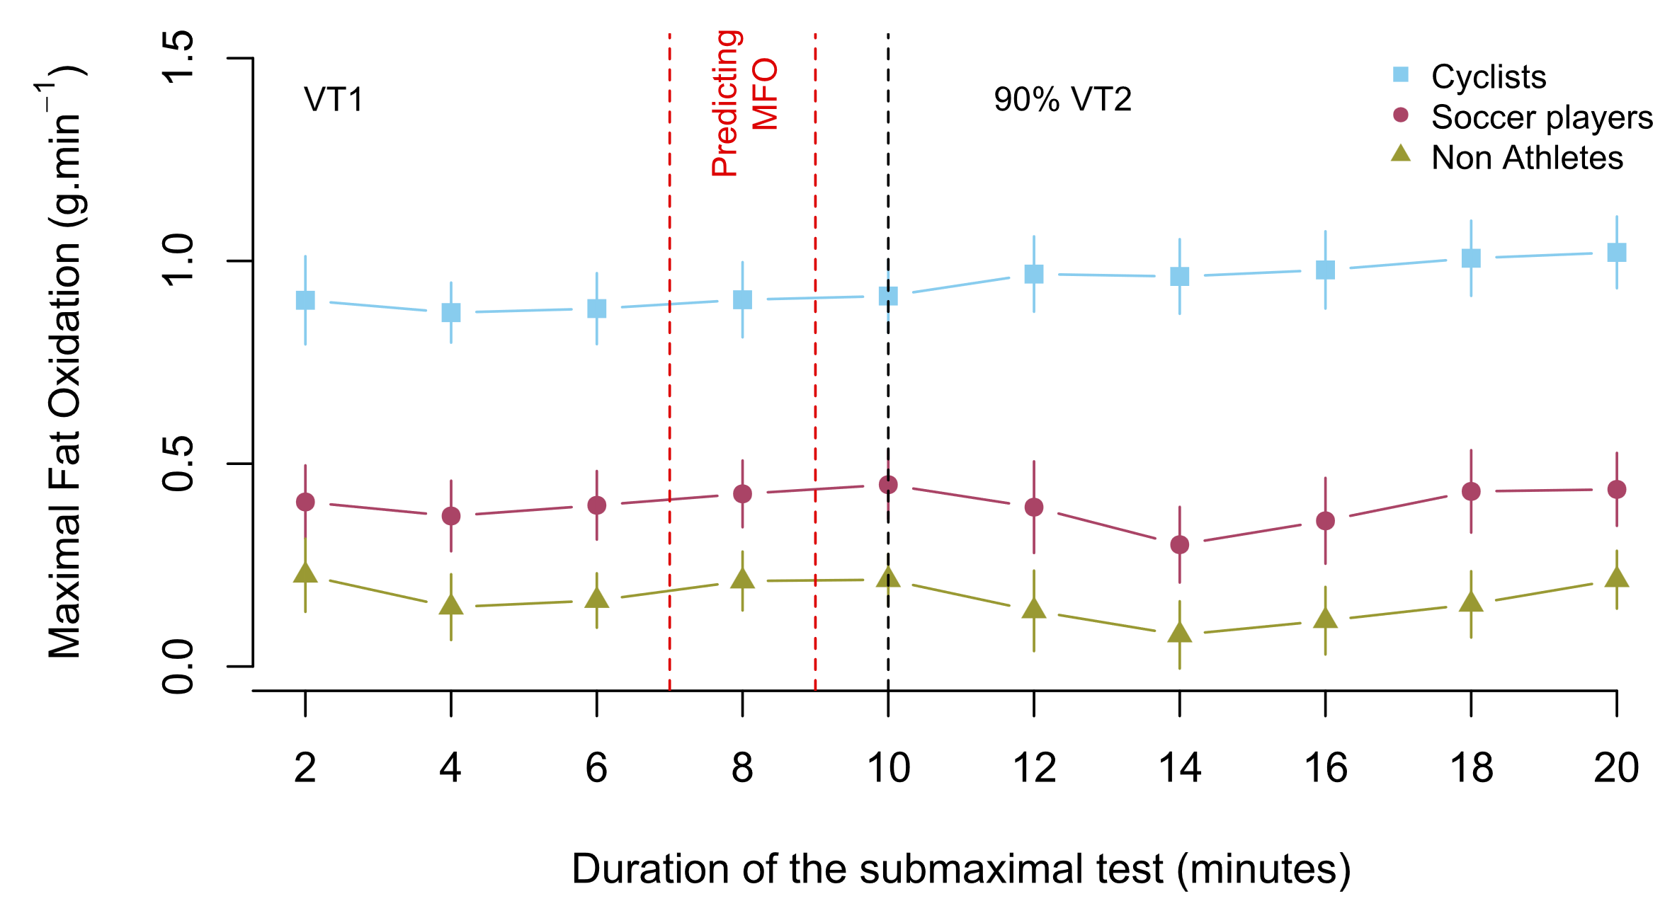
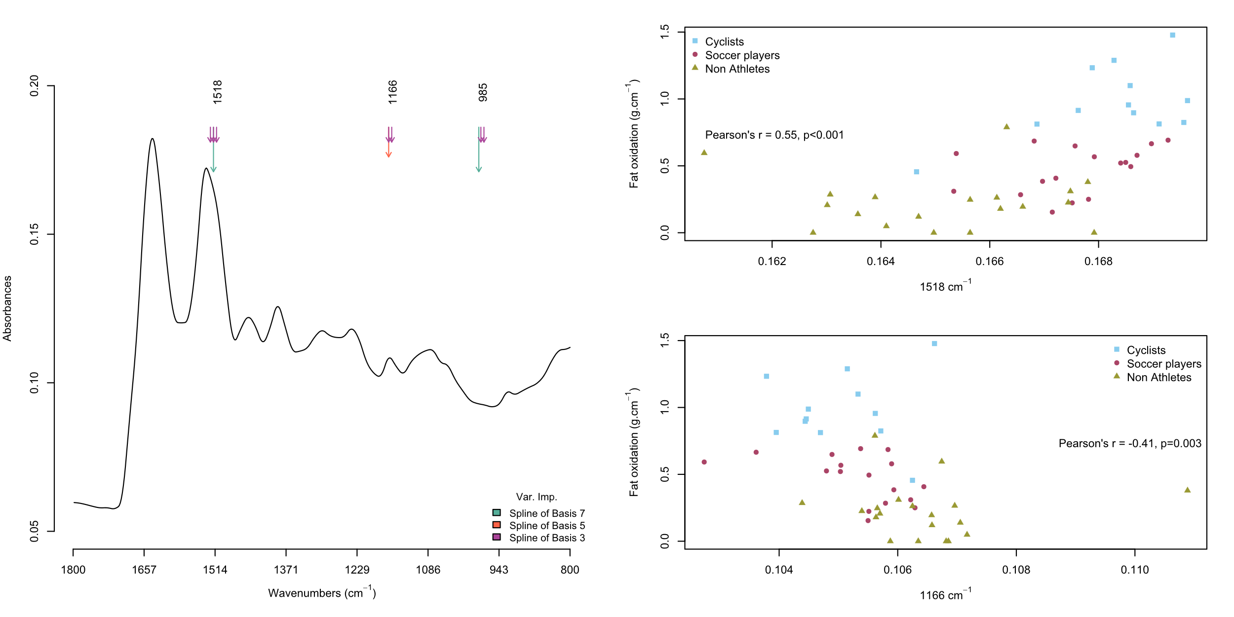

A
B
Sub-maximal test (20 minutes)
Explanatory variables
Mid-infrared Spectroscopy
Target variable
Maximal Fat Oxidation (MFO)
Machine learning model
(random forest)
Spectral fingerprint
Predictive performances

