Slide 1
E-LEARNING MANAGEMENT SYSTEM

Slide 2

introduction
Dynamic Online Learning Platform – Designed to support virtual education with interactive features.
Three Access Modes – Includes User Mode (students), Professor Mode (instructors), and Admin Mode (management).
Course Management – Enables streamlined course creation, enrollment, and administration.
Secure and Role-Based Access – Ensures controlled access for different users with distinct permissions.
Enhancing Virtual Education – Aims to improve efficiency and engagement in online learning.

Slide 3
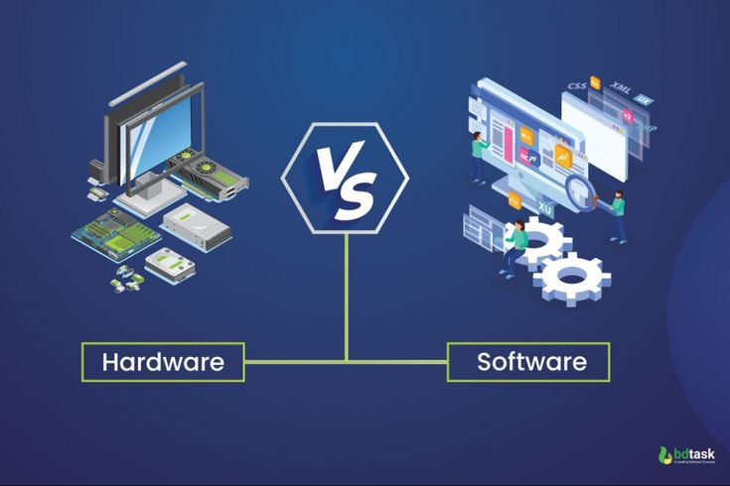
Requirements
Hardware Requirements –
Processor: Intel i3/AMD Ryzen 3 or higher.
Ram: 4GB or Higher
Storage: 256GB or higher
Software Requirements –
Frontend: Angular 15, Node.js
Backend: Spring Boot, Java 17
Database: MySQL
IDE: VS Code(Frontend), STS tool(Backend)

Slide 4
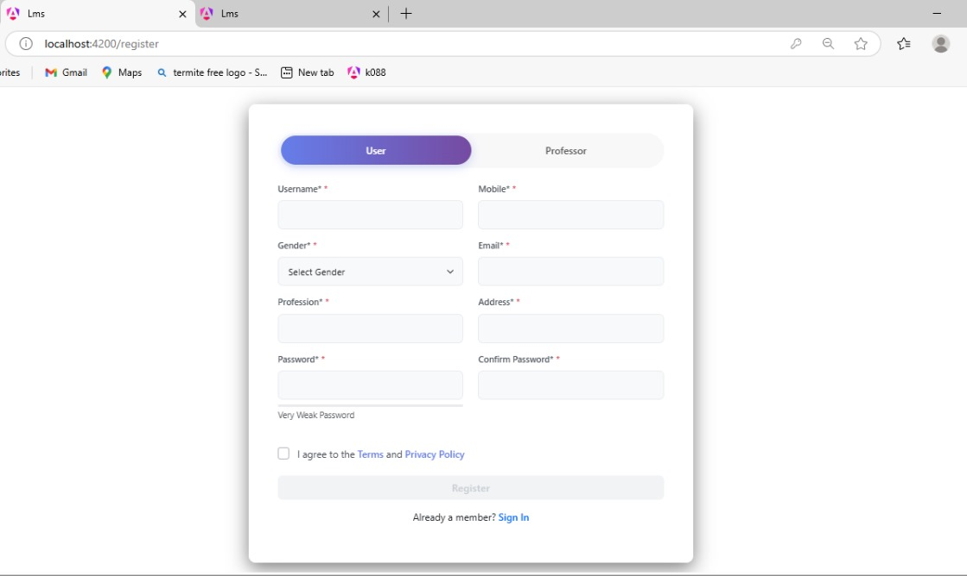
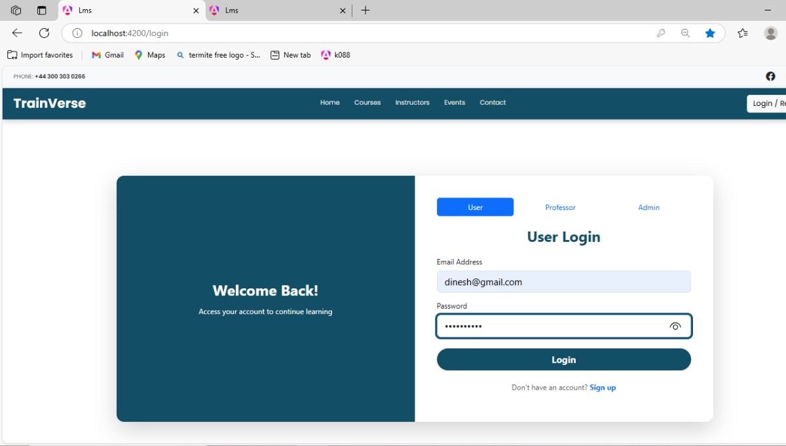
Login / Register ui
Registration Page :
Login Page :

Slide 5
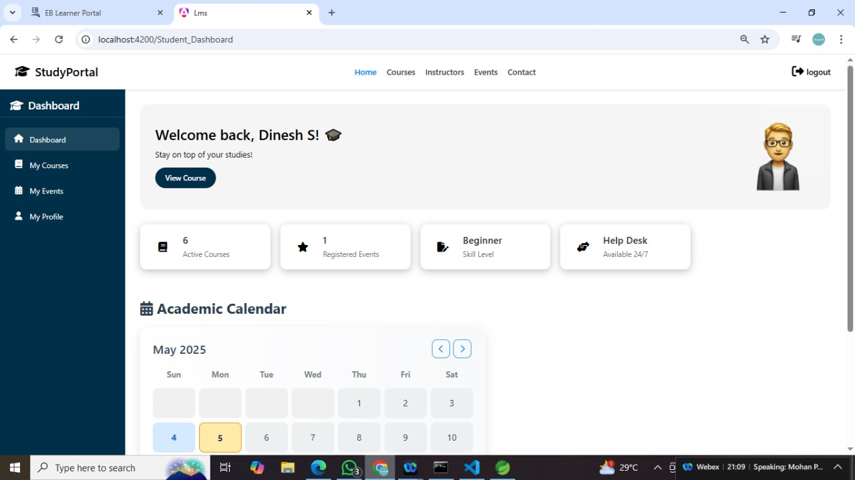
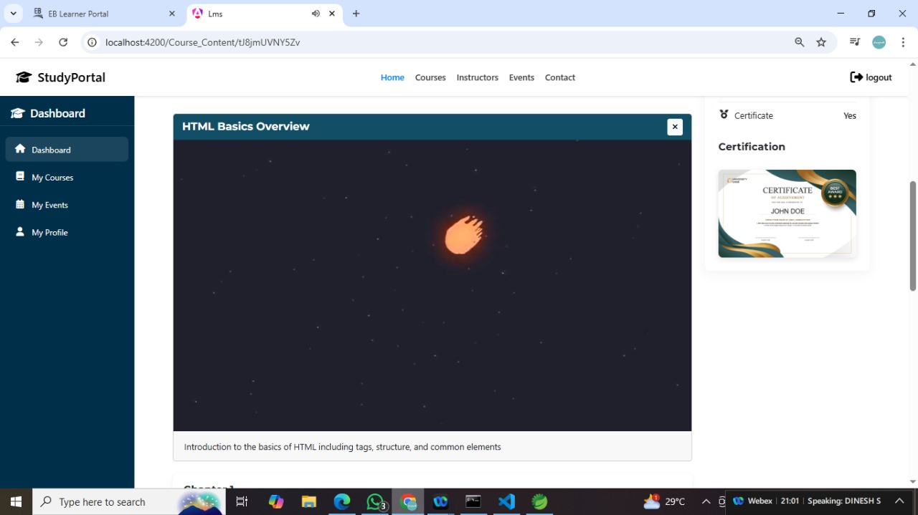
User mode ui
User Dashboard :
User Courses :

Slide 6
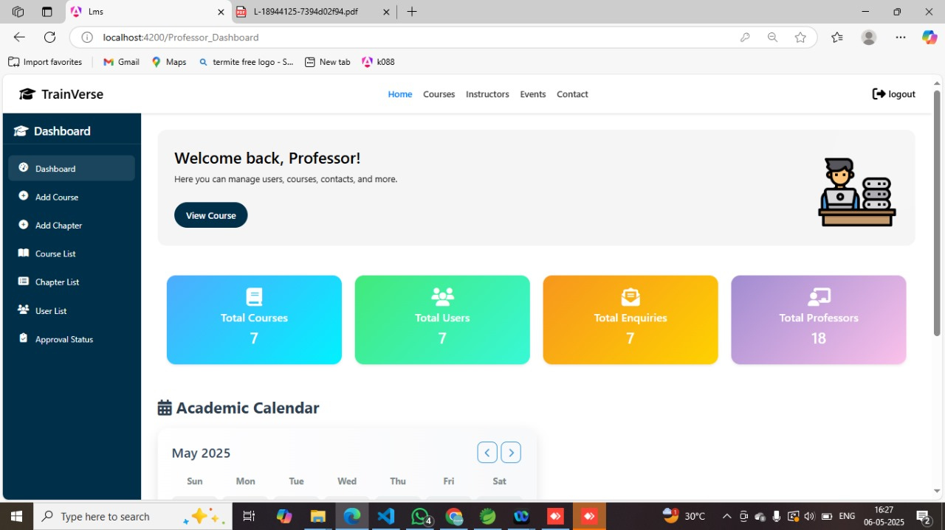
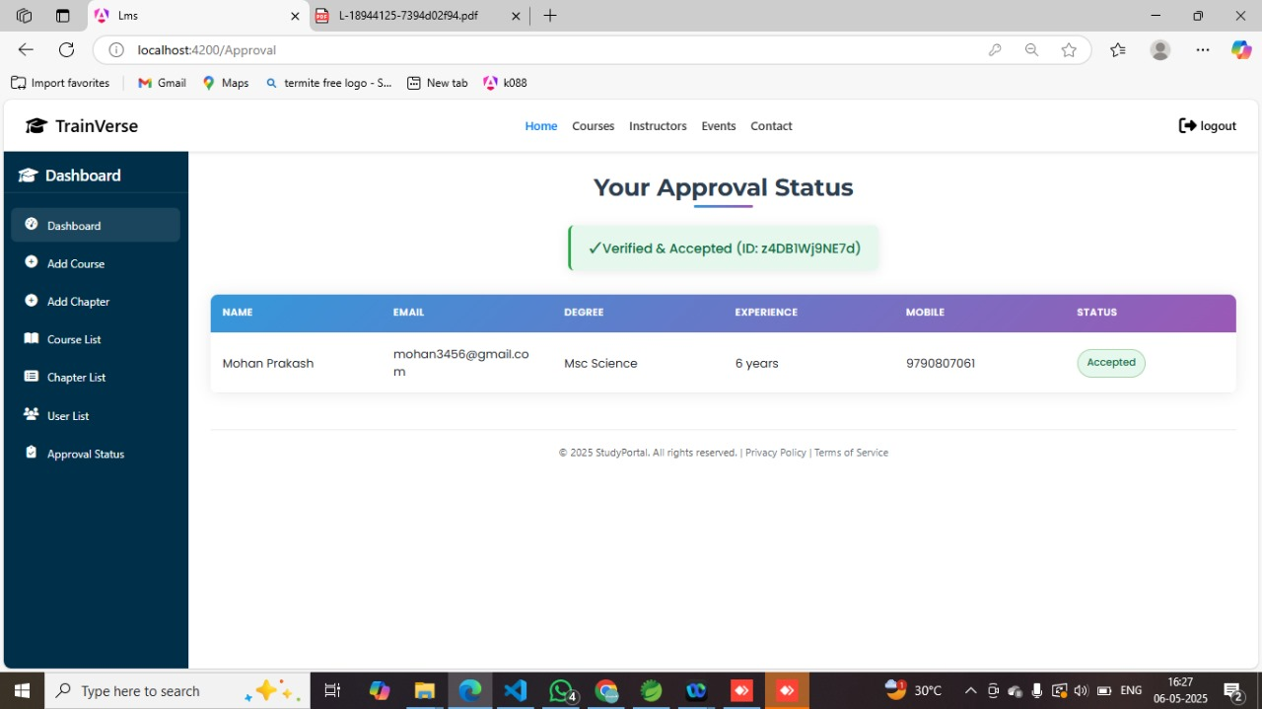
Professor mode ui
Professor Dashboard :
Professor Approval :

Slide 7
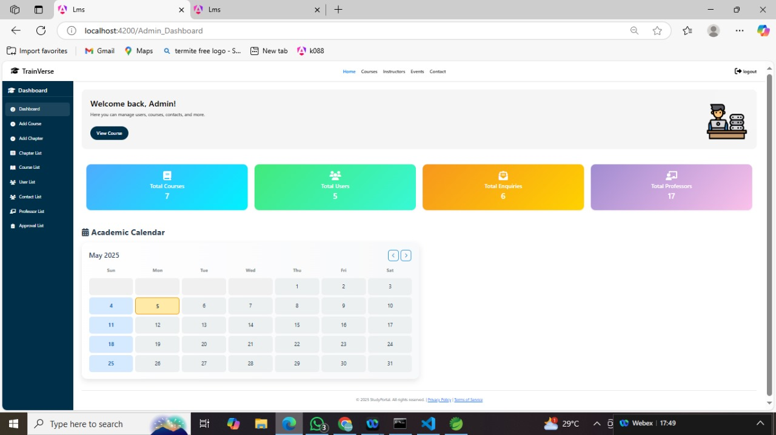
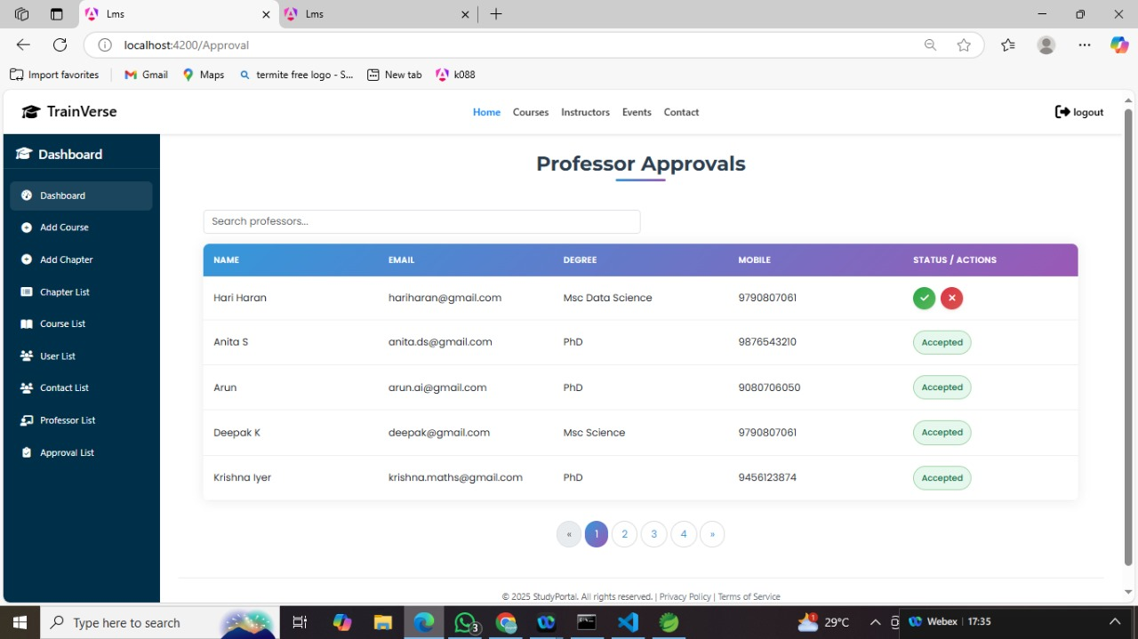
ADMIN mode ui
Admin Dashboard :
Professor Approvals :

Slide 8
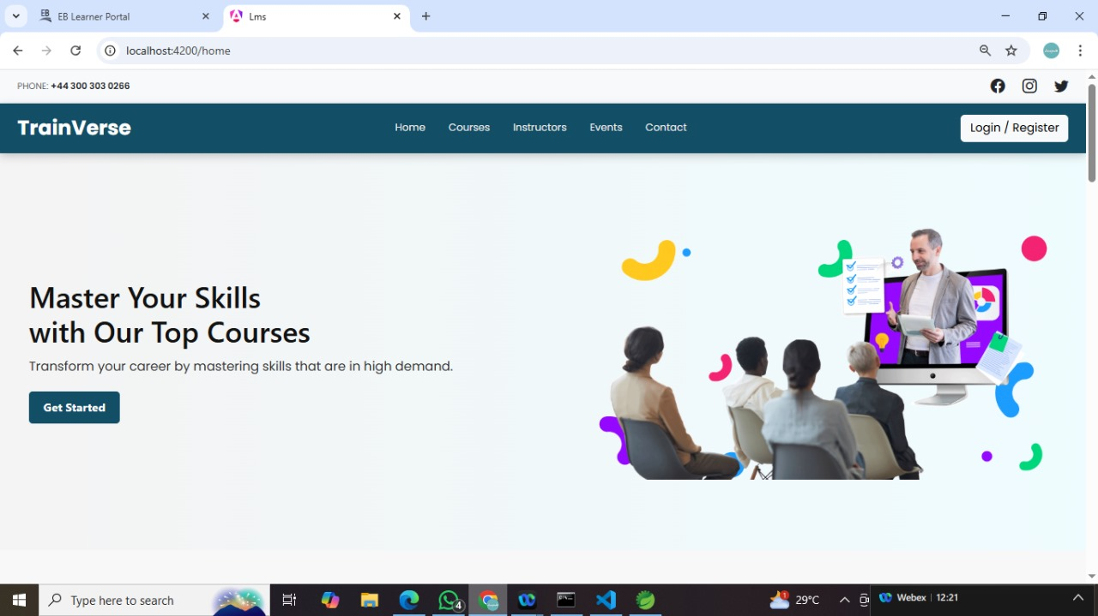
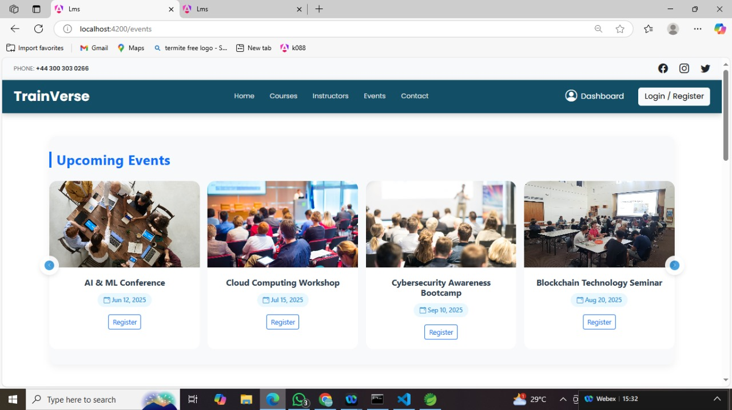
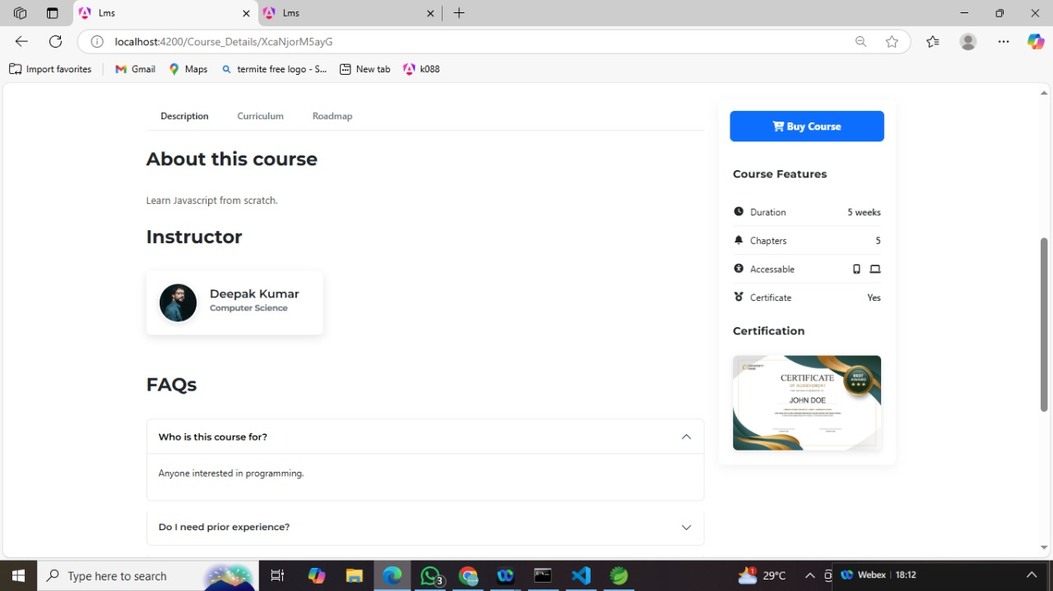
OTHER ui
Opening Page :
Event Page :
Course Page :

Slide 9

conclusion
Complete E-Learning Platform – Successfully built a full-stack system tailored for flexible and efficient learning.
Modular Role-Based Access – Implemented distinct functionalities for students, professors, and admins.
Seamless Course Management – Enabled easy course creation, enrollment, and tracking.
Data Security & Accessibility – Ensured a secure and user-friendly experience for all participants.
Scalability & Future Enhancements – Designed for future upgrades and continuous improvement in learning technology.

Slide 10
Thank you…!

