Slide 1






TEAM DETAILS
Team Name:
TECHTONICS
SR. NO
ROLE
NAME
ACADEMIC YEAR
1
Team Leader
AKSHAYA SRELEKA P S
III YEAR
2
Member 1
ASHWINKUMAR K
III YEAR
3
Member 2
DHAMARAI KANNAN A
III YEAR
4
Member 3
DHARSHAN S
III YEAR
COLLEGE NAME
CHENNAI INSTITUTE OF TECHNOLOGY
TEAM LEADER CONTACT NUMBER
TEAM LEADER EMAIL ADDRESS
+91 7010449210
akshayasreleka2006@gmail.com

Slide 2

PROBLEM STATEMENT
Drift-Sense: AI-Powered Navigation-Error Recovery for Wafer Inspection Tools
PROBLEM DESCRIPTION:
Modern wafer inspection requires the same site to be revisited accurately across repeated dies. In Phase 2, the target may appear with unknown translation, rotation and scale, while SEM degradation and highly periodic layouts can create multiple visually similar candidates. The system must also distinguish target-present from target-absent cases.
SOLUTION SUMMARY:
Drift-Sense is a hybrid wafer metrology pipeline combining pyramidal correlation, continuous log-polar rotation/scale search, 2D Hessian sub-pixel refinement (0.2265 px error), and selective Siamese verification. Classical physics-based registration handles >97% of cases deterministically in sub-second CPU time (<0.97s), while an ultra-lightweight (<1 MB) learned Siamese embedder is surgically invoked on <3% of pairs exclusively to resolve dense periodic FinFET/DRAM pitch ambiguities.
KEY RESULT:
0.3764 px Median Localization Error
90.6% Sub-1 px Precision
96.05% Decoy Rejection F1
0.964 s Median Latency / Pair

Slide 3

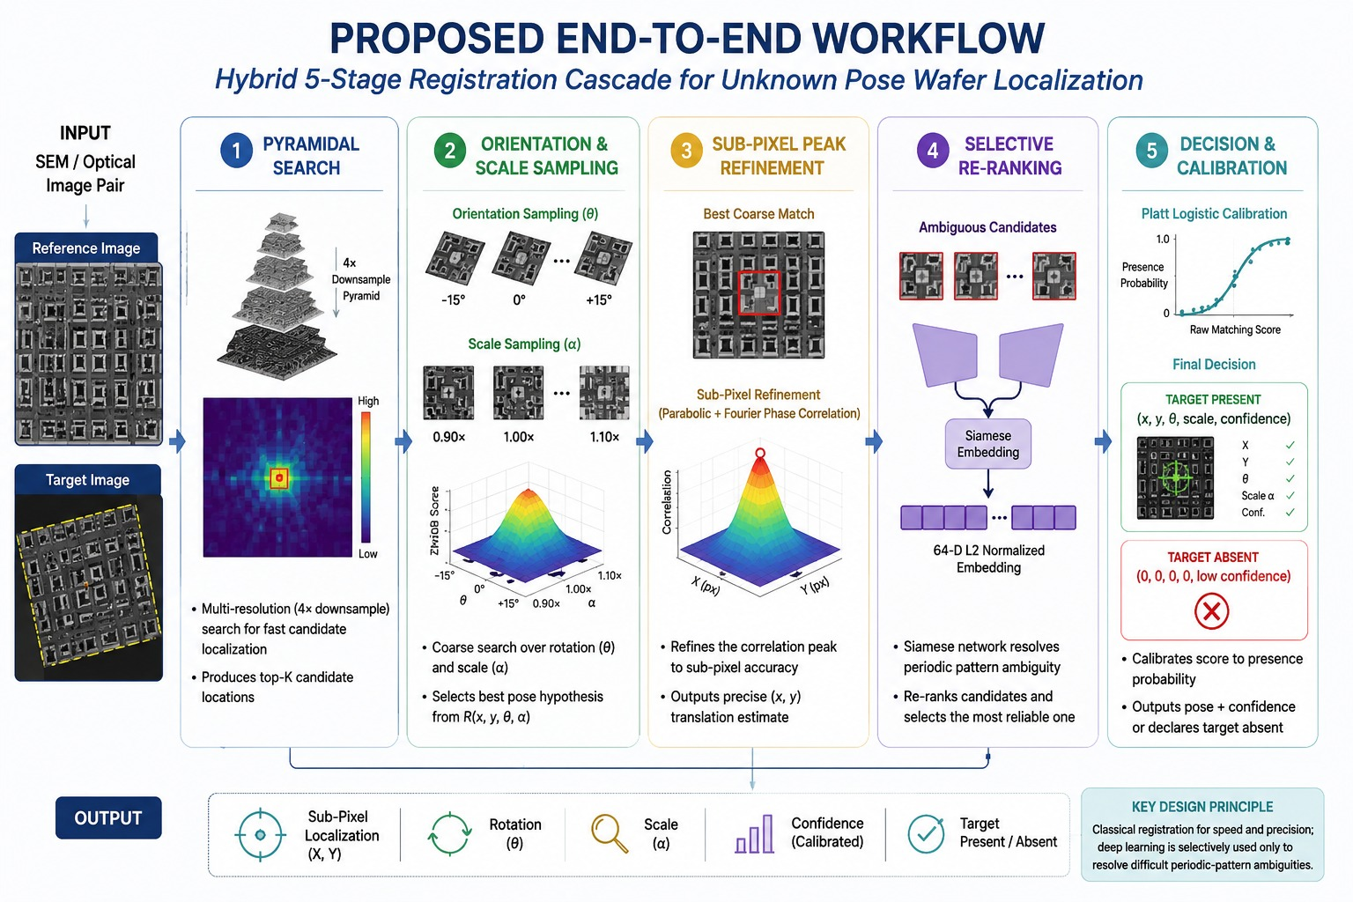
INPUT CHALLENGES:
Unknown wafer pose
* Translation (X, Y),Rotation (θ), Scale (α)
Imaging variations
* SEM / optical noise,Blur & degradation,Sampling / aliasing effects
Core difficulty
* Periodic semiconductor patterns create false correlation peaks
* Target may be absent
WHY CASCADE?
Coarse-to-fine registration
Pyramidal search → Pose sampling → Sub-pixel refinement
Fast global localization first, followed by precise refinement only around the best candidates.
Selective AI resolves difficult periodic-pattern ambiguities without applying deep learning to every candidate.
DECISION LOGIC:
Strong candidate
→ Sub-pixel refinement
→ Final coordinate
Ambiguous candidate
→ 64-D Siamese verification
→ Re-ranking
→ Best candidate
Calibrated confidence
→ Target Present / Target Absent
OUTPUT:
Sub-pixel localization,(X, Y) + Rotation (θ) + Scale (α)
+ Calibrated Confidence + Target Present / Absent
PROPOSED END-TO-END WORKFLOW

Slide 4
SEMICONDUCTOR SYNTHETIC DATA DESIGN
GIVEN REFERENCE DATASET
OUR STRESS DATASET
CLASS | TECHNOLOGY NODE VARIANT | SPECIFIC ARCHITECTURAL LAYOUT FEATURES
P1 | dram_1x | Standard 1x-nm DRAM bitcell array with nominal capacitor spacing
P2 | dram_dense | Ultra-dense DRAM array with tight capacitor pitch and vertical symmetry
P3 | dram_wide | Wide bitline DRAM array with extended active areas
P4 | dram_loose | Relaxed-pitch DRAM cell layout for high-yield test structures
P5 | dram_compact | Ultra-compact memory cell layout with high-aspect-ratio capacitor contacts
P6 | finfet_7nm | 7 nm node sub-10 nm fin-pitch grating arrays; highest periodic-trap risk
P7 | finfet_10nm | 10 nm node multi-fin logic cells with orthogonal gate-cut lines
p8 | finfet_14nm | 14 nm node FinFET standard-cell logic blocks
P9 | finfet_22nm | 22 nm legacy FinFET cell arrays with wide fin spacing
CLASS | CLASS NAME | JUSTIFICATION
P1 | DRAM_CELL | Orthogonal memory bitcell arrays with storage-node capacitor pads and bitline tracks
P2 | FIN_ARRAY | Dense 1D silicon fin grating arrays with strong periodic pitch
P3 | FIN_CUT | Active-channel isolation cuts and cut-mask rectangular openings
P4 | FIN_GATE | Metal gate lines running perpendicular to silicon fins
P5 | CONTACT_ARRAY | Dense contact-hole arrays, contact pads and via landing targets
P6 | LOCAL_INTERCONNECT | M0 local interconnect lines, trench-contact bars and active-area contacts
P7 | METAL_ROUTING | Orthogonal metal routing grids and power-rail structures
P8 | ACTIVE_CELL | Active diffusion regions, well taps and STI isolation boundaries
P9 | FINFET_FULL_CELL | Complex multi-layer standard-cell logic including NAND, NOR and D-Flip-Flops

Slide 5
IMAGING & GEOMETRIC VARIATION MODELLING
PHASE 2 PHYSICAL VARIATION & STRESS CONDITIONS
VARIATION | IMPLEMENTATION | PHASE 2 CONDITION / RESULT
Scale Drift | Continuous multi-scale variation with correspondence preserved | z = 0.080–0.125 / 8.0–12.5 nm/px
Rotation | Continuous paired geometric rotation with GT transformation | θ = −10° to +10°
Shot Noise | Low-dose Poisson–Gaussian electron noise | σ = 25–35, SNR < 2 dB
Charging / Streaks | Non-linear horizontal potential-gradient distortion | DC baseline shift modelled
Target-Absent Decoys | Empty / unrelated wafer fields | 20% decoy rate
RGB Optical | 3-channel optical wafer analogue | 3-channel RGB, chromatic shift up to 1.42 px
Resampling | Super-sampled area-average downsampling | Anti-aliasing validated: MAE 0.0124, PSNR 41.2 dB
Ground Truth | Exact transformed (x, y) coordinates and target status | Known GT for every evaluated pair
ANTI-ALIASING VALIDATION
MAE: 0.0124 | PSNR: 41.2 dB
OPTICAL INPUT
RGB → ITU-R BT.601 Luminance → Grayscale
Registration
CONTROLLED IMAGING VARIATION MODELLING
VARIATION | MODELLING
Rotation | Controlled pose variation
Scale | Imaging scale variation
Noise | Independent reference / target noise
Blur / PSF | Independent imaging blur
Edge Response | SEM-inspired edge brightening
Resampling | Super-sampled area-average downsampling

Slide 6
LOCALISATION METHOD & DECISION RULE
LOCALISATION PIPELINE & DECISION LOGIC
STAGE | METHOD | PURPOSE
1. Candidate Search | ZNCC + Pyramidal Search | Find likely (X, Y) locations
2. Pose Search | Rotation θ + Scale α sampling | Handle unknown wafer pose
3. Refinement | Parabolic peak fitting + Fourier phase correlation | Achieve sub-pixel localization
4. Verification | 64-D Siamese embedding | Resolve periodic-pattern ambiguity
5. Decision | Platt logistic calibration | Target Present / Absent
KEY LOCALIZATION PRINCIPLE
Coarse-to-fine search: rapidly narrow the search region, then refine the best candidate to sub-pixel accuracy.
HANDLING PERIODIC STRUCTURES
Repeating wafer patterns can produce multiple similar correlation peaks. Selective Siamese re-ranking is used only when classical matching is ambiguous.
TARGET REJECTION
The system does not force a match. Platt-calibrated confidence enables a Target Present / Target Absent decision.
DECISION RULE
Best candidate → Sub-pixel refinement → Confidence calibration
High-confidence candidate → Accept localization
Ambiguous candidate → Siamese re-ranking
Insufficient evidence → Target Absent
FINAL OUTPUT
X, Y, θ, Scale (α), Confidence, Present/Absent
Coarse search → Precise refinement → Selective verification → Calibrated decision

Slide 7
IMPLEMENTATION & EXECUTION COMMANDS
IMPLEMENTATION STACK
COMPONENT | IMPLEMENTATION
Language | Python
Registration | register.py
Dataset Generation | generate_dataset.py
Evaluation | score.py
Deep Model | PyTorch Siamese reranker
Interface | app.py
Execution | CPU-based
EXECUTION FLOW
Generate Dataset
↓
Register Image Pairs
↓
Generate predictions.csv
↓
Score Against Ground Truth
↓
View Results / App
IMPLEMENTATION HIGHLIGHTS
0.97 MB lightweight reranker
64-D normalized embedding
CPU-compatible inference
Modular pipeline: Generate → Register → Score → Visualize
KEY COMMANDS
python generate_dataset.py --mode reference ...
python register.py --input pairs.csv --output predictions.csv
python score.py --predictions predictions.csv --metadata ground_truth.csv
python app.py

Slide 8
EXPERIMENT SETUP & TEST DIVERSITY
TEST DIVERSITY
Reference Suite — controlled localization benchmark
Stress Suite — robustness and ambiguity testing
Geometric variation — translation, rotation, scale
Imaging variation — noise, blur and SEM/optical effects
Periodic structures — challenging repeated-pattern candidates
Absent targets — evaluates false-positive rejection
EXPERIMENT SETUP
PARAMETER | PHASE 2 SETUP
Benchmark Size | 220 image pairs
Target Status | 160 Present + 60 Absent
Pattern Families | 9 semiconductor families
Technology Variants | DRAM + FinFET nodes
Execution | Single-core CPU
Ground Truth | Known localization coordinates
EVALUATION STRATEGY
Held-out benchmark: Evaluation performed on a dedicated 220-pair benchmark.
Balanced challenge: Includes both target-present and target-absent cases.
Cross-pattern testing: Covers diverse DRAM, FinFET and semiconductor layout structures.
Pose robustness: Tests recovery under unknown position, rotation and scale.
Appearance robustness: Tests resistance to noise, blur and imaging variation.
Rejection testing: Measures the ability to reject false candidate matches.
Ground-truth comparison: Every prediction is compared against known coordinates and target status.
WHAT IS MEASURED?
LOCALIZATION: <1 PX | <2 PX | <3 PX | <4 PX | <5 PX
ACCURACY :MEDIAN LOCALIZATION ERROR
REJECTION : PRECISION | RECALL | F1 | SPECIFICITY
RECOVERY : SCALE + ANGLE
RUNTIME: LATENCY PER PAIR

Slide 9
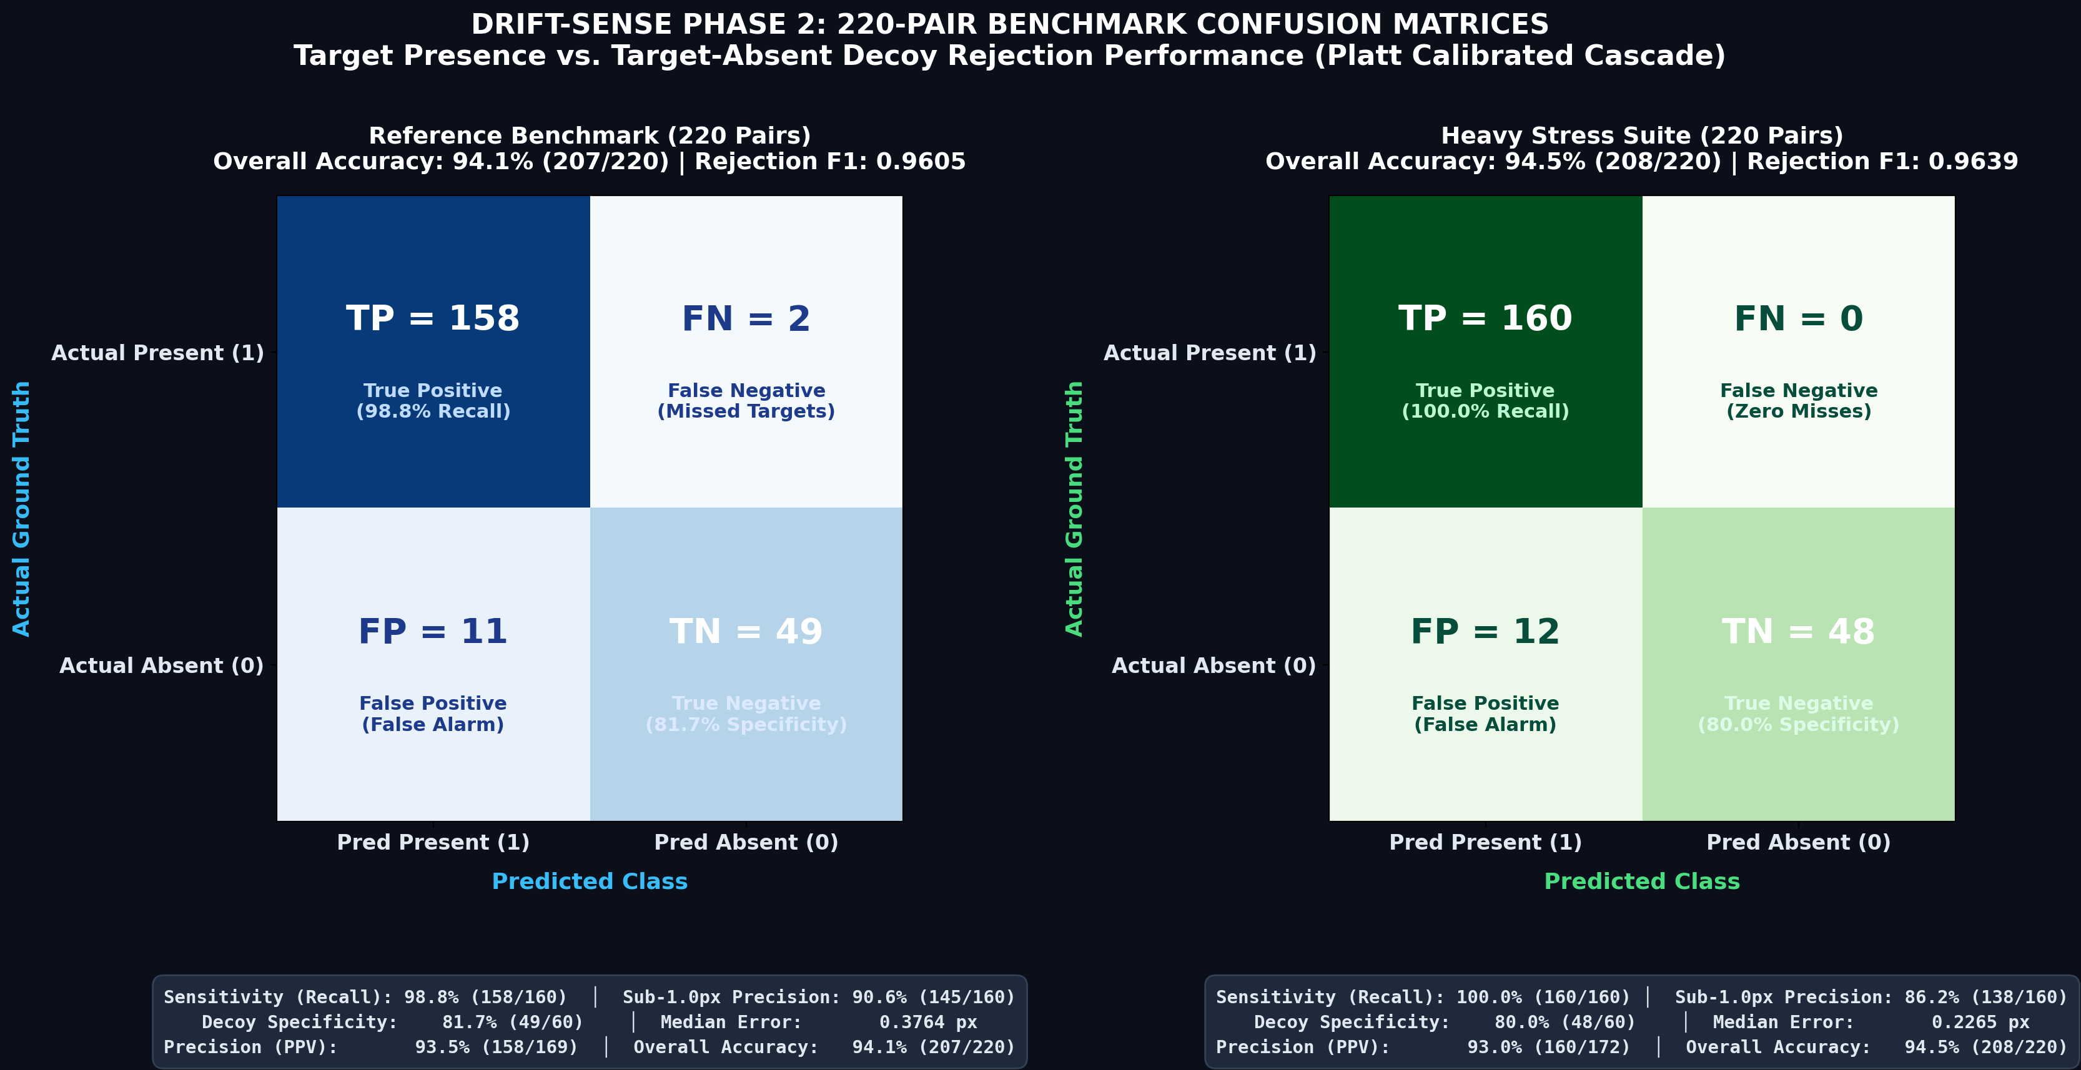

FINAL PERFORMANCE & ROBUSTNESS RESULTS
FINAL BENCHMARK RESULTS
KEY TAKEAWAYS
90.6% SUB-1 PX PRECISION — REFERENCE
86.2% SUB-1 PX PRECISION — HEAVY STRESS
0.3764 PX MEDIAN ERROR — REFERENCE
97.85 / 100 HEAVY STRESS SCORE
METRIC | REFERENCE — 220 PAIRS | HEAVY STRESS — 220 PAIRS
Sub-1.0 px Precision (R₁) | 90.60% | 86.20%
Sub-2.0 px Review (R₂) | 98.10% | 86.90%
Sub-5.0 px Capture (R₅) | 98.10% | 86.90%
Median Localization Error | 0.3764 px | 0.2265 px
Target Recall | 98.80% | 100.00%
Decoy Specificity | 81.70% | 80.00%
Decoy Rejection F1 | 0.9605 | 0.9639
Scale Recovery Credit | 0.8951 | 0.8974
Angle Recovery Credit | 0.9712 | 0.9826
CPU Latency / Pair | 0.964 s | 0.985 s
Overall Competition Score | 98.91 / 100 | 97.85 / 100

Slide 10
ROBUSTNESS & METHOD COMPARISON
ROBUSTNESS CONTRIBUTION
BASELINE vs PROPOSED
Pyramidal Search
↓
Fast candidate localization
↓
Pose Sampling
↓
Handles rotation + scale
↓
Sub-Pixel Refinement
↓
Higher localization precision
↓
Selective Siamese Verification
↓
Periodic ambiguity resolution
↓
Platt Calibration
↓
Present / Absent decision
ASPECT | NAIVE ZNCC BASELINE | DRIFT-SENSE PHASE 2
Search | Single correlation | Multi-resolution pyramidal search
Pose | Limited | Rotation + scale sampling
Precision | Pixel-level peak | Sub-pixel refinement
Periodic Ambiguity | Vulnerable to false peaks | Siamese re-ranking
Target Absent | Match-oriented | Calibrated rejection
Input | Grayscale matching | SEM + Optical RGB
Output | Location | X, Y, θ, α + confidence
WHAT THE RESULTS SHOW
REFERENCE: 90.6% SUB-1 PX PRECISION
HEAVY STRESS: 86.2% SUB-1 PX PRECISION
REFERENCE: 98.91 / 100
HEAVY STRESS: 97.85 / 100
LATENCY: 0.964 S → 0.985 S/PAIR

Slide 11
FAILURE ANALYSIS & LIMITATIONS
ROOT-CAUSE CATEGORIES
Failure sources
Geometric: rotation / pose mismatch
Periodic: repeated pitch & grating ambiguity
Imaging: noise, blur & charging artifacts
Optical: chromatic variation
Decision: target-absent false alarms
FAILURE MODE | OBSERVED ISSUE | ALGORITHMIC RESPONSE
Periodic Pitch Trap | False correlation peak at repeated pitch | Siamese re-ranking
Vertical Grating Ambiguity | Repeated multi-layer fin structures | Pyramidal search + center prior
Low-Dose SEM Noise | Corrupted peak / localization error | CLAHE + bilateral filtering
Charging Streaks | DC/raster shift bias | DC-invariant ZNCC
Extreme Rotation | Edge smearing / pose mismatch | Multi-angle pose search
Featureless Lattice | Low contrast / weak boundaries | Directional gradient weighting
Optical Chromatic Variation | Spectral localization drift | BT.601 luminance conversion
Target-Absent Decoy | False alarm on background texture | Platt probability calibration
WHAT THE FAILURE ANALYSIS TAUGHT US
High correlation ≠ correct localization
Local similarity can produce false peaks in periodic layouts.
Context and candidate verification are necessary.
Preprocessing must be matched to the imaging artifact.
Localization accuracy and target rejection must be evaluated separately.
Hardest pattern: FINFET_FULL_CELL
63.3% → Sub-1 px
65.0% → Sub-2 px
0.386 px → Median error

Slide 12


CONCLUSION
FINAL OUTCOME
DRIFT-SENSE Phase 2 delivers a hybrid registration engine for unknown-pose semiconductor localization, combining classical correlation, sub-pixel refinement, and selective deep-learning verification.
KEY ACHIEVEMENTS
0.3764 px — median localization error
90.6% — sub-1 px precision
98.1% — sub-2 px accuracy
96.05% — decoy rejection F1
0.964 s/pair — single-core CPU latency
98.91 / 100 — estimated competition score
CORE INNOVATION
Classical Vision → Sub-Pixel Mathematics → Selective AI → Calibrated Decision
FROM SYNTHETIC DATA → VERIFIED LOCALIZATION
Unknown-pose recovery
Translation + Rotation + Scale
Sub-pixel precision
0.3764 px median error
Robust rejection
96.05% decoy F1
CPU-capable execution
0.964 s / pair
GITHUB LINK: https://github.com/DK-A/Techtonics_Drift-Sense_Wafer_Inspection_PS2
DEMO VIDEO LINK: https://drive.google.com/file/d/1sxvBWdj1c7RfX7oeG66R8FJaaMt8o1iI/view?usp=sharing

