Slide 1

Online Library Management System
Notes:
Title Slide
Project Name: The title of the AWS-based project.
Team Members: Names and roles of all team members.
Date: Presentation date.

Slide 2

Introduction
Brief Outline: The Library Management App is a full-stack web application designed to streamline library operations. Built using the MERN stack (MongoDB, Express.js, React, Node.js), this application allows both librarians and members to efficiently manage and access library resources. Librarians have the capability to manage authors, genres, books, borrowals, and user accounts, while members can view available resources and manage their own borrowals.
Objectives:
Digitize Library Operations: Transform traditional library management into a digital format for ease of access and management.
Enhance User Experience: Provide an intuitive and user-friendly interface for both librarians and members.
Streamline Resource Management: Enable efficient management of authors, genres, books, and borrowals by librarians.
Simplify Member Access: Allow members to easily view available resources and manage their own borrowals.
Ensure Secure Access: Implement user authentication to ensure secure access to the system for both librarians and members.
Notes:
Introduction
Brief Outline: A summary of what the project is about.
Objectives: High-level goals to be covered in the presentation.

Slide 3

Project Objectives
Goals:
Develop a User Authentication System:
Implement secure login and registration functionalities for both librarians and members.
Create CRUD Operations for Library Resources:
Enable librarians to create, read, update, and delete (CRUD) authors, genres, books, and borrowals.
Set Up Database Integration:
Integrate MongoDB for efficient data storage and retrieval.
Expected Outcomes:
Enhanced Library Management Efficiency:
Reduced manual effort and errors in library operations.
Increased Accessibility to Library Resources:
Members can easily access and manage their borrowals online.
Greater visibility into available authors, genres, and books for members.
Notes:
Project Objectives
Goals: Specific milestones or deliverables.
Expected Outcomes: What the project aims to achieve.

Slide 4

Project Scope
Project Scope Statement: Digitize library operations, allowing users to borrow and access books and digital resources online.
What's Included?
User Management & User UI/UX:
We'll have two user roles: Librarians and Members.
Librarians can manage everything - adding, editing, and deleting authors, genres, books, user accounts, and borrowing records.
Members can view authors, genres, and books available in the library. They can also keep track of their own borrowings, including borrowing and returning books.
What's Excluded?
Now, to keep things manageable, there are some features we won't be including in this initial version. These might include:
Advanced search functionalities for books or users.
User account registration for members (Librarians will create accounts).
Integration with external library systems or databases.
Fancy features like mobile app compatibility or notifications.
Notes:
Project Scope
Statement: The project statement as provided by the instructor.
Scope Boundaries: What is and isn't covered by the project.

Slide 5


Key Concepts
Additional Features and Tools Utilized:
React Hooks: Utilized for building reusable components.
React Context: Employed for state management across components.
Material-UI (MUI): Used for applying consistent CSS and styling.
React Router DOM: Implemented for client-side routing.
MongoDB: Used as the database for storing all backend data.
JWT (JSON Web Tokens): Utilized for secure user authentication.
Express Server: Set up to handle server-side operations.
CRUD Operations: Implemented to allow Create, Read, Update, and Delete functionalities.
RESTful APIs: Designed and integrated for efficient backend communication.
Axios: Used for making HTTP requests to interact with APIs.
Primarily Used Tech Stack:
Notes:
Key Concepts
Features: Important AWS features utilized.
Services: Key AWS services employed and their significance.

Slide 6



Challenges and Solutions
Problem1: Ensuring Secure User Authentication
Challenge: Implementing a secure and reliable authentication mechanism to protect user data.
Solution: Utilized JWT (JSON Web Tokens) to create a secure authentication system. Tokens are generated upon successful login and verified for each subsequent request, ensuring secure access to protected routes.
Problem 2: Database Management: Challenge: Efficiently managing large volumes of data. Solution : Use MongoDB for scalable and flexible data storage. Implement indexing on frequently queried fields. Use Mongoose for schema management and data validation.
Notes:
Challenges and Solutions
Problem 1: Description and resolution.
Problem 2: Description and resolution.

Slide 7

Lessons Learned
Technical Insights: React Hooks and Context: Gained proficiency in using React Hooks and Context for efficient state management and component development. React Router DOM: Learned to implement seamless client-side routing. MongoDB: Developed expertise in using MongoDB for backend data storage. JWT Authentication: Implemented secure authentication mechanisms using JSON Web Tokens.
CRUD Operations and Working.
Process Insights: Effective Communication: Recognized the importance of regular and clear communication to align team efforts and goals.
Task Delegation: Learned to distribute tasks according to individual strengths and expertise, leading to efficient project progress.
Version Control: Enhanced skills in using version control systems (e.g., Git) for collaborative development and code management.
Time Management and Prioritization: Improved planning and prioritization skills, setting clear milestones and deadlines to ensure timely project completion.
Notes:
Lessons Learned
Technical Insights: What was learned technically.
Process Insights: What was learned about team collaboration.

Slide 8

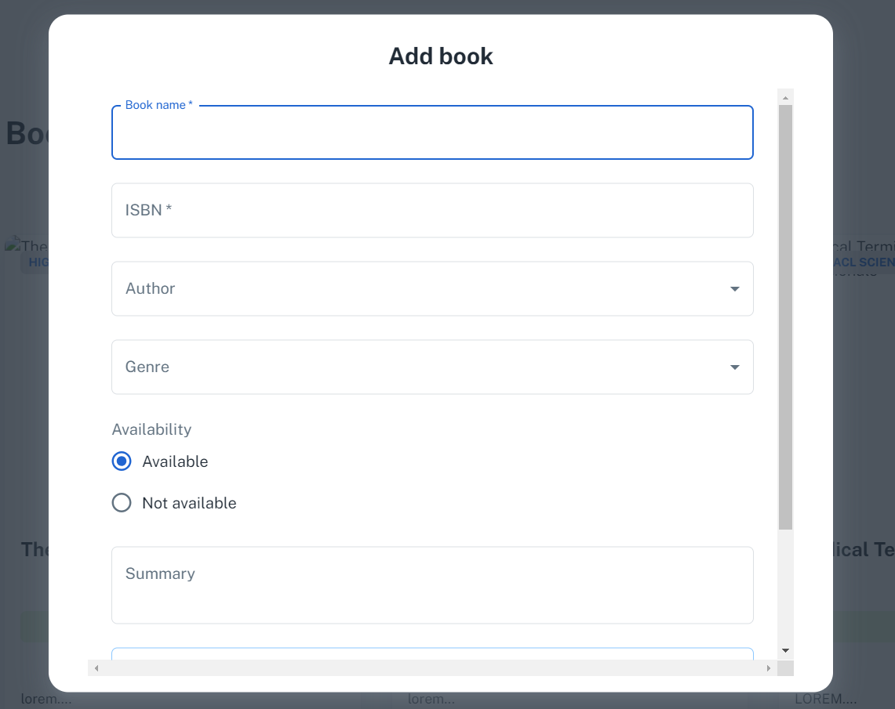
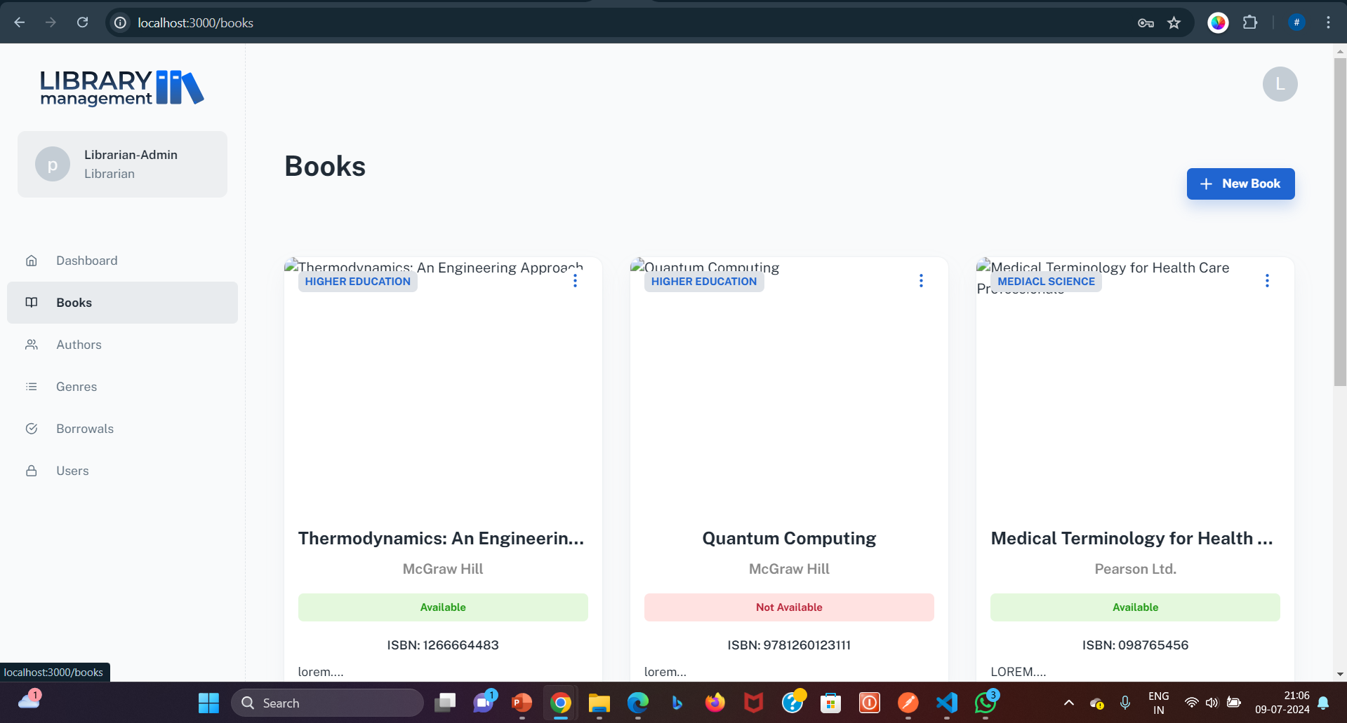
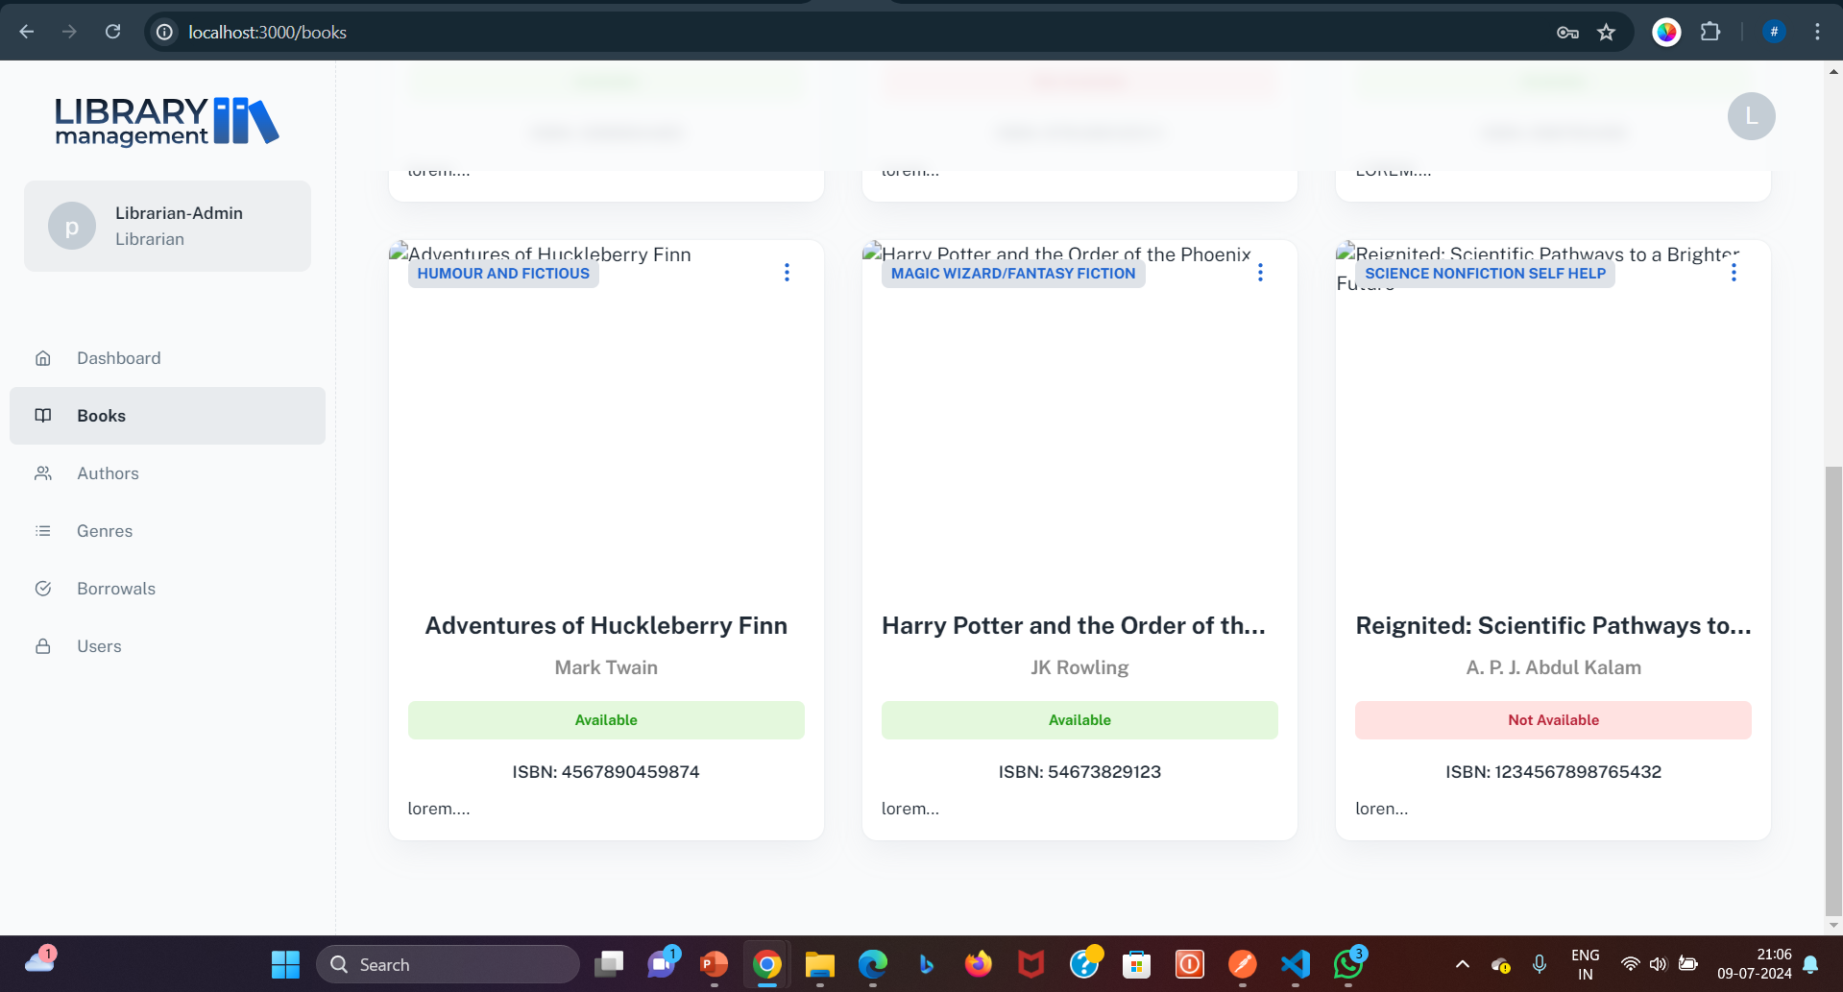
Screenshots
Books Section Screenshot Description:
This screenshot showcases the "Books" section of our Library Management System. It features a variety of categories including Science, Medicine, Novels, and the popular Harry Potter series. In the top right corner, there's an exclusive "Add Books" option accessible only to librarians. This feature allows librarians to efficiently manage the library's inventory by adding new books with detailed information such as the book name, book-cover page, genre, author, ISBN, availability status, and a brief description. This ensures the library's catalog remains up-to-date and comprehensive, providing users with a wide range of reading materials.
Notes:
Screenshots
Screen Captures: Visual snapshots to showcase key elements.
Context: Description explaining what the screenshot represents.

Slide 9
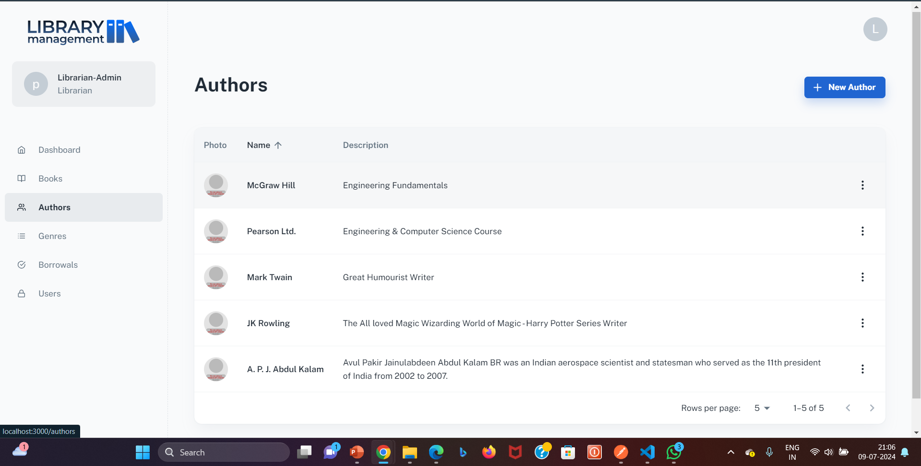
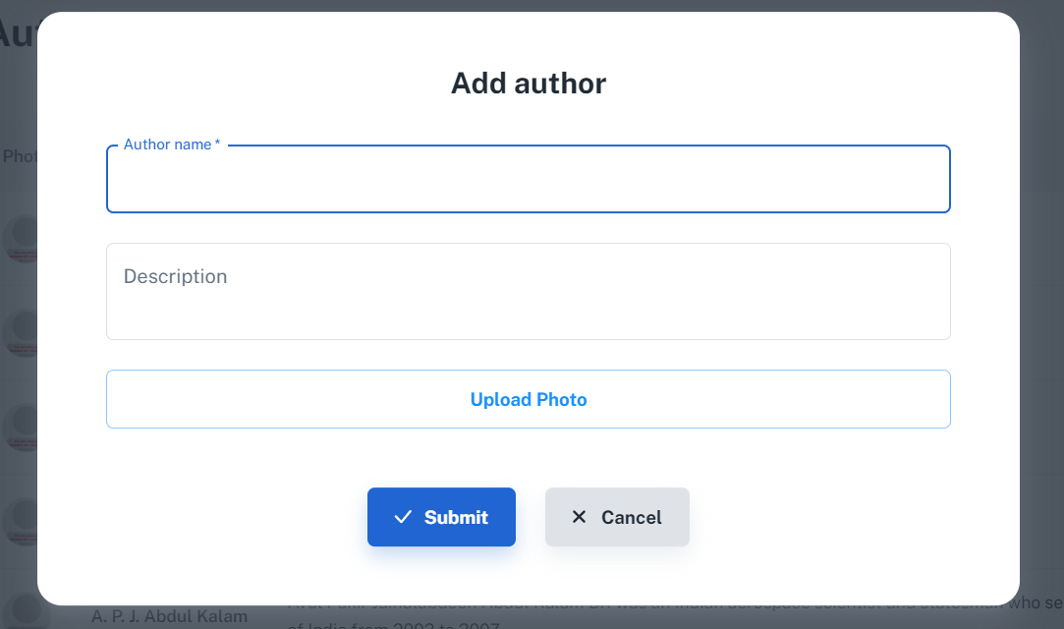
Screenshots
This screenshot presents the "Author's Section" of our Library Management System. It displays the names, pictures, and descriptions of various authors. Librarians have the ability to add new authors through an intuitive interface by providing the author's name, picture, and a brief description. Users can browse and view the displayed authors, gaining insights into their favorite writers and discovering new ones. This section ensures that the library's collection is enriched with detailed author information, enhancing the overall user experience.
Notes:
Screenshots
Screen Captures: Visual snapshots to showcase key elements.
Context: Description explaining what the screenshot represents.

Slide 10
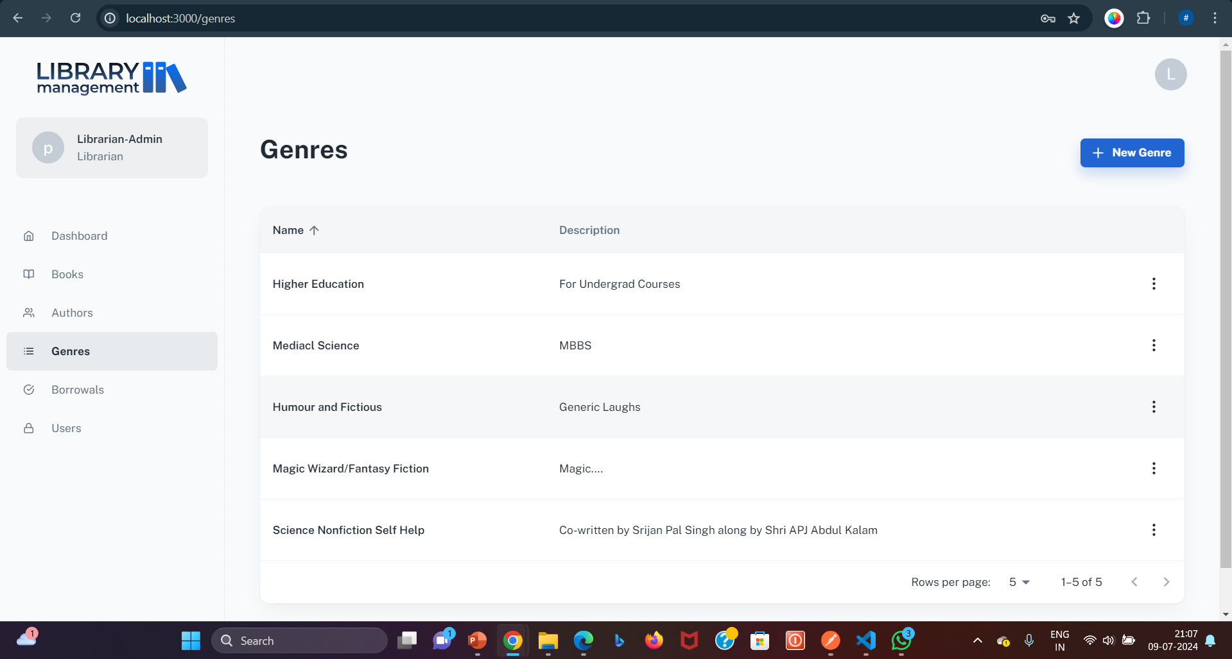
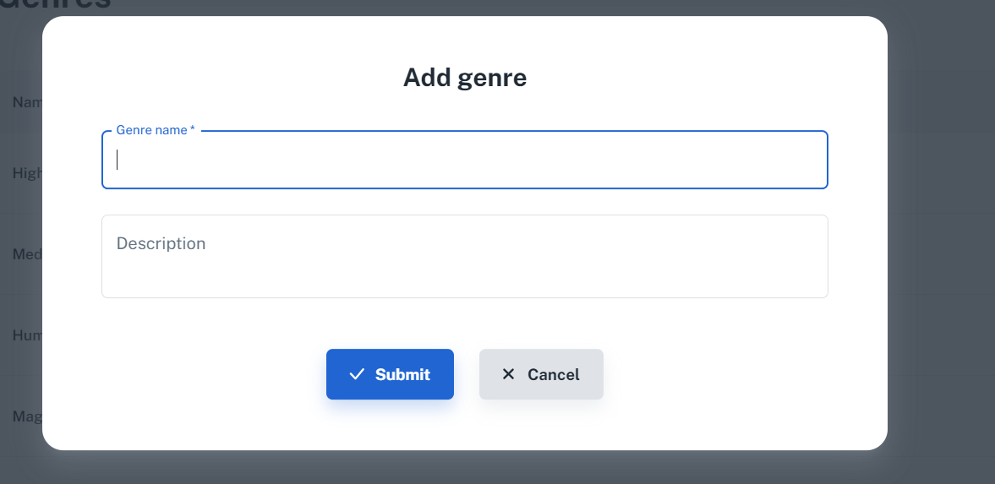
Screenshots
Genre's Section Screenshot Description:
This screenshot highlights the "Genre's Section" of our Library Management System. It showcases different genres along with a brief description of each. Librarians have the functionality to add new genres by entering the genre name and its description. This section helps users easily navigate and discover books based on their preferred genres, making the library's extensive collection more accessible.
Notes:
Screenshots
Screen Captures: Visual snapshots to showcase key elements.
Context: Description explaining what the screenshot represents.

Slide 11
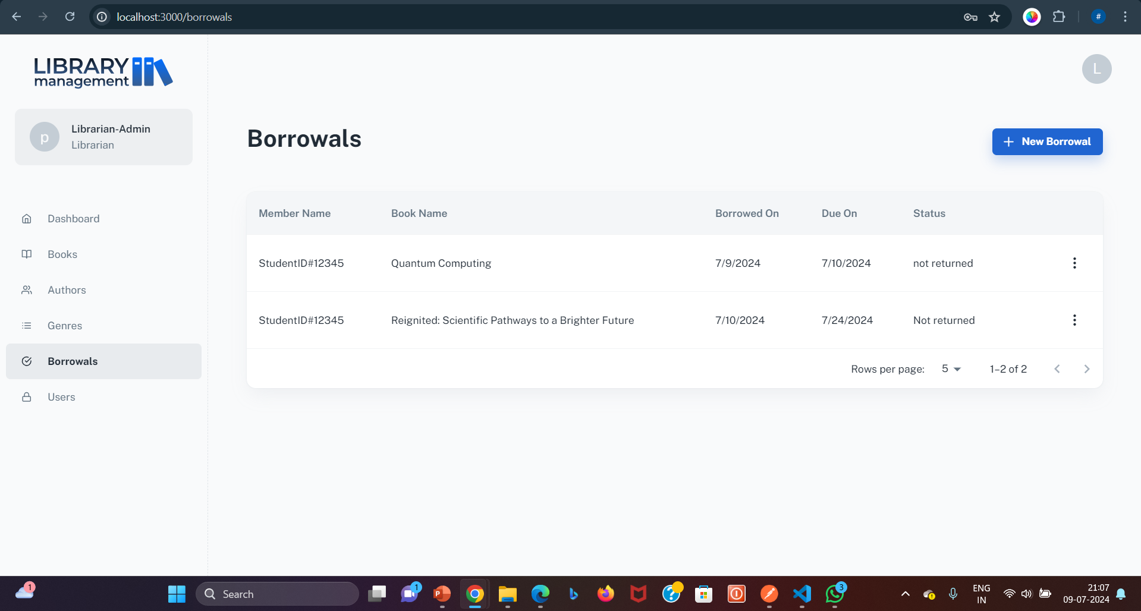
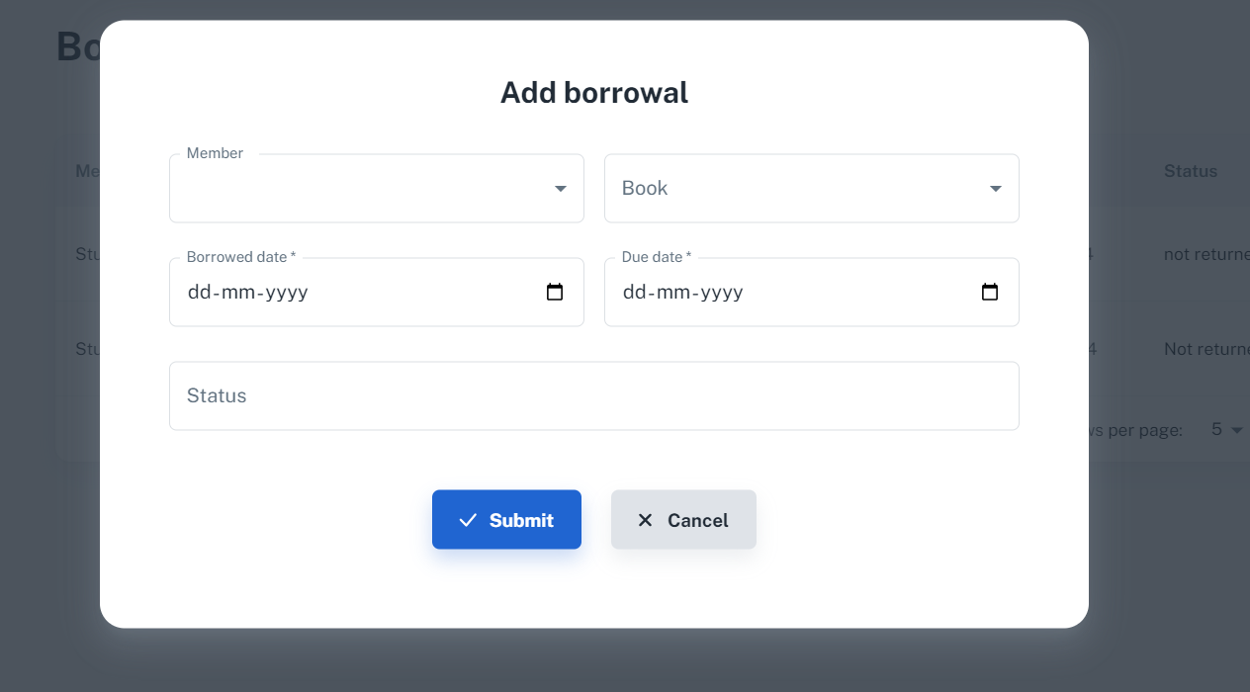
Screenshots
Borrowals Section Screenshot Description:
This screenshot depicts the "Borrowals Section" of our Library Management System. It includes details such as the member's name, the name of the borrowed book, the date it was borrowed, the due date, and the current status. Librarians have exclusive access to edit the return and due dates, ensuring proper management and timely returns of borrowed books. This section provides a clear overview of all active borrowals, streamlining the process of tracking and managing book loans.
Notes:
Screenshots
Screen Captures: Visual snapshots to showcase key elements.
Context: Description explaining what the screenshot represents.

Slide 12
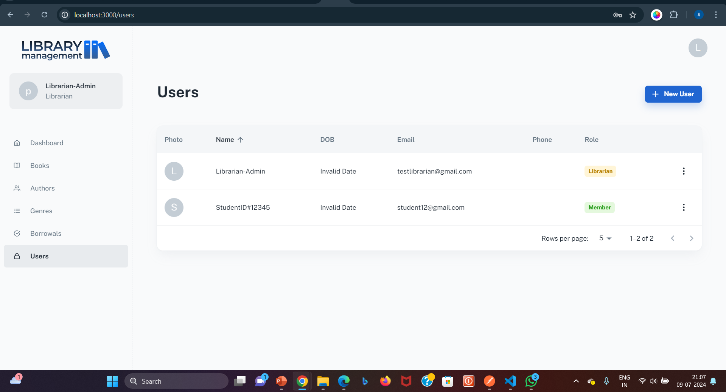
Screenshots
User's Section Screenshot Description:
This screenshot features the "User's Section" of our Library Management System. It displays detailed information about each member, including their picture, name, date of birth, email, phone number, and role (librarian or member). This section is exclusively visible to librarians, allowing them to manage and view member details efficiently. By having access to comprehensive member profiles, librarians can ensure better service and personalized assistance to each user.
Notes:
Screenshots
Screen Captures: Visual snapshots to showcase key elements.
Context: Description explaining what the screenshot represents.

Slide 13

Future Scope
Enhanced User Experience: Optimize the application for better performance on mobile devices and tablets. User Personalization: Implement personalized dashboards, reading recommendations based on user history, and user-specific notifications.
Multi-Language Support: Add support for multiple languages to cater to a diverse user base.
Advanced Search and Filtering: Implement a full-text search feature for better search accuracy and relevance & Allow users to filter search results by multiple criteria such as author, genre, publication date, and availability.
Community Features: Allow users to leave reviews and ratings for books, fostering a community of readers. & Create forums where users can discuss books, authors, and genres.8.
Integration with Other Systems: Learning Management Systems (LMS)-Integrate with educational institutions' LMS for seamless access to course materials and library resources.
Payment Gateways: Add support for online payments for fines, membership fees, and other transactions.
Notes:
Future Scope
Improvements: Potential updates or add-ons.
Next Steps: Future phases or expansions.

Slide 14


Questions
Questions: Opening the floor for any questions from the audience.
Notes:
Q&A
Questions: Opening the floor for any questions from the audience.

Slide 15

Thank You!
Notes:
Thank You
Acknowledgments: Thanks to those who contributed.
Contact Info: How to reach the team for further queries.

Slide 16


Live Demo
In-Session
Notes:
Live Demo
Demonstration: Real-time showcase of the project's functionality and features.
A specific example or scenario illustrating the project in action.

