Slide 1
Watu Sale And Repayment Anaysis
By
Malungu K. Daniel

Slide 2
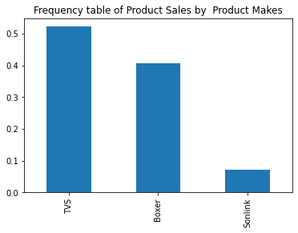
1. Product Make
Result: The Brand Popularity is as follows TVS 52.25 Boxer 40.70 Sonlink 7.05 TVS is the most popular make to sale the sales team my like to work on a partnership with TVS since it represents over 50% of all sales according to the data

Slide 3
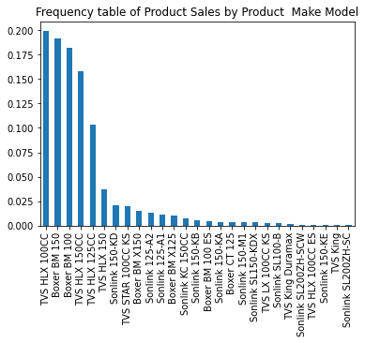
2. Product Make Model
Result: The most Popular engine capacity with clients is between 100 – 150cc representing majority the sales

Slide 4
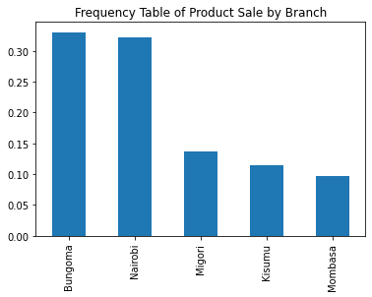
3. Product Sale By Branches
Result:
Bungoma is the most performing branch with 33.05% of all sale follow by Nairobi at 32.20%, Migori at 13.65%, Kisumu at 11.45%, and Mombasa at 9.65% in the order
The sell team should investigate by two branches are making 65.25% of all the sale and what can be done to increase sale rest of the branches.

Slide 5
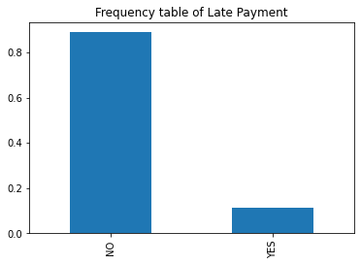
4. Late Repayment
Result:
11.1% of all loan applicant are late to make there repayments this ratio is bellow the Kenya rate of default which stands as 12% according to https://www.cgap.org/blog/its-time-slow-digital-credits-growth-east-africa
The credit department should make sure that this rate is reduced by offering financial advice and renegotiation facilities to all borrowers especially late borrowers

Slide 6
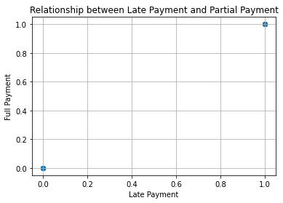
5. Relationship Between Latepayement And Patialpayment
Legend:
X-axis:
1 = Late Payment
0 = On time payment
Y-axis:
1 = Partial Payment
0 = Full payment
Result :-
There is a one to one relationship between late payment and partial. This is that all the individuals making late payments also made partial payments

Slide 7
The analysis scripts can be found at:
https://github.com/DKMalungu/watu_interview

