Slide 1
Message Classifier: HAM or SPAM
CSIS 4260 Term Project by:
DuyKhanh Nguyen (300316520)
Shringar Prakash (300356399)

Slide 2
Table of contents
01
02
03
04
Introduction
Data Cleaning and Text Preprocessing
Vectorization
Data Visualization

Slide 3
Table of contents
05
06
07
08
Classification Models
Performance
Metrics
Conclusion
Out of Sample Predictions

Slide 4
01
Introduction

Slide 5
Why build a Message Classifier?
Phishing attacks use social engineering in emails and messages to persuade people to hand over information such as passwords or financial information, or to get them to perform certain tasks such as downloading malware or completing a wire transfer.
More than 70% of phishing emails are opened by their targets.
90% of security breaches in companies are a result of phishing attacks.
Small and mid-size businesses lose an average of $1.6 million recovering from a phishing attack.
The Solution to Phishing Attacks?
Our Message Classifier!
Notes:
Don’t open that email.
Do you recognize the sender’s company name? Is it spelled right? Do you know the sender?
We aren’t accustomed to thinking of email messages as dangerous. But experts say we should be paranoid about our inboxes. Spear phishers are after us.
Spam filters are designed to identify incoming dangerous emails from attackers or marketers. Spam can also contain relatively harmless content but can clutter up your inbox, consuming valuable space and making it more difficult to identify important, useful emails. Spam filters can detect spam emails. These helpful tools can recognize patterns that spam emails tend to follow.

Slide 6
Spam Filters!
These helpful tools can recognize patterns that spam emails tend to follow.

Slide 7
Natural Language Processing(NLP)
Natural Language Processing or NLP is a branch of Artificial Intelligence that deals with bridging the machine’s understanding of humans in their Natural Language. Natural Language can be in form of text or sound, which are used for humans to communicate with each other. NLP can enable humans to communicate with machines in a natural way.
Some libraries we used for our project
Pandas and Numpy (Basic Data Manipulation)
Seaborn and Matplotlib (Data Visualization)
Natural Language Toolkit NLTK (Text Processing)
Scikit-learn (Classification Models and Performance Metrics)
Notes:
Natural language processing (NLP) describes the interaction between human language and computers. It's a technology that many people use daily and has been around for years, but is often taken for granted. A few examples of NLP that people use every day are: Spell check. Autocomplete.

Slide 8
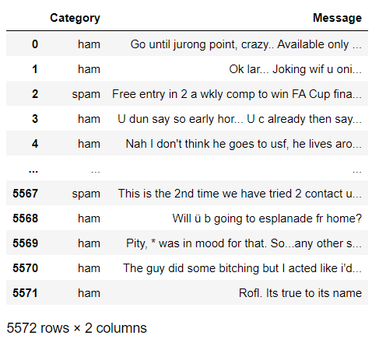
SMS Spam Collection - UCI Machine Learning Repository
SPAM
Unsolicited messages
Components
HAM
Authentic messages

Slide 9
02
Data Cleaning & Text Preprocessing

Slide 10
Data Cleaning Steps
Lowering Case
Removing New Lines
Removing Special Characters & Punctuations
Removing HyperLinks
Removing Numbers
Removing Whitespaces
Notes:
Data usually comes from a variety of sources and often in different formats. For this reason, transforming the raw data is essential. However, this transformation is not a simple process, as text data often contain redundant and repetitive words. This means that processing the text data is the first step in the solution. The fundamental steps involved in text preprocessing are: A. Cleaning the raw data B. Tokenizing the cleaned data
A. Cleaning the raw data: The data cleaning process Natural Language Processing is crucial. The machine does not understand the text. For the machine, it is only a cluster of symbols. To further process the data we need to clean the data.
This phase involves the deletion of words or characters that do not add value to the meaning of the text. Some of the standard cleaning steps are listed below:

Slide 11
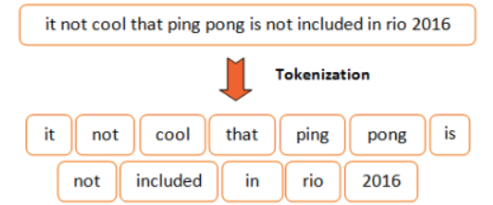
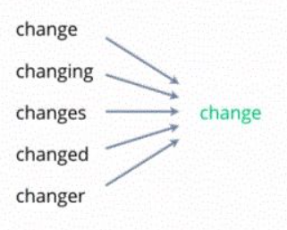
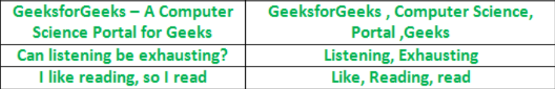
Text Preprocessing
Tokenization
Lemmatization
Stop-Words
Notes:
Tokenizing the cleaned data: - Tokenization: Here we decompose the text data into the smallest unit called tokens. The dataset consists long messagees which is made up of many lines and lines are made up of words. It is quite difficult to analyze the long message so first, we decompose the paragraphs into separate lines and then lines are decomposed into words. - Lemmatization: Here the word that is generated after chopping off the suffix is always meaningful and belongs to the dictionary that means it does not produce any incorrect word. The word generated after lemmatization is also called a lemma. - Stop-words: Words in any language that helps to combine the sentence and make it meaningful are know as Stop-words. In the English language various words like I, am, are, is to, etc. are all known as stop-words. But these stop-words are not very useful for the model so there is a need to remove these stop-words from the dataset so that we can focus on only important words rather than these supporting words.

Slide 12
03
Exploratory Data Analysis & Data Visualization

Slide 13
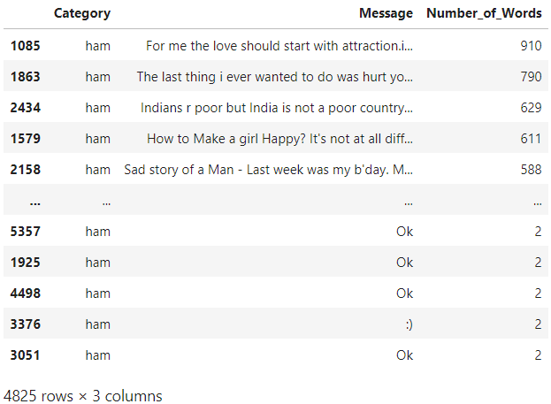
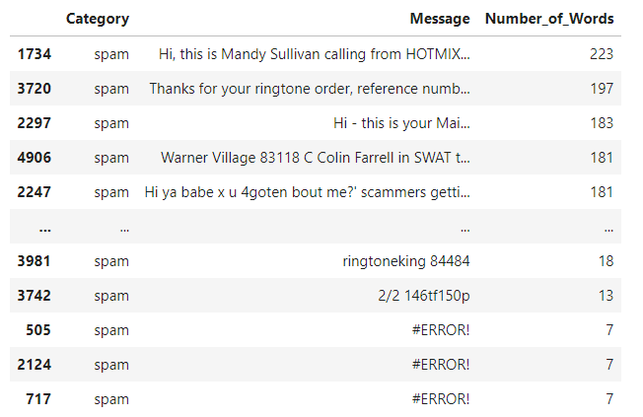
Longest and Shortest Ham and Spam Messages

Slide 14
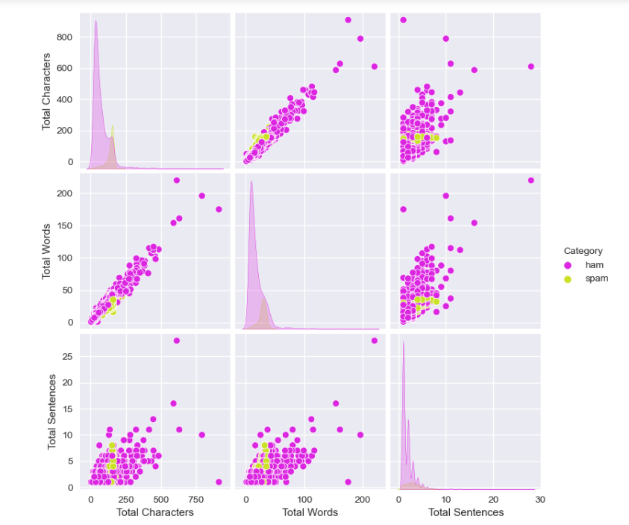
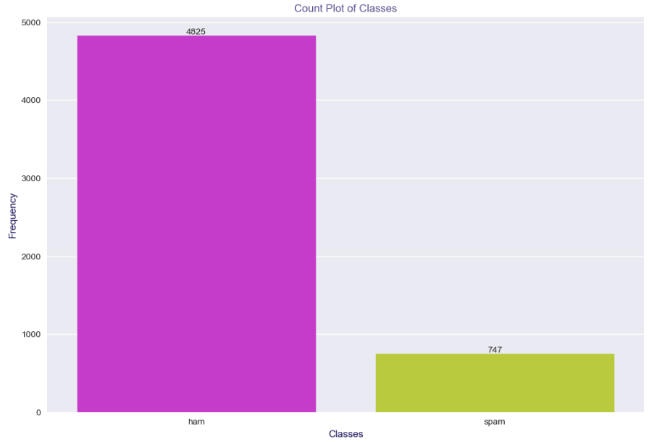
Distribution of Ham and Spam Messages

Slide 15
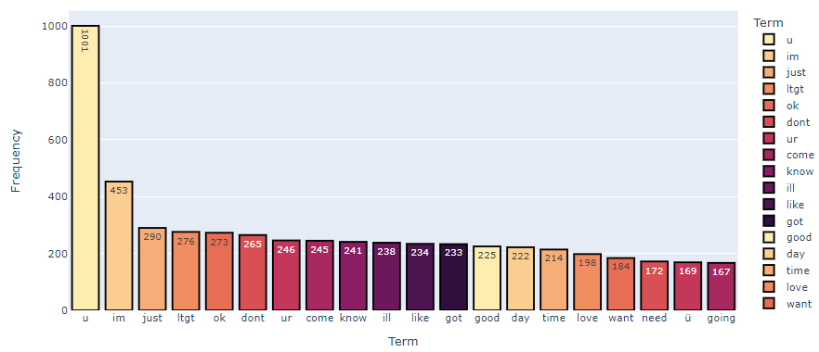
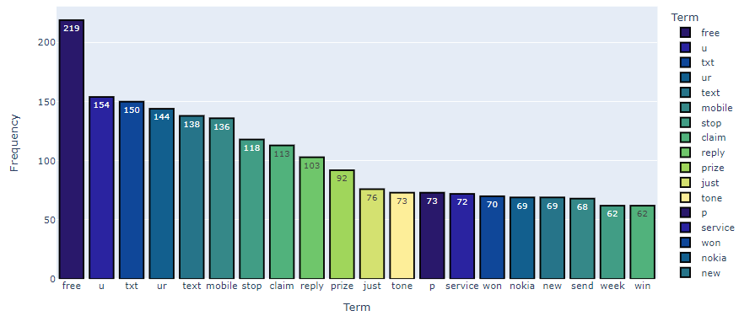
Top 20 Words in Ham and Spam Messages

Slide 16
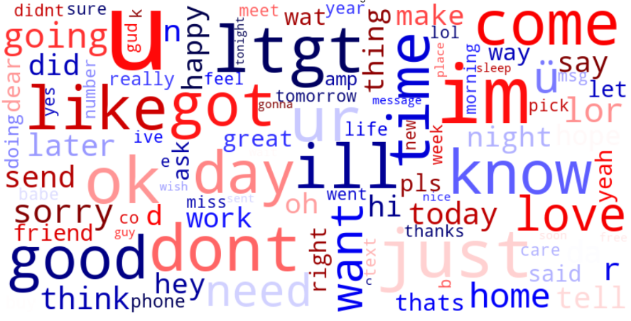
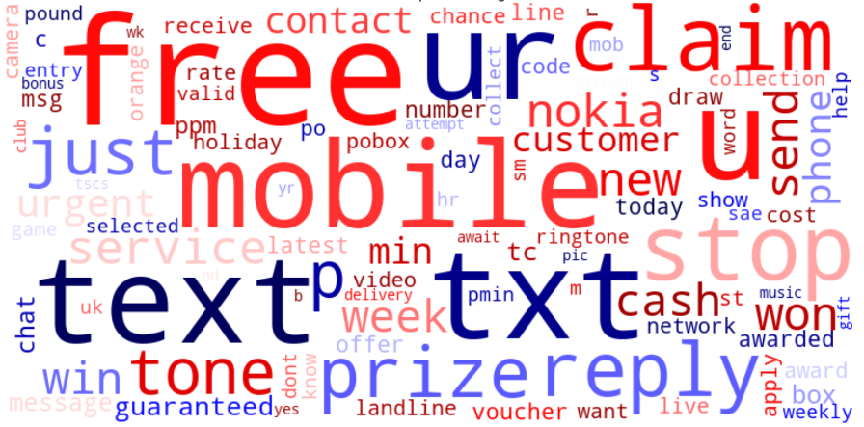
Word Clouds for Ham and Spam Messages

Slide 17
04
Vectorization

Slide 18
What is Vectorization?
CountVectorizer: It is used to transform a given text into a vector on the basis of the frequency (count) of each word that occurs in the entire text. This is helpful when we have multiple such texts, and we wish to convert each word in each text into vectors (for using in further text analysis)
Term Frequency: It is the raw count of instances a word appears in a document.
Inverse Document Frequency: How common or rare a word is in the entire document set. This metric can be calculated by taking the total number of documents, dividing it by the number of documents that contain a word, and calculating the logarithm. The closer it is to 0, the more common a word is.
Notes:
After tokenization, these words need to then be encoded as integers, or floating-point values, for use as inputs in machine learning algorithms. This process is called feature extraction (or vectorization). Scikit-learn’s CountVectorizer is used to convert a collection of text documents to a vector of term/token counts. It will fit and learn the word vocabulary and try to create a document term matrix in which the individual cells denote the frequency of that word in a particular document, which is also known as term frequency, and the columns are dedicated to each word in the corpus.
Term Frequency-Inverse Document Frequency ( TF-IDF) gives a measure that takes the importance of a word into consideration depending on how frequently it occurs in a document and a corpus.
Multiplying these two numbers results in the TF-IDF score of a word in a document. The higher the score, the more relevant that word is in that particular document.

Slide 19
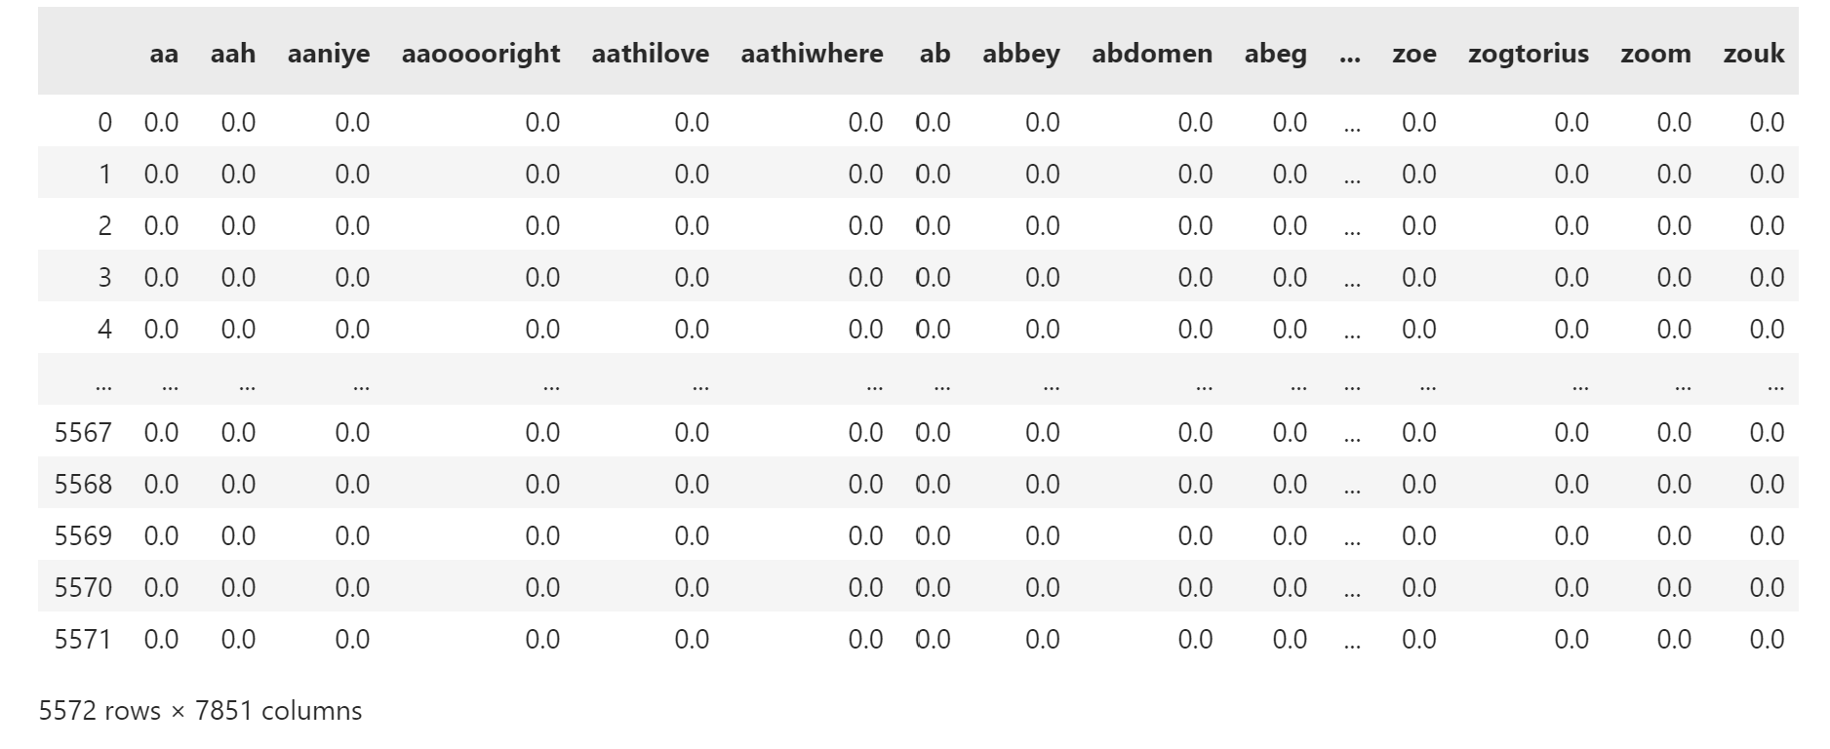
Clean Data

Slide 20
05
Classification Models

Slide 21
Models and Hyperparameters
Classification Models Used (w/ Hyperparameters) | Classification Models With Dense Matrix
Logistic Regression (C and multi_classes) K – Nearest Neighbours (leaf_sizes and n_neighbours) Support Vector Machine – Linear and RBF (Gamma and C) Random Forest (criterions and n_estimators) AdaBoost (learning_rates and n_estimators) Artificial Neural Network (hidden layers) | Decision Tree (criterions and splitters) Naïve Bayes (GaussianNB – var_smoothings) XGBoost (learning_rates and n_estimators) CatBoost (learning_rates and iterations)

Slide 22
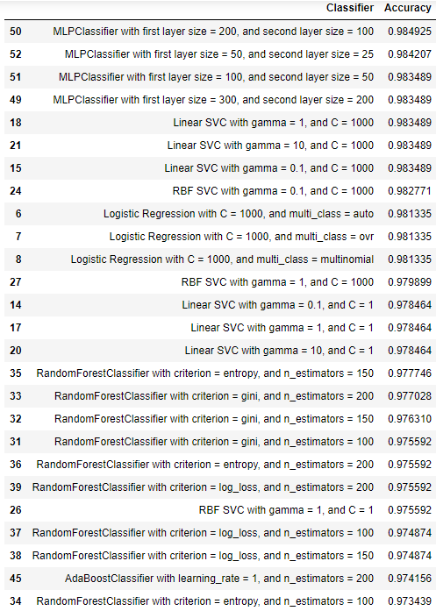
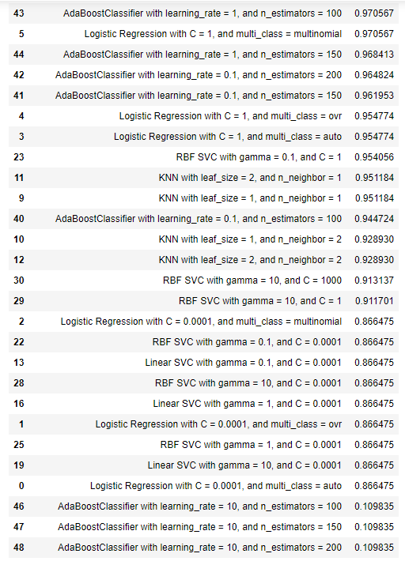
Accuracy Results of Models

Slide 23
06
Performance Metrics

Slide 24
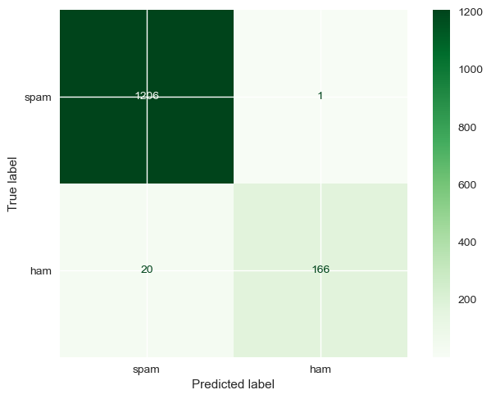
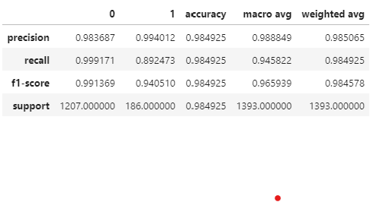
Confusion Matrix and Classification Report

Slide 25
07
Out-of-Sample Predictions

Slide 26
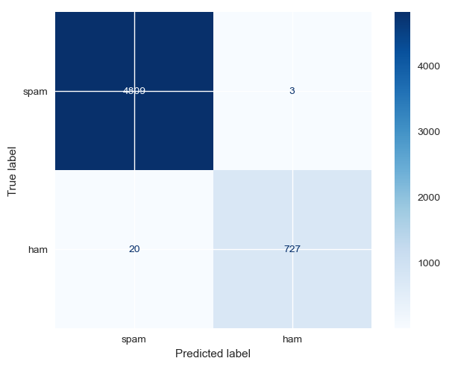
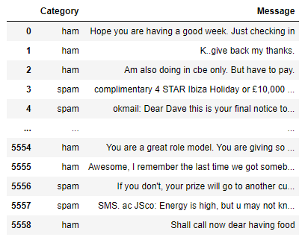
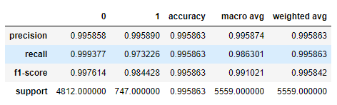
Out of Sample Dataset and Prediction Results

Slide 27
Conclusion
08

Slide 28
02
Thank You!

