Slide 1
תכנות מונחה עצמים תרגול 10
מייל : simon.pikalov@msmail.ariel.ac.il
נכתב ע"י : סמיון פיקלוב

Slide 2
נושאים להיום
String formatting
Try Except
File handling
Classes and Objects
python magic methods
Inheritance
abstract classes
Iterators
Comparator
Python JSON

Slide 3
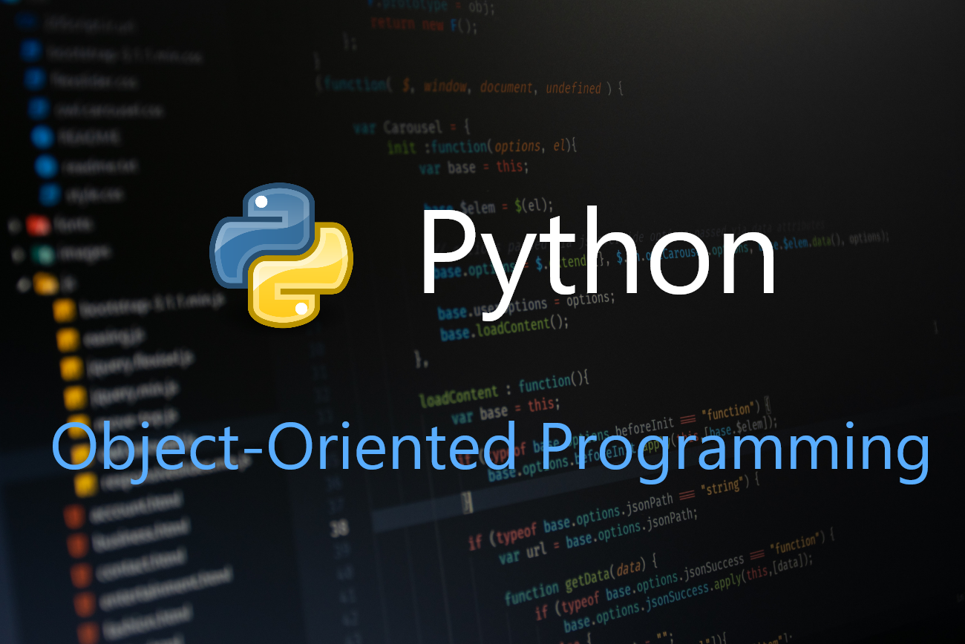
Python

Slide 4
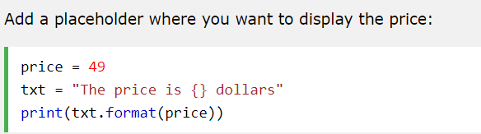

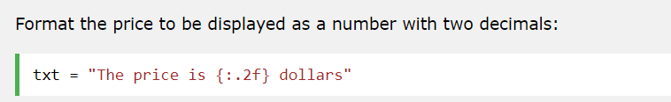

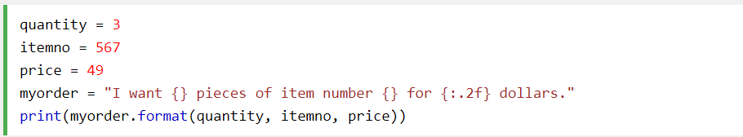

Python String Formatting
To make sure a string will display as expected, we can format the result with the format() method.
The format() method allows you to format selected parts of a string.
Sometimes there are parts of a text that you do not control, maybe they come from a database, or user input?
To control such values, add placeholders (curly brackets {}) in the text, and run the values through the format() method:
You can add parameters inside the curly brackets to specify how to convert the value:
If you want to use more values, just add more values to the format() method:

Slide 5

Python User Input
When input() function executes program flow will be stopped until the user has given an input.
The text or message display on the output screen to ask a user to enter input value is optional i.e. the prompt, will be printed on the screen is optional.
Whatever you enter as input, input function convert it into a string. if you enter an integer value still input() function convert it into a string. You need to explicitly convert it into an integer in your code using typecasting.

Slide 6
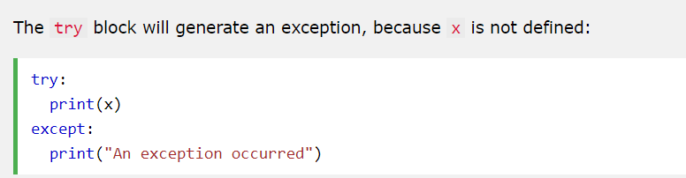

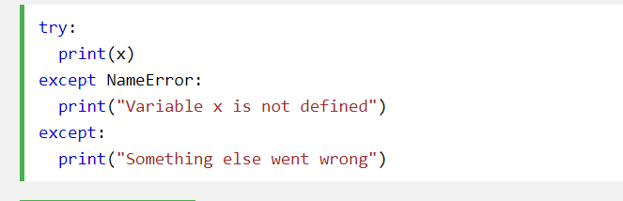
Python Try Except
The try block lets you test a block of code for errors.
The except block lets you handle the error.
The finally block lets you execute code, regardless of the result of the try- and except blocks.
You can define as many exception blocks as you want, e.g. if you want to execute a special block of code for a special kind of error:

Slide 7
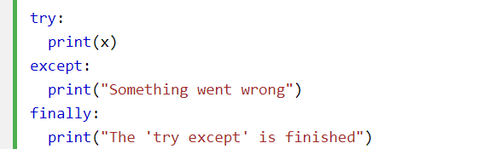
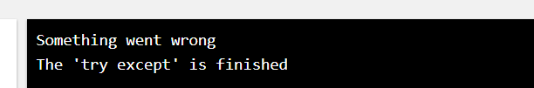
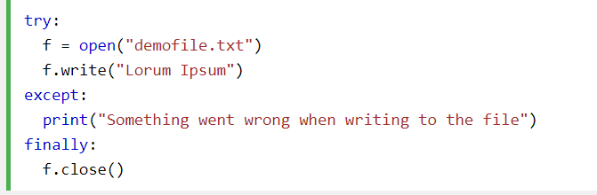
Python Try Except
The finally block, if specified, will be executed regardless if the try block raises an error or not.
This can be useful to close objects and clean up resources:

Slide 8
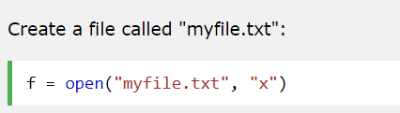
Create a New File
To create a new file in Python, use the open() method, with one of the following parameters:
"x" - Create - will create a file, returns an error if the file exist
"a" - Append - will create a file if the specified file does not exist
"w" - Write - will create a file if the specified file does not exist

Slide 9
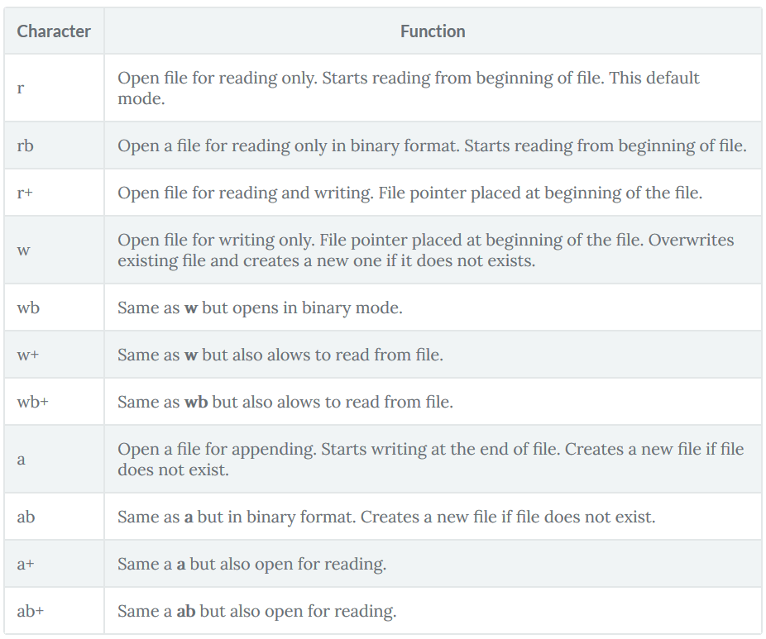
Open a File

Slide 10
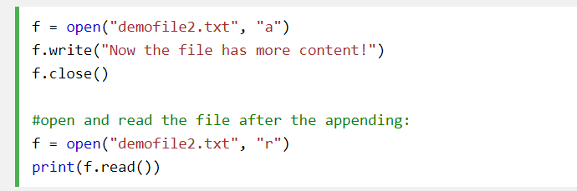
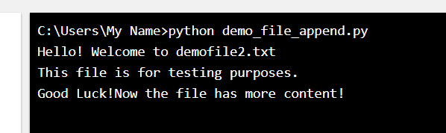
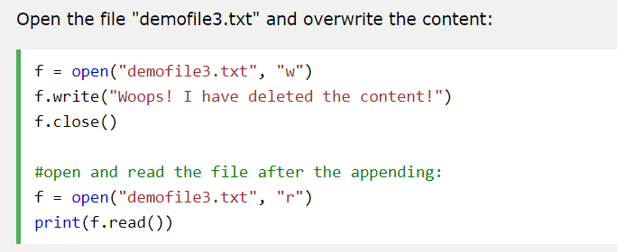
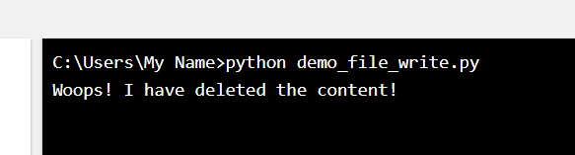
Python File Write
To write to an existing file, you must add a parameter to the open() function:
"a" - Append - will append to the end of the file
"w" - Write - will overwrite any existing content

Slide 11

The with statement
The with statement is used to wrap the execution of a block with methods defined by a context manager (see section With Statement Context Managers). This allows common try…except…finally usage patterns to be encapsulated for convenient reuse.

Slide 12
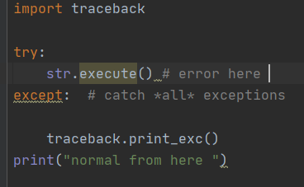
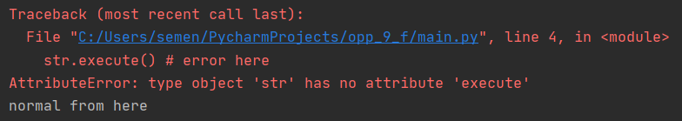
catch all exceptions
Notice the normal from here.

Slide 13
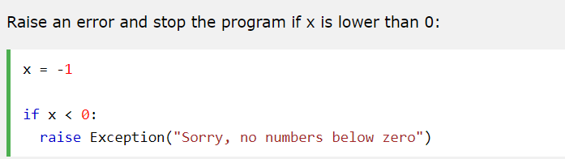
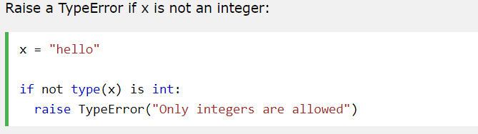
Raise an exception
As a Python developer you can choose to throw an exception if a condition occurs.
To throw (or raise) an exception, use the raise keyword
The raise keyword is used to raise an exception.
You can define what kind of error to raise, and the text to print to the user.

Slide 14
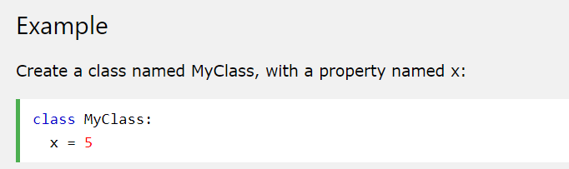
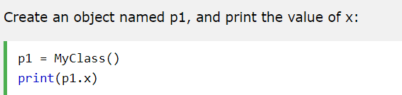
Python Classes and Objects
Python is an object oriented programming language.
Almost everything in Python is an object, with its properties and methods.
A Class is like an object constructor, or a "blueprint" for creating objects.
Create a Class
To create a class, use the keyword class:
Now we can use the class named MyClass to create objects:

Slide 15
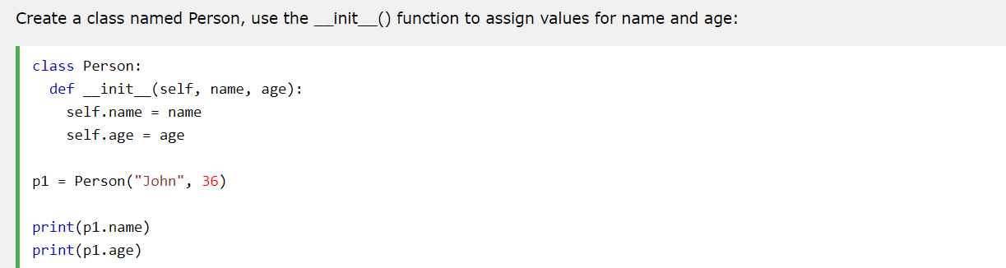
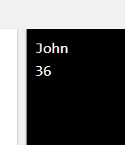
The __init__() Function
The examples above are classes and objects in their simplest form, and are not really useful in real life applications.
To understand the meaning of classes we have to understand the built-in __init__() function.
All classes have a function called __init__(), which is always executed when the class is being initiated.
Use the __init__() function to assign values to object properties, or other operations that are necessary to do when the object is being created:

Slide 16
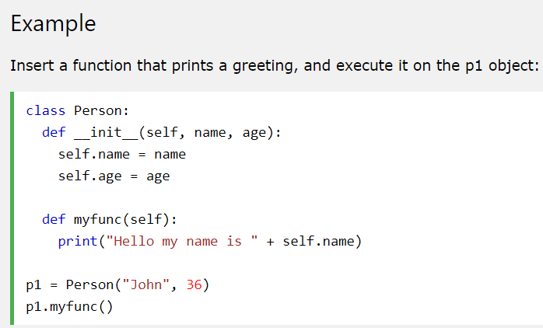

Object Methods
Objects can also contain methods. Methods in objects are functions that belong to the object.
Let us create a method in the Person class:

Slide 17
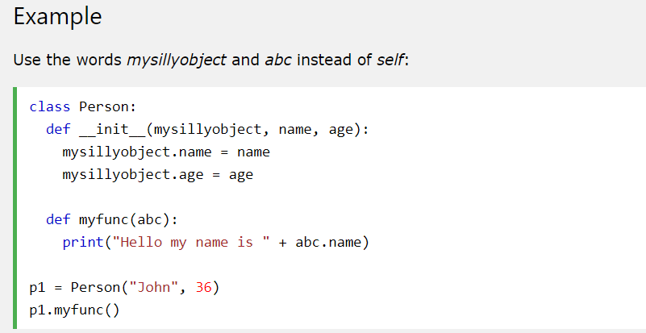
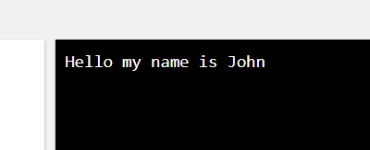
The self Parameter
The self parameter is a reference to the current instance of the class, and is used to access variables that belongs to the class.
It does not have to be named self , you can call it whatever you like, but it has to be the first parameter of any function in the class:

Slide 18
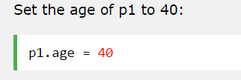
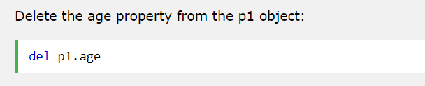
Modify Object Properties
You can modify properties on objects like this:
Delete Object Properties
You can delete properties on objects by using the del keyword:

Slide 19
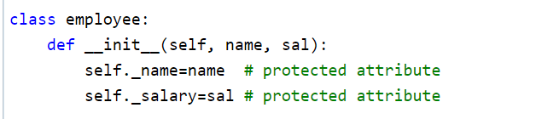
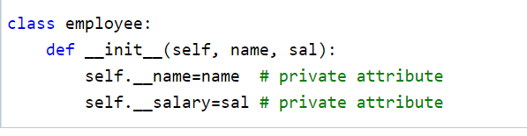
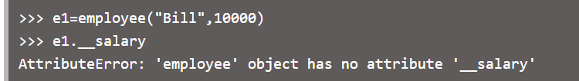
Python - public, private and protected
Classical object-oriented languages, such as C++ and Java, control the access to class resources by public, private and protected keywords. Private members of a class are denied access from the environment outside the class. They can be handled only from within the class.
Python doesn't have any mechanism that effectively restricts access to any instance variable or method. Python prescribes a convention of prefixing the name of the variable/method with single or double underscore to emulate the behaviour of protected and private access specifiers.
All members in a Python class are public by default. Any member can be accessed from outside the class environment.
Python's convention to make an instance variable protected is to add a prefix _ (single underscore) to it. This effectively prevents it to be accessed, unless it is from within a sub-class.
Similarly, a double underscore __ prefixed to a variable makes it private. It gives a strong suggestion not to touch it from outside the class. Any attempt to do so will result in an AttributeError:
Python performs name mangling of private variables. Every member with double underscore will be changed to _object._class__variable. If so required, it can still be accessed from outside the class, but the practice should be refrained.

Slide 20
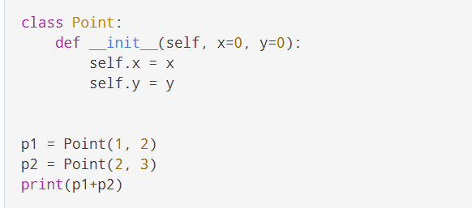
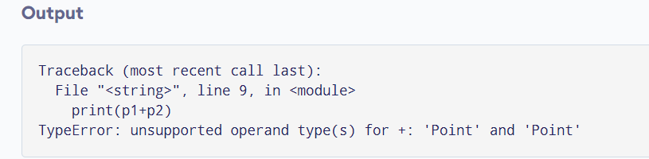
Operator Overloading
Python operators work for built-in classes. But the same operator behaves differently with different types. For example, the + operator will perform arithmetic addition on two numbers, merge two lists, or concatenate two strings.
This feature in Python that allows the same operator to have different meaning according to the context is called operator overloading.
So what happens when we use them with objects of a user-defined class? Let us consider the following class, which tries to simulate a point in 2-D coordinate system.

Slide 21
Operator Overloading
Python operators work for built-in classes. But the same operator behaves differently with different types. For example, the + operator will perform arithmetic addition on two numbers, merge two lists, or concatenate two strings.
This feature in Python that allows the same operator to have different meaning according to the context is called operator overloading.
So what happens when we use them with objects of a user-defined class? Let us consider the following class, which tries to simulate a point in 2-D coordinate system.

Slide 22
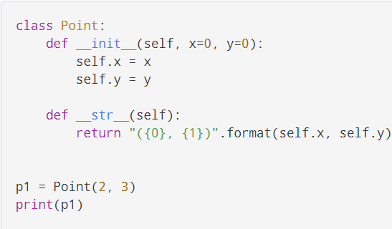
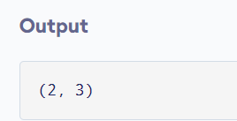
Python Special Functions also called magic or Dunder
Class functions that begin with double underscore __ are called special functions in Python.
These functions are not the typical functions that we define for a class. The __init__() function we defined above is one of them. It gets called every time we create a new object of that class.
There are numerous other special functions in Python. Visit Python Special Functions to learn more about them.
Using special functions, we can make our class compatible with built-in functions.

Slide 23
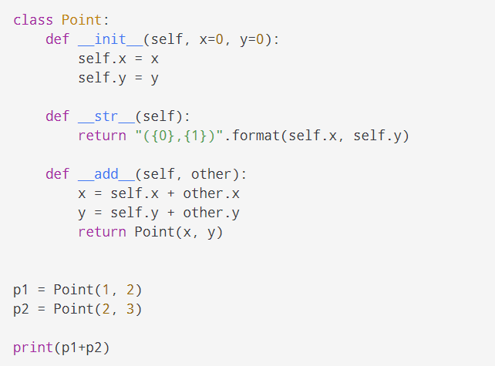
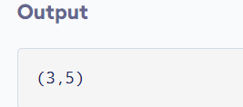
Operator Overloading
To overload the + operator, we will need to implement __add__() function in the class. With great power comes great responsibility. We can do whatever we like, inside this function. But it is more sensible to return a Point object of the coordinate sum.

Slide 24
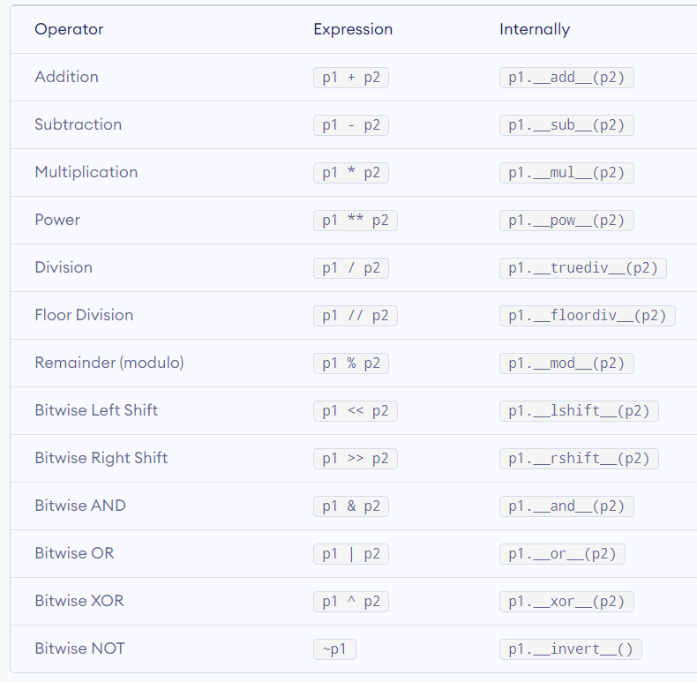
Operator Overloading

Slide 25
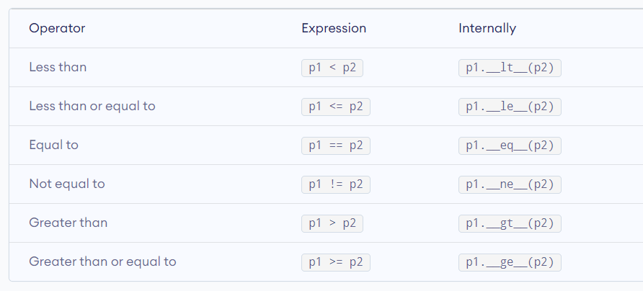
Operator Overloading
https://www.tutorialsteacher.com/python/magic-methods-in-python

Slide 26
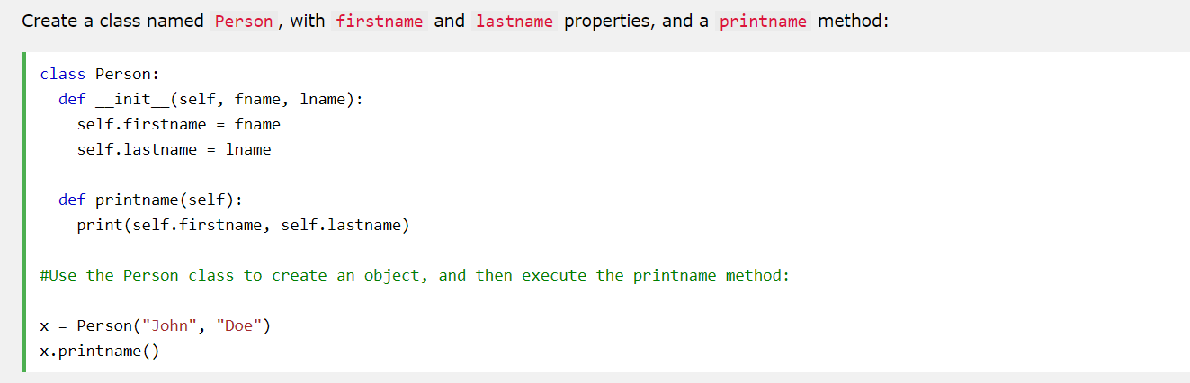
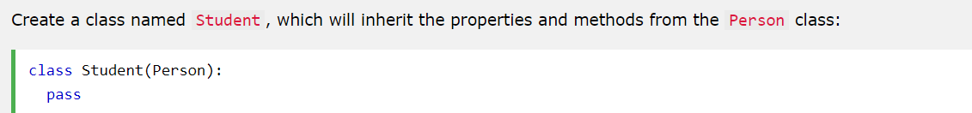
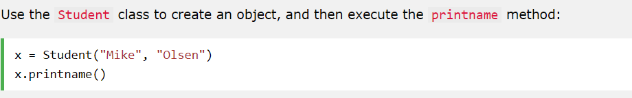
Python Inheritance
Python Inheritance
Inheritance allows us to define a class that inherits all the methods and properties from another class.
Parent class is the class being inherited from, also called base class.
Child class is the class that inherits from another class, also called derived class.
Create a Parent Class
Any class can be a parent class, so the syntax is the same as creating any other class:

Slide 27
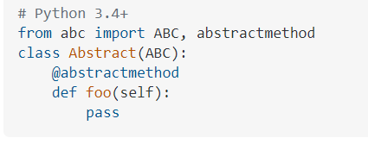
Abstract Classes in Python
An abstract class can be considered as a blueprint for other classes. It allows you to create a set of methods that must be created within any child classes built from the abstract class. A class which contains one or more abstract methods is called an abstract class. An abstract method is a method that has a declaration but does not have an implementation. While we are designing large functional units we use an abstract class. When we want to provide a common interface for different implementations of a component, we use an abstract class.
How Abstract Base classes work :
By default, Python does not provide abstract classes. Python comes with a module which provides the base for defining Abstract Base classes(ABC) and that module name is ABC. ABC works by decorating methods of the base class as abstract and then registering concrete classes as implementations of the abstract base. A method becomes abstract when decorated with the keyword @abstractmethod. For Example –

Slide 28
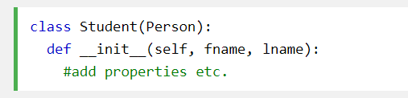
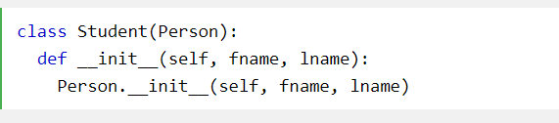
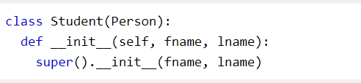
Python Inheritance
Add the __init__() Function
So far we have created a child class that inherits the properties and methods from its parent.
We want to add the __init__() function to the child class (instead of the pass keyword).
When you add the __init__() function, the child class will no longer inherit the parent's __init__() function.
Note: The child's __init__() function overrides the inheritance of the parent's __init__() function.
To keep the inheritance of the parent's __init__() function, add a call to the parent's __init__() function:

Slide 29
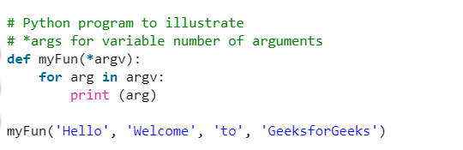
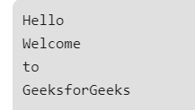
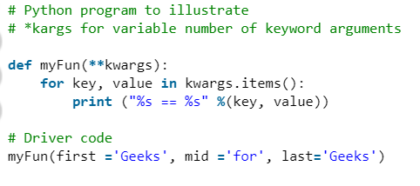
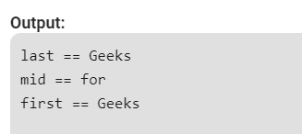
*args and **kwargs in Python
In Python, we can pass a variable number of arguments to a function using special symbols. There are two special symbols:
1.)*args (Non-Keyword Arguments)
2.)**kwargs (Keyword Arguments)
https://www.geeksforgeeks.org/args-kwargs-python/

Slide 30
Python - Iterator
iterators are everywhere in Python. They are elegantly implemented within for loops, comprehensions, generators etc. but are hidden in plain sight.
Iterator in Python is simply an object that can be iterated upon. An object which will return data, one element at a time.
Technically speaking, a Python iterator object must implement two special methods, __iter__() and __next__(), collectively called the iterator protocol.
An object is called iterable if we can get an iterator from it. Most built-in containers in Python like: list, tuple, string etc. are iterables.
The iter() function (which in turn calls the __iter__() method) returns an iterator from them.

Slide 31


Python - Iterator
Iterating Through an Iterator
We use the next() function to manually iterate through all the items of an iterator. When we reach the end and there is no more data to be returned, it will raise the StopIteration Exception. Following is an example.

Slide 32

Python - Iterator
Iterating Through an Iterator
We use the next() function to manually iterate through all the items of an iterator. When we reach the end and there is no more data to be returned, it will raise the StopIteration Exception. Following is an example.
A more elegant way of automatically iterating is by using the for loop. Using this, we can iterate over any object that can return an iterator, for example list, string, file etc.

Slide 33


Python - Iterator
Working of for loop for Iterators
As we see in the above example, the for loop was able to iterate automatically through the list.
In fact the for loop can iterate over any iterable. Let's take a closer look at how the for loop is actually implemented in Python.
Ironically, this for loop is actually an infinite while loop.

Slide 34


Building Custom Iterators
Building an iterator from scratch is easy in Python. We just have to implement the __iter__() and the __next__() methods.
The __iter__() method returns the iterator object itself. If required, some initialization can be performed.
The __next__() method must return the next item in the sequence. On reaching the end, and in subsequent calls, it must raise StopIteration.
Here, we show an example that will give us the next power of 2 in each iteration. Power exponent starts from zero up to a user set number.

Slide 35


Python Infinite Iterators
It is not necessary that the item in an iterator object has to be exhausted. There can be infinite iterators (which never ends). We must be careful when handling such iterators.
Here is a simple example to demonstrate infinite iterators.
The built-in function iter() function can be called with two arguments where the first argument must be a callable object (function) and second is the sentinel. The iterator calls this function until the returned value is equal to the sentinel.

Slide 36



Dict Sorting
Here, we have an array called kids where the dict has name, score and age. Suppose we want to sort them by score, what should we do?
Here are several solutions to solve it, one common way is using anonymous function. The ‘sort’ function has an argument called ‘key’, we can pass a function to it to specify the field for ranking.
In the anonymous function, the ‘x’ represents the element in the array, and in this problem it’s a dict. So we can use dict access element method which is to use brackets to find the value of the corresponding field.
What if we want to sort them by multiple fields?
Python also has its own libraries to solve this problem. The usage is very similar to that of anonymous functions and is a little easier to use.

Slide 37


python comparator
It converts a comparison function into a key function. The comparison function must return 1, -1 and 0 for different conditions. It can be used in key functions such as sorted(), min(), max().

Slide 38
python comparator
It converts a comparison function into a key function. The comparison function must return 1, -1 and 0 for different conditions. It can be used in key functions such as sorted(), min(), max().

Slide 39




JSON in Python
Python has a built-in package called json, which can be used to work with JSON data.
If you have a Python object, you can convert it into a JSON string by using the json.dumps() method.

Slide 40

JSON in Python

Slide 41
Sources
https://www.geeksforgeeks.org/args-kwargs-python/

