Slide 1


Customer Segmentation using Machine learning
DINESH KOTA
Prashant Karhale Akshay Tilekar
(Center Coordinator ) (External Guide)
Presented by:

Slide 2
Introduction
CUSTOMER SEGMENTATION USING MACHINE LEARNING
Now a days marketing is very important for selling a product
Customer segmentation can help us in doing proper marketing of a product.
Customer Segmentation is the process of division of customer base into several groups of individuals that share a similarity in different ways that are relevant to marketing such as gender, age, interests, and miscellaneous spending habits.

Slide 3
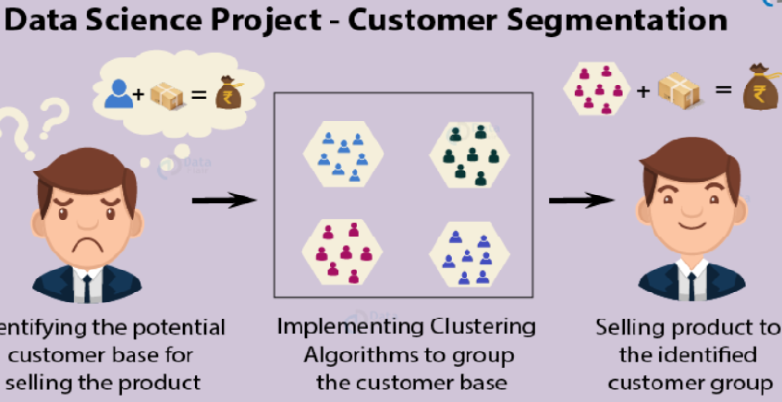
CUSTOMER SEGMENTATION USING MACHINE LEARNING
Look at the below image for more understanding.
Companies that deploy customer segmentation are under the notion that every customer has different requirements and require a specific marketing effort to address them appropriately. Companies aim to gain a deeper approach of the customer they are targeting..
Institute for Advanced Computing and Software Development, Akurdi

Slide 4
Segmentation is needed to drive higher profitability through understanding customer needs and delivering on those needs
Renewing our understanding
Typically customers are not created equal
..and different “segments” need different customer strategies to exploit their value
Many
Cherish and tailor
Relationship Development
Number of individuals
Retain and develop
Unprofitable
Marginally profitable
More profitable
Very profitable
Manage
20-30%
40-50%
Few
20-30%
Low
Value per individual
High
Meet
Customer Expectations
Exceed
Segmentation is an important tool in becoming customer-centric.
It is a key enabler of CRM.
“Recognise me, remember me, value me.”

Slide 5
Segmentation is an ongoing process for managing the customer base
Renewing our understanding
A segment is a group of customers who display similar attributes to each other...
They may react similarly in a product/service offering
They may provide comparable values (profitability) to the company
They may bear the same needs or behave in alike ways.
There is no one right way to segment (not should there be)
Many different approaches and techniques
Choosing an approach requires a mix of art, science, common sense, experience and practical knowledge
Also depends on market, business needs, availability of data
The aim is not necessarily to build one holistic model to meet all needs, several models used in conjunction with each other can work well.

Slide 6
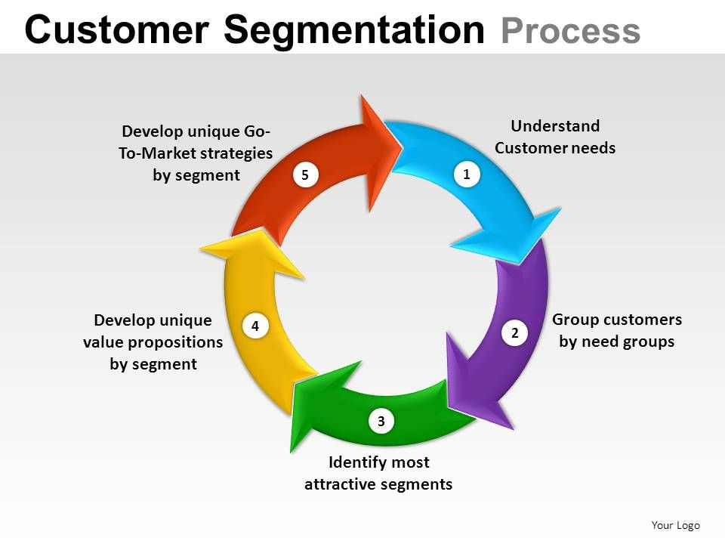

Slide 7
Proposed Methodlodgy
We are initially loading the data set which contains various factors such age,gender, income,spending capacity
We are doing various operations for summarizing the data and taking out results to know all the details of the customers so that we can analyse the customers all details and their income range and also spending capacity so that we can recognize the potential customer so that we offer the proper product

Slide 8
After all operations are conducted we are making the group of customer with similarities such as same range of income source and spending capacity
This thing is performed by using K means Algorithm
K means algorithm means The algorithm starts by selecting k objects from dataset randomly that will serve as the initial centers for our clusters. These selected objects are the cluster means, also known as centroids. Then, the remaining objects have an assignment of the closest centroid. This centroid is defined by the Euclidean Distance present between the object and the cluster mean

Slide 9
There are 3 ways for using K means algorithm
Elbow method
Silhouette method
Gap statistic

Slide 10
C onclusion
Through this customer segmentation we used a method of machine learning which is called supervised learning to process organize data and we also understood how to use to K means algorithm for clustering
Through visualtion of clusters we have understood all detailed analysis of all the variables present so that With the identification of customers, companies can release products and services that target customers based on several parameters like income, age, spending patterns.

Slide 11
Thank You
CUSTOMER SEGMENTATION USING MACHINE LEARNING

