Slide 1
Prediction of CUI of Medical Terms based on the Database of all Medical Concepts(UMLS)
Presented By:
Deepak Kumar Rakesh

Slide 2
MOTIVATION
To Develop System Which can Predict CUI
A/Q to Given Medical Terms
Medical terms can be from Different Domain Contains In Over 100 Source Vocabulary
MeSH (Medical sub Heading)=Concepts From
Anatomy , Biology , Physiology , Organisms , Diseases & Chemicals.

Slide 3
BACKGROUND
UMLS (Unified Medical Language System)
Project Started In 1986
National Library Of Medicine(U.S.A)
Aim
To overcome two Significant barrier to effective retrieval of Machine-Readable Information.
The variety of ways same concept can be represented in different Machine-Readable ways & By Different people.
Distribution of useful information among many Disparate Database & system.

Slide 4
What Is UMLS?
(Explanation Using Example)

Slide 5
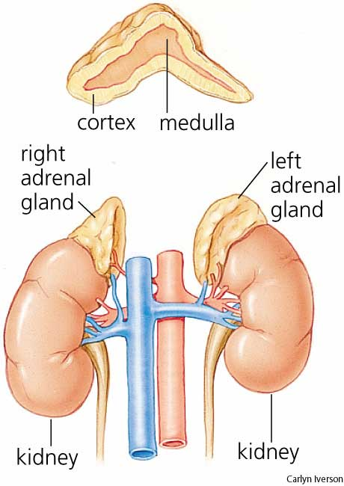
Addison’s Disease
Addison’s Disease is Rare Endocrine Disorder
Occurs When Endocrine Gland do not Produce Enough of Harmone Cortisol.
For this reason,
This Disease sometimes called
CHRONIC ADRENAL INSUFFICIENCY
HYPOCORTISOLISM

Slide 6
AD In Medical Vocabulary
Synonyms : Different Terms
Addisonian syndrome Eponym
Bronzed disease
Addison melanoderma Symptoms
Asthenia pigmentosa
Primary adrenal deficiency
Primary adrenal insufficiency Clinical Variants
Primary adrenocortical insufficiency
Chronic adrenocortical insufficiency

Slide 7
Terms Organized
Synonyms Terms Clustered Into Concept
Preferred Term
Unique Identifier(CUI)
Adrenal Gland Diseases
C0001621
Adrenal gland diseases MeSH
Adrenal disorder AOD
Disorder of adrenal gland Read
Diseases of the adrenal glands SNOMED

Slide 8
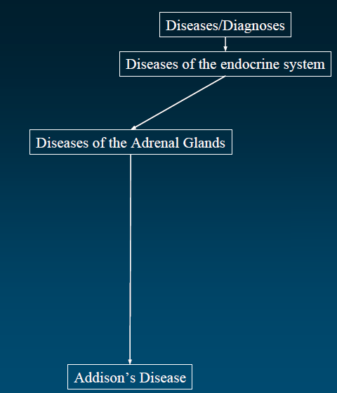
SNOMED
Systematized Nomenclature
Of Medical Terms

Slide 9
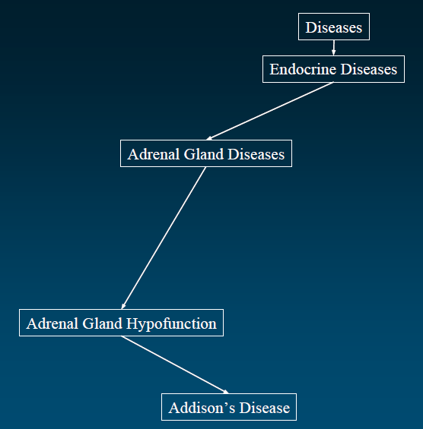
MeSH
Medical Sub Headings

Slide 10
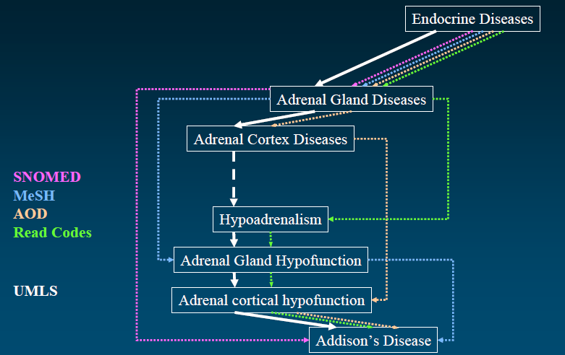

Slide 11
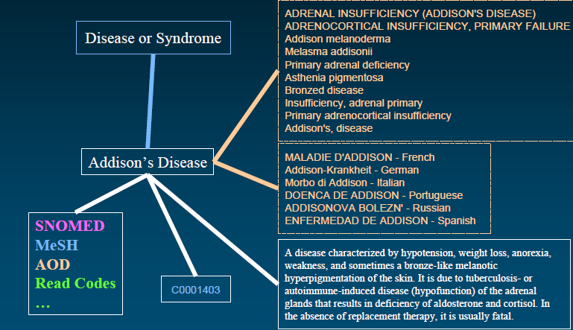
MRCONSO Files
MRDEF Files
MRRANK Files

Slide 12
UMLS KNOWLEDGE SOURCE

Slide 13
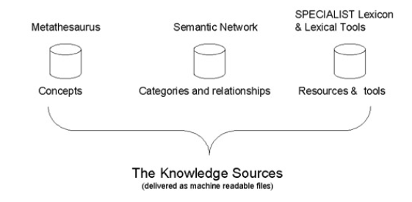
Continue…
Contains 1 million Biomedical Concepts
From over 100 source Vocabulary
Defines 133 Broad Categories & 54 Relationships
b/w Categories for Labeling Biomedical Domain
Provides Lexical Information
&
Programs For Language
Processing.

Slide 14
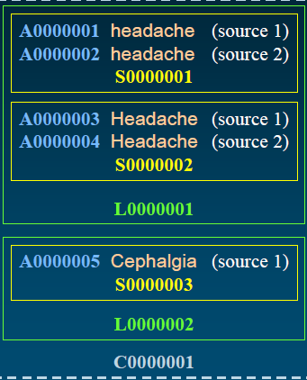
Metathesaurus Concept
Concept(>1M) CUI
Set of Synonymous Concept names
Term(>3.8 M) LUI
Set of Normalized Names
String(>4.3 M) SUI
Distinct Concept Name
Atom(>5.1 M) AUI
Concept name in Given Source

Slide 15
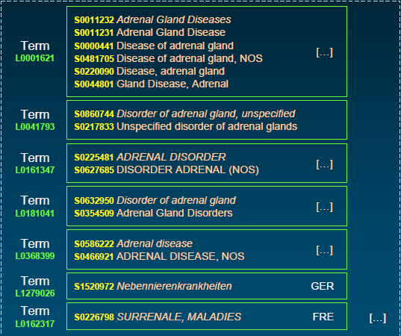
Concept = C0001621

Slide 16
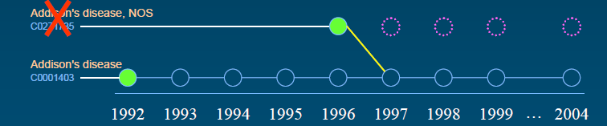
Metathesaurus Evolution Over Time
Concept Can merge or Split ,Resulting in New Concept.
Application Developed on Metathesaurus needs to be Updated Regularly.
CHANGE/DELETEDCUI.RRF

Slide 17
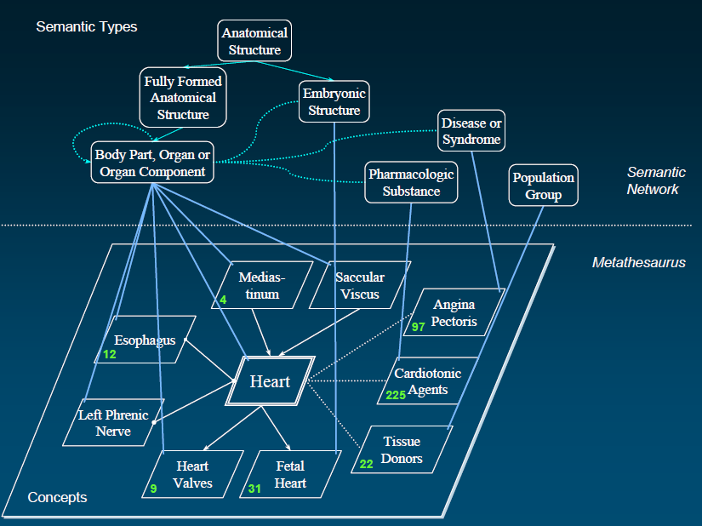

Slide 18
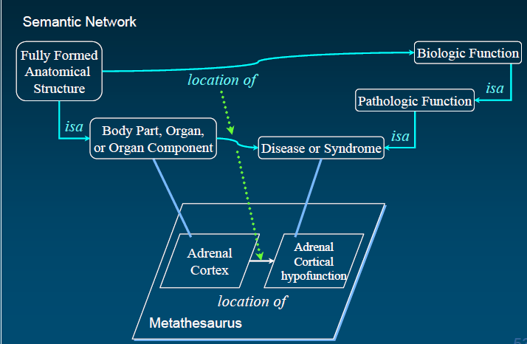
SEMANTIC NETWORK
Semantic Types(135)
Tree Structure
Semantic Network Relation(54)

Slide 19
Why a Semantic Network?
Semantic Types serve High level Categories assigned to Metathesaurus Concepts,
Independent Of their Positions in Hierarchy.
A relationship b/w 2 Semantic Types is possible Link B/W 2 Concepts that have
been assigned those STs.
→ The Relationship May or May not hold at Concept Level

Slide 20
METATHESAURUS
AUI: Unique Identifier for Atom
For Each(Occurrence(String, Source)) → AUI
SUI: Unique Identifier for String
Any Variation in Character Set, Upper-Lower Case or Punctuation is Separate String
LUI: Unique Identifier For Term
Each String linked To all Its Variant through Unique LUI
CUI: Unique Identifier For Concept
Each Concept is Identified by Unique CUI, Depends on Context & Source.

Slide 21
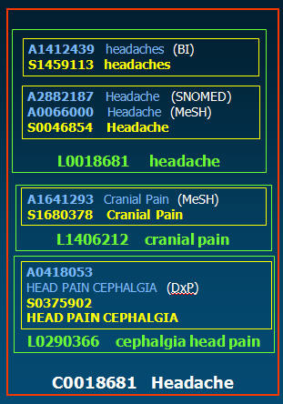

Slide 22
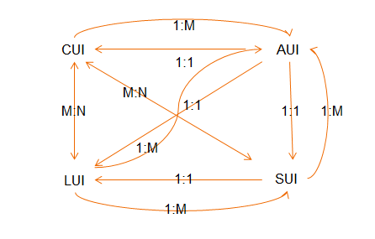
RELATION AMONG THEM

Slide 23
Example :
For COLD
Name for Temperature in One Vocabulary
Alternative Name For “Common Cold”
Acronym For “Chronic Obstructive Lung Disease”
So,
“cold” or “COLD”
May have more then Concept in Matathesaurus

Slide 24
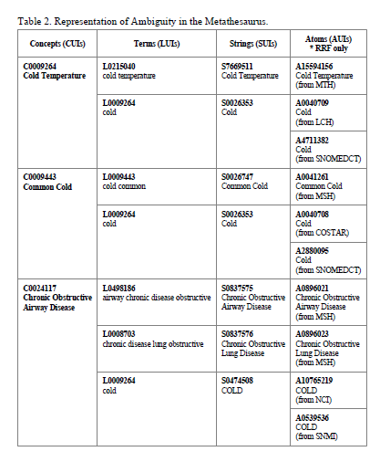

Slide 25
Cold → A4711832 → S0026353 → L0009264 C0009264
(SNOMEDCT)
Cold → A2880095 → S0026353 → L0009264 C0009443
(SNOMEDCT)
Analysis = Word + Context → CUI
S0026353
L0009264
S0474508

Slide 26
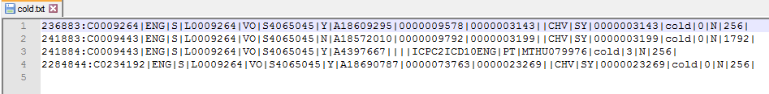
S4065045 → L0009264 → C0009264
S4065045 → L0009264 → C0009443
S4065045 → L0009264 → C0234192
AMBIGLUI.RRF= Contains LUIs of all Ambiguous Terms
AMBIGSUI.RRF= Contains SUIs of all Ambiguous Terms
OR
AMBIG.LUI & AMBIG.SUI in ORF

Slide 27
CURRENT SYSTEM

Slide 28
IMPLEMENTATION
Current System Has been Implemented Using VSM(Cosine Similarity)
Set of Documents Created pivoted around the Concepts of medical terms.
Terms referring to the same medical concept go into the same document and document name is the CUI-id of the concept.
The idea
Given a media term(query) it should be most similar to the document with similar concepts as described by the query.

Slide 29
EXAMPLE OF DOCUMENTS
GENERATED FROM THE ENTITIES IN TEST,
TRAIN SET
C0001973
Alcoholism
alcoholism/alcohol abuse
Addiction, Alcohol
disorder alcoholism
chronic alcoholism
abuse alcohol alcoholism
Intoxication, Chronic Alcoholic
C0002395
Alzheimer Disease
Alzheimer's Disease
Disease, Alzheimer
DAT
DEMENTIA OF THE ALZHEIMER TYPE
Syndrome, Alzheimer

Slide 30
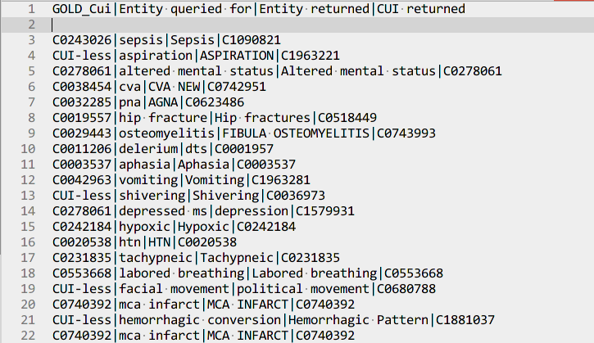
SAMPLE OUTPUT

Slide 31
LIMITATIONS OF THIS APPROACH
With Given Query,
Most Similar Query will be Output.
That May Exact Or Not.
A/Q to UMLS Feature
One Medical Entity may Relate To more than One CUI.
To Select the Expected Among Them is Challenge.

Slide 32
Problem With Different Language With this Approach
Extent to Which Word Uniquely Identifies Document
Depends (Frequency Of Word Occurrence/Number Of Words) in Documents
Number Of Words Includes Words From Different Language
Even they Contribute to Same Concept ,, For VSM
They are different Lexical Variants
Hence.. Ranking Of Document Decreases.
In CUI Prediction, Corresponding Document
will not be At First Place.
Because Of Different Language
IN UMLS

Slide 33
y
Cosines Graph
x
0
90
Angle B/W Two Lines Directly Related to Similarity B/W Two Documents.
Value Of Cosine Inversely Proportional to Angle Two Lines.
Value Of Cosine increases Angle B/W Two Lines decreases,
Hence Similarity b/w two document Decreases
Value Of Cosine

Slide 34
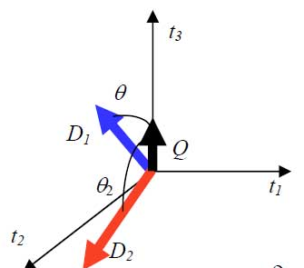


Number Of Different Distinct Terms Affects the Similarity Two Lines,
Hence , Two Document.
Number of Distinct Terms Increases CosSimilarity Decreases,
Hence, Angle B/W Lines Increases,
So Simiarity Decreases

Slide 35
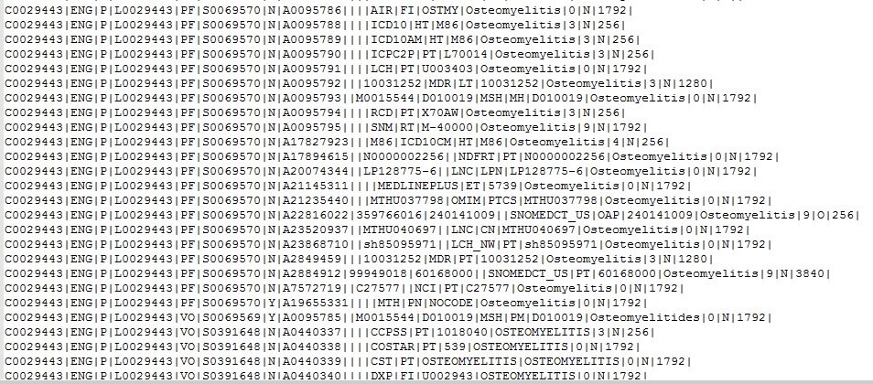

Slide 36
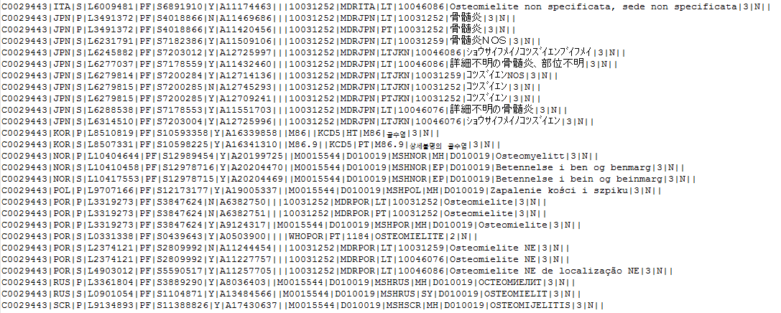

Slide 37
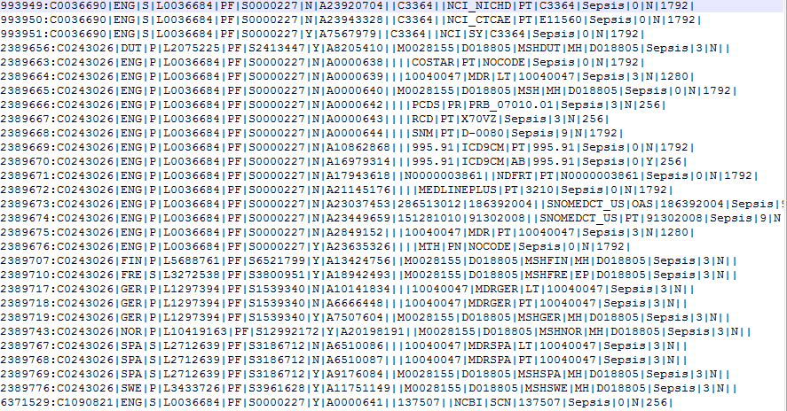

Slide 38
UMLS Consists 62% English And Rest Includes
Dutch , French, Italian, Japanese & Portuguese .
If Searched With Other Language Word.
Accuracy May Decrease More.
Problem With Focusing On one Language
There is Chance Of Skipping The Concept.
If any Concept not Related to ENGLISH(Drawback of System)
Also
If Prescription in Other Language.
Solution → Next

Slide 39
FUTURE WORK
Problem With Different Language
Focus On English Language
(Accuracy will Increase)
Building Similar System
For Other Language
Integrating these System
We will Need Information about
Medical Entity, Language at Terminal

Slide 40
Analyzing Different RRF Files Present In UMLS
Finding Out Relation B/W Them
It is Mentioned In UMLS Reference Manual
Metathesaurus Linked to Other Knowledge Sources
Semantic Network & SPECIALIST Lexicon
To Find Out…..HOW??
Can We Get any Solution To Our Problem with this Linkage.
With VSM Approach.

Slide 41
REFERENCES
www.ncbi.nlm.nih.gov/books/NBK9685/
alt.qcri.org/semeval2014/task7/
lucene.apache.org/
www.nlm.nih.gov/research/umls.
www.nlm.nih.gov/research/umls/knowledge_sources metathesaurus/release/columns_data_elements.
.

Slide 42
THANK YOU!

