Slide 1

Codealers

Slide 2
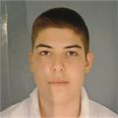
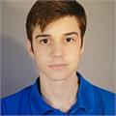
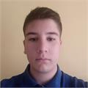
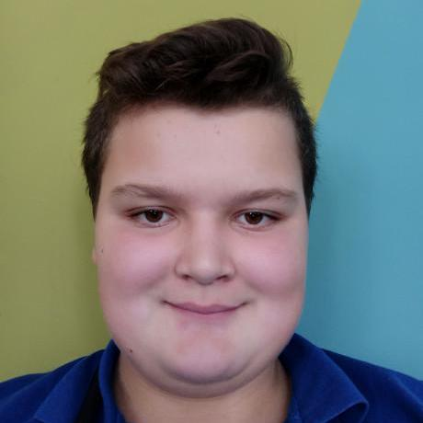

Team
Danail Todorov
SCRUM Trainer
10Г
Daniel Vasilev
Backend Developer
10Г
Anton Goreshtilov Designer
10Г
Zafir Stoyanov
Backend Developer
10Г
Trani Tranev
Backend Developer
10Г

Slide 3






TECHNOLOGIES USED
Teams
Visual studio
GitHub
PowerPoint
C++
Word

Slide 4
IMPLEMENTATION
01
02
03
Back-end
SCRUM
Designer

Slide 5
REPOSITORY

Slide 6
DEMONSTRATION

Slide 7
Thank you for your attention!

