Slide 1

Concurrency
August 24, 2020
송인호, 정성현

Slide 2

Concurrency
Shared Resources
code
data
heap
code
data
heap
stack
stack
stack
stack
registers
registers
registers
registers
<Single-thread>
<Multi-thread>
“Shared resources” cause “Race condition”
Reason for needing Concurrency
Mutual exclusion and Synchronization

Slide 3
Concurrency
① Lock
for Mutual exclusion
Method
Mechanism
Concurrent data structure
HW atomic operations + OS cooperation (SW)
Spin lock
Sleep lock
Producer & Consumer
Reader & Writer
Dining Philosophers
② Condition Variables
for Synchronization (ordering)
③ Semaphore
Used as lock and condition variable
Binary semaphore, Counting semaphore

Slide 4


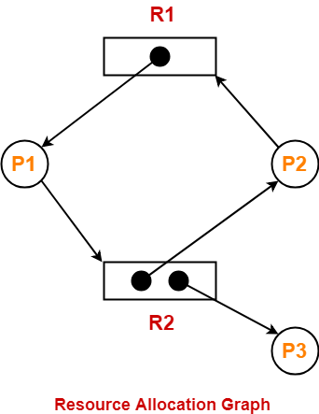

Concurrency
Parallel → throughput up!
Concurrency bugs
Concurrency
Deadlock
Threads wait for events that never occur
Deadlock condition
Solution
Mutual exclusion
Hold and Wait
No preemption for resource
Circular wait
Prevention
Avoidance with Scheduling
Detection and Recovery

Slide 5
Homework of OSTEP
Chap 26. Concurrency and Threads
[x86.py] Run some programs to see threads interleaving by changing the number of thread
and interrupt interval
Chap 27. Thread API
Debugging simple deadlock programs by using helgrind tool to capture race conditions
Chap 28. Locks
[x86.py] Run program (flag.s, test-and-set.s …) and trace variables and registers.
Chap 29. Locked Data structures
Write concurrent code (concurrent counter, sloppy counter...) and measure performance

Slide 6
Homework of OSTEP
Chap 30. Condition Variables
Run Producer & Consumer program with various configurations
Chap 31. Semaphores
Add code to use semaphores and solve some problems
Chap 32. Concurrency Bugs
Run some codes of avoiding deadlock
Chap 33. Event-based Concurrency
experience with event-based code with server

Slide 7
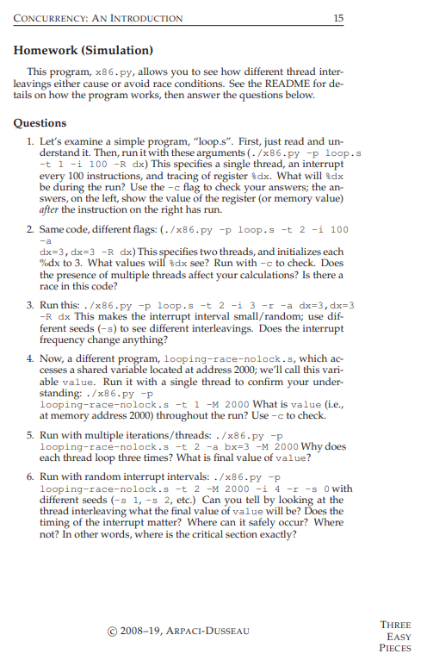
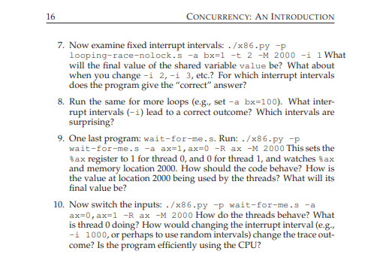
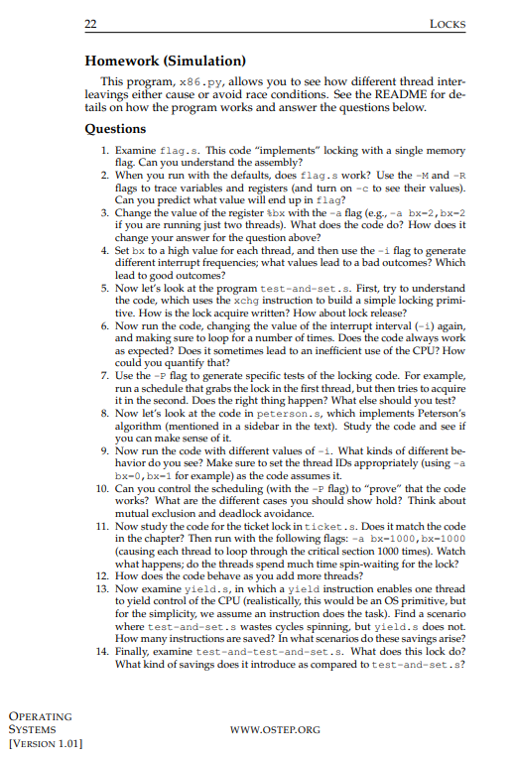
Homework of OSTEP
Homework Overview

Slide 8
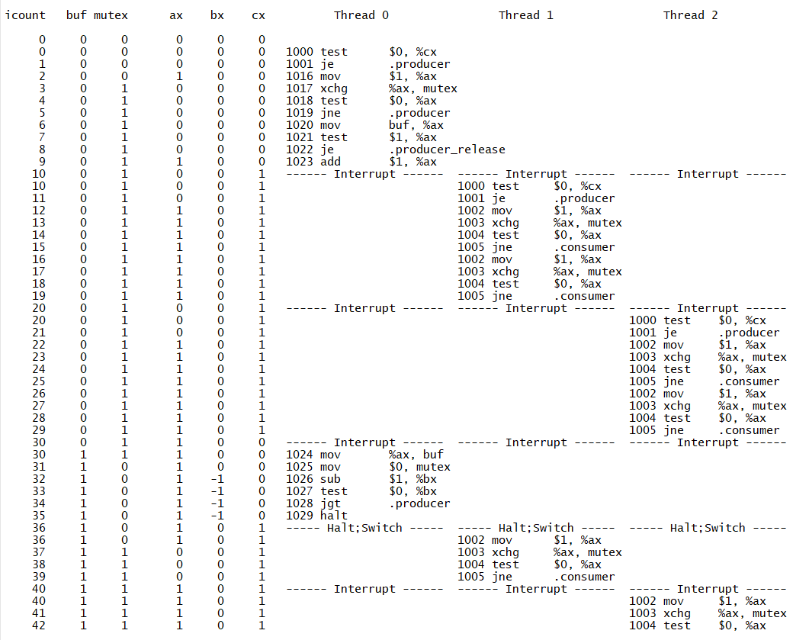
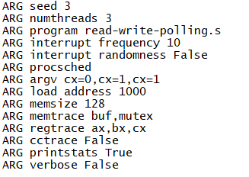
Homework of OSTEP
-S
-M
-R
x86.py
-s
-t
-p
-a
-M

Slide 9
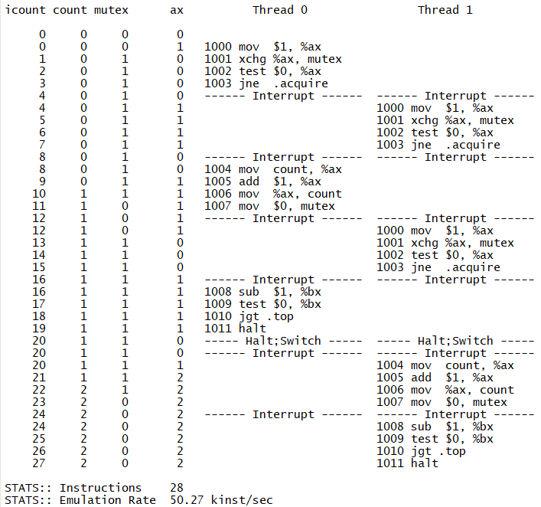
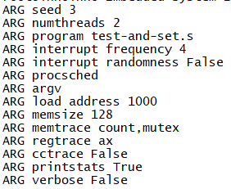
Homework of OSTEP
./x86.py -p test-and-set.s -R ax -M count,mutex -t 2 -i 4 -c -S -s 3

Slide 10
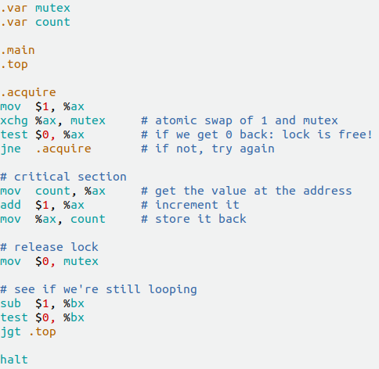
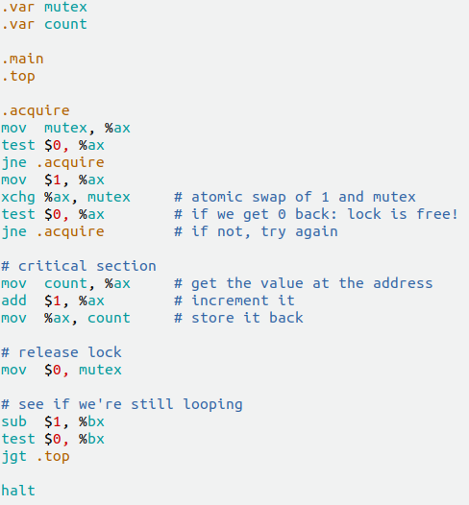
Experiment
Ch28, 문제 6번, 문제 15번
“이제 인터럽트 간격(-i)을 변경해가면서 코드를 실행해 보자.
반복문이 여러 차례 수행될 수 있도록 해야 하는 것을 유의하자.
코드가 항상 의도한 대로 동작하는가?
CPU를 비효율적으로 사용하는 경우가 가끔 발생하는가? 수치화 할 수 있겠는가?”
“test-and-test-and-set.s는 기존 test-and-set과 비교하여 무엇을 절약 할 수 있도록 해주는가?”
< Test-and-set.s >
< Test-and-test-and-set.s >

Slide 11
Experiment

Slide 12
Experiment
*SEC = # of instructions / (kinst/sec)

Slide 13
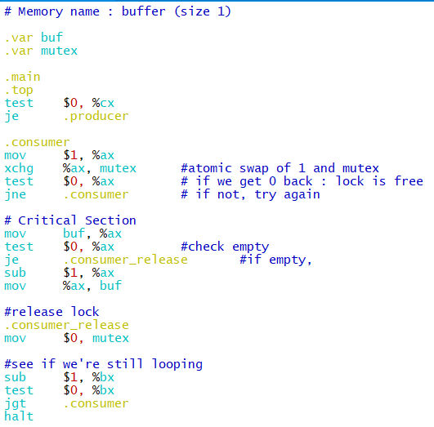
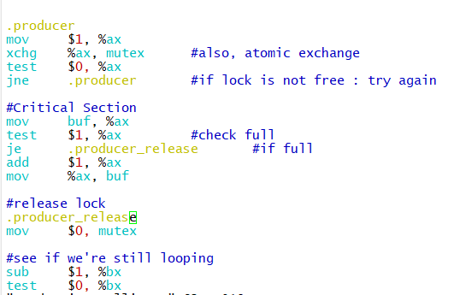
Experiment
Producer-Consumer.s
Polling 방식.

Slide 14
Experiment
produce-consumer-polling.s 향후 계획
Producer
Consumer
Consumer
./x86.py –p produce-consume-polling.s -R ax,bx,cx -M buf,mutex -a cx=0,cx=1,cx=1 -t 3 -i 10 -c -S -s 3

