Slide 1
리눅스 커널 파일 시스템 실습 2 myfs, minfs (환경설치)
15 Feb 2022
IN HO SONG
mearrong123@gmail.com

Slide 2
Chapter Objectives
linux-kernel-labs filesystem [gitblog][github]
Exercise(linux/tools/labs)
VM setup (QEMU)
myfs
register/unregister myfs
completing myfs superblock
Initialize myfs root inode
myfs mount/unmount
minfs

Slide 3
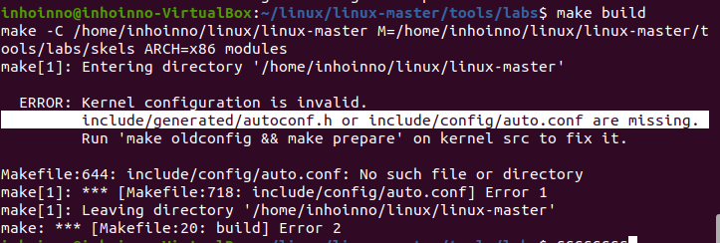
vmware ubuntu image kernel configuration 문제
ERROR: Kernel configuration is invalid. ~
ERROR: Kernel configuration is invalid. ~
Problem Shooting
☞
Kernel downgrade (kernel 5.10)
cd /tmp/
wget -c https://kernel.ubuntu.com/~kernel-ppa/mainline/v5.10/amd64/linux-headers-5.10.0-051000_5.10.0-051000.202012132330_all.deb
wget -c https://kernel.ubuntu.com/~kernel-ppa/mainline/v5.10/amd64/linux-headers-5.10.0-051000-generic_5.10.0-051000.202012132330_amd64.deb
wget -c https://kernel.ubuntu.com/~kernel-ppa/mainline/v5.10/amd64/linux-image-unsigned-5.10.0-051000-generic_5.10.0-051000.202012132330_amd64.deb
wget -c https://kernel.ubuntu.com/~kernel-ppa/mainline/v5.10/amd64/linux-modules-5.10.0-051000-generic_5.10.0-051000.202012132330_amd64.deb
sudo dpkg -i *.deb

Slide 4
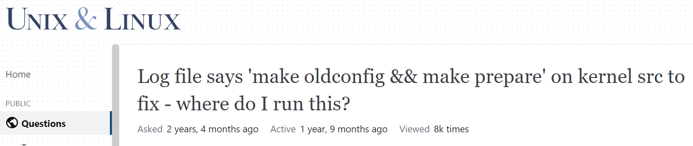
vmware ubuntu image kernel 문제2 : make build 시 make oldconfig && make prepare 메세지
Source : https://unix.stackexchange.com/questions/547186/log-file-says-make-oldconfig-make-prepare-on-kernel-src-to-fix-where-do-i
Problem Shooting
☞
install propriate kernel headers
sudo apt install linux-headers-$(uname -r)
sudo apt install linux-headers-generic

Slide 5
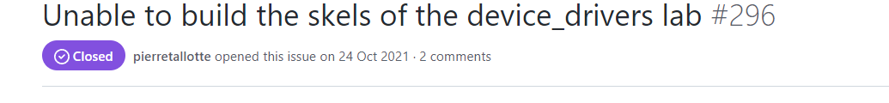
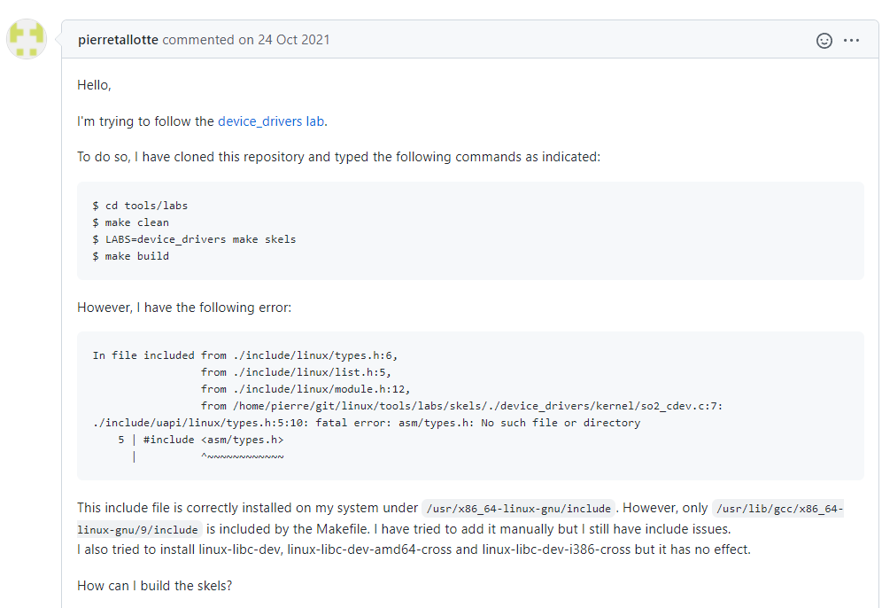
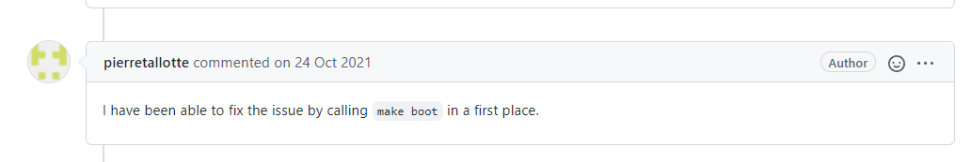
https://github.com/linux-kernel-labs/linux/issues/296
linux-kernel-labs 중 실습 환경 구축 문제 : make build (git issue#296)
cd tools/labs
make clean
LABS=device_drivers make skels
make build
Problem Shooting
☞
make boot
make build

Slide 6
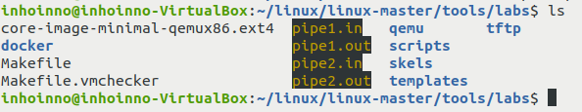

QEMU 이미지 만드는데 성공… >[gitblog] VM Setup 단계에 있음…
cd tools/labs
make clean
LABS=device_drivers make skels
make boot
make build
Finally, I generate QEMU image…

