Slide 1
Chapter 13 File I/O Buffering (Demo)
15 January, 2020
IN HO SONG
mearrong123@gmail.com

Slide 2
Chapter Objectives
Introduce Buffering of File I/O: Buffer Cache
Kernel : Buffer Cache
Library : Buffering in stdio
Discuss how they(Buffering) affect application performance.
Look at various techniques for influencing and disabling both types of buffering,
Look at a technique called direct I/O,
direct I/O is useful for by passing kernel buffering in certain circumstances
Summary

Slide 3
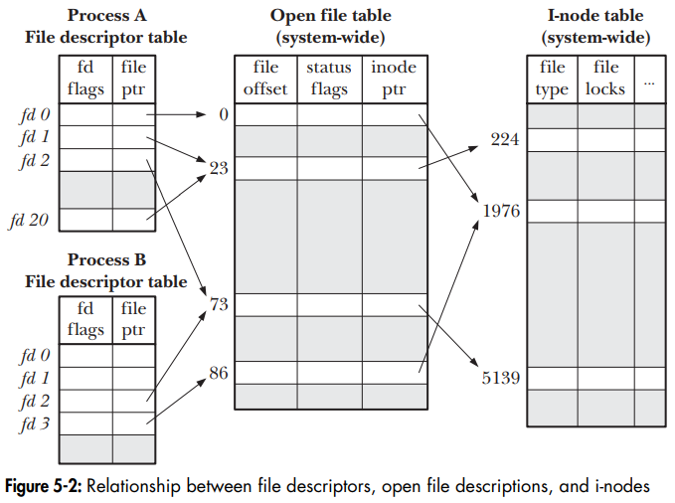
Buffering of File I/O (1/3)
lseek() : It does not cause any physical device access
1
2
Buffering of I/O Disk
lseek()
write()

Slide 4
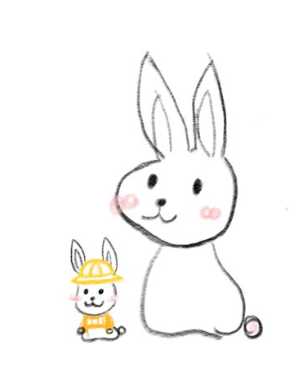


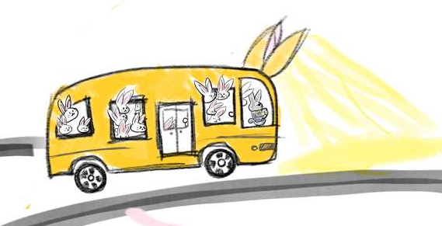
Buffering of File I/O (1/3)
Simple concept of Buffering of File I/O
Memory
Disk
X 1024
1024 인승
Buffering of I/O Disk

Slide 5
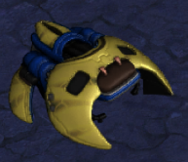
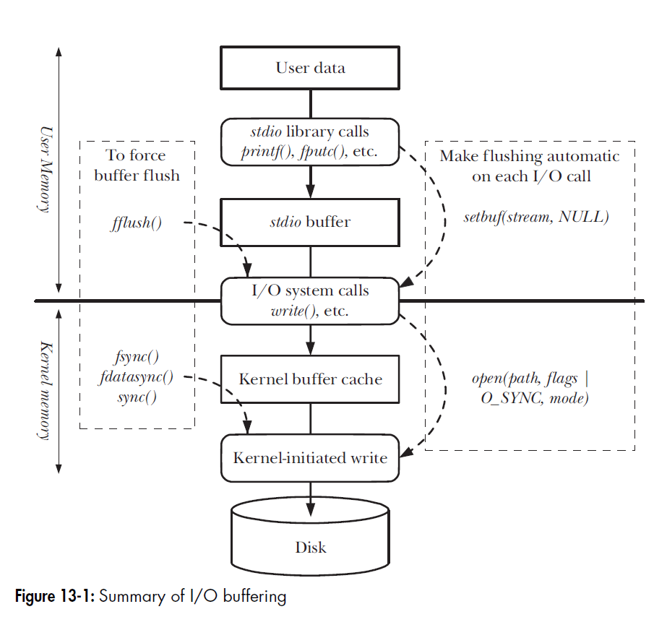
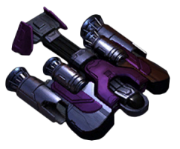


Summary of I/O Buffering
Library calls
System calls
Disk operation

Slide 6
Summary of I/O Buffering
Library calls
System calls
Disk operation

Slide 7
Summary of I/O Buffering
Library calls
System calls
Disk operation

Slide 8
Summary of I/O Buffering
Library calls
System calls
Disk operation

Slide 9
Q & A
Github Issue

