Slide 1
Cache and WAL
System Software Lab.
Name: 이대은, 하경준
Date: 2025/02/03

Slide 2
Contents: Compaction
Motivation
Experiment
Result and Discussion

Slide 3
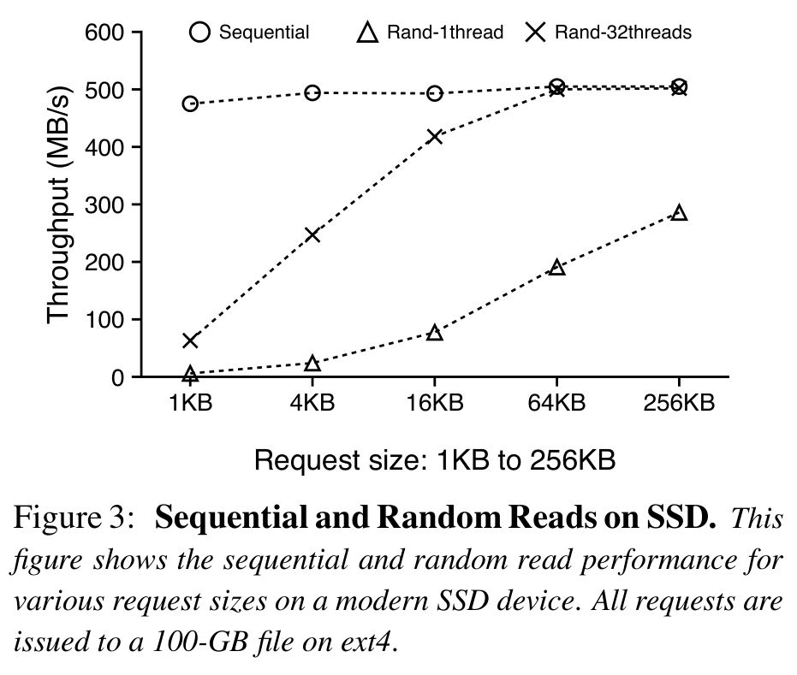
Motivation
I tried to make some of the experiments in RocksDB: Experiments on LevelDB's Sequential and Random Read on SSD in the WiscKey paper are as similar as possible in RocksDB.
It was expected that a graph similar to Figure 3 would appear in RocksDB.
Notes:
WiscKey 논문에 나오는 LevelDB의 Sequential and Random Reads on SSD의 일부 실험을 RocksDB에서 최대한 유사하게 하여 실험을 진행해보았다.
RocksDB에서도 Figure3과 유사한 그래프가 나올 것으로 예상하였다.

Slide 4
Experimental configuration
Linux Kernel: 6.6.72-1-lts
CPU: Intel i7-7700 (8) @ 4.200GHz
Memory: 32GB
Disk: SAMSUNG SSD 840 Pro 512GB
RocksDB: 9.9.3

Slide 5
Experimental result (before modify)
num값을 1,000,000 에서 100,000 으로 조절.
조절한 이유
이유1: 잦은 Disk I/O로 인해 중간에 밴치마크 에러 생김.
이유2: 밴치마크 돌리는데 시간이 너무 오래 걸림
 | 1KB | 2KB | 4KB | 8KB | 16KB | 32KB | 64KB | 128KB | 256KB
Sequential | 254.6 | 264.9 | 242.8 | 268 | 283.3 | 286.8 | 176 | 175.1 | 166.6
Rand-1thread | 160.8 | 213.1 | 128.5 | 85.3 | 83.9 | 64 | 71.3 | 52 | 38
Rand-8threads | 67 | 62 | 75 | 46.7 | 33.2 | 18.2 | 29 | 21.6 | 15.1
 | 1KB | 2KB | 4KB | 8KB | 16KB | 32KB | 64KB | 128KB | 256KB
Sequential | 853.2 | 976.7 | 1027.4 | 1531.6 | 2039.9 | 2451.8 | 2818.6 | 484.3 | 453.6
Rand-1thread | 31.4 | 60.5 | 127.6 | 292.3 | 283.9 | 361.3 | 240.1 | 173.4 | 140
Rand-8threads | 251 | 456 | 258 | 832.8 | 1097 | 385.2 | 1209 | 1059.7 | 1338
(MB/s)
(MB/s)

Slide 6
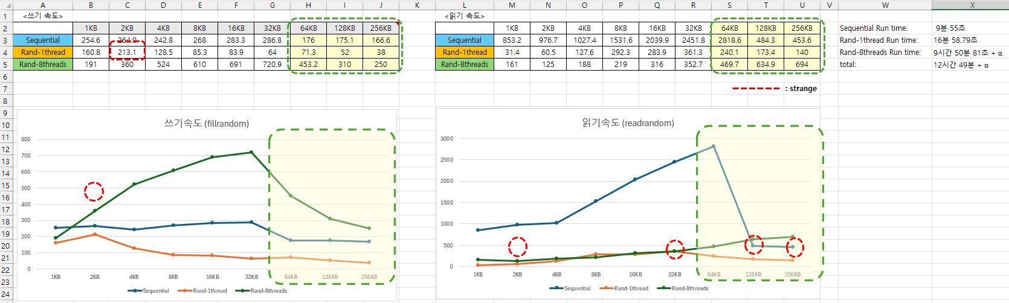

Slide 7

Experimental result (before modify)
Issue guess
num값을 1,000,000 에서 100,000 으로 조절.
조절한 이유
이유1: 잦은 Disk I/O로 인해 중간에 밴치마크 에러 생김.
이유2: 밴치마크 돌리는데 시간이 너무 오래 걸림
1. Compaction is not working well.
 | 1KB | 2KB | 4KB | 8KB | 16KB | 32KB | 64KB | 128KB | 256KB
Sequential | 254.6 | 264.9 | 242.8 | 268 | 283.3 | 286.8 | 176 | 175.1 | 166.6
Rand-1thread | 160.8 | 213.1 | 128.5 | 85.3 | 83.9 | 64 | 71.3 | 52 | 38
Rand-8threads | 67 | 62 | 75 | 46.7 | 33.2 | 18.2 | 29 | 21.6 | 15.1
 | 1KB | 2KB | 4KB | 8KB | 16KB | 32KB | 64KB | 128KB | 256KB
Sequential | 853.2 | 976.7 | 1027.4 | 1531.6 | 2039.9 | 2451.8 | 2818.6 | 484.3 | 453.6
Rand-1thread | 31.4 | 60.5 | 127.6 | 292.3 | 283.9 | 361.3 | 240.1 | 173.4 | 140
Rand-8threads | 251 | 456 | 258 | 832.8 | 1097 | 385.2 | 1209 | 1059.7 | 1338
2. Block size and Cache size are small
(MB/s)
(MB/s)
Issue 1: Temporarily pick
Why value is strange?
Issue 2: Temporarily Low
Issue 3: The value decreases rapidly.

Slide 8
Issue guess
1. Compaction is not working well.
2. Block size and Cache size are small
Notes:
Compaction이 잘 안되고 있다.
실험을 여러 방면에서 수정해 봤는데, 마땅한 결과가 없어서 포기.
Block과 Cache의 크기가 작아서 그렇다.
중점 분석
<원인분석>
L3에서 파일의 수가 너무 많다.
CompMerge 하는데 시간이 오래걸린다.
<해결책>
Blcok과 Cache의 크기를 늘리자-!

Slide 9
Issue guess
1. Compaction is not working well.
The performance improvement is minimal.
2. Block size and Cache size are small
Notes:
Compaction이 잘 안되고 있다.
실험을 여러 방면에서 수정해 봤는데, 마땅한 결과가 없어서 포기.
Block과 Cache의 크기가 작아서 그렇다.
중점 분석
<원인분석>
L3에서 파일의 수가 너무 많다.
CompMerge 하는데 시간이 오래걸린다.
<해결책>
Blcok과 Cache의 크기를 늘리자-!

Slide 10
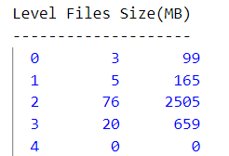
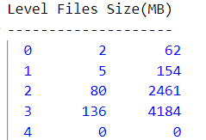


Issue guess
1. Compaction is not working well.
2. Block size and Cache size are small
Focus analysis
<Analysis>
The number of files in L3 is too many.
CompMerge takes a long time.
<Soultion>
Increase Block size and Cache size-!
64KB
128KB
Notes:
Compaction이 잘 안되고 있다.
실험을 여러 방면에서 수정해 봤는데, 마땅한 결과가 없어서 포기.
Block과 Cache의 크기가 작아서 그렇다.
중점 분석
<원인분석>
L3에서 파일의 수가 너무 많다.
CompMerge 하는데 시간이 오래걸린다.
<해결책>
Blcok과 Cache의 크기를 늘리자-!

Slide 11
Issue guess
1. Compaction is not working well.
2. Block size and Cache size are small
Focus analysis
<Analysis>
The number of files in L3 is too many.
CompMerge takes a long time.
<Soultion>
Increase Block size and Cache size-!
64KB
128KB
Notes:
Compaction이 잘 안되고 있다.
실험을 여러 방면에서 수정해 봤는데, 마땅한 결과가 없어서 포기.
Block과 Cache의 크기가 작아서 그렇다.
중점 분석
<원인분석>
L3에서 파일의 수가 너무 많다.
CompMerge 하는데 시간이 오래걸린다.
<해결책>
Blcok과 Cache의 크기를 늘리자-!

Slide 12
Modify experimental command
Command explain
Block size and Cache size modify for new experiment
time ./db_bench --benchmarks=fillseq,readseq
--num=100000
--value_size=OOO
--compression_type="snappy"
// --write_buffer_size=64MB
// --max_write_buffer_number=2
// --max_bytes_for_level_base=256MB
// --max_bytes_for_level_multiplier=10
// --block_size=4KB
// --cache_size=32MB
// --target_file_size_base=64MB
time ./db_bench \
--benchmarks="fillseq,readseq,levelstats,stats"
--num=100000
--value_size=OOO
--compression_type="snappy"
--write_buffer_size=256MB
--max_write_buffer_number=6
--max_bytes_for_level_base=1024MB
--max_bytes_for_level_multiplier=6
--block_size=128MB
--cache_size=2048MB
--target_file_size_base=256MB
// memtable 크기 설정
// 동시에 유지할 수 있는 최대 memtable 개수
// L1에서 허용할 수 있는 데이터 크기
// RocksDB의 Level 간 데이터 크기 증가 비율
// SST 파일 내에서 한 번에 읽어올 블록 크기
// Block Cache 크기
// SST 파일의 기본 크기
Before
After

Slide 13
Modify experimental command
Command explain
write_buffer_size=256MB : memtable 크기 설정
max_write_buffer_number=6 : 동시에 유지할 수 있는 최대 memtable 개수
max_bytes_for_level_base=1024MB : L1에서 허용할 수 있는 데이터 크기
max_bytes_for_level_multiplier=6 : RocksDB의 Level 간 데이터 크기 증가 비율
block_size=128MB : SST 파일 내에서 한 번에 읽어올 블록 크기
cache_size=2048MB : Block Cache 크기
target_file_size_base=256MB : SST 파일의 기본 크기
Block size and Cache size modify for new experiment
time ./db_bench --benchmarks=fillseq,readseq
--num=100000
--value_size=OOO
--compression_type="snappy"
// --write_buffer_size=64MB
// --max_write_buffer_number=2
// --max_bytes_for_level_base=256MB
// --max_bytes_for_level_multiplier=10
// --block_size=4KB
// --cache_size=32MB
// --target_file_size_base=64MB
time ./db_bench \
--benchmarks="fillseq,readseq,levelstats,stats"
--num=100000
--value_size=OOO
--compression_type="snappy"
--write_buffer_size=256MB
--max_write_buffer_number=6
--max_bytes_for_level_base=1024MB
--max_bytes_for_level_multiplier=6
--block_size=128MB
--cache_size=2048MB
--target_file_size_base=256MB
// memtable 크기 설정
// 동시에 유지할 수 있는 최대 memtable 개수
// L1에서 허용할 수 있는 데이터 크기
// RocksDB의 Level 간 데이터 크기 증가 비율
// SST 파일 내에서 한 번에 읽어올 블록 크기
// Block Cache 크기
// SST 파일의 기본 크기
Before
After

Slide 14
Experimental result (after modify)
 | 32KB | 64KB | 128KB | 256KB
Sequential | 286.8 | 176 | 175.1 | 166.6
Sequential (modify) | 335.6 | 296.8 | 278.3 | 253
 | 32KB | 64KB | 128KB | 256KB
Sequential | 2451.8 | 2818.6 | 484.3 | 453.6
Sequential (modify) | 2305.8 | 3107.1 | 2930.9 | 3044.2
(MB/s)
(MB/s)
Block size and cache size have a greater impact than compaction.

Slide 15
Contents: WAL
What is WAL(Write Ahead Log)?
How does it work?
WAL Overhead
Hypothesis
Design and Experiment
Result and Discussion
Code-Level Analysis (ongoing)
Summary
References

Slide 16
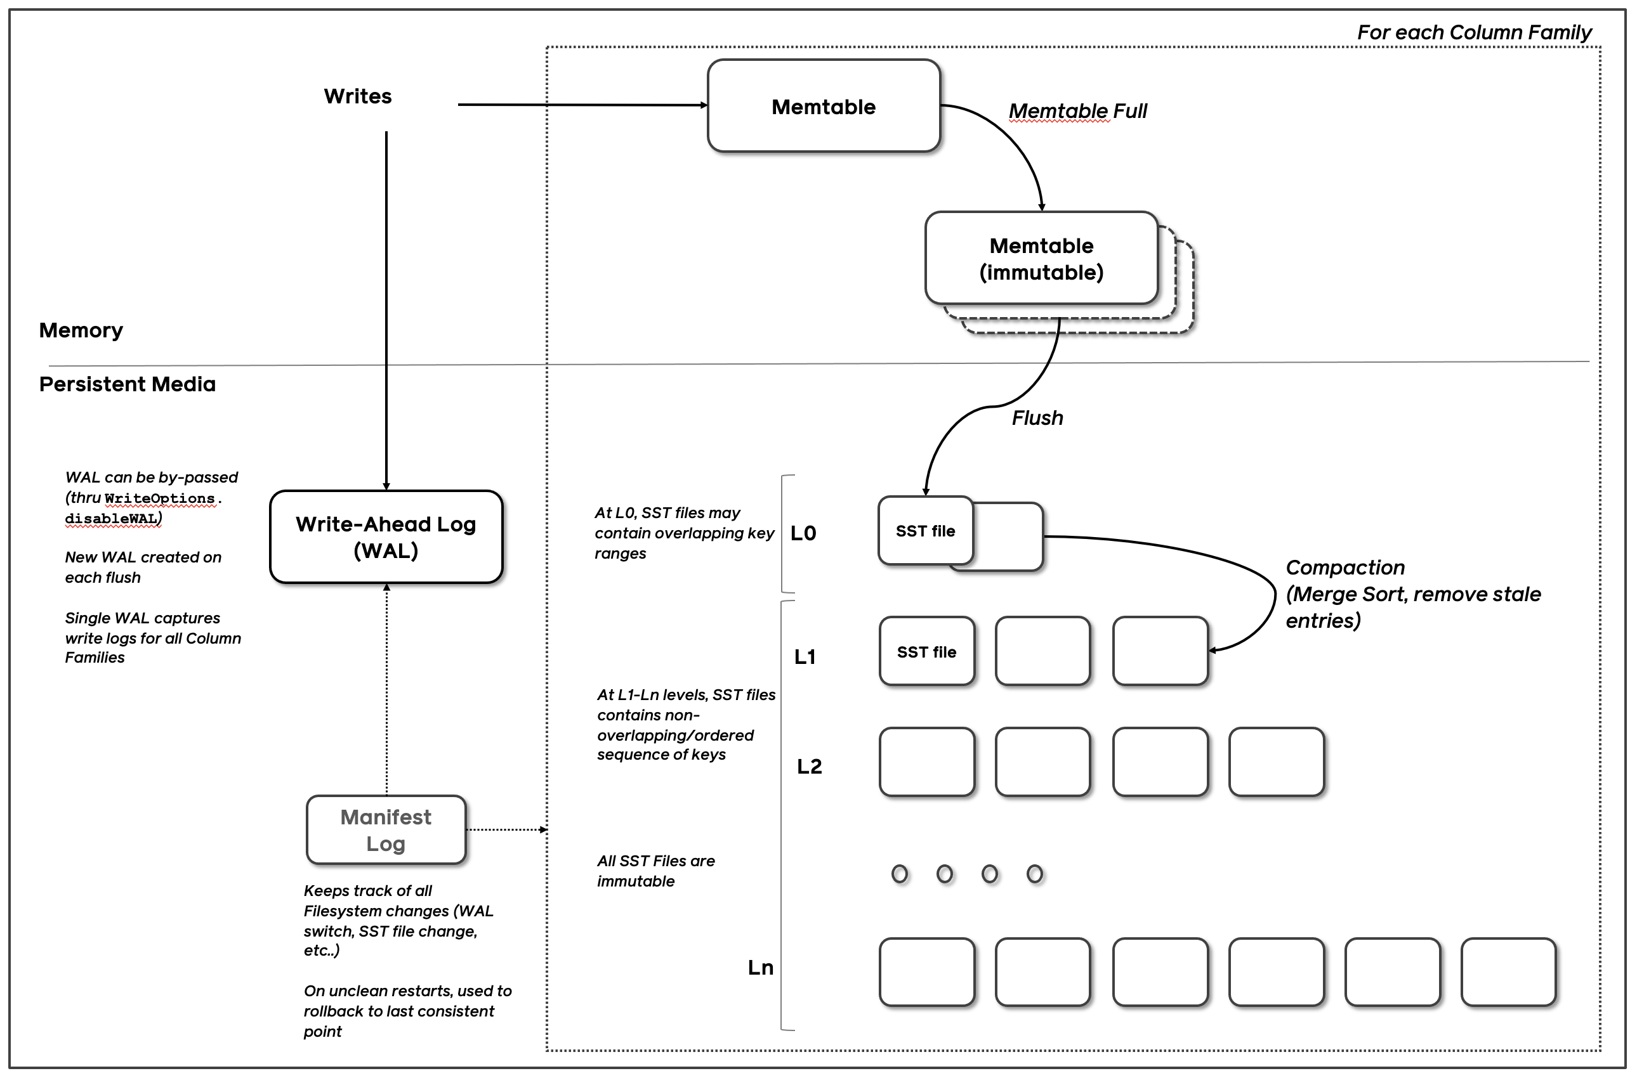
What is WAL(Write Ahead Log)?
Journals or Logs:
The metadata that describes a data system's hist-ory of state.
Key to RocksDB’ integrity and recovery.
RocksDB has two types of journals:
Write Ahead Log (WAL)
MANIFEST
WAL is for journaling the in-memory state updates, while MANIFEST is for journaling the on-disk state updates.
Ref: https://github.com/facebook/rocksdb/wiki/RocksDB-Overview

Slide 17
How does it work?
“default”
“new_cf”
Life Cycle of a WAL
For example, a RocksDB instance db is created with two column families ”default” and ”new_cf” (kind of logical partion).
Once the db is opened, a new WAL will be created on disk to persist all writes.
Key Point: A single WAL captures write logs for all column families!
WAL File

Slide 18
How does it work?
: new data
“default”
“new_cf”
Life Cycle of a WAL
3. db->Put(”new_cf”, “key1”, “value1”);
db->Put(“default”, “key2”, “value2”);
db->Put(“new_cf”, “key3”, “value3”);
db->Put(“default”, “key4”, “value4”);
At this point the WAL should have recorded all writes.
Note that the WAL will stay open and keep recording future writes until its size reaches -max_total_wal_size.
(”key2”, “value2”)
(”key1”, “value1”)
(”key4”, “value4”)
(”key3”, “value3”)
Put(1)
Put(2)
Put(3)
Put(4)
WAL File(.log)
(default size: [sum of all write_buffer_size * max_write_buffer_number] * 4)

Slide 19
How does it work?
“default”
“new_cf”
Life Cycle of a WAL
5. If user decides to flush the new_cf, new_cf’s data(key1 and key3) is flushed to a new SST file.
And then, a new WAL is created and all future writes to all column families now go to the new WAL
The older WAL will not accept new writes but the deletion may be delayed.
(”key2”, “value2”)
(”key1”, “value1”)
(”key4”, “value4”)
(”key3”, “value3”)
FLUSHED
Put(1)
Put(2)
Put(3)
Put(4)
the older WAL
(Immutable)
a new WAL

Slide 20
How does it work?
: new data
: live data
“default”
“new_cf”
Life Cycle of a WAL
7. db->Put(“new_cf”, “key5”, “value5”);
db->Put(“default”, “key6”, “value6”);
Because the older WAL still contains live data for at least one column family (default), it cannot be deleted yet.
(”key2”, “value2”)
(”key5”, “value5”)
(”key4”, “value4”)
(”key6”, “value6”)
Put(1)
Put(2)
Put(3)
Put(5)
Put(6)
Put(4)
the older WAL
(Immutable)
a new WAL

Slide 21
How does it work?
: Live data
“default”
“new_cf”
Life Cycle of a WAL
db->Flush(“default”) or Auto Flush
The older WAL will be archived and purged separately.
(”key2”, “value2”)
(”key5”, “value5”)
(”key4”, “value4”)
(”key6”, “value6”)
1. FLUSHED
Put(1)
Put(2)
Put(3)
Put(5)
Put(6)
Put(4)
2. ARCHIVED
OR
DELETED
the older WAL
(Immutable)
a new WAL
(may be immutable too)

Slide 22
How does it work?
To summarize
WAL is created when:
A new DB is opened.
A column family is flushed.
WAL is deleted (or archived if archival is enabled) when:
All data in the WAL have been persisted to SST files.
So, why use WAL?
In the event of a failure, It can be used to completely recover the data in the Memtable.
Ensure data integrity and durability.
But, trade-off may occur between performance and reliability.

Slide 23
WAL Overhead
As you can see in the previous slides, additional file write operations (e.g, flush, write, fsync, fdatasync, etc.) will occur when WAL is enabled.
“default”
“new_cf”
In-Memory
On-Storage
flush, write, fsync, fdatasync, …
WAL File

Slide 24
Hypothesis
When using WAL, every update request logs to WAL, causing additional file writes that negatively impact write performance (Write latency).
Thus, writes with WAL enabled will always have higher latency than those without it.
Let’s prove it now!

Slide 25
Experimental Environment
Version
OS | Ubuntu 20.04.5 LTS(64-bit)
Kernel | Linux 5.15.0-131-generic
CPU | 8 * 11th Gen Intel(R) Core(TM) i5-1155G7 @ 2.50GHz
MEM | 16GB
SSD | imation M.2 PCIe 1TB SSD X831B

Slide 26
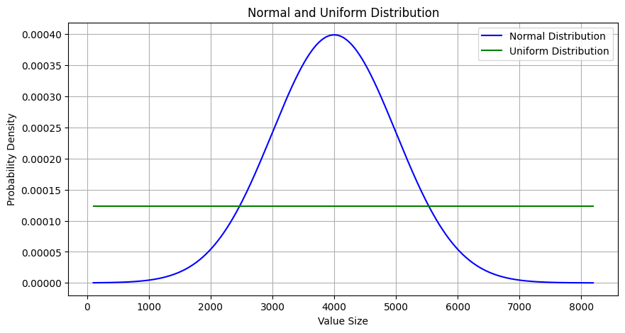
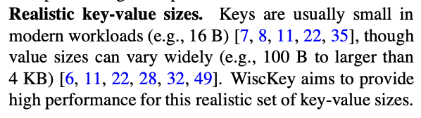
Design and Experiment
$ ./db_bench -use_direct_io_for_flush_and_compaction=true \
-value_size_distribution_type=$DISTRIBUTION_TYPE \
-value_size_min=100 \
-value_size_max=8192 \
-disable_wal=$BOOL \
-histogram \
--benchmarks=$FILL_TYPE
To create a more realistic workload with varying value sizes(instead of a fixed value size workload)
OPTION | DESCRIPTION
-use_direct_io_for_flush_and_compaction | Use O_DIRECT for background flush and compaction writes
-value_size_distribution_type | Value size distribution type
-value_size_min/-value_size_max | Min/Max size of random value
-disable_wal | WAL ON(false) / WAL OFF(true)
-histogram | Print histogram of operation timings.
--benchmarks | Comma-separated list of operations to run in the specified order.
Lu, Lanyue, et al. "Wisckey: Separating keys from values in ssd-conscious storage."
ACM Transactions On Storage (TOS) 13.1 (2017): 1-28.

Slide 27
Design and Experiment
$ ./db_bench -use_direct_io_for_flush_and_compaction=true \
-value_size_distribution_type=$DISTRIBUTION_TYPE \
-value_size_min=100 \
-value_size_max=8192 \
-disable_wal=$BOOL \
-histogram \
--benchmarks=$FILL_TYPE
Enable or Disable WAL
OPTION | DESCRIPTION
-use_direct_io_for_flush_and_compaction | Use O_DIRECT for background flush and compaction writes
-value_size_distribution_type | Value size distribution type
-value_size_min/-value_size_max | Min/Max size of random value
-disable_wal | WAL ON(false) / WAL OFF(true)
-histogram | Print histogram of operation timings.
--benchmarks | Comma-separated list of operations to run in the specified order.

Slide 28
Design and Experiment
$ ./db_bench -use_direct_io_for_flush_and_compaction=true \
-value_size_distribution_type=$DISTRIBUTION_TYPE \
-value_size_min=100 \
-value_size_max=8192 \
-disable_wal=$BOOL \
-histogram \
--benchmarks=$FILL_TYPE
”fillseq” for performing sequential writes, “fillrandom” for random writes
OPTION | DESCRIPTION
-use_direct_io_for_flush_and_compaction | Use O_DIRECT for background flush and compaction writes
-value_size_distribution_type | Value size distribution type
-value_size_min/-value_size_max | Min/Max size of random value
-disable_wal | WAL ON(false) / WAL OFF(true)
-histogram | Print histogram of operation timings.
--benchmarks | Comma-separated list of operations to run in the specified order.

Slide 29
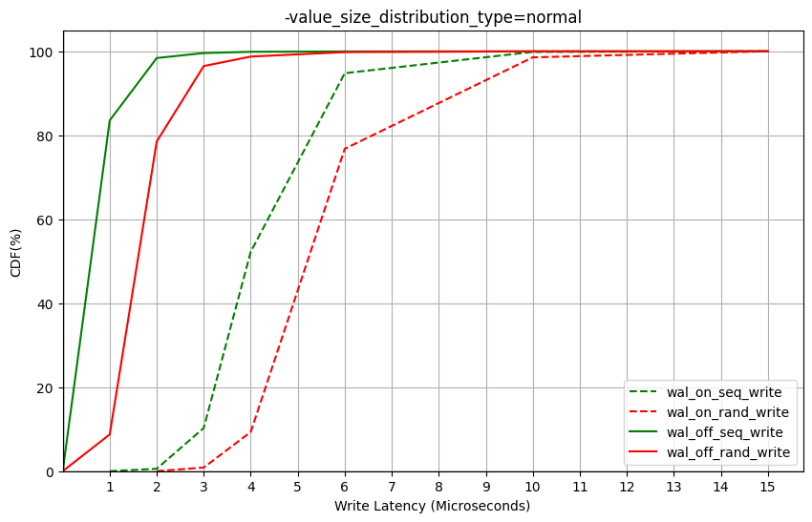
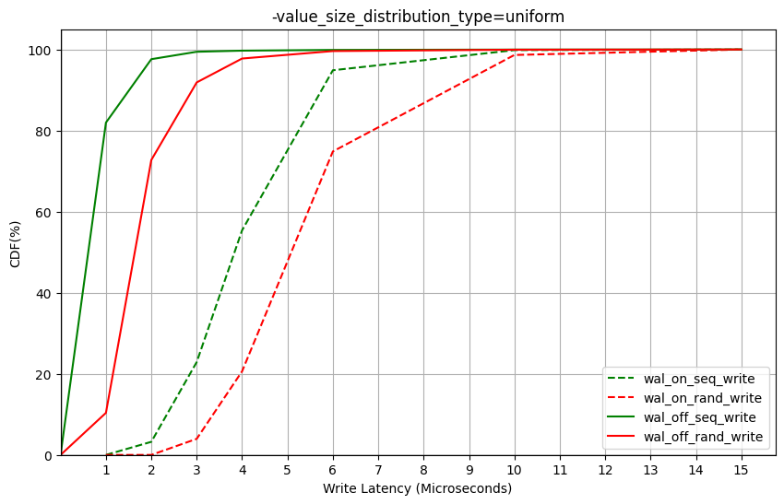
Result and Discussion
VARIABLE | VALUE
$DISTRIBUTION_TYPE | fixed | normal | uniform
$BOOL | true | false
$FILL_TYPE | ”fillseq” | “fillrandom”
Value Size: Normal
Value Size: Uniform

Slide 30
Result and Discussion
Regardless of sequential or random, write operations with WAL ON have higher average latency.
Value Size: Normal
Value Size: Uniform

Slide 31
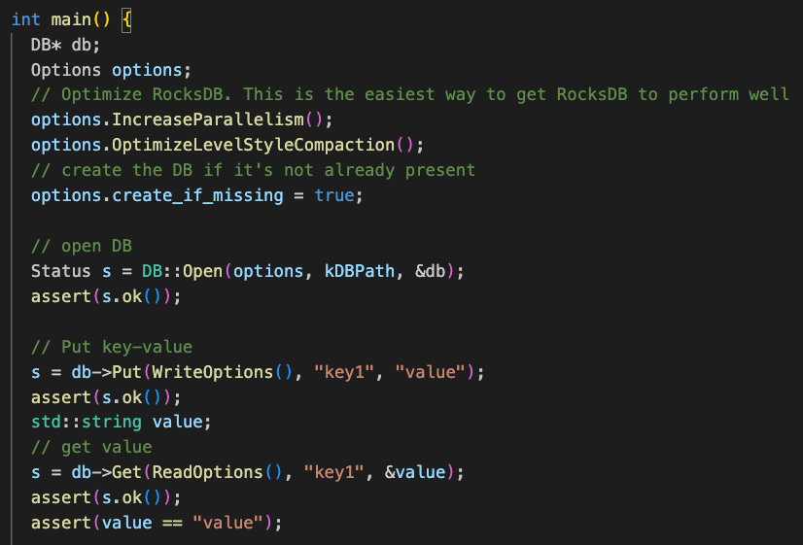
Code-Level Analysis
RocksDB 6.11.4, commit: f15414b6562f39953281e5dd0e95dd8c506d5c87
Anaysis tool: ftracer(https://github.com/finaldie/ftracer)
simple_example.cc

Slide 32
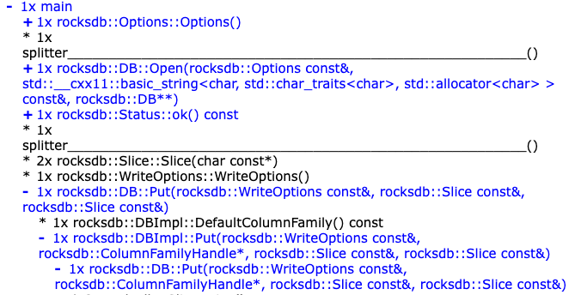
Code-Level Analysis
RocksDB 6.11.4, commit: f15414b6562f39953281e5dd0e95dd8c506d5c87
1.
2.
3.
Ref: https://finaldie.com/learning/rocksdb_6_11_4

Slide 33
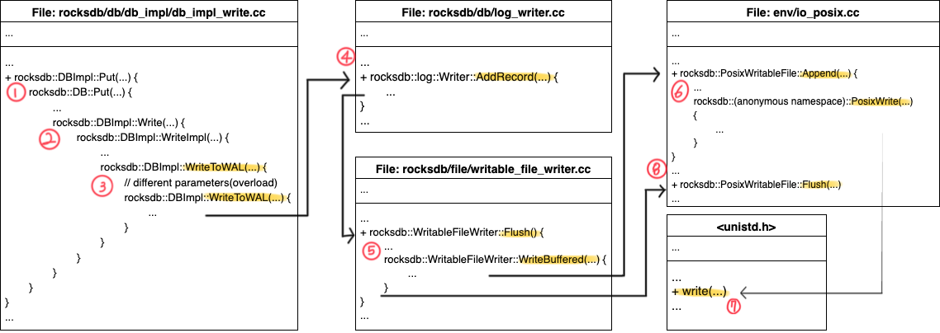
Code-Level Analysis(ongoing)
RocksDB 6.11.4, commit: f15414b6562f39953281e5dd0e95dd8c506d5c87
Ref: https://github.com/DKU-StarLab/leveldb-study/blob/main/analysis
[analysis]WAL,Manifest_week5.pdf

Slide 34
Summary
Last weeks
Learn how to use db_bench
Studied RocksDB’ key mechanisms, Compaction and WAL
This week
Code-Level Analysis(ongoing)
Try to improve WAL overhead
Advanced experiments on WAL trade-off

Slide 35
References
[1] 신호진, and 최종무. "RocksDB 에서 집약과 WAL 의 성능 특성 분석." 한국정보과학회 학술발표논문집 (2021): 1470-1472.
[2] SSLAB at DkU. LevelDB Wiki. Accessed 4 Feb. 2025, https://sslab.dankook.ac.kr/leveldb-wiki/.
[3] SSLAB at DKU. DKU-StarLab GitHub Repository. Accessed 4 Feb. 2025, https://github.com/DKU-StarLab/.
[4] Finaldie. Learning RocksDB 6.11.4. Accessed 4 Feb. 2025, https://finaldie.com/learning/rocksdb_6_11_4.
[5] Facebook. RocksDB Wiki. Accessed 4 Feb. 2025, https://github.com/facebook/rocksdb/wiki.
[6] Lu, Lanyue, et al. "Wisckey: Separating keys from values in ssd-conscious storage." ACM Transactions On Storage (TOS) 13.1 (2017): 1-28.

Slide 36
Thank you QnA?

