Slide 1
RocksDB Experiments
System Software Lab
Suhwan Shin, Zhu Yongzie
25.02.04

Slide 2
Contents
Size and Performance
Compared RocksDB Performance
Optimize RocksDB in Ceph

Slide 3
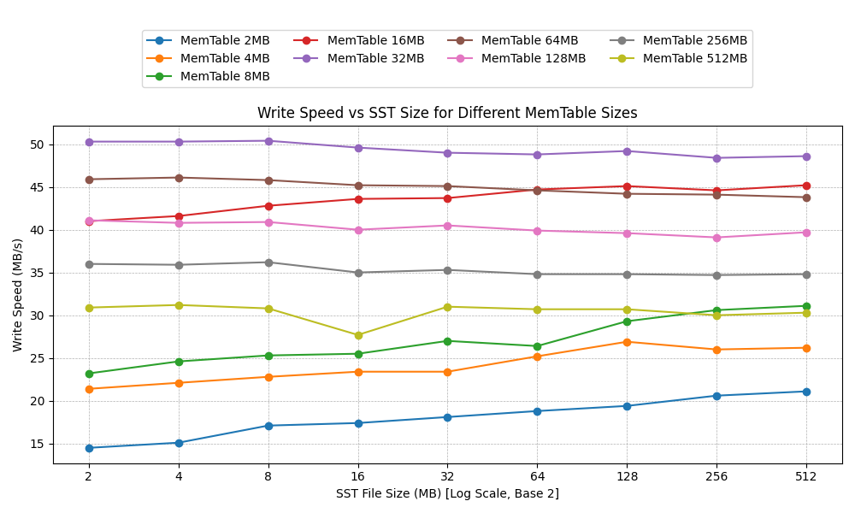
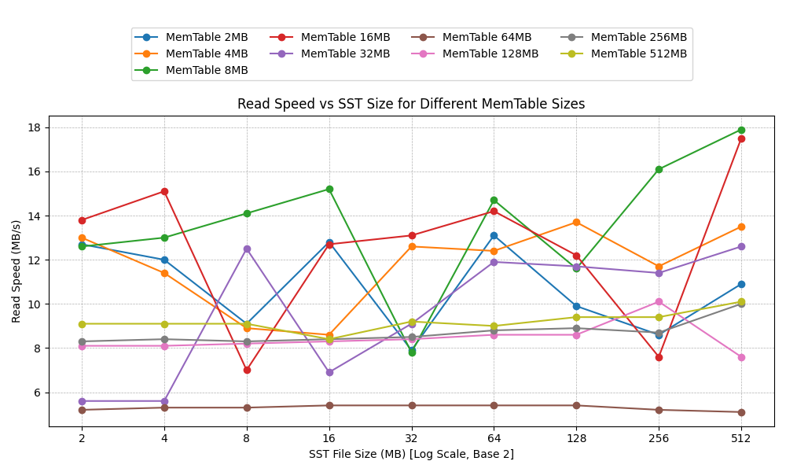
Size and Performance
How does the size of Memtable and SST affect performance in RocksDB
16 thread CPU, 64GB Ram, Samsung 980 Pro @PCIE 4.0 x 4 SSD
The writing performance is significantly related to the size of Memtable and SST
???

Slide 4
Size and Performance
How does the size of Memtable and SST affect performance in RocksDB
16 thread CPU, 64GB Ram, Samsung 980 Pro @PCIE 4.0 x 4 SSD
The positive impact of changes in Memtable size on write performance only exists in cases where the size is less than 64MB
The impact trend of SST size on write performance also changes with the variation of Memtable size
Memtable size from 2MB to 16 MB
Memtable size from 32MB to 512 MB

Slide 5
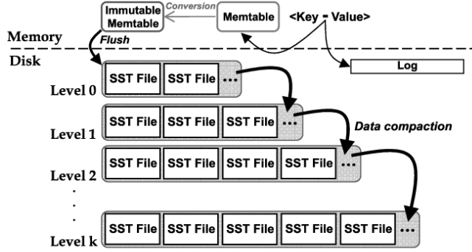
Size and Performance
Why does SST size affect writing performance?
Compaction & WAF
Flush
Compaction
Larger SST results in fewer Compaction counts
WAF down
But
The size of Compaction will become larger
WAF up
benefit
loss

Slide 6
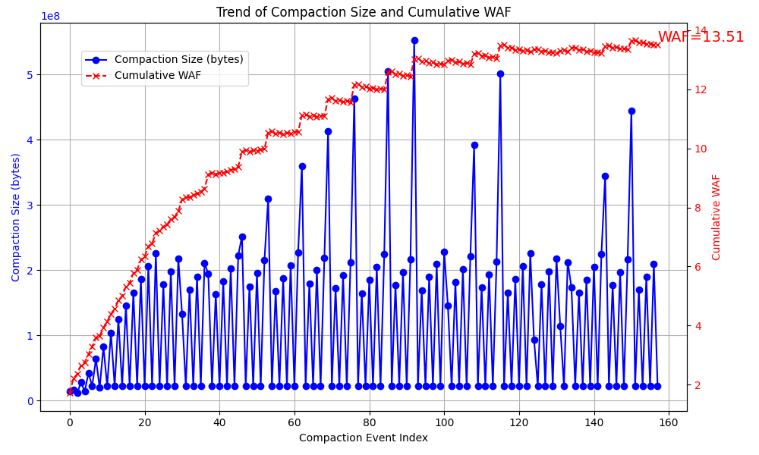
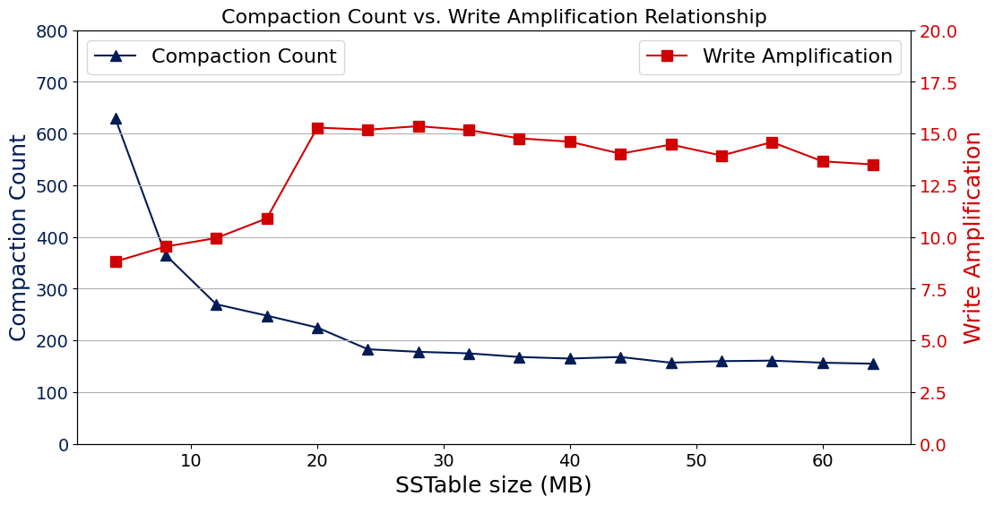
Size and Performance
Why does SST size affect writing performance?
Compaction Count & Compaction Size → WAF ?
benefit
loss
4MB Memtable Size
64MB SST Size

Slide 7
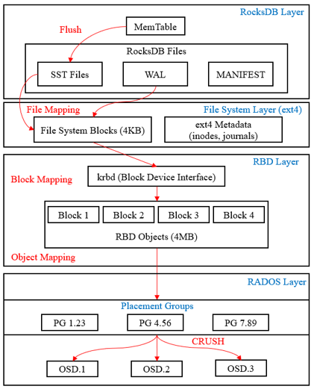
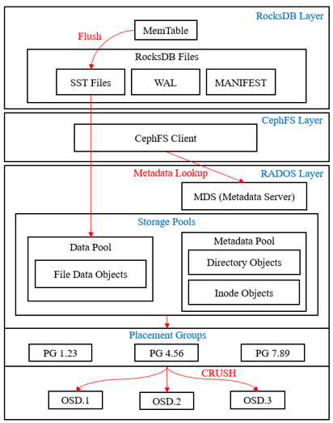
RocksDB in Ceph Architecture
Ceph RBD
Ceph File System

Slide 8
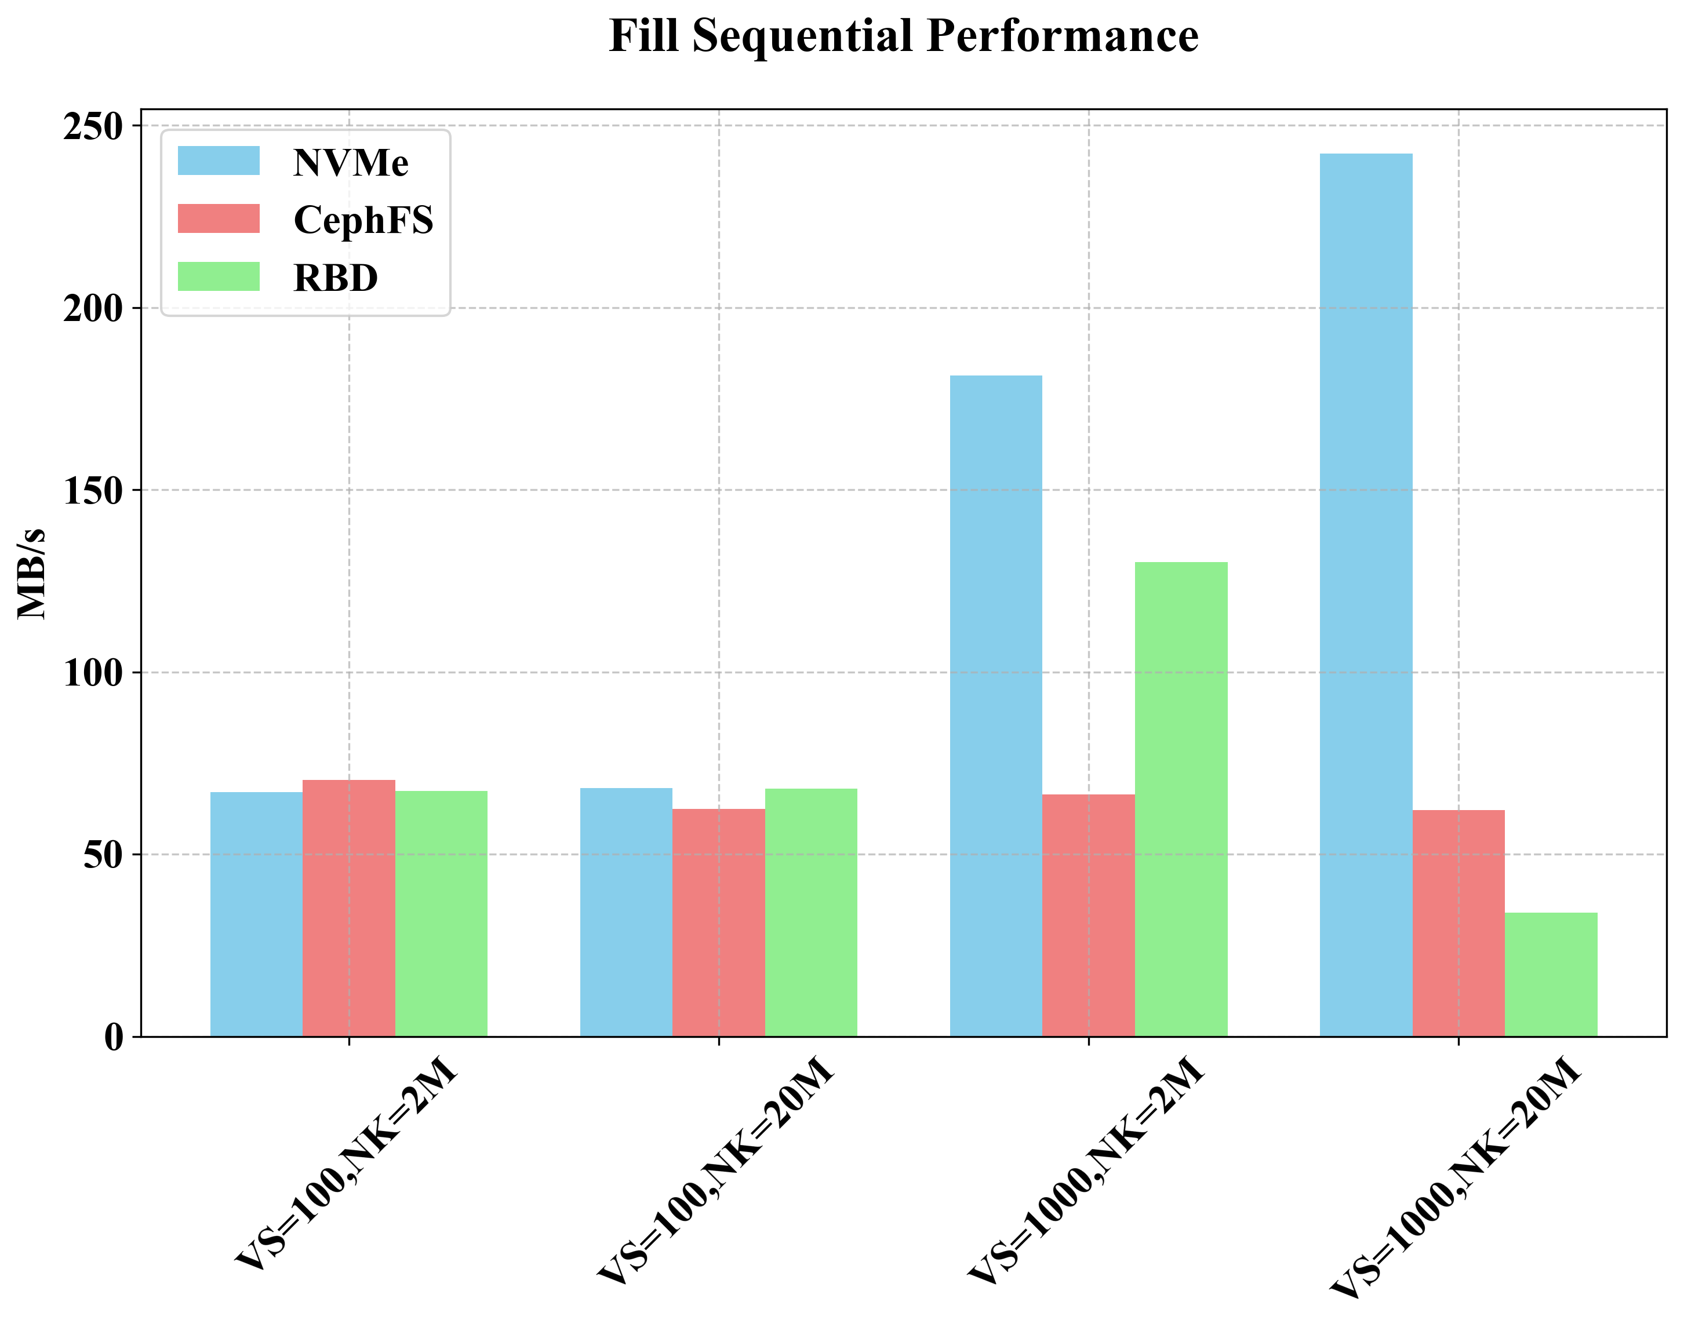
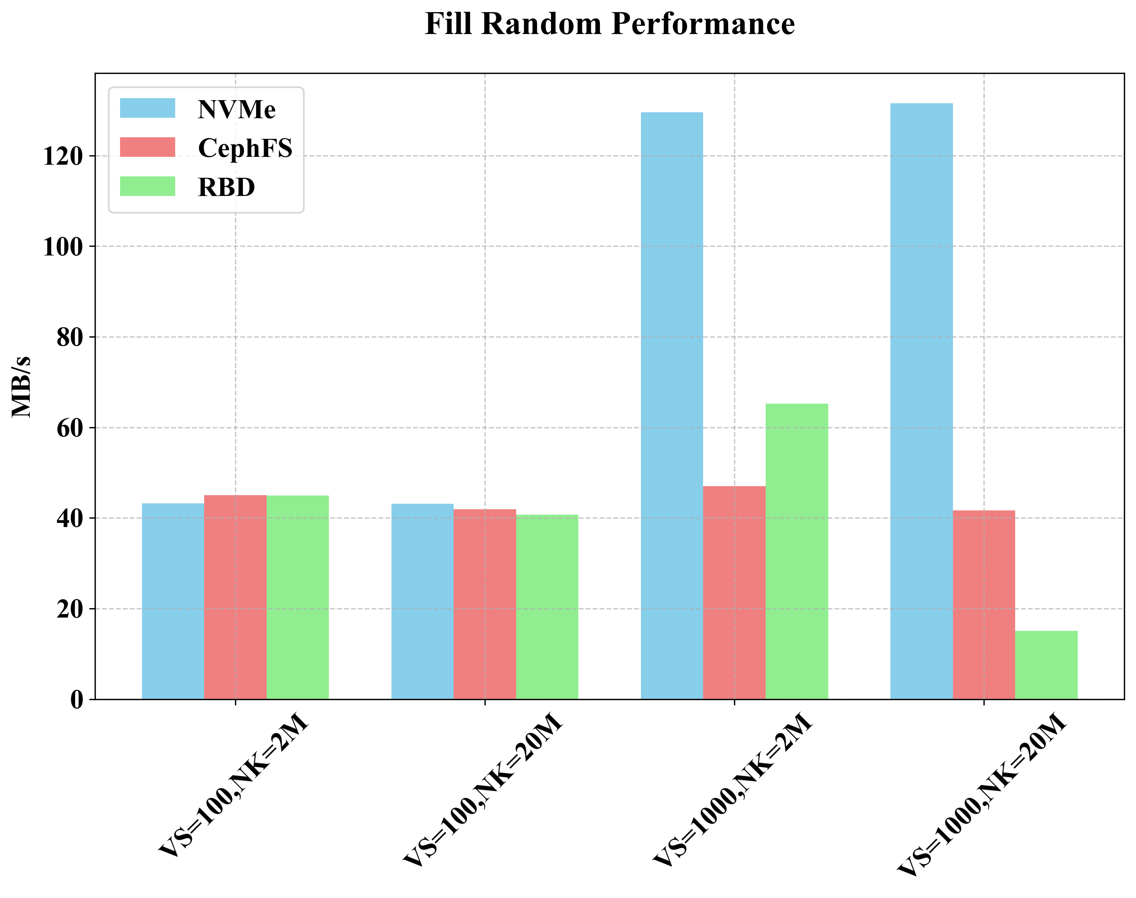
Compared RocksDB Performance
Local(NVMe) vs Ceph File System vs Ceph RBD (Rados Block Device)
Sequential / Random Write
Value Size(VS): 100 / 1000, NK: Num Keys(NK): 2M / 20M, max_write_buffer_number: 8, max_background_jobs: 32

Slide 9
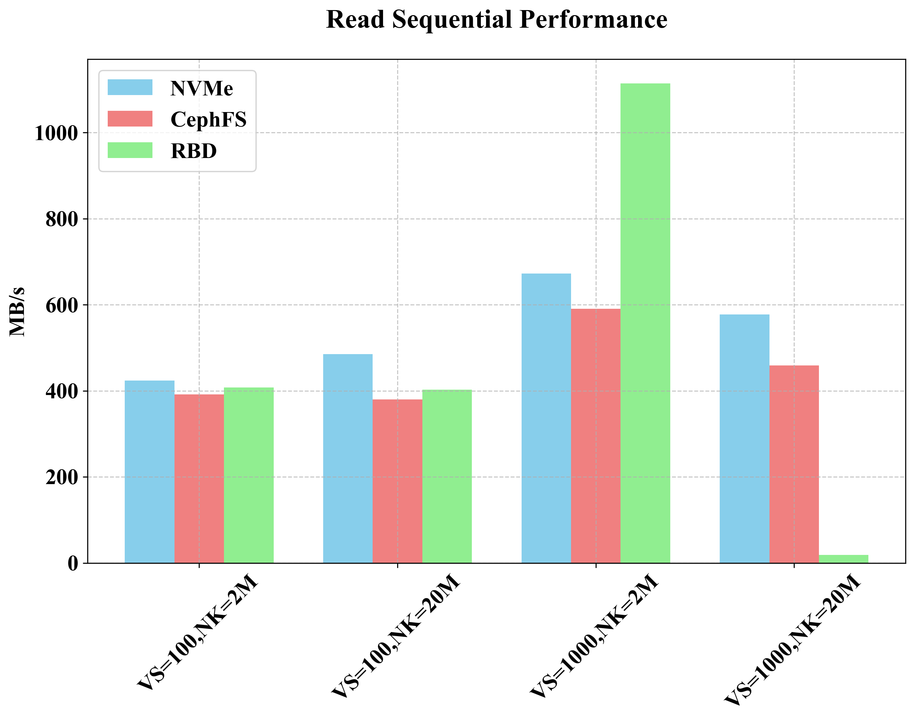
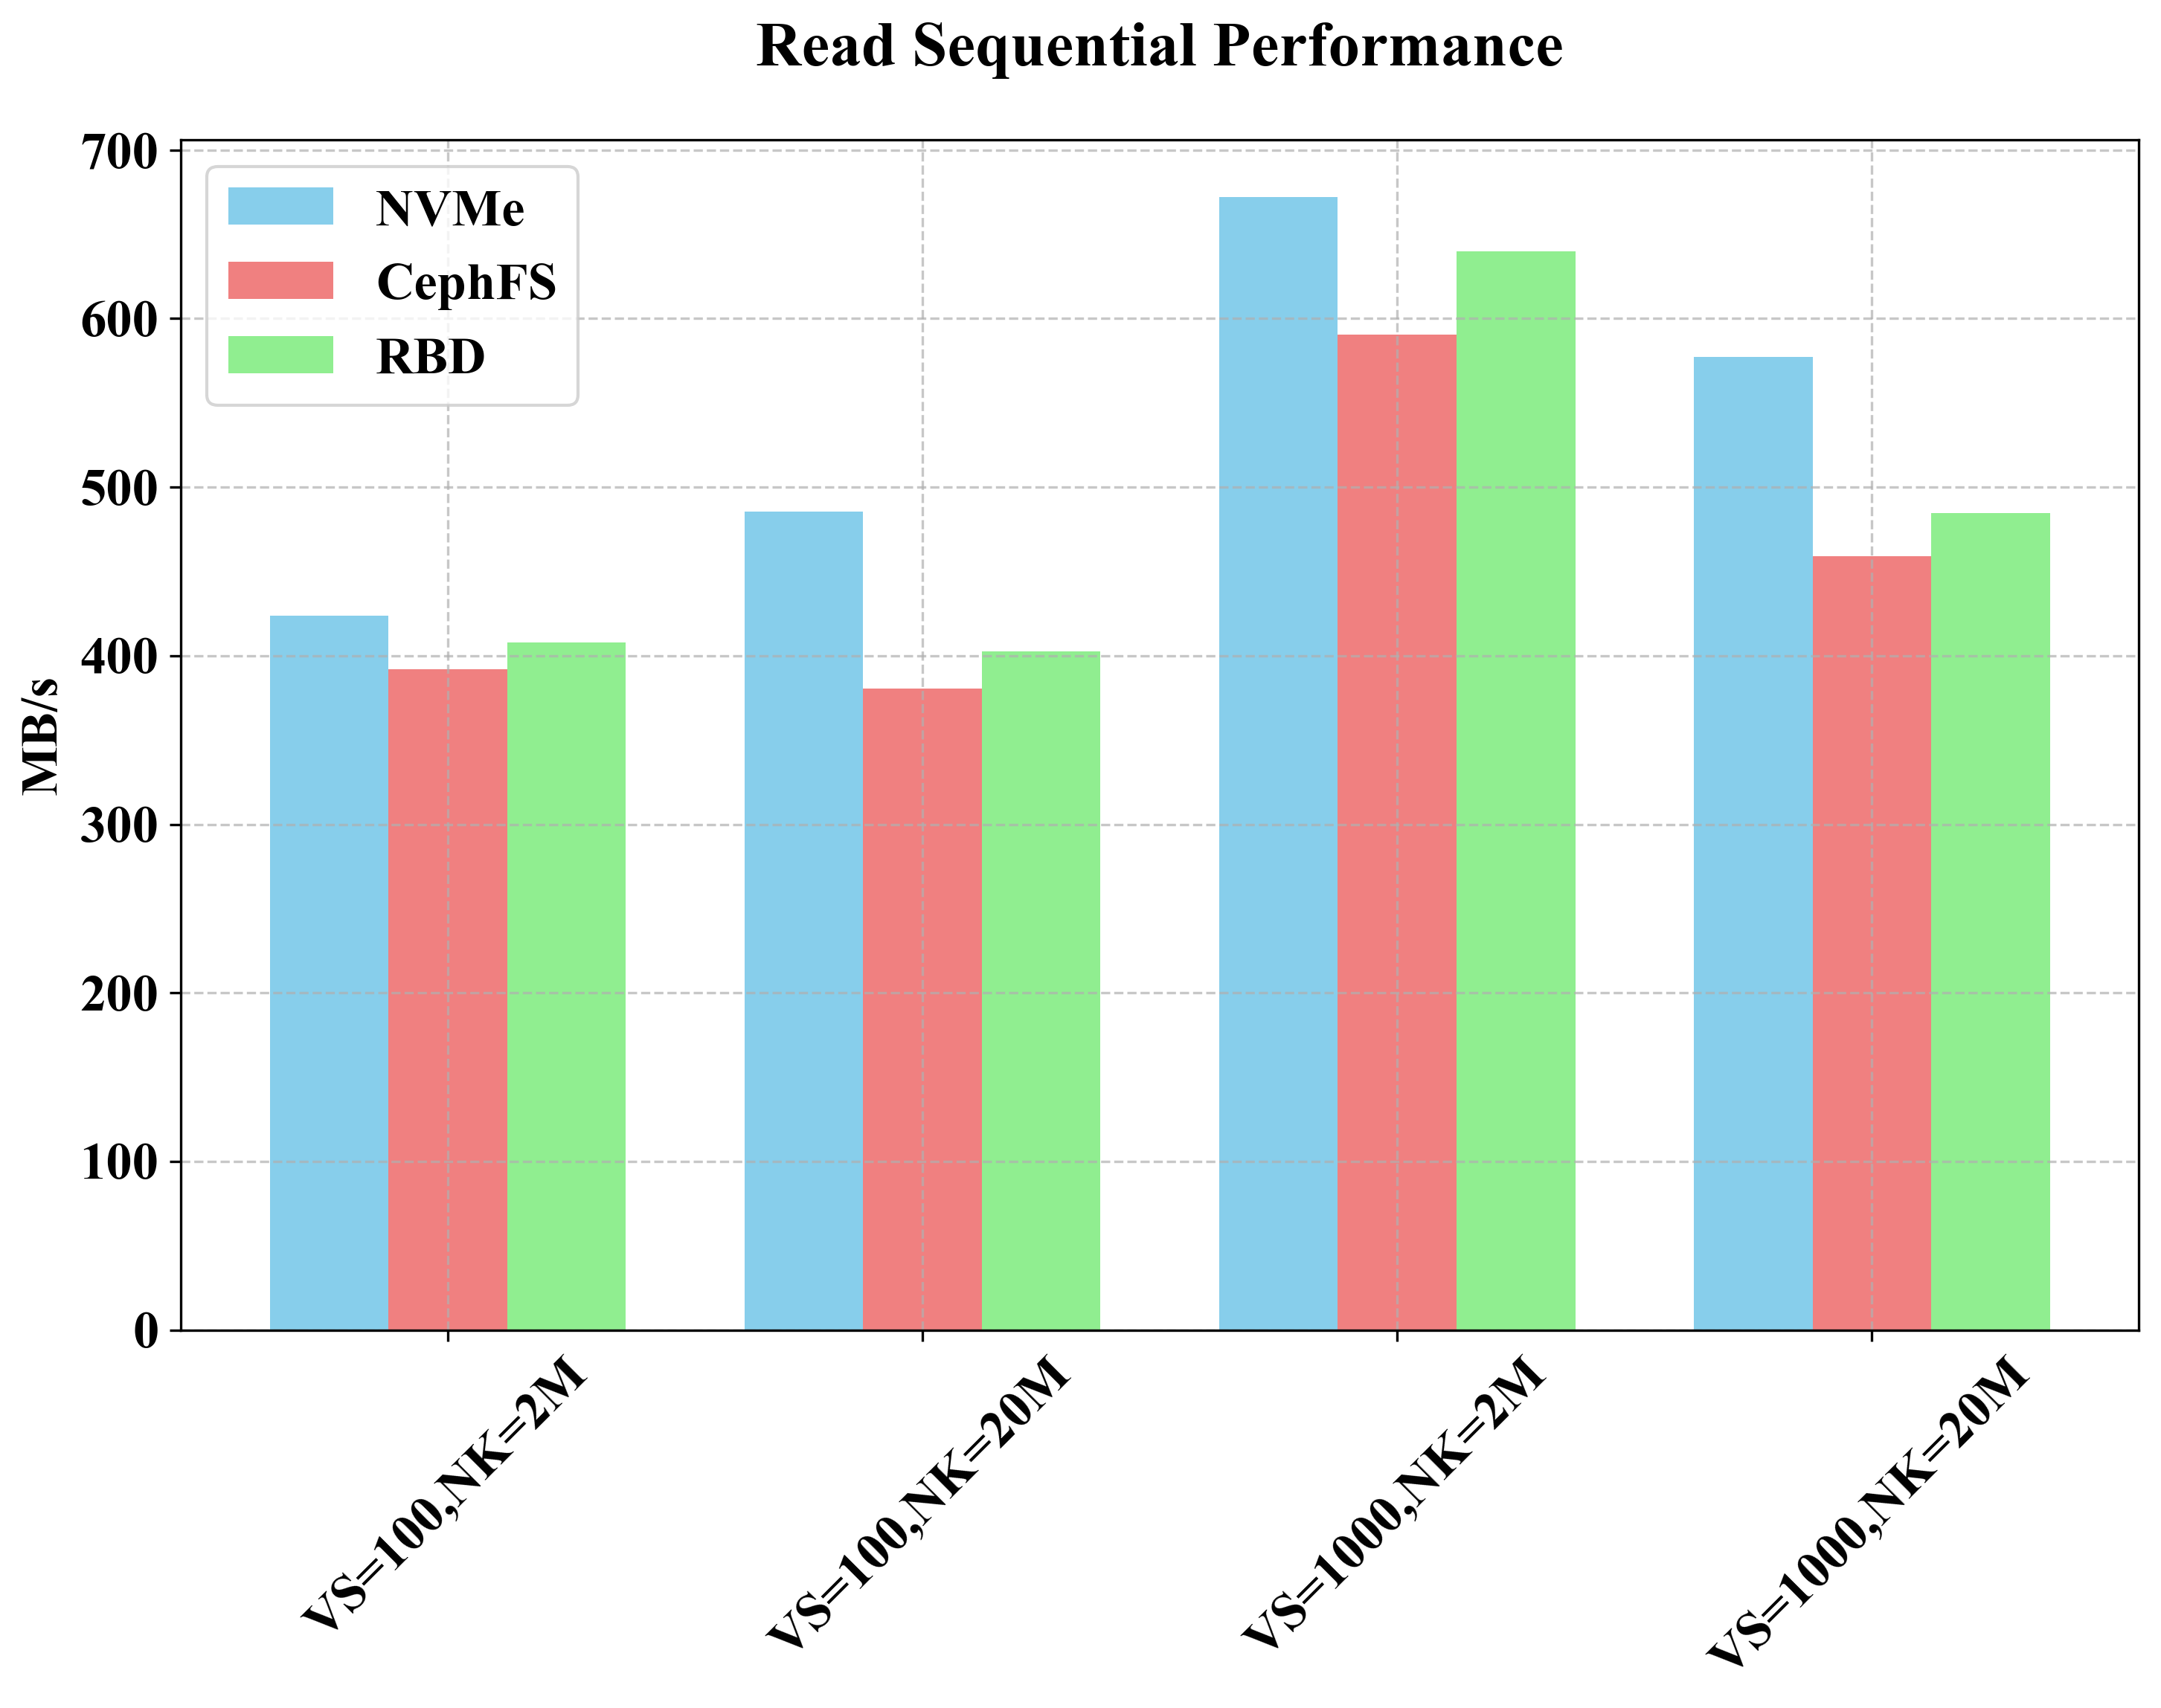
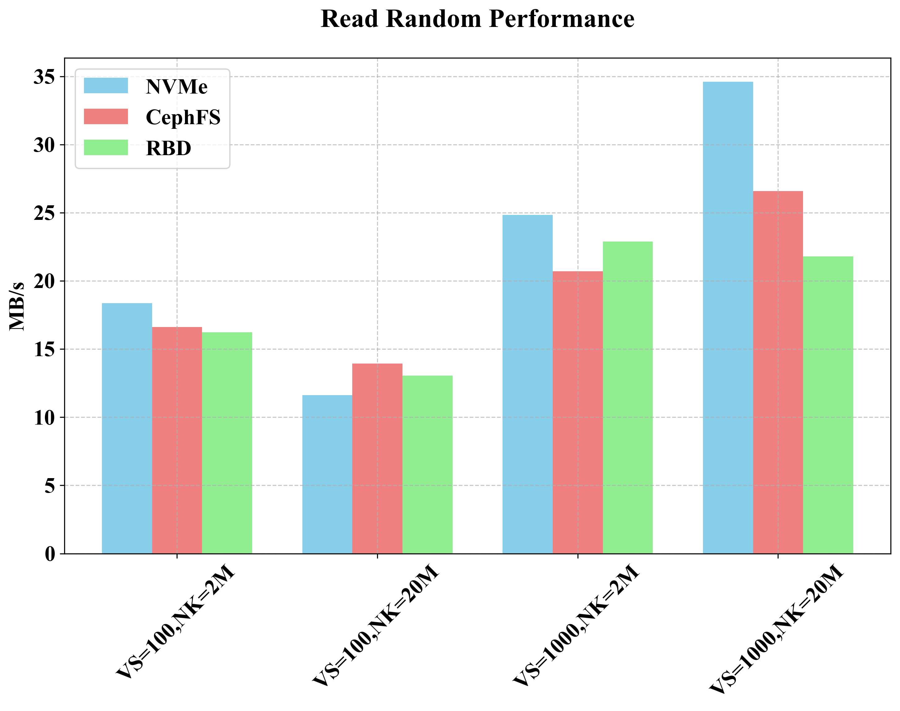
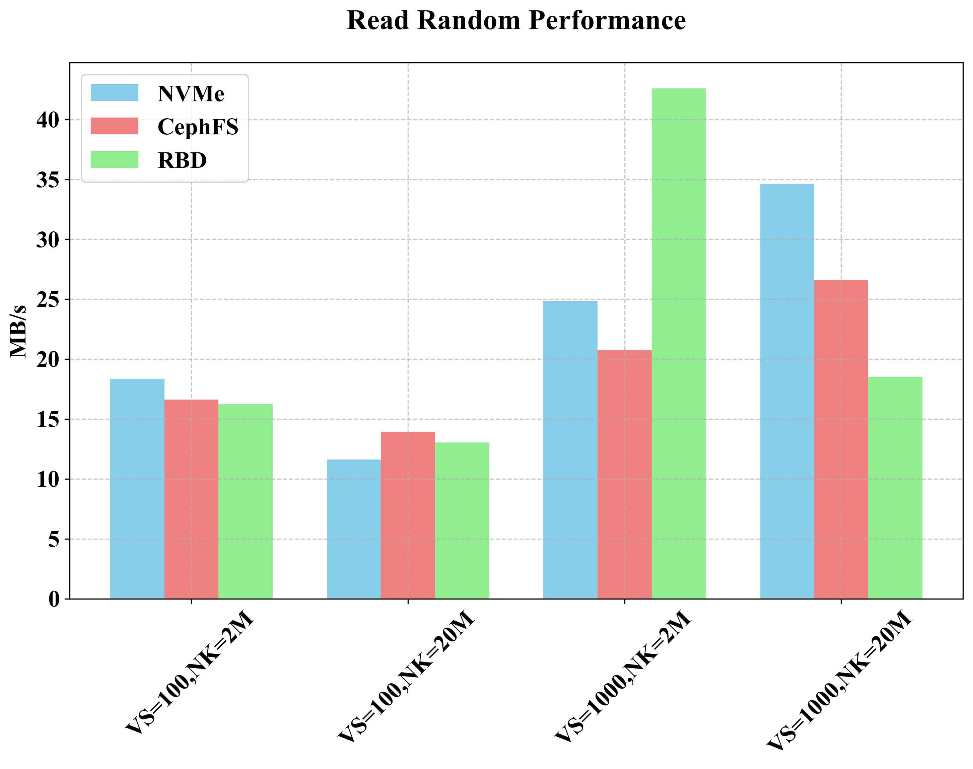
Compared RocksDB Performance
Local(NVMe) vs Ceph File System vs Ceph RBD (Rados Block Device)
Sequential / Random Read
Value Size(VS): 100 / 1000, NK: Num Keys(NK): 2M / 20M, max_write_buffer_number: 8, max_background_jobs: 32

Slide 10
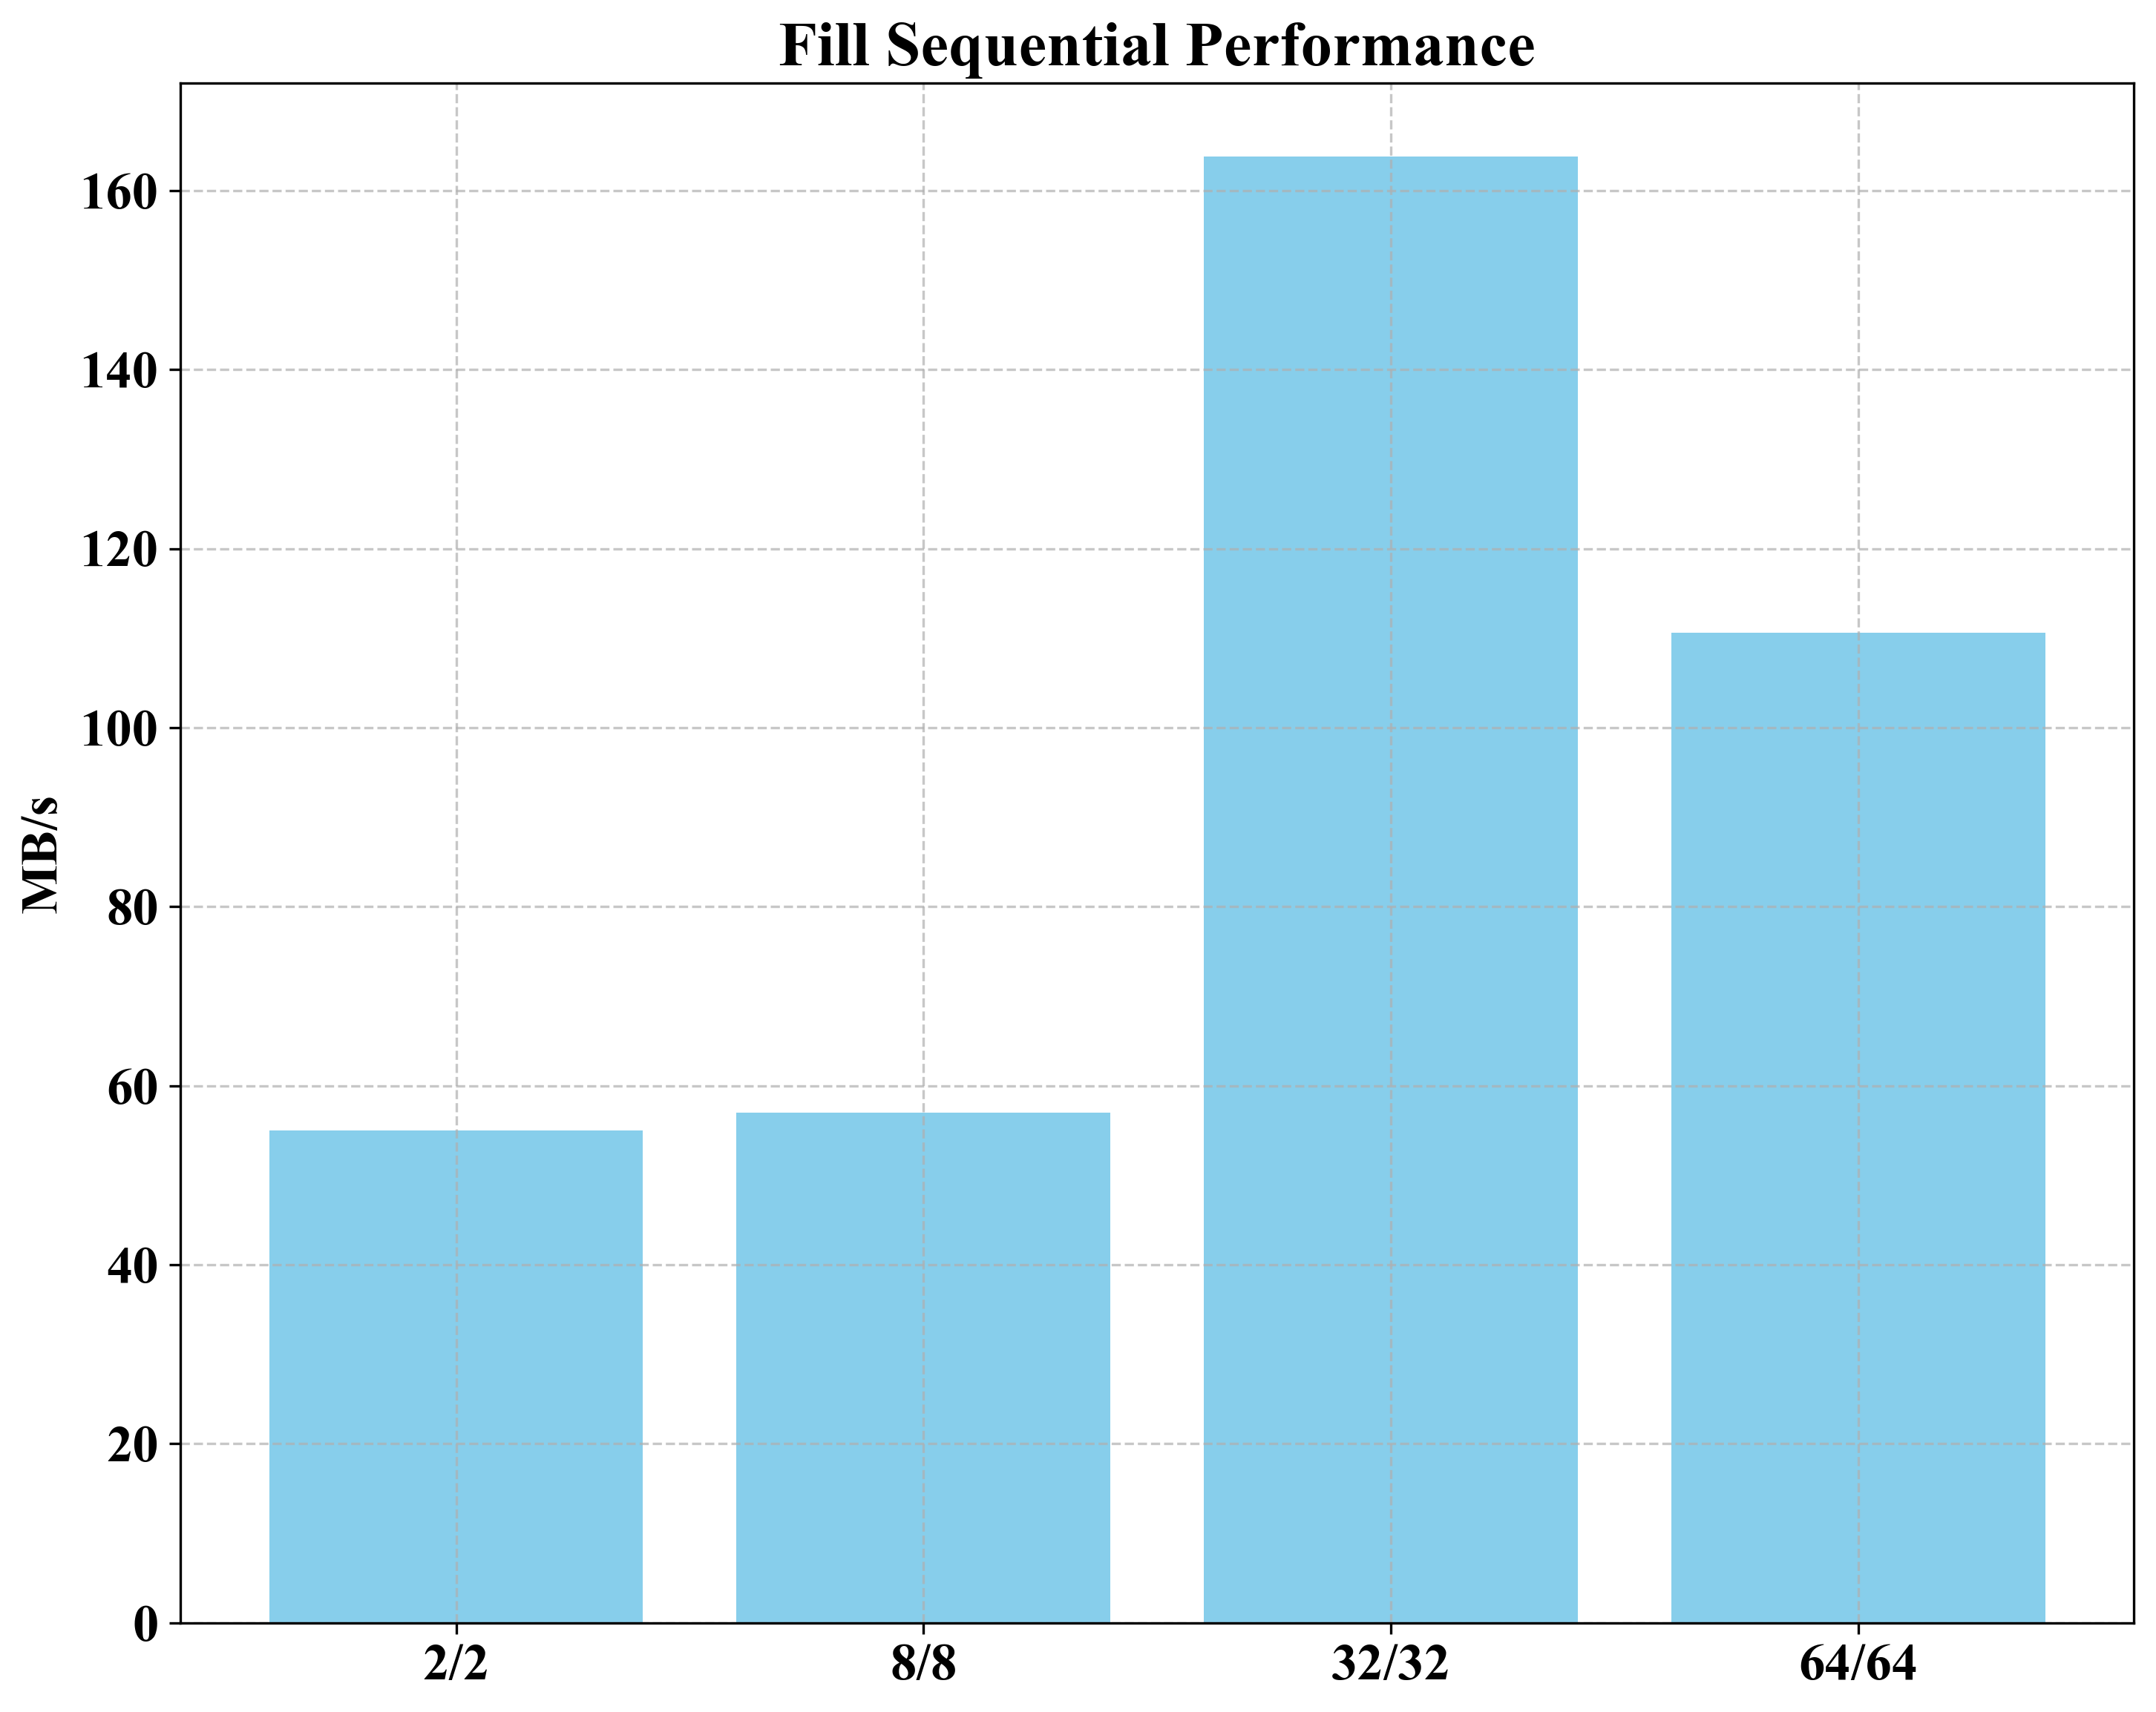
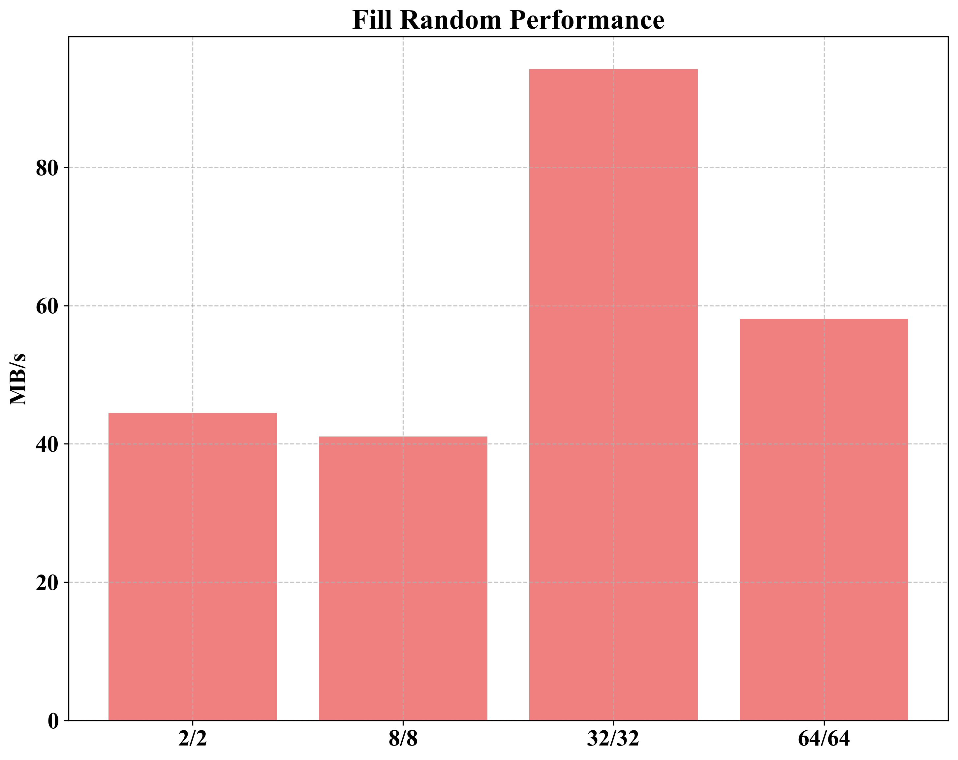
Optimize RocksDB in CephFS
CephFS Tuning
Sequential / Random Write
Value Size(VS): 1000, NK: Num Keys(NK): 2M, max_write_buffer_number: 2/8/32/64, max_background_jobs: 2/8/32/64

Slide 11
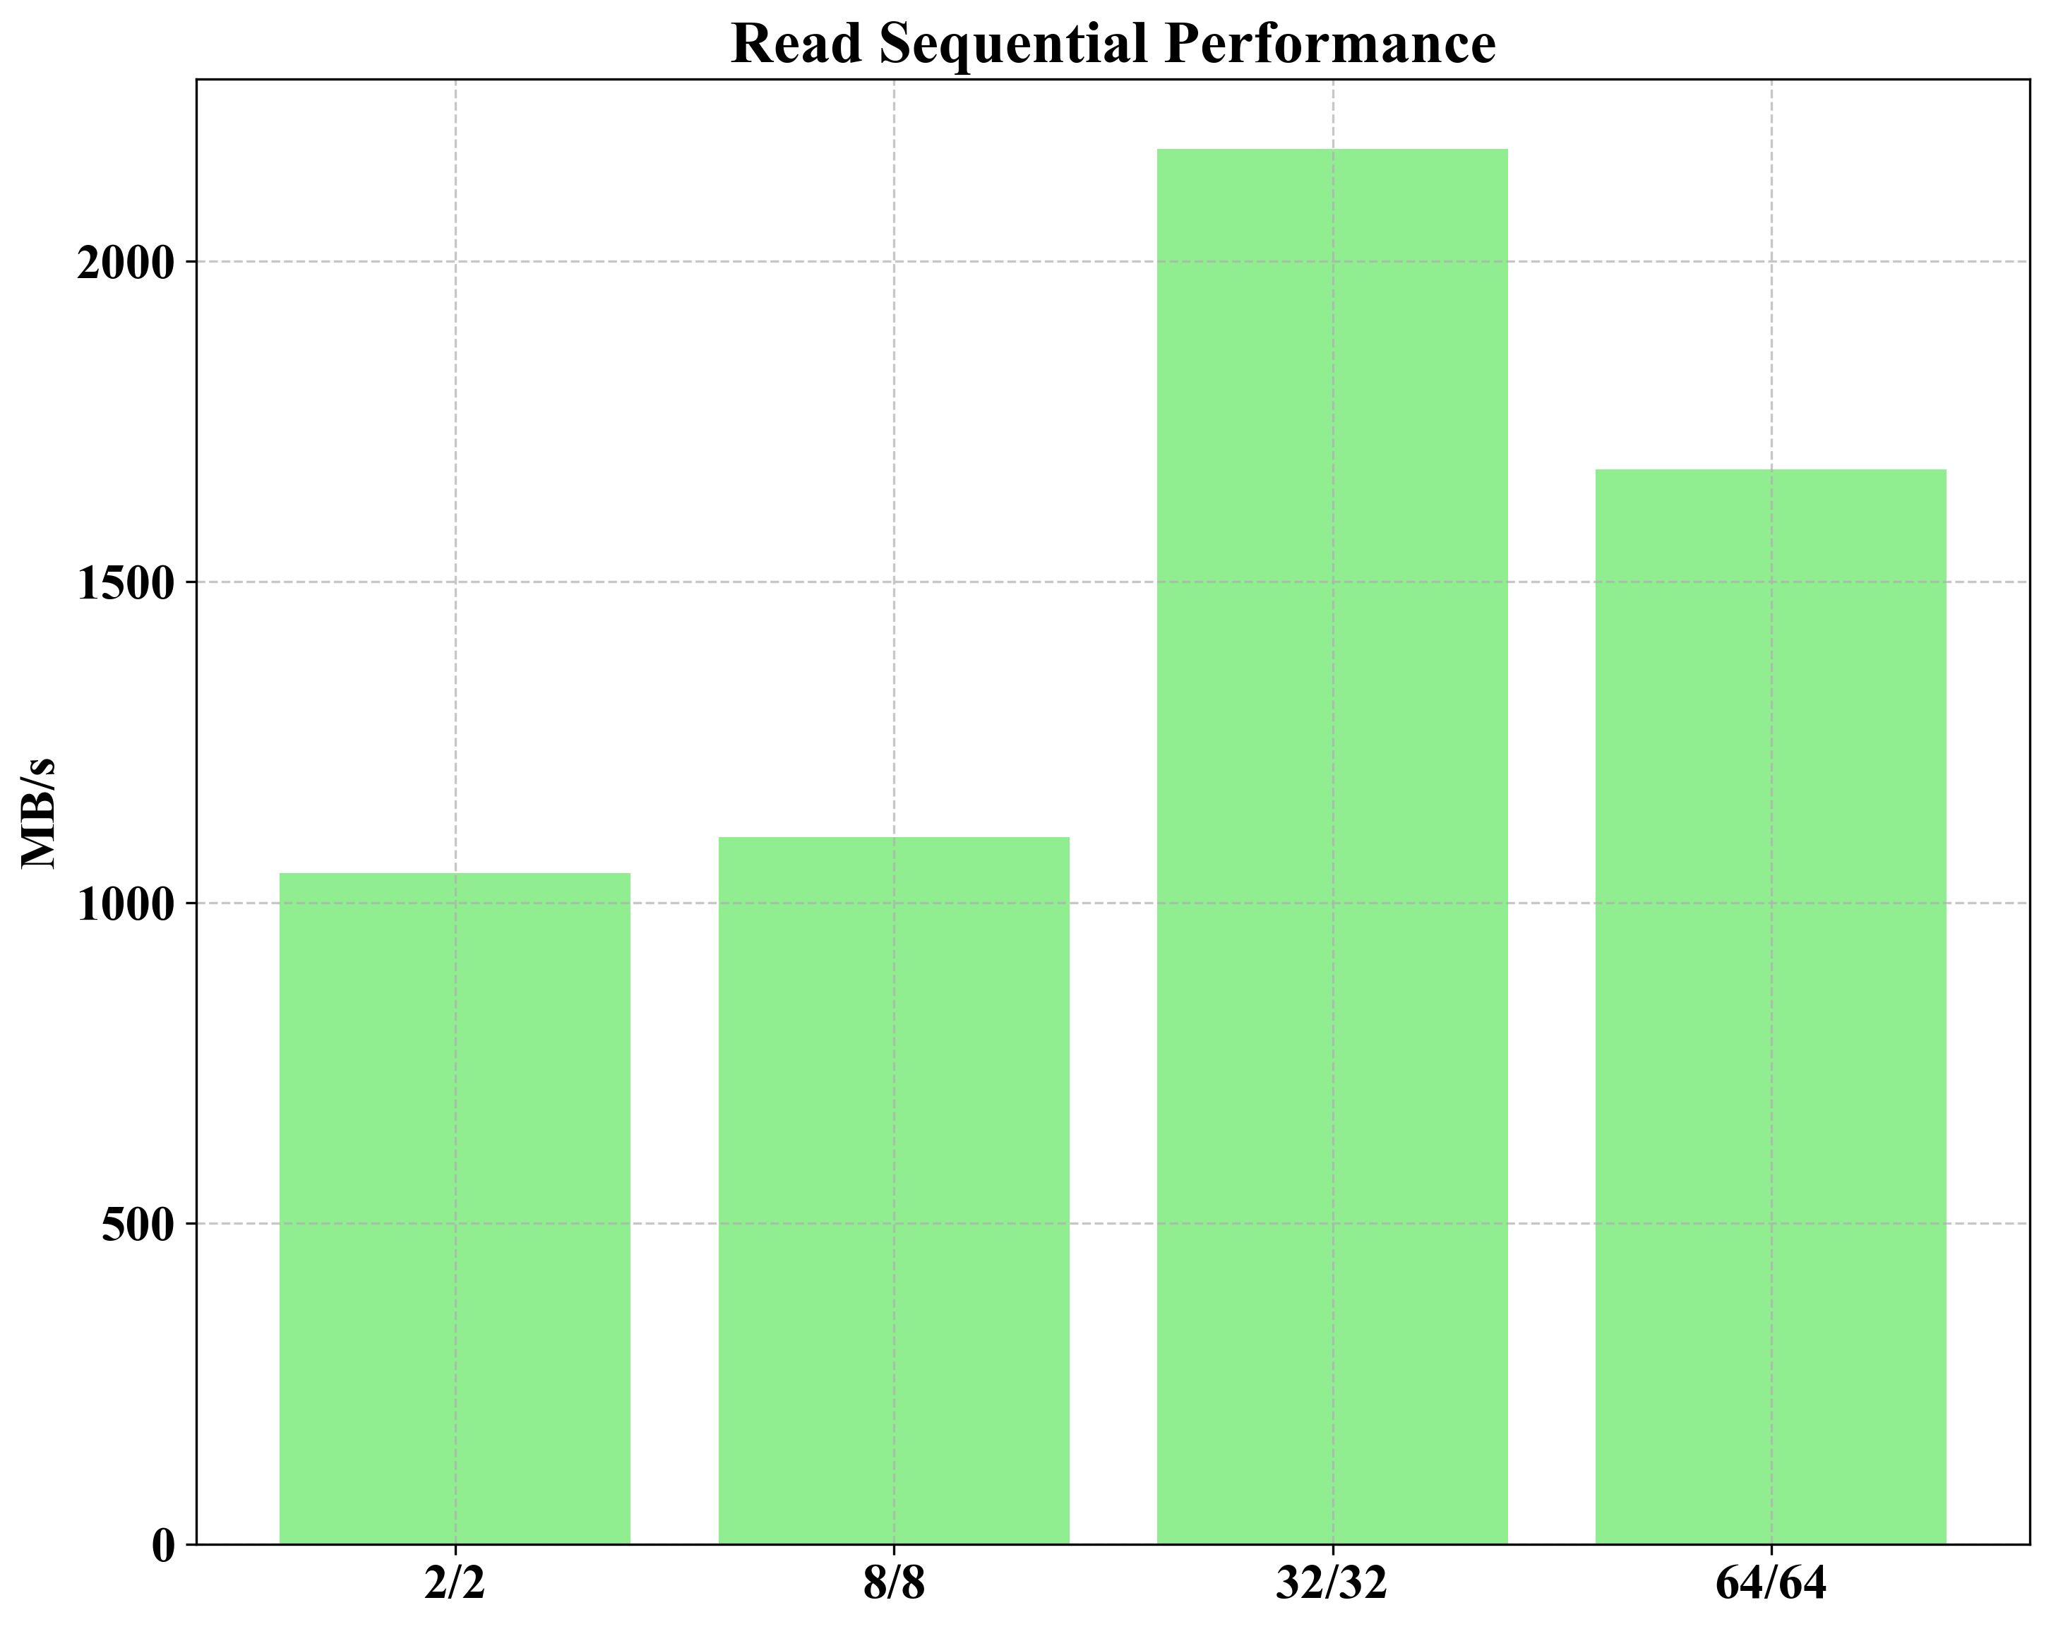
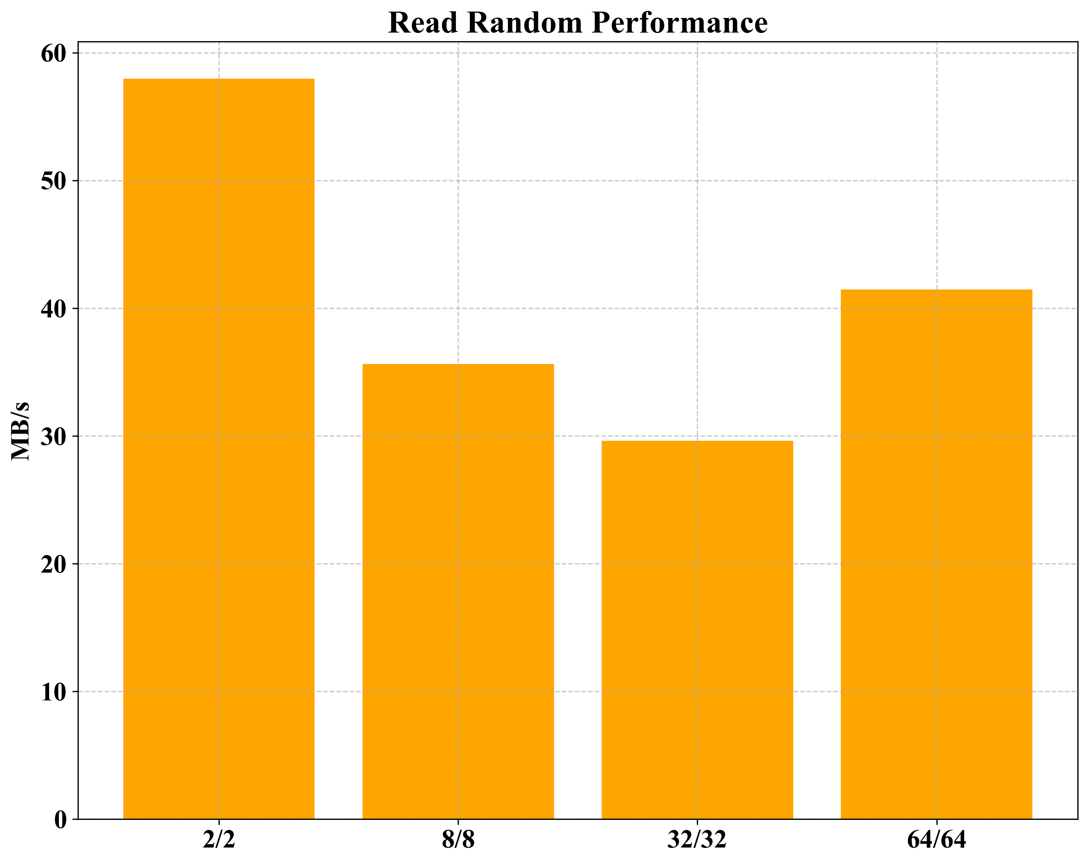
Optimize RocksDB in CephFS
CephFS Tuning
Sequential / Random Read
Value Size(VS): 1000, NK: Num Keys(NK): 2M, max_write_buffer_number: 2/8/32/64, max_background_jobs: 2/8/32/64

Slide 12
Thank you

