Slide 1
Indexes: SkipList, B+tree, ART
Lee YongMin
nascarf16@dankook.ac.kr

Slide 2
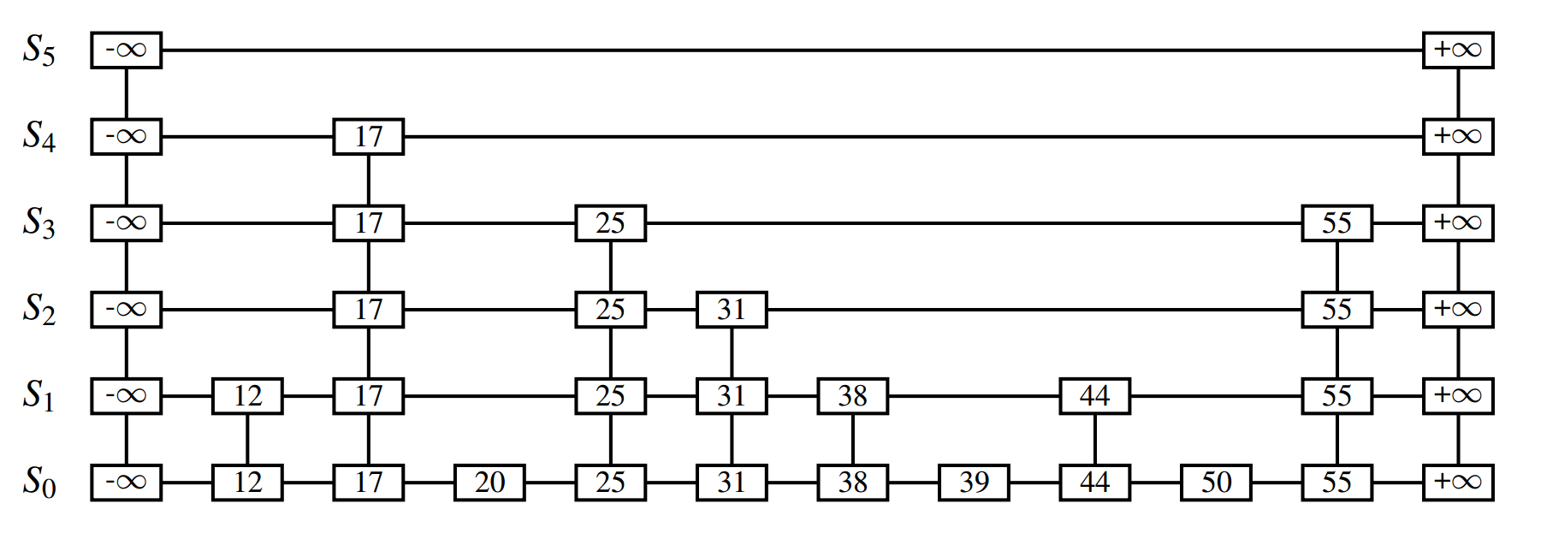
Skip List
Skip lists are a probabilistic alternative to balanced trees … balanced by consulting a random number generator (William Pugh. 1990. Skip lists: a probabilistic alternative to balanced trees.)
Linked list-like data structure; but have multiple layer
Higher layer act as shortcut, which some of the elements didn’t appears.
Ref: Data Structures & Algorithms in Java

Slide 3
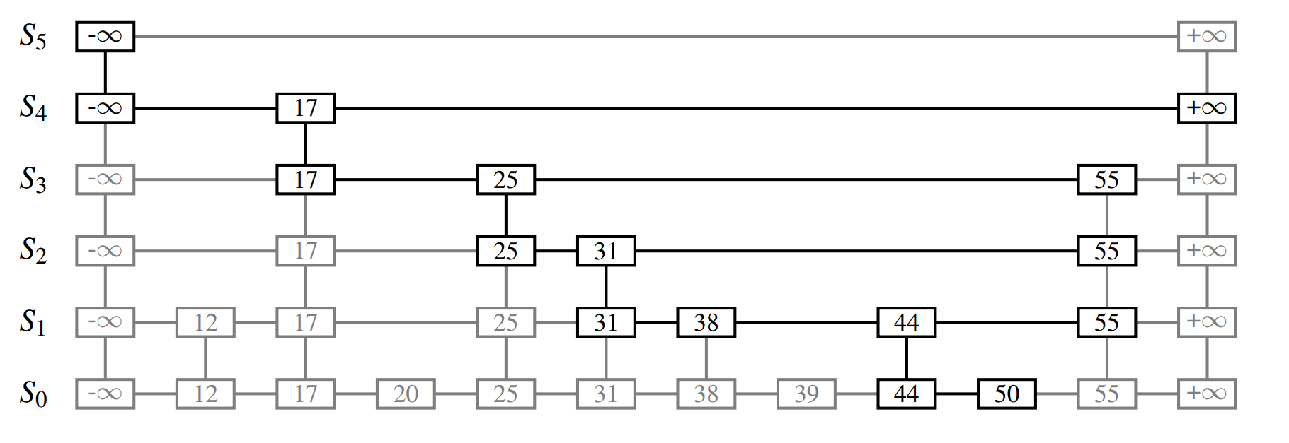
Skip List
Search for 50
Ref: Data Structures & Algorithms in Java

Slide 4
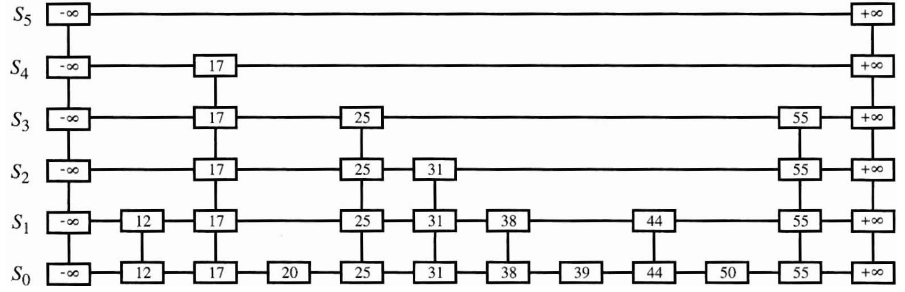

Skip List
Insert element 25
Ref: Data Structures & Algorithms in Java

Slide 5
Skip List
Characteristics
Randomness: Whether an element exists in that layer or not is determined by randomness (coin flip)
Pros:
Avg. performance (lookup, insertion, deletion): O(log n)
No rebalancing overhead (Compare to tree structures)
Cons:
Non-deterministic: Worst case O(n)
Duplicate lists (Space complexity): same elements

Slide 6
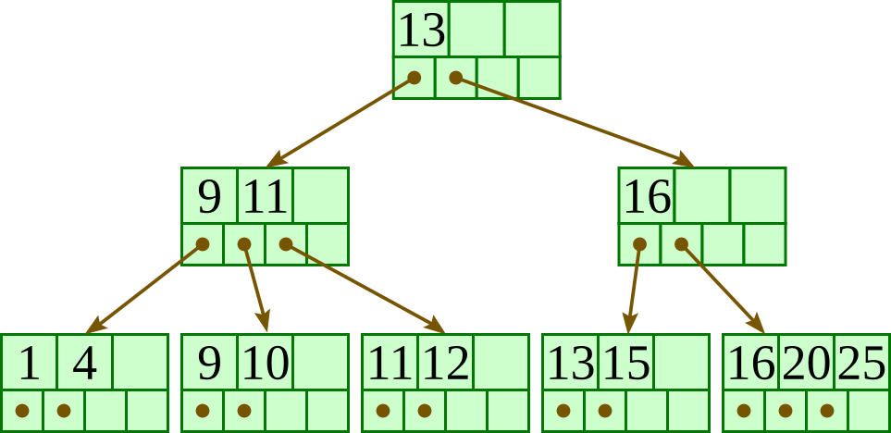
B+Tree
Variation of B-tree
Balanced Tree: Time complexity is guaranteed O(log n)
m-ary tree: each node has no more than m children (example below is m = 4)
An internal node can hold up to m – 1 keys / each lead node contains at least floor(m/2) keys
Internal nodes
Leaf nodes
Ref: https://cuuduongthancong.com/~galles/visualization/BPlusTree.html

Slide 7
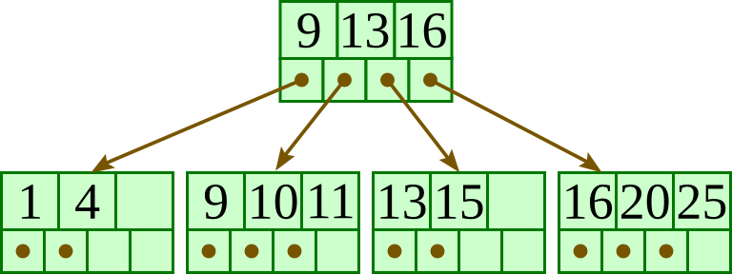
B+Tree
Rebalancing when node is full or too few keys
Insert element 12
12
More than 3 keys, need to split

Slide 8
B+Tree
Rebalancing when node is full or too few keys
Insert element 12
More than 3 keys, need to split
11
If the node is a non-leaf, exclude the middle key
during the split and insert the middle key into parent node
11
12
If the target of split is leaf node, duplicate the middle key
Middle key = $⌈(K+1)/2⌉$-th key

Slide 9
B+Tree
Rebalancing when node is full or too few keys
Insert element 12
Excluded middle key (13) becomes a new root = B+ trees grow at the root and not at the leaves.

Slide 10
B+Tree
Characteristics
Rebalancing: B+ trees grow at the root and not at the leaves.
Pros:
Guaranteed O(log n) performance: Worst case is also O(log n)
Range queries: good at range-based searches
Cons:
Balancing overhead (reconstruction overhead)

Slide 11
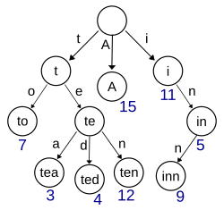
ART
Trie
nodes do not store their associated key. Instead, each node’s position within the trie determines its associated key.
Ref: https://en.wikipedia.org/wiki/Trie

Slide 12
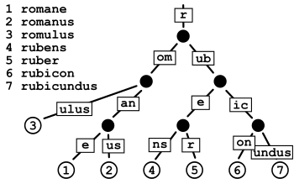
ART
Radix Trie (Radix Tree)
Edges can be labeled with sequences of elements as well as single elements

Slide 13
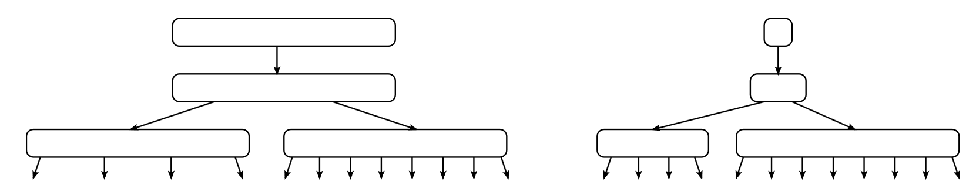
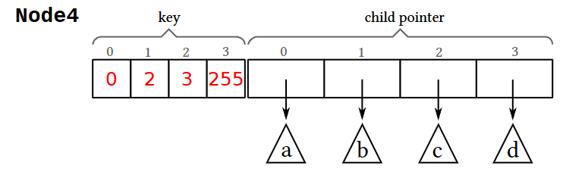
ART
Problem of Radix Tree
Node is fixed sized
Element that have one child = Element that have 256 children
(same size!)

Slide 14
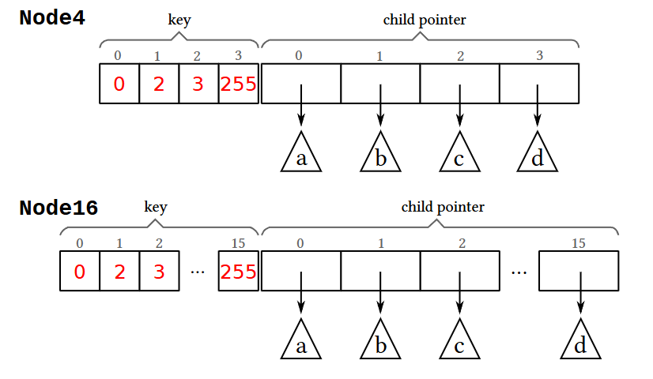
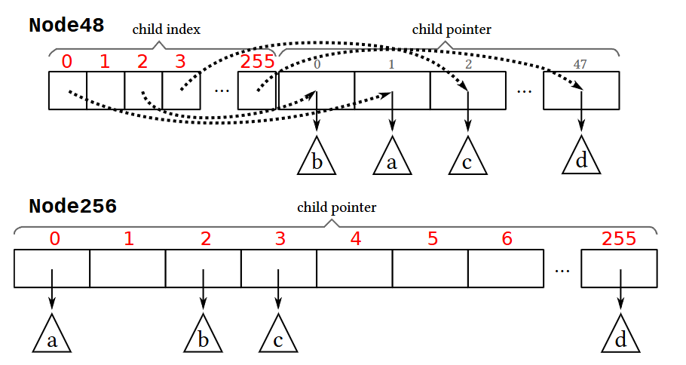
ART
ART: Adaptive Radix Tree (Trie)

Slide 15
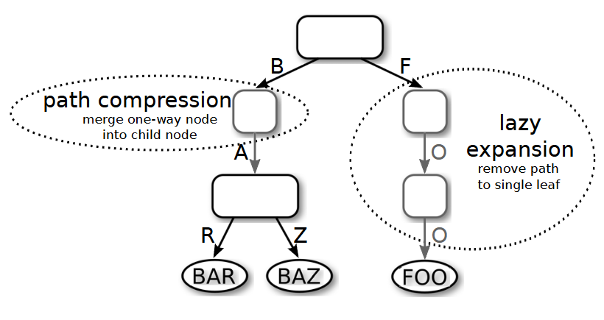
ART
Two unique techniques from ART

Slide 16
ART
Characteristics
Dynamic node size
Pros:
Efficient memory usage: using dynamic node size
Cons:
Insertion overhead: Dynamic node size changes
Sequential workload: long common prefixes (e.g., 10001, 10002, 10003)

Slide 17
Experiment 1 Setup
Get (read) in RocksDB (1 Billion)
Varying cache size: 1MB, 64MiB, 128MiB, 512MiB, 1GiB
System setup:
RocksDB setup:
CPU | Intel i7-6700
RAM | DDR4 8GB * 2 (16GB) @ 2133 MT/s
Storage | Samsung SATA SSD 850 PRO 512GB
OS | Ubuntu 22.04.1
Kernel | 6.8.0-51-generic
RocksDB version | 9.11.0
Key size | 48 Bytes
Value size | 43 Bytes
Num. of keys | 400 Million

Slide 18
Experiment 1 Results

Slide 19
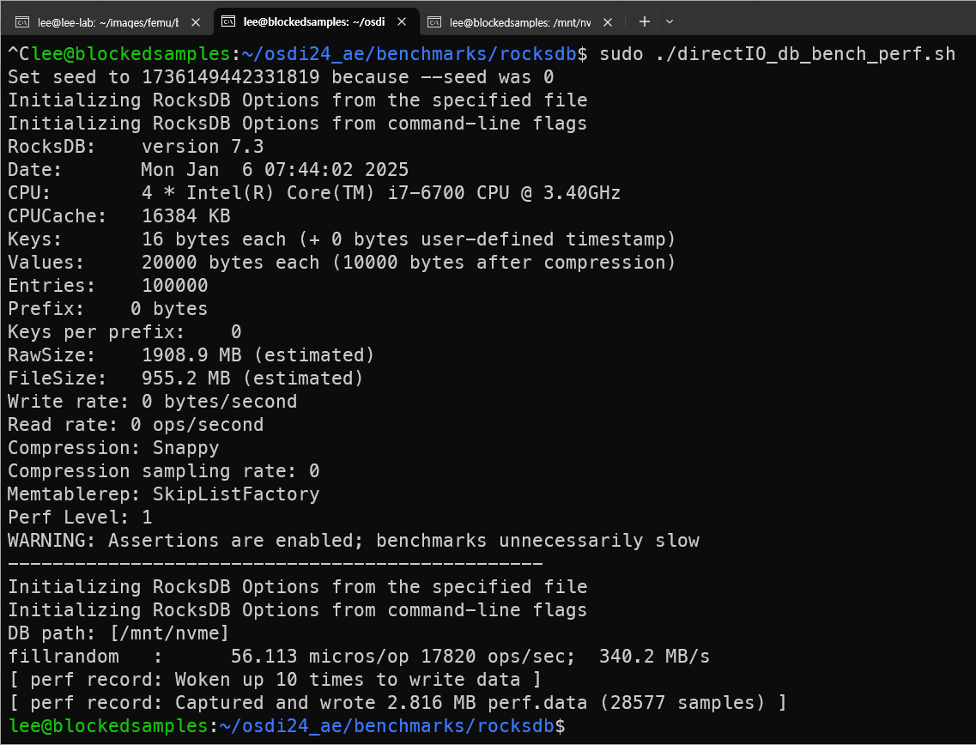
Experiment 2 Setup
Host RAM | 16 GBs
FEMU CPU | 4 vCPUs
FEMU RAM | 4 GBs
FEMU page read latency | 40000 / 80000 / 120000 ns
FEMU page write latency | 200000 / 400000 / 800000 ns
RocksDB key num. / size | 100000 / 16 Bytes
RocksDB value size | 20000 Bytes
Workload | Fill random
latency increased => slow read/write

Slide 20
Experiment 2 Results
latency increased => slow read/write

Slide 21
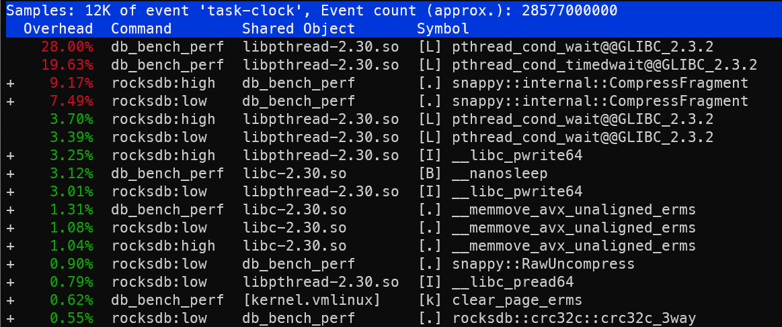
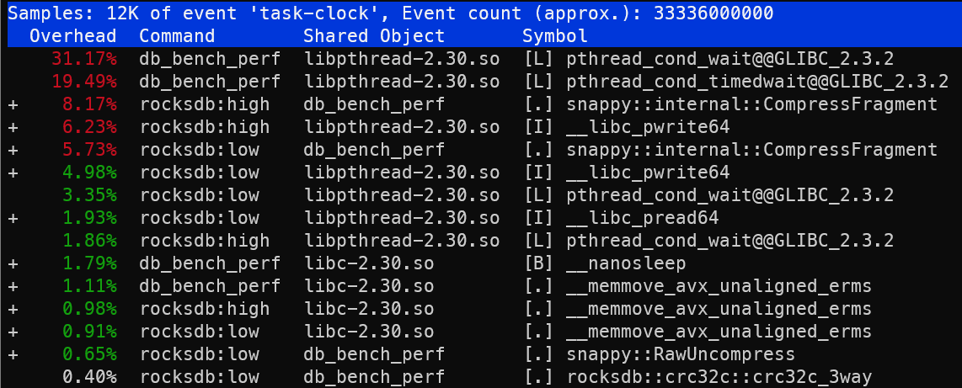
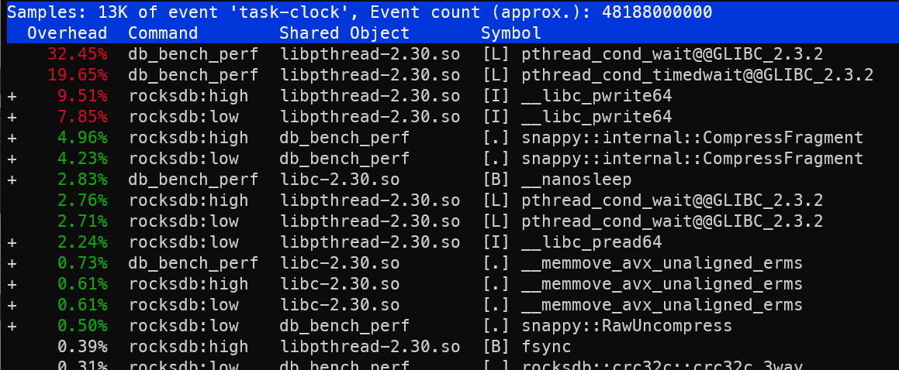
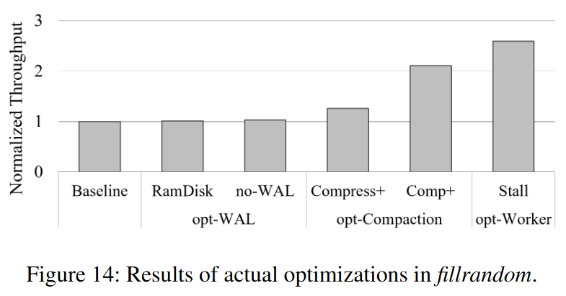
bperf results
femu_default
80/400
120/800

