Slide 1
SkipList and Secondary Instance
System Software Lab.
Name: 이대은, 하경준
Date: 2025/02/18

Slide 2
Before we start…
Goals for last weeks
Code-Level Analysis
memtable/skiplist.h
memtable/inlineskiplist.h (actually used in RocksDB)
Do experiments on SkipList
Especially, kBranching_
Investigate various variants of SkipList
Some features of RocksDB to improve performance

Slide 3
Contents
SkipList
Hypothesis and Design
Experiment
Results and Discussion
Limitations
Secondary Instance
Primary Instance
Read only and Secondary instances
Hypothesis and Design
Experiment and Result
Limitations
Final Week

Slide 4
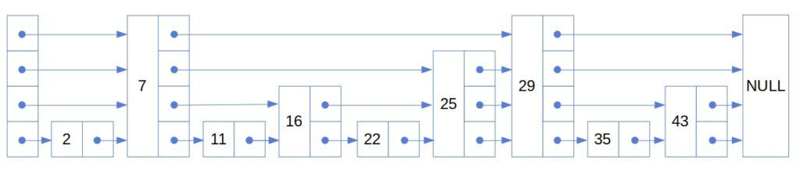
Week 4: SkipList (memtable/skiplist.h)
MemTable
In-memory data structure holding data before they are flushed to SST files.
Based on SkipList(default), HashLinkList, HashSkipList or Vector.
Skiplist-based MemTable
Consists of multiple nodes with “random” height (levels).
General good performance to both read and write, random access and sequential scan.
Support Concurrent Insert and Insert with Hint.

Slide 5
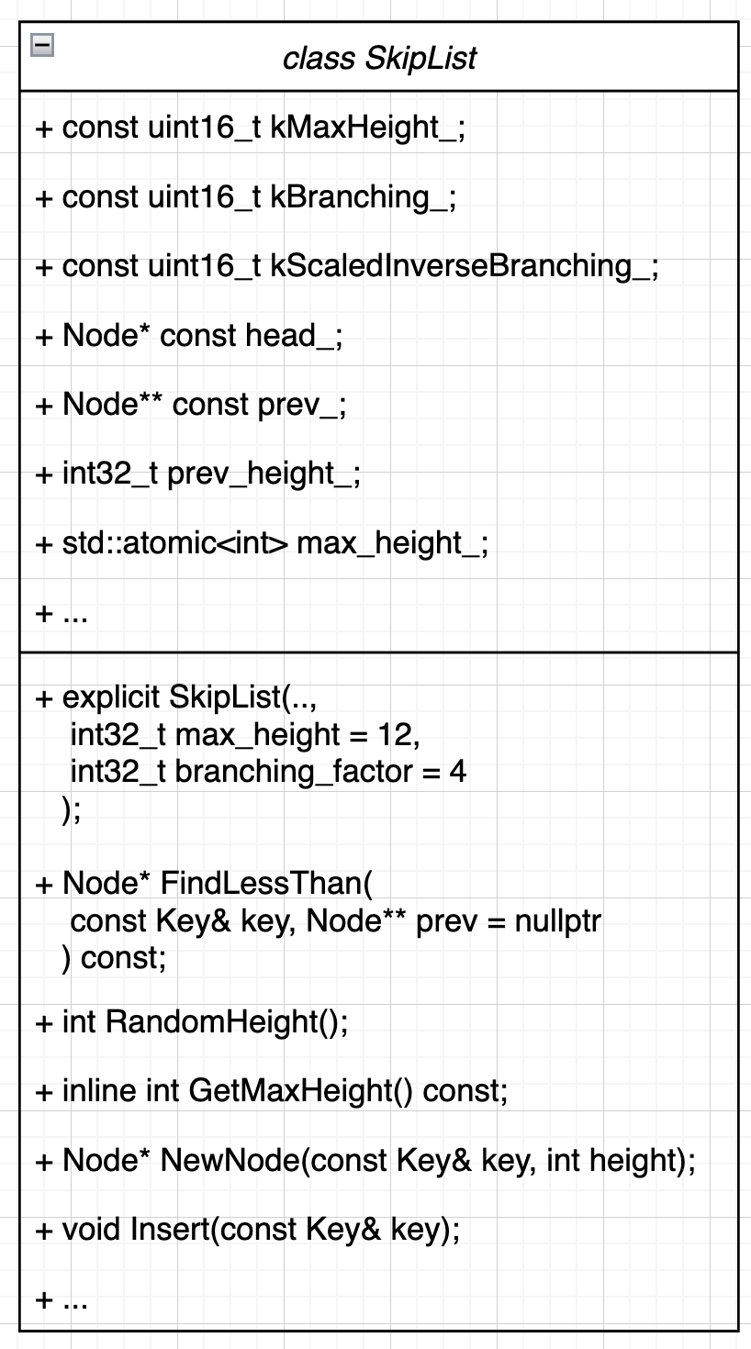
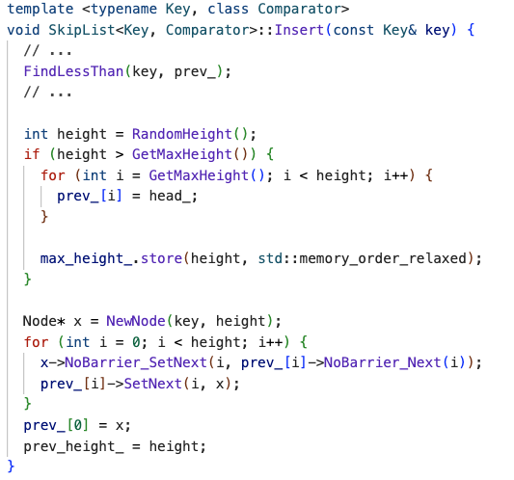
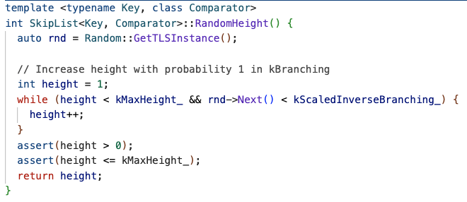

Week 4: SkipList (memtable/skiplist.h)
RandomHeight
CALL
(Implementation)
kScaledInverseBranching_ = ($\frac{Random∷kMaxNext + 1}{kBranching_})$;

Slide 6
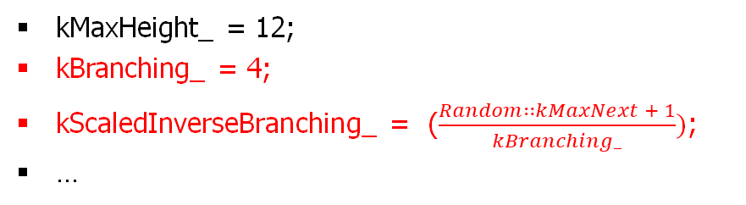
Week 4: SkipList (memtable/skiplist.h)
Member or Method | Description
kMaxHeight_ | The max height of a skiplist
kBranching_ | The branching factor of a skiplist
kScaledInverseBranching_ | The scaled inverse of the branching factor
kMaxHeight_ = 12;
kBranching_ = 4;
kScaledInverseBranching_ = ($\frac{Random∷kMaxNext + 1}{kBranching_})$;
…
Random::kMaxNext = 2³¹ - 1
SkipList Instance

Slide 7

Hypothesis and Design
If the coin flip probability is too low (increase branching_factor_), the SkipList will converge to a common linked list, losing its search advantage.
Conversely, if it’s too high (decrease branching_factor), too many nodes will appear at each level, also diminishing the search efficiency.
In RocksDB, the coin flip probability is set to 25% instead of 50% and Why?
RandomHeight(), kScaledInverseBranching, kBranching_
memtable/skiplist.h
memtable/inlineskiplist.h

Slide 8
Hypothesis and Design
The impact of coin flip probability in SkipList on the Average Latency of Write and Read operations.
If the hypothesis is correct, lower probabilities should correspond to higher average latency.
If the probability becomes too high, the average latency should also increase.
Experiment tool
Instead of using db_bench, which involves various variables such as Flush and Compaction, use skiplist_test to independently test SkipList.
branching_factor_ (kBranching_) = [2, 4, 8, 16, 32] and N (or R) = [1M, 2M, 4M, 8M, 16M]
Let’s check it out!!

Slide 9
Experimental Environment
Version
OS | Ubuntu 20.04.5 LTS(64-bit)
Kernel | Linux 5.15.0-131-generic
CPU | 8 * 11th Gen Intel(R) Core(TM) i5-1155G7 @ 2.50GHz
MEM | 16GB
SSD | imation M.2 PCIe 1TB SSD X831B

Slide 10
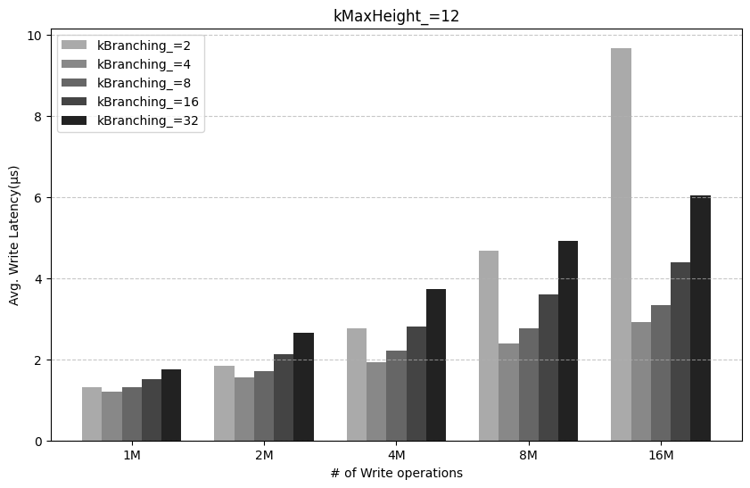
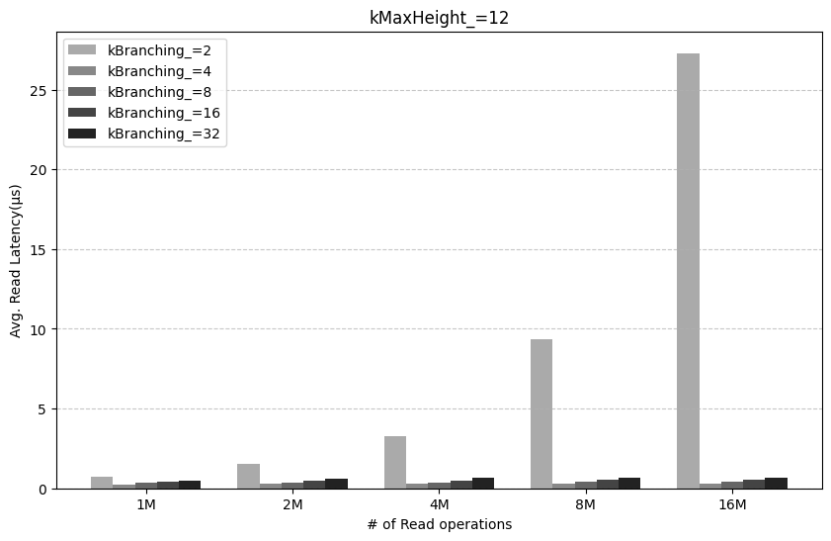
Results and Discussion

Slide 11
Results and Discussion
The best performance is observed when kBranching_ is 4.
Lower probabilities (8, 16, 32) should correspond to higher average latency.
The higher the probability (max=2), the greater the average latency.

Slide 12
Results and Discussion
>
Observations
1. In most cases, Read operations are significantly faster than Write operations.
The reason is likely due to the write overhead involved in dynamically creating nodes and linking pointers at each level.

Slide 13
Results and Discussion
Observations
2. When kBranching_ is 2, Write and Read operations show the worst performance.
As expected, higher probabilities lead to more nodes, resulting in lower performance.
The performance also drops significantly compared to other probabilities, increasing the number of operations. (especially, read ops)
Why..?

Slide 14
Limitations
The experiment did not take the effect of height (kMaxHeight_) into account.
Fixed at a default value of 12.
There may be a correlation between probability and height as well.
For a sophisticated analysis, it would be beneficial to include additional metrics beyond latency, considering various perspectives:
CPU Instruction
Memory usage
Number of SkipList nodes
…

Slide 15
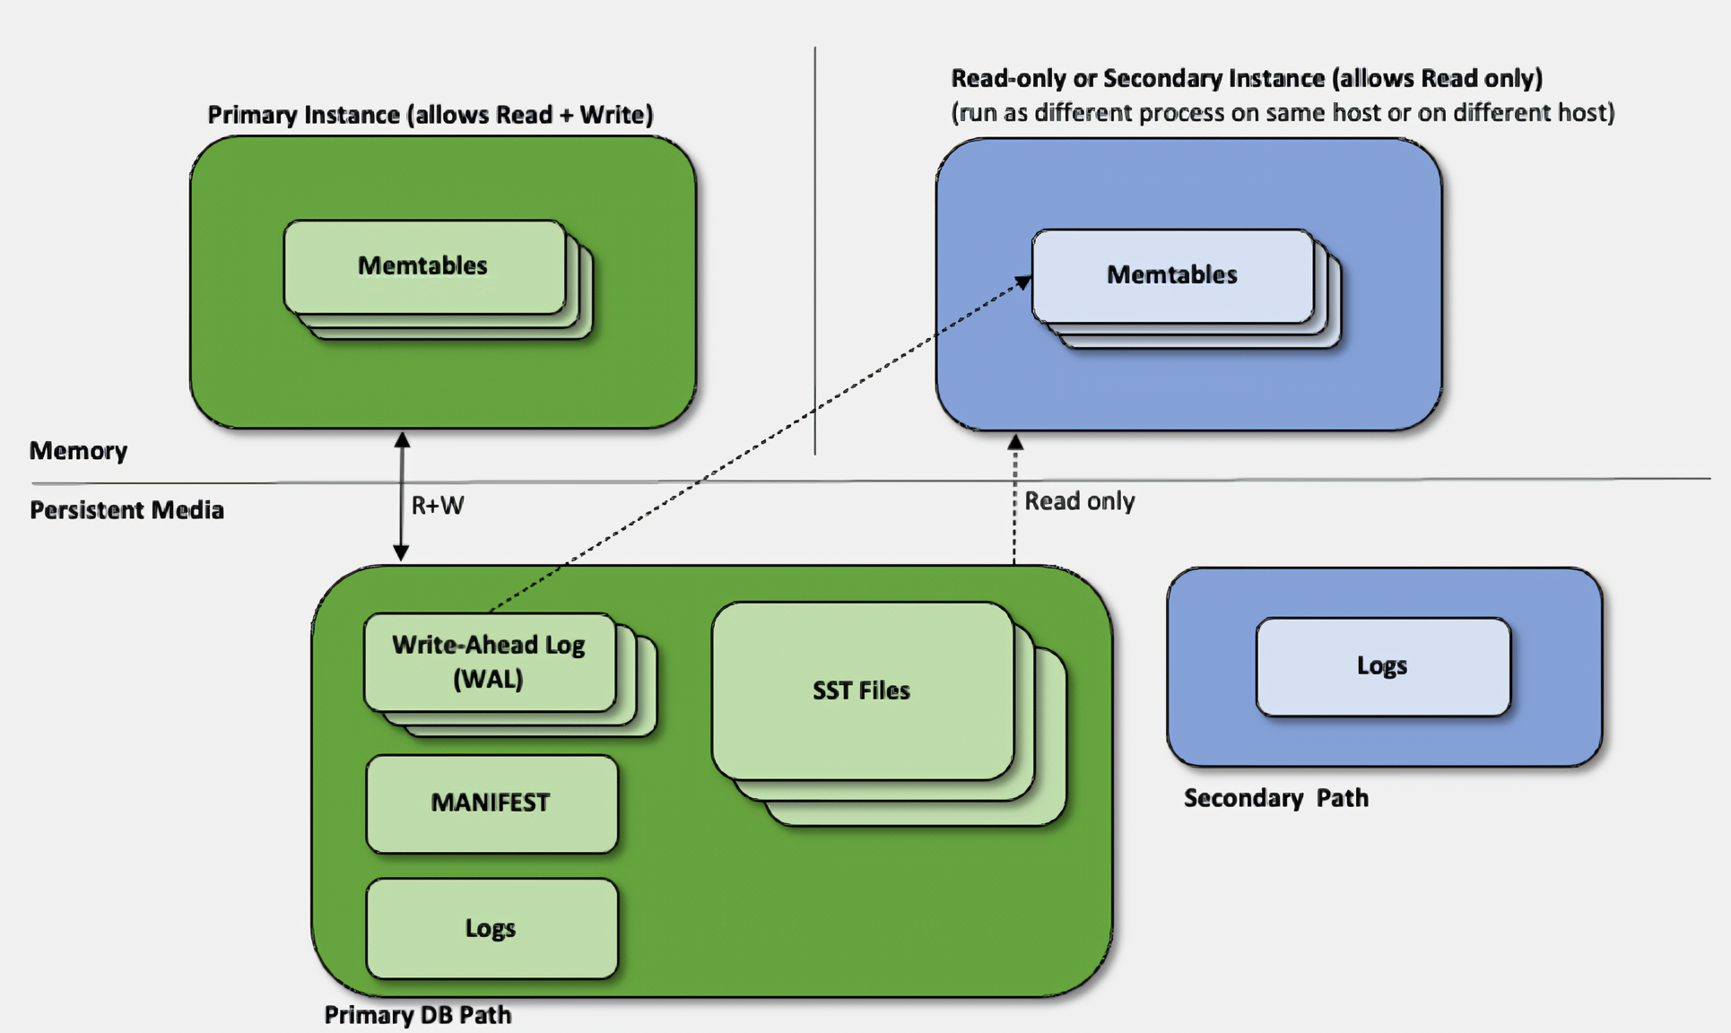
Overview figure

Slide 16
Primary Instance
Primary Instance Data Flow
Request write work → Recorded in WAL (for data recovery)
Stored in Memtable
When Memtable is full, flushed to SST file
Runs Compaction → SST files are optimized
Once all data in WAL is reflected in SST, WAL files are automatically deleted
Read Load Distribution
Notes:
Primary Instance 데이터 흐름
쓰기 요청 발생→ WAL에 기록 (데이터 복구를 위해)
Memtable에 저장
Memtable이 가득 차면 SST 파일로 Flush
Compaction 실행→ SST 파일 정리 및 최적화
모든 WAL의 데이터가 SST로 반영되면, WAL 파일을 자동 삭제

Slide 17
Primary Instance
Problems with Primary Instances
Read/Write Load Concentration
The Primary Instance must handle both read and write operations simultaneously.
Resource Consumption of Primary
If there are many read requests on the Primary, CPU and I/O resources may become constrained.
Performance Degradation During Compaction
Performance degradation caused by the Primary's Compaction and Flush processes.
Read Load Distribution
Notes:
Primary Instance의 문제점
읽기/쓰기 부하 집중
Primary Instance는 읽기 및 쓰기 작업을 동시에 처리해야 한다.
Primary의 리소스 소모
Primary에서 읽기 요청이 많아지면 CPU 및 I/O 리소스가 부족해질 수 있다.
Compaction 중 성능 저하
Primary의 Compaction 및 Flush 과정에서 성능 저하가 발생할 수 있다.
-> 읽기 작업을 분산시키자

Slide 18
Primary Instance
Problems with Primary Instances
Read/Write Load Concentration
Resource Consumption of Primary
Performance Degradation During Compaction
Read Load Distribution
Notes:
Primary Instance의 문제점
읽기/쓰기 부하 집중
Primary Instance는 읽기 및 쓰기 작업을 동시에 처리해야 한다.
Primary의 리소스 소모
Primary에서 읽기 요청이 많아지면 CPU 및 I/O 리소스가 부족해질 수 있다.
Compaction 중 성능 저하
Primary의 Compaction 및 Flush 과정에서 성능 저하가 발생할 수 있다.
-> 읽기 작업을 분산시키자

Slide 19

Read only and Secondary instances
User (get)
User (put)
User (put)
User (get)
User (get)
User (put)
User (put)
User (get)
Read only and Secondary instances
Read only instances
Reads only SST files.
Does not reflect Memtable and WAL.
Secondary instances
Reads SST files.
Replays WAL to update Memtable.
Primary Instance (Memtable)
Primary Instance (Memtable)
Secondary instances (Memtable)
Secondary instances (Memtable)
Primary DB Path (SST Files)
Primary DB Path (SST Files)
Notes:
Read only instances
SST 파일을 읽기만 한다.
Memtable하고 WAL은 반영하지 않는다.
Secondary instances
SST 파일을 읽는다.
WAL을 리플레이해서 Memtable을 업데이트한다.

Slide 20
Read only and Secondary instances
Secondary Instance Data Flow
Directly reads the SST files of the Primary (read-only)
Can not access Memtable → WAL is replayed to create its own Memtable
Operating logs that track the actions of the Secondary.
USER
Primary Instance (Memtable)
Primary Instance (Memtable)
Secondary instances (Memtable)
Secondary instances (Memtable)
Memory
Primary DB Path (SST Files)
Primary DB Path (SST Files)
SSD
Notes:
Secondary Instance 데이터 흐름
Primary의 SST 파일을 직접 읽음 (읽기 전용)
Memtable 접근 불가 → WAL을 Replay하여 자체 Memtable 생성

Slide 21
Hypothesis and Design
Hypothesis
Distribute the Secondary Instance. (Distribute memtable)
For a good experiment, run multiple db_bench tests.
USER
User (put)
User (get)
User (get)
User (put)
User (put)
User (get)
User (get)
User (put)
Secondary Instance (Memtable)
Secondary Instance (Memtable)
Memory
Primary Instance (Memtable)
Primary Instance (Memtable)
SSD
Primary DB Path (SST Files)
Primary DB Path (SST Files)
<Primary Instance Experiment>
< Secondary Instance Experiment>
Notes:
Hypothesis
•Secondary 인스턴스를 분배한다. (memtable 분배)
•좋은 실험을 위해 여러 db_bench 테스트를 실행한다.
•하지만 실험이 잘못 진행되었다. (빨간 점선)
잘못된 가설
•일단은 계속 진행한다.
•Secondary의 속도는 Primary와 비슷하거나 느릴 것이다.

Slide 22
Hypothesis and Design
Wrong
Hypothesis
Distribute the Secondary Instance. (Distribute memtable)
For a good experiment, run multiple db_bench tests.
USER
User (put)
User (get)
User (get)
User (put)
User (put)
User (get)
User (get)
User (put)
Secondary Instance (Memtable)
Secondary Instance (Memtable)
Memory
Primary Instance (Memtable)
Primary Instance (Memtable)
But the experiment was conducted incorrectly. (Red dashed line)
SSD
Primary DB Path (SST Files)
Primary DB Path (SST Files)
<Primary Instance Experiment>
< Secondary Instance Experiment>
Wrong Hypothesis
For now, keep going.
The speed of the Secondary will be similar to or slower than the Primary.
Notes:
Hypothesis
•Secondary 인스턴스를 분배한다. (memtable 분배)
•좋은 실험을 위해 여러 db_bench 테스트를 실행한다.
•하지만 실험이 잘못 진행되었다. (빨간 점선)
잘못된 가설
•일단은 계속 진행한다.
•Secondary의 속도는 Primary와 비슷하거나 느릴 것이다.

Slide 23
Hypothesis and Design
Hypothesis
Distribute the Secondary Instance. (Distribute memtable)
For a good experiment, run multiple db_bench tests.
Wrong
USER
User (put)
User (get)
User (get)
User (put)
User (put)
User (get)
User (get)
User (put)
But the experiment was conducted incorrectly. (Red dashed line)
Secondary Instance (Memtable)
Secondary Instance (Memtable)
Memory
Primary Instance (Memtable)
Primary Instance (Memtable)
Wrong Hypothesis
For now, keep going.
Maybe the speed of the Secondary will be similar to or slower than the Primary.
SSD
Primary DB Path (SST Files)
Primary DB Path (SST Files)
<Primary Instance Experiment>
< Secondary Instance Experiment>
Notes:
Hypothesis
•Secondary 인스턴스를 분배한다. (memtable 분배)
•좋은 실험을 위해 여러 db_bench 테스트를 실행한다.
•하지만 실험이 잘못 진행되었다. (빨간 점선)
잘못된 가설
•일단은 계속 진행한다.
•Secondary의 속도는 Primary와 비슷하거나 느릴 것이다.

Slide 24
Experiment and Result​
Each run Primary and Secondary.
Unexpectedly, the Secondary was slightly faster. ↑
The reason is that the Primary performs compaction during reads.
However, no operations like compaction or flushes occur in the Secondary.
If a proper experimental setup is in place, it shows the possibility that the Secondary could have better read performance than the Primary.
Read ( MB/s)
value_size
 | 128 | 512 | 1024 | 4096 | 8192
Primary | 9.4 | 32.2 | 56.3 | 176.1 | 279.7
Secondary 1 | 10.1 | 32.9 | 56.6 | 187.8 | 302.8
Notes:
Primary와 Secondary를 각자 실행했다.
예상외로, Secondary가 조금 더 빨랐다. ↑
그 이유는 Primary가 읽기 작업을 할 때 compaction을 수행하는 반면, Secondary에서는 compaction이나 flush와 같은 작업이 이루어지지 않기 때문이다.
적절한 실험 환경이 갖춰지면, Secondary가 Primary보다 더 나은 읽기 성능을 가질 수 있다는 가능성을 보여준다.

Slide 25
Limitations​
This is an incorrect experiment.
In the correct experiment, WAL recovery should be performed, but it was not done.
We should periodically update the Secondary using the TryCatchUpWithPrimary API. (Probably) this feature is not available in db_bench.
Consider read compaction
Compaction occurs when reading operations are performed on the Primary.
We consider whether this process affects the performance of the Secondary.
ㄴ What is option ‘secondary_update_interval’?
Notes:
이 실험은 잘못된 실험이다.
올바른 실험에서는 WAL 복구가 이루어져야 하지만, 그것이 수행되지 않았다.
우리는 TryCatchUpWithPrimary API를 사용하여 Secondary를 주기적으로 업데이트해야 한다. (아마도) 이 기능은 db_bench에서 제공되지 않는다.
읽기 중 compaction 고려
Primary에서 읽기 작업을 할 때 compaction이 발생한다.
이 과정이 Secondary의 성능에 영향을 미치는지 고려해야 한다.
디스크 페이징 캐시 고려 (Memtable)

Slide 26
Final Week

Slide 27
Thankyou

