Slide 1
Advanced RocksDB
System Software Lab
Suhwan Shin, Zhu Yongjie
25.02.18

Slide 2
Contents
Optimizing Learned Index in LSM Tree
RocksDB Performance in CephFS vs CephRBD

Slide 3

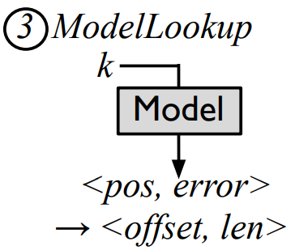

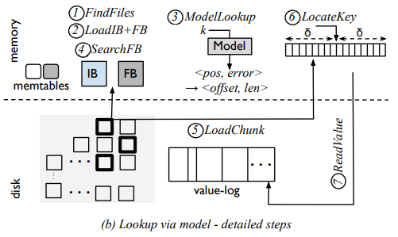
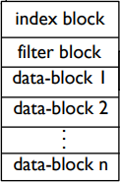


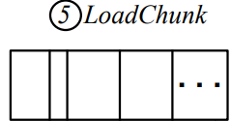
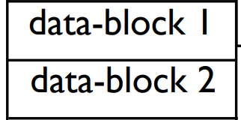


Optimizing Learned Index in LSM Tree
Learned Index in LSM-Tree (Bourbon)

Slide 4


Optimizing Learned Index in LSM Tree
Learned Index in LSM-Tree (Bourbon)
Avoid unnecessary use
Kernel Linear Model 1
Kernel Linear Model 2
Kernel Linear Model n

Slide 5
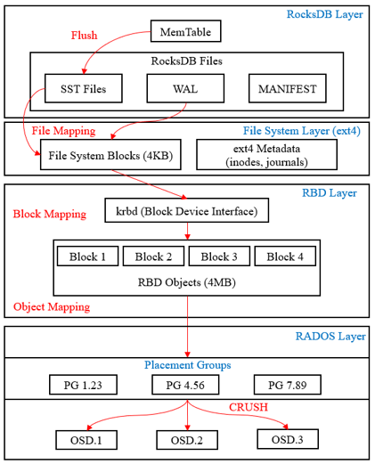
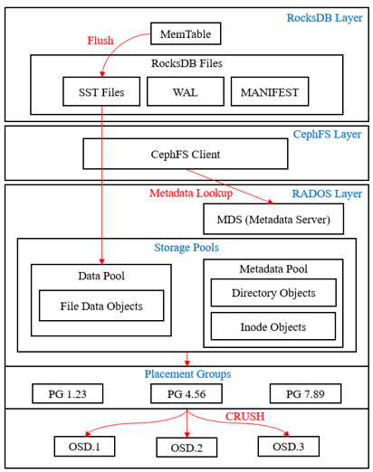
RocksDB in Ceph Architecture
Ceph RBD
Ceph File System

Slide 6
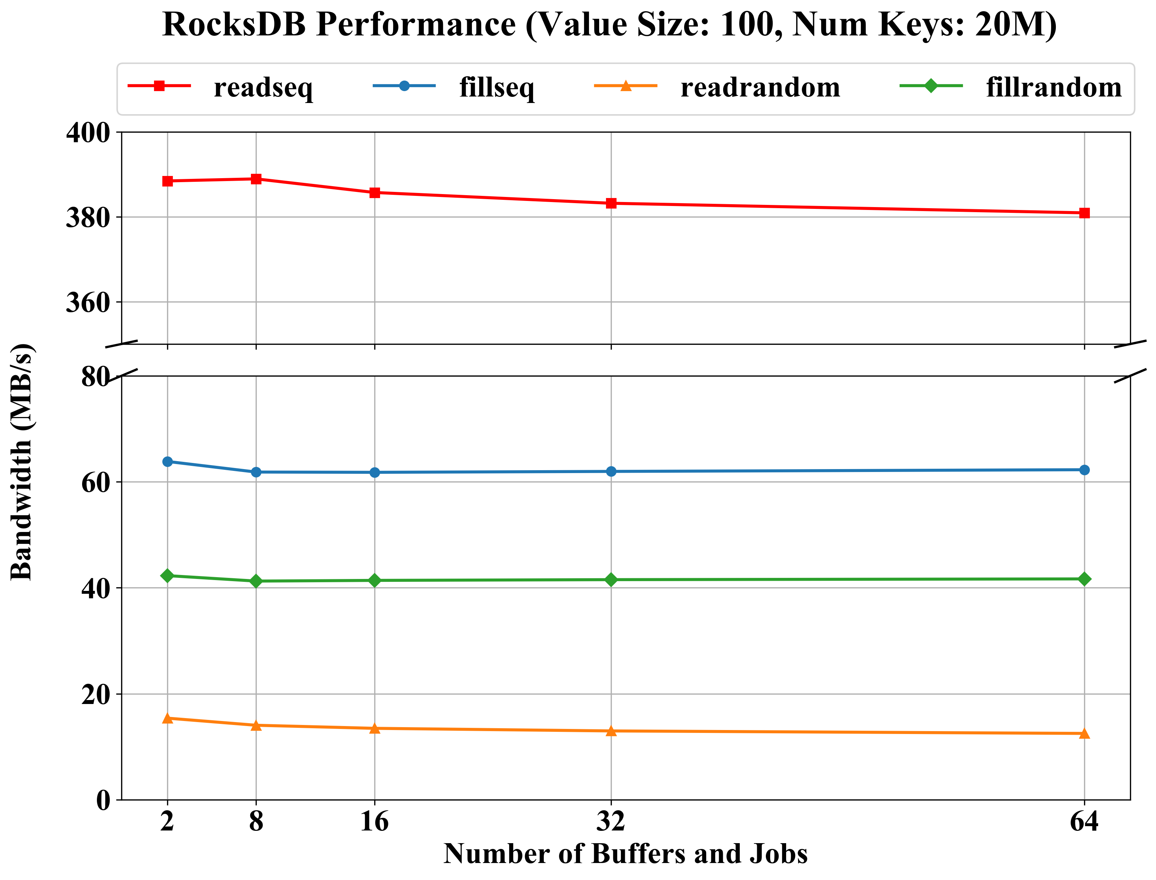
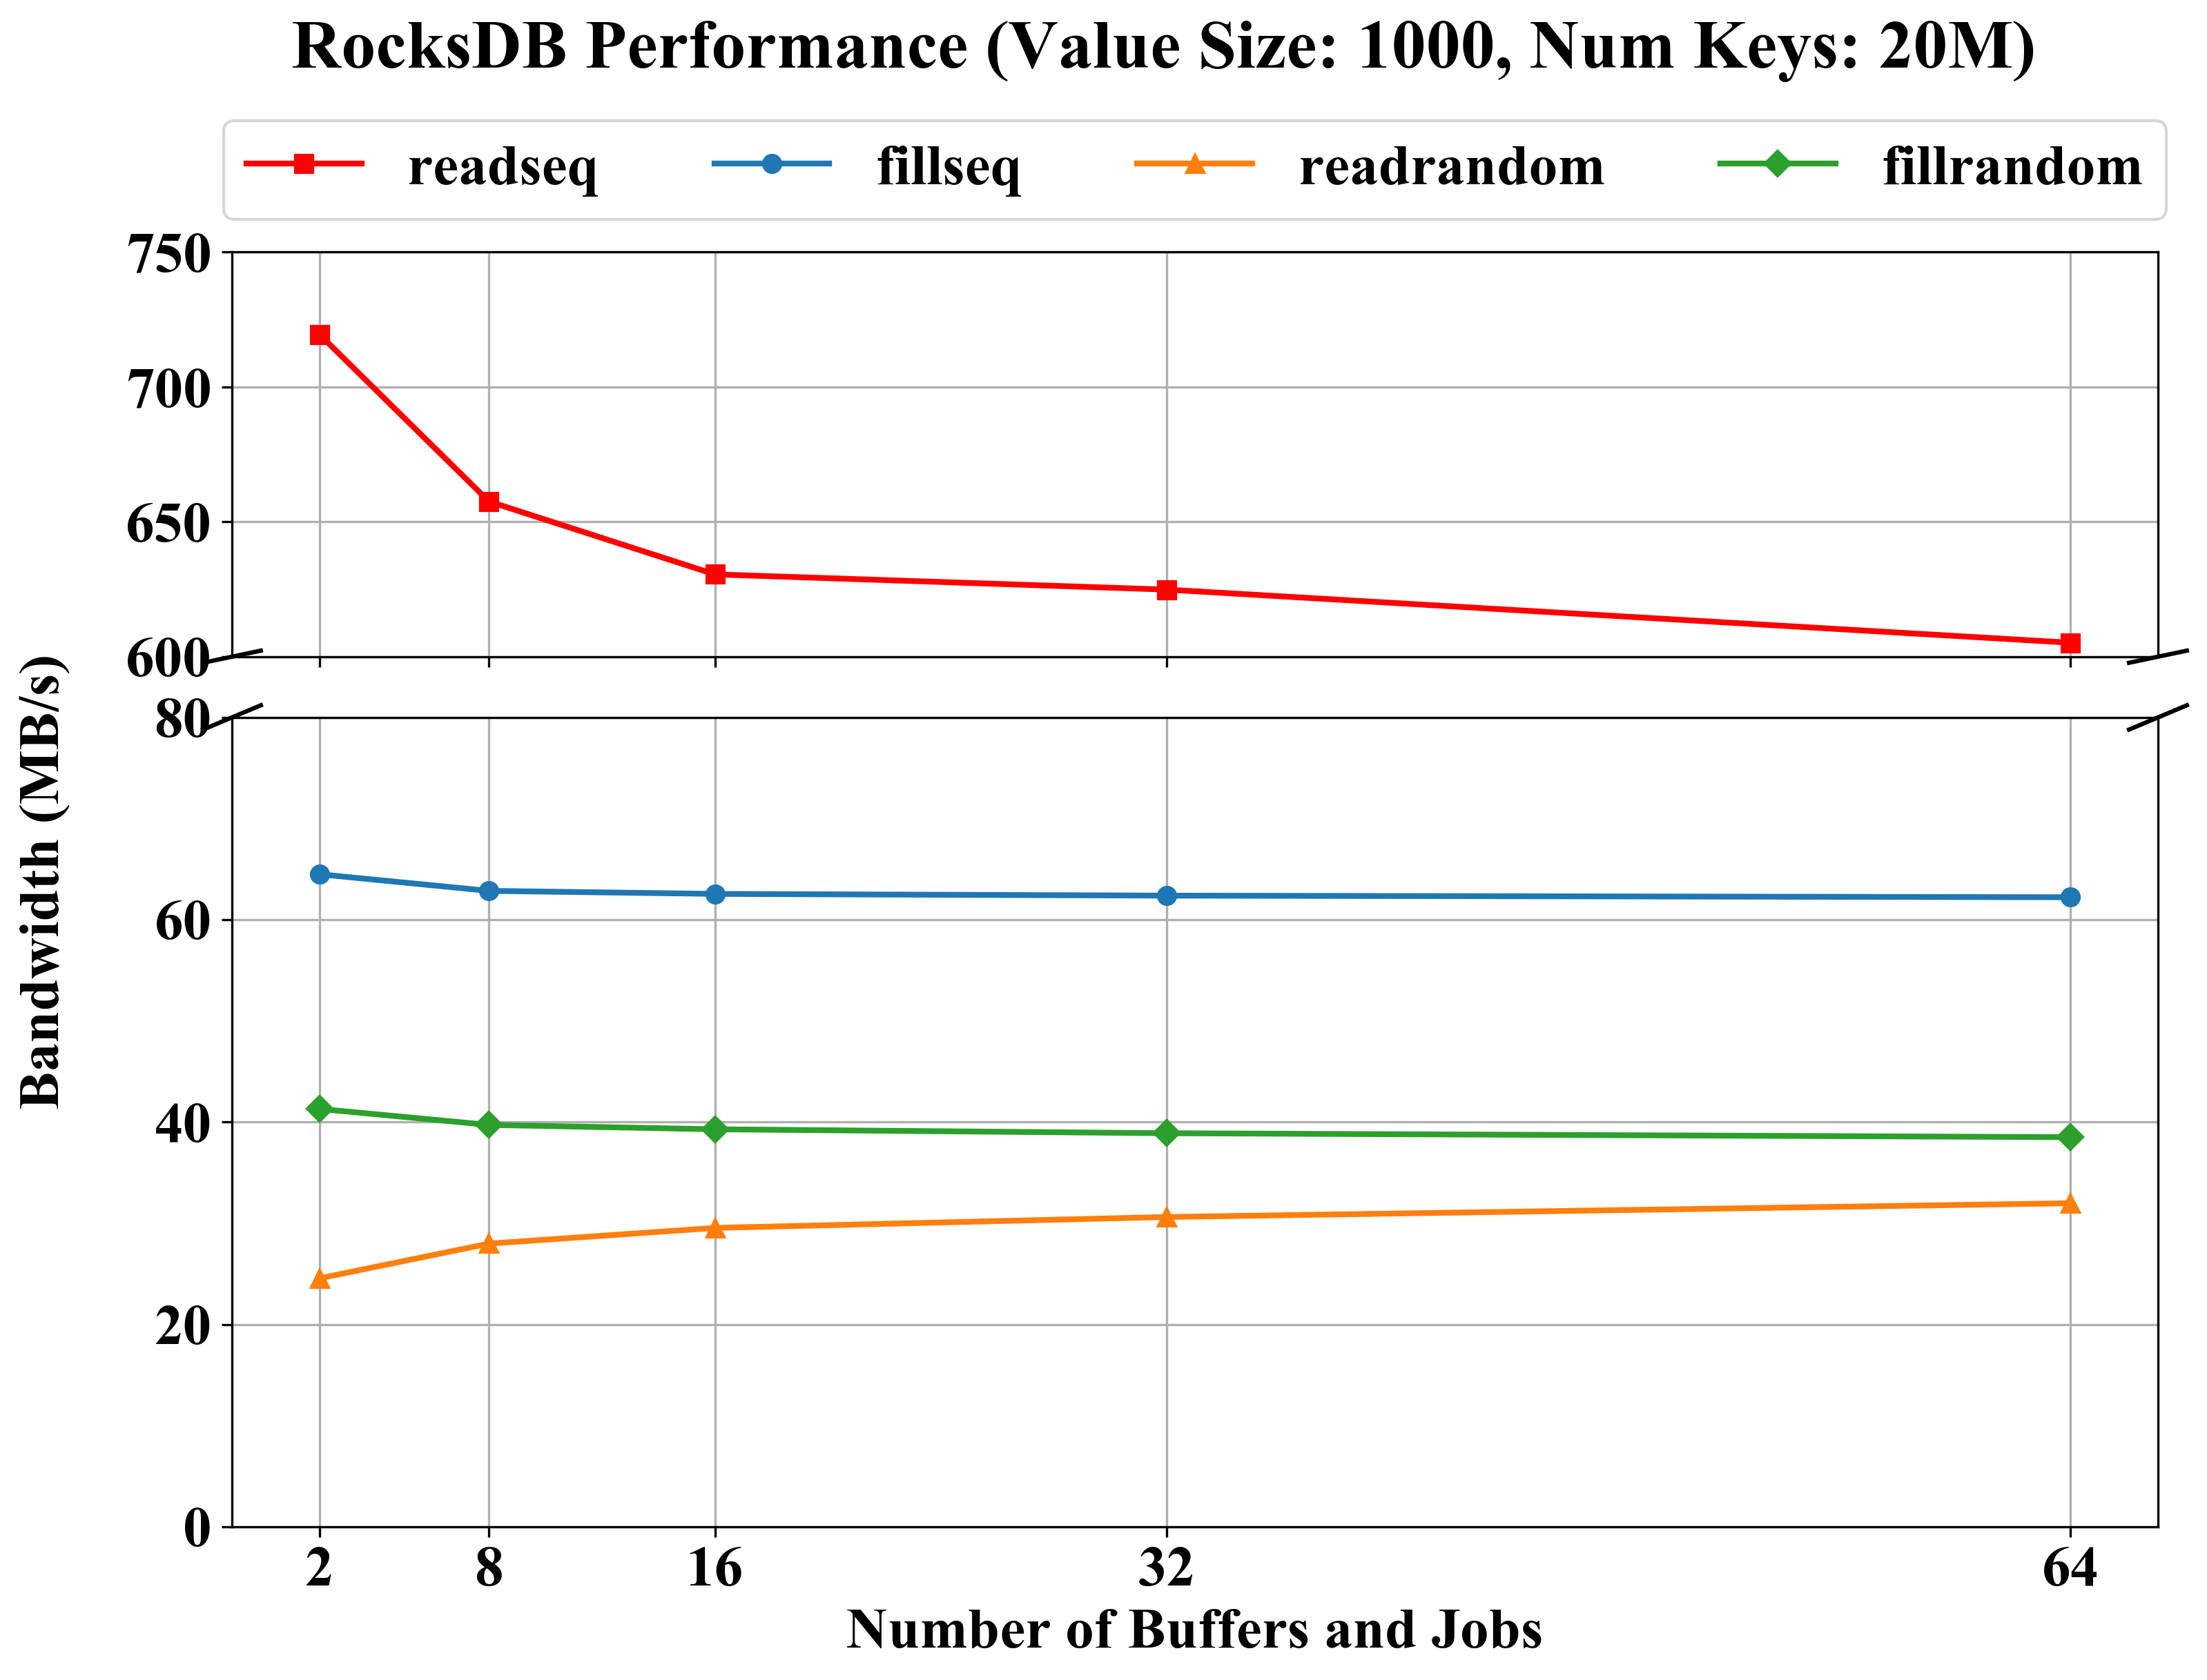
Compared RocksDB CephFS
Ceph File System

Slide 7
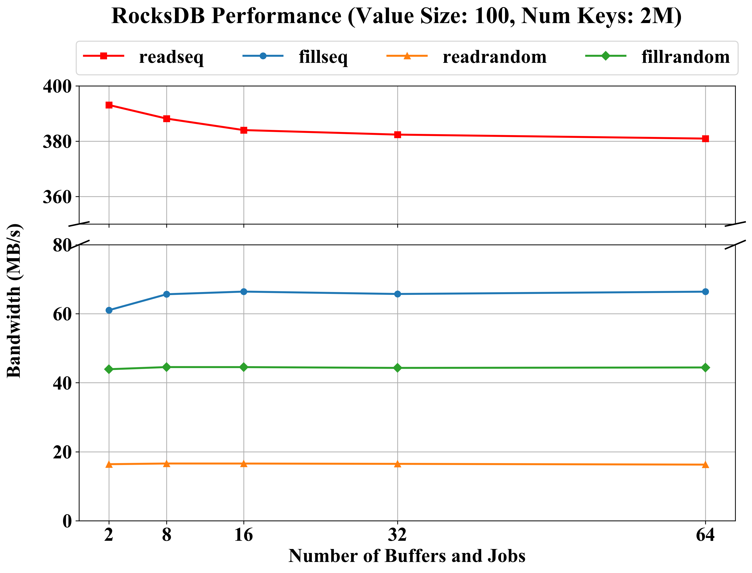
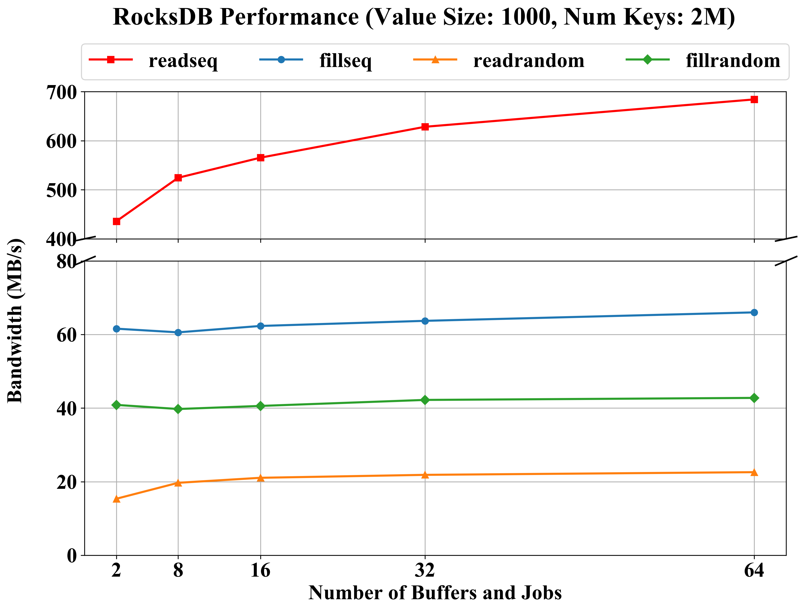
Compared RocksDB CephFS
Ceph File System

Slide 8
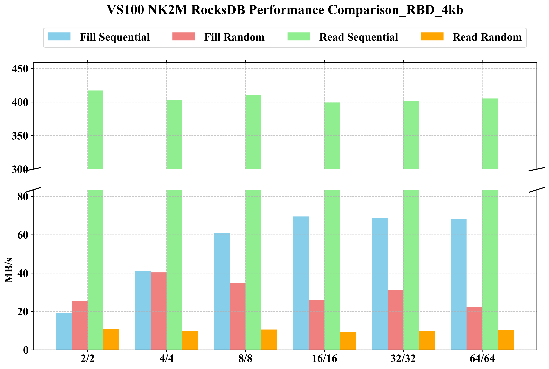
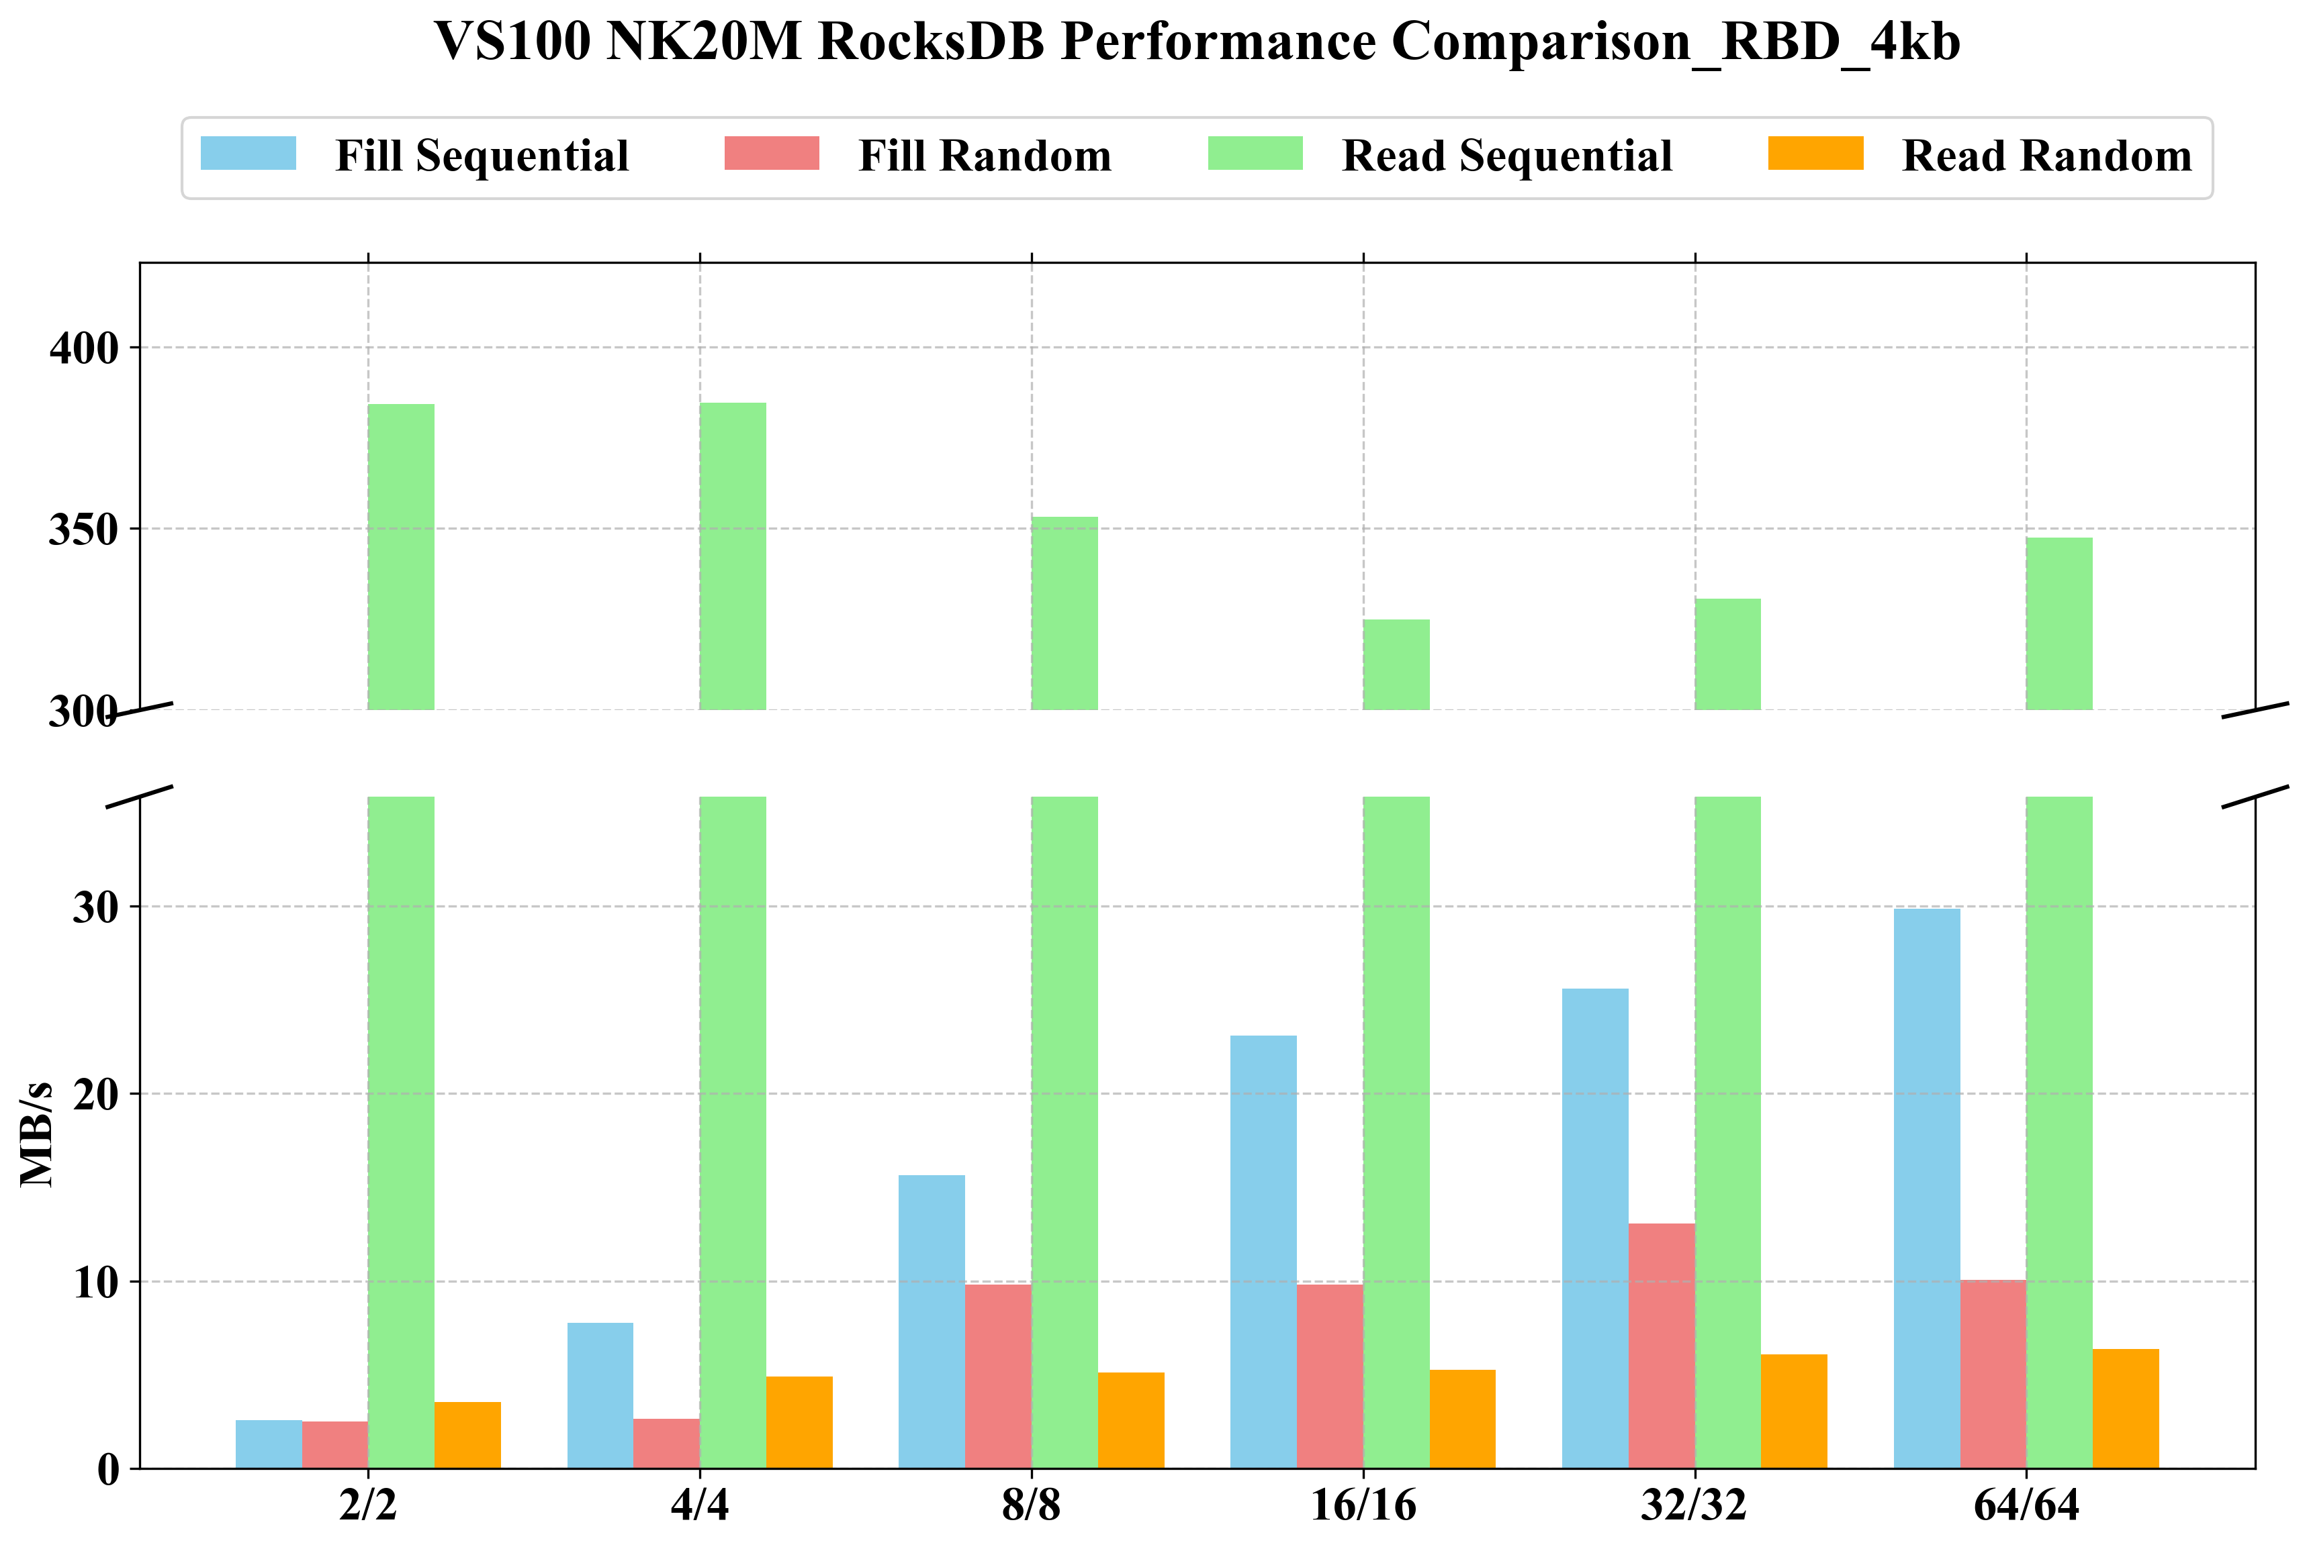
Compared RocksDB Ceph RBD
Ceph RBD - Block Size: 4kb

Slide 9
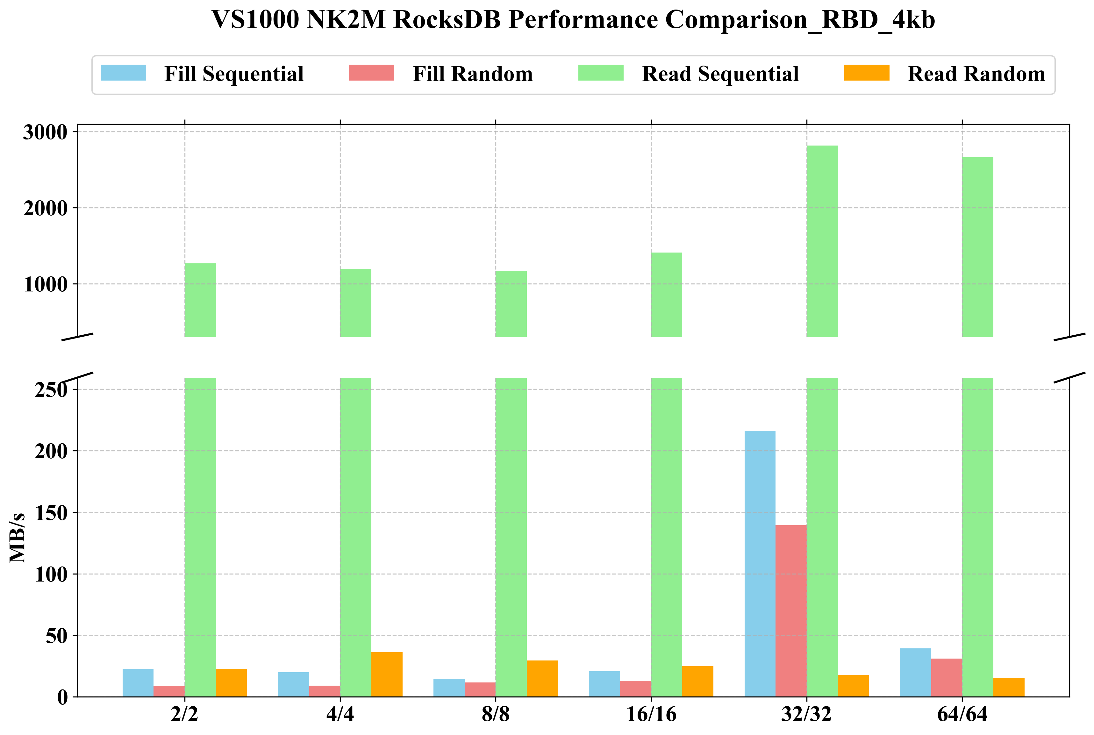
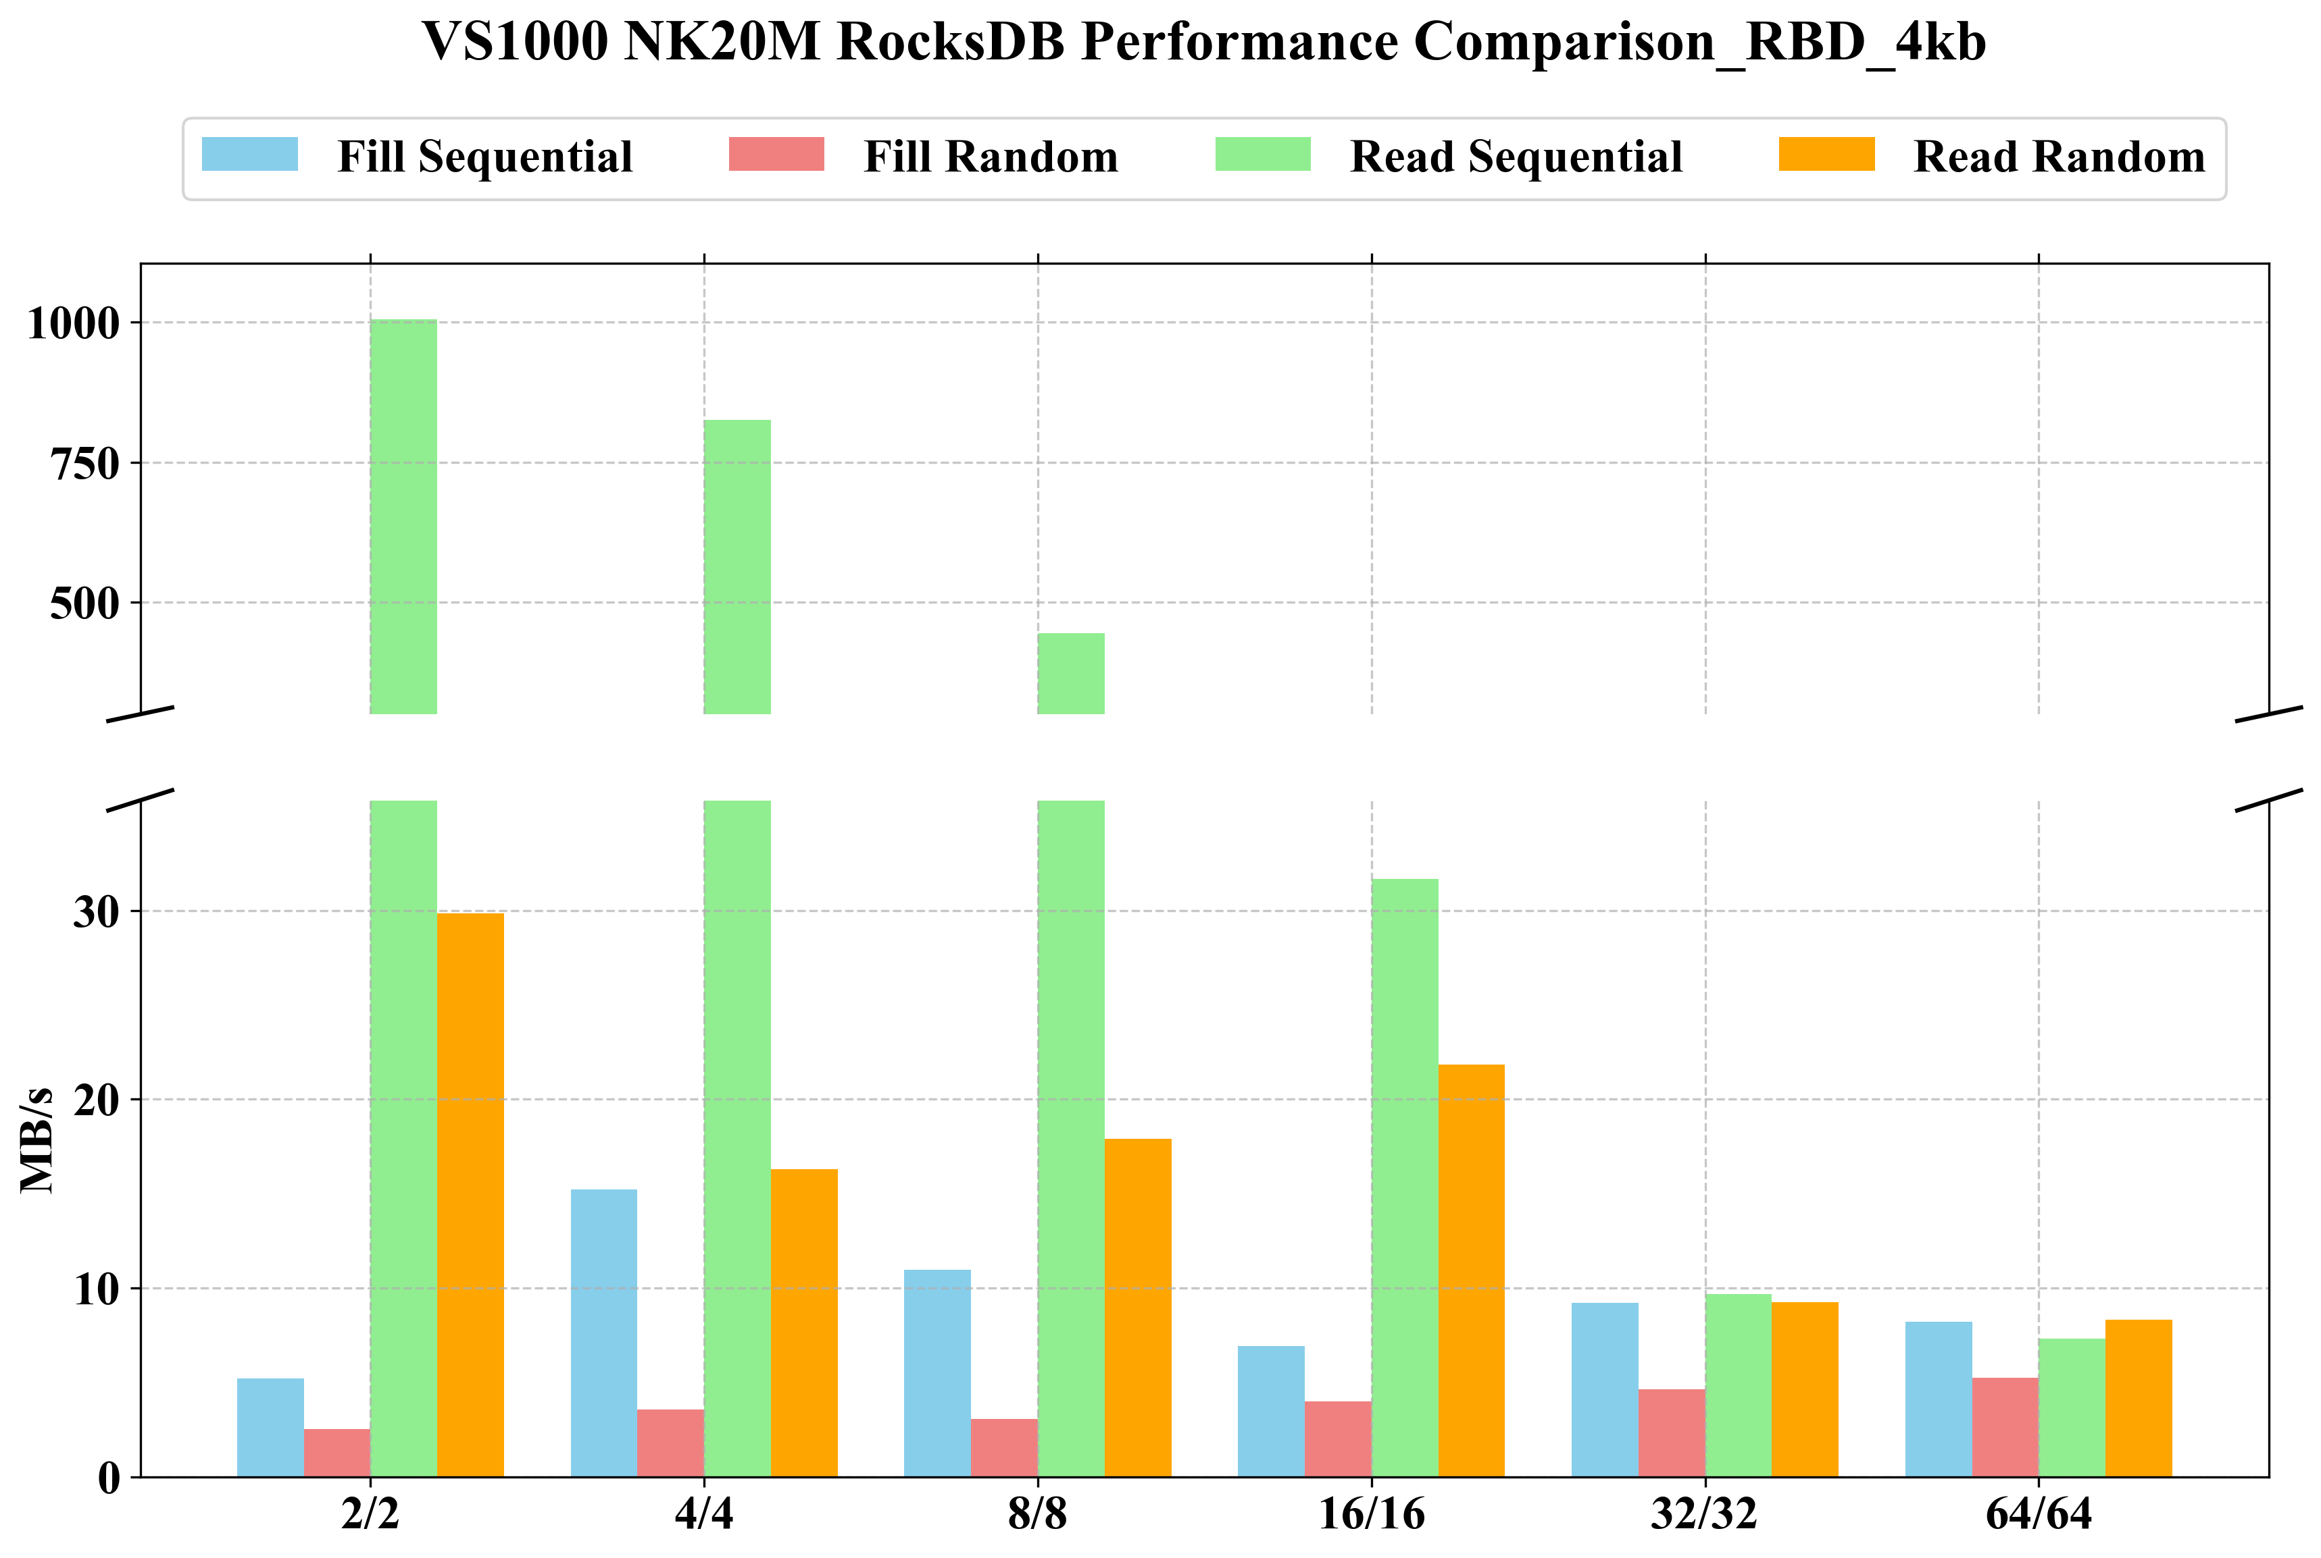
Compared RocksDB Ceph RBD
Ceph RBD - Block Size: 4kb

Slide 10
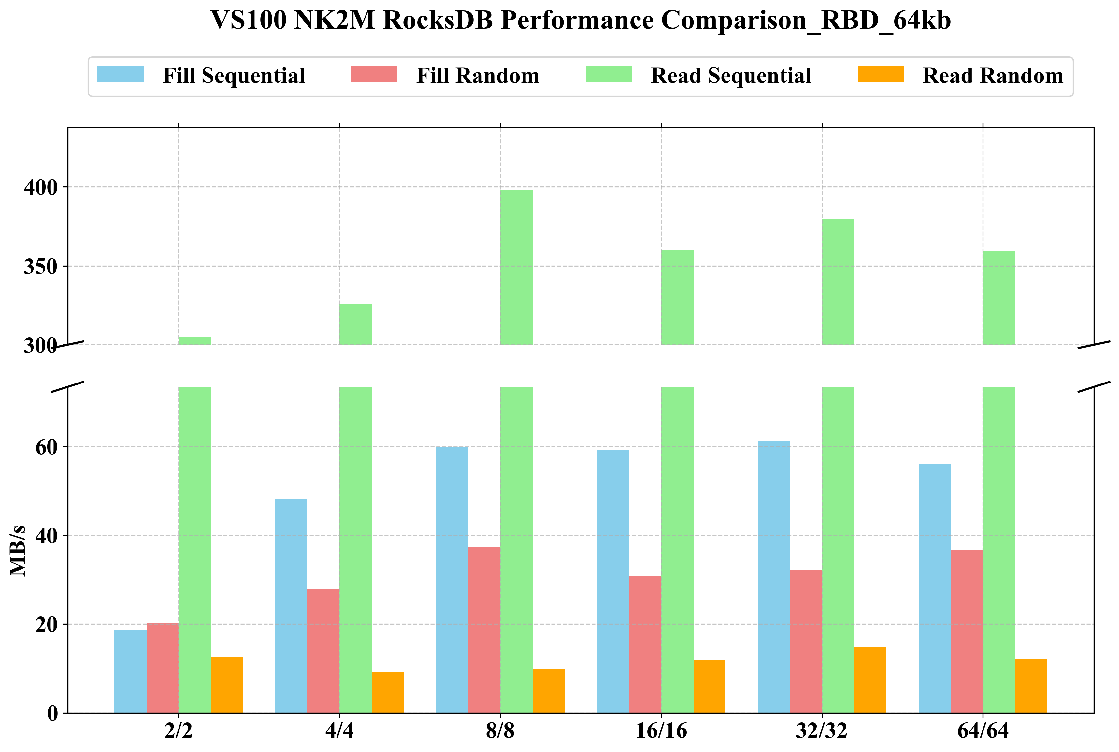
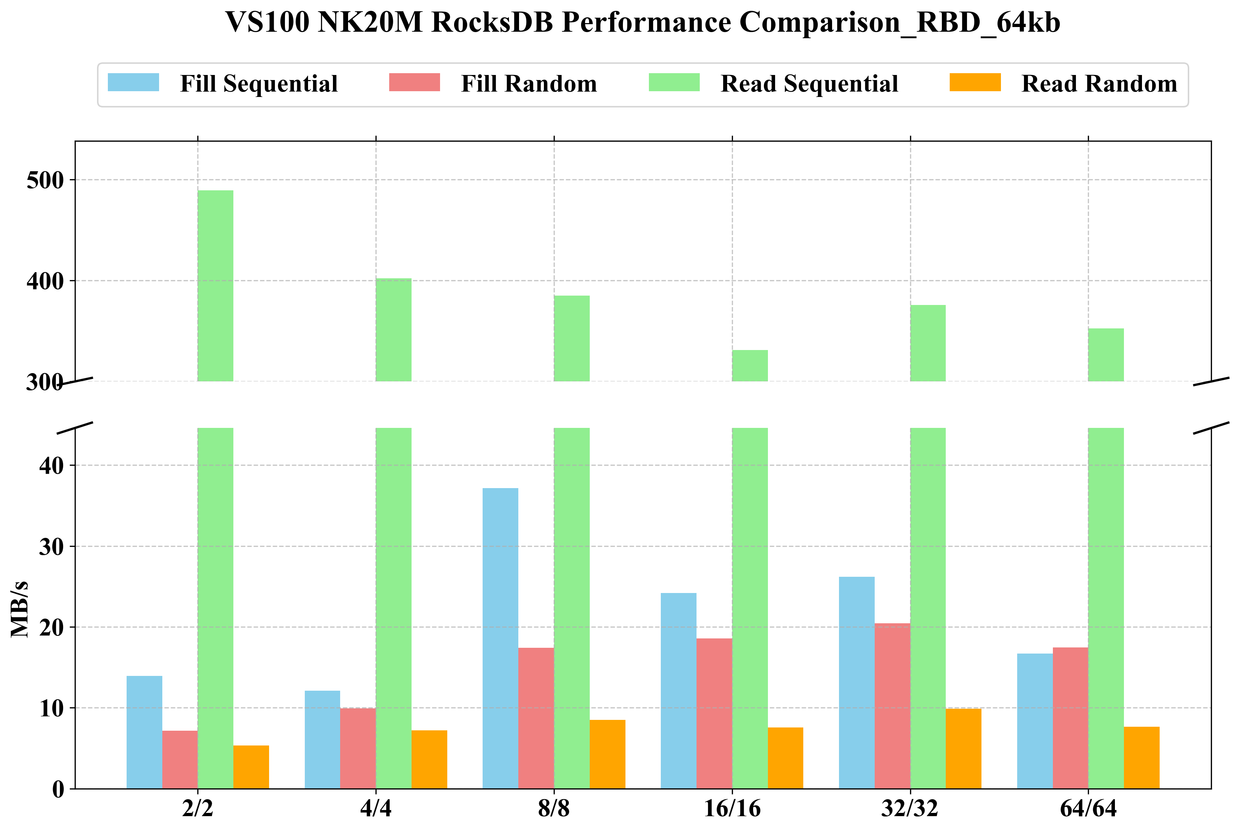
Compared RocksDB Ceph RBD
Ceph RBD - Block Size: 64kb

Slide 11
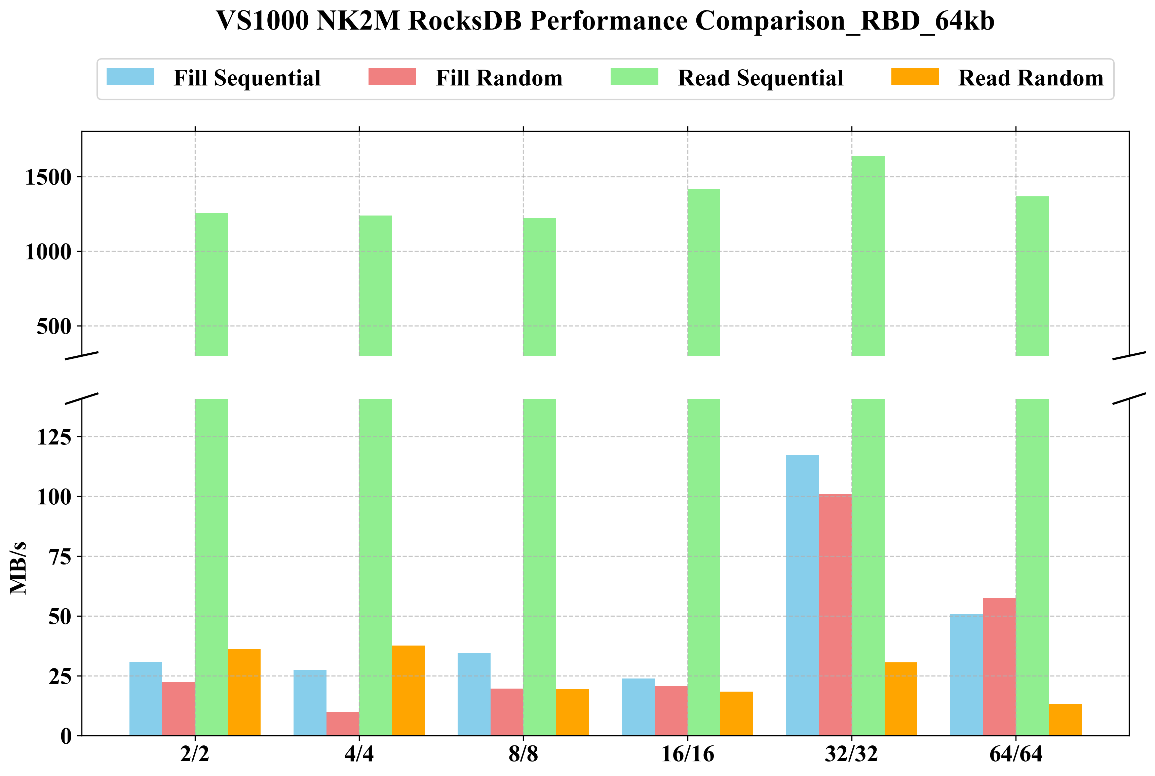
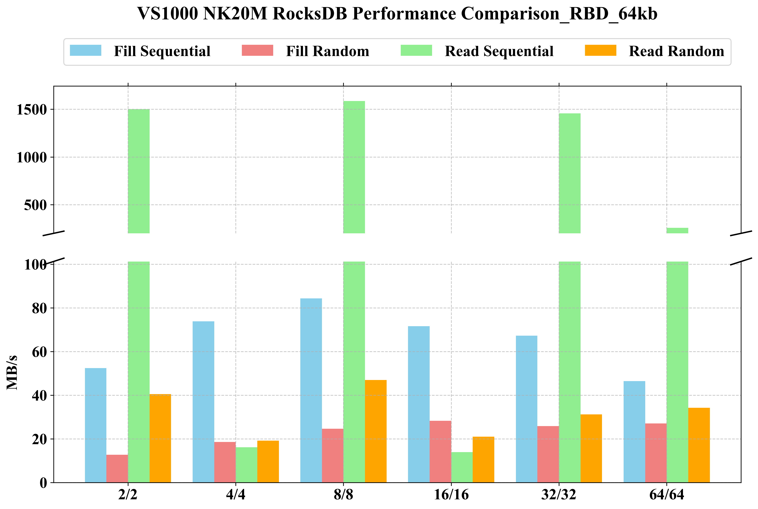
Compared RocksDB Ceph RBD
Ceph RBD - Block Size: 64kb
L0, L1 Compaction이 여러 노드에 걸쳐 이루어지면서, 모든 노드의 bandwidth를 제한
따라서, background 작업 수와 memtable의 개수가 많아지더라도 쓰기 성능에 좋은 영향을 주기 어려움

Slide 12
Thankyou

