Slide 1
Varying Latency of SSD (using FEMU)
Week 5 db_bench evaluation
2025.02.18
Presentation by Yongmin Lee
Email nascarf16@dankook.ac.kr
Notes:
실험을 진행하였습니다.

Slide 2
Previous experiments
Varying latency of SSD
Hypothesis
Experiment setup
Results & Analysis
Other Subjects
YCSB experiment
What is YCSB and Zipfian?
Hypothesis
Experiment setup
Results & Analysis

Slide 3
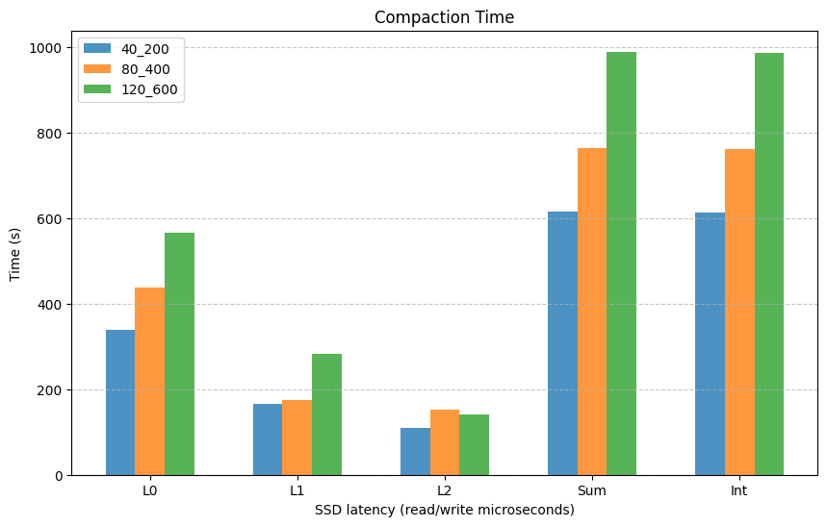
Previous Experiments
Compare between slow SSD vs fast SSD (using FEMU)
Both read and write latency are increased simultaneously
Increase independently?
(Does write latency influences more than read
latency?)

Slide 4
Using db_bench in FEMU
Hypothesis
How read and write latency affect stall and compaction
Write stall: Write latency is more important than read latency
Compaction: Write latency is also more important than read latency

Slide 5
Experiment Setup
Host
fillrandom operation
CPU | Intel i7-6700
RAM | DDR4 8GB * 4 (32GB) @ 2133 MT/s
Storage | Samsung SATA SSD 850 PRO 512GB
OS | Ubuntu 22.04.1
Kernel | 6.8.0-51-generic
FEMU Settings
Host RAM | 16 GBs
FEMU CPU | 4 vCPUs
FEMU RAM | 4 GBs
FEMU page read latency | 40 / 80 / 120 µs
FEMU page write latency | 200 / 400 / 600 µs
RocksDB version | 9.11.0
Key size | 16 Bytes
Value size | 1000 Bytes
Num. of keys | 5 Million

Slide 6
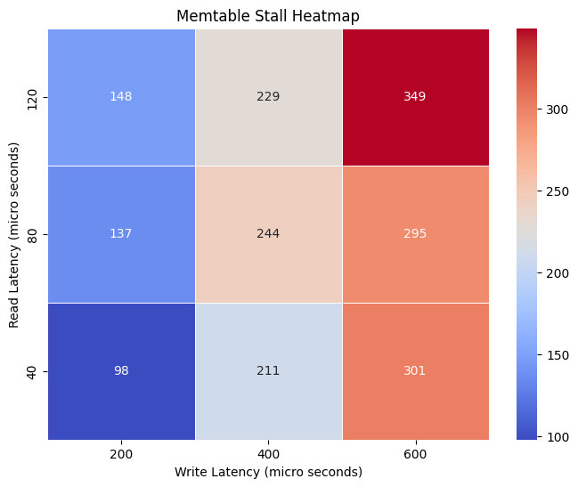
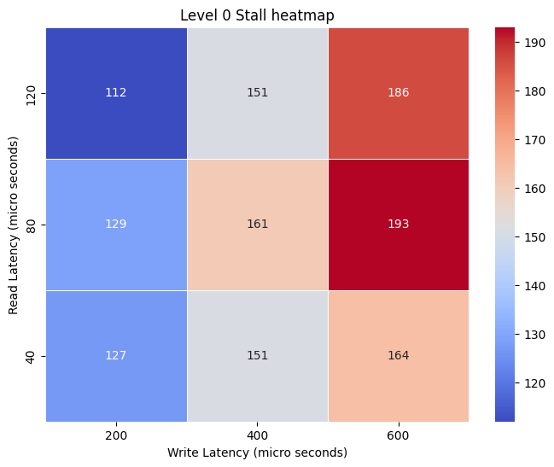
Results

Slide 7
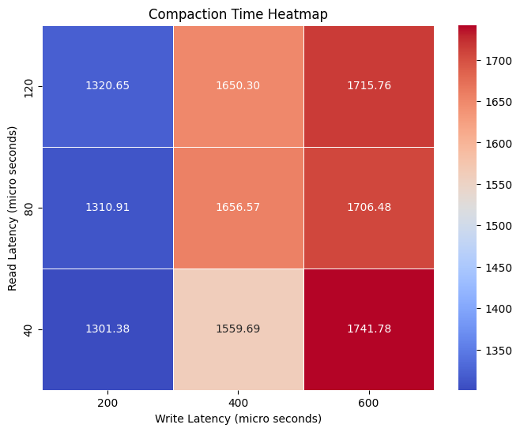
Results

Slide 8
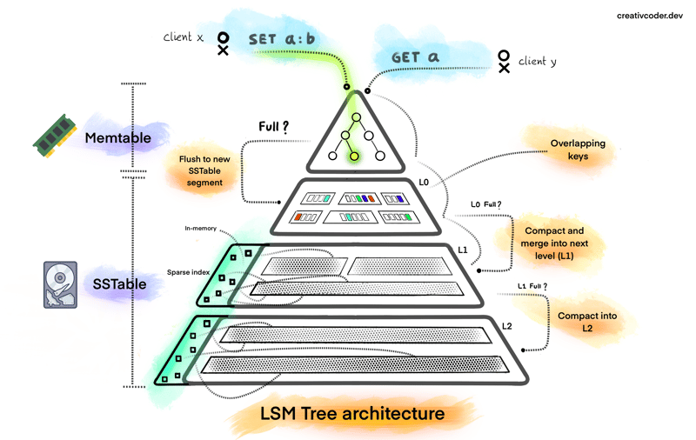
Other Subjects
Compaction:
Duplicate keys are going down to lower level
= Hot data are going down to lower level
Should hot data have to locate in higher level?
Write hot vs. Read hot?
Read Block Cache:
Words about RocksDB read cache hit ratio are low. -> How to improve? Is it actually not good?
Experiment: Using hot-cold data (Zipf: YCSB), get the read cache hit ratio
Ref: https://dev.to/creativcoder/what-is-a-lsm-tree-3d75

Slide 9
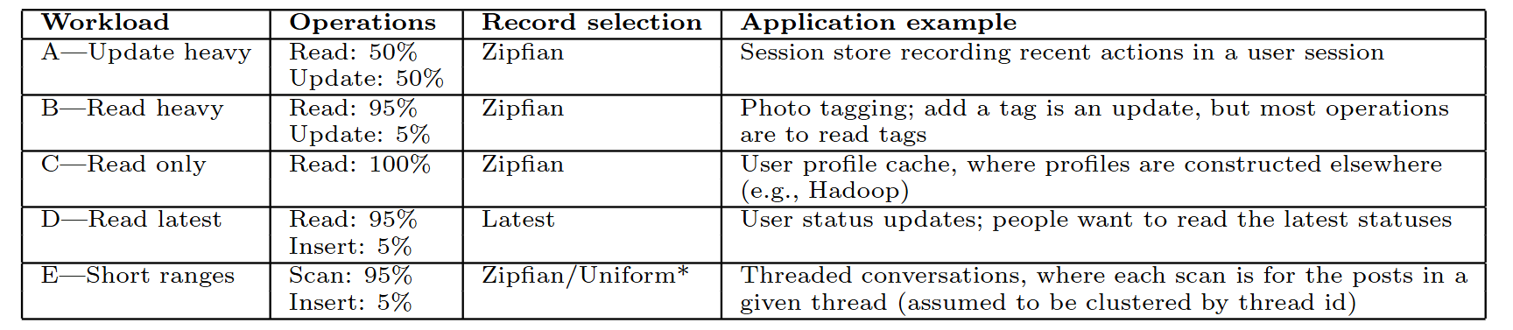
What is YCSB and Zipfian?
YCSB: Yahoo! Cloud Serving Benchmark
Benchmark that often used to compare the relative performance of NoSQL databases.
Have 5 workloads
What is Zipfian?
Ref: Cooper, Brian F., et al. "Benchmarking cloud serving systems with YCSB." Proceedings of the 1st ACM symposium on Cloud computing. 2010.

Slide 10

What is YCSB and Zipfian?
Zipfian: Zipfian distribution that follows Zipf’s law
Zipf’s law: In short,
Distribution that have hot and cold
Hot: Accessed relatively frequently
Cold: Accessed relatively infrequently
Cache hit ratio will improve compared to uniform distribution
Ref: https://en.wikipedia.org/wiki/Zipf%27s_law

Slide 11
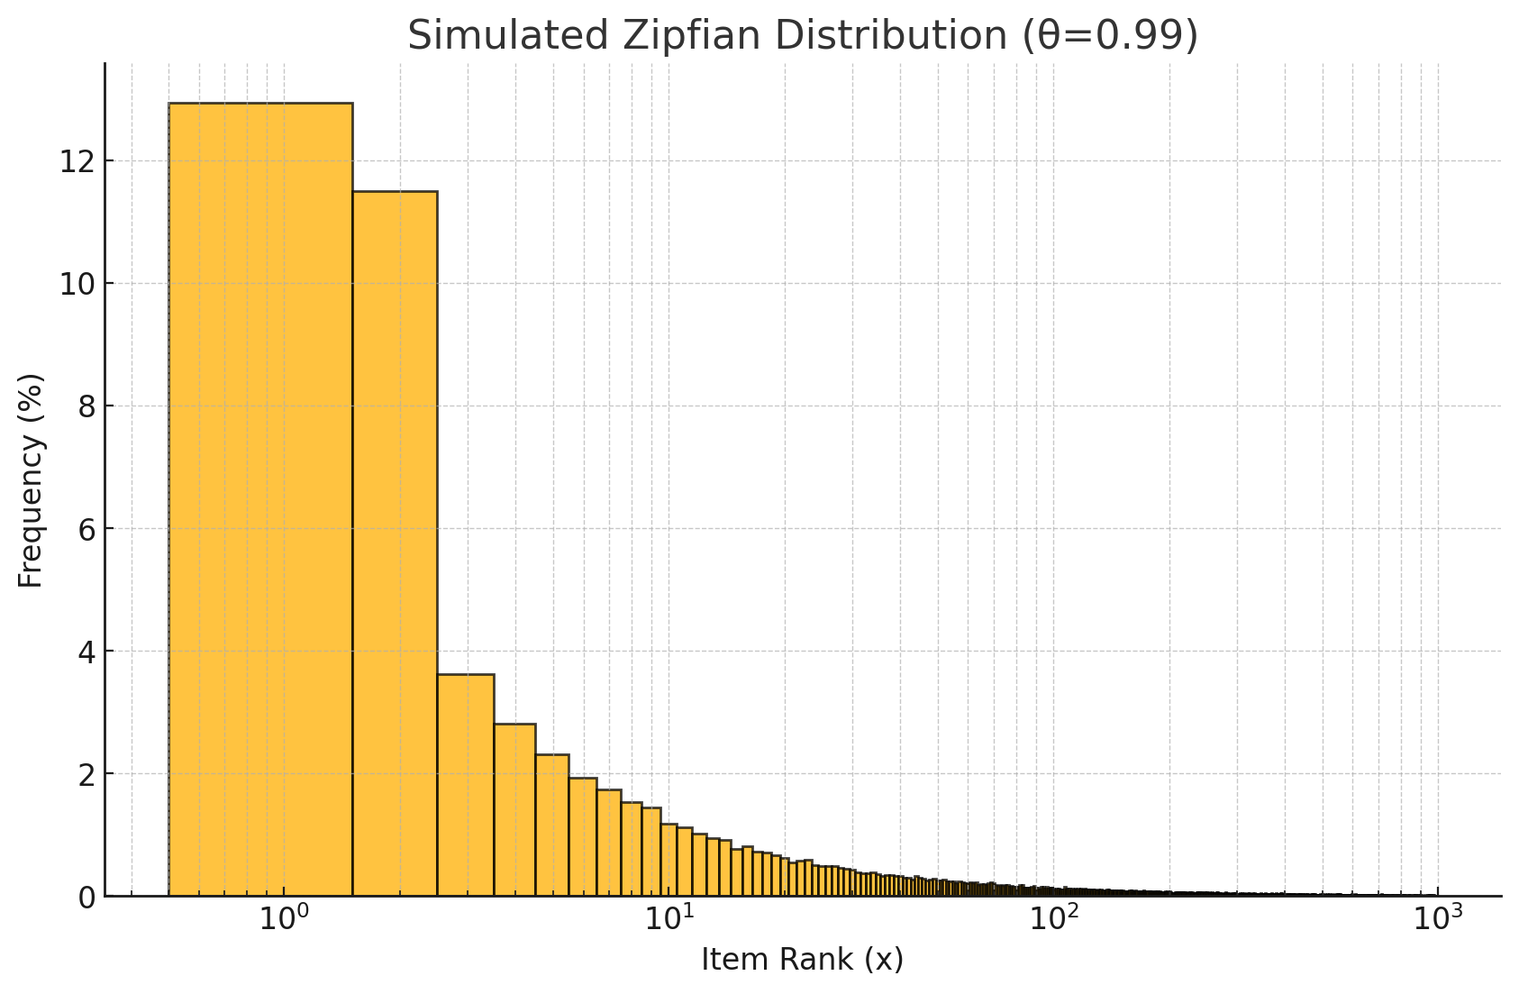
What is YCSB and Zipfian?
Implementation on RocksDB: SLIK
SILK: Preventing Latency Spikes in Log-Structured Merge Key-Value Stores (ATC 2019)
Implemented YCSB in db_bench
https://github.com/theoanab/SILK-USENIXATC2019/tree/master

Slide 12
YCSB experiment
Hypothesis
Using YCSB: utilize RocksDB’s Read cache
Compare block cache hit ratio: readseq, readrandom, YCSB
YCSB’s cache hit ratio is better than readseq and readrandom
If not, its plausible to say that there is room for cache hit improvement

Slide 13
Experiment Setup
Host
fillrandom operation
CPU | Intel i7-6700
RAM | DDR4 8GB * 4 (32GB) @ 2133 MT/s
Storage | Samsung SATA SSD 850 PRO 512GB
OS | Ubuntu 22.04.1
Kernel | 6.8.0-51-generic
Readseq, readrandom settings
Num. of keys | 50 Million
RocksDB version | 9.11.0
Key size | 16 Bytes
Value size | 1000 Bytes
Num. of keys | 50 Million
YCSB settings
Key range | 50 Million
Duration | 1800 seconds (30 mins.)

Slide 14
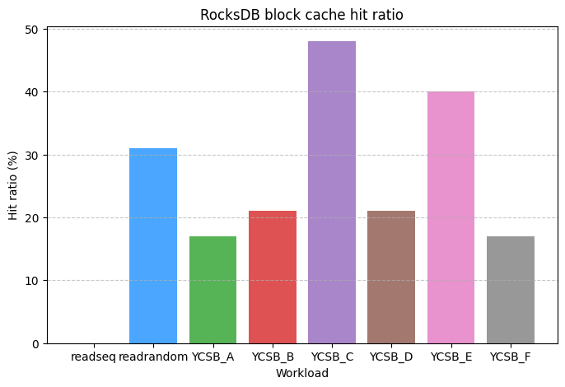
Results
Workload F: Read-modify-write workload
Read/read-modify-write ratio: 50/50

Slide 15
Thank you!
Q & A ?
2025.02.18
Presentation by Yongmin Lee
Email nascarf16@dankook.ac.kr

