Slide 1
Advanced RocksDB
System Software Lab
Suhwan Shin, Zhu Yongjie
25.02.25

Slide 2
Contents
Optimizing Learned Index in LSM Tree
RocksDB Performance in Ceph

Slide 3

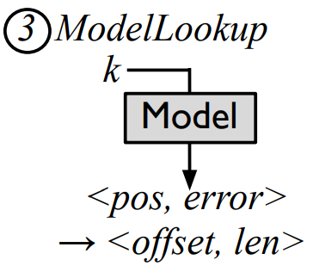

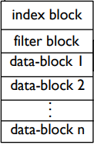


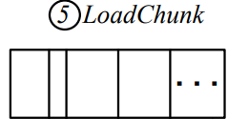
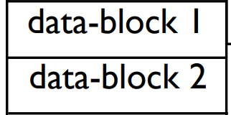


Multi DataBlock Access
Check the impact of using Error bound on the Lookup process

Slide 4
Multi DataBlock Access
Check the impact of using Error bound on the Lookup process
Num of Keys
About 50% of data access is due to filtering occurring in multiple data blocks

Slide 5

Multi DataBlock Access
Check the impact of using Error bound on the Lookup process
Kernel Linear Model 1
Kernel Linear Model 2
Kernel Linear Model n
A one-to-one mapping between the model and the DataBlock can avoid such situations
&
Kernel functions(Log Transformation) or RMI(Recursive Model Index)
can reduce model complexity

Slide 6
Get rid of the FilterBlock?
Check the impact of using Error bound on the Lookup process
LSM Tree still needs to check if there is a lookup key in the data block.

Slide 7
Get rid of the FilterBlock?
Can indexes replace filters?
0
180
Key’s position
300
400
1504
1709
300
Key
RMI typically uses the first key of a segment for learning.

Slide 8
Get rid of the FilterBlock?
Can indexes replace filters?
Gap-based RMI
0
180
Key’s position
300
400
1504
1709
180
300
Key
By using the last key and first key of the segment, we can construct an empty model
We can use this method to preliminarily filter out negative readings

Slide 9
Get rid of the FilterBlock?
Can indexes replace filters?
0
180
Key’s position
300
400
1504
1709
？
Key
But how to filter out negative reads within the range of the data-block still needs to be considered

Slide 10
Contents
Optimizing Learned Index in LSM Tree
RocksDB Performance in Ceph

Slide 11
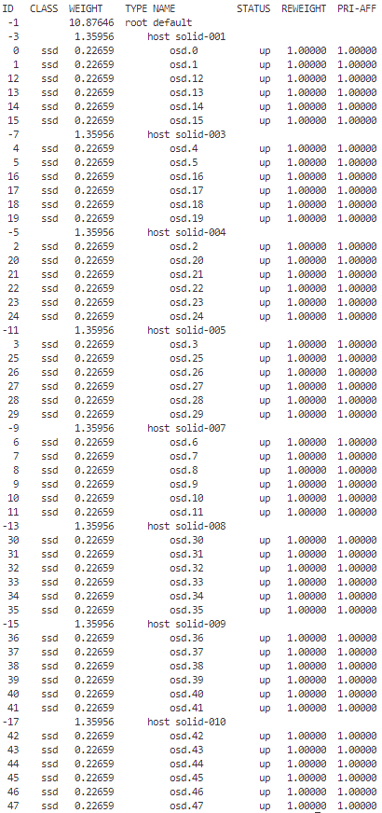
Experiment Setup
Ceph: solid-001~010 (except solid-002, 006(master))
Local: solid-002
CPU
Intel Xeon Silver 4210R @ 2.40GHz
Dual socket with 10 cores per socket (20 cores total)
Hyper-threading enabled (40 threads total)
L3 cache: 27.5MB (13.75MB per socket)
Storage
System disk (sda): 894.3GB - Configured with Ubuntu LVM
Additional disks
sdb: 931.5GB, sdc: 931.5GB, sdd: 465.8GB → Ceph OSD (per about 500GB)

Slide 12
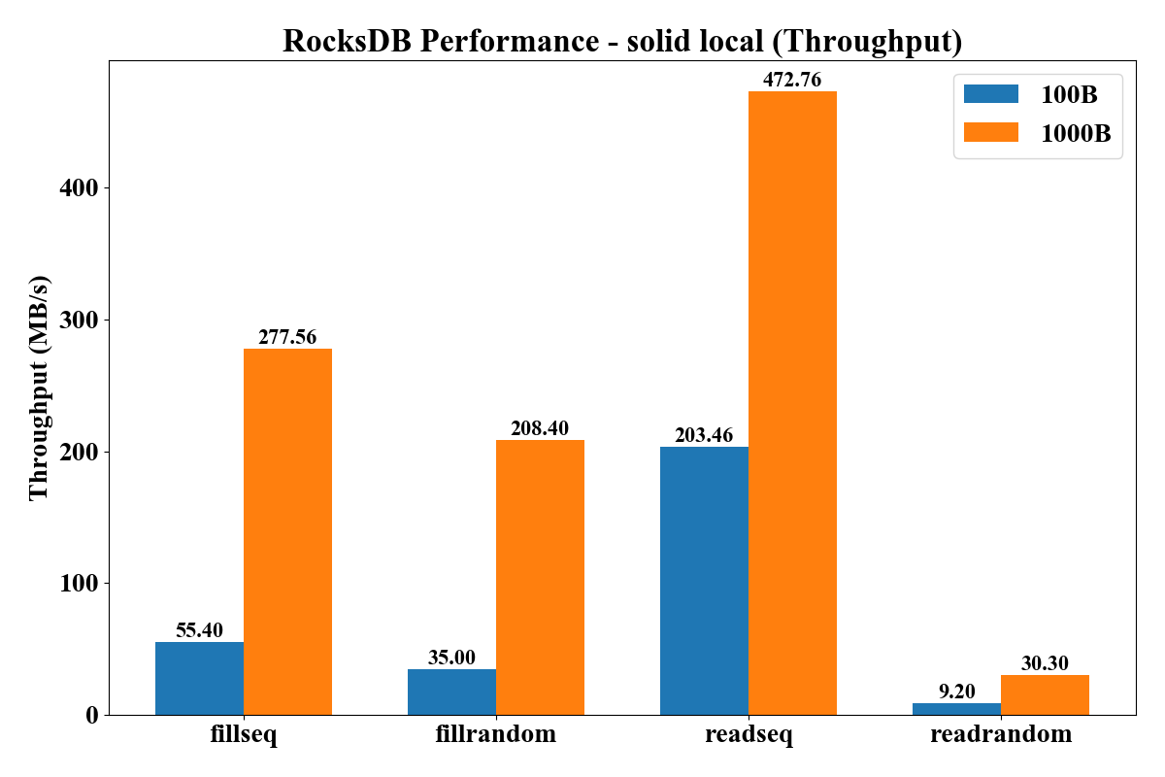
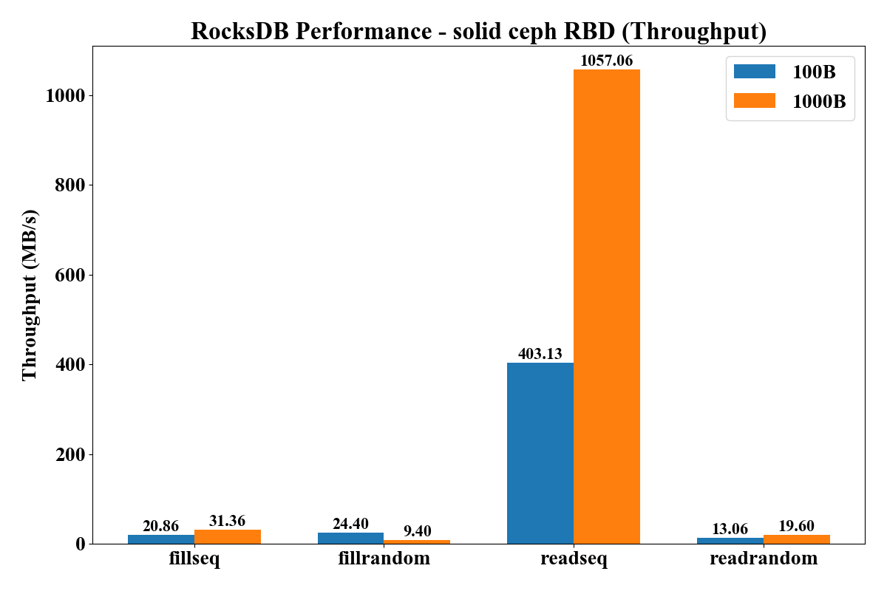
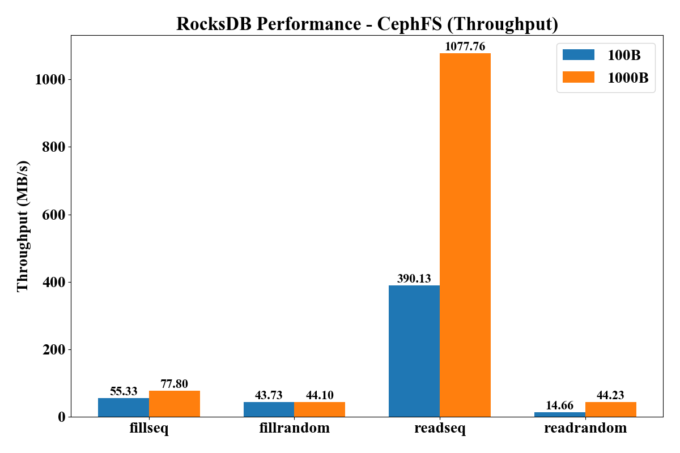
Compared RocksDB: Single Machine vs Ceph
RocksDB db_bench Performance (Bandwidth) - Local (Solid-002) vs Ceph RBD vs Ceph FS
Value Size: 100 Byte / 1000 Byte
Key Entries: 2M
Performance: readseq > fillseq > fillrandom > readrandom

Slide 13
Compared RocksDB: Single Machine vs Ceph
RocksDB db_bench Performance (Bandwidth) - Local (Solid-002) vs Ceph RBD vs Ceph FS
Value Size: 100 Byte / 1000 Byte
Key Entries: 2M
Performance: readseq > fillseq > fillrandom > readrandom
x2

Slide 14
Compared RocksDB: Single Machine vs Ceph
RocksDB db_bench Performance (Bandwidth) - Local (Solid-002) vs Ceph RBD vs Ceph FS
Value Size: 100 Byte / 1000 Byte
Key Entries: 2M
Performance: readseq > fillseq > fillrandom > readrandom
Best performance

Slide 15
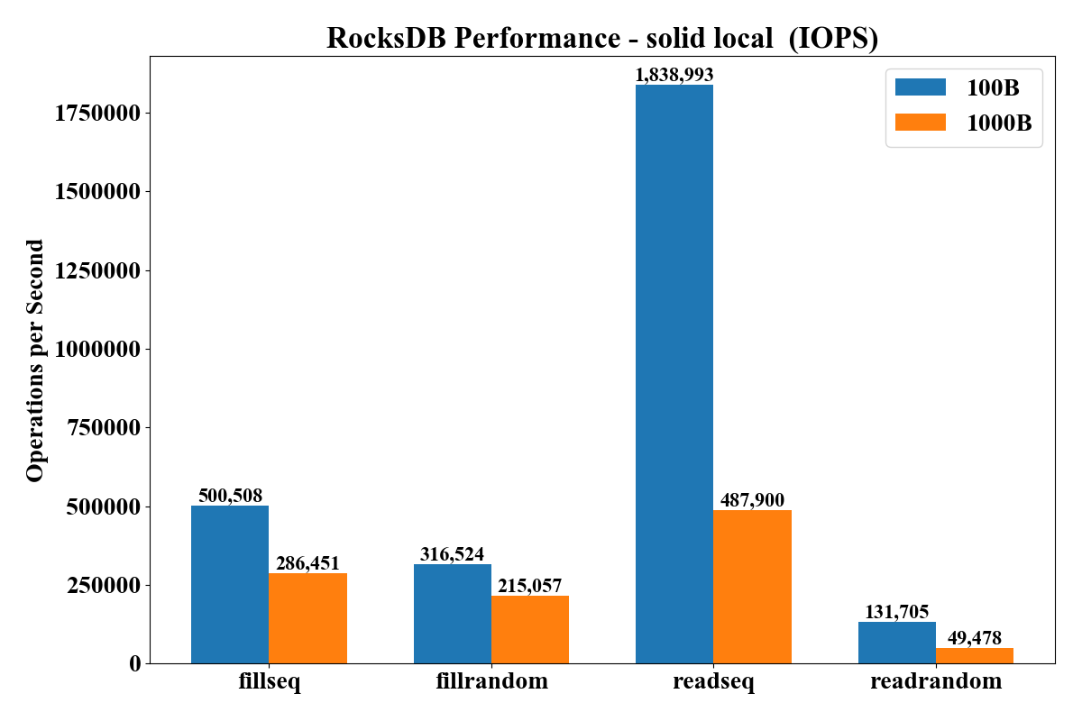
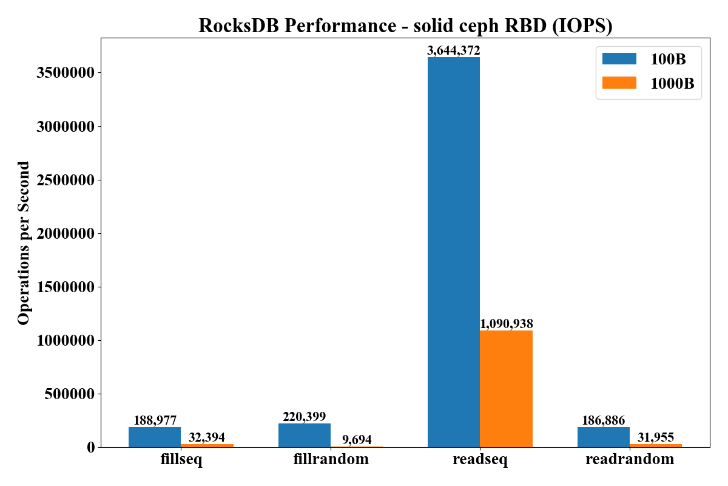
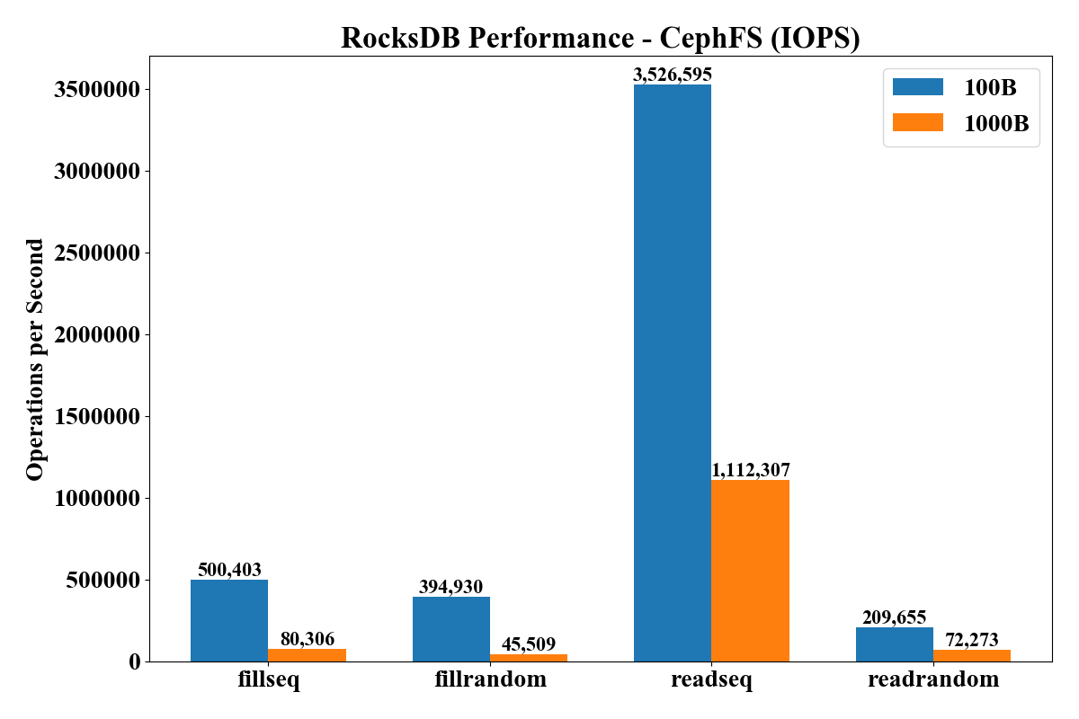
Compared RocksDB: Single Machine vs Ceph
RocksDB db_bench Performance (Bandwidth) - Local (Solid-002) vs Ceph RBD vs Ceph FS
Value Size: 100 Byte / 1000 Byte
Key Entries: 2M
Performance: readseq > fillseq > fillrandom > readrandom

Slide 16
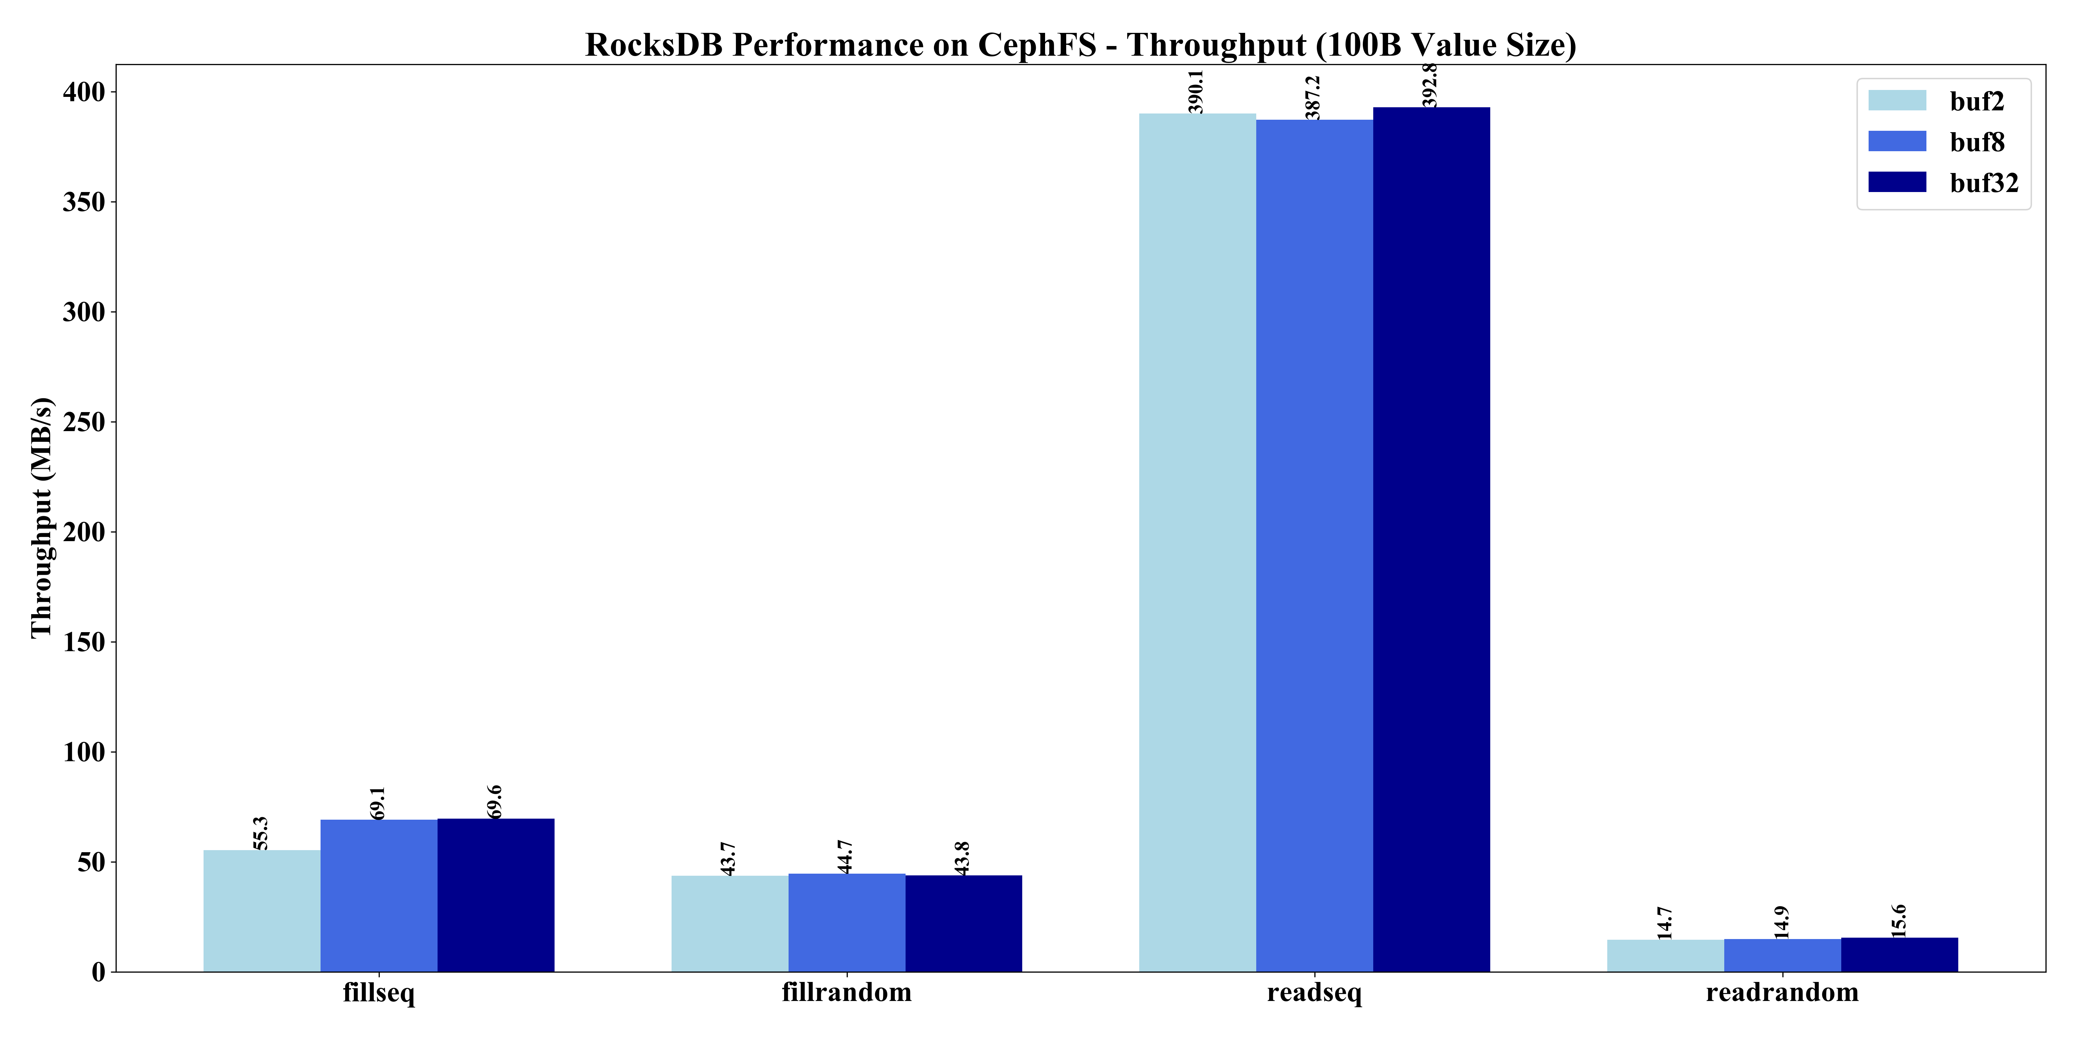
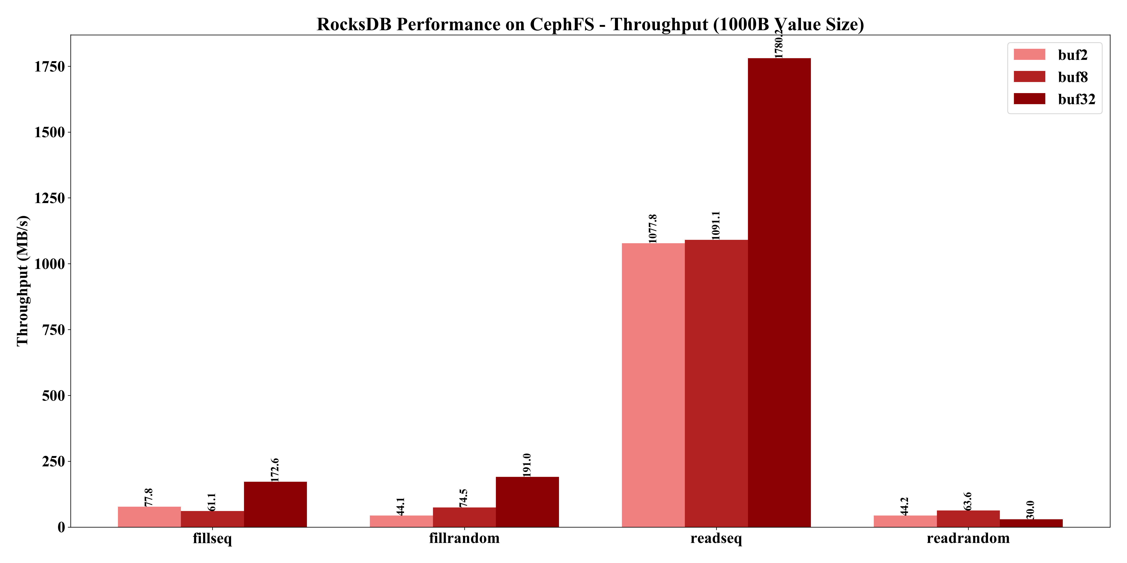
Compared RocksDB - Ceph File System
RocksDB db_bench Performance (Bandwidth) - Local (Solid-002) vs Ceph RBD vs Ceph FS
Value Size: 100 Byte, 1000 Byte
Key Entries: 2M
Max_write_buffer_number, Max_background_jobs: 2, 8, 32
Performance: readseq > fillseq > fillrandom > readrandom

Slide 17
Thank you

Slide 18
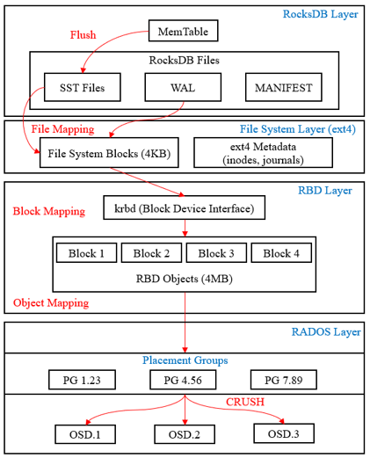
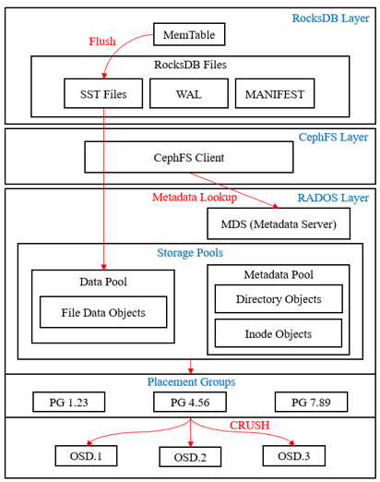
RocksDB in Ceph Architecture
Ceph RBD
Ceph File System

