Slide 1
Final Presentation
2025.02.25
Presentation by Yongmin Lee
Email nascarf16@dankook.ac.kr
Notes:
실험을 진행하였습니다.

Slide 2
Exp. 1: Block Cache hit ratio
Using YCSB
Exp. 2: Block Align
Align data block size and SSD page size

Slide 3
Experiment 1
Block cache hit ratio
Using YCSB: utilize RocksDB’s Read cache
Compare block cache hit ratio: readseq, readrandom, YCSB
YCSB’s cache hit ratio will be better than readseq and readrandom
If not, its plausible to say that there is room for cache hit improvement

Slide 4
Experiment 1 Setup
Host
fillseq/fillrandom operation
CPU | Intel i7-6700
RAM | DDR4 8GB * 4 (32GB) @ 2133 MT/s
Storage | Samsung SATA SSD 850 PRO 512GB
OS | Ubuntu 22.04.1
Kernel | 6.8.0-51-generic
readseq, readrandom, YCSB: 50 Million keys
RocksDB version | 9.11.0
Key size | 16 Bytes
Value size | 1000 Bytes
Num. of keys | 50 Million

Slide 5
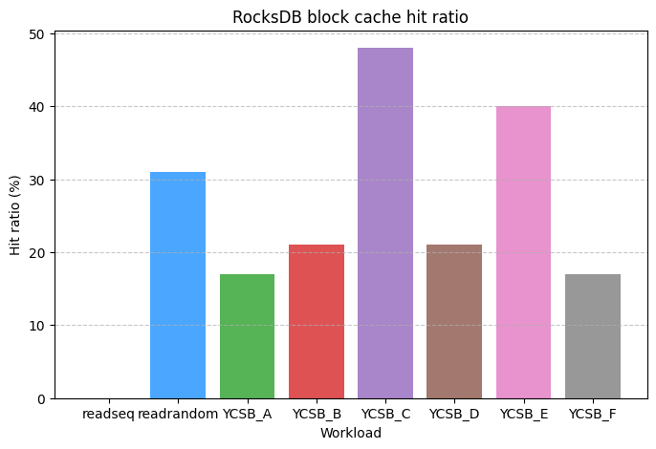
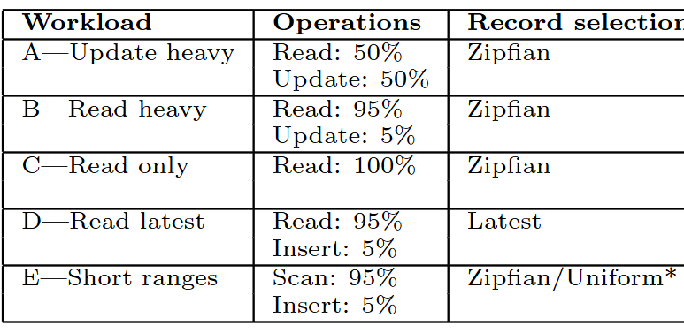
Experiment 1 Results: fillrandom
Workload F: Read-modify-write workload
Read/read-modify-write ratio: 50/50

Slide 6
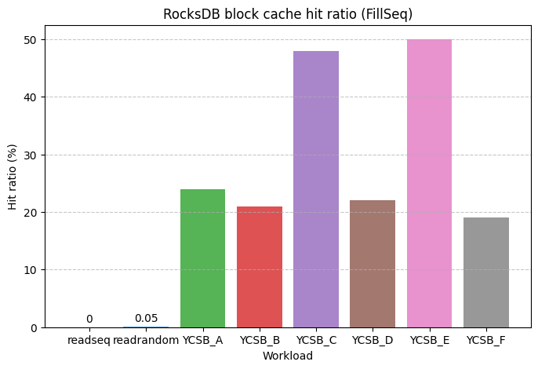
Experiment 1 Results: fillseq
Workload F: Read-modify-write workload
Read/read-modify-write ratio: 50/50
Note: YCSB_D done 101118999 operations (reads:96,064,476 writes:5,054,523)
Notes:
ycsbwkldd : 17.811 micros/op 56146 ops/sec 1800.991 seconds 101118999 operations; ( reads:96064476 writes:5054523 total:52428800 found:96064476 done:52428800)

Slide 7
Experiment 1 results
YCSB Workload shows better hit ratio than readseq and readrandom
Cache make a good use of hot data.
Readrandom shows good hit ratio on fillrandom but not in fillseq
Non-existing keys in fillrandom
YCSB_D performed more operation than the specified num
Code error or insert operation exaggerates operation numbers.

Slide 8
Experiment 2
Block Align
RocksDB default data block size: 4KB
Normal SSD’s page size: 16KB
Samsung 850 PRO 512 GB (SATA): 16KB page size
SK Hynix Platinum P51 500 GB (PCIe 5.0): 16KB page size
Option: block_align (Align data blocks on page size) type: bool default: false
Align the data block size to SSD’s page size: Bigger data block size

Slide 9
Experiment 2
Hypothesis
Keeping the page size and block size the same will improve performance.
Readseq: spatial locality
Using block_align will help aligning pages
Will show organized LBA access pattern

Slide 10
Experiment 2 Setup
Host
fillrandom/fillseq operation
FEMU Settings
CPU | Intel i7-6700
RAM | DDR4 8GB * 4 (32GB) @ 2133 MT/s
Storage | Samsung SATA SSD 850 PRO 512GB
OS | Ubuntu 22.04.1
Kernel | 6.8.0-51-generic
Host RAM | 16 GBs
FEMU CPU | 4 vCPUs
FEMU RAM | 4 GBs
FEMU page read latency | 40 µs (default)
FEMU page write latency | 200 µs (default)
FEMU page size | 512*8 = 4KB (default) 2048*8 = 16KB
RocksDB version | 9.11.0
Key size | 16 Bytes
Value size | 1000 Bytes
Num. of keys | 15 Million
sector size * number of sectors in a flash page
-block_align (Align data blocks on page size) type: bool default: false
Have to turn off compression
Using zero-fill to align

Slide 11
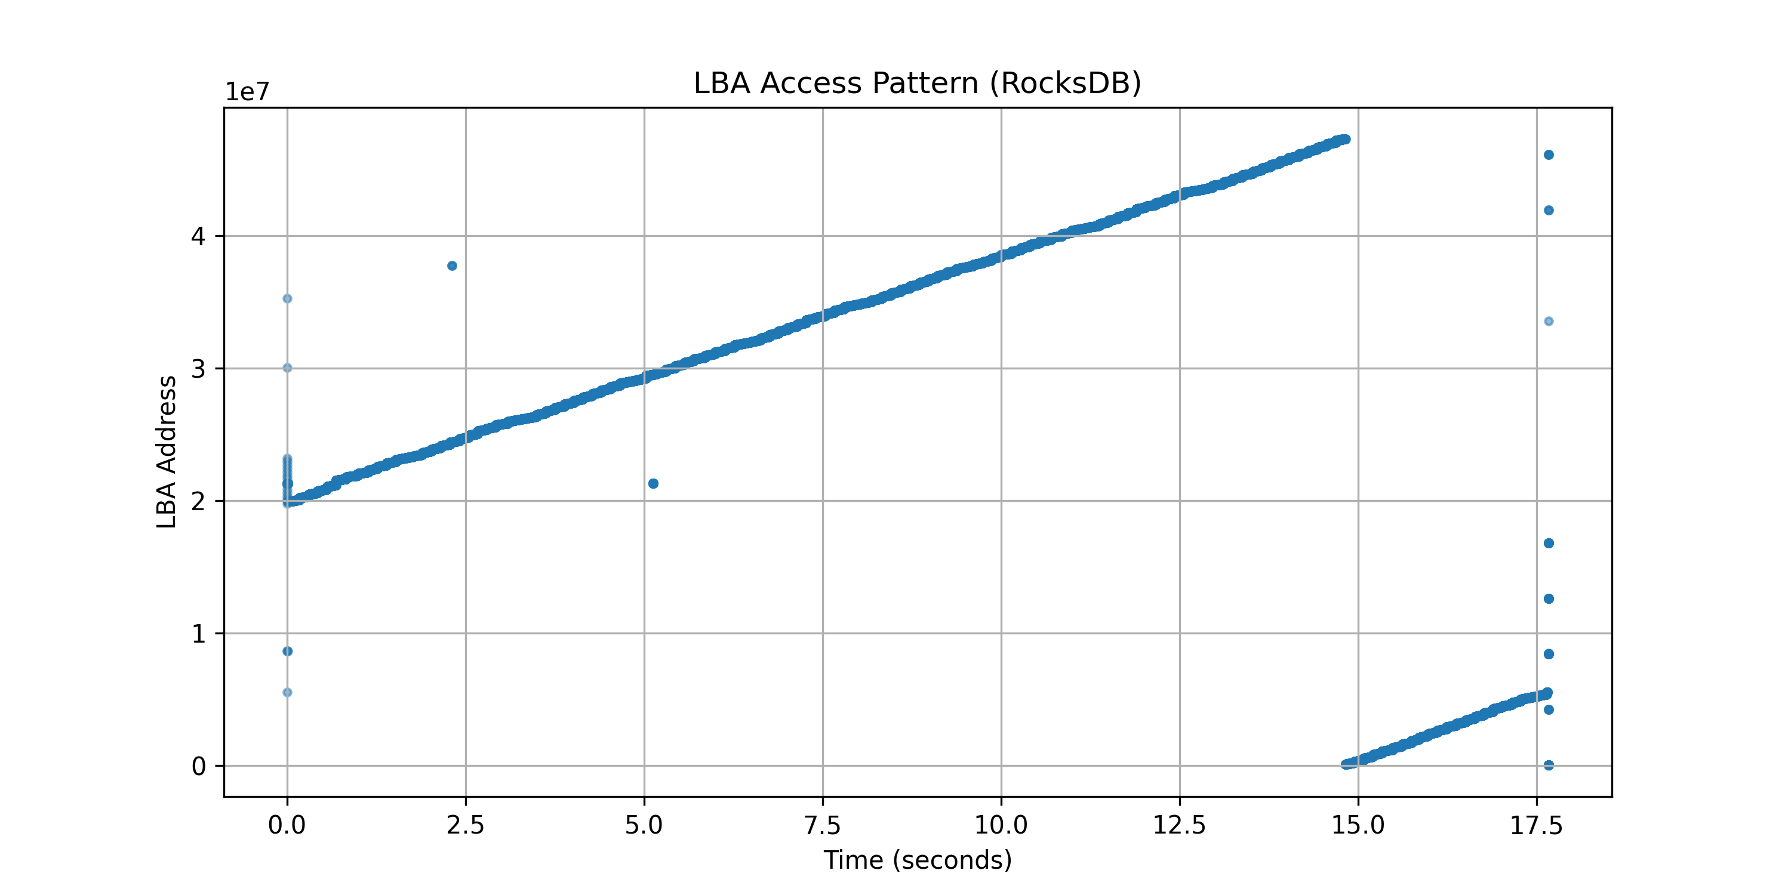
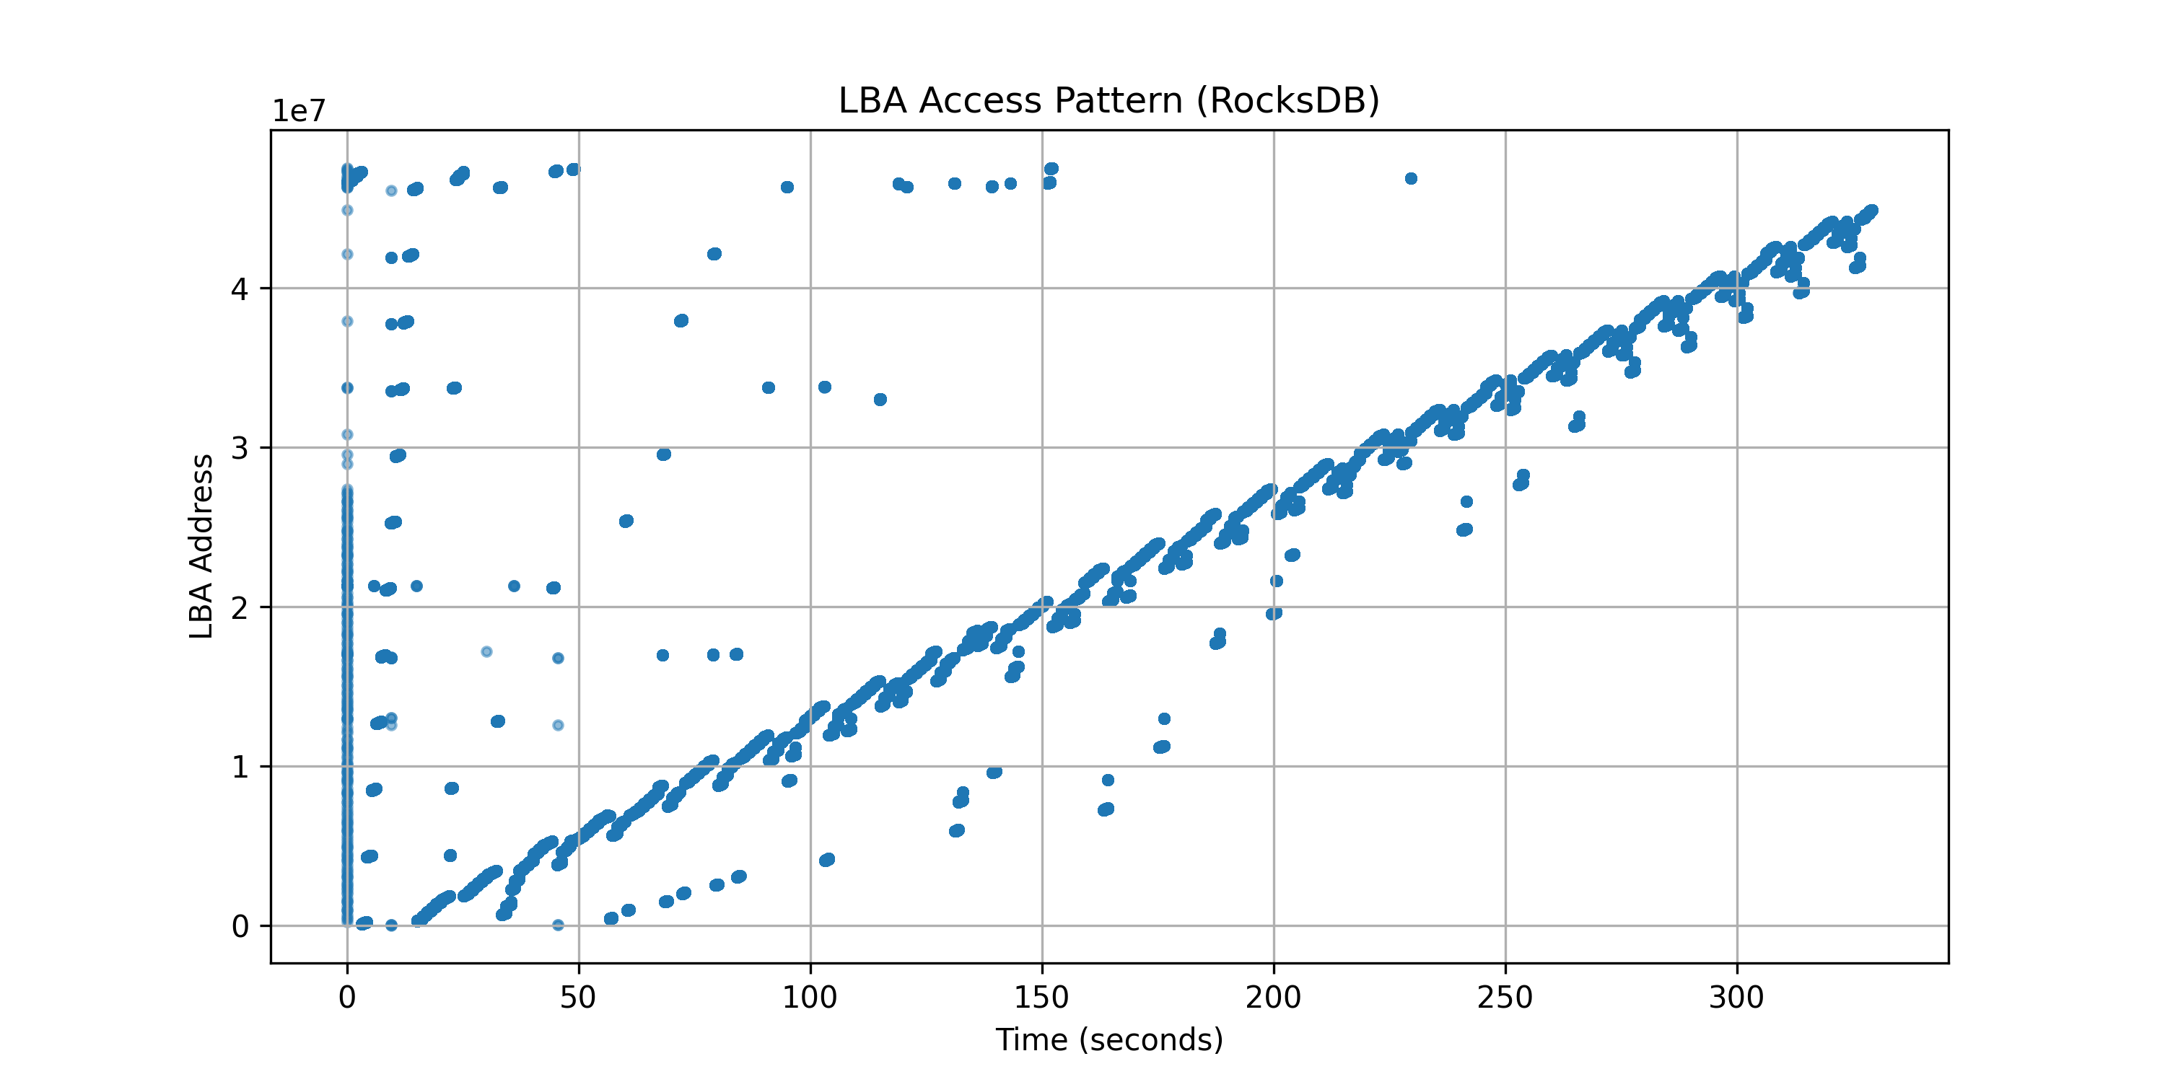
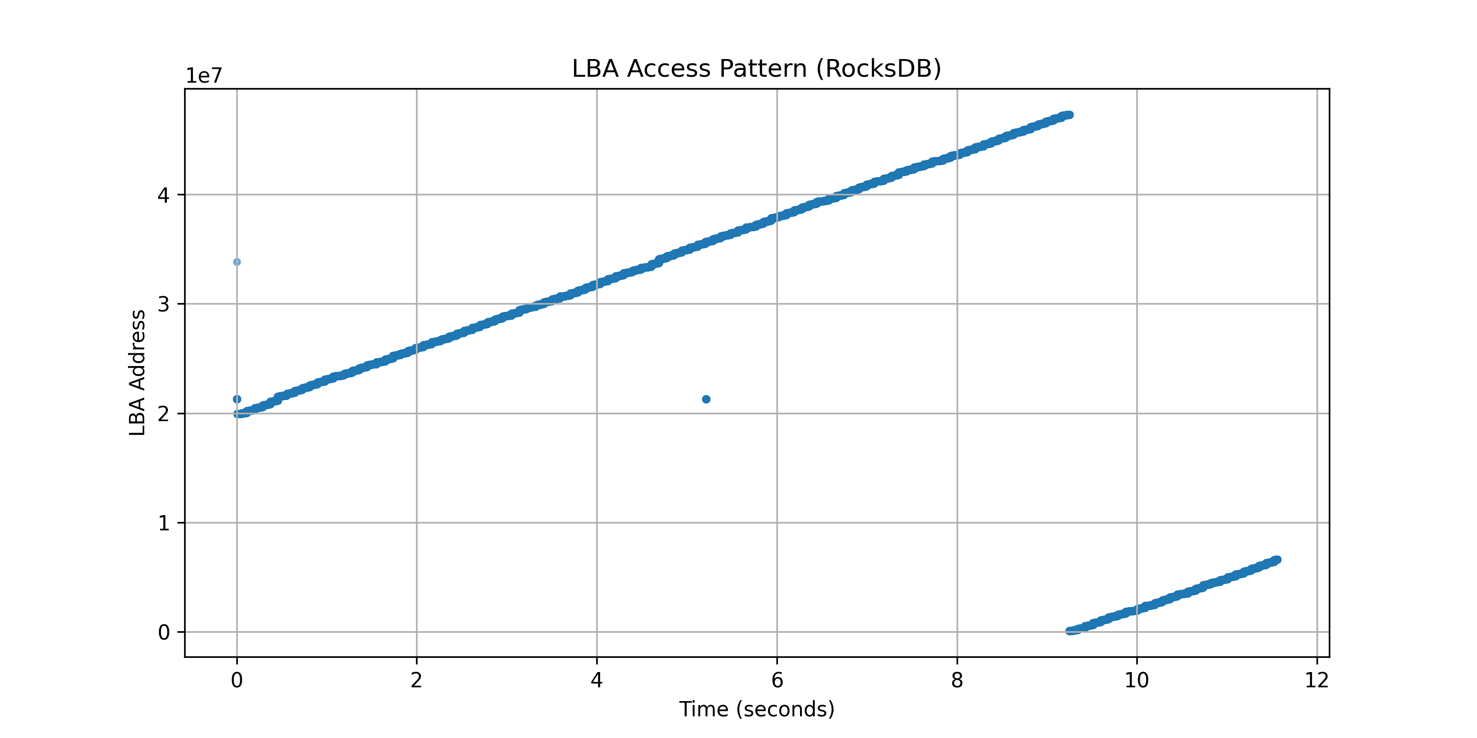
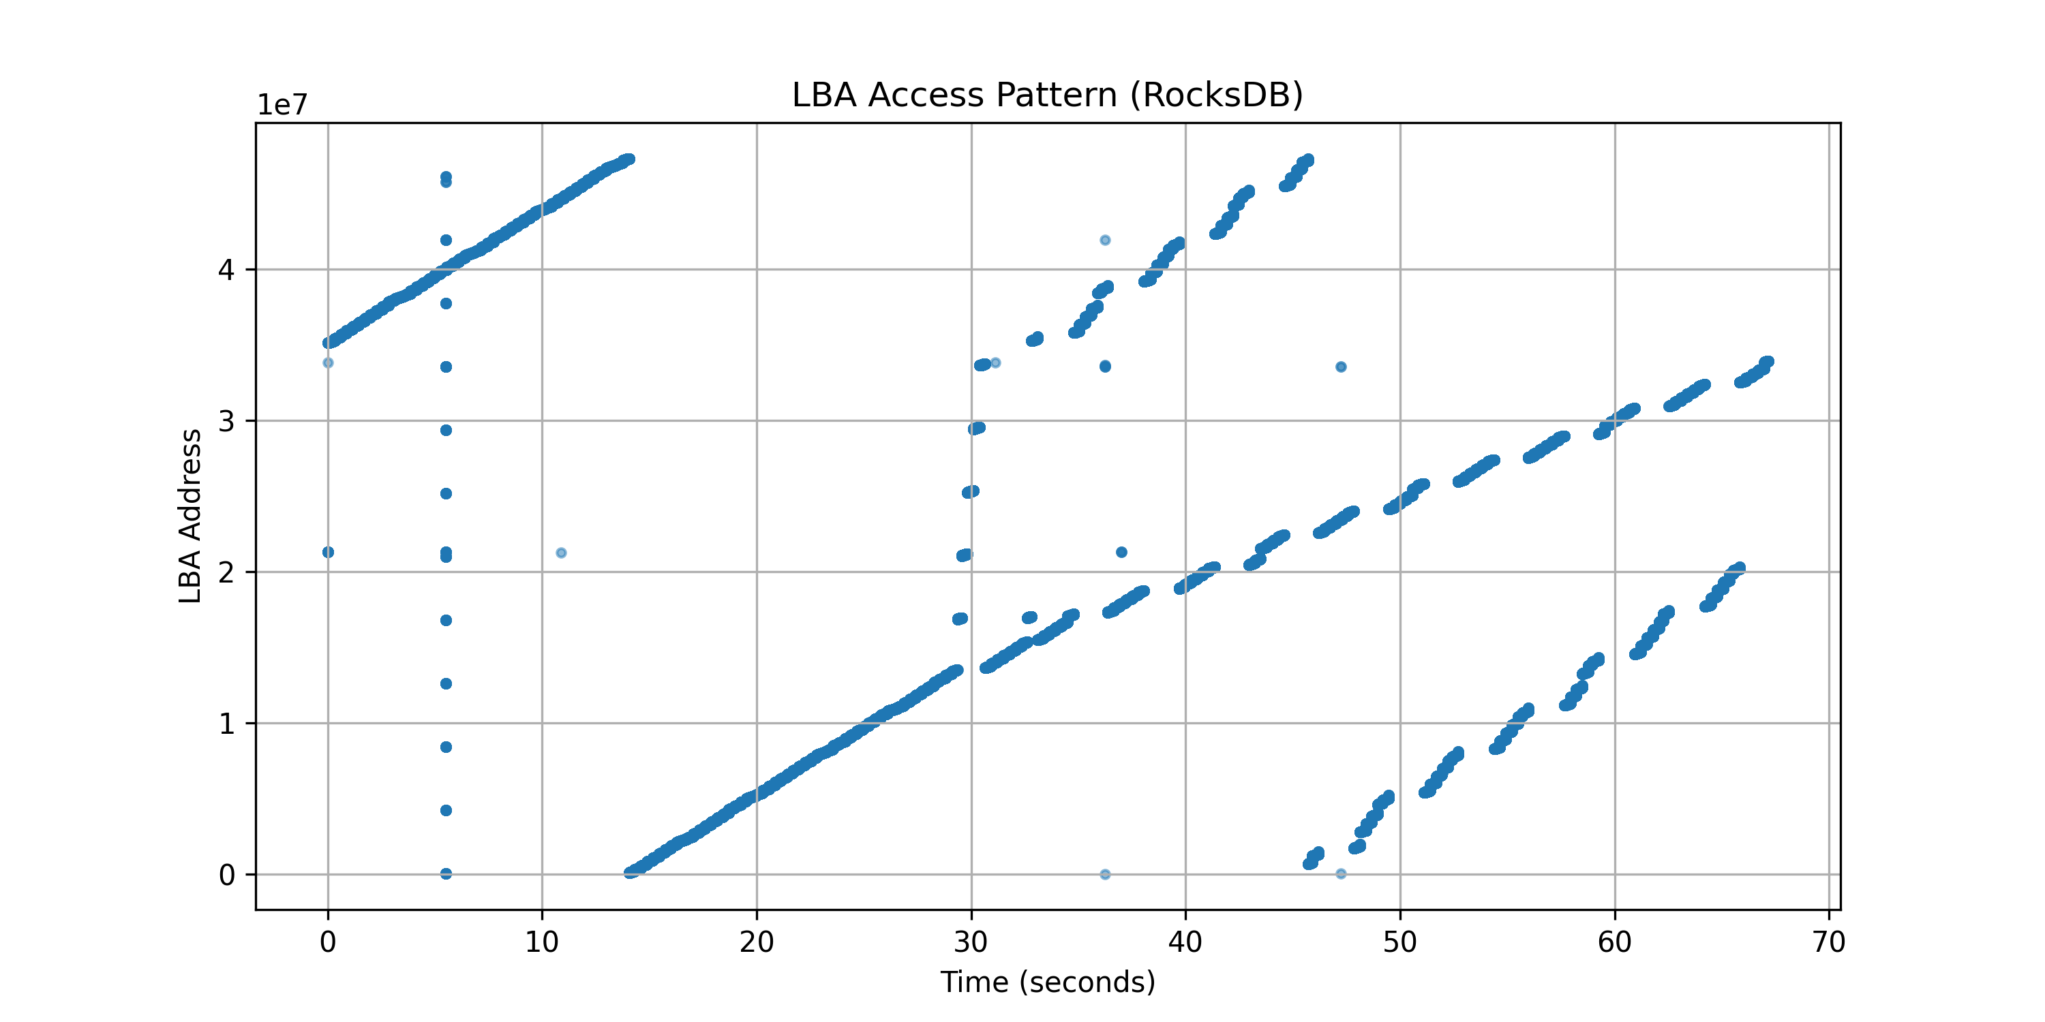
Experiment 2: fillseq/readseq
4KB page (no align, 4K block)
4KB page (aligned, 4K block)
16KB page (no align, 16K block)
16KB page (aligned, 16K block)

Slide 12
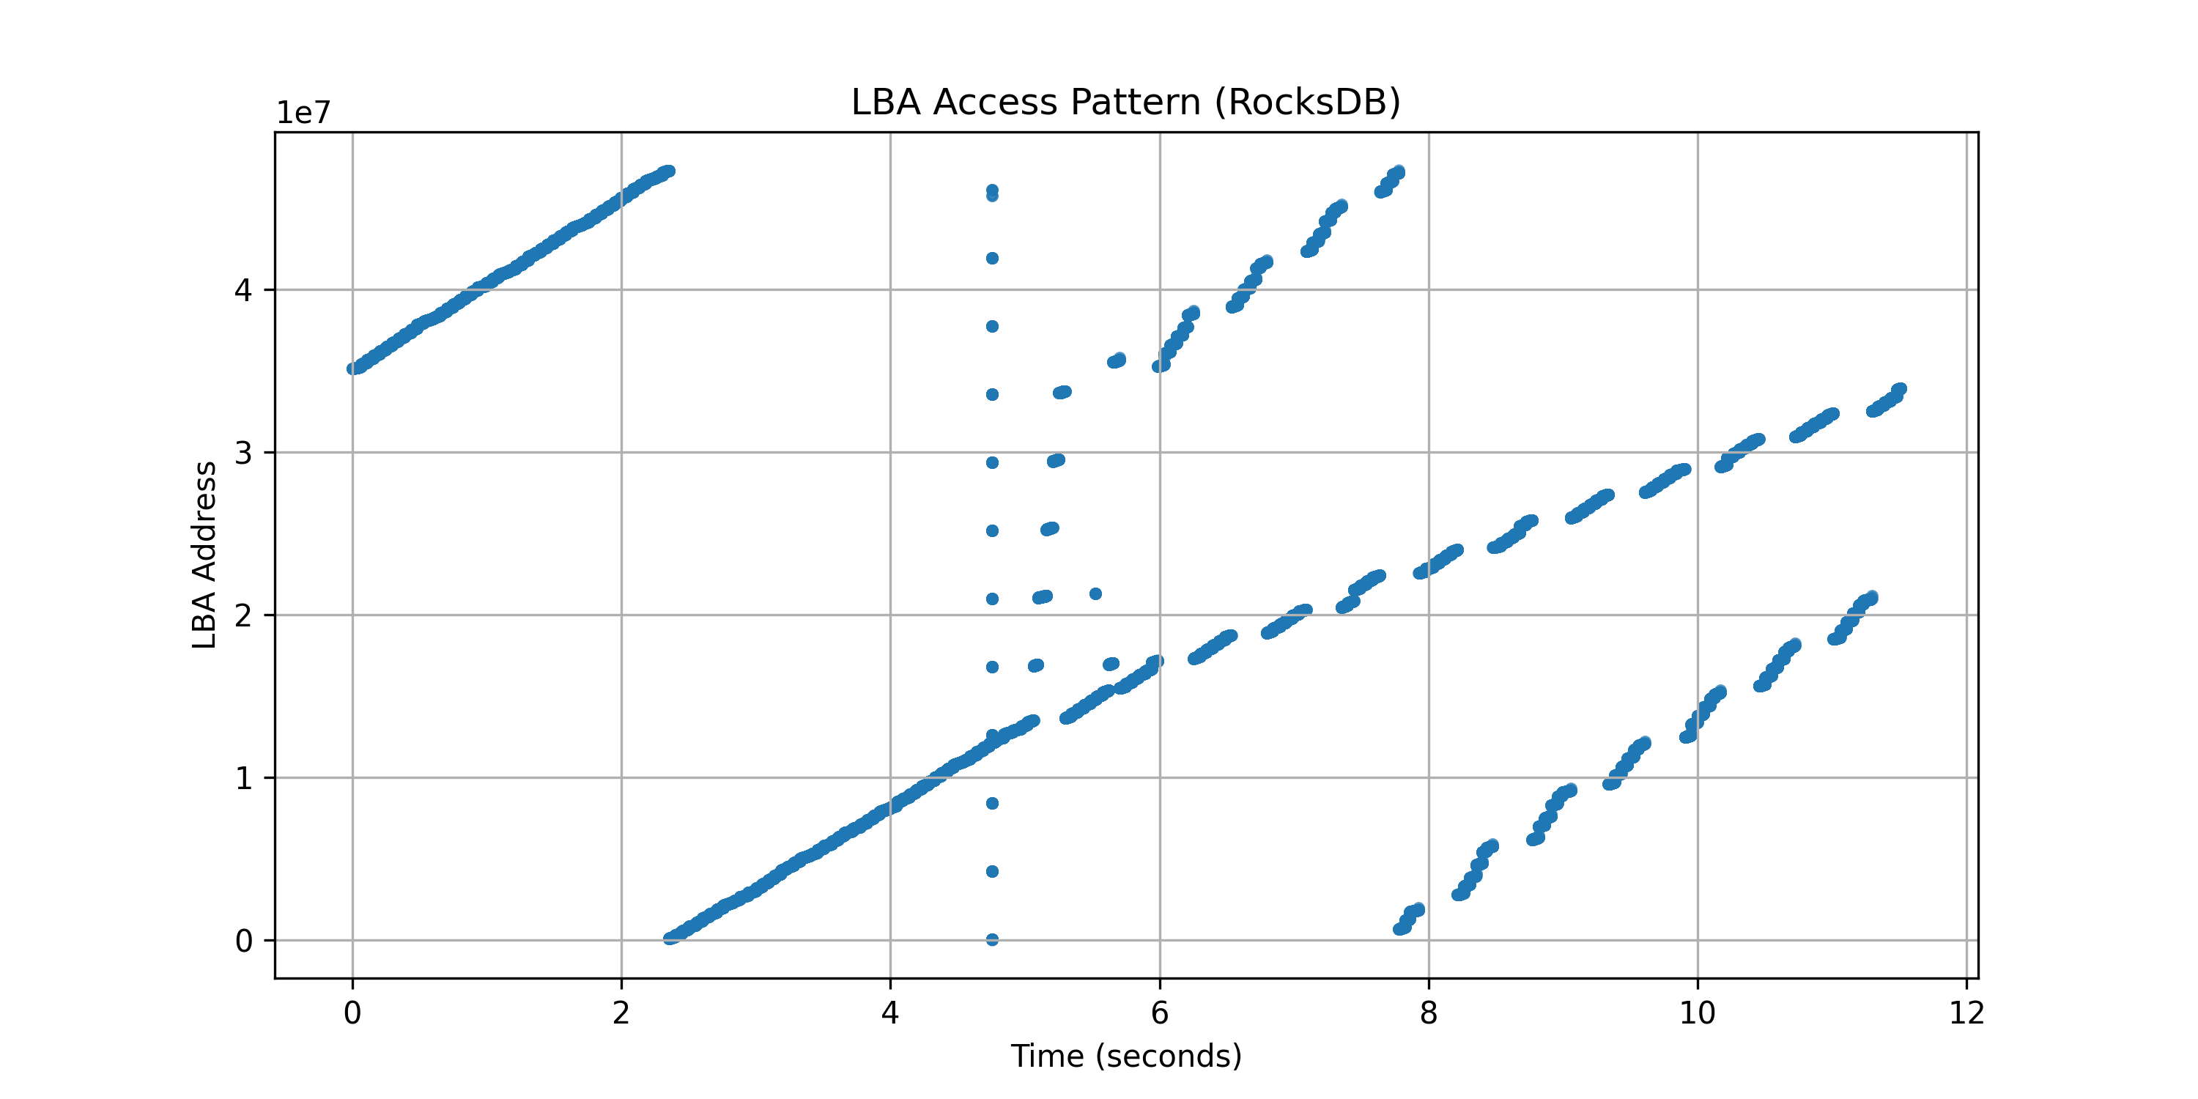
Experiment 2: fillseq/readseq
No compression (no align 16K block)
16KB page (aligned, 16K block)
Throughput: 1323.9 MB/s
Throughput: 226.9 MB/s

Slide 13
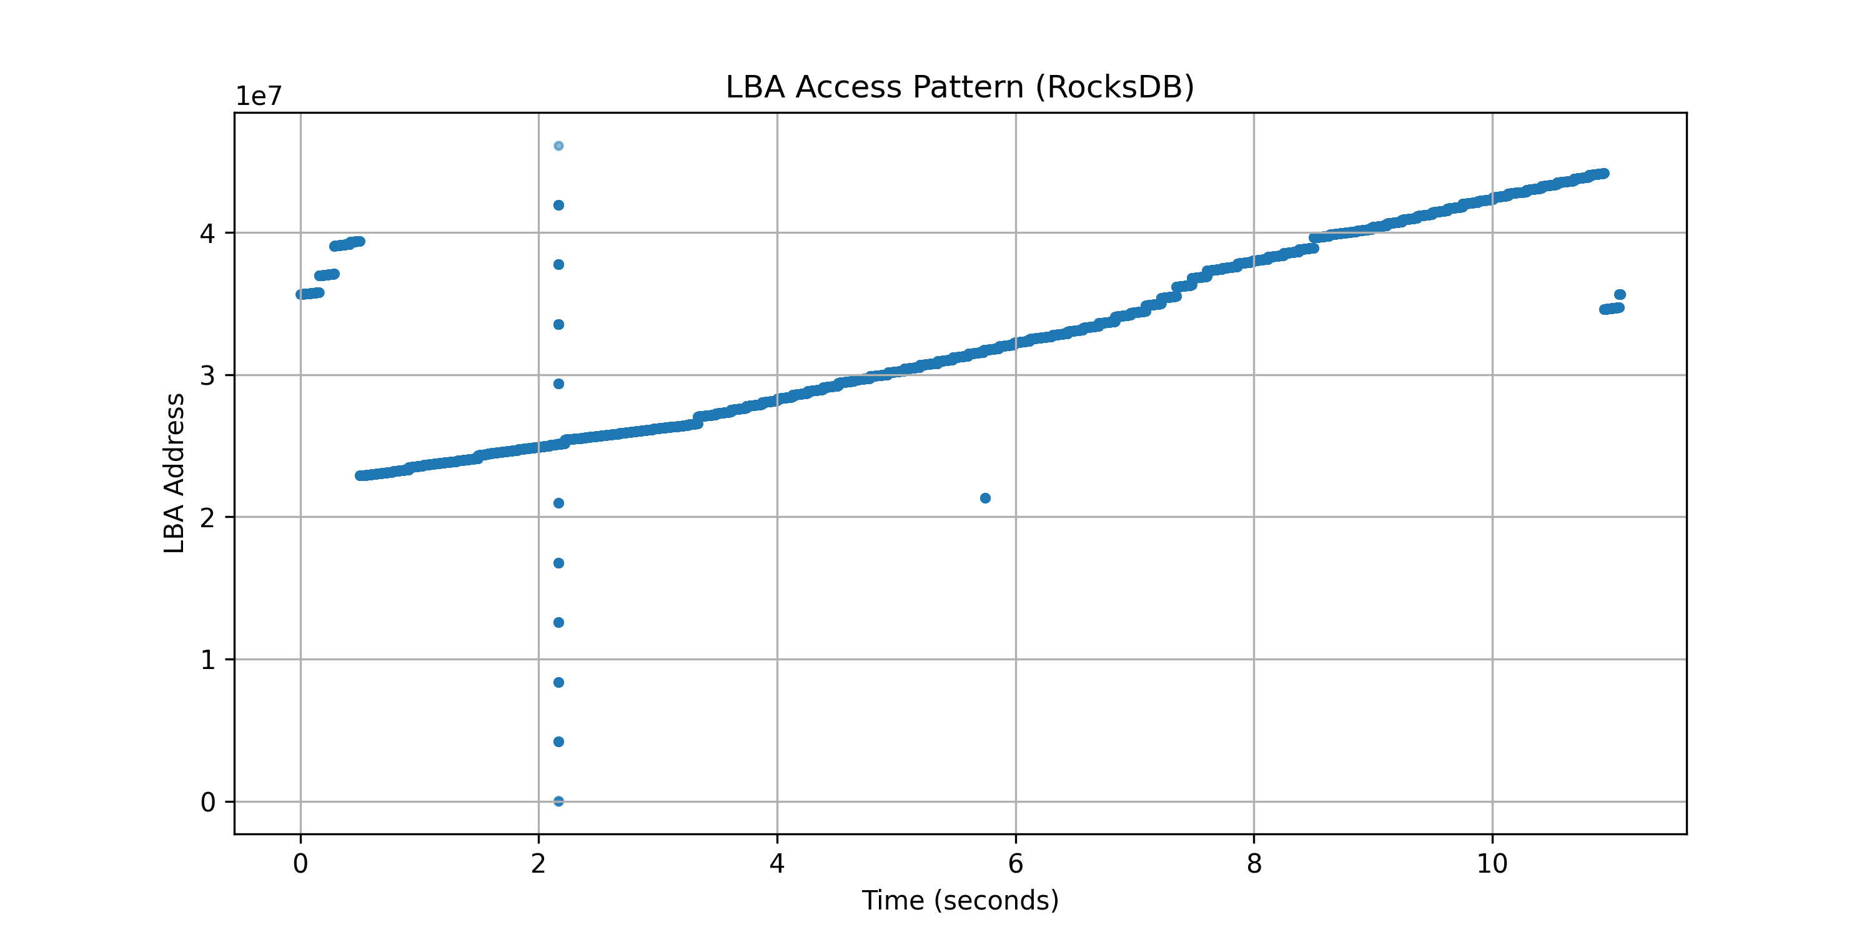
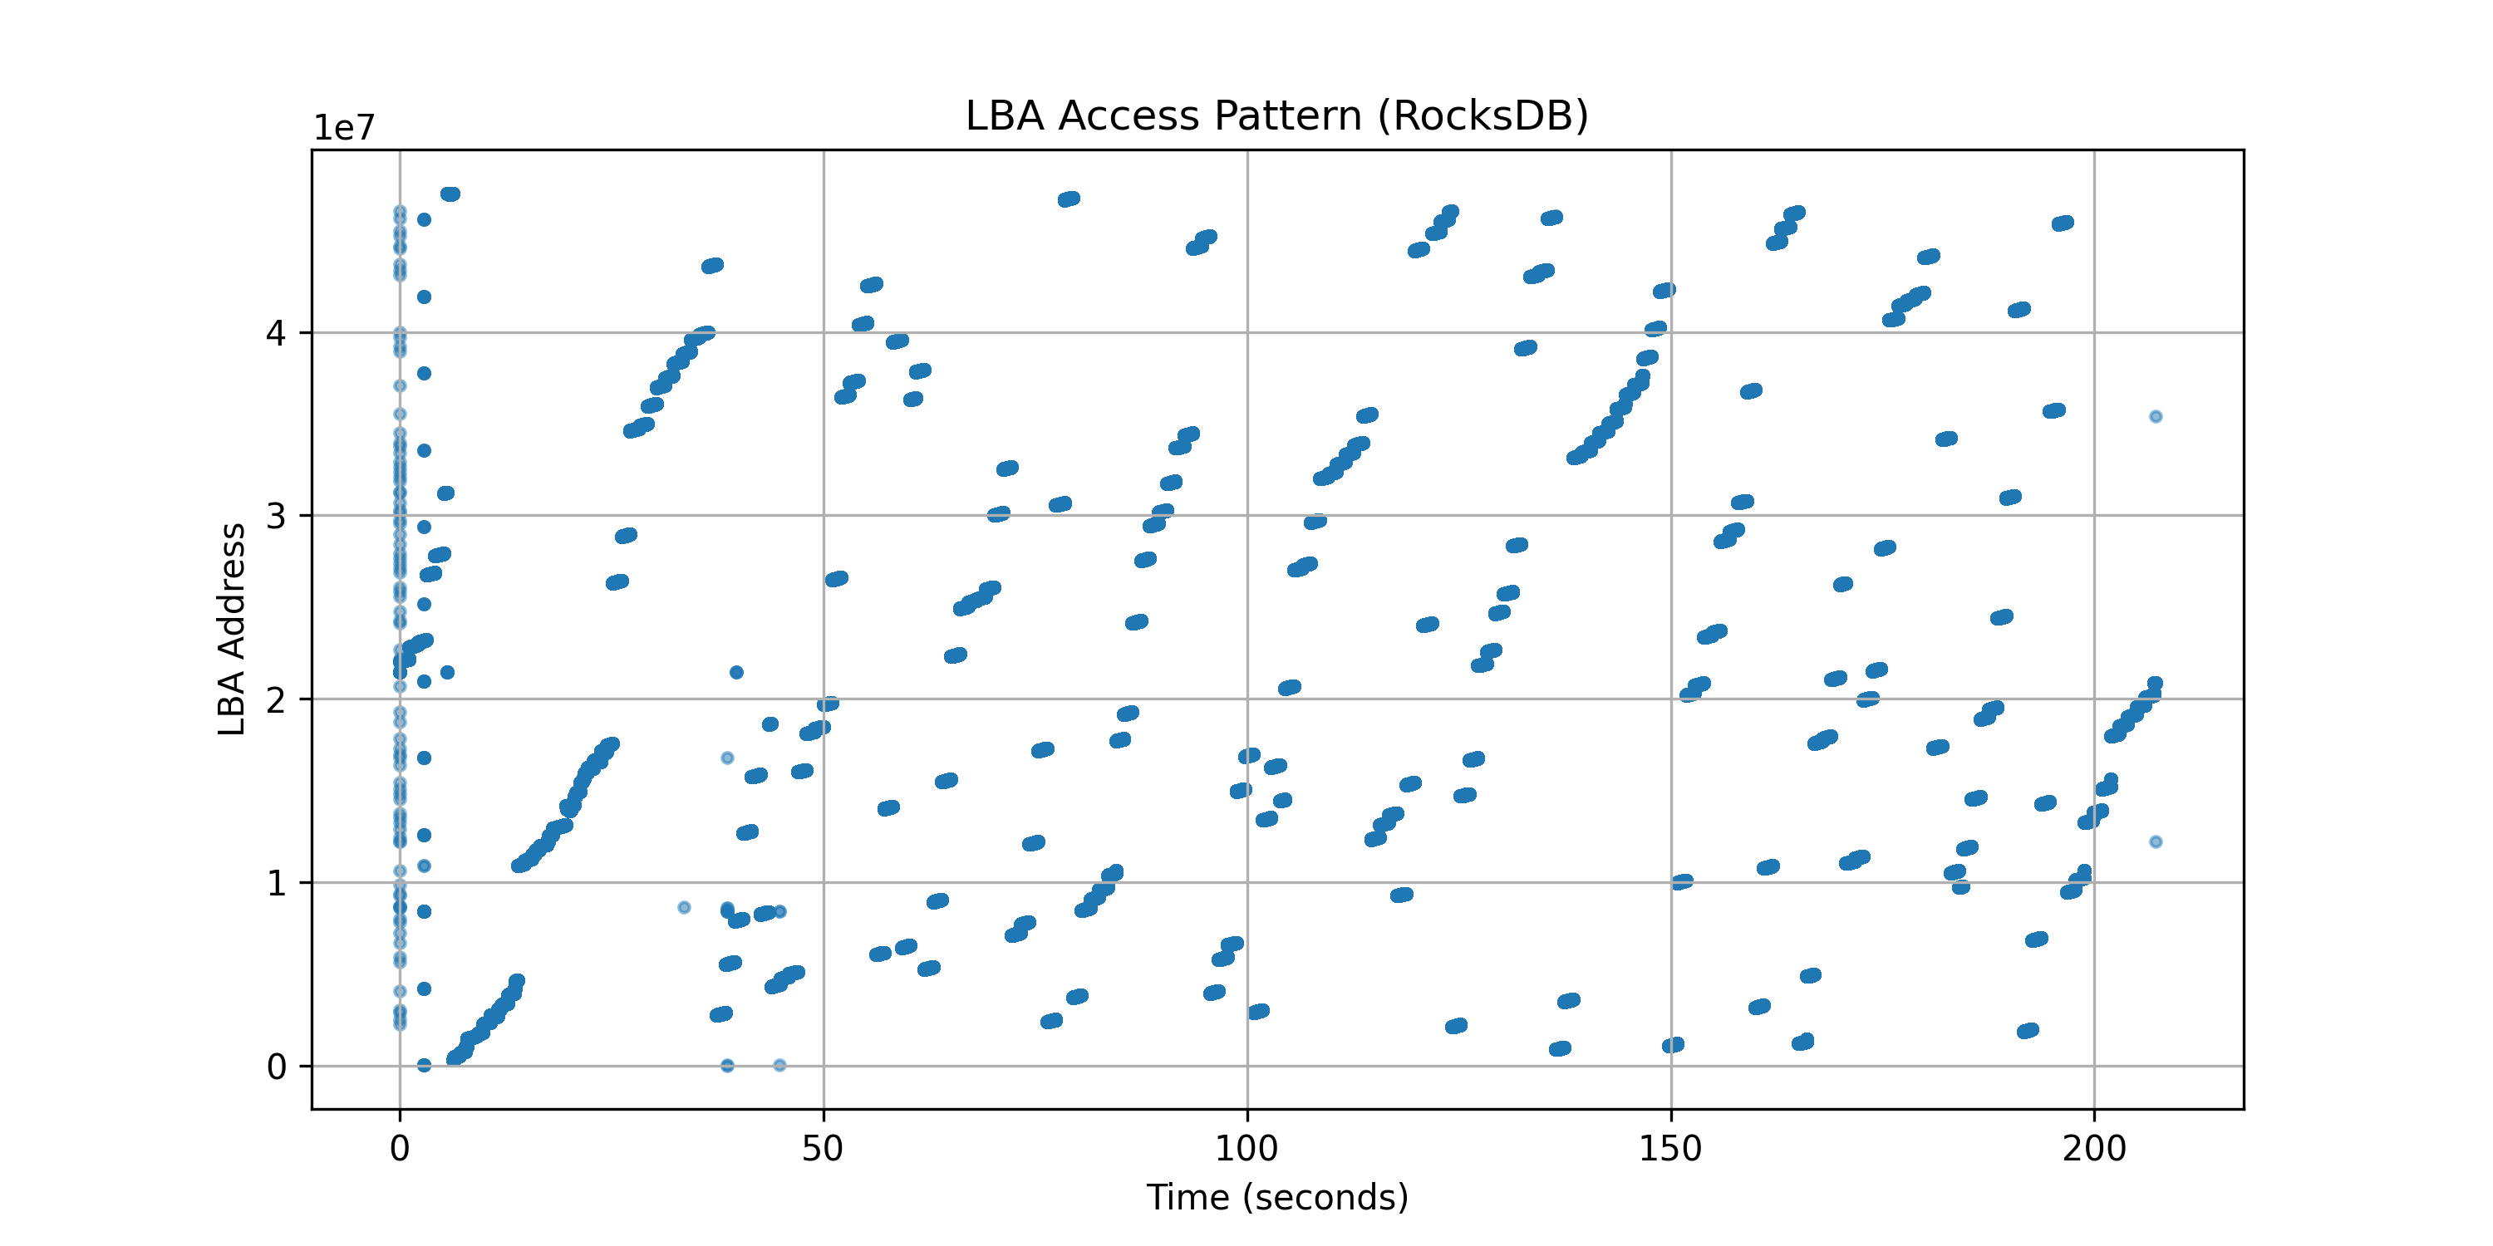
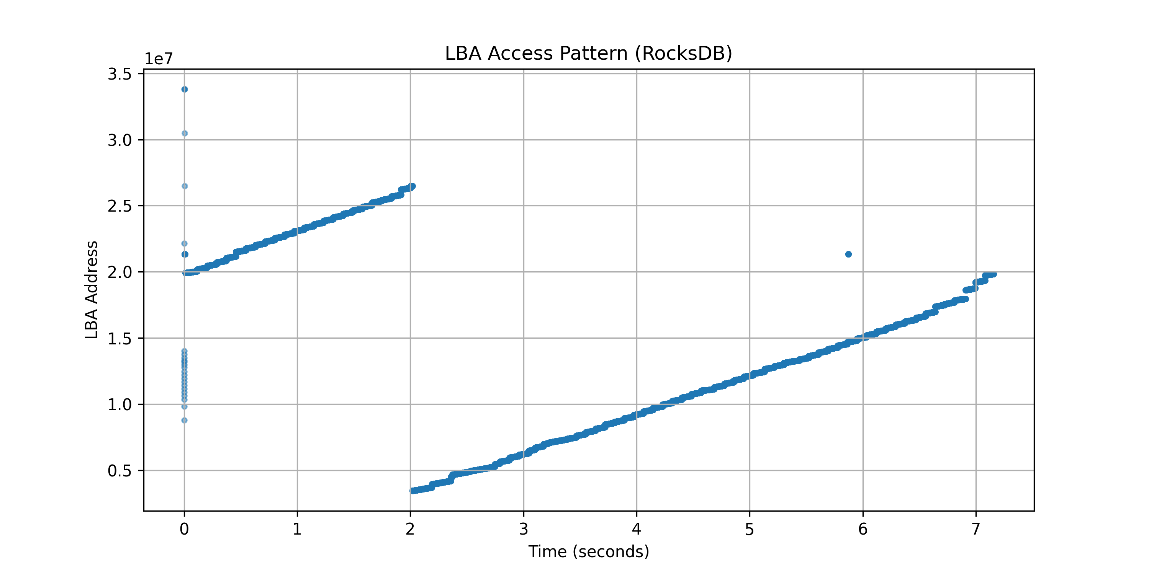
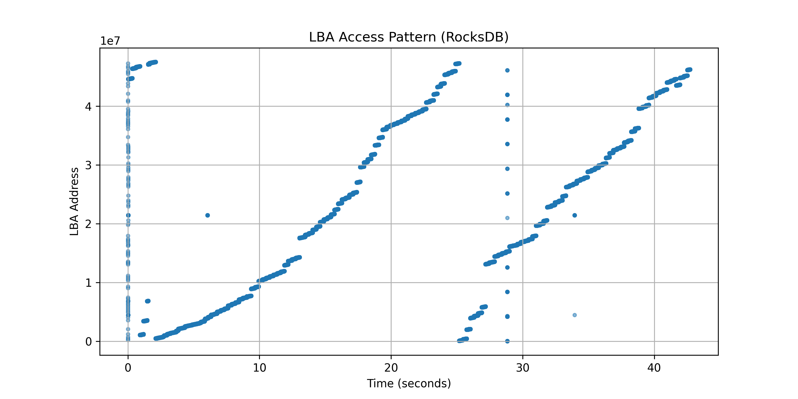
Experiment 2: fillrandom/readseq
4KB page (no align, 4K block)
4KB page (aligned, 4K block)
16KB page (no align, 16K block)
16KB page (aligned, 16K block)

Slide 14
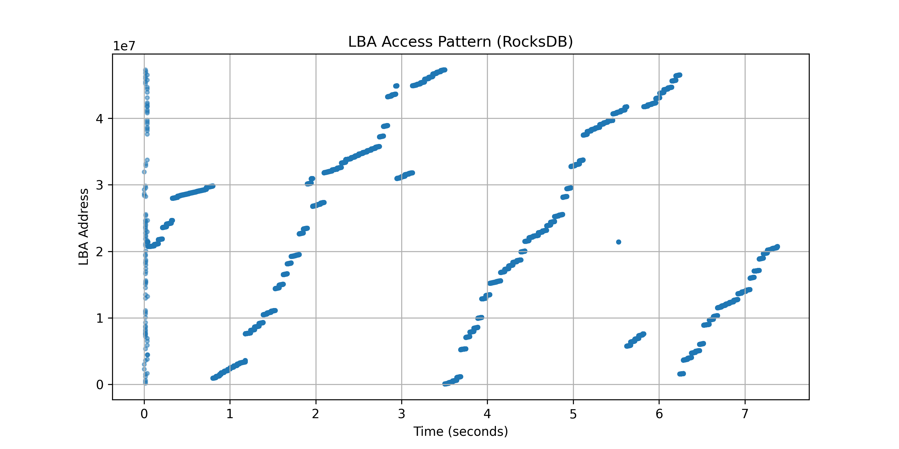
Experiment 2: fillrandom/readseq
No compression (no align 16K block)
16KB page (aligned, 16K block)
Throughput: 820.2 MB/s
Throughput: 225.7 MB/s

Slide 15
Experiment 2 results
Using 16KB page in SSD shows better performance
But both 4KB and 16KB pages have same latencies: not fair
block_align option have a negative impact on performance
No compaction show similar LBA access pattern compared to block_align
Compression doesn’t have big impact on throughput
Throughput difference is severe; Zero padding is not effective
Have to find better block align method?

Slide 16
Thank you!
Q & A ?
2025.02.25
Presentation by Yongmin Lee
Email nascarf16@dankook.ac.kr

