Slide 1
In-memory data structure: SkipList
System Software Lab.
Name: 이대은, 하경준
Date: 2025/02/11

Slide 2
Before we start…
Original goals for this week
Code-Level Analysis
How does WAL work?
Try to WAL overhead
Advanced experiments on WAL trade-off
Revised goals for this week
Code-Level Analysis
memtable/skiplist.h
memtable/inlineskiplist.h (actually used in RocksDB)
Do experiments on SkipList
Investigate various variants of SkipList

Slide 3
Contents
SkipList (memtable/skiplist.h)
Code-Level Analysis (Node and Insert)
Experiment
Hypothesis and Design
Run (Next week)
Result and Discussion (Next week)
Summary
General advantages and disadvantages of SkipList
Variants of SkipLists
References

Slide 4
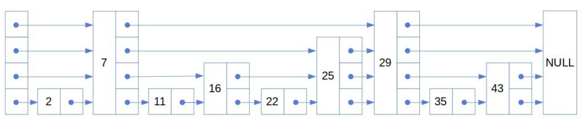
SkipList (memtable/skiplist.h)
MemTable
In-memory data structure holding data before they are flushed to SST files.
Based on SkipList(default), HashLinkList, HashSkipList or Vector.
Skiplist-based MemTable
Consists of multiple nodes with “random” height (levels).
General good performance to both read and write, random access and sequential scan.
Support Concurrent Insert and Insert with Hint.

Slide 5
SkipList (memtable/skiplist.h)
Question:
What exactly means “Random” height?

Slide 6
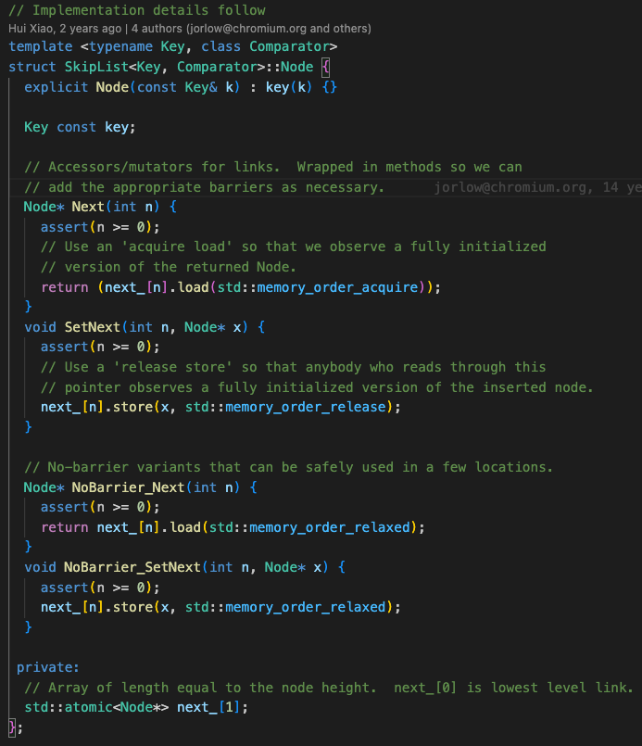
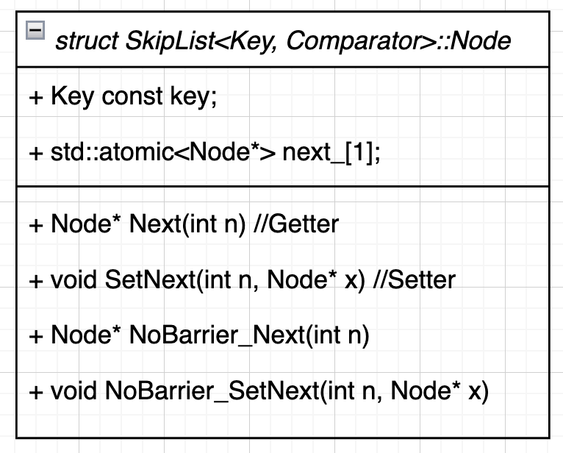
Node (memtable/skiplist.h)
key = xxxxx…xxx;
next_ ->
Dynamically allocated later by NewNode()
next_[0] | next_[1] | … | next_[RandomHeight()-1]
RandomHeight()
Node Instance

Slide 7
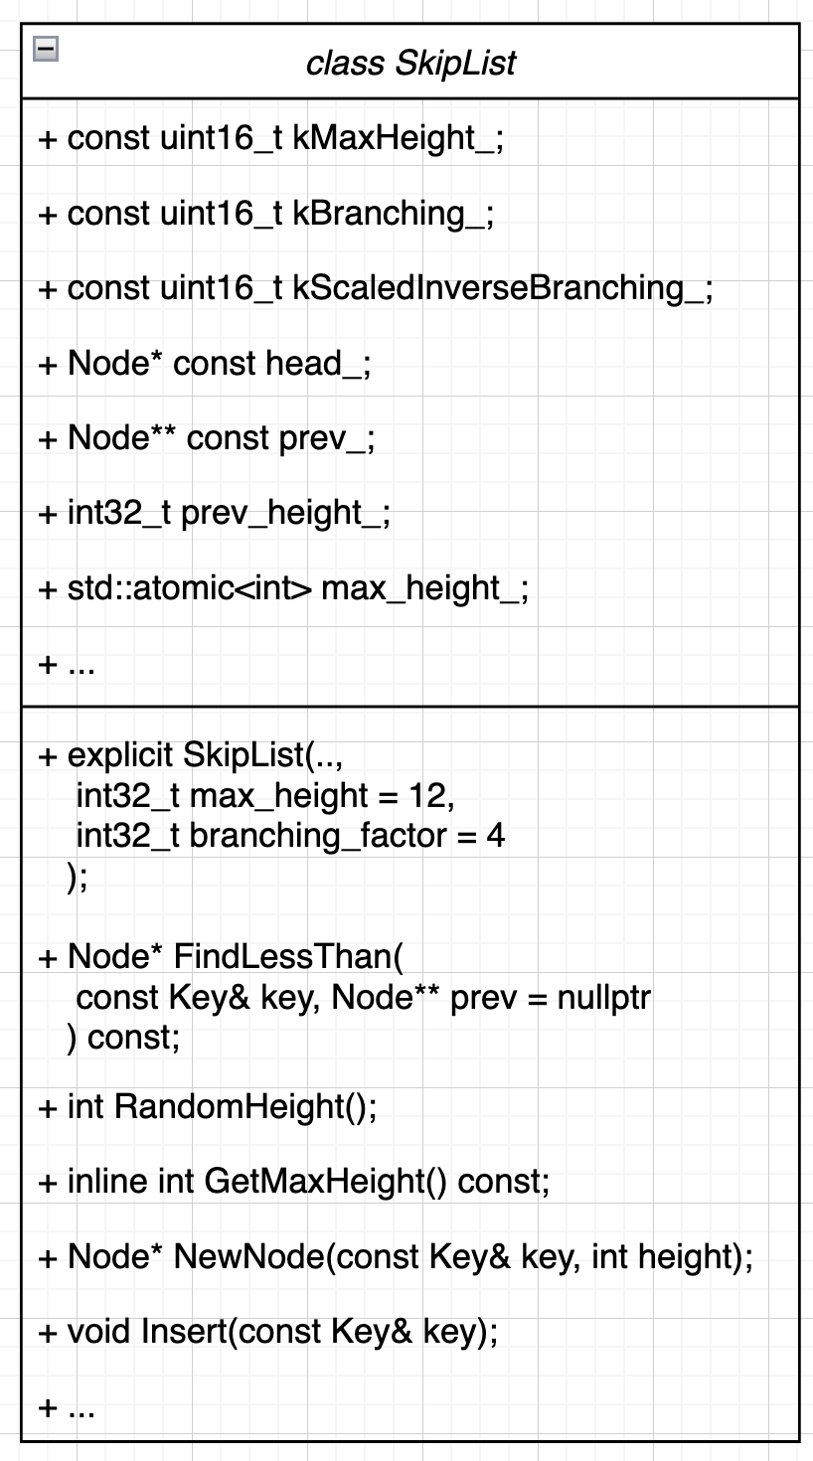
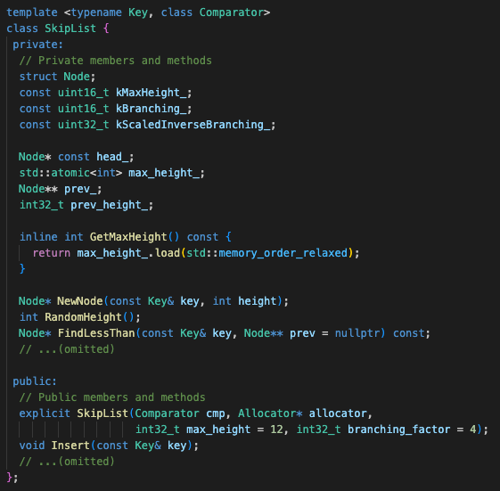
SkipList (memtable/skiplist.h)

Slide 8

SkipList (memtable/skiplist.h)
Member or Method | Description
kMaxHeight_ | The max height of a skiplist
kBranching_ | The branching factor of a skiplist
kScaledInverseBranching_ | The scaled inverse of the branching factor
head_ | The head node of a skiplist
prev_ | An array of the largest nodes smaller than the target node at each level
max_height | The current max height of the skiplist
kMaxHeight_ = 12;
kBranching_ = 4;
kScaledInverseBranching_ = ($\frac{Random∷kMaxNext + 1}{kBranching_})$;
prev_height = 1;
max_height = 1;
head_ ->
prev_ ->
Random::kMaxNext = 2³¹ - 1
kMaxHeigh (default: 12)
Key key = 0; | next_[0] | next_[1] | … | next_[kMaxHeight-1]
head_ | head_ | … | head_
SkipList Instance

Slide 9
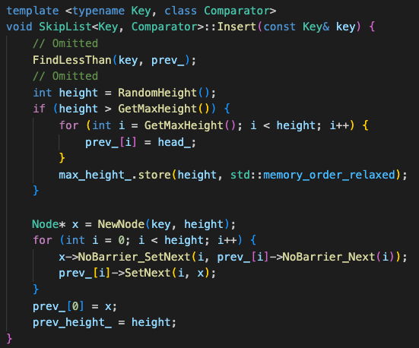
Insert operation (memtable/skiplist.h)
Insert(”17”)
1
2
3

Slide 10
Insert operation (memtable/skiplist.h)
FindLessThan(key, prev_);
prev_[3]
1
prev_[3] is the pointer to Node(”7”). (17 < 29)

Slide 11
Insert operation (memtable/skiplist.h)
FindLessThan(key, prev_);
prev_[3]
1
prev_[2]
prev_[3] is the pointer to Node(”7”). (17 < 29)
prev_[2] is the pointer to Node(”7”). (17 < 25)

Slide 12
Insert operation (memtable/skiplist.h)
FindLessThan(key, prev_);
prev_[3]
1
prev_[2]
prev_[1]
prev_[3] is the pointer to Node(”7”). (17 < 29)
prev_[2] is the pointer to Node(”7”). (17 < 25)
prev_[1] is the pointer to Node(”16”). (17 > 16), (17 < 25)

Slide 13
Insert operation (memtable/skiplist.h)
FindLessThan(key, prev_);
prev_[3]
1
prev_[2]
prev_[1]
prev_[0]
prev_[3] is the pointer to Node(”7”). (17 < 29)
prev_[2] is the pointer to Node(”7”). (17 < 25)
prev_[1] is the pointer to Node(”16”). (17 > 16), (17 < 25)
prev_[0] is the pointer to Node(”16”). (17 > 11), (17 > 16), (17 < 22)

Slide 14
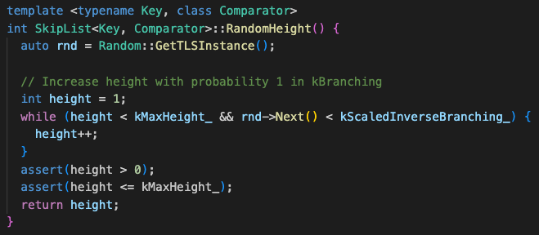

Insert operation (memtable/skiplist.h)
2. RandomHeight and NewNode
prev_[3]
prev_[2]
2
prev_[1]
prev_[0]
CALL
(Implementation)
kScaledInverseBranching_ = ($\frac{Random∷kMaxNext + 1}{kBranching_})$;

Slide 15
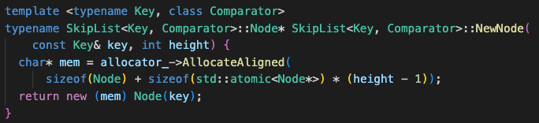
Insert operation (memtable/skiplist.h)
2. RandomHeight and NewNode
prev_[3]
prev_[2]
2
prev_[1]
prev_[0]
CALL
(Implementation)

Slide 16
Insert operation (memtable/skiplist.h)
2. RandomHeight and NewNode
prev_[3]
prev_[2]
2
prev_[1]
prev_[0]
If RandomHeight() returned 2, the current state is as follows:
Node* x
point to
next_[1]
17
next_[0]

Slide 17
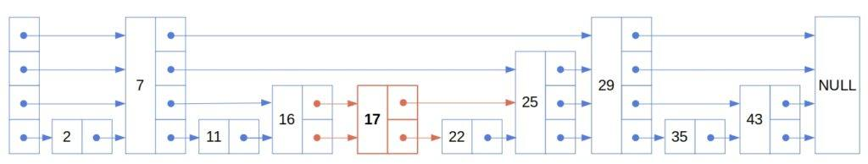
Insert operation (memtable/skiplist.h)
3. Insert Node(“17”)
prev_[3]
prev_[2]
prev_[1]
prev_[0]
①
②
3
②
①

Slide 18
Insert operation (memtable/skiplist.h)
3. Insert Node(“17”)
prev_[3]
prev_[2]
prev_[1]
prev_[0]
①
②
3
②
①

Slide 19
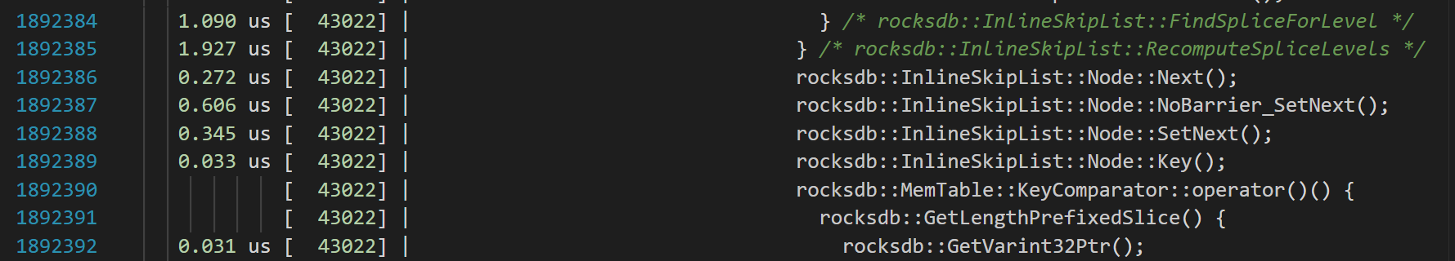
Experiment
We analyzed how insert operation works in SkipList at the code level and understood real meaning of Random height.
We reviewed the file “memtable/skiplist.h”, but figured out that RocksDB actually uses “memtable/inlineskiplist.h”.
modified for a multi-threaded environment and memory efficiency.
but the same core algorithm.
Use uftrace

Slide 20



Hypothesis and Design
If the coin flip probability is too low (increase branching_factor_), the SkipList will converge to a common linked list, losing its search advantage.
Conversely, if it’s too high (decrease branching_factor), too many nodes will appear at each level, also diminishing the search efficiency.
Therefore, finding an optimal probability is crucial.
In RocksDB, the coin flip probability is set to 25% instead of 50% and Why?
Until next week
RandomHeight(), kScaledInverseBranching, kBranching_
kScaledInverseBranching_ = ($\frac{Random∷kMaxNext + 1}{kBranching_})$;
memtable/skiplist.h
memtable/inlineskiplist.h

Slide 21
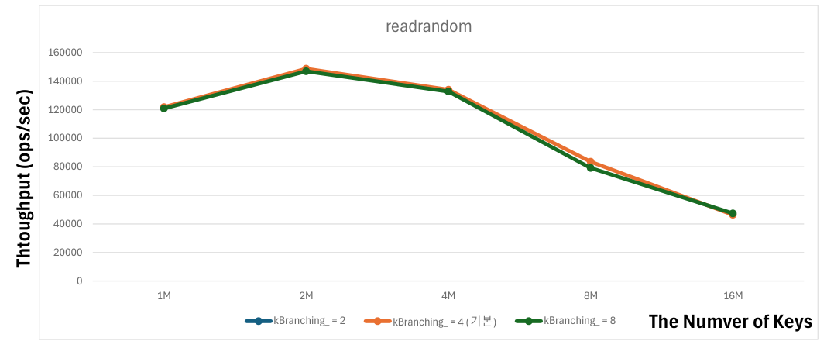
Experiment
We try to measure the throughput (ops/sec) of SkipList using db_bench.
However, db_bench is a disk I/O-centric benchmark.
It is not suitable for benchmarking SkipList, which requires memory I/O measurements.
Notes:
db_bench를 이용하여 skiplist의 Throughput (ops/sec)을 구하려고 시도했다.
하지만 db_bench는 디스크 I/O 위주의 밴치마크이다. 메모리 I/O를 측정해야 하는 SkipList의 밴치마크로써 db_bench는 적합하지 않다.

Slide 22
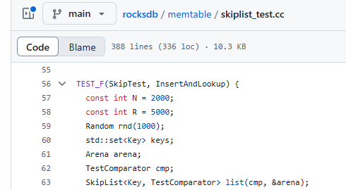
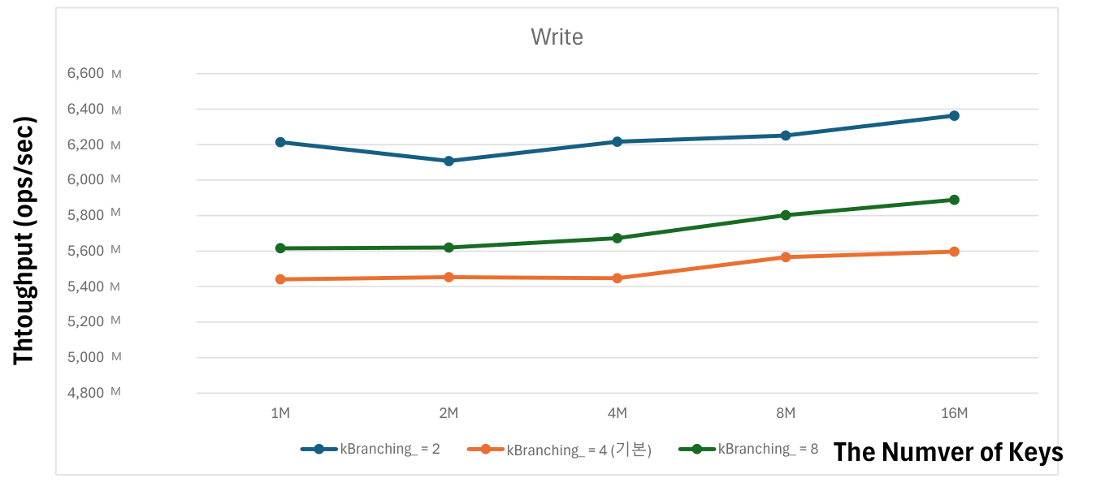

Experiment
We modified skiplist_test.cc to perform the benchmark.
However, it seems that the benchmark is incorrect. → Additional code modifications are needed.
// Write Count
// Read Count
Something wrong.
Notes:
Skiplist_test.cc 를 수정해서 밴치마크를 해 보았다.
하지만 밴치마크가 잘못된거 같다. -> 추가적인 코드 수정이 필요하다.

Slide 23
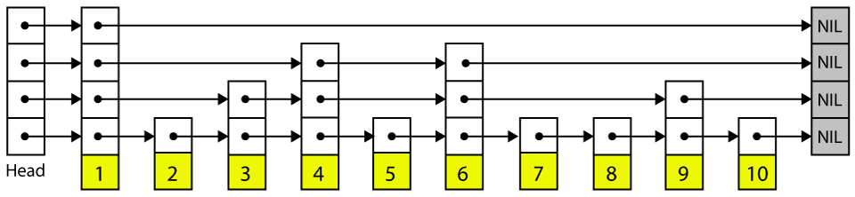
Summary: Skiplist pros
Fast Search Speed
By narrowing the search range, it provides fast search speeds O(LogN).
Probabilistic Balance (Coin Flip)
Uses probabilistic balancing to avoid O(N).
Simple Data Structure
The implementation is somewhat tricky, but not excessively difficult.
Less Rebalancing Overhead
While B-trees maintain uniformly sorted data, SkipLists do not need to maintain perfect balance at all times. → Rebalancing less frequently.
Notes:
빠른 검색 속도
검색 범위를 좁혀가므로 이진탐색처럼 빠른 검색 속도를 제공한다. -> O(LogN))
확률적 균형 (코인 플립)을 사용하여 O(N)을 피한다.
단순한 자료구조 사용
구현이 다소 까다로우나 아주 많이 까다롭지 않다.
Rebalancing 오버헤드 감소
B트리는 항상 균등한 데이터 정렬을 유지하지만, SkipList는 항상 균등한 균형을 유지 할 필요는 없다.

Slide 24
Summary: Skiplist cons
Probabilistic Method
In the worst case, results is O(N) performance.
Space Efficiency
Increasing the height results in unnecessary linked list creation, which leads to poor space efficiency. → Is it really space efficient?
Cache Friendly
As search operations increase, the number of instructions and pointer operations grows, which leads to a decrease in CPU cache efficiency
Notes:
Probabilistic method
하지만 최악에는 O(N)의 성능이 나온다.
Space efficiency
높이를 높이면 불필요한 연결리스트가 생긴다. -> 공간 효율성이 안 좋다. -> Is it really space efficient?
Cache Friendly
탐색을 하면서 명령어의 개수의 증가와 여러 포인터 연산으로 인해 CPU 캐시 의효율이 저하된다.

Slide 25
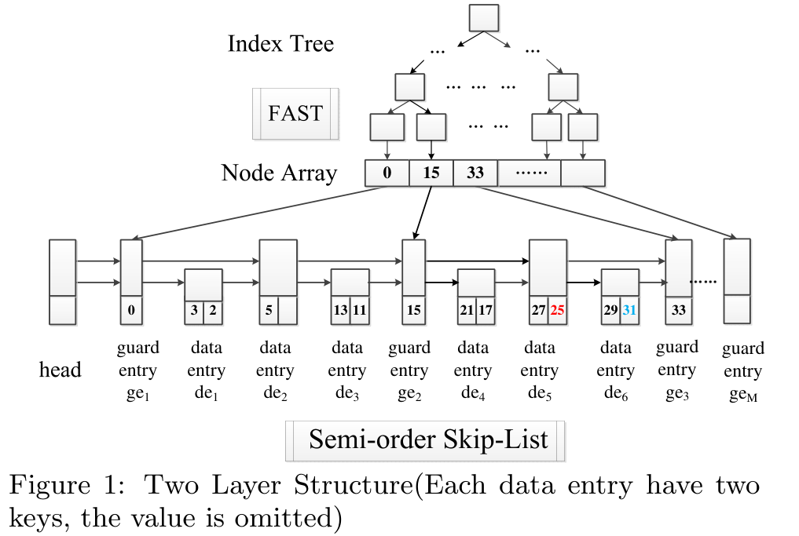
Summary: Variants of SkipList
0xA4F2 0xC1D3
0xE973 0xFBA2
Two-layer structure. (feat. Cache friendly)
Tree (FAST)
Top layer nodes are balanced.
Each node is arranged to align with the CPU's cache lines →Reducing cache misses
By caching past paths (using guard entries), nodes are pre-stored.
SkipList
0x00A 0x00B 0x00C 0x00D
[VLDB 2019] S3: A Scalable In-memory Skip-List Index for Key-Value Store
Notes:
상위 계층의 노드 모두가 균형 잡혀 있다.
각 노드를 CPU의 캐시 라인에 맞춰 배치했다. (캐시 미스를 줄였다)
과거의 경로를 캐싱하여 (가드 엔트리로 사용)노드를 미리 저장.

Slide 26
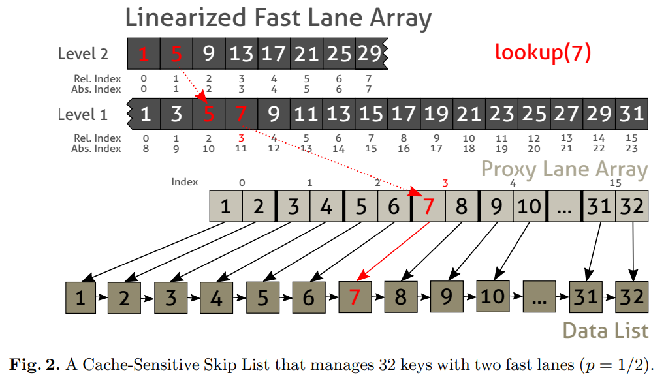
Summary: Variants of SkipList
Use Array
L2
L1
All lists, except for L0, are managed as a single array.
By managing them as an array. → Improve Cache friendly
Array
Linked List
L0
Data
[IMDM 2016] Cache-Sensitive Skip List: Efficient Range Queries on Modern CPUs
Notes:
L0를 제외한 모든 레벨에 존재하는 리스트를 단일 배열로 관리한다.
배열로 관리함으로써 캐시의 활용도를 높였다.

Slide 27
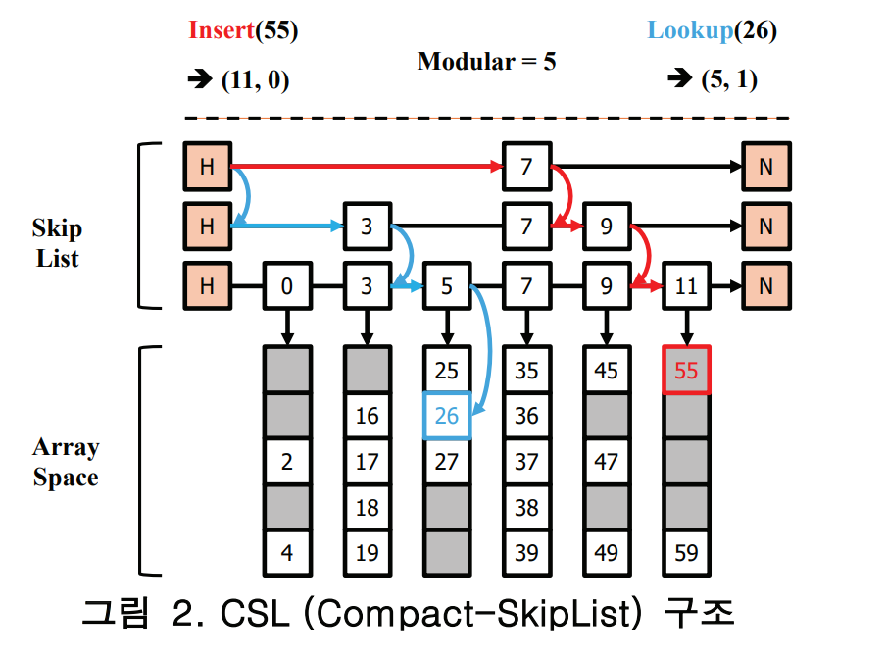
Summary: Variants of SkipList
Use Array
Top layer uses a SkipList structure, Bottom layer uses a Array
Modulo operation is used on the key. (The quotient is the SkipList key, and the remainder is in the array.)
[KCC 2024 우수논문] Compact-SkipList: 모듈러 연산과 스킵리스트를 활용한 데이터 그룹핑 기법
Notes:
Top layer uses a SkipList structure, Bottom layer uses a Array
Key에 모듈러 연산을 사용하였다. (몫은 SkipListd의 키로, 나머지는 배열로)

Slide 28
References
[1] [VLDB 2019] S3: A Scalable In-memory Skip-List Index for Key-Value Store
[2] [IMDM 2016] Cache-Sensitive Skip List: Efficient Range Queries on Modern CPUs
[3] [KCC 2024 우수논문, 신호진] Compact-SkipList: 모듈러 연산과 스킵리스트를 활용한 데이터 그룹핑 기법
[4] [KCC 2024, 신호진] RB-SkipList: 탐색 성능 향상을 위한 SkipList와 RB-Tree의 통합 기법
[5] [KCC 2023, 신호진] LA-SkipList: 효율적인 탐색을 위한 트리 기반 SkipList 최적화
[6] Facebook. RocksDB Wiki. Accessed 4 Feb. 2025, https://github.com/facebook/rocksdb/wiki.

Slide 29
Thank you QnA?

