Slide 1
Advanced RocksDB
System Software Lab
Suhwan Shin, Zhu Yongjie
25.02.11

Slide 2
Contents
Learned Index in LSM-Tree
RocksDB Performance in Ceph File System

Slide 3
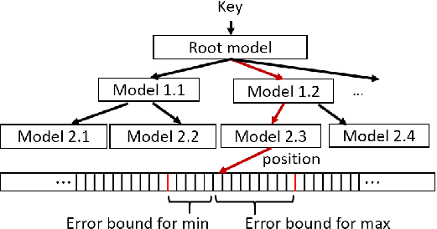
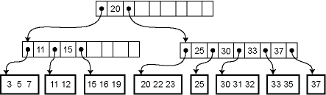
Learned Index in LSM-Tree
Learned Index
Key
Position
Data & Pointer entries
ML model node
B-Tree
Learned index

Slide 4
Learned Index in LSM-Tree
Two Steps of Lookup
The number of models
Prediction
The layer of Index
ML model node
Correction
Boundary width
Learned index
Which parameter will affect these?
Error Bound

Slide 5







Learned Index in LSM-Tree
Data distribution in LSM-Tree
Key’s position
Key’s position
Key
Key
5 segments = 5 Linear model
2 segments = 2 Linear model

Slide 6
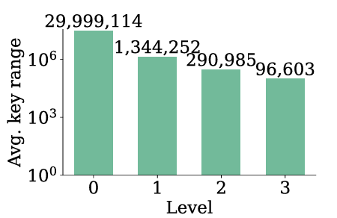
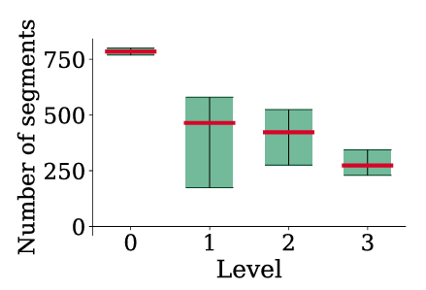
Learned Index in LSM-Tree
Data distribution in LSM-Tree
In LSM Tree, there are various key distributions within SST
Avg. Key Range in SSTable
Avg. Num of Segments in SSTable
The data distribution within SSTable is dynamic
Error bound needs to adapt to different SSTables
Reinforcement Learning

Slide 7
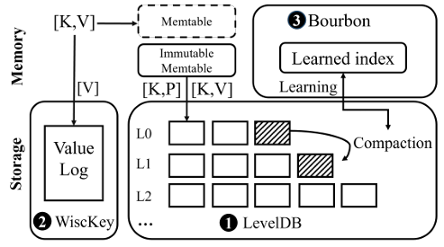
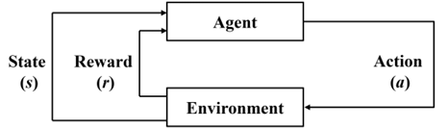

Learned Index in LSM-Tree
Data distribution in LSM-Tree
Is RL a good combination with LSM-Tree?
Compaction occurs constantly
RL needs iteration

Slide 8
Learned Index in LSM-Tree
Wild-Learning
Analyze the data distribution of SST
Compaction
RL Agent
Index Build
Get Error Bound

Slide 9
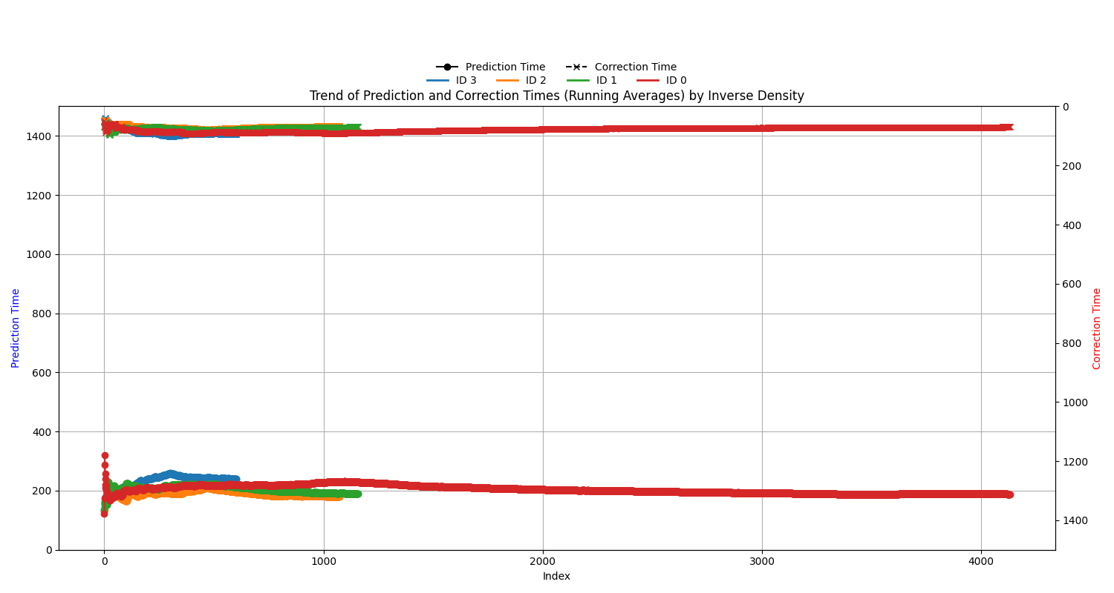
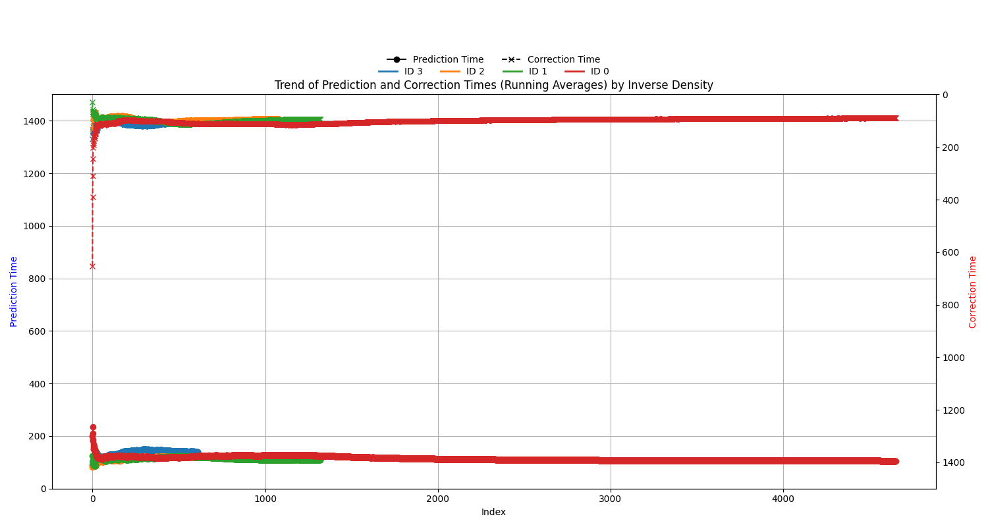
Learned Index in LSM-Tree
Wild-Learning
Evaluation
Bourbon
Bourbon + Wild-Learning
Stable Correction Performance
Unstable Correction Performance
Unstable Prediction Performance
Stable Prediction Performance

Slide 10
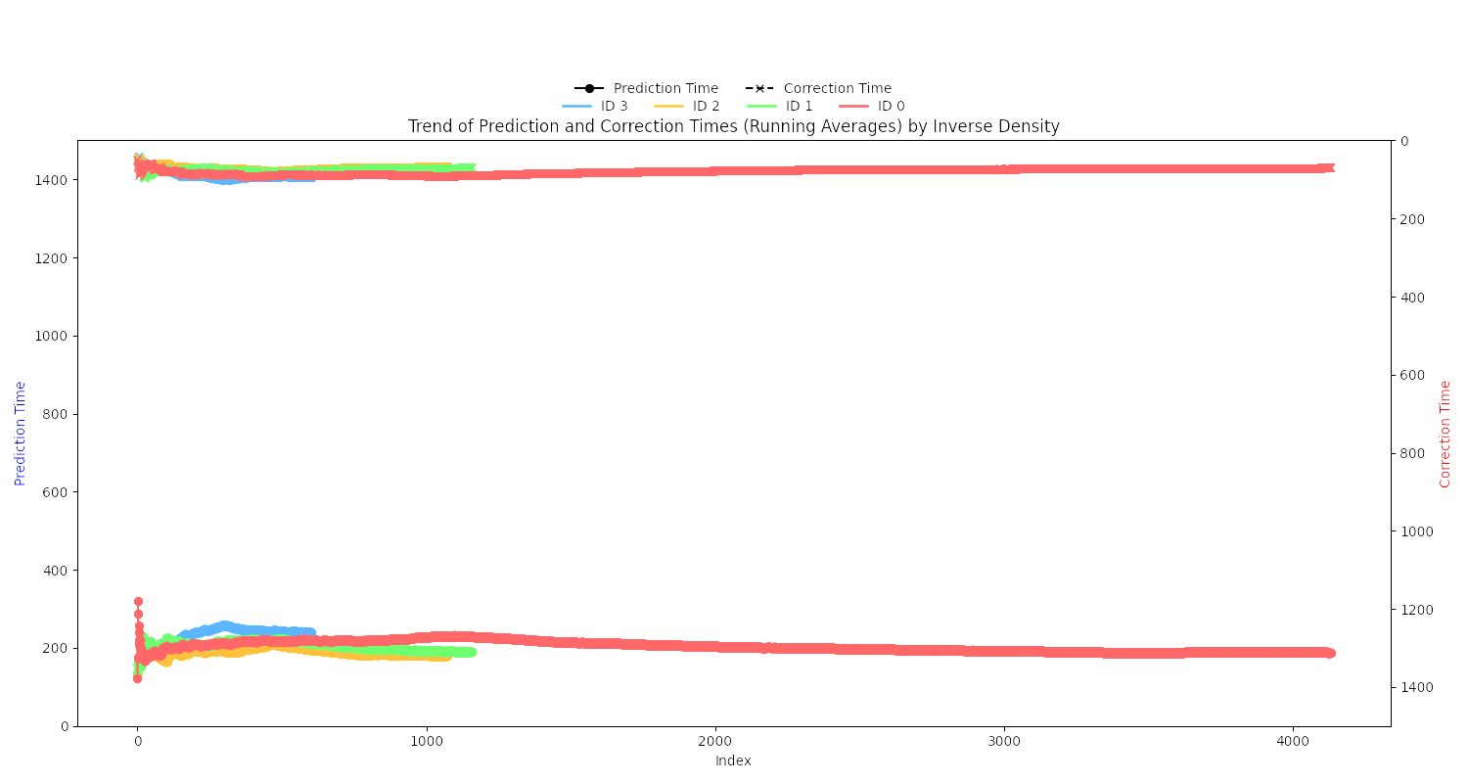
Learned Index in LSM-Tree
Wild-Learning
Evaluation
Wild Learning achieves stronger Prediction performance at the cost of minimal Correction performance through adaptive Error bounds

Slide 11
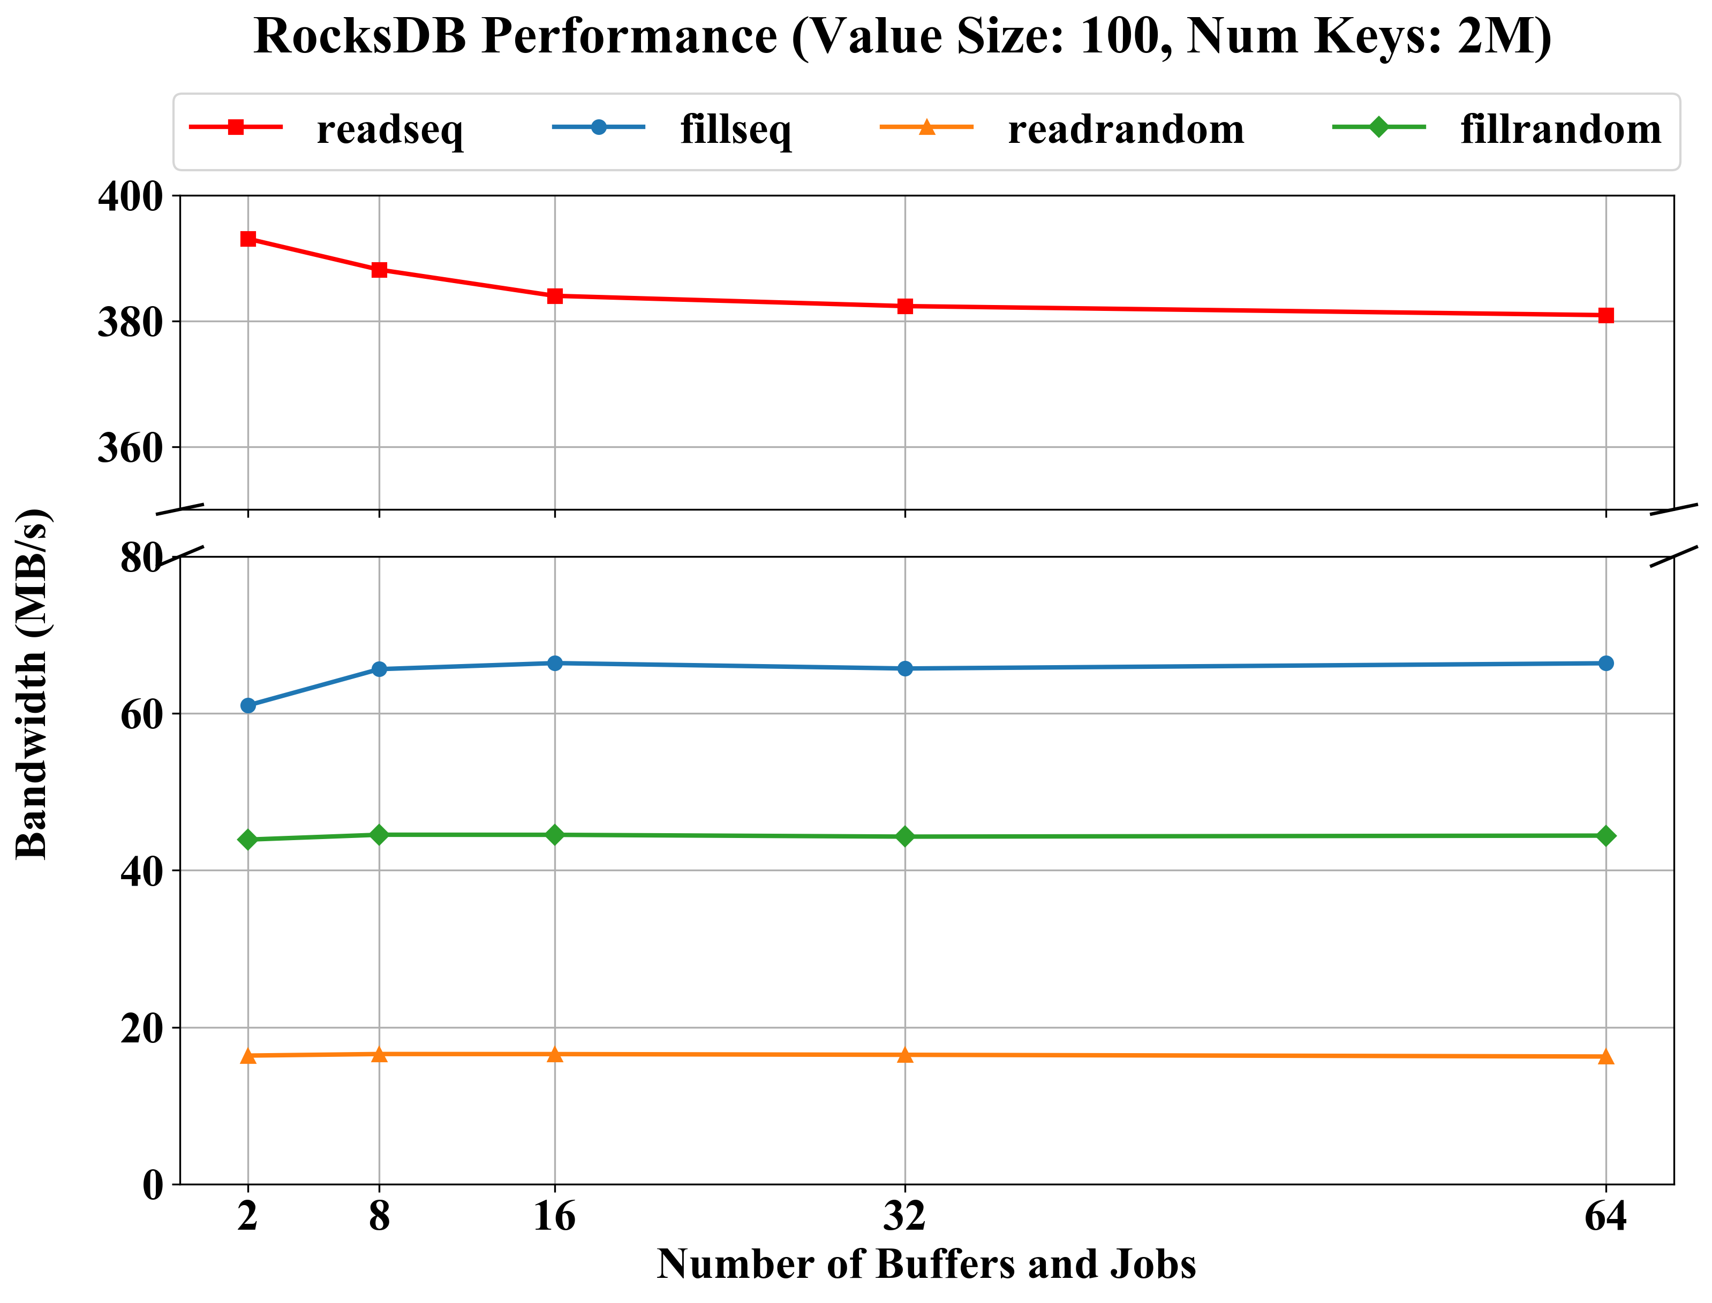
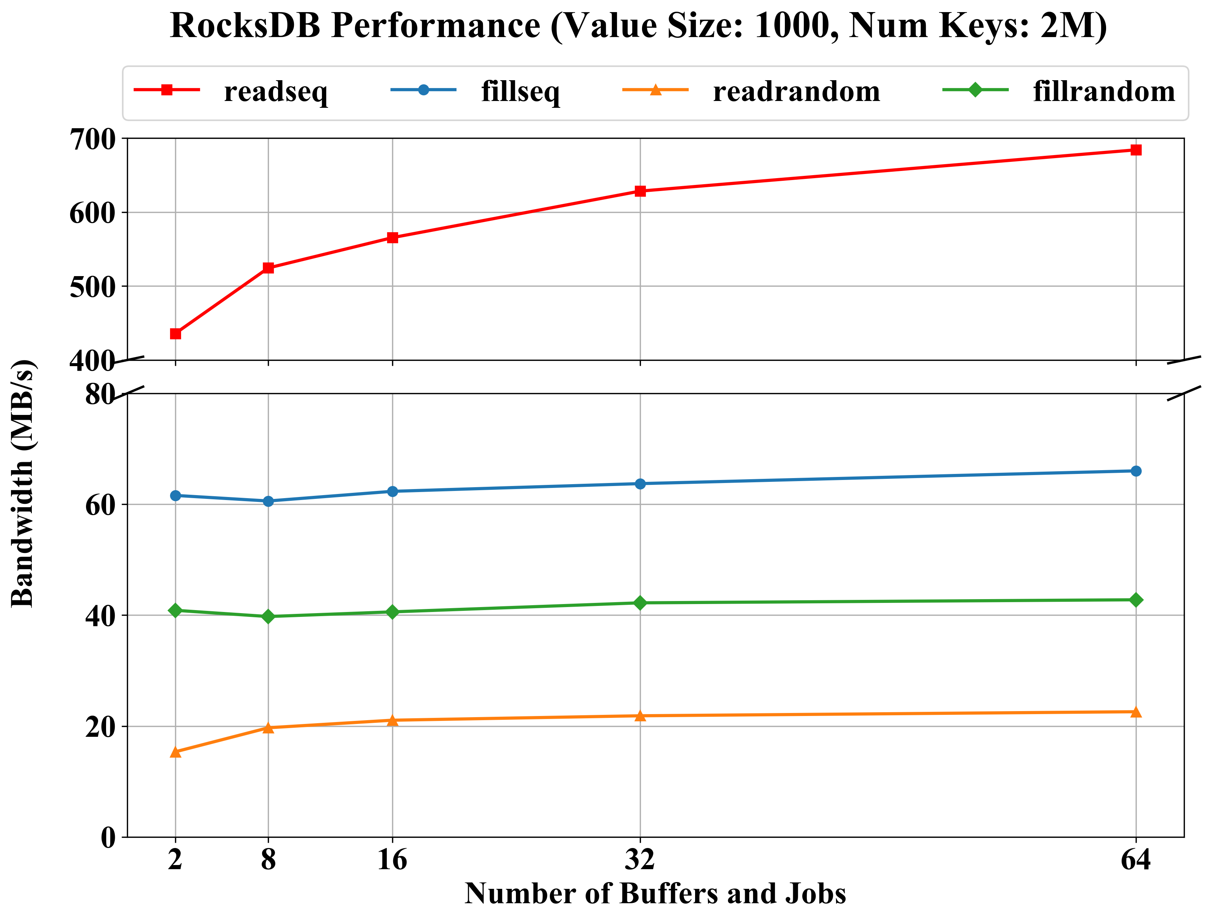
Compared RocksDB Performance
Ceph File System
Analysis
Sequential Read: 큰 value size에서는 더 많은 버퍼와 백그라운드 작업이 병렬 처리를 효과적으로 지원하며, 한 번의 읽기로 더 많은 데이터를 처리할 수 있음
Sequential Write: 순차 쓰기는 value size와 관계없이 비슷한 성능을 보이는데, 이는 CephFS의 write buffer와 page cache가 효과적으로 작동하기 때문
Random Read: 큰 value size에서는 버퍼 수 증가가 캐시 활용을 개선하여 랜덤 읽기 성능 향상에 도움
Random Write: 랜덤 쓰기는 memtable 관리와 compaction 오버헤드로 인해 value size에 관계없이 비슷한 성능을 보임

Slide 12
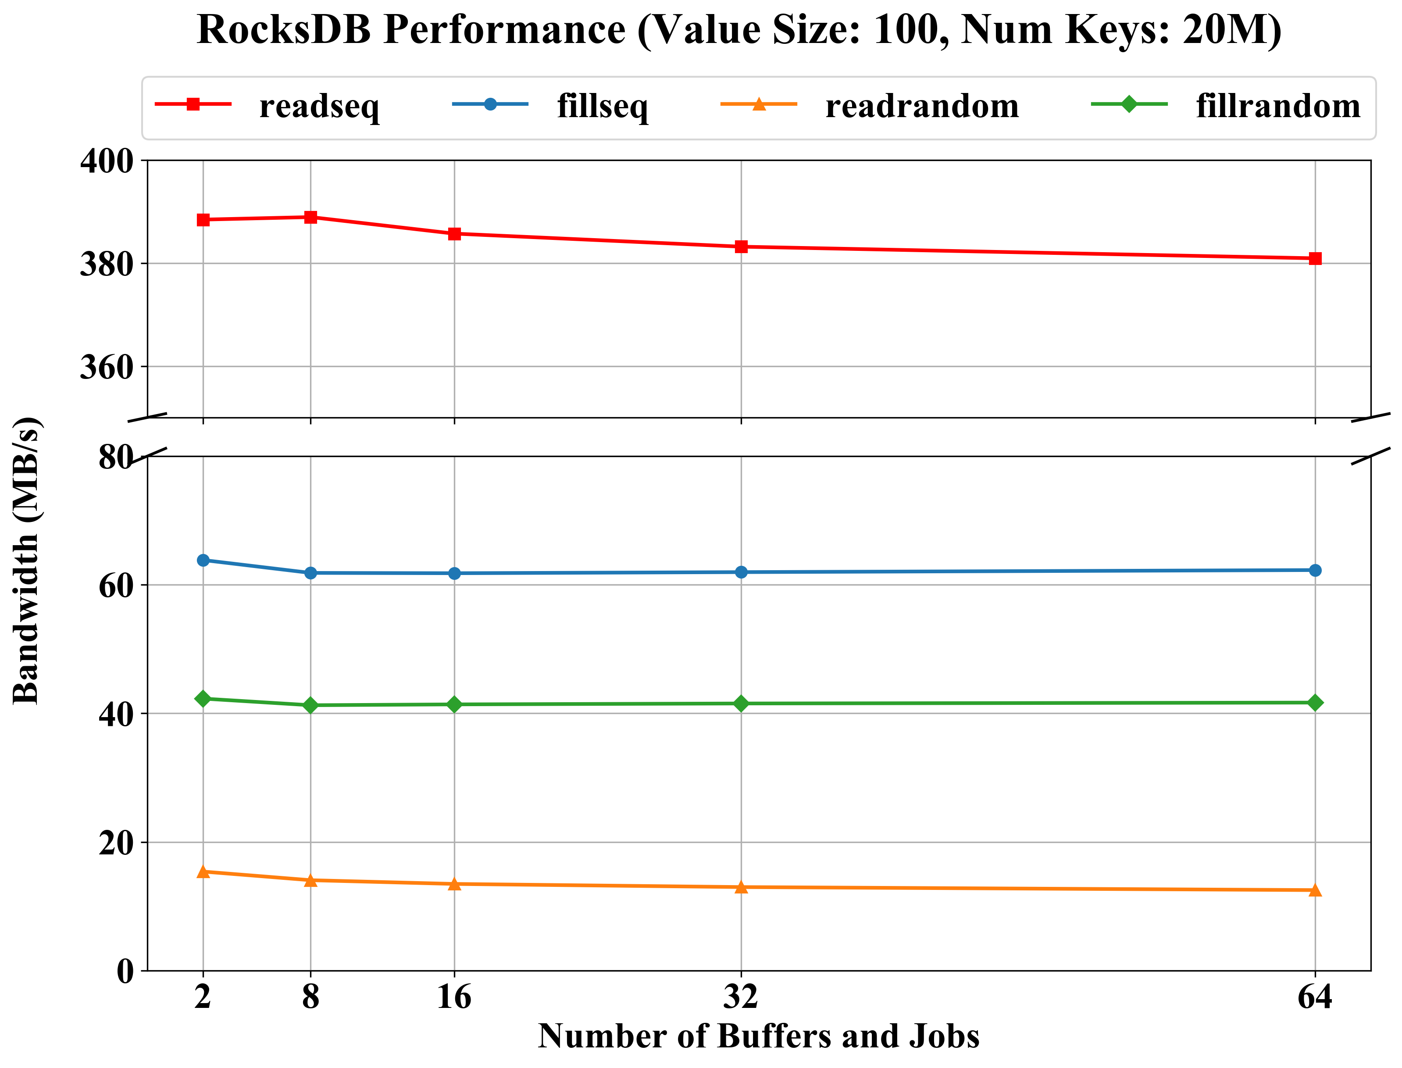
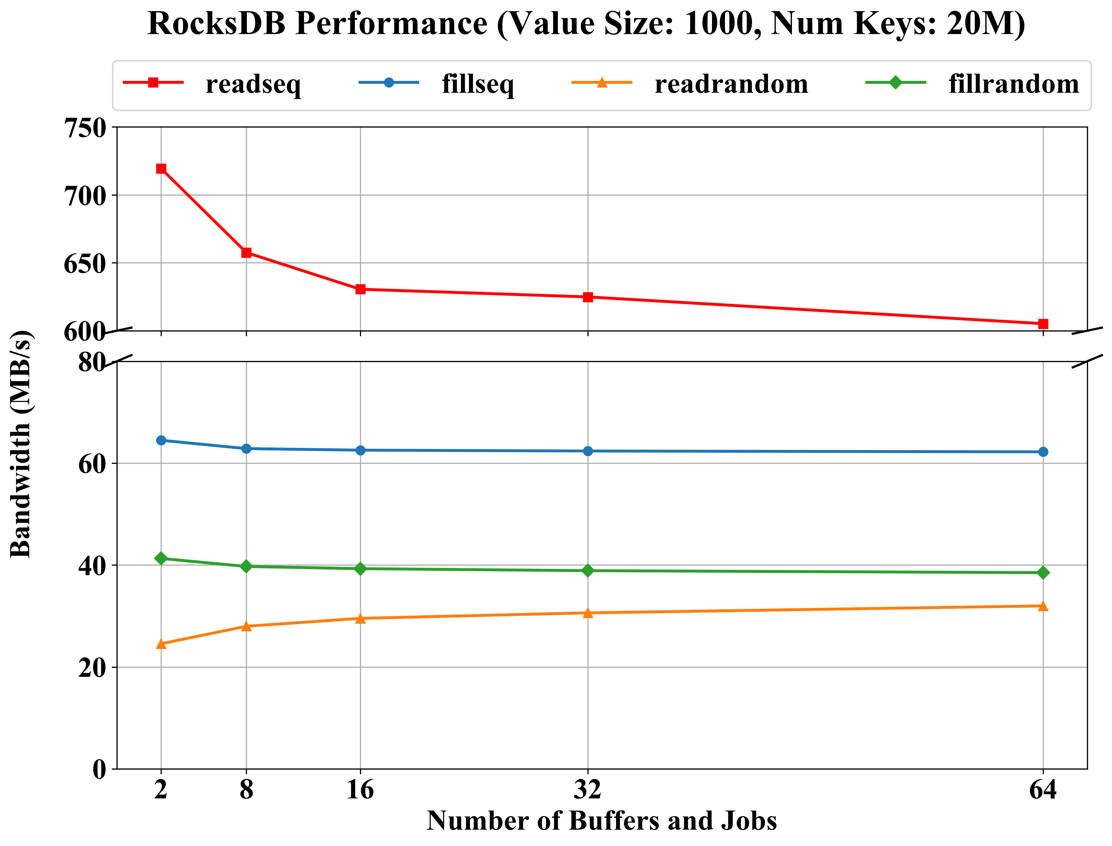
Compared RocksDB Performance
Ceph File System
Analysis
Sequential Read: 큰 value size에서는 더 많은 데이터를 처리해야 하며, 버퍼 수 증가는 메모리 관리 오버헤드를 증가시킴
Sequential Write: 순차 쓰기는 page cache와 write buffer의 효과적인 활용으로 value size의 영향이 크지 않음
Random Read: 큰 value size에서는 한 번의 읽기로 더 많은 데이터를 처리할 수 있으며, 버퍼 증가가 캐시 활용을 개선
Random Write: 큰 value size에서는 compaction 오버헤드가 더 커짐

Slide 13
Thankyou

