Slide 1
Using db_bench in FEMU
Week 4 db_bench evaluation
2025.02.11
Presentation by Yongmin Lee
Email nascarf16@dankook.ac.kr
Notes:
실험을 진행하였습니다.

Slide 2
FEMU
What is FEMU?
Features
Using db_bench in FEMU
Hypothesis
Experiment setup
Results & Analysis
Further research

Slide 3
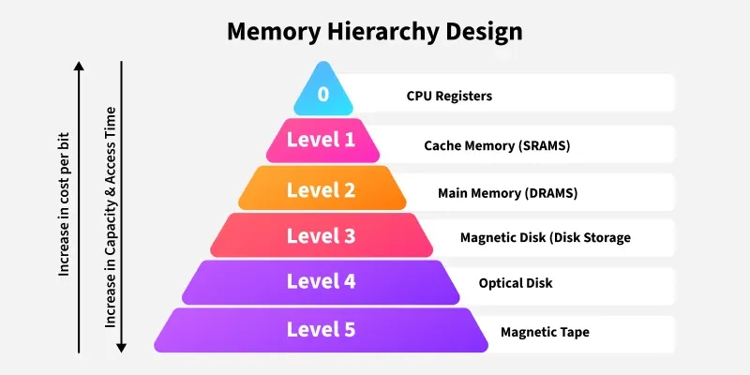
FEMU
What is FEMU?
The CASE of FEMU: Cheap, Accurate, Scalable and Extensible Flash Emulator (FAST 2018)
Store data on RAM
Ref: https://www.geeksforgeeks.org/memory-hierarchy-design-and-its-characteristics/

Slide 4
FEMU
Features
QEMU-based: Virtual Machine
Emulates NVMe SSD: nvme-cli is available
Configurable R/W latency, SSD layout:
Sector size, page size, block size, GC threshold...
No write buffer
Write buffer is common in current conventional NVMe SSDs

Slide 5
Using db_bench in FEMU
Hypothesis
If SSD (stores SSTable) is faster, these factor will improve:
Throughput, compaction speed, etc…
Find out what other metrics are improved

Slide 6
Experiment Setup
Host
fillrandom operation
CPU | Intel i7-6700
RAM | DDR4 8GB * 4 (32GB) @ 2133 MT/s
Storage | Samsung SATA SSD 850 PRO 512GB
OS | Ubuntu 22.04.1
Kernel | 6.8.0-51-generic
FEMU Settings
Host RAM | 16 GBs
FEMU CPU | 4 vCPUs
FEMU RAM | 4 GBs
FEMU page read latency | 40 / 80 / 120 µs
FEMU page write latency | 200 / 400 / 600 µs
RocksDB version | 9.11.0
Key size | 16 Bytes
Value size | 1000 Bytes
Num. of keys | 5 Million

Slide 7
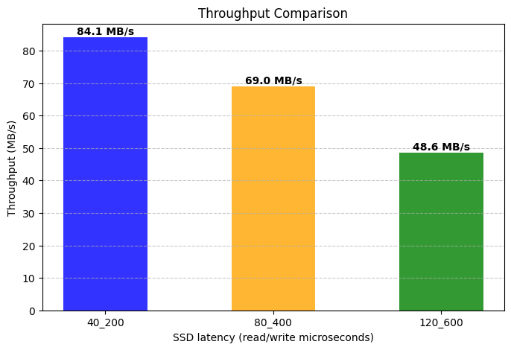
Results & Analysis
Fastest Slowest

Slide 8
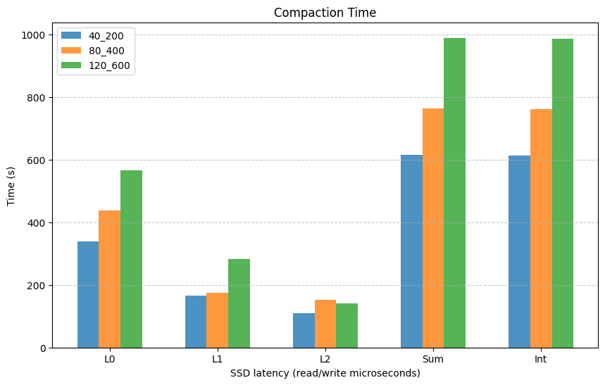
Results & Analysis
?
Fastest Slowest

Slide 9
Results & Analysis
Interlude: Three Different Write Stalls
Memtable Stall: too many memtable (write buffer full)
Level 0-Level 1 Compaction (L0) stall: too many SSTable in Level 0
In RocksDB, the default slow-down threshold is 20, while at 36 the input stream is stopped.
Pending Input Size (PS) stall: compaction jobs exceeds a certain threshold
Ref: Yu, Jinghuan, et al. "{ADOC}: Automatically Harmonizing Dataflow Between Components in {Log-Structured}{Key-Value} Stores for Improved Performance." 21st USENIX Conference on File and Storage Technologies (FAST 23). 2023.

Slide 10
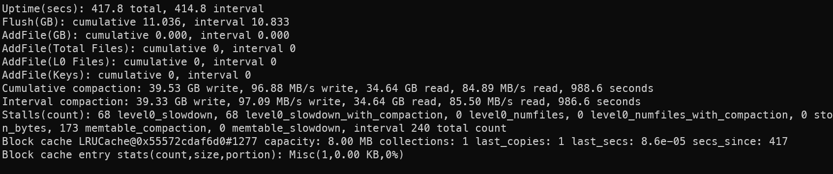
Results & Analysis
Can find in --statistics

Slide 11
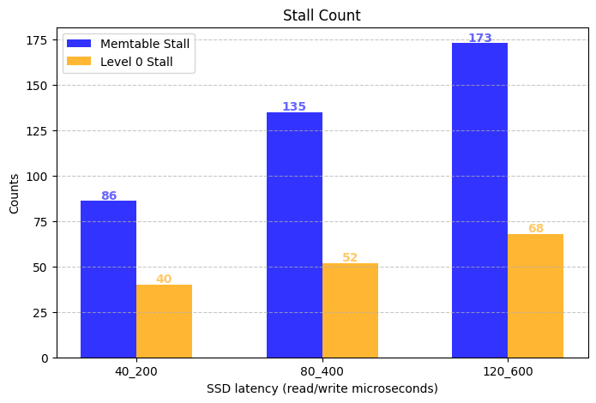
Results & Analysis

Slide 12
Further research
More key-value pairs: currently 5M
SSTables are located in L0, L1 and L2 (not available over L3)
Tail latency analysis (write)
 | P50 | P75 | P99 | P99.9
40_200 | 20.25 | 29.91 | 187.48 | 4071.09
120_600 | 20.07 | 29.42 | 1399.61 | 4006.56
Percentiles
Latency

Slide 13
Thank you!
Q & A ?
2025.02.11
Presentation by Yongmin Lee
Email nascarf16@dankook.ac.kr

