Slide 1
Design a NAND FTL
2023.08.25​
쥬용지에​
arashio1111@dankook.ac.kr​

Slide 2
1. Design

Slide 3
Struct & function
#define TOTAL_BLOCKS 256
#define PAGE_PER_BLOCK 16
#define PAGE_SIZE 4096
Flash : Block flash[TOTAL_BLOCKS]
Int allowcateBlock()
Page
Block
Void eraseBlock(int blockNumber)
Page pages[PAGE_PER_BLOCK]
GC
Char data[PAGE_SIZE]
Int InvalidPageInBlock(int blockNumber)
Int valid[PAGE_PER_BLOCK]
Void readPage(int LBN, int PN, char *buffer)
Void writePage(int LBN, int PN, char *buffer)

Slide 4
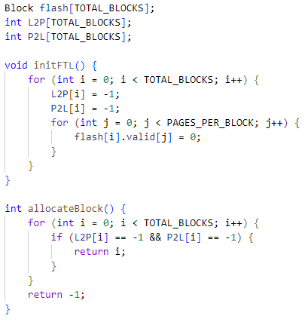
Allocate & mapping
#define TOTAL_BLOCKS 256
#define PAGE_PER_BLOCK 16
#define PAGE_SIZE 4096
int L2P[TOTAL_BLOCKS]
int P2L[TOTAL_BLOCKS]

Slide 5
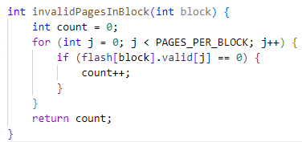
InvalidPageInBlock
#define TOTAL_BLOCKS 256
#define PAGE_PER_BLOCK 16
#define PAGE_SIZE 4096
Page
Valid
0
1
1
1
2
1
3
…
1
0
Count 1
…
1
…
1
15
0
Count 2
Block

Slide 6
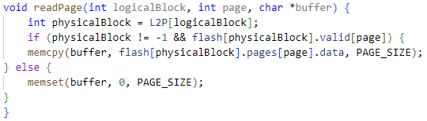
ReadPage
LogicalBlock input
Mapping
PhysicalBlock
If != -1 && flash.valid[page] = 1
else
Memcpy(buffer, data, PAGE_SIZE)
Memset(buffer,0,PAGE_SIZE)

Slide 7
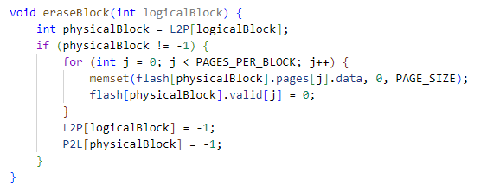
EraseBlock
LogicalBlock input
Mapping
PhysicalBlock
If != -1
else
memset
Flash.Valid[] = 0
Init mapping

Slide 8
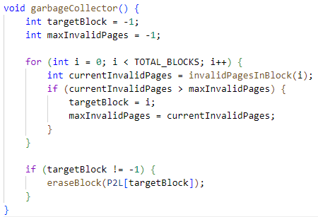
GC
Block 0
Block 1
Block
2
Block
3
InvalidPageInBlock()
Block
255
Find target block which has the max invalid pages.
Erase target block
Copy valid pages operation in write page.

Slide 9
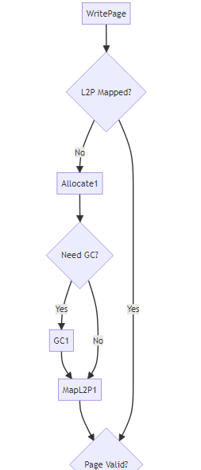
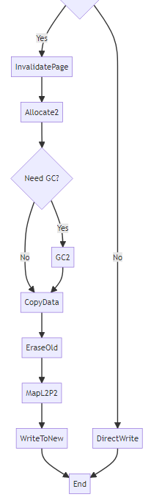
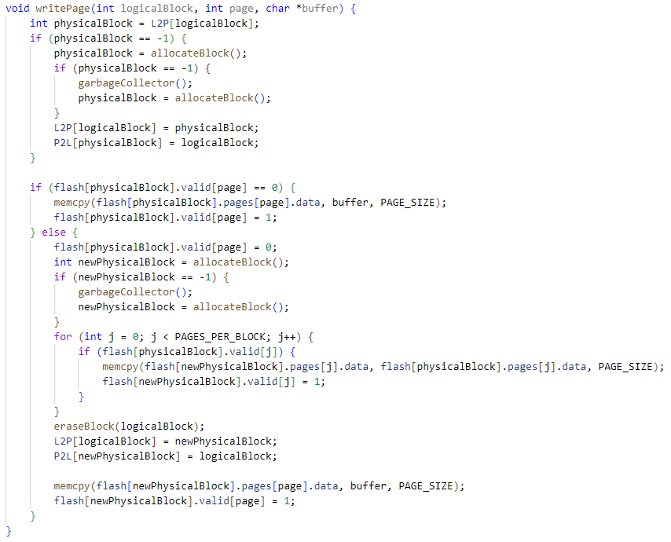
WritePage

Slide 10
2. Test

Slide 11
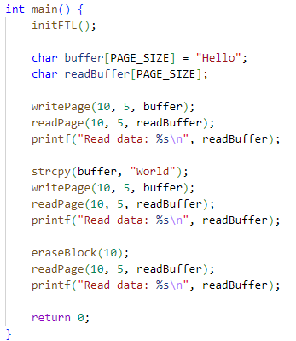

Test
writePage & readPage test
GC test
eraseBlock test
Test result :

Slide 12
Design a NAND FTL
Thank you!
Q & A ?
2023.08.25​
쥬용지에​
arashio1111@dankook.ac.kr​

