Slide 1
S3: A Scalable In-memory Skip-List Index for Key-Value Store
Jingtian Zhang et al. VLDB’19
2024.01.24
Presentation by Boseung Kim, Yeongyu Choi
bskim1102@dankook.ac.kr, dusrb1418@naver.com

Slide 2
Introduction
Architecture of S3
Basic Operator
Optimizations
Experiments
Conclusions

Slide 3
Introduction
Existing in-memory indexing structures
Hash based:
HashSkipList, HashLinkList
Do not maintain the keys in order
Do not support range query
Tree based:
B+Tree, MassTree
Require complex operations to keep balance
z
0
Tiger
y
10
Hash
Function
1
Cat
11
2
Dog
12
3
Frog
z
x
4
Pig
T1
T2

Slide 4
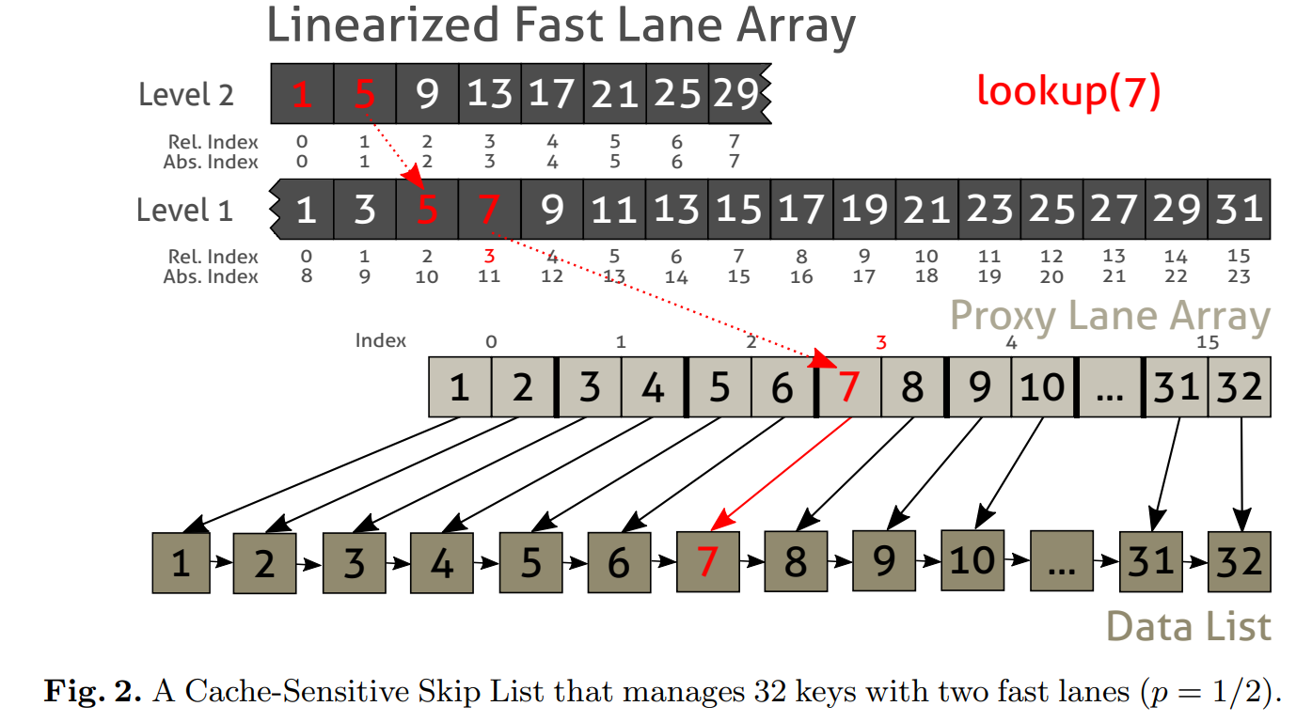
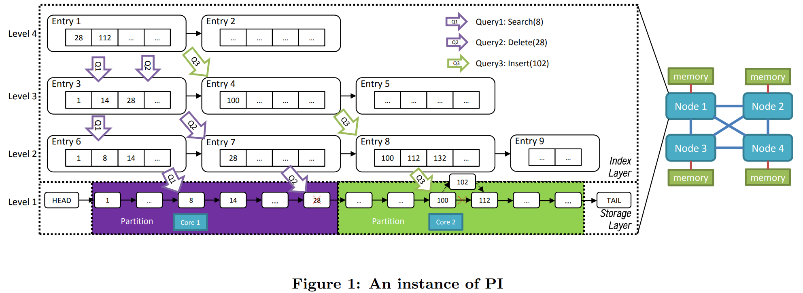
Introduction
Existing in-memory indexing structures
Skip-list based:
CSSL, PI
Restructure the index to optimize the performance
During the restructure process, R/W operations are blocked

Slide 5



Introduction
Using Skip-List for
in-memory indexing structure.
Because …
Its Maintenance cost is low
It can be efficiently flushed to disk

Slide 6
Introduction
Using Skip-List for
in-memory indexing structure.
Because …
Its Maintenance cost is low
It can be efficiently flushed to disk
But…
Skip-list performance is worse than other recently proposed in-memory indexes
Most in-memory indexes do not consider how to efficiently flush data into disk

Slide 7
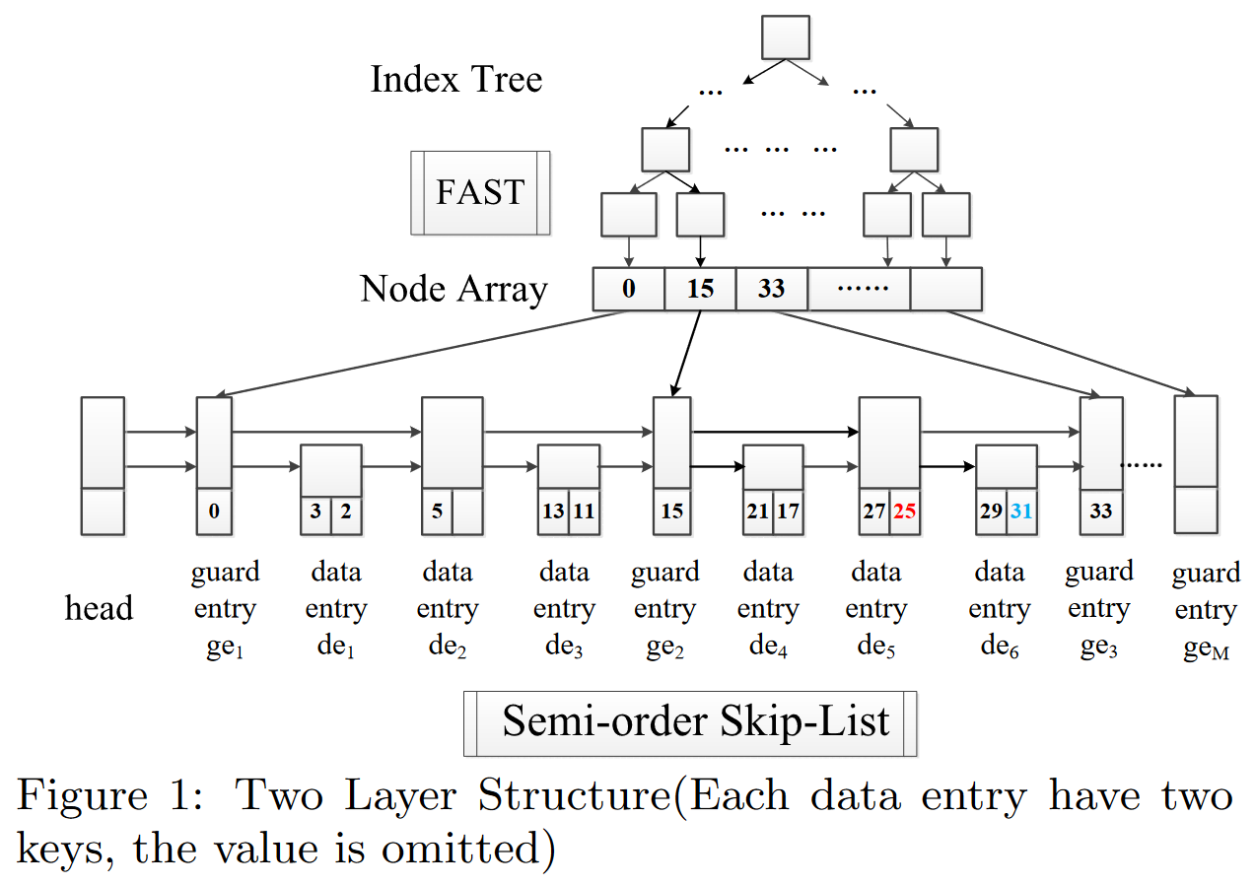
Architecture of S3
S3
Top Layer
Cache-sensitive index
FAST(Fast Architecture Sensitive Tree)
Bottom Layer
Semi-order skip-list
Guard Entry
Data Entry

Slide 8
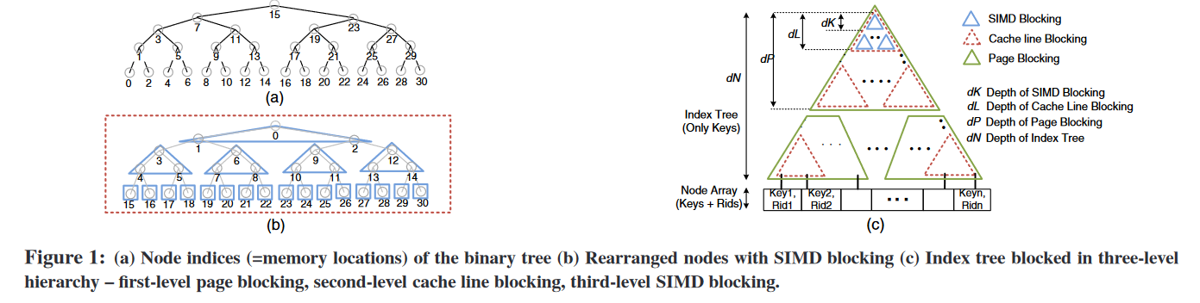
Top Layer of S3
FAST
Architecture sensitive layout of the index tree
Using SIMD to boost the key comparison during index traversal
Small enough to always be in cache
Notes:
트리구조가 고정되면 업데이트 X

Slide 9
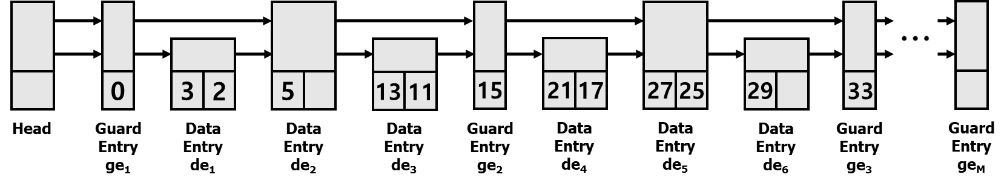
Bottom Layer of S3
Semi-order Skip-List
Two types of entries: Guard Entry, Data Entry
Using guard entries as short-cut
Maintaining general order for data entries

Slide 10
Architecture of S3
Semi-order Skip-List
Guard Entry
Indicating a routing key for speeding up the search processing
Guard entries are created during the initialization of the index structure

Slide 11
Architecture of S3
Semi-order Skip-List
Data Entry
Maintaining the user data
Keys in a data entry are not sorted, append keys to the end of list
Continuous memory area

Slide 12
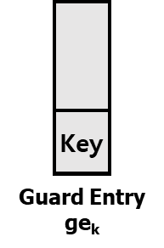
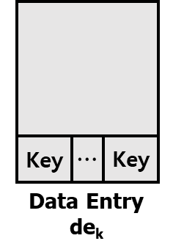
Architecture of S3
Semi-order Skip-List
Guard Entry
Data Entry
Boolean variable
Indicative Keys
Num
Max_key
Pointer
Value
Boolean variable
Indicative Key
Pointer
M

Slide 13
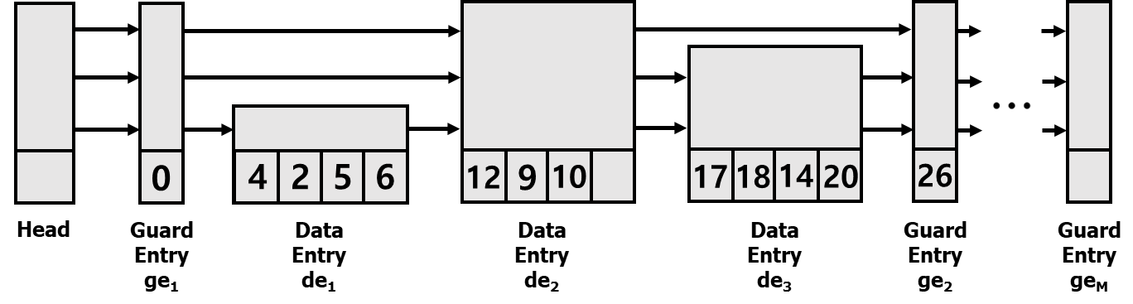
Architecture of S3
Penalty of Semi-order Skip-List
Keys in a data entry are not sorted
Slightly slow down the search process
Sorting the keys before flushing

Slide 14
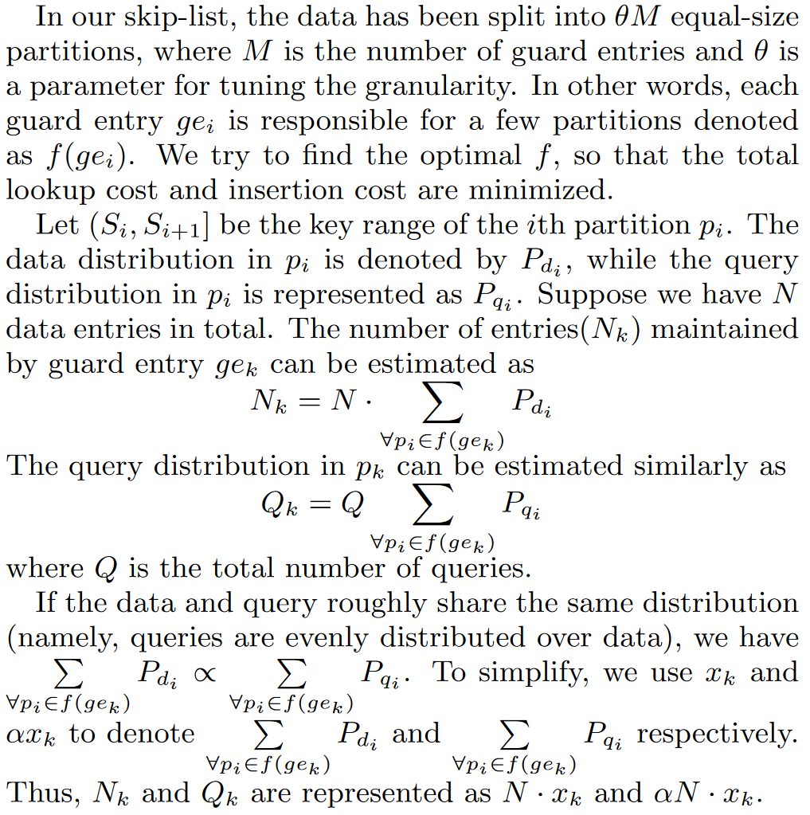
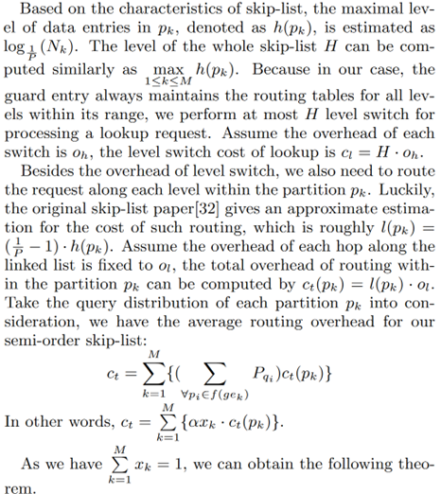
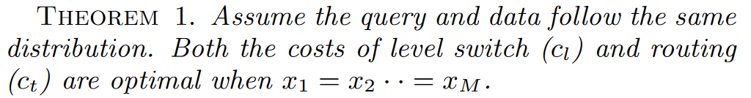
Architecture of S3
Selection of Guard Entry
The lookup cost is optimal when the sum of the data distributions of the partitions that each guard entry is responsible for are all equal

Slide 15
Implementation Details
Size of Top layer Index
Keep the top layer index(FAST) small enough to always be in cache
Concurrent Processing
Threads are assigned to manage specific guard entries and data entries
Cold-Start Problem
Predict which guard entries should be created based on the previous index

Slide 16
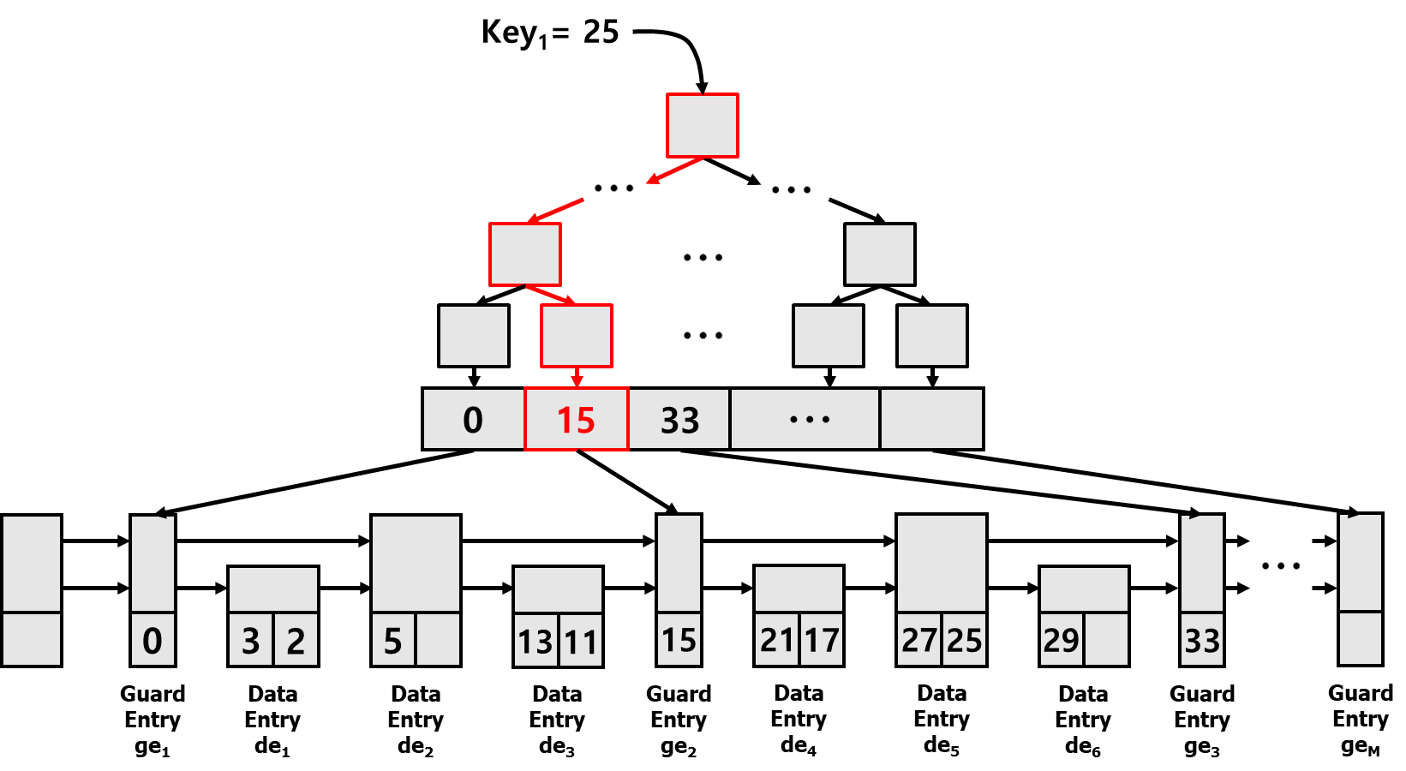

Basic Operators
Search
1. Find rightmost guard entry ge_{i} less than key_{i}

Slide 17
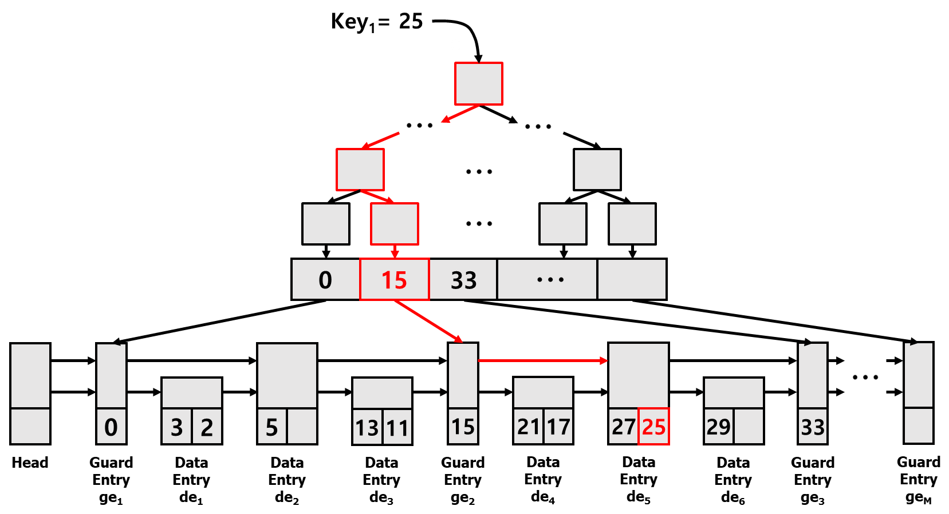
Semi-order Skip-List
Search
2. Find rightmost data entry which max_key is less than key_{i}
3. Follow the link to find key_{i}

Slide 18
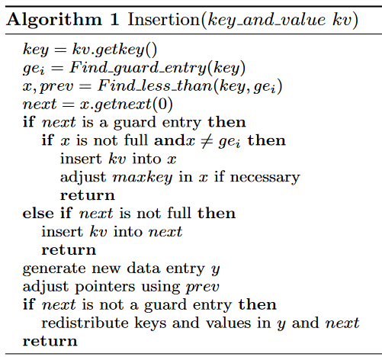
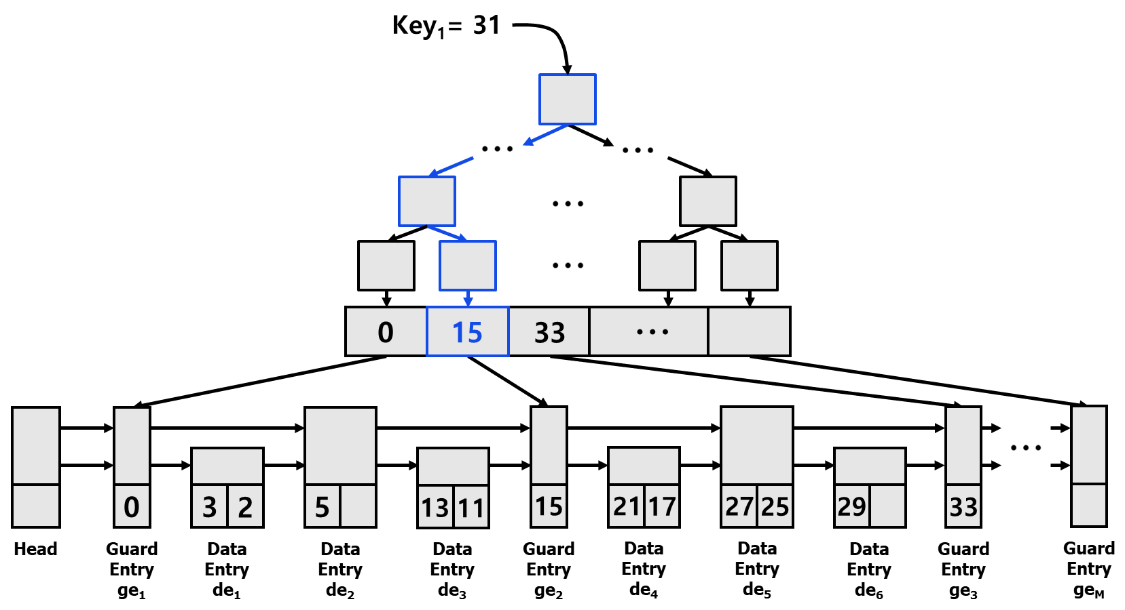

Basic Operators
Insert

Slide 19
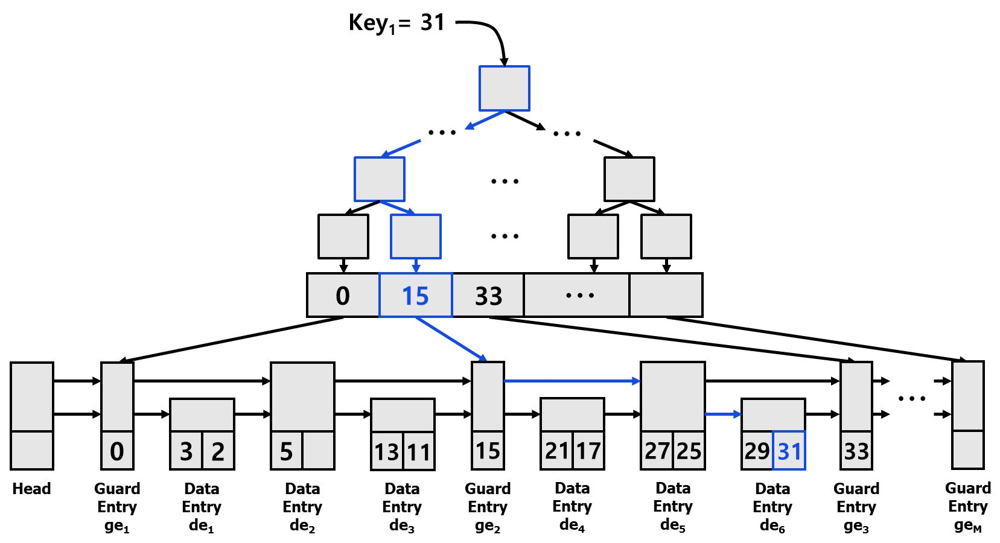
Basic Operators
Insert

Slide 20
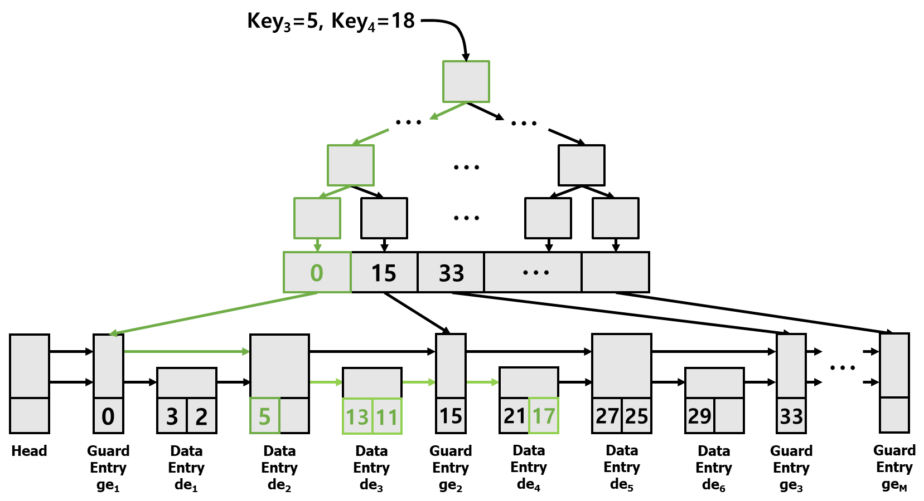
Basic Operators
Range Query
Find rightmost guard entry ge_{i} larger than or equal to key_{i}
Find the last data entry de_{i} which max_key is less than key_{i}
From the de_{i}, find the first entry de_{j} which max_key is larger than or equal to key_{j}

Slide 21
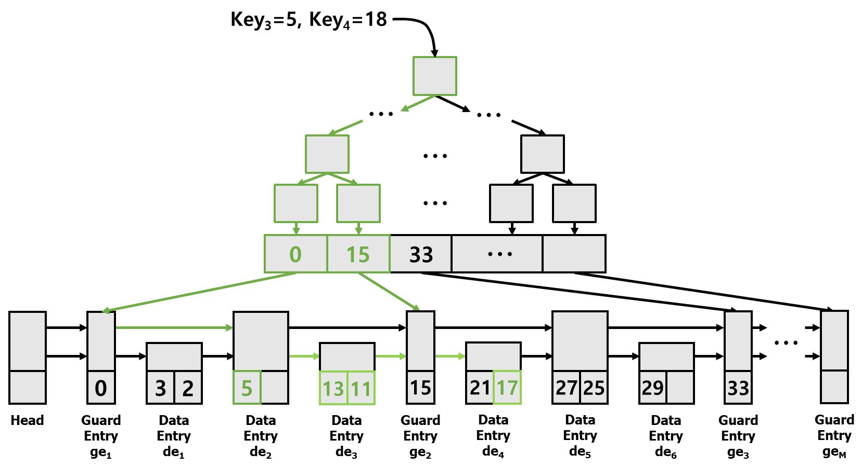
Basic Operators
Range Query
Split range query into sub-queries
Thread 1
Thread 2

Slide 22
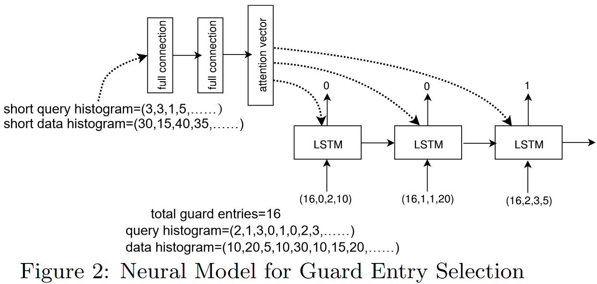
Optimizations
Neural Model for Guard Selection
Simple seq2seq model
Predict the guard entries for the new MemTable

Slide 23
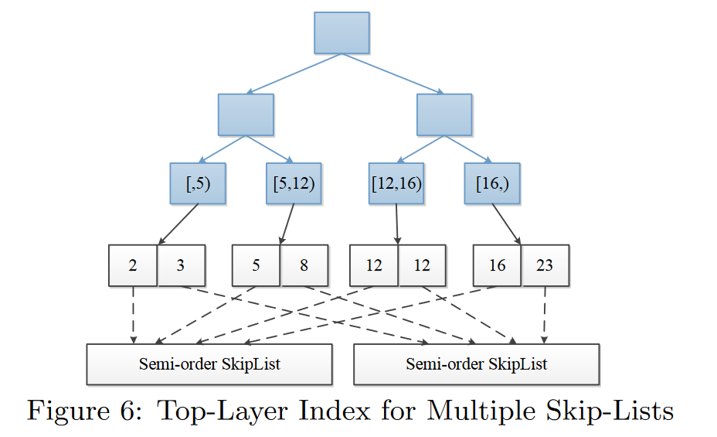
Optimizations
Multiple Semi-order Skip-list
Global top layer index for all skip-lists
Even if we have multiple skip-lists, the top-layer index can be maintained in cache

Slide 24
Evaluation
CPU : Intel Xeon Processor E5 2660 v2 (25M Cache, 2.20 Ghz)
In-Memory Index Key Length : 4bytes
Comparison Target
Cicada, Masstree: Open Sourced
Bwtree: Retrieve from code of Peleton
Query Workloads: YCSB C-Implementation (for generating)

Slide 25
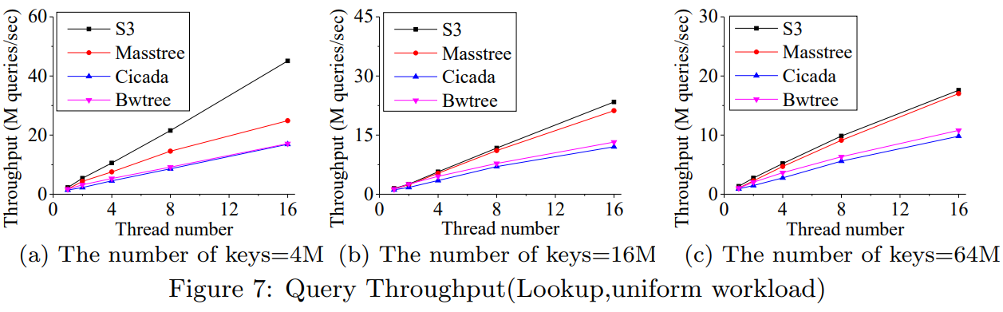
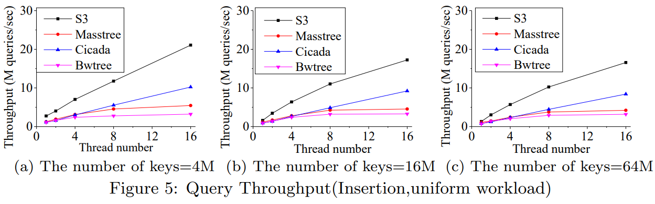
Evaluation
Concurrent Test
(Uniform Workload)
Which test are we do?
Performance comparison test
by number of keys and threads
What did we know?
As increased number of threads
Insertion and lookup throughput increased
As increased number of keys
Insertion and lookup decreased
Shrink the throughput gap
S3 is better than others

Slide 26
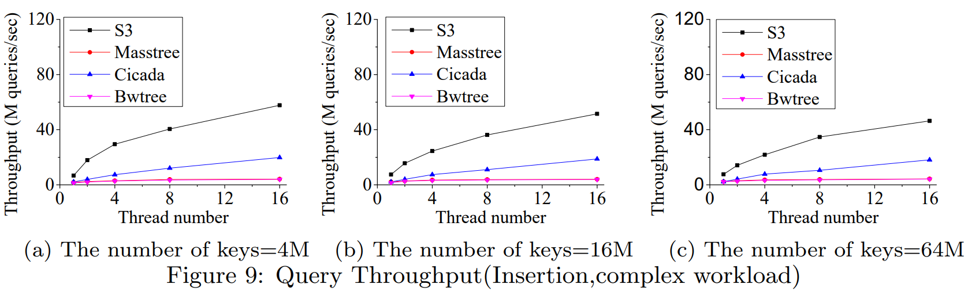
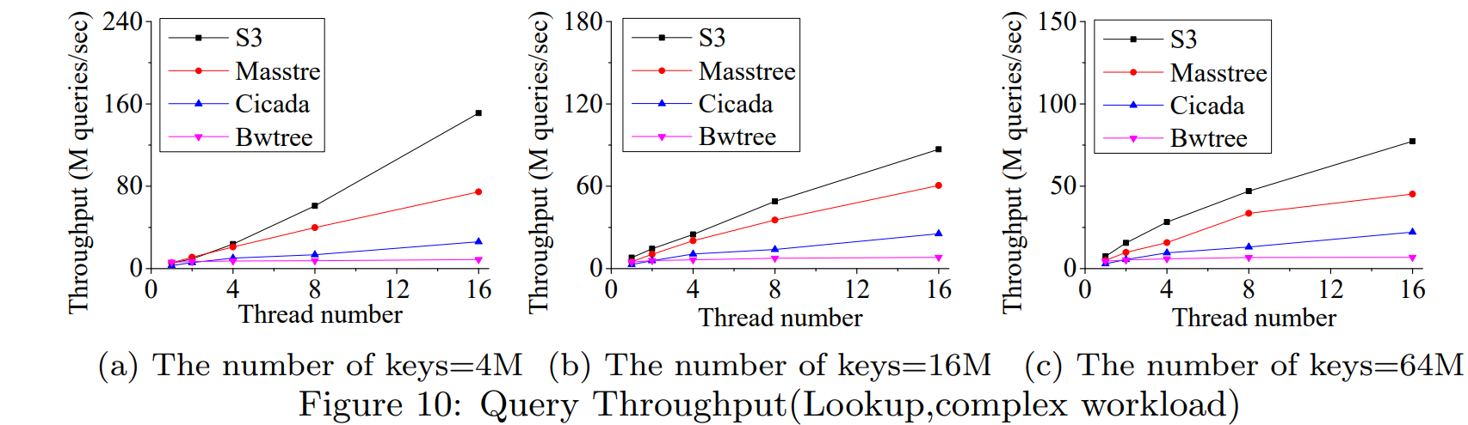
Evaluation
Concurrent Test
(Zipfian Workload)
Which test are we do?
Performance comparison test
by number of keys and threads
What did we know?
Same results like uniform distribution
But, scalability drops for the complex distribution
On complex workload, speedup of lookup is better than insertion
Cause, insertion incurs high processing overhead
S3 is better than others

Slide 27
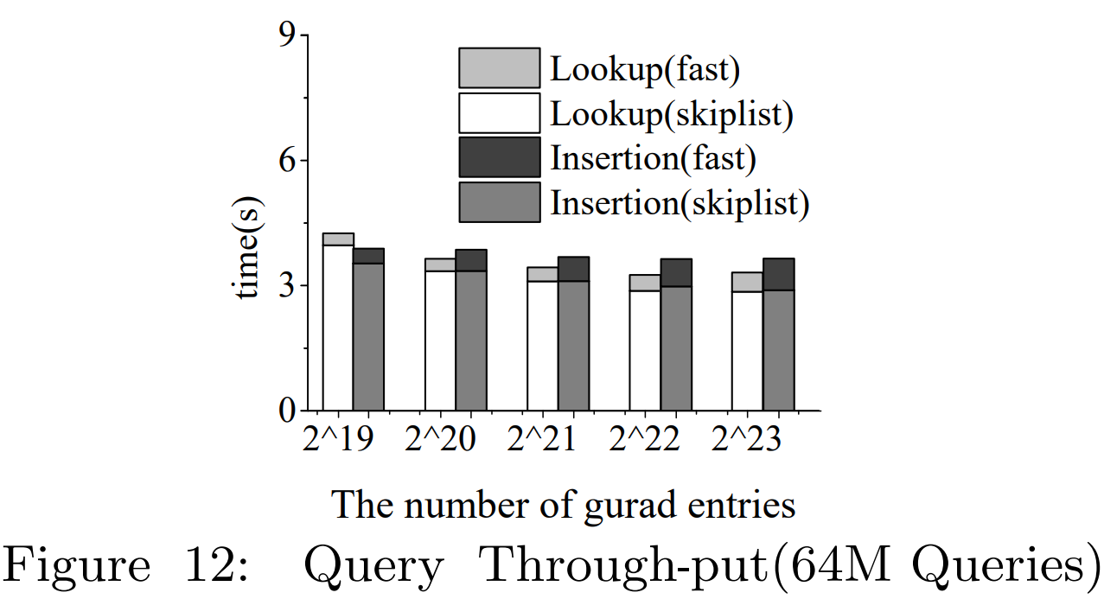
Evaluation
Query Throughput Test
(Guard Entry Selection)
Which test are we do?
To examine effect of the number of guard entries
How are we do test?
First, insert 64M keys
Second, collect the total insertion time of each module
Third, accumulative time of each module for processing
all 64M insertions and lookup
What did we know?
As increase the number of guard entries
The search cost of top-layer index increases, while the search cost of bottom-layer index decreases
Total search cost is optimal, when guard entries number 2^22

Slide 28
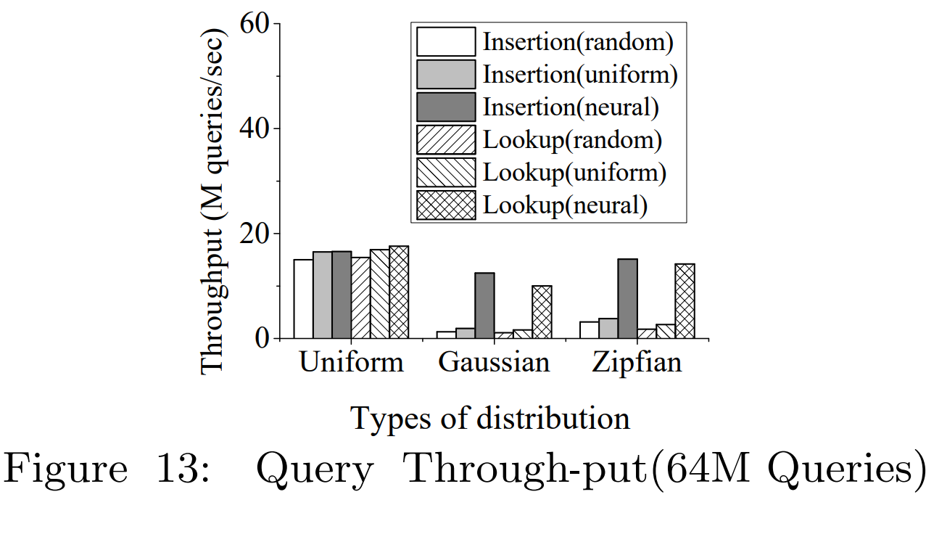
Evaluation
Query Throughput Test
(Guard Entry Selection)
Which test are we do?
To examine which workloads are effectiveness of neural
model for guard entry selection
How are we do test?
Random :Randomly select a key to create a guard entry
Uniform: To uniformly generate guard entries among all keys
Neural: Neural model based guard entry selection
What did we know?
Uniform distribution do not differ much
But for Gaussian and Zipfian distribution, the neural model shows improvement over the others
The neural model based on guard entry selection is best performance on Gaussian and Zipfian distribution

Slide 29
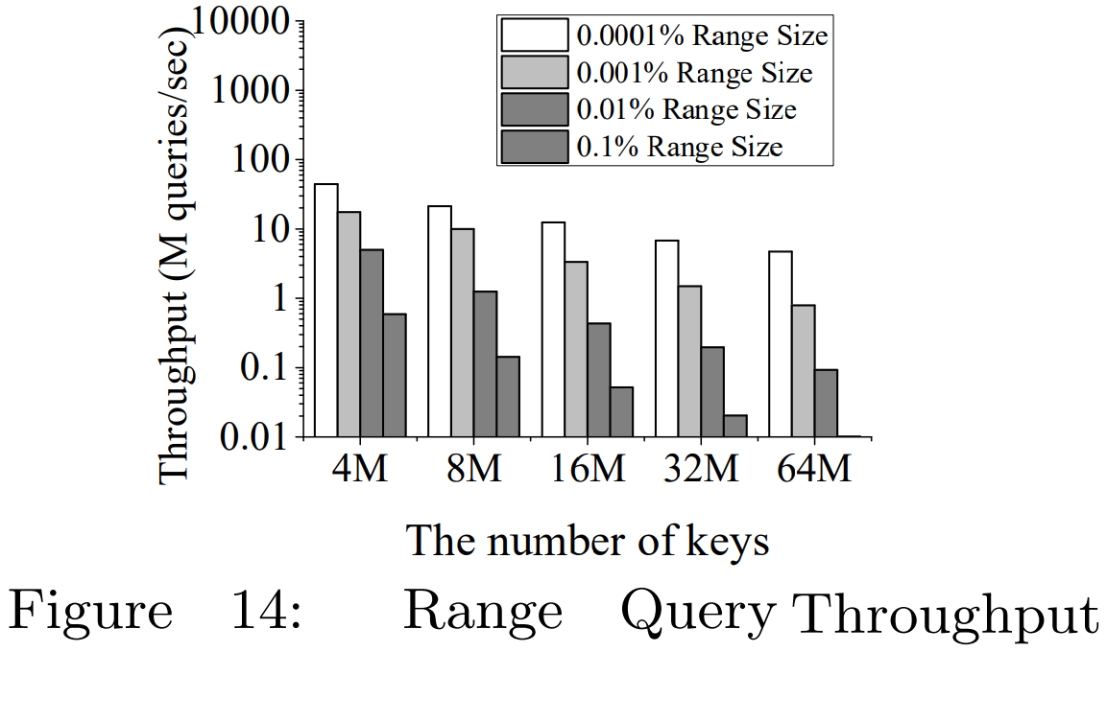
Evaluation
Concurrent Test
(Range Query Performance)
Which test are we do?
To examine the performance of range query
How are we do test?
The number of keys varies from 4M to 64M
The query range varies from 0.0001% to 0.1% key range
What did we know?
As increase the range size, decrease the range query throughput
Unsorted date decreases the throughput of range query

Slide 30
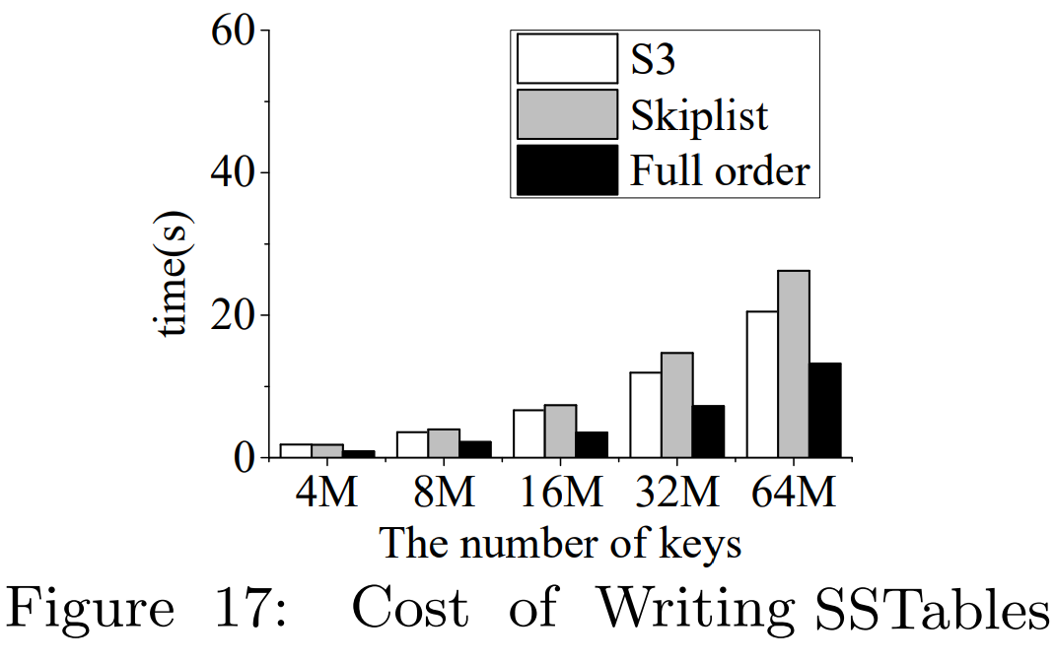
Evaluation
Cost of Flushing Data as SSTables
Which test are we do?
To examine the efficiency of flushing the data
from S3 to disk part of RocksDB
What is Full order?
The best case that sorted entries are kept in
the contiguous memory space
What did we know?
The flushing efficiency of S3 is better than skip-list
S3 needs to sort the data before flushing them back to the disk,
however the cost is acceptable compared to the benefit of using continuous storage

Slide 31
Conclusion
S3 is an in-memory skip-list index for disk-based key-value stores
Using guard entries to enable fast search operations
S3 is designed with two layers
Top layer: Cache Sensitive Index(FAST)
Bottom layer: Semi-order skip-list
Achieve high write performance while slightly sacrificing the read performance
The performance of RocksDB can be improved by the equipment with S3

Slide 32
Thank you
2024.01.24
Presentation by Boseung Kim, Yeongyu Choi
bskim1102@dankook.ac.kr, dusrb1418@naver.com

