Slide 1
No Hot Spot Non-Blocking Skip List
Tyler Crain, Vincent Gramoli, Michel Raynal, 2023 ICDCS
2024. 01. 17
Presentation by Nakyeong Kim, Suhwan Shin
seven3126@gmail.com, tlstnghks77@naver.com

Slide 2
Background & Introduction
Design
Evaluation
Conclusion

Slide 3
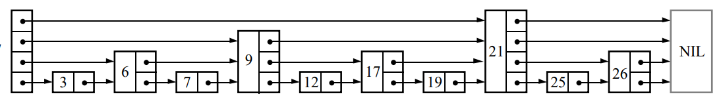
Background
Skip List
top
hot spot
if one thread using lock, all other threads are blocked!
forward[0]
forward [maxLevel - 1]
head
{search,insert,delete} key 19
The higher height, the greater contention

Slide 4
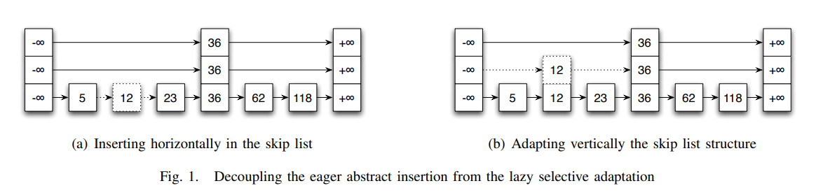
Introduction
Decouple update access into 2-phase
1. Eager abstract modifications
2. Lazy selective adaptation
move hot spot contention to bottom

Slide 5
Introduction
CAS(compare and swap)
bool compare_and_swap(int *reg, int val, int newval)
{
if (*reg == val) {
*reg = newval;
return true;
} else {
*reg = val;
return false;
}
}
for lock-free algorithm

Slide 6
Design
Prev data structure
typedef struct zskiplistNode {
...
struct zskiplistNode *backward;
struct zskiplistLevel {
struct zskiplistNode *forward;
unsigned long span;
} level[];
} zskiplistNode;
typedef struct zskiplist {
struct zskiplistNode *header, *tail;
unsigned long length;
int level;
} zskiplist;
template<typename Key, class Comparator>
class SkipList {
...
Node *const head_;
std::atomic<int> max_height_;
Node **prev_;
int32_t prev_height_;
};
template <typename Key, class Comparator>
struct SkipList<Key, Comparator>::Node {
std::atomic<Node *> next_[1];
Key const key;
}
redis/src/server.h
rocksdb/memtable/skiplist.h

Slide 7
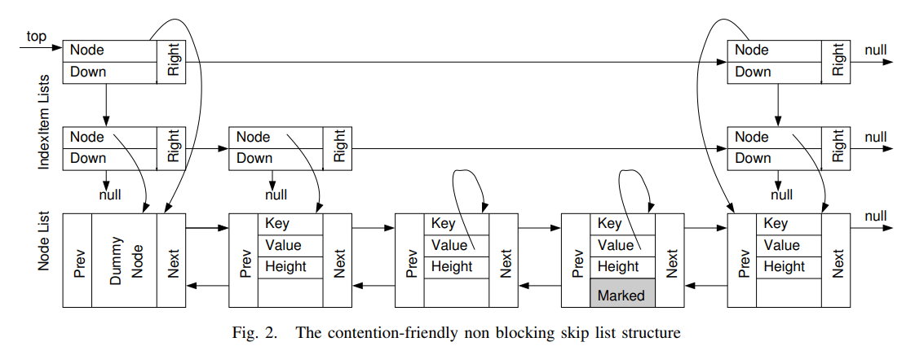
Design
New data structure
public class ConcurrentSkipListMap<K, V> extends AbstractMap<K, V>
implements ConcurrentNavigableMap<K, V>, Cloneable, java.io.Serializable {
private transient volatile HeadIndex<K, V> head;
private final Comparator<? super K> comparator;
...
static final class Node<K, V> {
final K key,
volatile Object value;
volatile Node<K, V> next;
...
}
static class Index<K, V> {
final Node<K, V> node;
final Index<K, V> down;
volatile Index<K, V> right;
...
}
}
jdk7u-jdk/src/share/classes/java/util/concurrent/ConcurrentSkipListMap.java

Slide 8
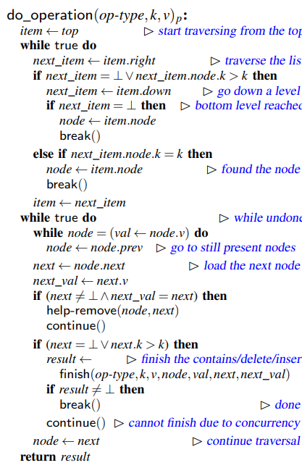
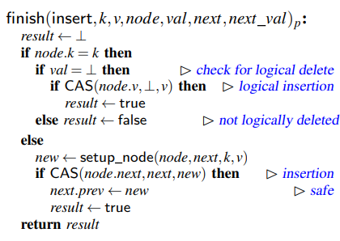
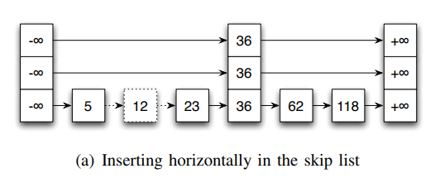
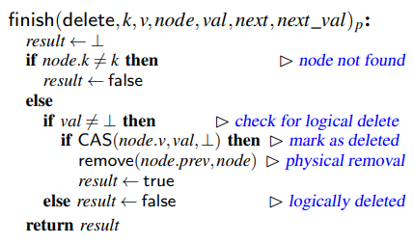
Design
Eager abstract modifications

Slide 9
Design
Lazy structural adaptation
Physical removal for logically deleted nodes
Raising towers
Lowering towers
in adapting thread
adapting thread is single and runs in background

Slide 10
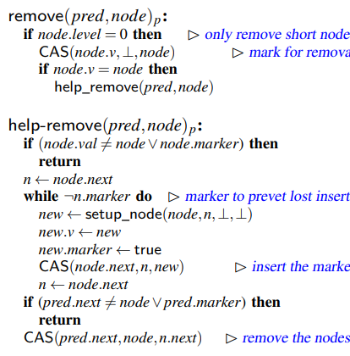
Design
Lazy structural adaptation
1) Physical removal

Slide 11
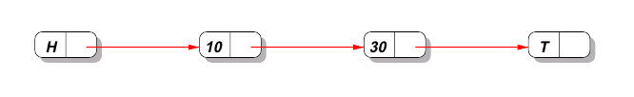
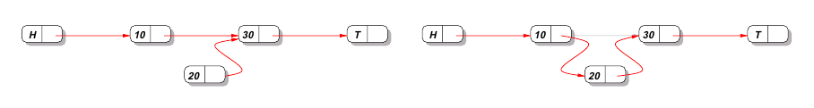

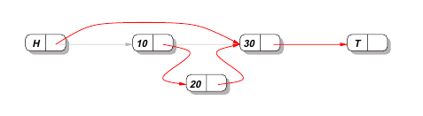

Design
Lost insertion problem
lost!
marked
if insertion occurs, next pointer changed and CAS will fail

Slide 12
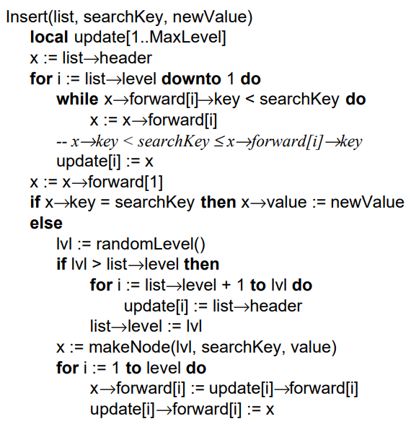
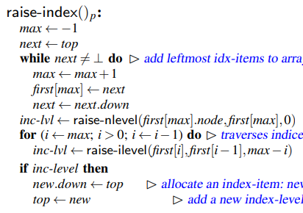
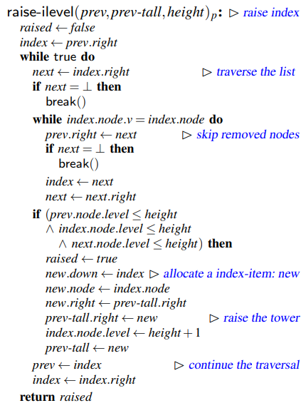
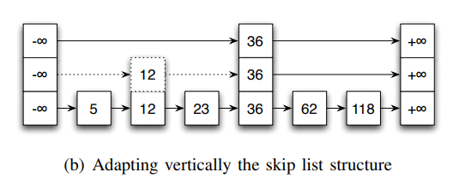
Design
Lazy structural adaptation
2) Raising index
calculate deterministically

Slide 13
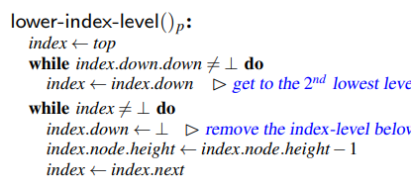
Design
Lazy structural adaptation
3) Lowering index
assume height n(n > 1) tower is logically deleted
threshold = logically deleted nodes / total nodes

Slide 14
Evaluation
Environment
Hardware
2 AMD 12-core processors / 24 hardware threads
Test
Insertion, deletion, and contain operations in program threads using Microbench
Calculated probability: Insertion and deletion are performed with equal probability
JDK
Java SE 1.6.0 12-ea and HotSpot JVM 11.2-b01 in server mode
Compare JDK 1.6 - Java Skip List (Contention-friendly skip list)

Slide 15
Evaluation
Algorithms
CF-NR(Non-removal contention-friendly)
No physical removal (Use marking)
Dedicated adapting threads
Examine the cost of contention caused by physical removals
CF-NA(Non-adapting contention-friendly)
Delete only nodes with height 1
A height greater than 1 will only be chosen if both of the node’s neighbors have a height of 1
Examine the benefits of using an adapting thread

Slide 16
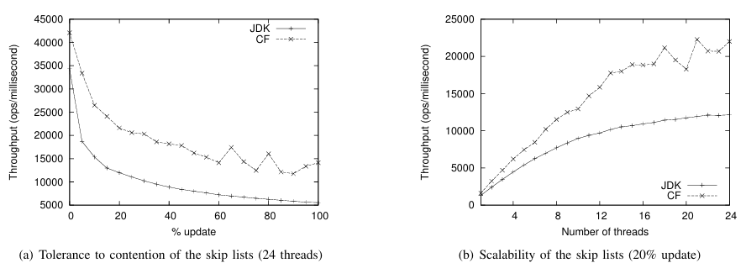
Evaluation
Metrics
Update rate (0% ~ 50%)
More write operations require more concurrency management and synchronization
Number of threads

Slide 17
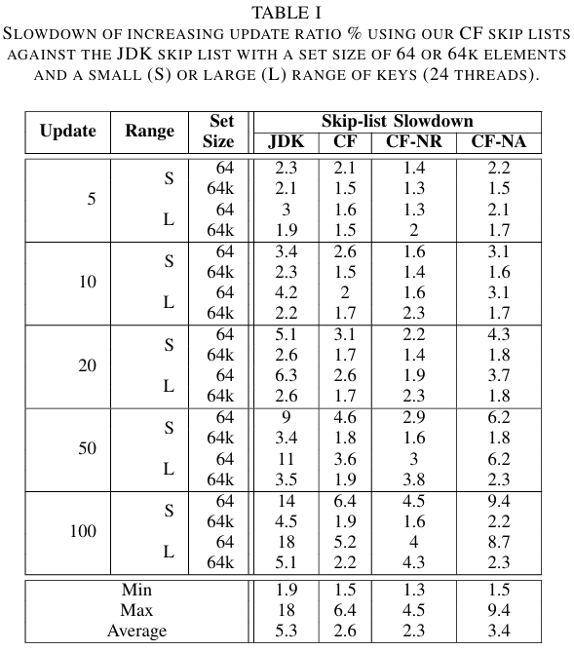
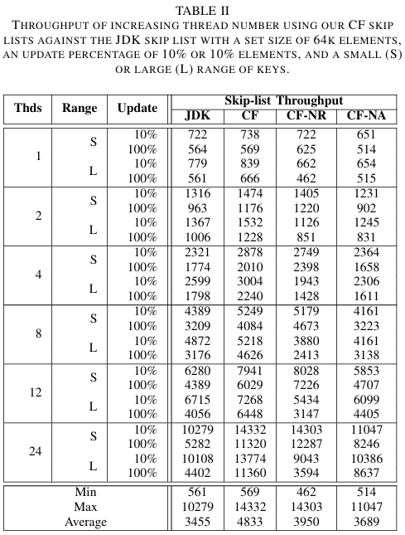
Evaluation
Performance

Slide 18
Evaluation
Performance

Slide 19
Evaluation
Performance

Slide 20
Evaluation
Performance

Slide 21
Evaluation
Performance

Slide 22
Evaluation
Performance

Slide 23
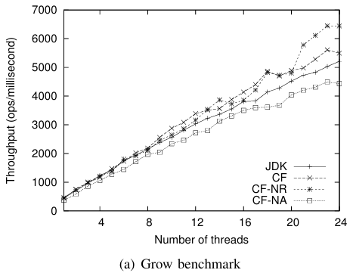
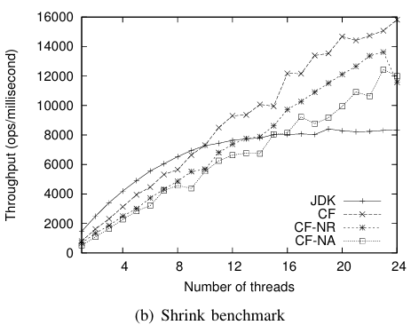
Evaluation
Benchmark
Grow Benchmark
Data set size gradually increases (0 ~ 500000)
Algorithms with adaptive threads have a performance advantage
Shrink Benchmark
Data set size gradually decreases (500000 ~ 2500)
Less contention in low-thread environments

Slide 24
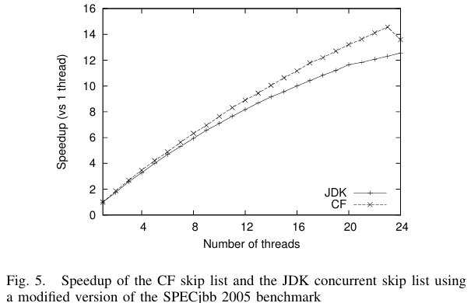
Evaluation
Benchmark
SPECjbb 2005
A standard method for comparing the performance of Java-based systems
Adapting thread and program threads must compete for processor time in 24 threads

Slide 25
Evaluation
Analysis
Why CF-NR performs well in most cases? (When compared to CF-NA and JDK)
Dynamic adjustment
Optimization of delete operations

Slide 26
Conclusion
Conclusion
In a multithreaded environment, traditional skip list suffer from blocking due to hotspot contention and locks.
We split the update into two phase: eager abstract modifications, which only change pointers in the bottommost list, and lazy selective adaptation, which works in the background thread and reflects the entire change of structure.
For detailed comparison, JDKs were compared by dividing them into CF, CF-NR and CF-NA and there was a performance improvement of up to x1.8

Slide 27

Q&A

Slide 28
Thank you!

