Slide 1
Benchmarking learned indexes
Marcus, Ryan, et al. VLDB 2020
2024. 01. 23
Presentation by YeoJin Oh, ZhuYongjie
yeojinoh@dankook.ac.kr, aeashio1111@dankook.ac.kr

Slide 2
Motivation
Background
Definition
CDF (cumulative distribution function)
Index structure
Evaluation
Setup
Pareto analysis
CPU interaction / Multithread / build time
Notes:
Pareto analysis 와 explaining the performanc는 왜 learned model이 좋은 성능을 내는지 설명
뒤에 3개는 learned index structure 에서 다른 중요한 요소들 조사. (real world에서…)

Slide 3
Motivation
Problem
The lack of open-source implementation
Inadequate Datasets and Standardized Benchmark Suite
Unfair advantage on synthetic dataset
solution
A first open-source implementation of RMI
Creating a repository of several real-world datasets and workloads for testing
Creating a benchmarking suite
Notes:
3 problem 3 solution

Slide 4
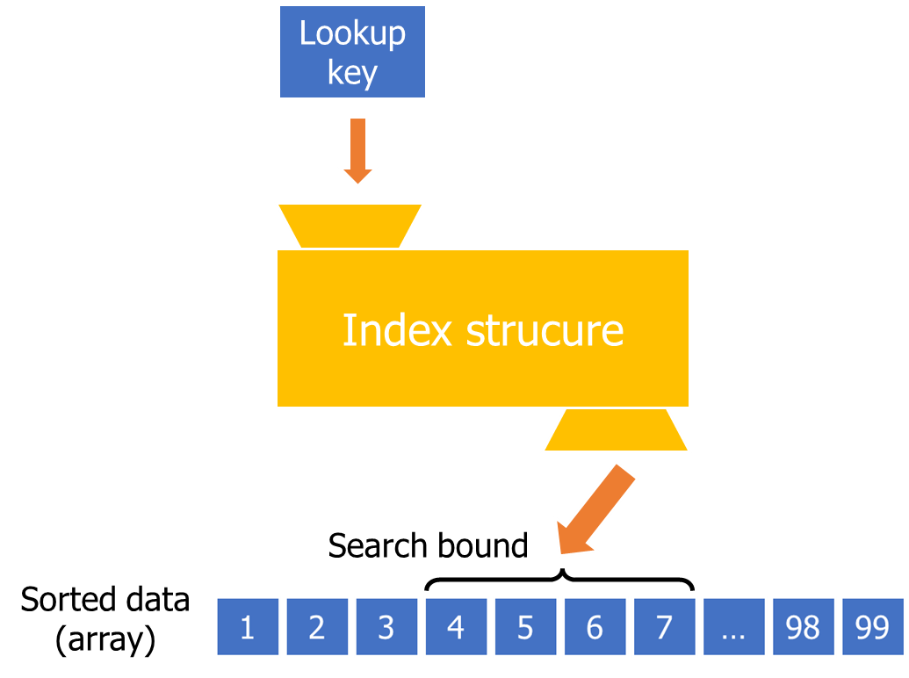
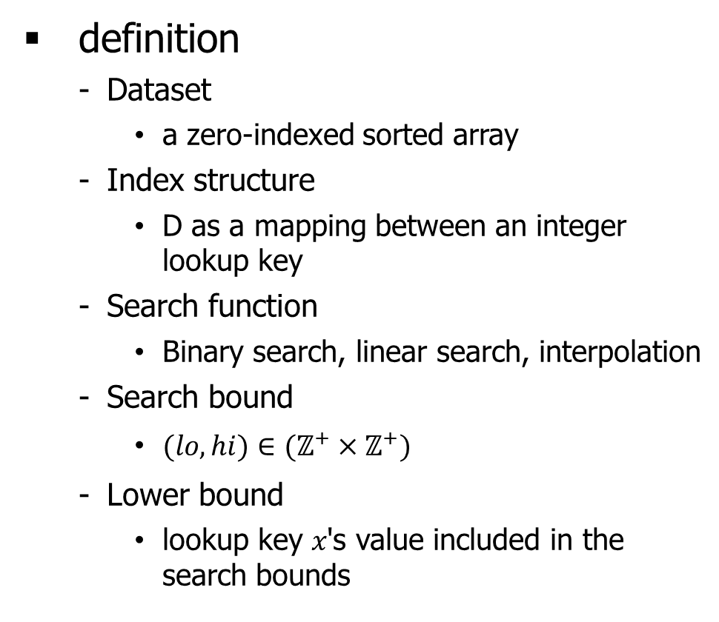
Index definition
definition
Dataset
a zero-indexed sorted array
Index structure
D as a mapping between an integer lookup key
Search function
Binary search, linear search, interpolation
Search bound
$(lo,hi)∈(ℤ^{+}×ℤ^{+})$
Lower bound
lookup key 𝑥's value included in the search bounds
Notes:
Search bound 정의
Search function 예시 넣기
Data -> underlying 1차원 배열
Sorted data, integer key, array structure
Dataset 특징
Index 정의
Data도 배열로 바꾸기
Lower bound정의

Slide 5
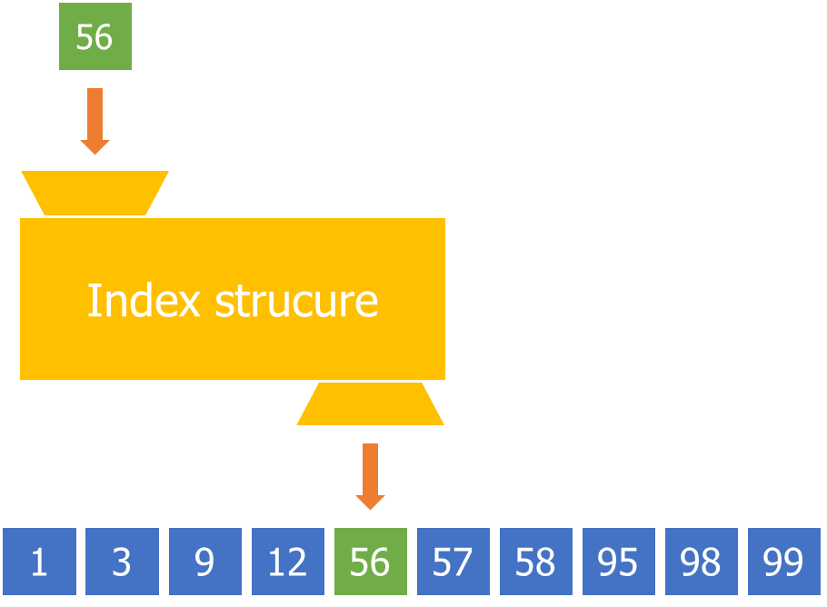
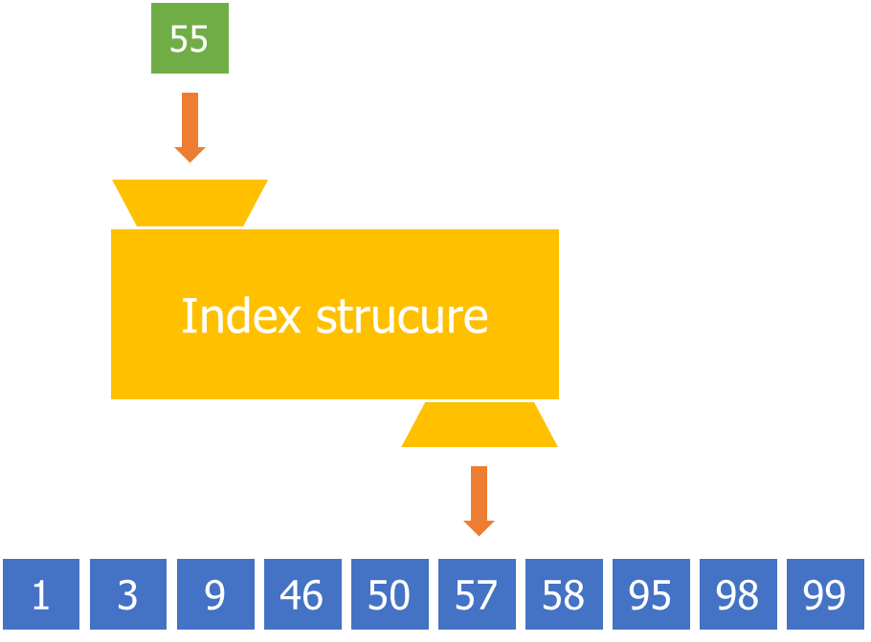
Index definition
Existing key
Missing key
Notes:
56정도
Search bound 에서 searc해서 56찾아가기

Slide 6
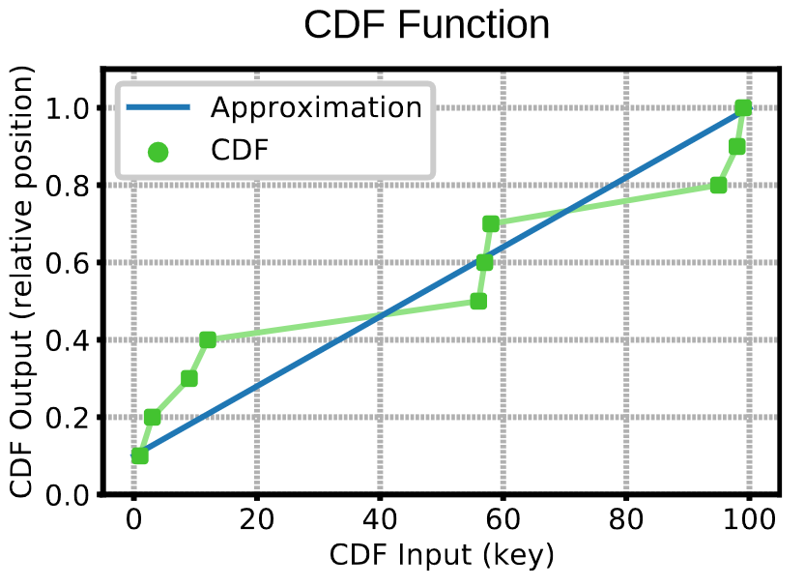
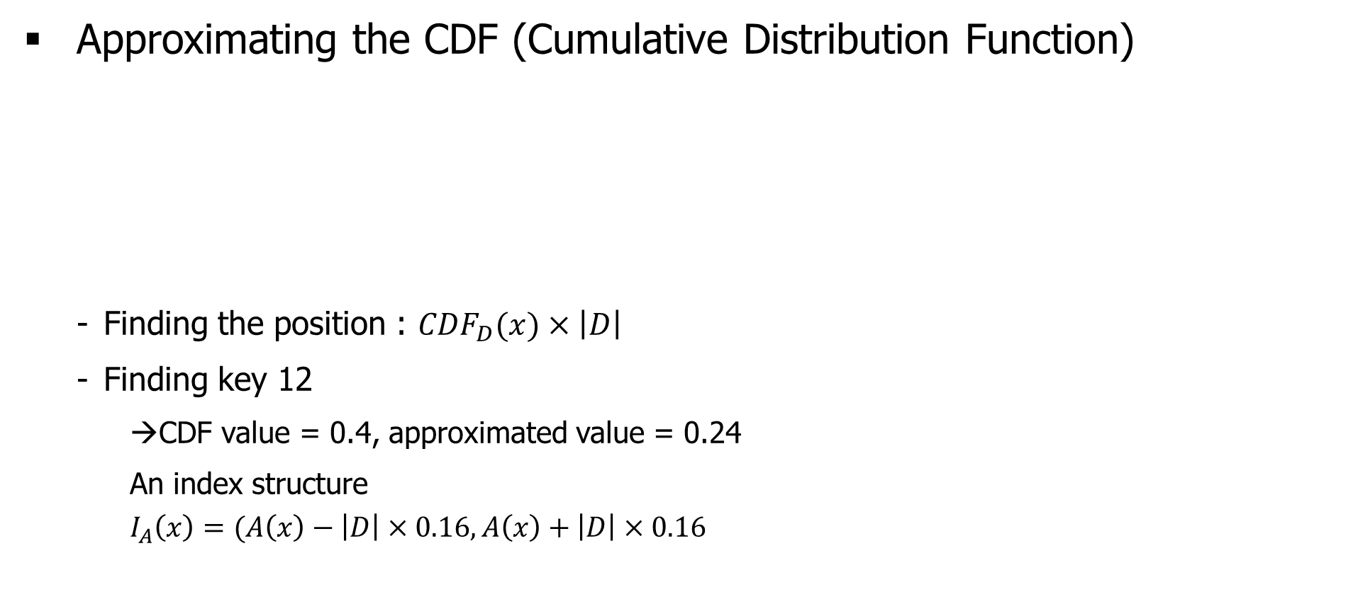
Index definition
Approximating the CDF (Cumulative Distribution Function)
Finding the position : ${CDF}_{D}(x)×\left|D\right|$
Finding key 12
CDF value = 0.4, approximated value = 0.24
An index structure
$$I_{A}\left(x\right)=(A\left(x\right)−\left|D\right|×0.16, A\left(x\right)+\left|D\right|×0.16$$
data
1
3
9
12
56
57
58
95
98
99
Relative position
0.1
0.2
0.3
0.4
0.5
0.6
0.7
0.8
0.9
1.0
Notes:
CDF : the function mapping keys to their relative position in an array

Slide 7
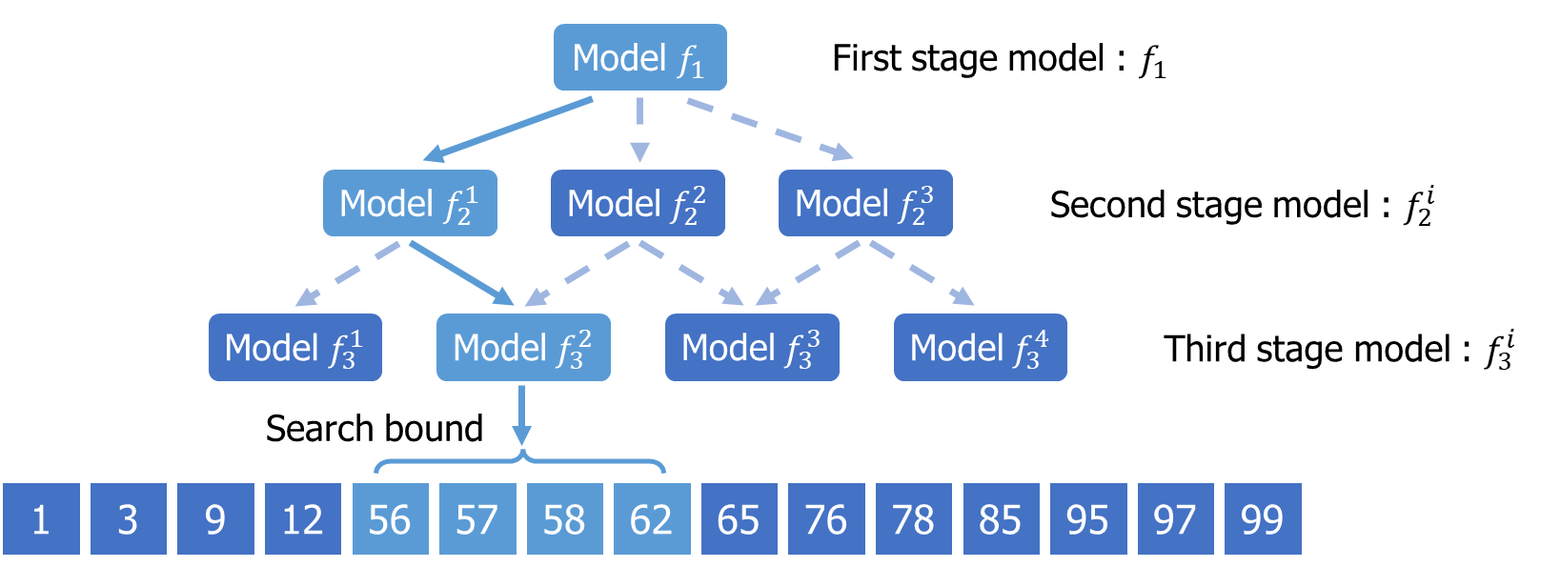

RMI (recursive model index)
RMIs use a multi-stage model
$A\left(x\right)=f_{2}^{\left\lfloor B×f_{1}(x)/\left|D\right|\right\rfloor }$ (in two stage model)
Minimize MSE (Mean Squared Error)
$\left(x,y\right)∈D$ is the set of key/index pairs
$$\sum_{(x,y)∈D}{{(F\left(x\right)−y)}^{2} }$$
Notes:
Dataset 배열 맨 밑에 넣기

Slide 8
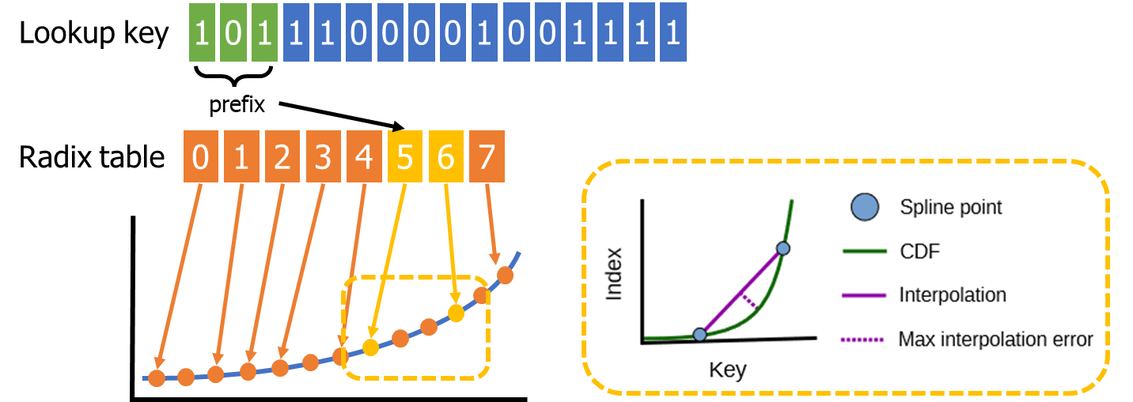
RS (Radix spline indexes)
Components
A set of Spline points : subset of points and a radix table
Radix table: quickly locate the correct spline points
Notes:
RS는 Radix -> 정렬된 데이터를 검색하는데 사용되는 알고리즘
spline -> 유선형
A set of spline point: 이 부분집합에 들어갈 key들이 선택되고, interpolation을 통해 예측된 값이 error bound 내에 있다.
Radix table : lookup key와 맞는 spline points를 빠르게 찾아가기 위해 도와주는 역할

Slide 9
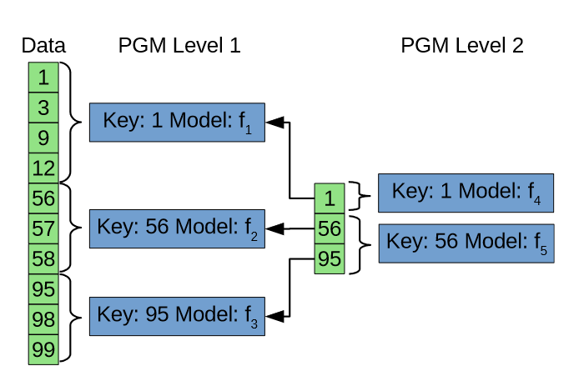
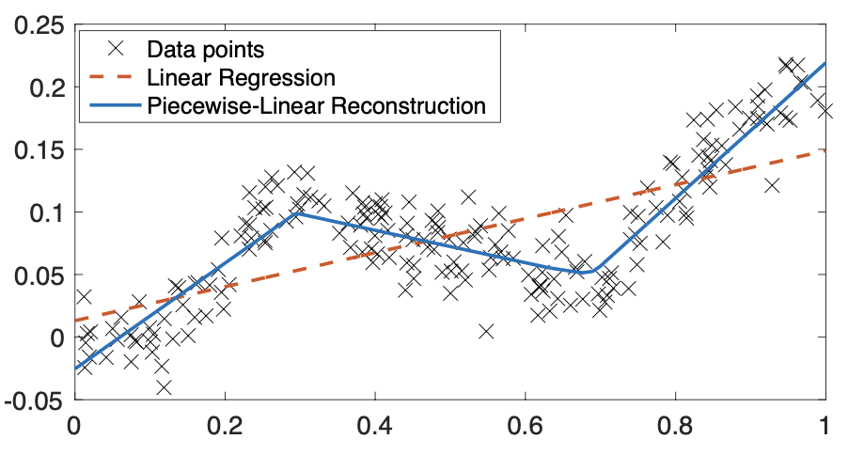

Three index structure
PGM (Piecewise geometric model index)
an error bound is chosen
a minimal piecewise linear model is found
This process is repeated until the piecewise models
become smaller than some threshold
The entire piecewise linear regression
$F\left(x\right)= \left\{\begin{aligned}a_{0}×x+b_{0} if x<p_{0} \\ a_{1}×x+b_{1} if x≥p_{0} and x<p_{1} \\ a_{2}×x+b_{2} if x≥p_{1} and x<p_{2} \\ … \\ a_{n}×x+b_{n} if x≥p_{n} and x<p_{n}\end{aligned}\right.$
Notes:
Piecewise linear model
그림 합치기 12,13
Piecewise linear regression googling

Slide 10
Discussion
Model type
RS and PGM indexes use one model
RMI indexes use a variety of model type → flexible
Top-down VS Bottom-up
Top-down : RMI → no fixed error-bound
Bottom-up: PGM, RS → more branches or cache misses than RMI

Slide 11
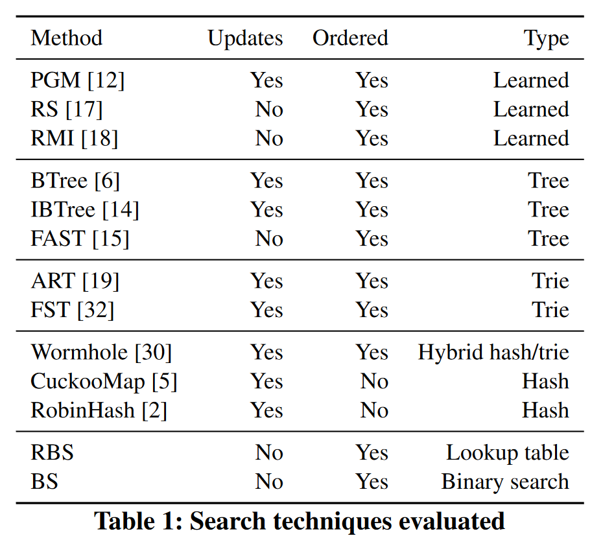
Set up
Learned index
RMI, RS, PGM
Tree structure
Btree, IBTree, ART, FAST, FST, Wormhole
Hashing
robinhash, cuckoomap
Baseline
BS (binary search), RBS (radix binary search)

Slide 12
Set up
Dataset
4 real-world datasets
amzn : book popularity data from Amazon → popularity of a particular book
face : randomly sampled facebook user IDs → identifies a user
osm : cell IDs from Open Street Map → embedded location
wiki : timestamps of edits from Wikipedia → time an edit was committed
Why not test synthetic datasets?
either entirely random → unable to learn effectively
drawn from a known distribution → learning the distribution is trivial

Slide 13
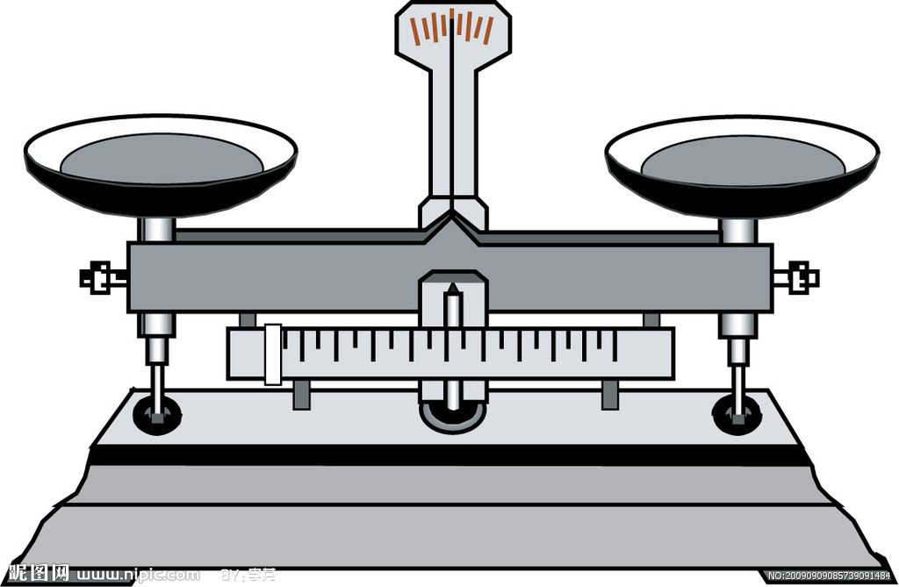
Evaluation
Pareto analysis
What is pareto optimal
Lookup
Size
To achieve a performance balance between lookup time and index size
Notes:
衡量一个index的性能一般需要评价lookup速度与index size两项指标， 并且在理想状态下，两者需要达到平衡。

Slide 14
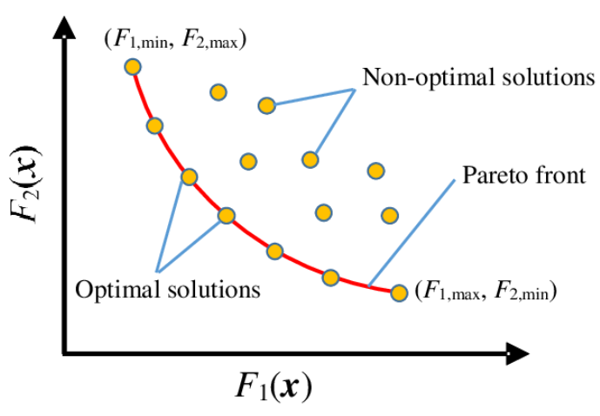
Evaluation
Pareto analysis
What is pareto optimal
Notes:
Pareto optimality는 자원분배의 이상적 상태를 이미한다.
예를들면 두개 성능의 지표 F1(X), F2(X)가 있고 성능을 표현하는 POINT가 좌표에 있다고 합니다,
그럼 POINT들이 꼭 이런 경계를 형성합니다, 이 경계선에 있는 POINT들은 한 방향의 성능을 희생하지 않아도 다른 방향의 성능을 올릴수 있다는것을 의미합니다.

Slide 15
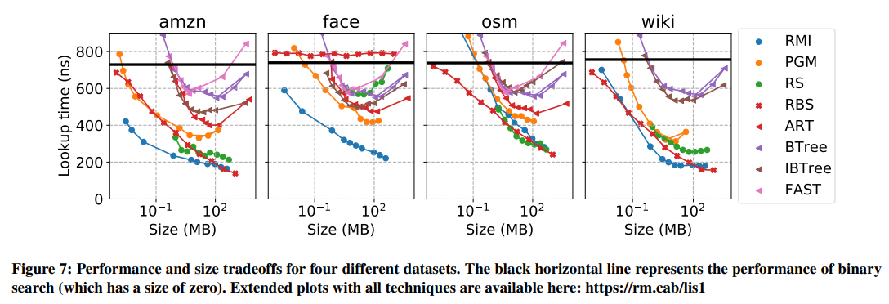
Evaluation
Pareto analysis
Lookup speed & Index size
Learned index
Radix binary search
Traditional index
When the index size is below 100MB, the performance of the learned index is better than that of the traditional index, while when it exceeds 100MB, it is RBS
Notes:
图7是八种index在四种不同dataset与不同的index size下的lookup时间性能对比图。 每种index都配置了从最小到最大的10种index size配置, 各自都是 pareto optimality
（下一动画）
可以看到amazon和wiki pedia的workload下， learned index在100MB以下的index size中总是可以得到最佳pareto值， 但也可以看见的是，超过了100MB的index size后， 只有使用了RBS的RS的性能或许会更好。
此页加入实验背景以及对应描述

Slide 16
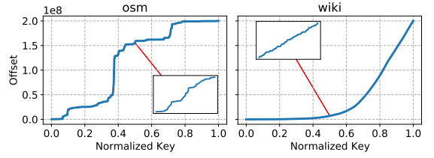
Evaluation
Pareto analysis
Lookup speed & Index size
Learned index cannot provide sufficient performance in workloads with poor key distribution patterns
Notes:
在open street map应用数据上， 可以看到learned index的性能不如单纯的radix binary search算法， 这可能是因为learned index 无法学习规律性差的数据导致。
提供可供对比的workload key图片以及解释

Slide 17
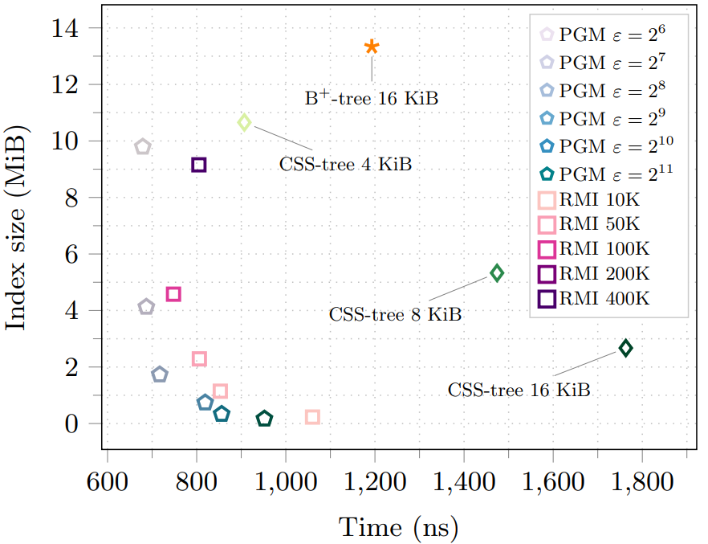
Evaluation
PGM indexing outperforms RMI in performance.
From The PGM-index: a fully-dynamic compressed learned index with provable worst-case bounds
Pareto analysis
Lookup speed & Index size
Notes:
在PGM的论文中，提到了一种观点，是RMI在不同stage中搜索可能会导致性能变差，所以PGM性能上会优于RMI
如图所示PGM论文中的的index size， lookup time pareto optimal图中表明了它们的观点

Slide 18
Evaluation
PGM indexing outperforms RMI in performance.
From The PGM-index: a fully-dynamic compressed learned index with provable worst-case bounds
Pareto analysis
Lookup speed & Index size
But the performance of PGM index is significantly lower than RMI
Notes:
但在这篇论文的测试数据中，可以看到RMI明显地优于PGM

Slide 19
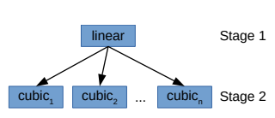
Evaluation
Pareto analysis
Lookup speed & Index size
CDFShop: Exploring and Optimizing Learned Index Structures
The PGM-index: a fully-dynamic compressed learned index with provable worst-case bounds
The RMI constructions used by the two are different
Notes:
原因则是在本论文中，作者构建RMI时使用了不同类型的模型， 但PGM的论文中则仅使用了linear模型，导致无法充分发挥RMI的全部性能。
这正代表了learned index的性能评价需要公认的基准。

Slide 20
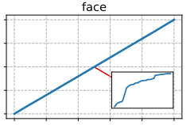
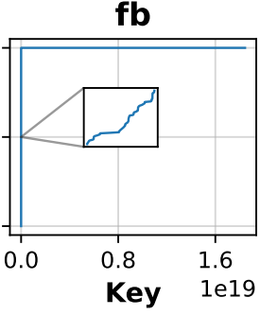
Evaluation
Pareto analysis
Lookup speed & Index size
Without outliers
Within outliers
Most keys fall within (0, 2**50)
Approximately 100 outliers fall in (2**59, (2**64)-1)
Notes:
在amazon， open street map， wiki上都能得到不错性能的RBS，在face book上却有着很差的pareto性能。
这是因为face book数据集上绝大多数key落在了（0， 2**50)的位置上，但有大约100个异常key落在了（2**59， 2**64-1）， 由于RBS的radix table取自于RS， 而RS在构建radix table时的sampling是根据key值2进制的前缀（前几位）， 所以即便绝大多数key的分布有较强的规律性，异常值会导致对应的key区间变得异常的大，彻底妨碍了RBS算法。
由此可见包含了RBS的RS的learned index的弱点就在key必须均匀分布且不能存在异常值。.
RMI由于它是先在stage1笼统学习整体CDF分布的特征，之后stage2时的分段学习可以适应数据间的变化，所以它能适应更多的key分布。

Slide 21
Evaluation
Pareto analysis
Lookup speed & Index size
Learned index can provide a balance between lookup time and index size performance
Hash table can consume more memory to achieve ultimate lookup performance
Notes:
Table 2 是在规定了key为32bit的int type时构建的各种index 以及hash table的 lookup time和 对应性能最好的index的size。
Learned index在lookup time与 index size上得到的比较好的平衡，而Hash table则可以用内存的消耗来做到最好的lookup性能。

Slide 22

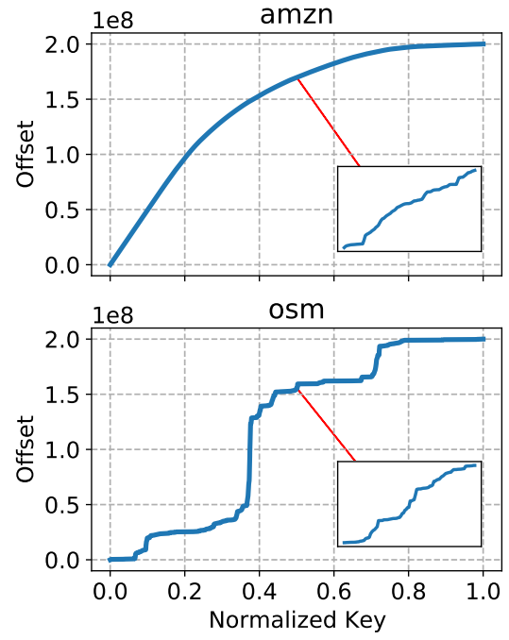
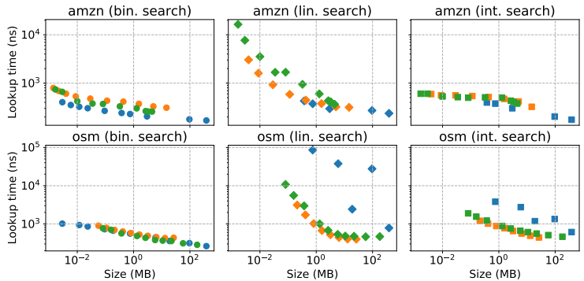
Evaluation
Pareto analysis
Performance & Search function
Due to the premise of learning index being the ordered arrangement of keys, binary search is superior to linear search.
If the distribution of keys is irregular, binary search is better than interpolation search
Notes:
接下来是三种learned index在得到（lo， hi）后使用什么算法来精确定位key， 在测试中提供给每种learned index三种search算法， 分别为binary search， linear search，以及interpolation search。
使用的数据集是更有规律的amazon dataset和 相对没有规律的osm。
通过binary search与linear search对比可以得到binary search的性能更好， 从dataset分析也可知道两组dataset都是sorted， 即使是osm看着无序实际上也只是key的cdf分布无序而已， 所以binary search性能更好
Interpolation search是根据数据的分布来估算它的位置， 当dataset如amazon那样有规律的分布，就可以提供类似binary search的性能， 但dataset像osm这样分布无序，性能就相对弱于binary search。

Slide 23
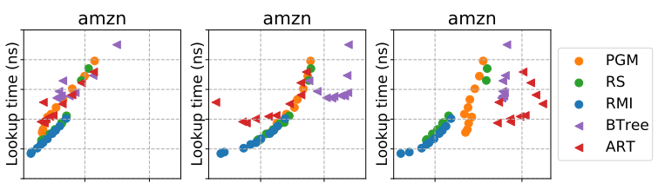
Evaluation
Explaining the performance
Why does the learned index perform well ?
In terms of lookup time, learned index has an advantage in multiple comparisons
Notes:
在这里用amazon dataset 给三种learned index与两种传统index进行了cache miss， branch miss， instruction 与lookup time的性能测试来分析为何learned index性能比传统index更好。
通过结果可以看见learned index的cache miss与instruction count对比两种traditional index 普遍更少，且lookup 性能更好。
而branch miss方面，虽然有部分traditional index如Btree， 可以做到比较好的branch miss，但同样情况下则是learned index的lookup time更好。

Slide 24
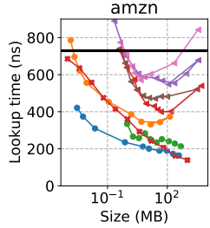
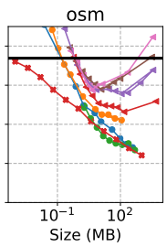
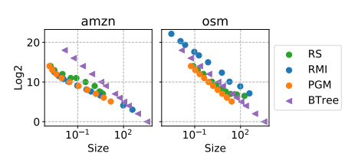
Evaluation
Explaining the performance
Why does the learned index perform well ?
A good learned index model will also have
better performance in log2 errors
Log2 error can be used to evaluate
the learned index
Notes:
这个实验是让三种learned index与Btree在key分布较为规律的Amazon，与key分布规律较差的osm 的dataset进行log2 error与 index size的关系测试。
关于log2 error，在learned index中是指得到了（lo，hi）后进行binary search的次数，而在Btree中则是作为基准的binary search次数。 次数越少代表性能越好。
之前的测试中有相关的bench mark结果是amazon dataset中learned index有明显的优势，而osm dataset中，则优势变小， 由此可以得出结论为： 评价learned index 可以用log2 error来进行评价

Slide 25
Evaluation
CPU interaction
Caching
Memory fence (operator reordering)
Multithread
Varying thread count
Varying index size

Slide 26
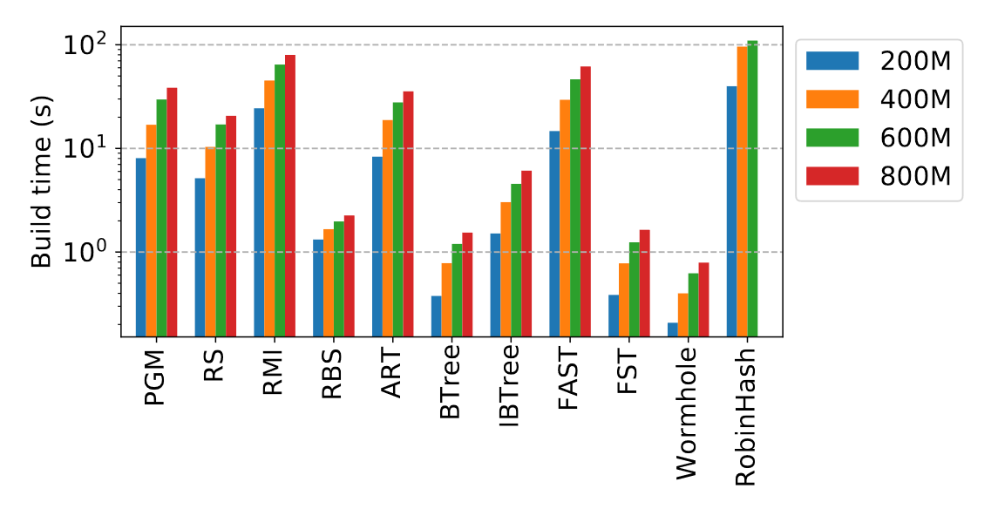
Evaluation
build time
dataset : amzn
Index up to 10x slower in build time
Among learned indexes, RS consistently exhibits the shortest build time regardless of dataset size.
Learned index
Traditional index
Hash index

Slide 27
Conclusion
Conclusion
learned structures generally had higher build time
Examine the end-to-end impact of learned index structures on real applications
The learned index used here is read-only; research on updatable structures is needed

Slide 28
Thank you

Slide 29
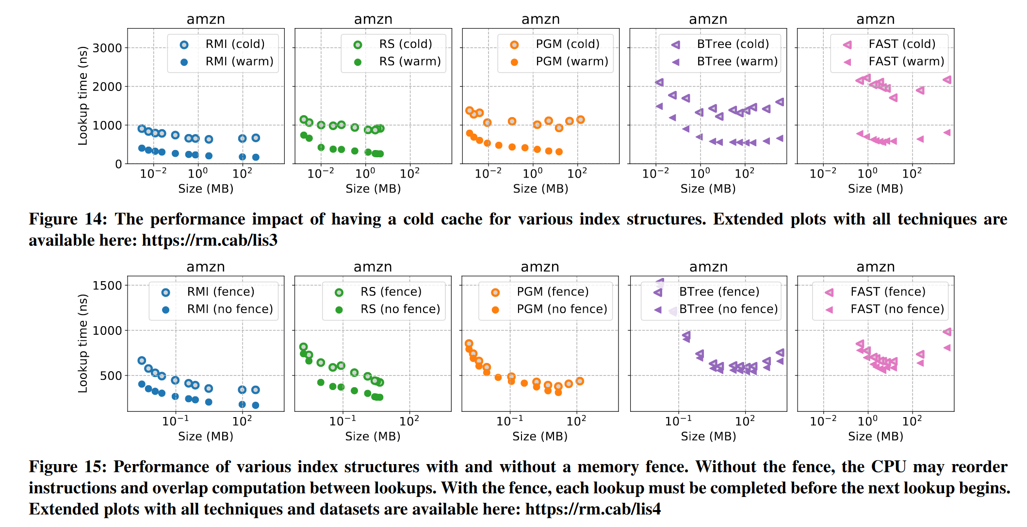
Appendix
Caching
Cache state is more crucial than the choice of index structure in real-size indexes
Memory fence (operator reordering)
With a memory fence, RMI and RS see a significant 50% performance drop
CPU interaction
Learned indexes achieve
a performance/size tradeoff
Decreased performance
But still best

Slide 30
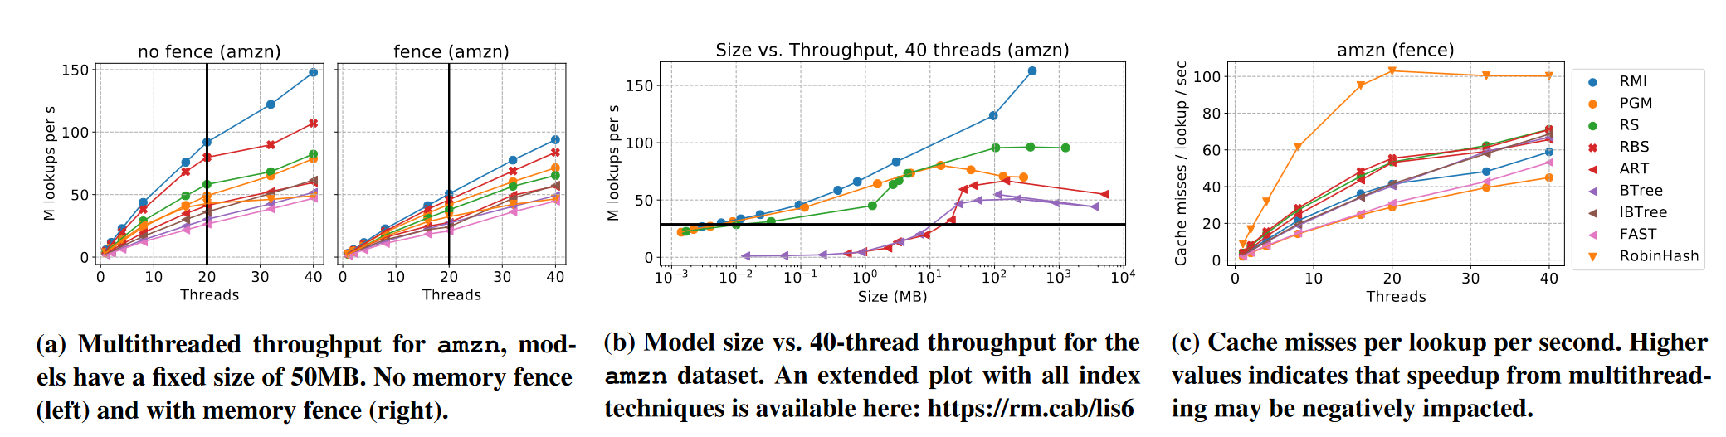
Appendix
Multi thread
Varying thread count
Cache misses impact the speed improvement of a structure but aren't always the deciding factor
Varying index size
Larger indexes show higher throughput
Despite smaller models in the cache, larger models perform better due to cache misses in the final search

Slide 31

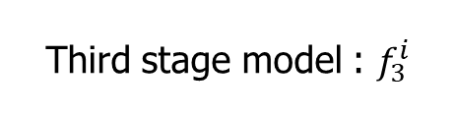


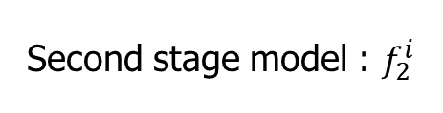

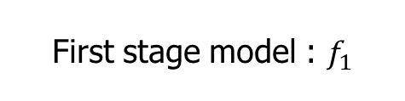




Three index structure
First stage model : $f_{1}$
Model $f_{1}$
Second stage model : $f_{2}^{i}$
Model$f_{2}^{1}$
Model$f_{2}^{2}$
Model$f_{2}^{3}$
Third stage model : $f_{3}^{i}$
Model$f_{3}^{1}$
Model$f_{3}^{2}$
Model$f_{3}^{3}$
Model$f_{3}^{4}$
Search bound
1
3
9
12
56
57
58
62
65
76
78
85
95
97
99
Notes:
Dataset 배열 맨 밑에 넣기

Slide 32
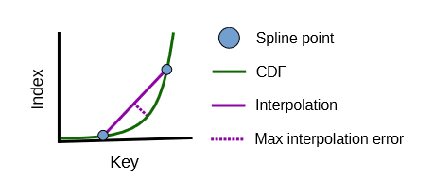
Three index structure
Lookup key
1
0
1
1
1
0
0
0
0
1
0
0
1
1
1
1
prefix
Radix table
0
1
2
3
4
5
6
7
Notes:
RS는 Radix -> 정렬된 데이터를 검색하는데 사용되는 알고리즘
spline -> 유선형
A set of spline point: 이 부분집합에 들어갈 key들이 선택되고, interpolation을 통해 예측된 값이 error bound 내에 있다.
Radix table : lookup key와 맞는 spline points를 빠르게 찾아가기 위해 도와주는 역할

