Slide 1
Learned Index: A Comprehensive Experimental Evaluation
Zhaoyan Sun, Xuanhe Zhou, Guoliang Li, 2023 VLDB
2024. 01. 31
Presentation by Nakyeong Kim, Suhwan Shin, Yeongyu Choi
seven3126@gmail.com, shshin@dankook.ac.kr, dusrb1418@naver.com

Slide 2
Background
Motivation
Learned indexes are not evaluated under the same benchmark
No guideline to help practitioners select suitable learned indexes
No testbed to design new learned indexes

Slide 3
Background
Introduction
Design
Experiment
Conclusion

Slide 4
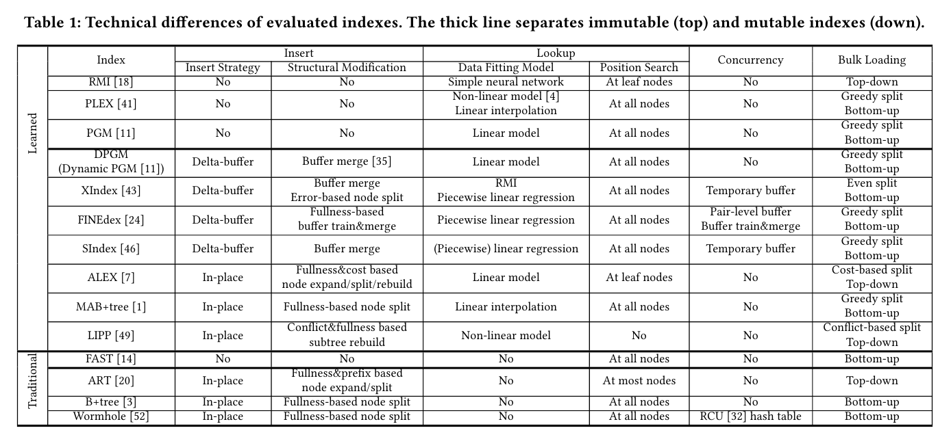
Introduction
Compare Indexes
Notes:
14개

Slide 5
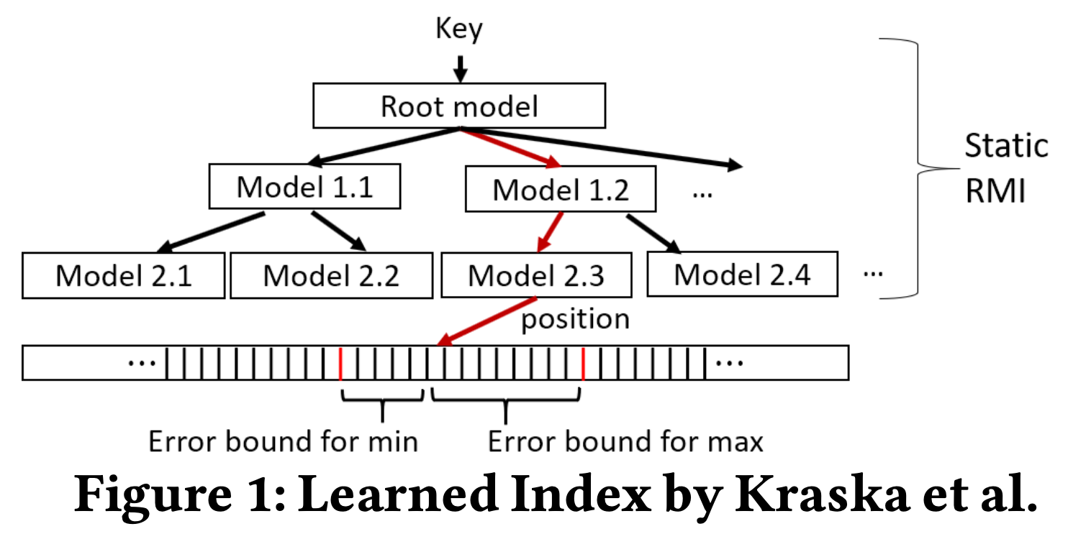
Introduction
Learned Index
Goal
Reduce query(lookup) latency
Reduce index size
Composition
Sorted list of key-position pair
Hierarchical structure
Data fitting model: Each node get model for key-position mapping
Position search: Find correct position when prediction fail
Notes:
+ range query

Slide 6
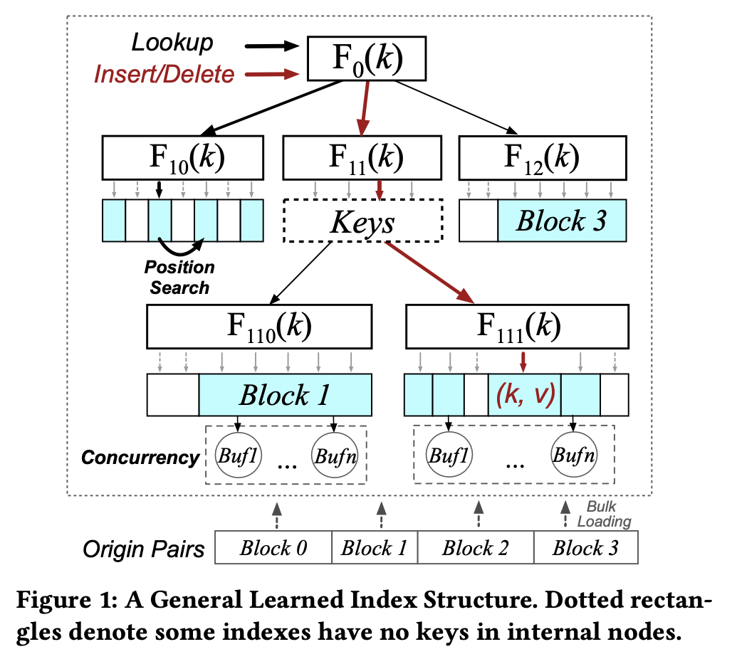
Introduction
Learned Index
Operations
Lookup: Find pair with given key
Insert: Add new pair with given key & value and update index structure
Delete: Remove pair with given key and update index structure
Concurrency: Occur multiple lookups, inserts or deletes simultaneously
Only support at XIndex, FINEdex
Bulk Loading: Construct index structure for batch of pairs
Notes:
+ range query 왜 update structure를 해야하는지? 어떻게 수행하는지?>> 말로 뒤에서 설명하는게 좋을 것 같아요

Slide 7
1. Lookup Design
1.1. Data fitting model
Linear: lightweight, widely used
linear interpolation (e.g., MAB+tree, ALEX, PLEX)
linear regression (e.g., ALEX, FINEdex, SIndex)
Non-Linear: high prediction accuracy
polynomial fitting (e.g., LIPP)
neural network (e.g., RMI)
Hybrid: mixed
RMI + piecewise linear model (XIndex)
Notes:
Identify the first key not smaller than the left bound
And sequentially scan pairs until a key larger than the right bound is reached
Duplicated key may have multiple positions.

Slide 8
1. Lookup Design
1.2. Position search methods
No position search
e.g., LIPP
Only leaf node search
e.g., RMI, ALEX
Both leaf and internal node search
e.g., MADEX, PGM, FINEdex, XIndex, SIndex
Notes:
Identify the first key not smaller than the left bound
And sequentially scan pairs until a key larger than the right bound is reached
Duplicated key may have multiple positions.

Slide 9
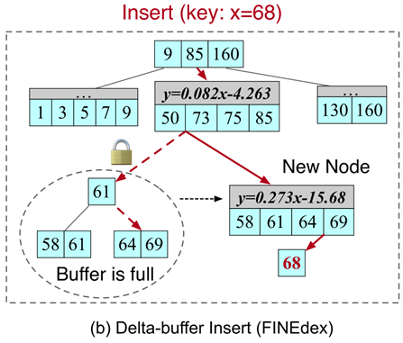
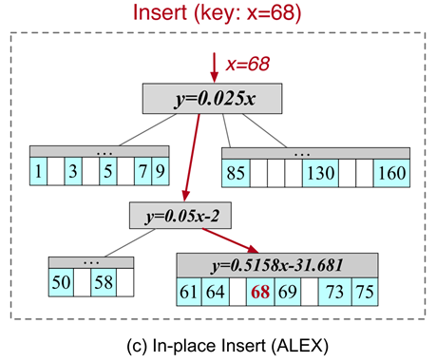
2. Insert Design
2.1. Insert strategies
Delta-buffer insert
Delta buffer : Temporary storage that holds newly inserted key-position pairs
Not modify index structure
Store temporarily in delta buffer
Merge and update periodically
In-place insert
Modify index structure
Reserve gaps for direct insertion
Resolve gap conflict
ALEX
Shift the pairs between the target position
LIPP
Create a new node with both inserted and existing pair in the target position
Replace the target position with a pointer to the new node

Slide 10
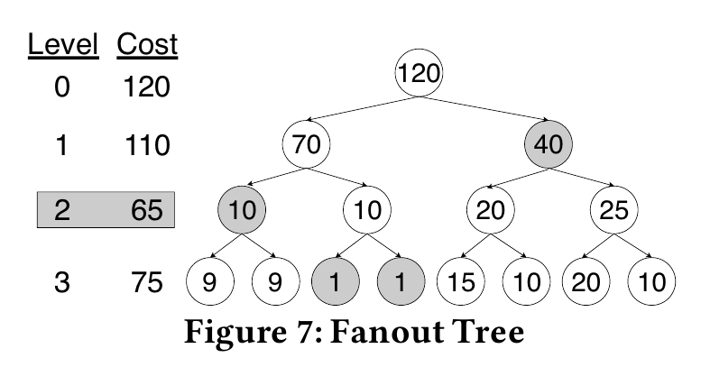
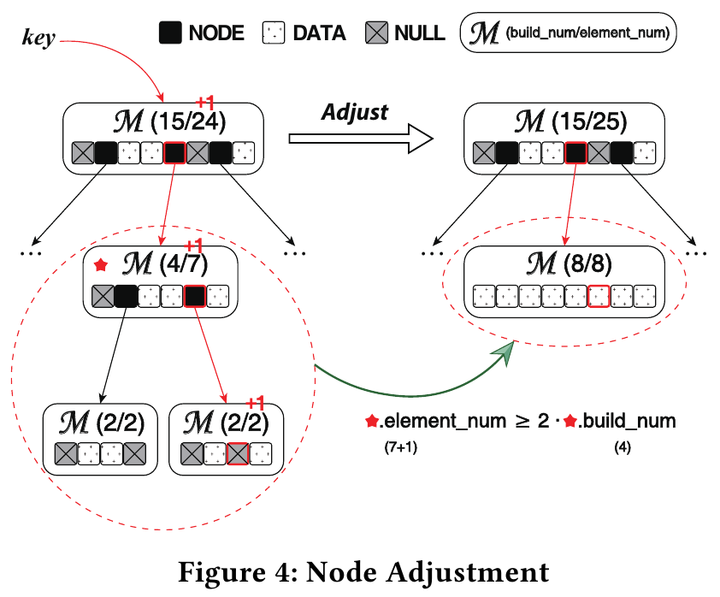
2. Insert Design
2.2. Structural modifications
What is structure modification?
Node is full of pairs, it need to update index structure.
Triggered
Fullness-based: The number of pairs in the node
e.g., FINEdex, ALEX, MAB+tree, LIPP, ART, B+tree, Wormhole
Error-based: The prediction error of a node
e.g., XIndex
Cost-based: Cost & Benefit Model (Fanout Tree)
e.g., ALEX
Conflict-based: The number of conflict pairs in the subtree
Records the number of pairs mapped to the same position
e.g., LIPP
ALEX
LIPP

Slide 11
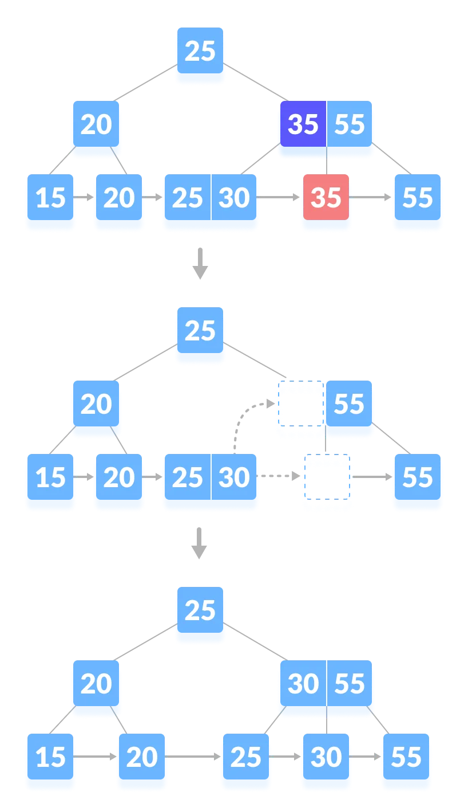
3. Delete Design
Delete
Similar to insert workflow
Similarities
Both insert and delete use lookup
After lookup, update structure possibly
Differences
Insert: Split node (raise height)
Delete: Merge nodes (lower height)
Merge sibling nodes after delete
Notes:
Delete로 인한 SMO 그림

Slide 12
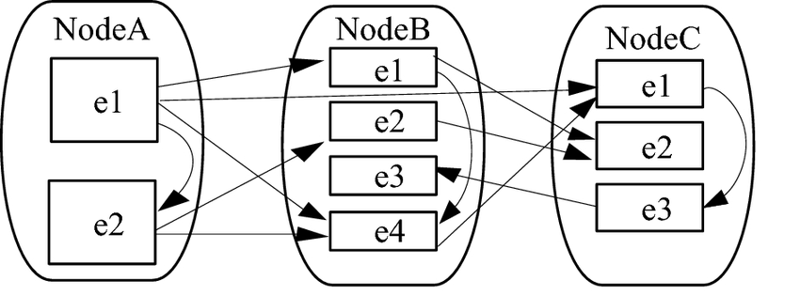
4. Concurrency Design
4.1. Intra-Node
Concurrency issues within a single node
Not modify index structure
Concurrent update
Different key-position pairs (O) with pair-level buffers
Same key-position pairs (X)
thread 1
thread 2
Intra-Node — Inter-Node —

Slide 13
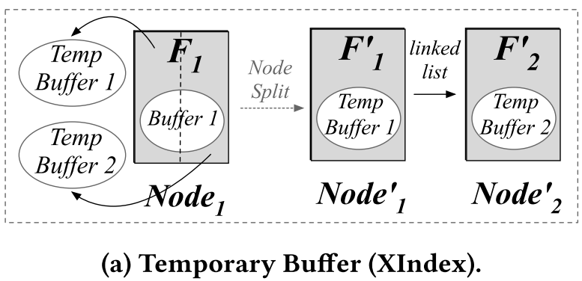
4. Concurrency Design
4.2. Inter-Node
Concurrency issues across from different nodes
Need to modify index structure
Strategies
Temporary Buffer (e.g., XIndex)
Assume that node’s buffer is full
Lock target node and node’s buffer
Allow to insert new pair into temp buffer during splitting
Move temp buffer to the delta buffers of new nodes

Slide 14
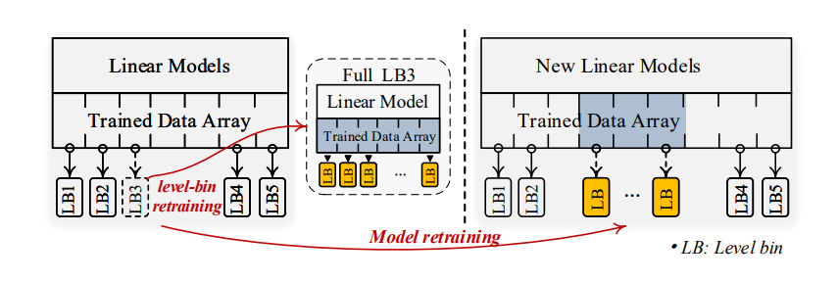
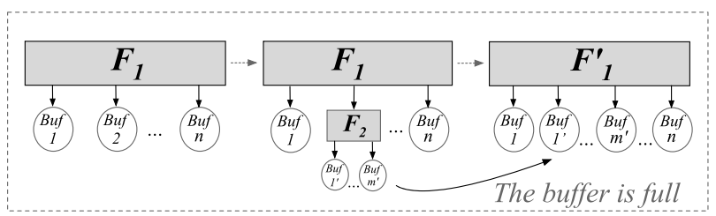
4. Concurrency Design
4.2. Inter-Node
Strategies
(2) Buffer-Train-Merge (e.g., FINEdex)
Allow to update across from other buffers during training sub-node’s model
Lock the node’s model when merge sub-nodes with the origin node
The buffers of the original node and sub-nodes become new node’s buffer
sub-node

Slide 15
5. Bulk Loading Design
5.1. Strategies
Top-down
Generate multiple child nodes from root
Decide not to split
Complete leaf node
Train a model to predict the key-to-position
Decides to split
Train a key-to-child model in internal node
Split the pairs to multiple child nodes
Bottom-up
Split the pairs to leaf nodes
Train a model to predict the position
Extract the minimal or maximal keys from each node and generates a subset
Decide not to split
Construct a root node with pairs
Train a key-to-child model
Decides to split
Split pairs to different nodes
Train a key-to-child model
Extract the minimal or maximal keys

Slide 16
5. Bulk Loading Design
5.2. Challenges
Whether to split
Decide manually
Use some conditions (e.g., prediction accuracy)
How to assign pairs
Greedy split: based on prediction error, not fair
e.g., MAB+tree, PGM, FINEdex, PLEX, SIndex
Even split: based on fixed number
e.g., XIndex
Cost-based split: adopts cost model(e.g, average latency)
e.g., ALEX
Conflict-based split:
e.g., LIPP
Notes:
LI decide the number of levels, then the nodes except the last level will be split.
If the prediction error is larger than a threshold, then it splits the nodes.
Greedy: It incrementally checks whether to add the next pair into the node.
adds the pairs if prediction error for the pairs do not exceeds a threshold. (PGM, PLEX)
adds the pairs in batch until the prediction error exceeds a threshold. (FINEdex, SIndex)
Even: set a number of split nodes and splits equally.
Cost-based:

Slide 17
5. Bulk Loading Design
5.3. Comparison
Bottom-up
Have prediction errors
Adopt non-monotonic model for sorted list of keys
Distant keys are mapped to the same node
Predictions for non-existent keys have overhead
Old-fashioned
Top-down
No prediction errors
Adopt monotonic model
Newly
Trends in Bulk Loading Adoption of Learned Indexes
Notes:
LI decide the number of levels, then the nodes except the last level will be split.
If the prediction error is larger than a threshold, then it splits the nodes.
Greedy: It incrementally checks whether to add the next pair into the node.
adds the pairs if prediction error for the pairs do not exceeds a threshold. (PGM, PLEX)
adds the pairs in batch until the prediction error exceeds a threshold. (FINEdex, SIndex)
Even: set a number of split nodes and splits equally.
Cost-based:

Slide 18
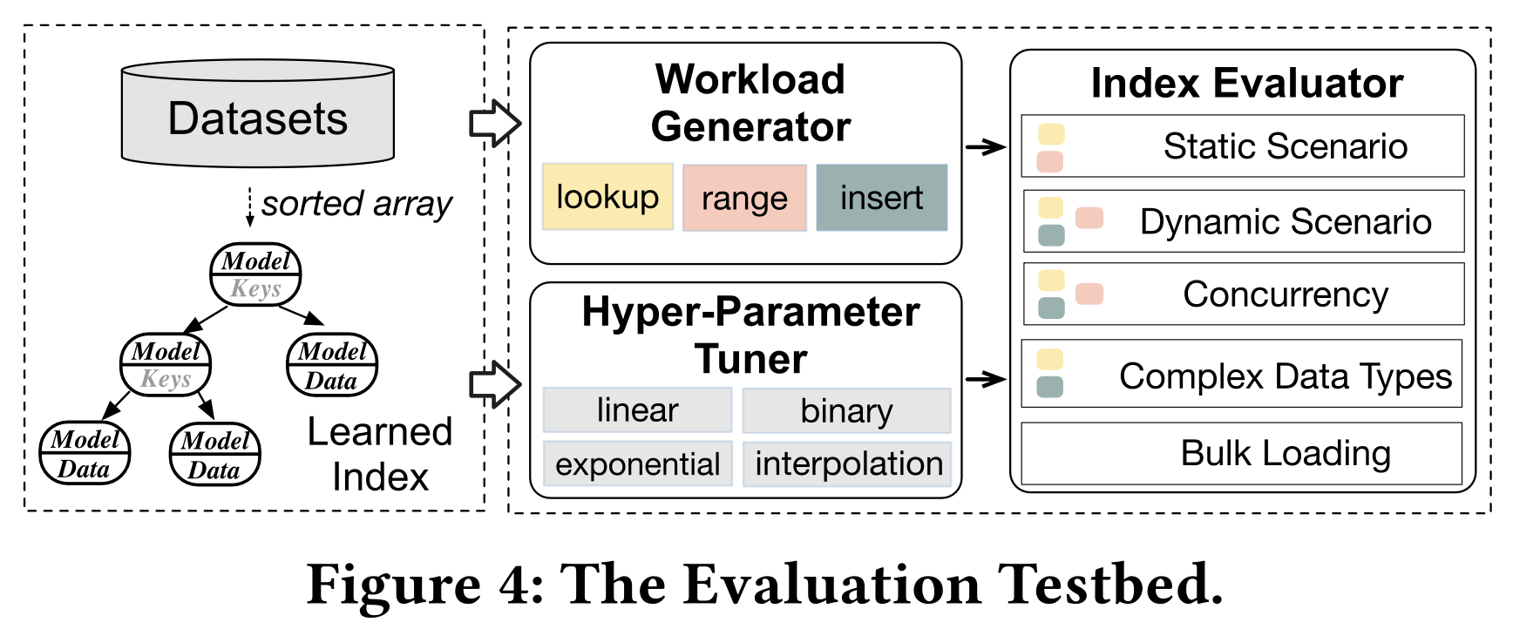
Experiment
Testbed
Purpose
Practitioners to select a learned index
Researchers to design new learned indexes
Architecture
Workload Generator
Static
Lookup
Range query
Dynamic
Insert
Lookup after insert
Hybrid
Lookup, range query, insert
Concurrency
Multi-thread lookup and insert
Hyper-Parameter Tuner
Index Evaluator
Notes:
location, string info -> complicated data (spend more time to search)

Slide 19
Experiment
Environment
Datasets (200M integer keys)
Amzn (Amazon book IDs)
Face (Facebook user IDs)
Wiki (Wikipedia article IDs with edit timestamps, duplicated)
Osmc (OpenStreetMap cell IDs, high dimensional locations)
Url (Memetracker URLs, 90M string keys with variable lengths)
Settings
Linux server machine with 128GB RAM, two 10-core Intel Xeon CPU E5-2630 v4 @ 2.20GHz
Notes:
location, string info -> complicated data (spend more time to search)

Slide 20
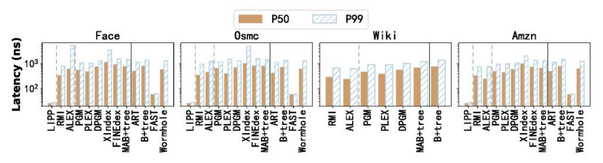
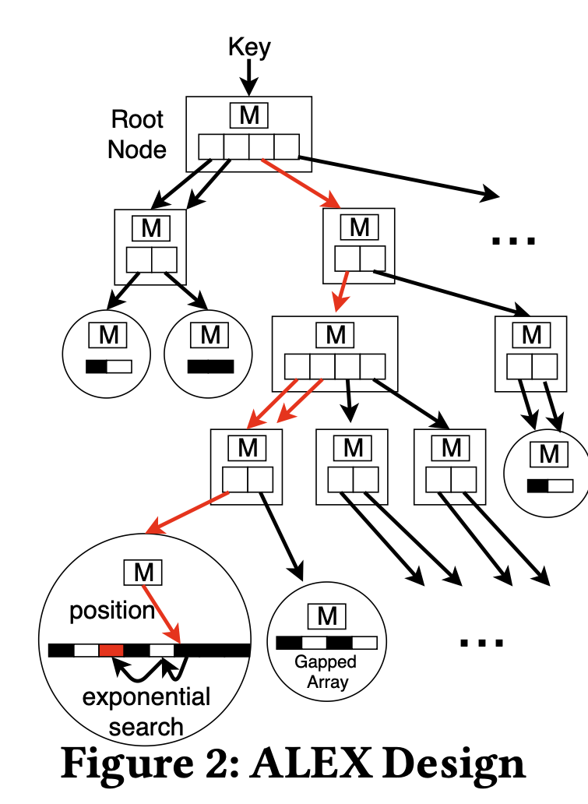
1. Static Scenario
1.1. Lookup
Workload: Bulk Load 200M → Uniform Random Lookup 20M
Position search methods are key point of lookup performance No position search >> Only leaf node search > Both leaf and internal node
P50 and P99 latencies look similar, except ALEX ALEX use exponential search for position search
LIPP performs the best in most of datasets, not all
Notes:
Performance
Data Fitting Model

Slide 21
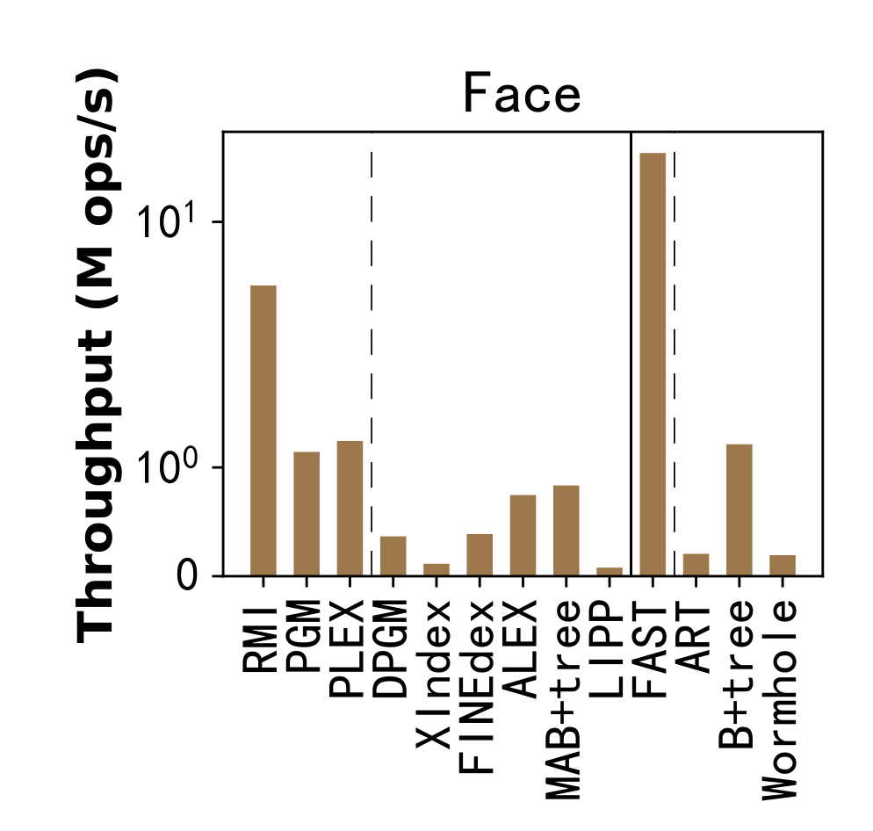
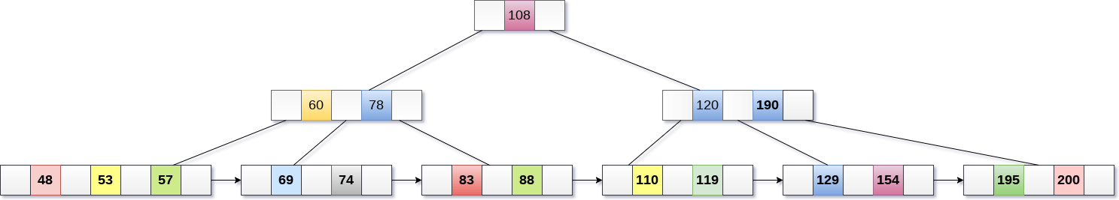
1. Static Scenario
1.2. Range Query
Workload: Bulk Load 200M → Uniform Random Random Range Query 20M
B+Tree Linked in Leaf Node
Mutability and connection of leaf nodes are key point of range query performance Immutable >> Mutable with linked in leaf node > Mutable with non-linked
Range queries performance: traditional index > learned index

Slide 22
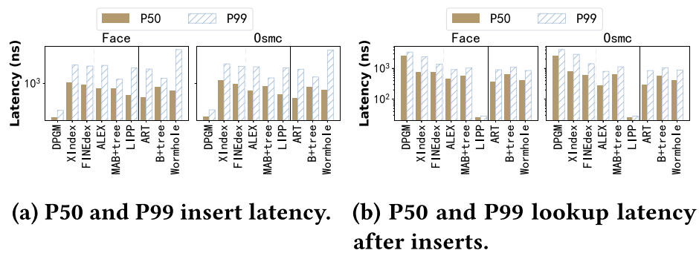
2. Dynamic Scenario
2.1. Insert
Structural Modifications are key point of insert performance No position search (LIPP) >> Only leaf node search (ALEX) > Both leaf and internal node
Insert strategies
In-place inserts have higher lookup performances
Delta-buffer inserts can achieve highest insert performance
For structural modification, most indexes (except DPGM) have similar overhead
Notes:
Dynamic Scenario에서 Dynamic의 의미
Insert/Lookup에서 Learned Index 차이
DPGM: PGM에서 Insert를 위해 delta-buffer를 사용하며 이에 따른 구조적 수정 발생(buffer-merge)
Osmc 데이터 셋
Insert/Lookup tail latency - 그림 9
Workload의 data pattern에 따른 Insert/Lookup 성능 비교 - 그림 10
Insert factor에 따른 Insert throughput - 그림 12

Slide 23
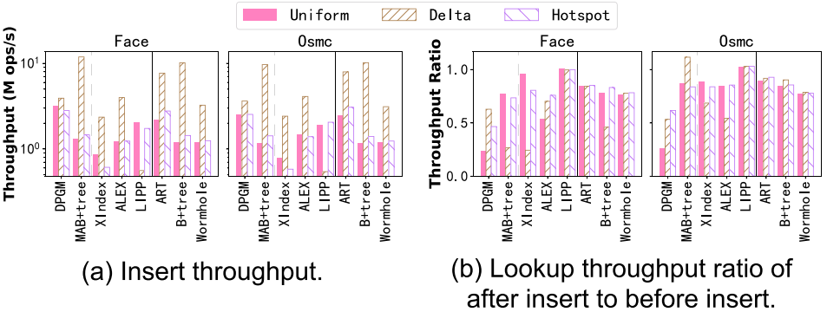
2. Dynamic Scenario
2.1. Insert
Distribution patterns of inserted pairs:
Uniform: sampled randomly
Hotspot: sampled randomly (small part of the dataset)
Delta: appended sequentially (pairs larger than bulk-loaded)
The key of the inserted data is always larger than the existing data
For uniform insert, learned indexes gain high insert throughput
For skewed pattern(e.g., hotspot), learned indexes have no advantage over traditional indexes
Notes:
Delta: 데이터베이스나 인덱스에서 새로운 데이터가 기존의 데이터 집합에 추가될 때, 새 데이터(삽입된 쌍)가 기존 데이터(대량 로드된 쌍)보다 항상 더 큰 키 값을 가지며, 이러한 새 데이터들이 키 값의 순서에 따라 추가된다는 특정한 패턴, 이는 새로운 데이터가 시간이나 다른 기준에 따라 증가하는 순서대로 들어온다고 가정할 때, 데이터베이스 구조가 이러한 증가 패턴에 맞춰 최적화될 수 있음을 의미. 예를 들어, 시간에 따라 증가하는 ID 값이나 순차적인 이벤트 로깅 시스템에서 볼 수 있는 패턴일 수 있음

Slide 24
2. Dynamic Scenario
2.2. Lookup after Insert
Distribution patterns of inserted pairs:
Uniform: sampled randomly
Hotspot: sampled randomly (small part of the dataset)
Delta: appended sequentially (pairs larger than bulk-loaded)
The key of the inserted data is always larger than the existing data
Most indexes have lookup throughput ratios larger than 0.5
After the insert, lookup performance is maintained by more than half compared to before the insert
Reflect their structural modifications are effective in improving lookup throughput
Indexes using cost-based and conflict-based modifications >> fullness-based modification (less robust)
Notes:
index size

Slide 25
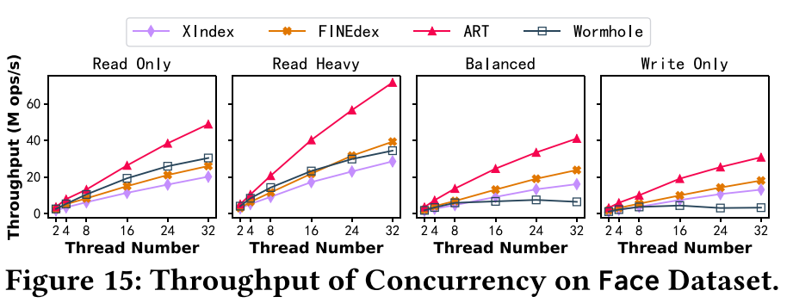
3. Concurrency Scenario
Throughput of Concurrency
Read Only (0% insert / 100% lookup)
Read Heavy (5% insert / 95% lookup)
Balanced (50% insert / 50% lookup)
Write Only (100% insert)
Learned indexes cannot outperform traditional indexes for concurrent lookups/writes
Search both the index and delta buffers (Learned indexes both use delta-buffer) → Slow down lookups
Retrain models for structural modification → Slow down insert
Structural modification lock related nodes, but FINEdex does not adopt advanced lock mechanisms → Negative effect on insert/lookup

Slide 26
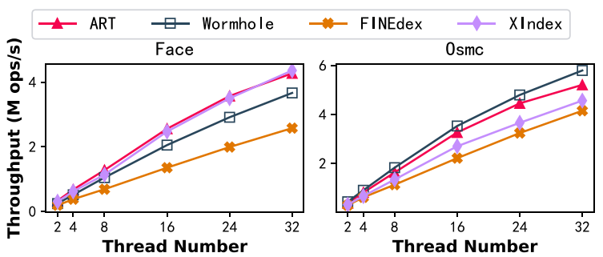
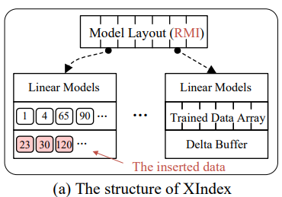
3. Concurrency Scenario
Throughput of Concurrent Range
Concurrent Range Workload
(95% range query + 5% insert)
XIndex & ART is the best in Face
In Face, XIndex links leaf nodes and buffers in a sorted list → Advantage range query
Wormhole is the best in Osmc
In OSmc, Inaccurate model predictions by complicated data distribution affects insert/range throughput

Slide 27
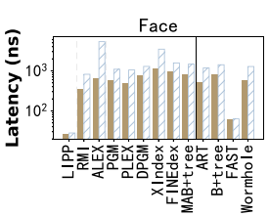
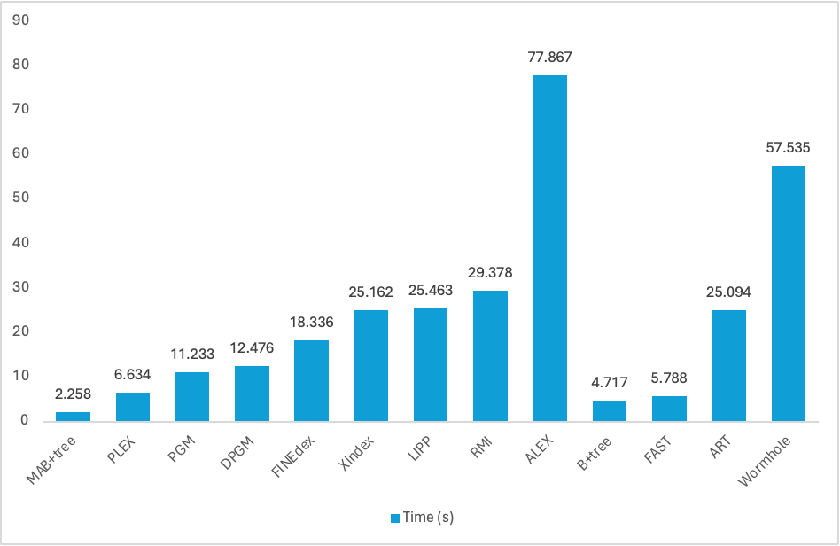
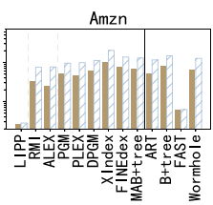
4. Bulk Loading Scenario
Bulk Loading Time
Amzn Dataset
Learned (Greedy)
Learned (Not Greedy)
Traditional
Lookup
Bulk Loading Time on Amzn
Learned indexes do not outperform traditional indexes in bulk loading time
Learned Index Overhead: Train model and split key-position pairs
Learned index (Greedy split) gain faster bulk loadings, but worse lookup latency (smallest time complexity)
The Longest bulk loading time in ALEX (cost-based split) : Iterating many times per node to determine the index structure

Slide 28
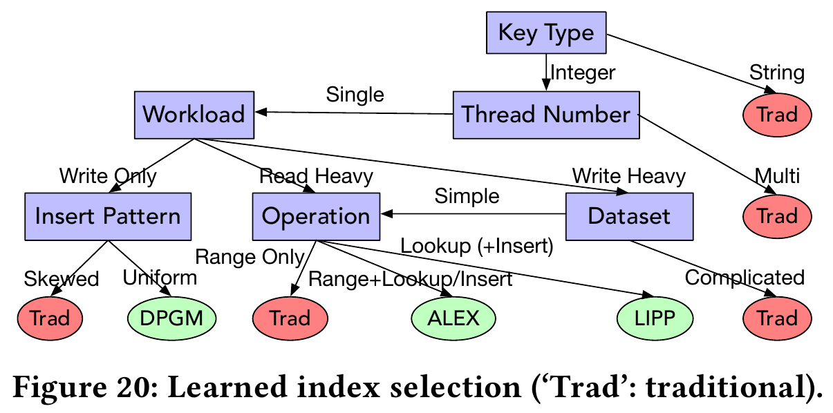
Experiment
Result

Slide 29
Conclusion
Conclusion
Motivation
Existing learned indexes are not evaluated under the same evaluation framework
No guideline to select suitable learned indexes
Design
Design a comprehensive evaluation framework that tests state-of-the-art learned and traditional indexes across a variety of datasets and workloads
Evaluation
The evaluation confirmed that while learned indexes could offer performance benefits in certain cases, they did not universally outperform traditional indexes

Slide 30

Q&A

Slide 31
Thank you!

Slide 32
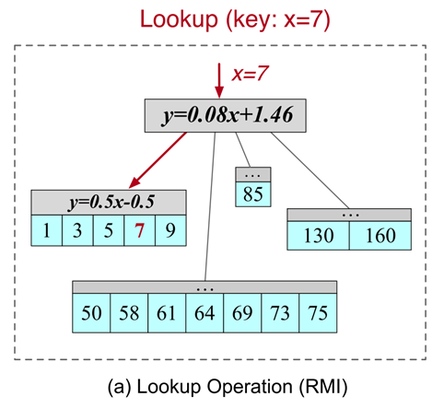
Design
Structure
●Hierarchical Structure:Each node get machine learning model for key-position mapping
●Each node get machine learning model for key-position mapping
●Type of Node
●Leaf node: Predict the position of the query key
●Internal node: Predict child node that contains the query key
●Better than binary search in node
●Error in the Predicted Position
●Using position search

