Slide 1
TreeLine: An Update-In-Place Key-Value Store for Modern Storage
저자 및 학회
2024. 01. 16
Presentation by Yeojin Oh, Jisoo Lee, Zhu Yongjie
yeojinoh@dankook.ac.kr, lkhejj1@gmail.com,

Slide 2
Structure of TreeLine
Building a TreeLine Environment
Future Experimental Plans

Slide 3
1. Structure of TreeLine
What is TreeLine?
An update-in-place key-value store.
Well-balanced between read and write performance.
Highly efficient in large-scale database systems.

Slide 4
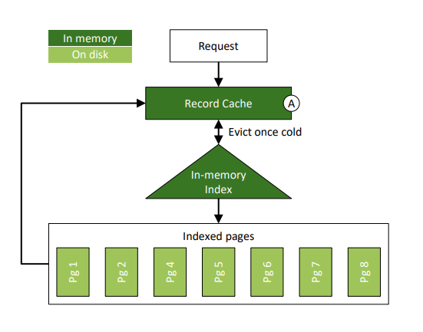
1. Structure of TreeLine
Record Caching
Optimizes write operations using in-memory caching
Enhances read performance by maximizing the retention time of hot records in memory

Slide 5
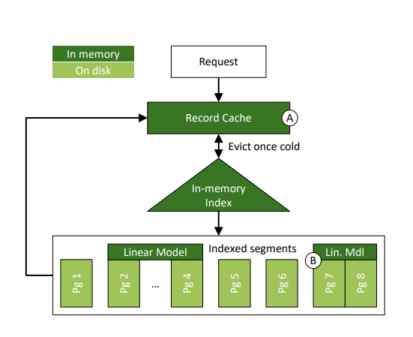
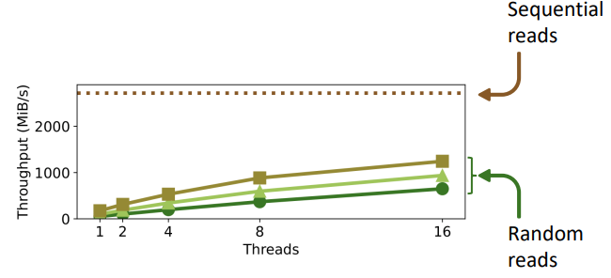
1. Structure of TreeLine
Page Grouping
Groups pages that store adjacent keys
Stores grouped pages consecutively to improve access efficiency

Slide 6
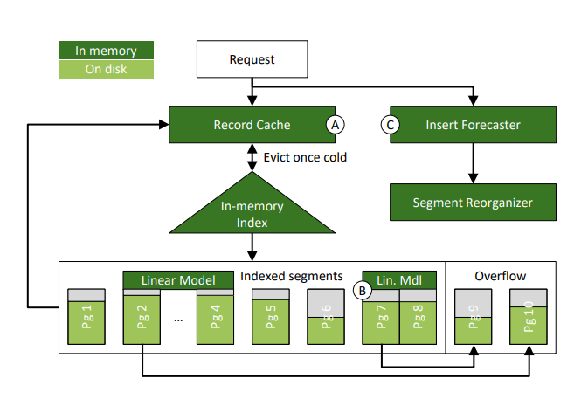
1. Structure of TreeLine
Insert Forecasting
Analyzes insertion patterns to predict future insert loads for intelligent space management

Slide 7
2. Building a TreeLine Environment
TreeLine is an open-source project on GitHub.
git clone https://github.com/mitdbg/treeline.git
Dependencies
libtbb-dev
autoconf
libjemalloc-dev
CMake3.17+
apt install libtbb-dev autoconf libjemalloc-dev
Create a virtual Python environment using anaconda and “pip install cmake==3.17”

Slide 8
2. Building a TreeLine Environment
TreeLine is an open-source project on GitHub.
Compile
mkdir build && build
cmake -DCMAKE_BUILD_TYPE=Release .. && make –j
cmake -DCMAKE_BUILD_TYPE=Release -DTL_BUILD_TESTS=ON .. && make –j
cmake -DCMAKE_BUILD_TYPE=Release -DTL_BUILD_BENCHMARKS=ON .. && make –j

Slide 9
2. Building a TreeLine Environment
TreeLine BenchMark
YCSB
Go to the " /path/to/db/treeline/build/bench " directory and “./run_custom”
The workload configuration file is located in “ /tree/bench/workload_configs/ ”
Run “ ./run_custom –workload_config= /path/to/db/tree/bench/workload_configs/phased_64B_A_B_A_B_A.yml ”
Other Bench (adjust options)
Temporarily not found

Slide 10
3. Future Experimental Plans
How does TreeLine compare against RocksDB and LeanStore on throughtput and the amount of physical I/O performed?
How do the record cache and page grouping contribute to TreeLine’s overall performance?
How does the choice of the page grouping parameters affect the grouping “effectiveness”?
How effective is insert forecasting?
Notes:
어떻게 Treeline을 RocksDB와 LeanStore를 처리량과 physical I/O perform으로 비교할것인가
어떻게 Treeline의 전체적인 성능에 기여하기 위해 cache를 기록하고 page를 그룹핑할것인가
그룹핑이 가장 효과적이기 위해 페이지 그룹핑 parameter를 어떻게 설정할것인가.
Insert forecasting이 얼마나 효율적인가

Slide 11
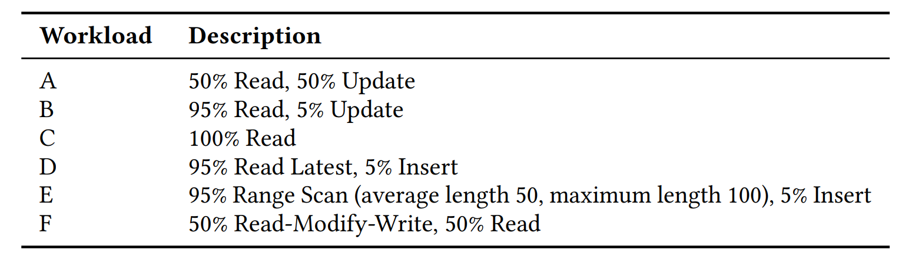
3. Future Experimental Plans
YCSB workload
Notes:
YSCB workload는 다음과 같이 설정하여 Read와 Update비율을 조정하여 각각의 workload A,B,C,D,E,F에서 RocksDB, LeanStore, Treeline의 thread 수 (1,2,4,8,16)에 따라서 throughput 수를 측정해 비교

Slide 12
Thank you

