Slide 1
ParlayANN: Scalable and Deterministic Parallel Graph-Based Approximate Nearest Neighbor Search Algorithms
Magdalen Dobson Manohar, Zheqi shen, Guy E. Blelloch, Laxman Dhulipala, Yan Gu,
Harsha Vardhan Simhadri, Yihan Sun
PPoPP 2024
2024. 10. 23
Hojin Shin (Dankook University)
ghwls03s@gmail.com or hojin03s@dankook.ac.kr

Slide 2
Introduction
Background
Motivation
ParlayANN (Libaray)
Evaluation
Conclusion

Slide 3
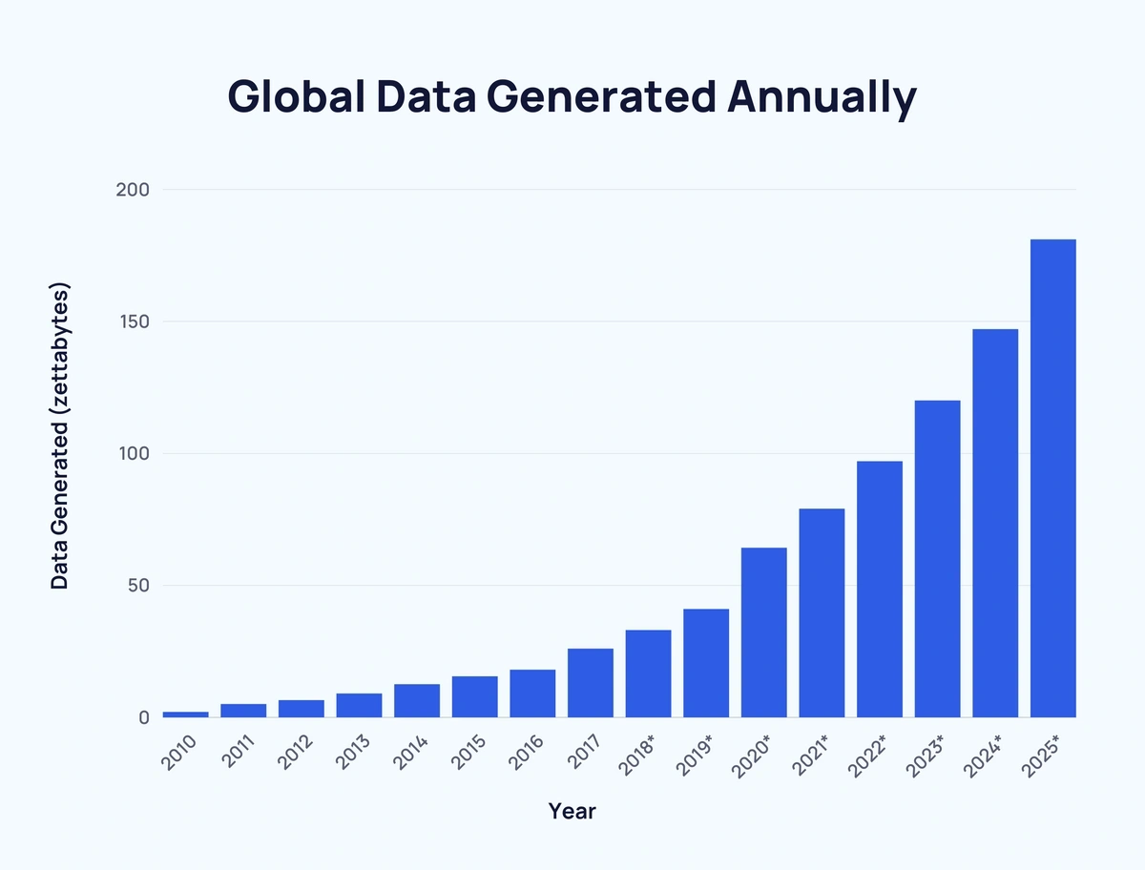
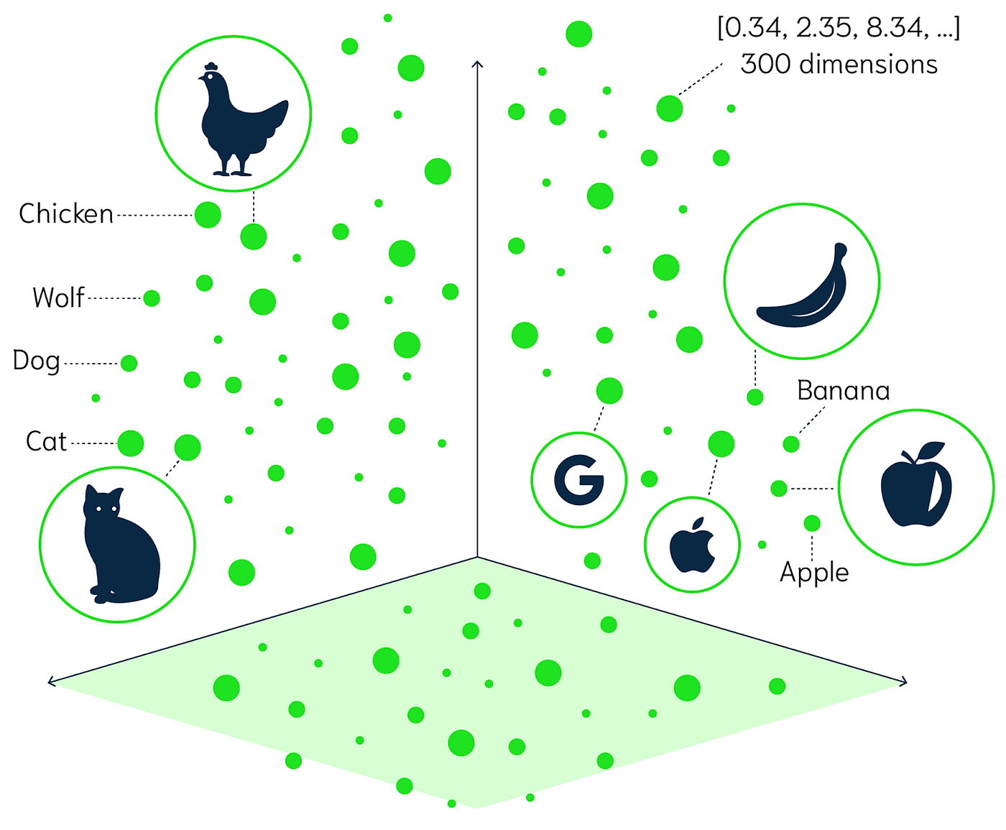
1. Introduction
source:https://www.statista.com/statistics/871513/worldwide-data-created/
source:https://medium.com/@serkan_ozal/vector-similarity-search-53ed42b951d9
Constantly growing amount of the available information resources
High demand in scalable and efficient similarity search data structures

Slide 4
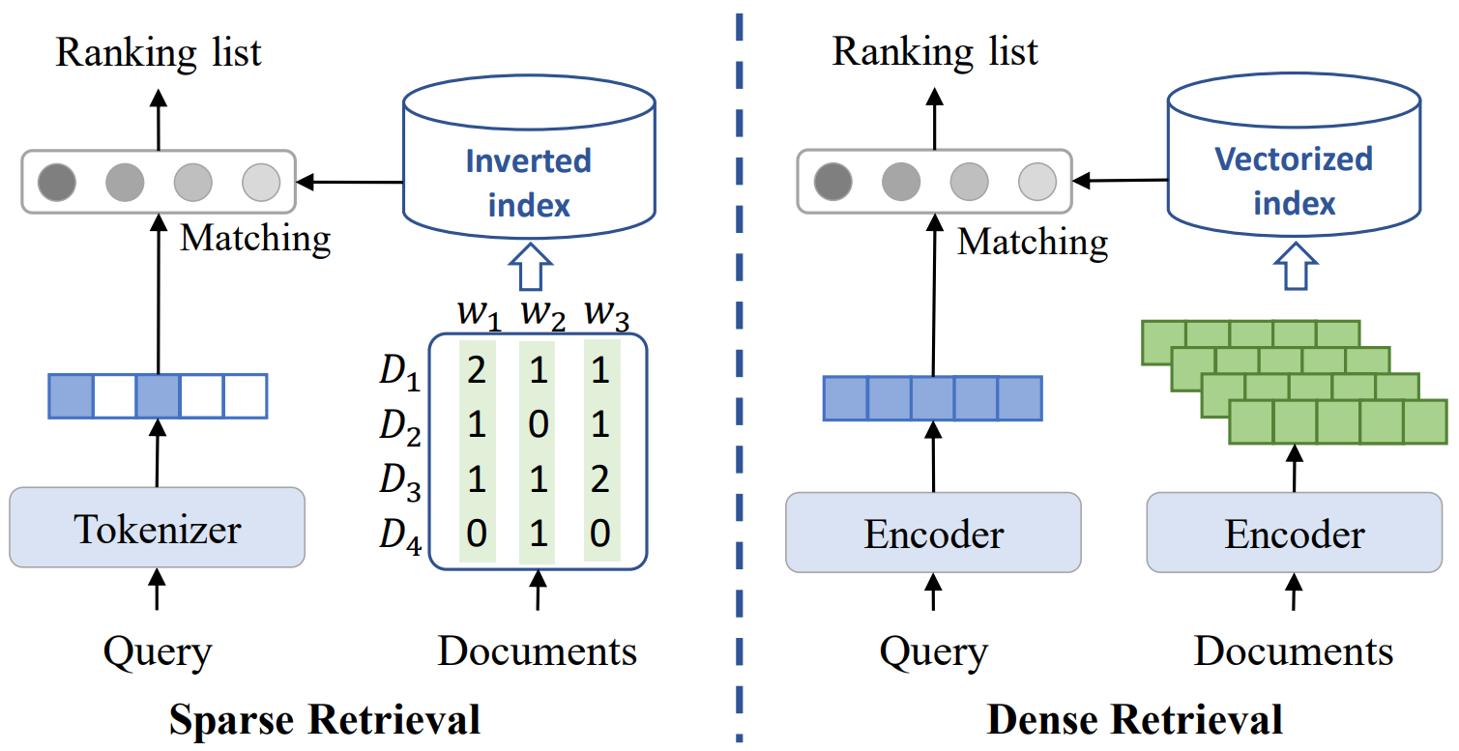
1. Introduction
Consider only some words in the target documents and search terms among a large number of words

Slide 5
1. Introduction
have similar meanings but do not match
경기도민의 수는 얼마?
경기도의 인구는 00명
Consider only some words in the target documents and search terms among a large number of words

Slide 6
1. Introduction
have similar meanings but do not match
경기도민의 수는 얼마?
경기도의 인구는 00명
Consider only some words in the target documents and search terms among a large number of words
Continuous vector spaces, capturing semantic similarity beyond exact term matching

Slide 7
1. Introduction
Similarity Search (K-NNS)
Result Vector
Query
Vector
k = 3

Slide 8
1. Introduction
Similarity Search (K-NNS)
Strengths
Exact nearest neighbor search
➔ High Accuracy
Result Vector
Query
Vector
Limitations
The number of stored elements making it infeasible for large-scale dataset (High-D)
k = 3
➔ Whole search

Slide 9
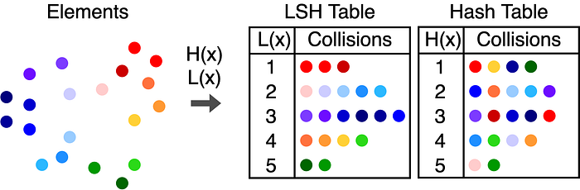
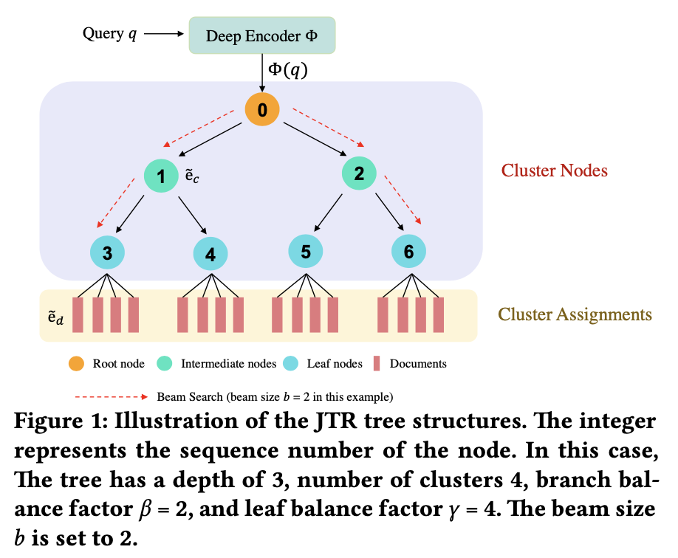
1. Introduction
Hash-based
Approximate NNS
LSH
Emergence of
Approximate NNS
Tree-based
Approximate NNS
JTR
Graph-based
Approximate NNS
HNSW

Slide 10
1. Introduction
Hash-based
Approximate NNS
LSH
Emergence of
Approximate NNS
Tree-based
Approximate NNS
JTR
Graph-based
Approximate NNS
HNSW
Graph
➔ best throughput-recall tradeoffs

Slide 11
2. Background
Layer=2
Layer=1
Layer=0
HNSW
Hierarchical Navigable Small World
DiskANN (Vamana)

Slide 12
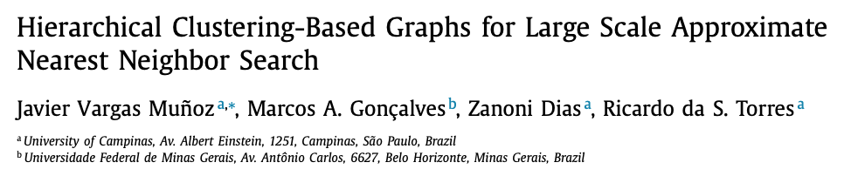
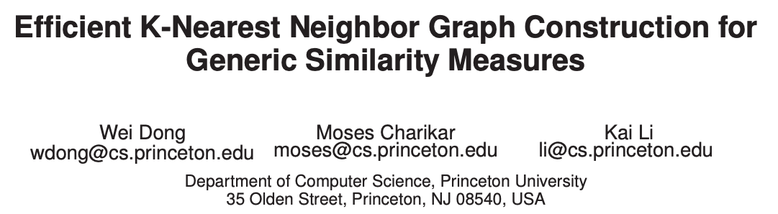
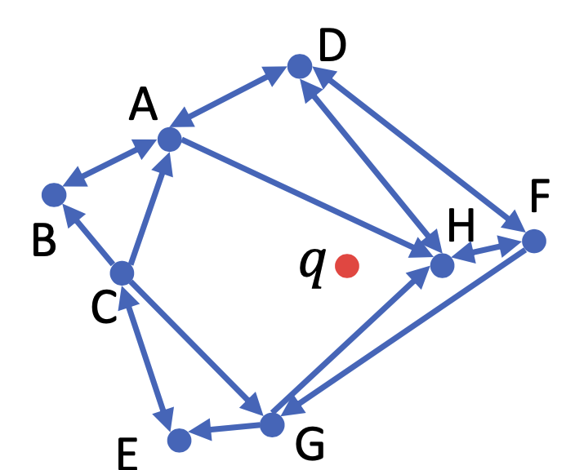
2. Background
Vectors
HCNNG (Hierarchical Clustering-based Nearest Neighbor Graph)
Clustering Tree
PyNNDescent (Python Nearest Neigbhor Descent)
Merge

Slide 13
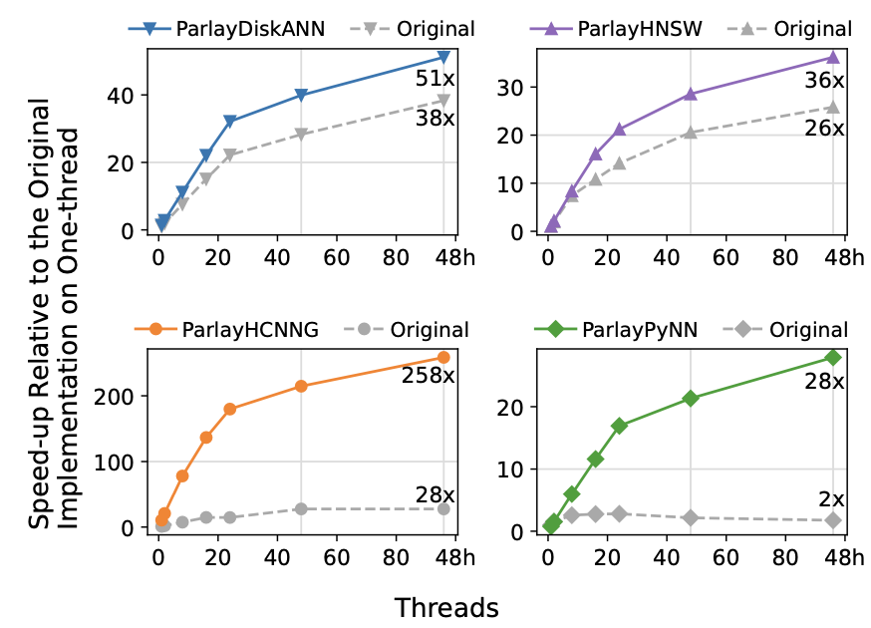
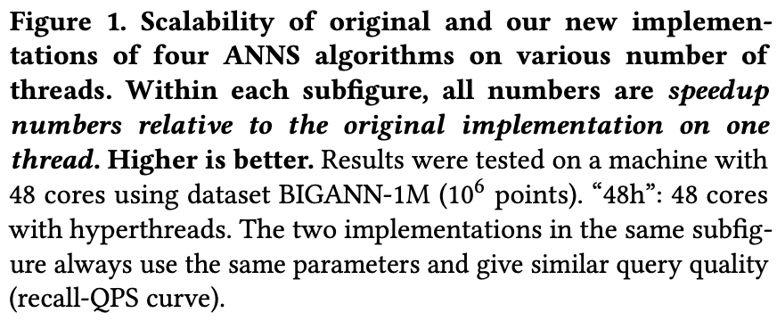
3. Motivation
Performance Issues on Large Datasets
High-dimensional vector embeddings
➔ Essential element
Transform into millions or billions of vectors
Graph-based ANNS suffer from scalability issues on large datasets
During parallel processing due to use of locks (per-point locks)

Slide 14
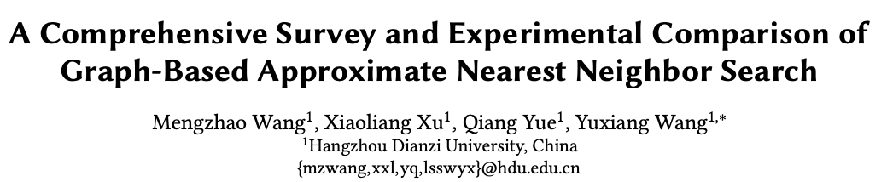
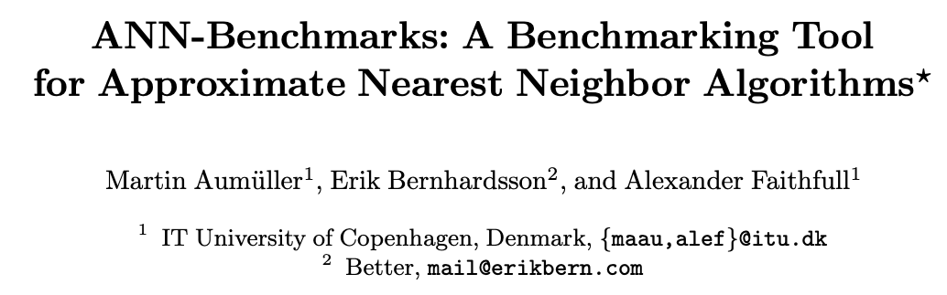
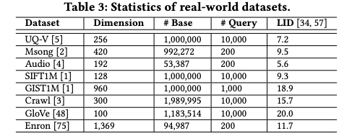
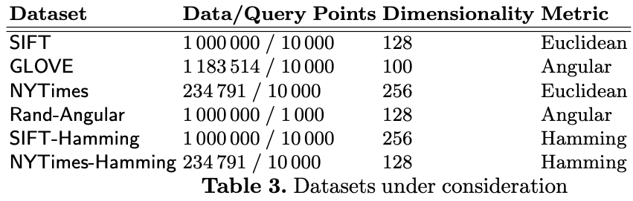
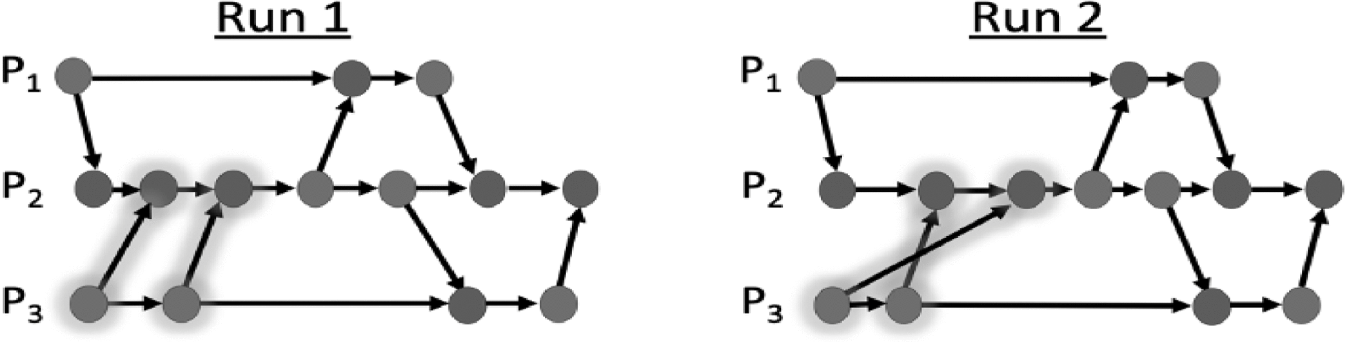
3. Motivation
Use of Locks Limitations
Existing Benchmarks Limitations
Existing parallel ANNS use locks to prevent data conflicts
Locks are effective in maintaining data consistency
Most of the existing studies evaluate relatively small dataset of millions of data
The execution results depending on the order in which the locks are acquired
Application (persistence, crash recovery)
Non-determinism
Notes:
Application ➔ Pinecone, Weaviate, Lucene

Slide 15

4. ParlayANN
New Techniques: Prefix Doubling
(1) Batch Insertion
Divide the data points into batches and insert them incrementally/independently
Batch Size
1
2
4
… …
N < $θ$ (Threshold)
Vector Batch
… …
Graph
T1
Build Process
T2
Greedy Search
Candidate Set
T3
Immutable
Snapshot
T4

Slide 16
4. ParlayANN
New Techniques: Prefix Doubling
(2) Pruning and SemiSort
Remove unnecessary connections and reduce the complexity of the graph
Groups items by key, arranging with the same key in a sequence
A
1
1
B
A
A
2
B
C
2
B
C
C
4
4
3
3
Existing Points
Pruning
SemiSort
A
B
C
Semisort Process
2
3
1
2
4
3
1
1
2
2
3
1
3
4

Slide 17
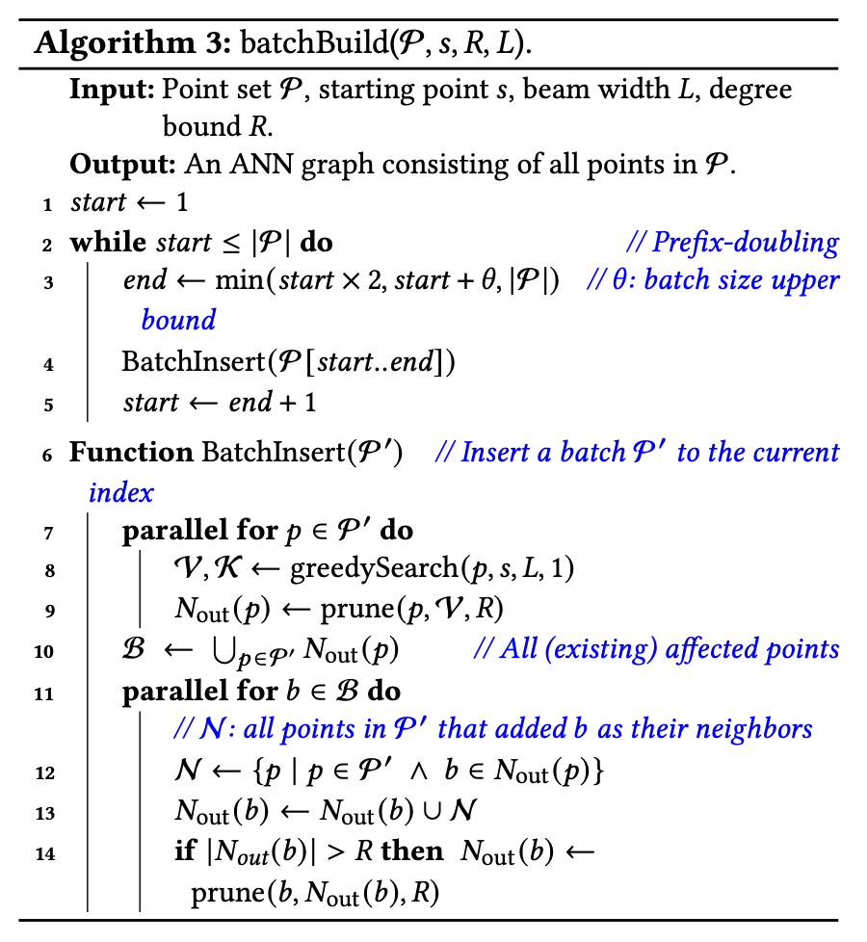
4. ParlayANN
Batch Insertion
Pruning
SemiSort

Slide 18
5. Evaluation
Comparison with multi-thread

Slide 19
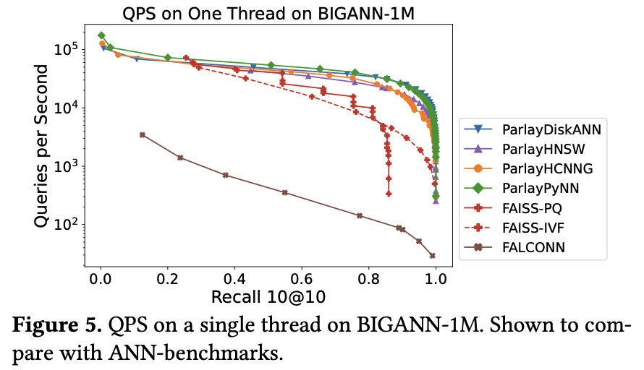
5. Evaluation
Comparison with another library

Slide 20
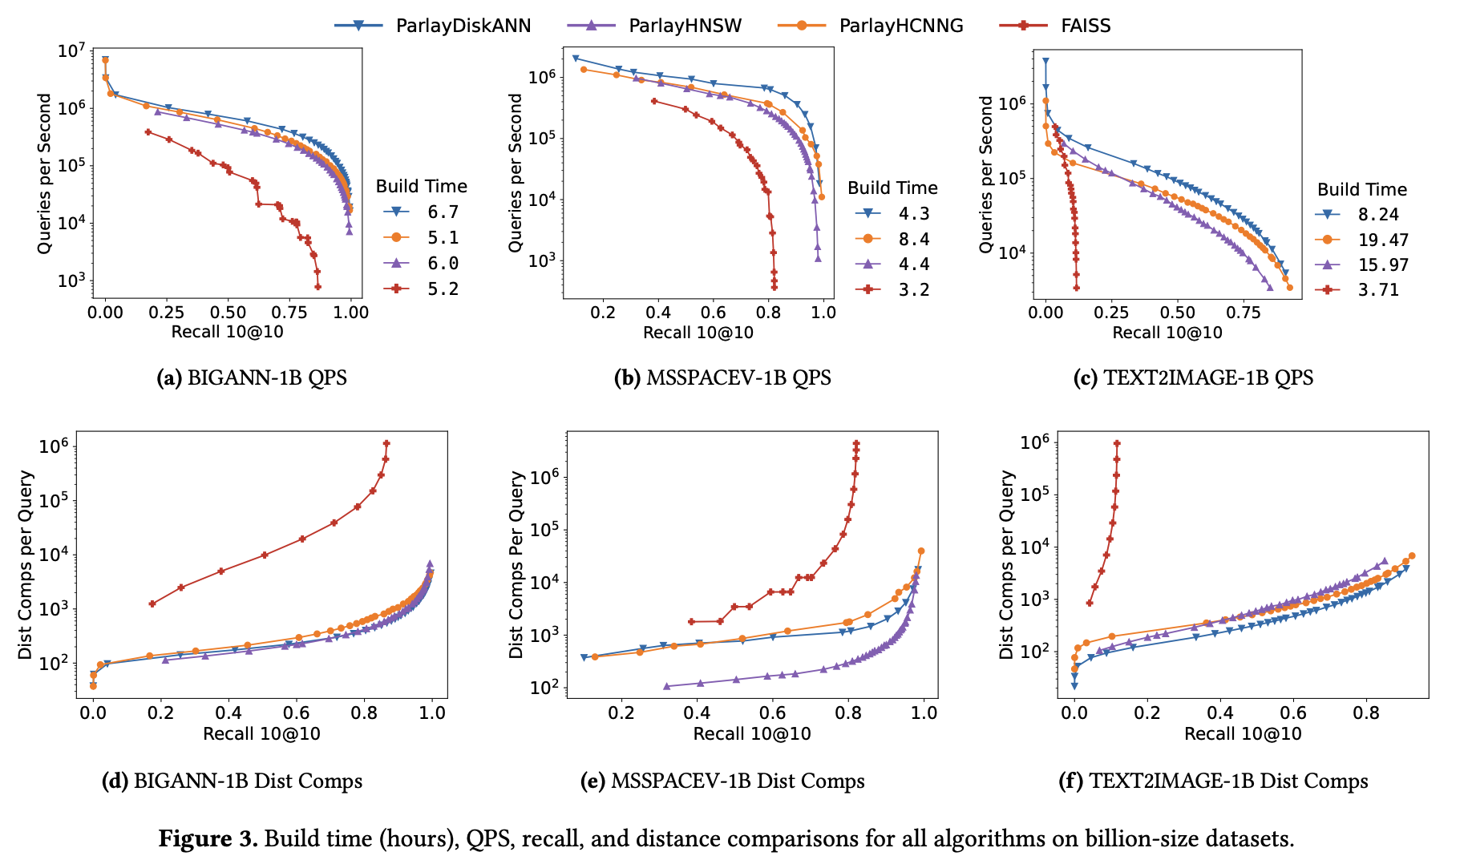
5. Evaluation
Comparison with Billion-scale Dataset

Slide 21
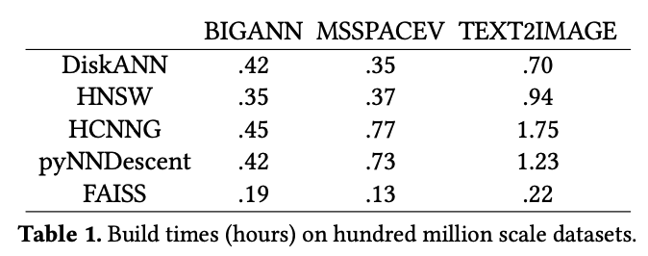
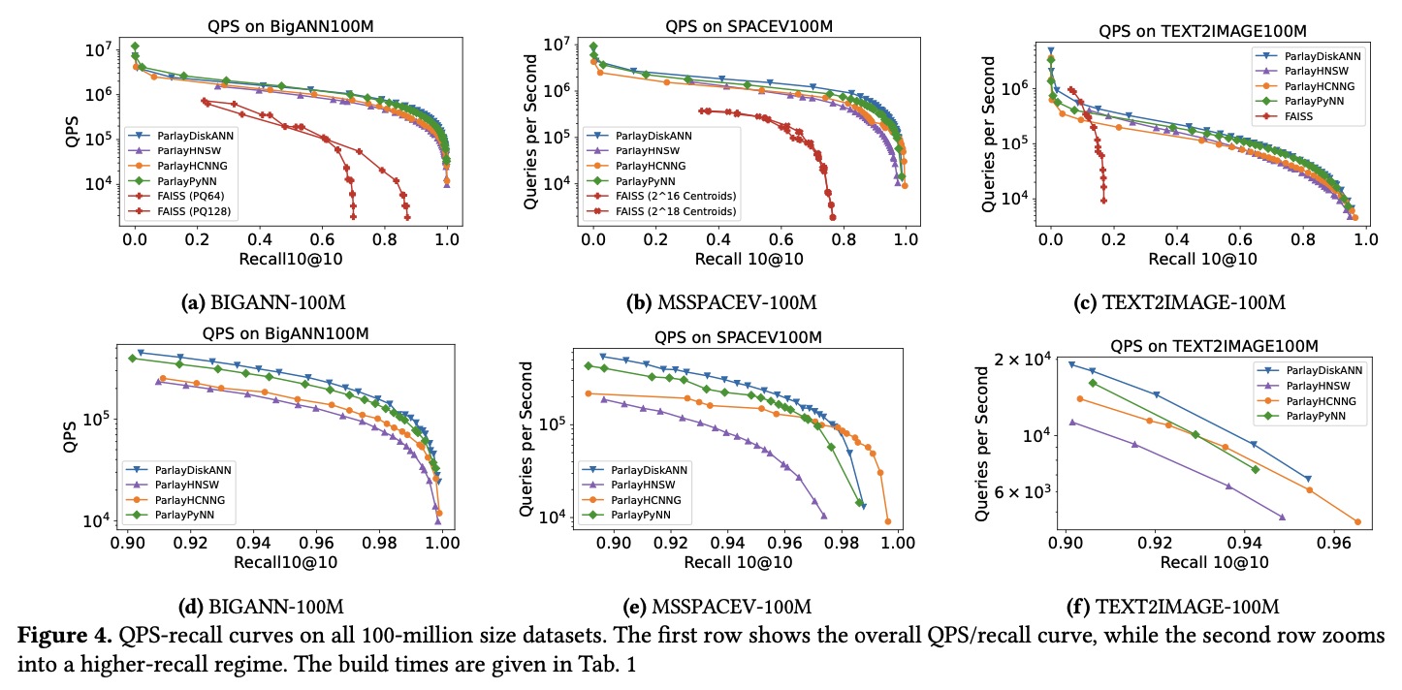
5. Evaluation
Comparison with Million-scale Dataset

Slide 22
6. Conclusion
Present ParlayANN, which implements four parallel deterministic graph-based ANNS algorithms
ParalyANN that scale to billion-scale inputs on a single machine with high recall
Avoid the use of locks, achieve better scalability than existing implementations
Outperformed existing non-graph implementations in the ability of achieving high recall

Slide 23
ParlayANN: Scalable and Deterministic Parallel Graph-Based Approximate Nearest Neighbor Search Algorithms
Magdalen Dobson Manohar, Zheqi shen, Guy E. Blelloch, Laxman Dhulipala, Yan Gu,
Harsha Vardhan Simhadri, Yihan Sun
PPoPP 2024
2024. 10. 23
Hojin Shin (Dankook University)
ghwls03s@gmail.com or hojin03s@dankook.ac.kr
Thank you !

