Slide 1
Compaction priority Option
Supported by IITP, StarLab.
August 23, 2021
고산하, 김정민
sanha0498@gmail.com, jeongmin981@gmail.com
두 얼간이

Slide 2
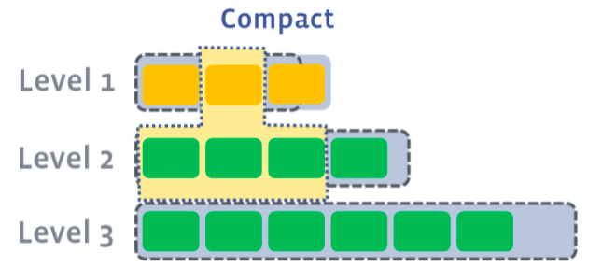
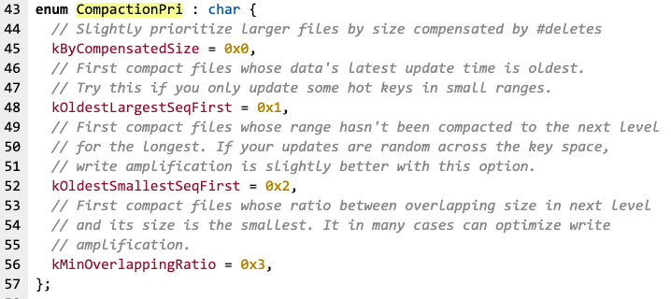
Picking compaction candidates in LCS
Leveled compaction workload
L1 exceeded its target size. (Compaction triggered)
Pick at least one file from L1 and merge it with the overlapping range of L2
Result files will be placed in L2
Which file to pick to compact may differ by its compaction priority option
2
Notes:
Compaction 후, L1의 크기가 타겟 크기를 초과할 수 있다. 이 경우, L1에서 하나 이상의 파일을 선택하고, 그 파일과 중복되는 key 범위를 갖는 L2 파일들과 병합한다. 결과 파일은 L2에 새로 쓰여진다.
Compaction 과정에서 어떤 sstable을 선택하여 합병할지가 흥미로운 주제였고 여러 선택 옵션에 따른 장단점과 성능비교가 궁금하여 이번주 주제로 선정하게 되었다.

Slide 3

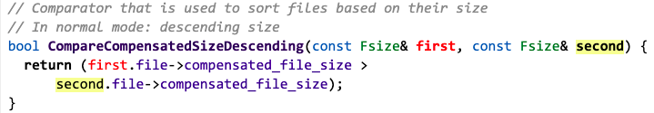
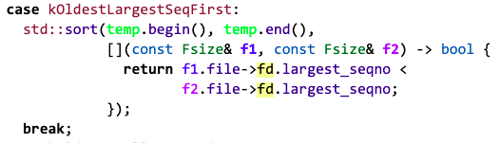
Option of Compaction Priority
kByCompensatedSize (0x0) :
If number of deletes in a file exceeds number of inserts,
it is more likely to be picked for compaction.
kOldestLargestSeqFirst (0x1) :
Pick a file whose latest update is the oldest.
By compacting coldest range first,
we leave the hot ranges in the level.

Slide 4
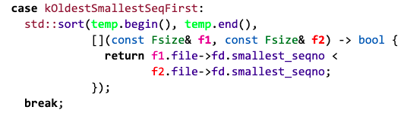

Option of Compaction Priority
kOldestSmallestSeqFirst (0x2) :
Pick the file covers the oldest updates in the level,
which usually is contains the densest key range.
kMinOverlappingRatio (Default, 0x3) :
Compact files whose ratio between
overlapping size in next level and its size is the smallest.

Slide 5
Option of Compaction Priority
Experiment Env
rocksDB = version 6.24
CPU = 1 * Intel(R) Core(TM) i5-4250U CPU 1.30GHz
key_size = 16 bytes
value_size = 1KB
Entries = 1,000,000, 2,000,000, 4,000,000
TestCase :
fillrandom, deleterandom
(Write Amp, Comp cnt, Wnew)

Slide 6
Option of Compaction Priority
Fillrandom + deleteramdom
 | W-Amp | Comp_cnt | Wnew(GB)
0 | 2.2 | 19 | 0.9
1 | 2.9 | 21 | 1.0
2 | 2.9 | 21 | 1.0
3 | 2.2 | 21 | 0.9
Entries =
1,000,000
 | W-Amp | Comp_cnt | Wnew(GB)
0 | 2.9 | 40 | 1.4
1 | 3.5 | 44 | 1.6
2 | 3.0 | 40 | 1.4
3 | 1.7 | 34 | 1.5
Entries =
2,000,000
 | W-Amp | Comp_cnt | Wnew(GB)
0 | 2.5 | 70 | 3.5
1 | 3.9 | 86 | 3.8
2 | 3.0 | 75 | 3.9
3 | 2.9 | 76 | 4.0
Entries =
4,000,000

Slide 7
Option of Compaction Priority

Slide 8
Option of Compaction Priority

Slide 9

Discussion

Slide 10
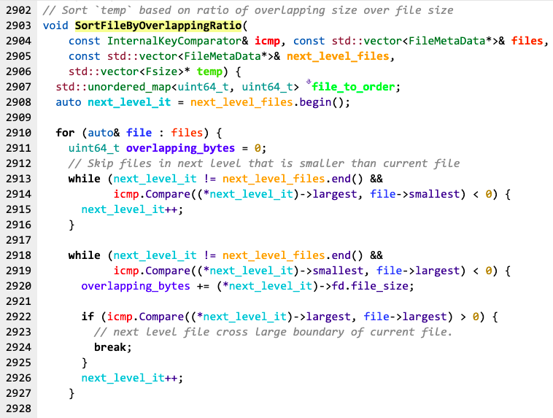
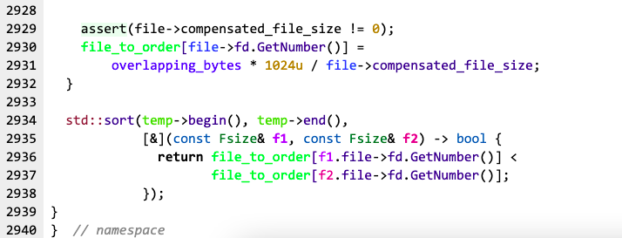
Appendix : kMinOverlappingRatio
SortFileByOverlappingRatio function code

