Slide 1
Tunning Options: Compaction
Supported by IITP, StarLab.
August 9, 2021
고산하, 김정민, 이성준
sanha0948@gmail.com, jeongmin981@gmail.com, sung0651@naver.com
세 얼간이

Slide 2
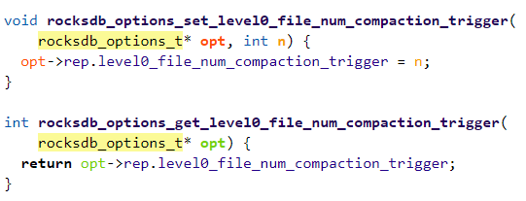
Tunning Options: Compaction
Options: Compaction
Compaction triggers when number of L0 files reaches level0_file_num_compaction_trigger, files of L0 will be merged into L1.
Level0_file_num_compaction_trigger
A value < 0 means that Level-0 compaction will not be triggered by number of files at all.
Level0_file_num_compaction_trigger cannot be 0
default: 4
2

Slide 3
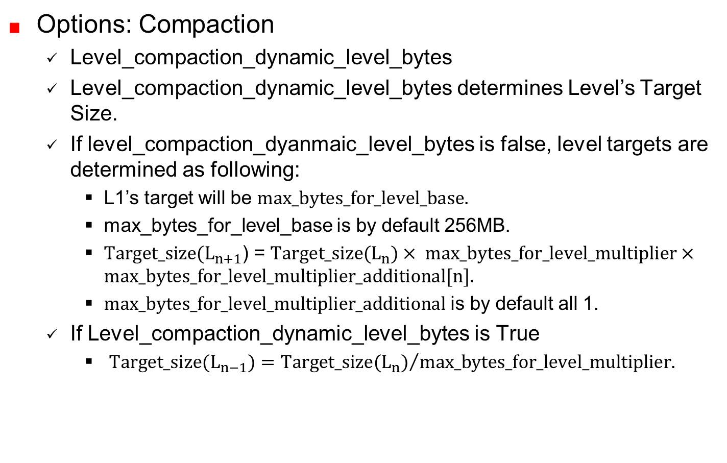
Tunning Options: Compaction
Options: Compaction
Level_compaction_dynamic_level_bytes
Level_compaction_dynamic_level_bytes determines Level’s Target Size.
If level_compaction_dyanmaic_level_bytes is false, level targets are determined as following:
L1’s target will be $max_bytes_for_level_base$.
max_bytes_for_level_base is by default 256MB.
$Target_size(L_{n+1}$) = $Target_size(L_{n})× max_bytes_for_level_multiplier×max_bytes_for_level_multiplier_additional[n].$
$max_bytes_for_level_multiplier_additional$ is by default all 1.
If Level_compaction_dynamic_level_bytes is True
$Target_size(L_{n−1})={Target_size(L_{n})}/{max_bytes_for_level_multiplier}$.

Slide 4
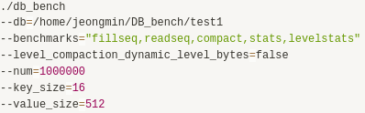

Tunning Options: Compaction
Tunning Options 1
Level0_file_num_compaction_trigger : 4 (default)
Level_compaction_dynamic_level_bytes = false
$Target_size(L_{n+1}$) = $Target_size(L_{n})× max_bytes_for_level_multiplier×max_bytes_for_level_multiplier_additional[n].$
Size of L1, L2, L3, and L4 will be 256MB, 2560MB, 25600MB, 256000MB
Expected result: Compaction will trigger, and file will be in L1.

Slide 5
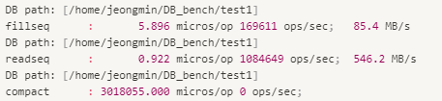
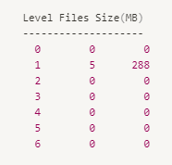
Tunning Options: Compaction
Test result:

Slide 6
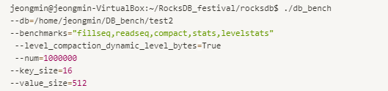
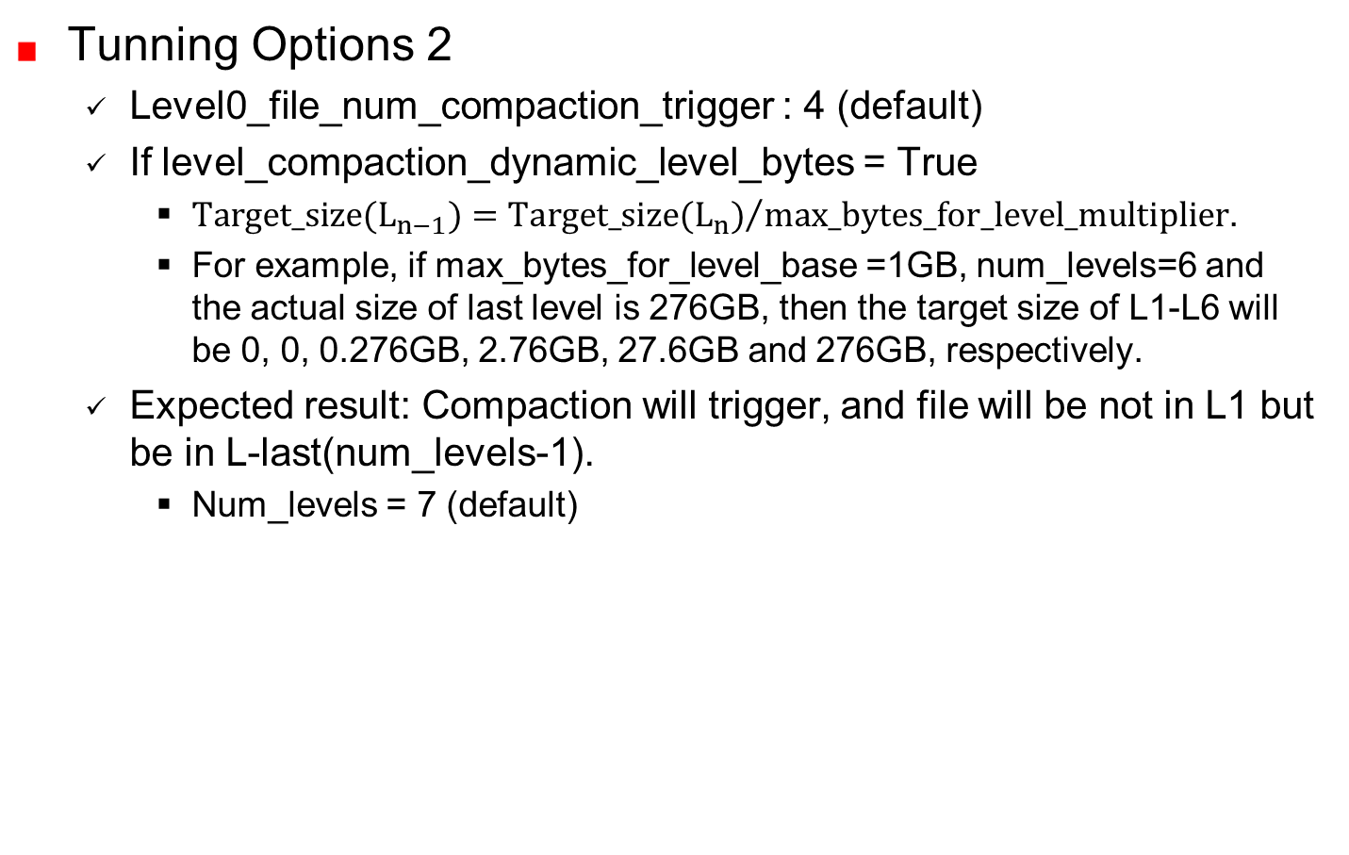
Tunning Options: Compaction
Tunning Options 2
Level0_file_num_compaction_trigger : 4 (default)
If level_compaction_dynamic_level_bytes = True
$Target_size(L_{n−1})={Target_size(L_{n})}/{max_bytes_for_level_multiplier}$.
For example, if max_bytes_for_level_base =1GB, num_levels=6 and the actual size of last level is 276GB, then the target size of L1-L6 will be 0, 0, 0.276GB, 2.76GB, 27.6GB and 276GB, respectively.
Expected result: Compaction will trigger, and file will be not in L1 but be in L-last(num_levels-1).
Num_levels = 7 (default)

Slide 7
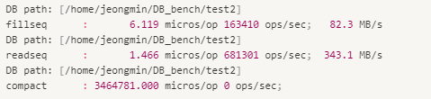
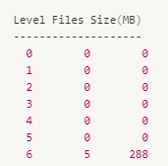
Tunning Options: Compaction
Test result:

Slide 8

Discussion

