Slide 1
RocksDB Festival 3nd
Supported by IITP, StarLab.
AUG 9, 2021
박경미, 황예진
kmi0817@naver.com, hyj3463@naver.com
BGR

Slide 2
RocksDB Festival
Contents
Overview
Related Options
Experiment
- number of memtable
- block size
- level0 file num compaction trigger
- block cache size
Next week
‹#›

Slide 3
RocksDB Festival
Overview
Memory
Write
Memtable
Immutable
Memtable
Read
Disk
L0
SST
SST
L1
SST
SST
SST
WAL
L2
SST
SST
SST
SST
L3
SST
SST
SST
SST
SST
‹#›

Slide 4
RocksDB Festival
Experiment Info
RocksDB version 6.21
CPU 1 * Intel(R) Core(TM) i5-7500 CPU @ 3.40GHz
Key 16 bytes
Values 1KB
Entries 4,000,000
Other options are defaults
‹#›

Slide 5
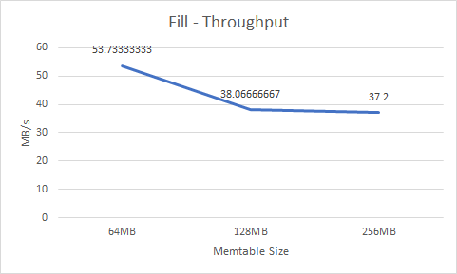
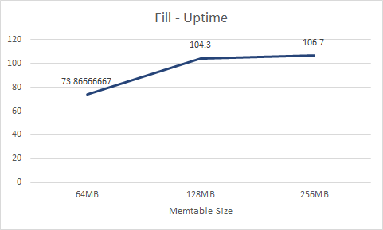
RocksDB Festival
Experiment 1
memtable size (fillseq, value=1024, entries=4,000,000)
Immutable
Memtable
Memtable
Immutable
Memtable
Memtable
‹#›

Slide 6
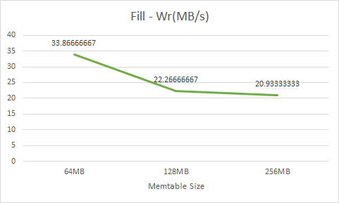
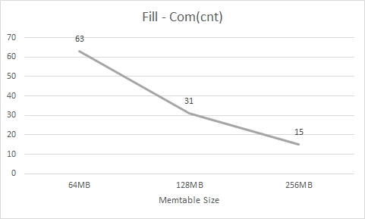
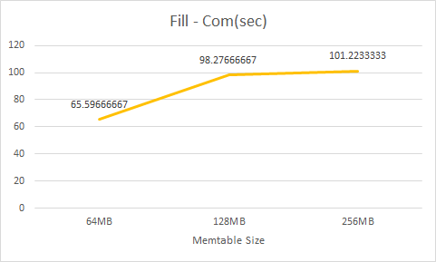
RocksDB Festival
Experiment 1
memtable size (fillseq, value=1024, entries=4,000,000)
?
‹#›

Slide 7
RocksDB Festival
Experiment 2
block size (value=256, entries=4,000,000)
Data block
Key -> Value
Data block
Key -> Value
Key -> Value
Data block
...
SST
Data block
Data block
Index block
...
‹#›

Slide 8
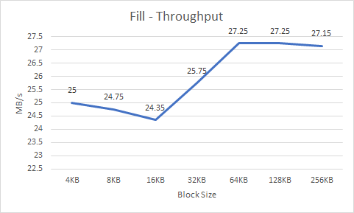
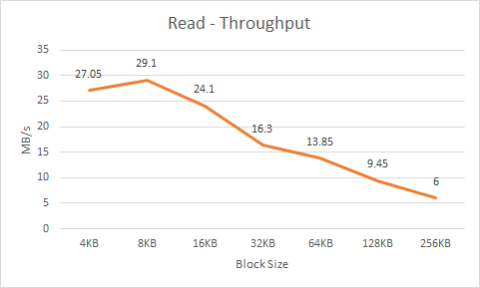
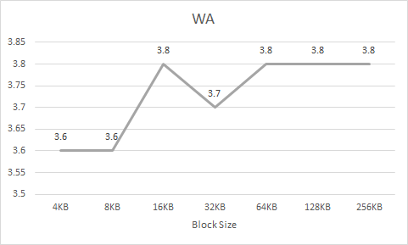
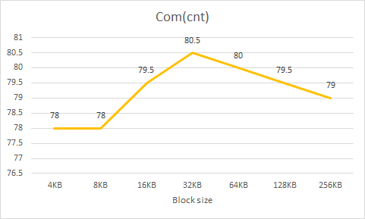
RocksDB Festival
Experiment 2
block size (value=256, entries=4,000,000)
‹#›

Slide 9
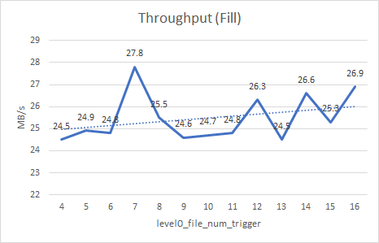
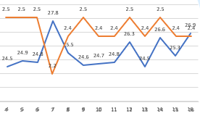
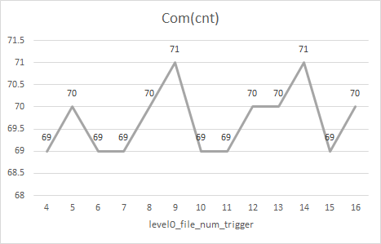
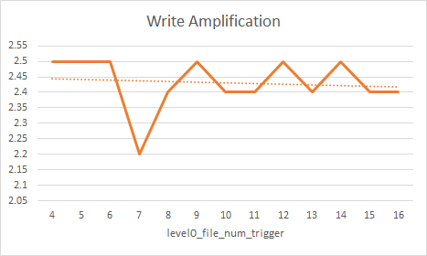
RocksDB Festival
Experiment 3
level0 file num compaction trigger (value=1024, entries=4,000,000)
‹#›

Slide 10
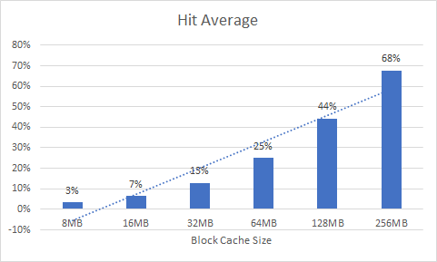
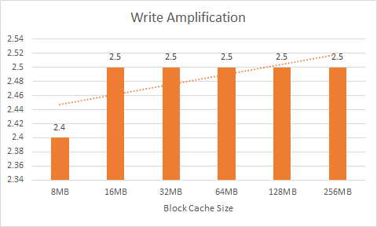
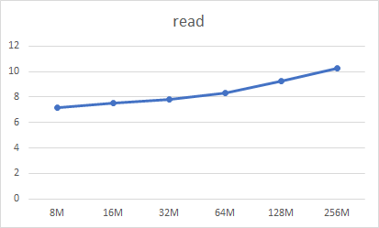
RocksDB Festival
Experiment 4 - Bonus
block cache size (value=256, num=5,000,000)
Not related to WA ?
‹#›

Slide 11
RocksDB Festival
Next week
Other ways to reduce Write Amplification !
level_compaction_dynamic_level_bytes, target_file_size_multiplier...
‹#›

Slide 12

Discussion

