Slide 1
RocksDB Festival Personal Research
Supported by IITP, StarLab.
July 5, 2021
Hoijn Shin, Jongmoo Choi
choijm@dankook.ac.kr
http://embedded.dankook.ac.kr/~choijm

Slide 2
RocksDB Festival: Members
일정: 7월 5일 (월) 오후 1시 첫번째 미팅
장소: 미디어센터 509호
참여자
Student
송인호, 한예진, 허진, 이정원, 김산, 강정현, 최민국, 조광훈, 박경미, 김정민, 황예진, 고산하, 김민준, 김한얼, 이빈, 이규열, 이성준
Assistant
신호진, 이성현
Professor
최종무 교수님, 유시환 교수님
Reference Site
https://github.com/DKU-StarLab/RocksDB_Festival.git
https://github.com/DKU-StarLab/RocksDB_Explorer.git
2

Slide 3

RocksDB Festival: Calendar
Upcoming Events
7.5 : Install RocksDB and explanation, Team research
7.12 : Explain RocksDB architecture and operation, Team activation
7.19 : Online class and discussion with Team
7.26 ~ 8.2, 9, 16, 23 : Team discussion and share progress
Final Goal : New idea and Paper submission (KSC 2021 …)
Each team announces at least 3 times
3

Slide 4
RocksDB Festival: Personal Research
Main Topic
1) Compaction Related
2) WAL (Write-Ahead-Log) Related
3) Read Optimization Related
4) Memtable/SSTable Related
5) Key/Value Related
6) Parallelism Related
7) Interface Related
8) Hybrid Storage Related
9) Others
4

Slide 5

RocksDB Festival: Personal Research
Common Research Area
RocksDB: Establishment of experimental environment
RocksDB db_bench practice and interpret results
RocksDB Wiki
5

Slide 6
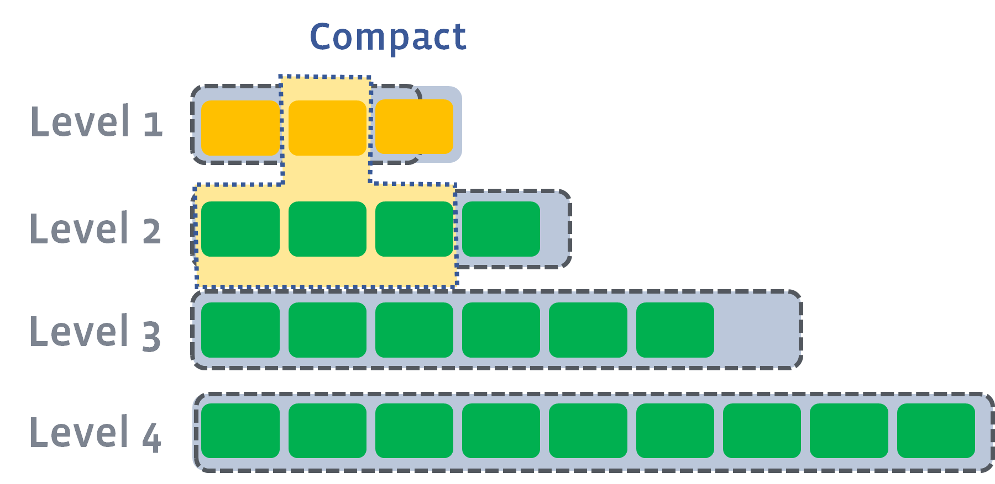
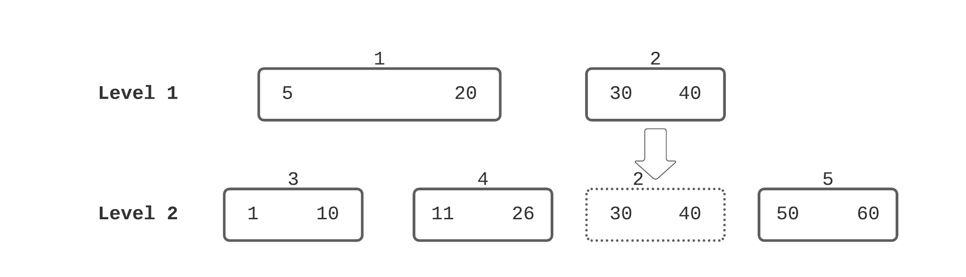
RocksDB Festival : Personal Research
Personal Research
1) Compaction Related
Classic Leveled
Leveled-N
Tiered
Tiered+Leveled
FIFO
Leveled Compaction
Trivial Move
6

Slide 7

RocksDB Festival : Personal Research
Personal Research
2) WAL Related
With/Without WAL
WAL in separated SSDs
With/Without buffering (fsync, fdatasync)
User
WAL
Memtable
Memory
Storage
Storage
Heterogeneous/Homogeneous
7

Slide 8
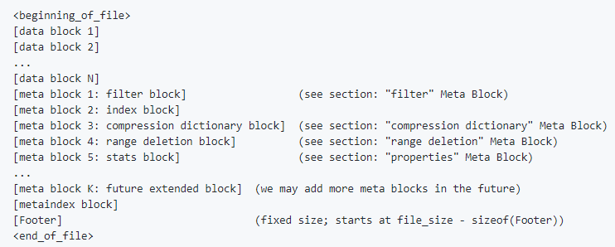
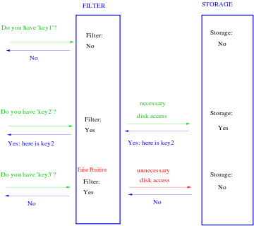
RocksDB Festival : Personal Research
Personal Research
3) Read optimization Related
Block-based Table format
PlainTable format
CuckooTable format
Index Block format
Bloom Filter
File format
Bloom filter
8

Slide 9
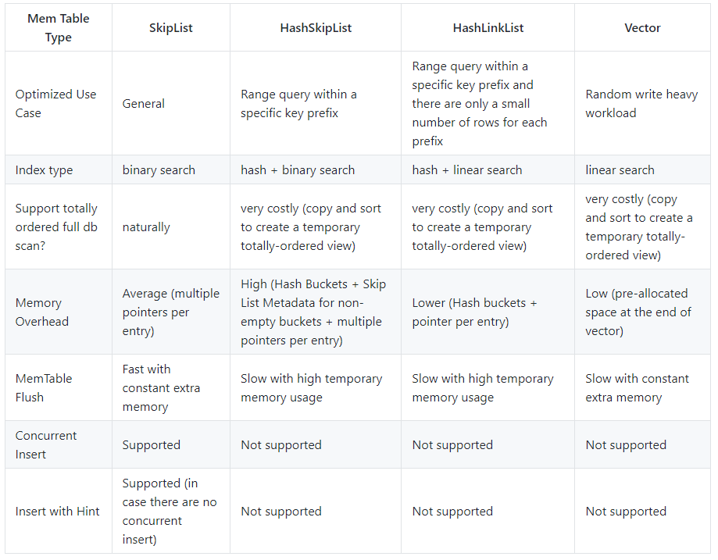
RocksDB Festival : Personal Research
Personal Research
4) Memtable/SSTable Related
Control Memtable configuration
Control SSTable configuration
Active
Memtable
Immutable
Memtable
Memory
L0
SSTable
L1
SSTable
SSTable
L2
SSTable
SSTable
…
Compare with Memtable Type
Simple Architecture
9

Slide 10
RocksDB Festival : Personal Research
Personal Research
5) Key/Value Related
Key distribution : Sequential, Random
Existing Key trace analysis
A large scale analysis of hundreds of in-memory cache clusters at Twitter, OSDI 20
https://github.com/twitter/cache-trace.git
From WiscKey to Bourbon: A Learned Index for Log-Structured Merge Trees, OSDI 20
https://registry.opendata.aws/
10

Slide 11
RocksDB Festival : Personal Research
Personal Research
6) Parallelism Related
Number of user threads
Number of background threads (flush/compaction)
How to make use of column family (or graph DB) of two instance
Immutable
Memtable
Active
Memtable
Immutable
Memtable
Active
Memtable
Flush
Flush
Memory
L0
SSTable
L0
SSTable
Disk
Compaction
Compaction
L1
SSTable
SSTable
L1
SSTable
SSTable
L2
SSTable
SSTable
…
L2
SSTable
SSTable
…
CF 1
WAL
CF 2
MANIFEST
DB
11

Slide 12
RocksDB Festival : Personal Research
Personal Research
7) Interface Related
Make Proxy application (ex. Smart factory, IoT log, SNS log …)
MyRocks(RocksDB+MySQL), MongoDB(Document DB)
8) Hybird Storage Related
Optane + SSD
SSD + HDD
Heterogeneous
9) Others
Adaptive Scheme
Layout (ex. Wisckey – BlobDB)
12

Slide 13
RocksDB Festival: Personal Research
Main Topic
1) Compaction Related
2) WAL (Write-Ahead-Log) Related
3) Read Optimization Related
4) Memtable/SSTable Related
5) Key/Value Related
6) Parallelism Related
7) Interface Related
8) Hybrid Storage Related
9) Others
13

Slide 14

Discussion

